Slide 1
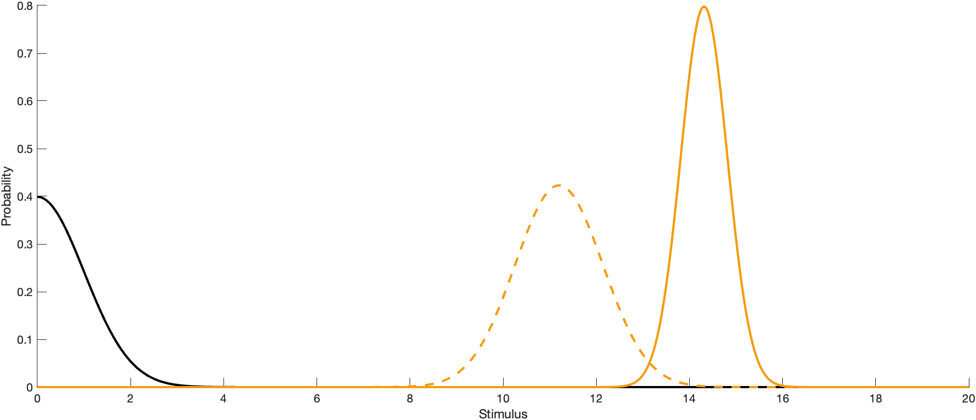
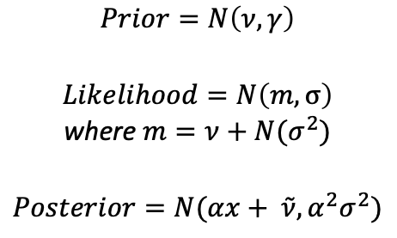
Point estimate distribution based on stimulus measure and prior
Likelihood
$$Prior=N\left(ν,γ\right)$$
$$Likelihood=N\left(m,σ\right)$$
where $m=ν+N(σ^{2})$
$$Posterior=N(αx+ \tilde{ν}, α^{2}σ^{2})$$
Point estimation
Prior

Slide 2
How does the prior and point estimate change with varying sigma (standard deviation of measurement)?
Increased sigma = narrower point estimate and shift towards prior
Less certainty of the stimulus measure
Relying on prior (a priori information) rather than the stimulus measure itself
Biased towards prior

Slide 3
How does the prior and point estimate change with varying gamma (standard deviation of prior)?
Increased gamma = wider prior
Less certainty of prior knowledge
Pushes point estimate closer to stimulus
Relying on measurement (stimulus) more than prior (a priori information)

Slide 4
Psychometric function for Gaussian prior and 2 measurements with equal standard deviations ($σ$ = 1)
Joint distribution

Slide 5


How does the psychometric curve change as the standard deviation of the measurements change?
Probability of Discrimination
Probability of Discrimination
Stimulus X2 (X1 = 4)
Stimulus X2 (X1 = 4)
Change of psychometric curve with changing stimulus 2 $σ$
Change of psychometric curve with changing stimulus 1 $σ$

