Slide 1
Data Structures and Algorithms (CS210A) Semester I – 2014-15
Lecture 37
A new algorithm design paradigm:
part IV
Greedy strategy

Slide 2
Problems solved till now
Job Scheduling Problem
Mobile Tower Problem
MST
Did you notice anything commons in their solutions ?
Ponder over this question before moving ahead

Slide 3
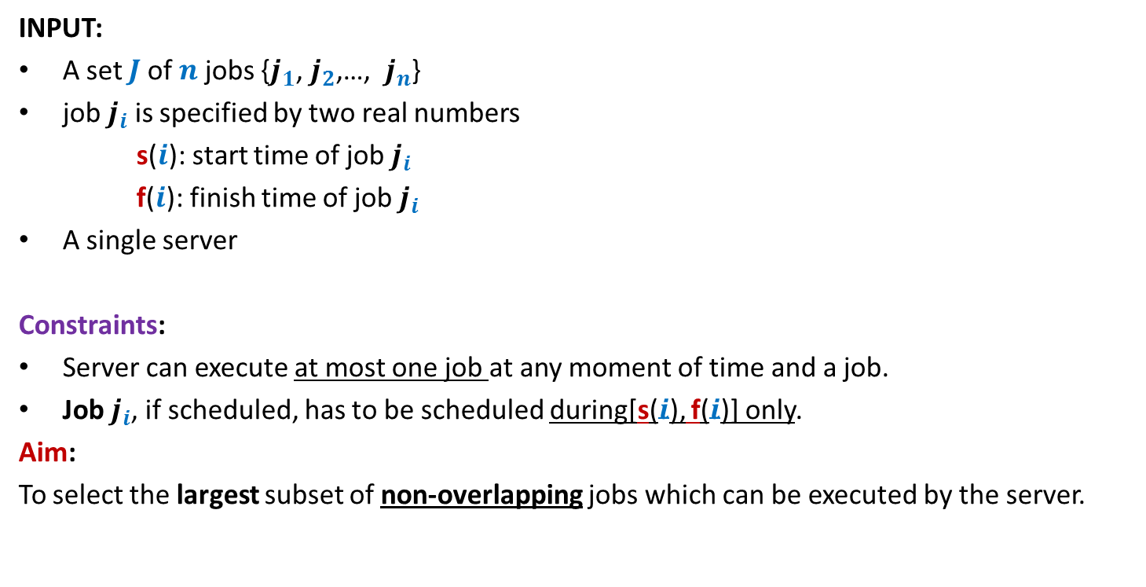
Problem 1 Job scheduling Problem
INPUT:
A set $J$of $n$ jobs {$j_{1}$, $j_{2}$,…, $j_{n}$}
job $j_{i}$ is specified by two real numbers
s($i$): start time of job $j_{i}$
f($i$): finish time of job $j_{i}$
A single server
Constraints:
Server can execute at most one job at any moment of time and a job.
Job $j_{i}$, if scheduled, has to be scheduled during[s($i$), f($i$)] only.
Aim:
To select the largest subset of non-overlapping jobs which can be executed by the server.
We could not say anything about the complete solution of this problem.

Slide 4


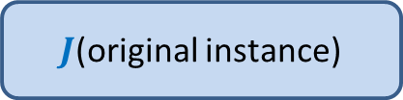

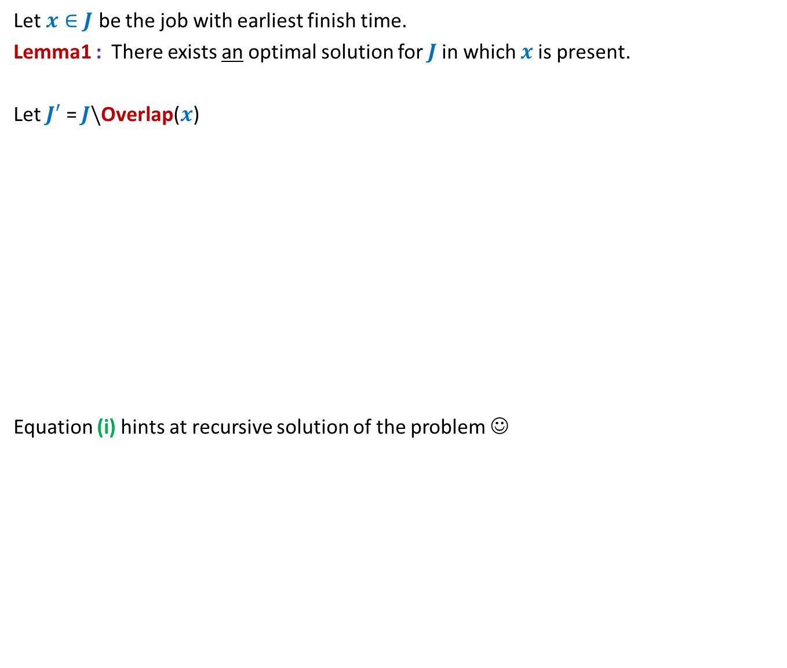

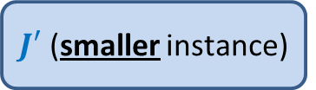
All that we could do was to make a local observation
Let $x∈J$ be the job with earliest finish time.
Lemma1 : There exists an optimal solution for $J$in which $x$is present.
Let $J′$ = $J\backslash$Overlap($x$)
Equation (i) hints at recursive solution of the problem ☺
Lemma 1 gives very small information about the optimal solution ☹
How to use it to compute this solution ?
$J$(original instance)
Opt($J$)
Greedy
step
Opt($J$)= Opt($J′$) + 1 -- (i)
Lemma1
$J′$ (smaller instance)
Opt($J′$)

Slide 5


Theorem: Opt($J$) = Opt($J′$) + 1.
Proof has two parts
Opt($J$) ≥ Opt($J′$) + 1
Opt($J′$) ≥ Opt($J$) – 1
Proof for each part is a proof by construction

Slide 6



Problem 2 Mobile Tower Problem
$$d$$
$$d$$
Problem statement:
There is a set $H$of $n$ houses located along a road.
We want to place mobile towers such that
Each house is covered by at least one mobile tower.
The number of mobile towers used is least possible.
We could not say anything about the complete solution of this problem.

Slide 7

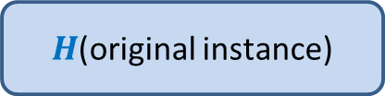



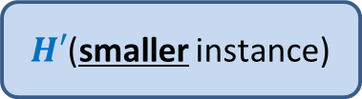
All that we could do was to make a local observation
Lemma 2: There is an optimal solution for the problem in which
the leftmost tower is placed at distance $d$ to the right of the first house.
Let $x$ be the tower located at $d$ to the right of the first house.
Let $H′$ = $H\backslash$ {all houses within distance $d$ from $x$}
Equation (i) hints at recursive solution of the problem ☺
Lemma 1 gives very small information about the optimal solution ☹
How to use it to compute this solution ?
$H$(original instance)
Opt($H$)
Opt($H$)= Opt($H′$) + 1
Greedy
step
Lemma 2
$H′$(smaller instance)
Opt($H′$)

Slide 8
What is a greedy strategy ?
A strategy that is
Based on some local approach
With the objective to optimize some function.
Note:
Recall that the divide and conquer strategy takes a global approach.

Slide 9
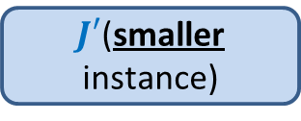
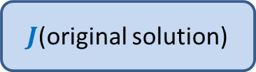
Design of a greedy algorithm
Let A be an instance of an optimization problem.
Make a local observation about the solution.
Use this observation to express optimal solution of A
in terms of
Optimal solution of a smaller instance A’
Local step
This gives a recursive solution.
Transform it into iterative one.
$J$(original solution)
Greedy
step
$J′$(smaller instance)

Slide 10
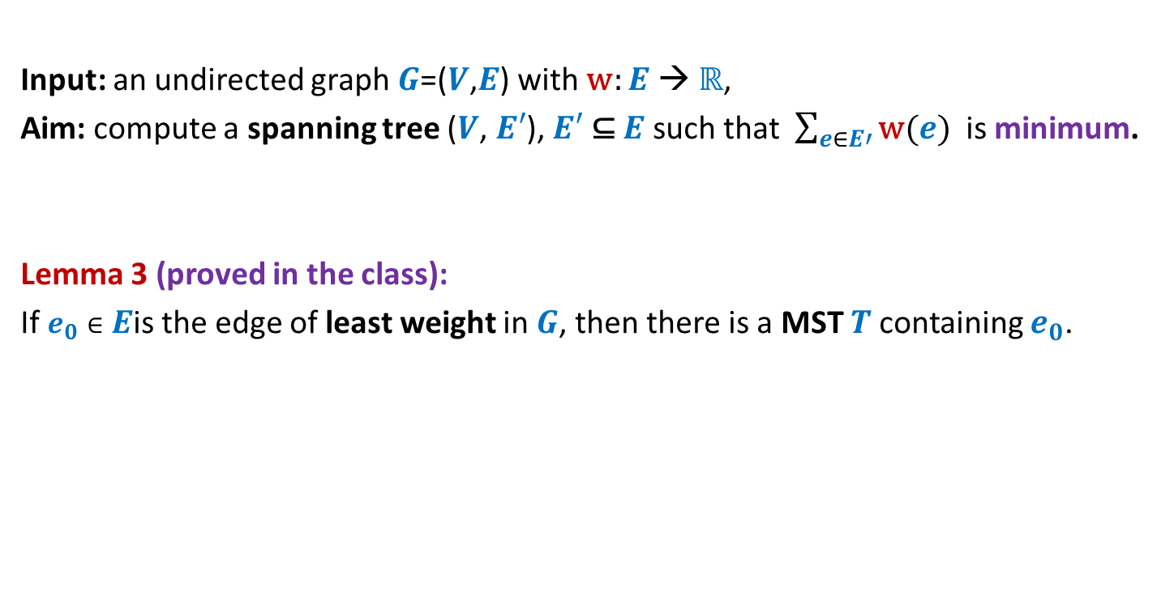
MST
Input: an undirected graph $G$=($V$,$E$) with w: $E$ → ℝ,
Aim: compute a spanning tree ($V$, $E′$), $E′$ ⊆ $E$ such that $\sum_{e∈E′}{\text{w}(e)}$ is minimum.
Lemma 3 (proved in the class):
If $e_{0}∈E$is the edge of least weight in $G$, then there is a MST $T$containing $e_{0}$.
If you have understood a generic way to design a greedy algorithm, then try to solve the MST problem.
How to use this Lemma to design an algorithm for MST ?

Slide 11
How to compute a MST ?
170
54
33
63
35
50
70
31
41
81
64
78
53
42
52
80
49
54
42
60
44
43
50
30
49
57
29
102

Slide 12
How to compute a MST ?
170
54
33
63
35
50
70
31
41
81
64
78
53
42
52
80
49
54
42
60
44
43
50
30
49
57
u
29
102
v

Slide 13
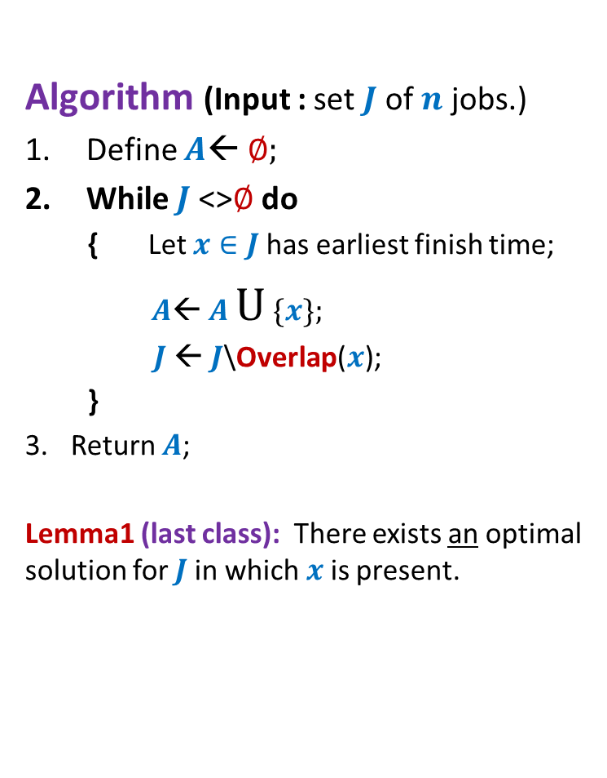
How to compute a MST ?
170
54
33
63
35
50
70
31
41
81
64
78
53
42
52
80
49
54
42
44
60
43
50
30
49
57
w
102
This is graph $G′$

Slide 14
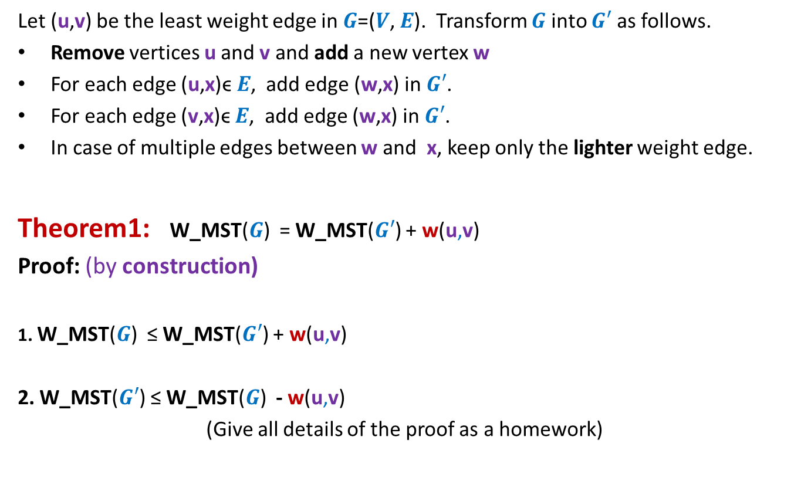
How to compute a MST ?
Let (u,v) be the least weight edge in $G$=($V$, $E$). Transform $G$ into $G′$ as follows.
Remove vertices u and v and add a new vertex w
For each edge (u,x)ϵ $E$, add edge (w,x) in $G′$.
For each edge (v,x)ϵ $E$, add edge (w,x) in $G′$.
In case of multiple edges between w and x, keep only the lighter weight edge.
Theorem1: W_MST($G$) = W_MST($G′$) + w(u,v)
Proof: (by construction)
1. W_MST($G$) ≤ W_MST($G′$) + w(u,v)
2. W_MST($G′$) ≤ W_MST($G$) - w(u,v)
(Give all details of the proof as a homework)
straightforward
Use Lemma 3

Slide 15
Problem 4 Overlapping Intervals
The aim of this problem is to make you realize that
it is sometime very nontrivial to design a greedy algorithm. In particular, it is quite challenging to design the smaller instance.
In the end semester exam of the course, no problem of this level of difficulty will be asked ☺

Slide 16

Overlapping Intervals
Problem statement:
Given a set A of $n$ intervals, compute smallest set B of intervals so that
for every interval I in A\B, there is some interval in B which overlaps/intersects with I.
A

Slide 17
Overlapping Intervals
Problem statement:
Given a set A of $n$ intervals, compute smallest set B of intervals so that
for every interval I in A\B, there is some interval in B which overlaps/intersects with I.
A
Not an optimal solution ☹
another optimal solution ☺
an optimal solution ☺

Slide 18
Overlapping Intervals
Strategy 1
Interval with maximum length should be there in optimal solution
Intuition:
Selecting such an interval will cover maximum no. of other intervals
There is a counter example ☹

Slide 19
Overlapping Intervals
Strategy 1
Interval with maximum length should be there in optimal solution
Intuition:
Selecting such an interval will cover maximum no. of other intervals
There is a counter example ☹

Slide 20
Overlapping Intervals
Strategy 2
Interval that overlaps maximum no. of intervals should be there in optimal solution
Intuition:
Selecting such an interval will cover maximum no. of other intervals
There is a counter example ☹

Slide 21
Overlapping Intervals
Strategy 2
Interval that overlaps maximum no. of intervals should be there in optimal solution
Not an optimal solution ☹

Slide 22
Overlapping Intervals
Strategy 2
Interval that overlaps maximum no. of intervals should be there in optimal solution
An optimal solution has size 2.
Think for a while :
After failure of two strategies, how to proceed to design the algorithm.

Slide 23
Overlapping Intervals
Let I* be the interval with earliest finish time.
Let I’ be the interval with maximum finish time overlapping I*.
Lemma1: There is an optimal solution for set A that contains I’.
Proof:(sketch) :
If I* is overlapped by any other interval in the optimal solution, say I^,
I^ will surely overlap all intervals that are overlapped by I’.
➔ Swapping I^ by I’ will still give an optimal solution.
I’
A
I*
Exploit the fact that I* has earliest finish time for this claim.

Slide 24
Overlapping Intervals
Question: How to obtain smaller instance A’ using Lemma 1 ?
I’
A
I*

Slide 25
Overlapping Intervals
Question: How to obtain smaller instance A’ using Lemma 1 ?
Naive approach : remove from A all intervals which overlap with I’. This is A’.
There is a counter example ☹
A’
I’
A
I*

Slide 26
Overlapping Intervals
Question: How to obtain smaller instance A’ using Lemma 1 ?
Naive approach : remove from A all intervals which overlap with I’. This is A’.
The problem is that some deleted interval (in this case I’’) could have been used for intersecting many intervals if it were not deleted. But deleting it from the instance disallows it to be selected in the solution.
There is a counter example ☹
A’
I’
A
I*
I’’

Slide 27
Overview of the approach
In order to make sure we do not delete intervals (like I’’ in the previous slide) if they are essential to be selected to cover many other intervals, we make some observations and introduce a terminology called Uniquely covered interval. It turns out that we need to keep I’’ in the smaller instance if there is an interval there which is uniquely covered by I’’ . Otherwise, we may discard I’’.

Slide 28
Carefully constructing A’
Question: Among the intervals that overlap I’, which intervals should be kept in A’ ?
I’
A
I*
I’’

Slide 29
Carefully constructing A’
Question: Among the intervals that overlap I’, which intervals should be kept in A’ ?
Observation1: Among the intervals which cross red line,
only the interval with maximum finish time (I’’ in this picture) may be required.
Look at the current example,
Why is I’’ so crucial ?
Try to formalize your ideas.
A’
I’
A
I*
I’’
But how to decide whether to keep I’’ or not ?
Convince yourself that this is an important point.

Slide 30
Uniquely covered interval
I2 is said to be uniquely covered by I1 if
I2 is fully covered by I1
Every interval overlapping I2 is also full covered by I1.
Lemma2 : There is an optimal solution containing I1.
Proof: Surely I2 or some other interval overlapping it must be there in the optimal solution. If we replace that interval by I1, we still get a solution of the same size and hence an optimal solution.
I1
I2

Slide 31
We are now ready to give description/construction of the smaller instance A’ from A.
There will be two cases.
We shall then prove that |Opt(A)| = |Opt(A’)| + 1 for each of these cases.
Important note:
The reader is advised to full understand Lemma1, Lemma2, Observation1, and the notion of Uniquely covered interval.
Also fully internalize the notations I*, I’, and I”.
This will help the reader understand the rest of the solution.

Slide 32
Constructing A’ from A

Slide 33
Constructing A’ from A
I’
A
I*
I”

Slide 34
Constructing A’ from A
I
I’
A
I*
I”
We need to take care of intervals whose starting point is to the right of red line (finish time of I’).
D
E
We can partition these intervals into two sets.
D: those which overlap with I”.
E: those that start after the end of I” and hence do not overlap with I”.
Now we shall describe the two cases for construction of A’.
Case1: There is an interval I ϵ D uniquely covered by I”
I
I”
A’
D
E

Slide 35
Constructing A’ from A
If there is an interval I ϵ D uniquely covered by I”, then we define A’ as follows. Remove all intervals from A which overlap with I’ (this was our usual way of defining A’ in our wrong solution). Now add I” to this set. This set is the smaller instance A’ for Case 1.
We shall now define A’ for Case 2.

Slide 36
Constructing A’ from A
I”
D
E
Case2: There is no interval uniquely covered by I”
A’
D
E

Slide 37
Constructing A’ from A
If there is no interval in D uniquely covered by I”, then we define A’ as follows. Remove all intervals from A which overlap with I’ (this was our usual way of defining A’ in our wrong solution). This set is the smaller instance A’ for Case 2.

Slide 38
Theorem1: |Opt(A)| = |Opt(A’)| + 1
We shall prove this theorem for case 1 as well as case 2.

Slide 39
Case1: There is an interval I ϵ D uniquely covered by I”
|Opt(A)| ≤ |Opt(A’)| + 1
I
I’
A
I*
I”
The optimal solution of A’ takes care of all intervals to the right of red line ?
D
E
What to add to this solution to take care of intervals to the left of red line ?
We need to add just I’ to get a solution for A and we are done.
I
I”
A’
D
E

Slide 40
Case1: There is an interval I ϵ D uniquely covered by I”
|Opt(A’)| ≤ |Opt(A)| -1
I
I’
A
I*
I”
Using Lemma1 , it follows that there is an optimal solution for A containing I’.
D
E
But I’ takes care of only intervals to the left of red line and I”.
So there must be intervals in the optimal solution to take care of intervals to the right of I’. So how to get a solution for A’ ?
We need to just remove I’ from this optimal solution for A to get a solution for A’ and we are done.
I
I”
A’
D
E

Slide 41
This finishes the proof of Theorem for Case 1.
We shall now analyze Case2 and prove Theorem for this case as well.

Slide 42
Case2: There is no interval uniquely covered by I”
|Opt(A)| ≤ |Opt(A’)| + 1
I’
A
I*
I”
D
E
Consider any optimal solution for A’. Note that this optimal solution takes care of D and E.
So we just need to take care of intervals from A which are to the left of the red line. These are taken care by adding I’ to this solution. We are done.
A’
D
E

Slide 43
Case2: There is no interval uniquely covered by I”
|Opt(A’)| ≤ |Opt(A)| - 1
I’
A
I*
I”
Using Lemma1, it follows that there is an optimal solution for A containing I’.
D
E
If I’’ is not in this optimal solution, we can see that removing I’ from this optimal solution gives a valid solution for A’.
So let us consider the case when I’’ is present in the optimal solution of A.
The problem is that I’’ is not present in A’, so we need a substitute of I’’ from A’.
Notice that I’’ can serve the purpose of overlapping of intervals from D only. So we should search for substitute for I’’ from D only.
We replace I” by the interval from D which intersects the violet line and has earliest start time. See the following slide for its justification.
A’
D
E

Slide 44
Let Ϊ be the interval in D which intersects the violet vertical line (has finish time greater than that of I”) and has earliest start time. It suffices if we can show that every interval of D overlaps with Ϊ . We proceed as follows. Consider any interval Ǐ in D. There are two cases.
Finish time of Ǐ is less than that of I”. In other words, Ǐ does not intersects the violet line. In this case, there must be some other interval in D that overlaps Ǐ and intersects the violet line (otherwise, Ǐ would be uniquely covered by I”); since start time of Ϊ is less than this interval, so Ǐ is overlapped by Ϊ as well.
Finish time of Ǐ is more than I”. In other words, Ǐ does intersect the violet line. Hence Ǐ overlaps with Ϊ as well since the latter also intersects the violet line.
➔ Hence if remove I’ and I” from the given optimal solution of A, and add Ϊ to it, we get a solution for A’. Since optimal solution for A’ has to be smaller or equal in size related to this solution, we get |Opt(A’)| ≤ |Opt(A)| - 1 for Case 2.
Hence we have proved Theorem1: |Opt(A)| = |Opt(A’)| + 1
Now in order to design the algorithm for our problem based on the greedy strategy, we just need to determine whether the smaller instance A’ corresponds to Case 1 or Case 2.

Slide 45
How to distinguish between Case1 and Case2 ?
I’
A
I*
I”

Slide 46
How to distinguish between Case1 and Case2 ?
I
I’
Let
I : the interval in D with earliest finish time.
Mf(I,D) : the finish time of that interval in D that overlaps I and has max. finish time.
If f(I”) > Mf(I,D)
then Case 1 (keep I” in A’)
else Case 2 (there is no need to keep I” in A’)
A
I*
I”
D
Thanks to Aayush Ojha and Shubham Jain for correcting me. Earlier I had written start instead of finish here.
(Feel grateful to teach such bright students)

Slide 47
Algorithm
From the discussion till now,
We have an algorithm for the problem.
A polynomial bound on the time complexity is obvious.
A necessary (but not sufficient) condition to score A* in the course is the following exercise.
Exercise: Provide the most efficient implementation of the algorithm discussed in the class along with its pseudocode.
Submit handwritten (but very neat) report as a solution of this exercise.
If someone has an alternate algorithm, he/she has to provide proof of correctness along with the pseudocode.

