Slide 1
Design and Analysis of Algorithms
CS345A
https://moodle.cse.iitk.ac.in
Algorithms-II
Lecture 1
Overview of the course
Closest Pair problem

Slide 2
Aim of the course
To empower each student with the skills to design algorithms
With provable guarantee on correctness.
With provable guarantee on their efficiency.

Slide 3
Algorithm Paradigm
Motivation:
Many problems whose algorithms are based on a common approach.
➔ A need of a systematic study of the characteristics of such approaches.
Algorithm Paradigms:
Divide and Conquer
Greedy Strategy
Dynamic Programming
(advanced)
(advanced)

Slide 4



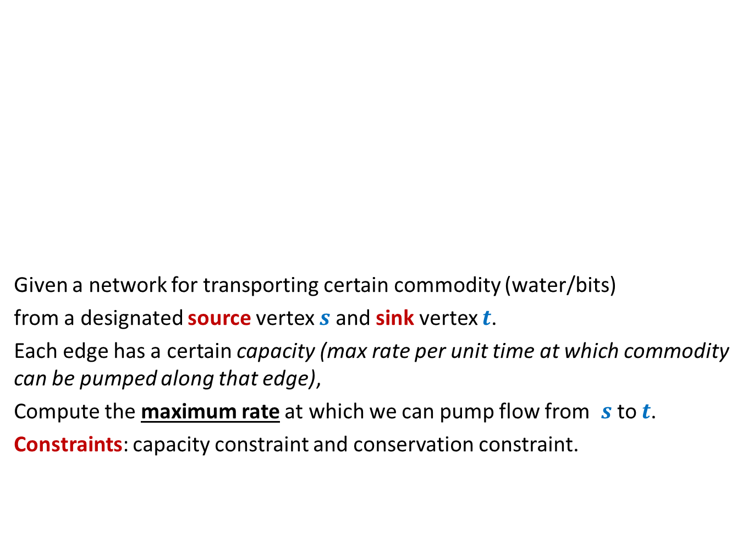



Maximum Flow
2
Given a network for transporting certain commodity (water/bits)
from a designated source vertex $s$and sink vertex $t$.
Each edge has a certain capacity (max rate per unit time at which commodity can be pumped along that edge),
Compute the maximum rate at which we can pump flow from $s$to $t$.
Constraints: capacity constraint and conservation constraint.
$$v$$
$$x$$
5
16
15
8
$$t$$
$$s$$
6
17
14
7
17
$$u$$
4
$$y$$

Slide 5
Miscellaneous
Matching in Graphs
Maximum matching, Stable matching
Amortized Analysis
A powerful technique to analyse time complexity of algorithms
String Matching
Linear Programming

Slide 6
Last topic on Algorithms
NP Complete problems
Approximation/randomized Algorithms

Slide 7
Data Structures

Slide 8
Data structures
Augmented Binary Search Trees
Range Minima Data structure (optimal size)
Fibonacci Heap
: Additional information

Slide 9

Orthogonal Range searching
A novel application of augmented BST
Problem: Preprocess a set of $n$ points so that given any query rectangle,
the number of points lying inside it can be reported efficiently.
Data structure:
size = O($n log n$), Query = O($\log^{2} n$),
size = O($n$), Query = O($\sqrt{n}$),
Rectangle
Rectangle
Try to solve it…
You can surely do it…☺

Slide 10
Divide and Conquer
A paradigm for Algorithm Design

Slide 11
An Overview
A problem in this paradigm is solved in the following way.
Divide the problem instance into two or more instances of the same problem.
Solve each smaller instance recursively (base case suitably defined).
Combine the solutions of the smaller instances
to get the solution of the original instance.
This is usually the main nontrivial step in the design of an algorithm using divide and conquer strategy

Slide 12

Example Problems
Merge Sort
Multiplication of two $n$-bit integers.
Counting the number of inversions in an array.
Median finding in linear time.

Slide 13
problem 1
Closest Pair of Points

Slide 14

The Closest Pair Problem
$$δ$$

Slide 15
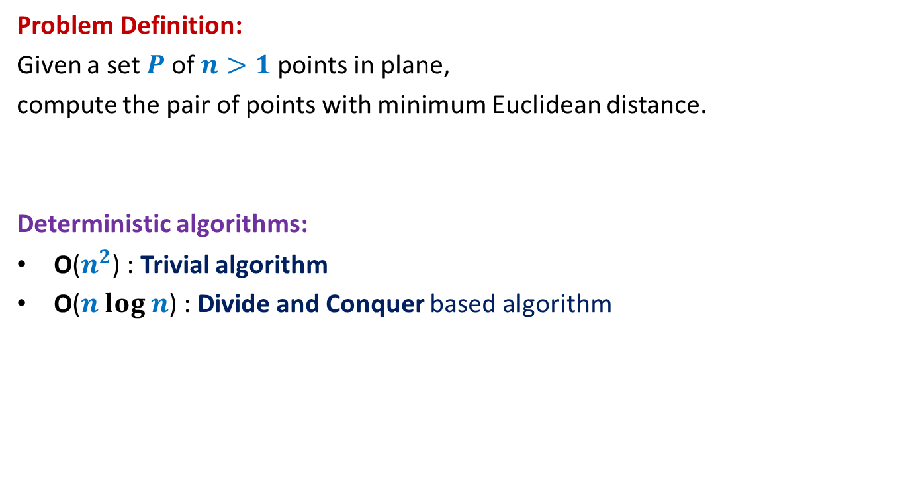
Closest Pair of Points
Problem Definition:
Given a set $P$of $n>1$points in plane,
compute the pair of points with minimum Euclidean distance.
Deterministic algorithms:
O($n^{2}$) : Trivial algorithm
O($n log n$) : Divide and Conquer based algorithm

Slide 16

Hint/Tool No. 1
A discrete math exercise
Exercise:
What is the maximum number of points that can be placed in a unit square
such that the minimum distance is at least 1 ?
Answer: 4.
If there are more than 4 points, at least one of the four small squares will have more than 1 points.
$$\frac{1}{\sqrt{2}}$$
1

Slide 17
Hint/Tool No. 2
When do we use a data structure ?
Question:
For which algorithmic problems do we need a suitable data structure ?
Answer:
If the problem involves “many” operations of same type on a given data.
For example, it is worth sorting an array only if there are going to be many search queries on it.
Let us see if you can use this principle in today’s class itself ☺

Slide 18

The divide step
$\frac{n}{2}$points
$\frac{n}{2}$points

Slide 19



The conquer step
Compute closest pair of the left half set
Compute closest pair of the right half set
$$δ_{L}$$
$$δ_{R}$$
Notice $δ_{L}$ ${<δ}_{R}$ for this given instance

Slide 20


The combine step
Which points do we need to focus on for the closest pairs ?
$$δ_{L}$$
$$δ_{R}$$
$$δ_{L}$$
$$δ_{L}$$

Slide 21
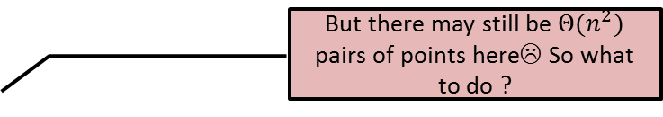

The combine step
But there may still be $Θ(n^{2})$ pairs of points here☹ So what to do ?
$$δ_{L}$$
$$δ_{R}$$
$$δ_{L}$$
$$δ_{L}$$

Slide 22

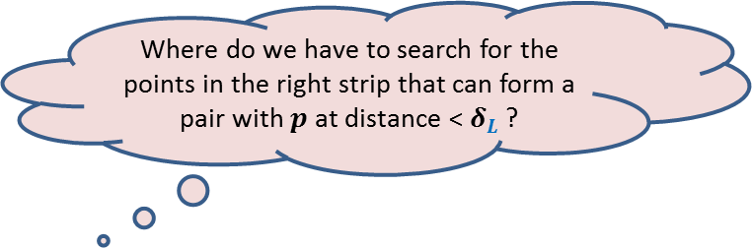
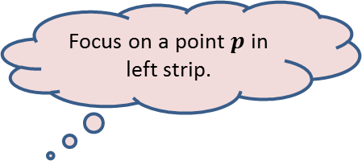
The combine step
Focus on a point $p$in left strip.
Where do we have to search for the points in the right strip that can form a pair with $p$ at distance < $δ_{L}$ ?
$$δ_{L}$$
$$p$$
$$δ_{R}$$
$$δ_{L}$$
$$δ_{L}$$

Slide 23

The combine step
$$δ_{L}$$
$$δ_{L}$$
$$p$$
$$δ_{L}$$
$$δ_{R}$$
$$δ_{L}$$
$$δ_{L}$$

Slide 24
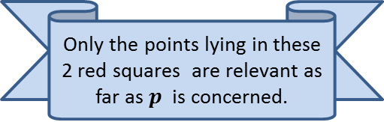


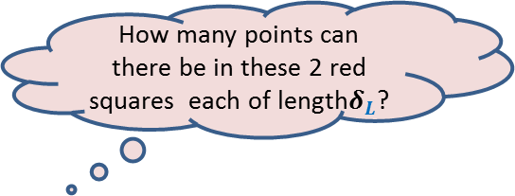
The combine step
How many points can there be in these 2 red squares each of length$δ_{L}$?
Only the points lying in these 2 red squares are relevant as far as $p$ is concerned.
How to find the points in these red square for point $p$?
$$δ_{L}$$
It will take $O(n)$time for a given $p$.
Surely not more than 8
(using Hint 1)
$$δ_{L}$$
$$p$$
$$δ_{L}$$
$$δ_{R}$$
$$δ_{L}$$
It is time to use Hint/Tool no. 2. Think for a while before going to the next slide.
$$δ_{L}$$

Slide 25

The combine step
$$δ_{L}$$
$$δ_{L}$$
An array storing the points of the right strip in increasing order of y-coordinates.
$$δ_{L}$$
We need to find points in the 2 red square for every point in the left strip.
What will be
the data structure ?
$$δ_{L}$$
$$δ_{L}$$
$$δ_{L}$$
So build a suitable data structure
for points in the right strip so that
we can answer such query efficiently
for each point in the left strip.
$$δ_{L}$$
$$δ_{R}$$
$$δ_{L}$$
$$δ_{L}$$

Slide 26

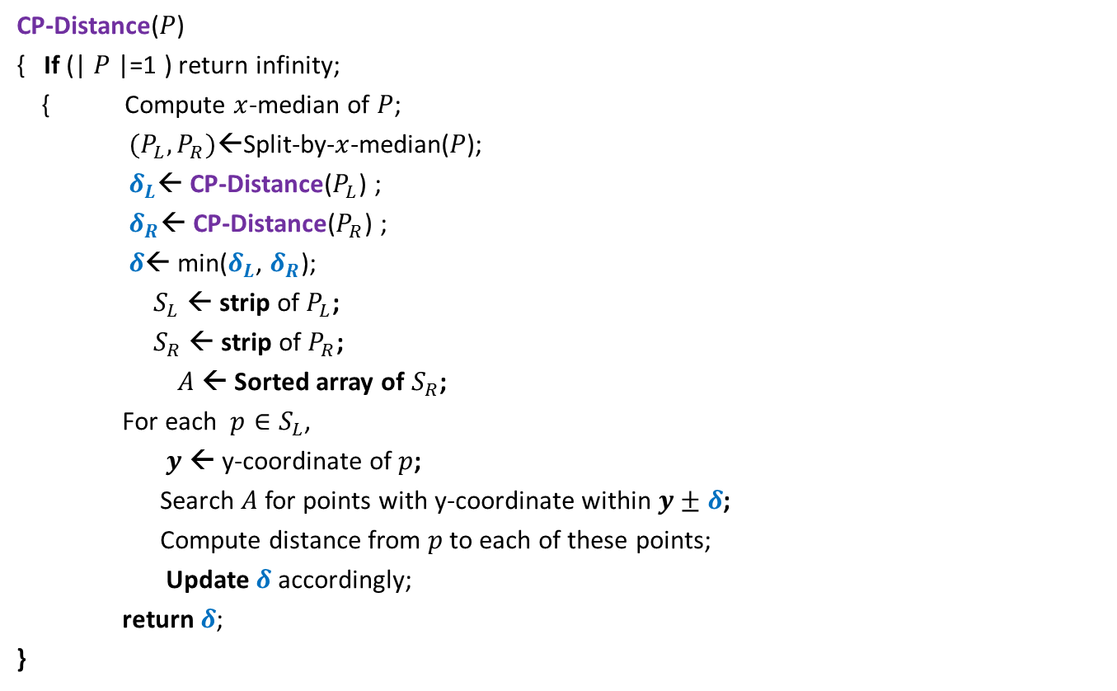

Divide and Conquer based algorithm
CP-Distance($P$)
{ If (| $P$|=1 ) return infinity;
{ Compute $x$-median of $P$;
$(P_{L},P_{R})$←Split-by-$x$-median($P$);
$δ_{L}$← CP-Distance($P_{L}$) ;
$δ_{R}$← CP-Distance($P_{R}$) ;
$δ$← min($δ_{L}$, $δ_{R}$);
$S_{L}$ ← strip of $P_{L}$;
$S_{R}$ ← strip of $P_{R}$;
$A$← Sorted array of $S_{R}$;
For each $p∈S_{L}$,
$y$ ← y-coordinate of $p$;
Search $A$for points with y-coordinate within $y±δ$;
Compute distance from $p$to each of these points;
Update $δ$ accordingly;
return $δ$;
}
$O(\left|P\right|)$ + 2 T(|$P$|/2) time
Divide step
$O(\left|P\right| \log{P})$ time
Combine/conquer step

Slide 27

Running time of the algorithm
What is the recurrence for running time?
T($n$) = c $n$ log $n$ + 2 T($n$/2)
➔
T($n$) = O( $n$ $\log^{2}n$)
Theorem:
There exists an O( $n$ $\log^{2}n$) time algorithm to compute closest pair of $n$points in plane.

Slide 28

Conclusion
Homework:
Try to improve the running time to O( $n\log{n}$).
Hint: “the code will look similar to that of MergeSort”.
2. Ponder over the data structure for orthogonal range searching.

Slide 29
How does one design an algorithm ?
If you wish to find the answer on your own,
try to solve the first assignment problem on your own.
Without any help from the web
Without any help from the your friends

Slide 30
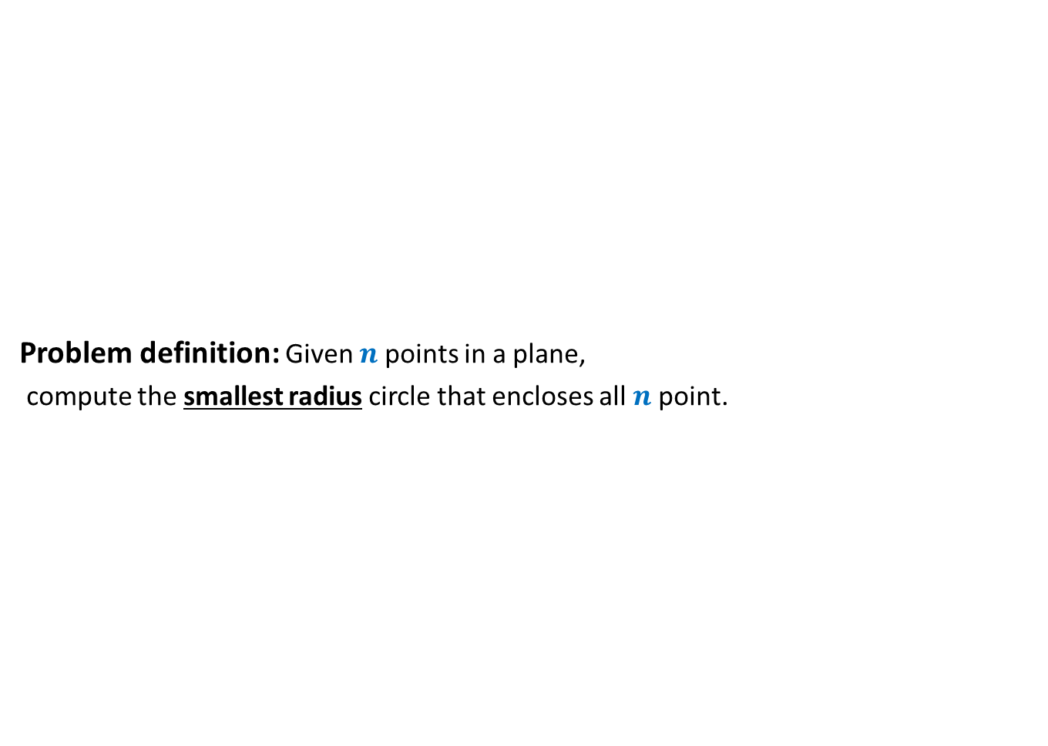
Assignment 1 Smallest Enclosing circle
Problem definition: Given $n$ points in a plane,
compute the smallest radius circle that encloses all $n$ point.

