Slide 1
Design and Analysis of Algorithms (CS345/CS345A)
Lecture 10
Shortest paths
in graphs with positive weights

Slide 2
Shortest pathS in a graph

Slide 3


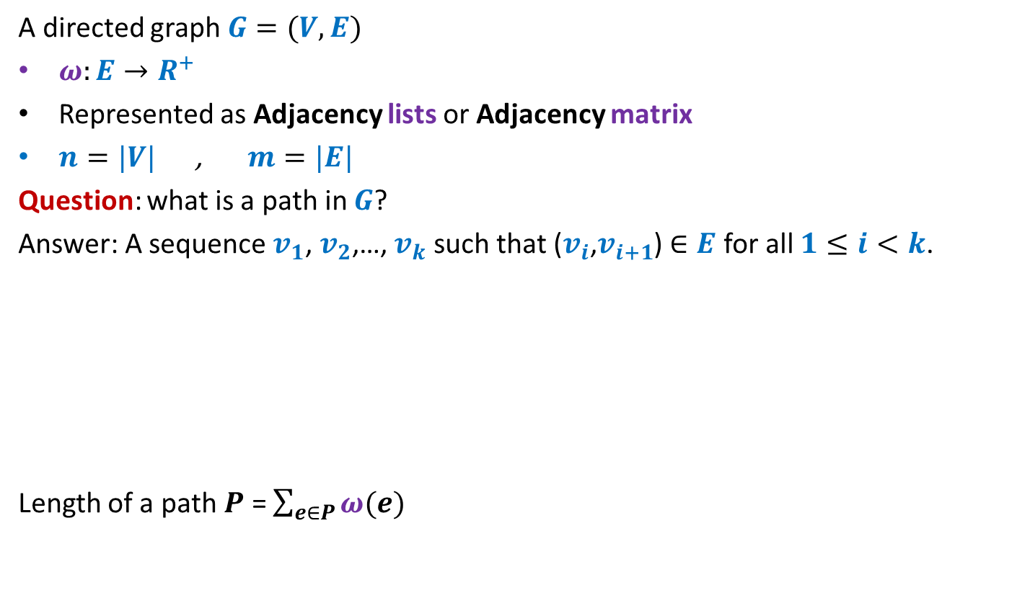



Notations and Terminologies
A directed graph $G=(V,E)$
$ω:E→R^{+}$
Represented as Adjacency lists or Adjacency matrix
$n=|V|$ , $m=|E|$
Question: what is a path in $G$?
Answer: A sequence $v_{1}$, $v_{2}$,…, $v_{k}$ such that ($v_{i}$,$v_{i+1}$) $∈E$ for all $1≤i<k$.
Length of a path $P$ = $\sum_{e∈P}{ω(e)}$
No vertex is repeated
12
3
…
29
$$v_{1}$$
$$v_{2}$$
$$v_{3}$$
$$v_{k−1}$$
$$v_{k}$$

Slide 4
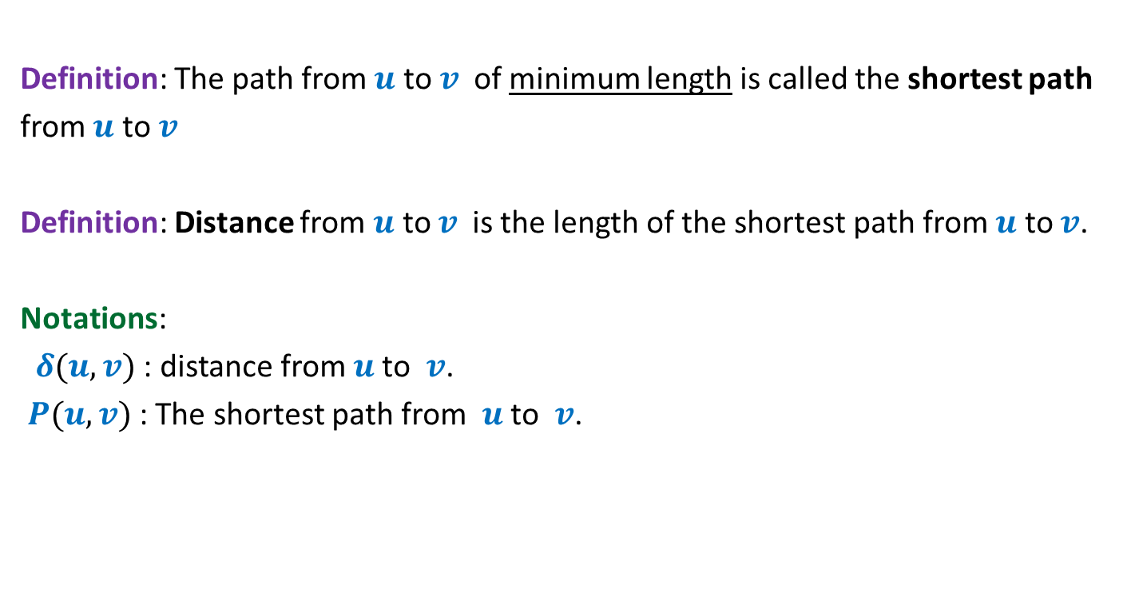
Notations and Terminologies
Definition: The path from $u$ to $v$of minimum length is called the shortest path
from $u$ to $v$
Definition: Distance from $u$ to $v$is the length of the shortest path from $u$ to $v$.
Notations:
$δ(u,v)$ : distance from $u$to $v$.
$P(u,v)$ : The shortest path from $u$to $v$.

Slide 5
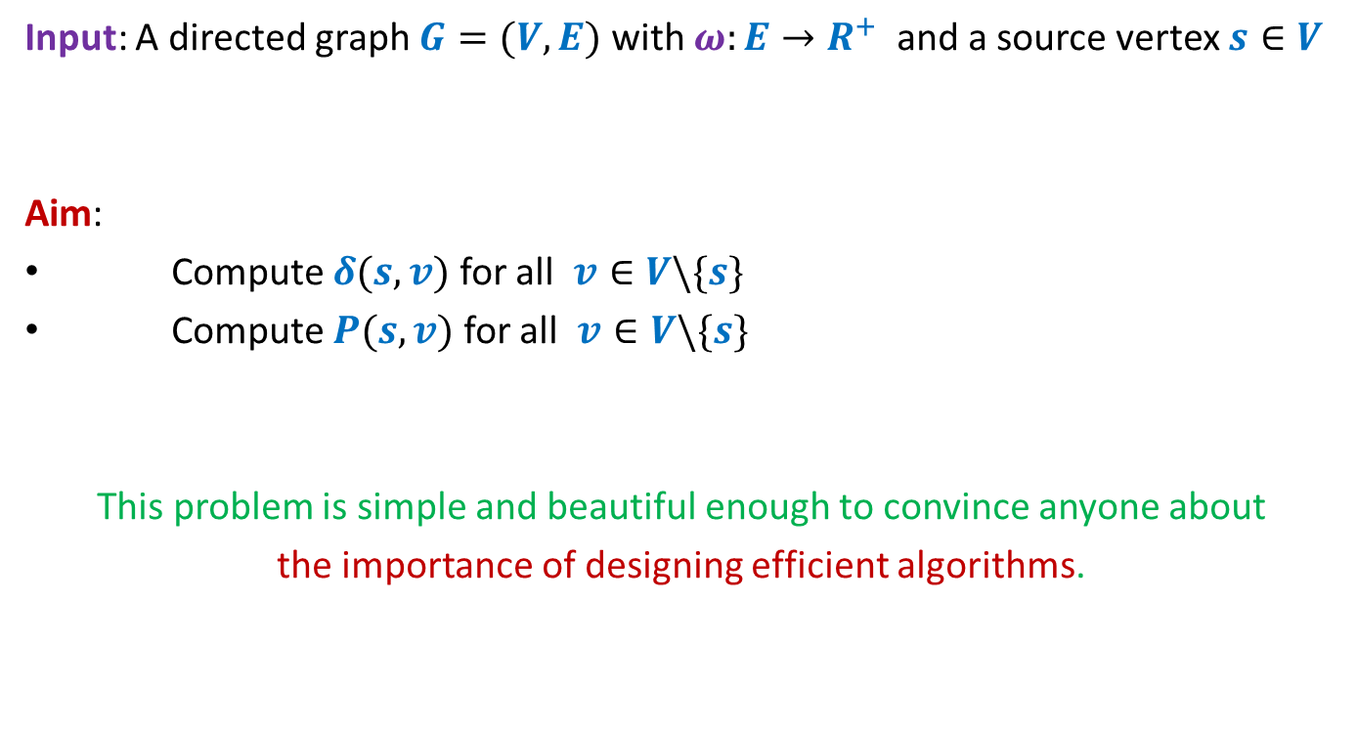
Problem Definition
Input: A directed graph $G=(V,E)$ with $ω:E→R^{+}$ and a source vertex $s∈V$
Aim:
Compute $δ(s,v)$ for all $v∈V\backslash \{s\}$
Compute $P(s,v)$ for all $v∈V\backslash \{s\}$
This problem is simple and beautiful enough to convince anyone about
the importance of designing efficient algorithms.

Slide 6


An example to get an insight into this problem
Inference:
The distance to any vertex depends upon global parameters.
$$q$$
5
7
6
12
G
$$s$$
16
4
9
11

Slide 7


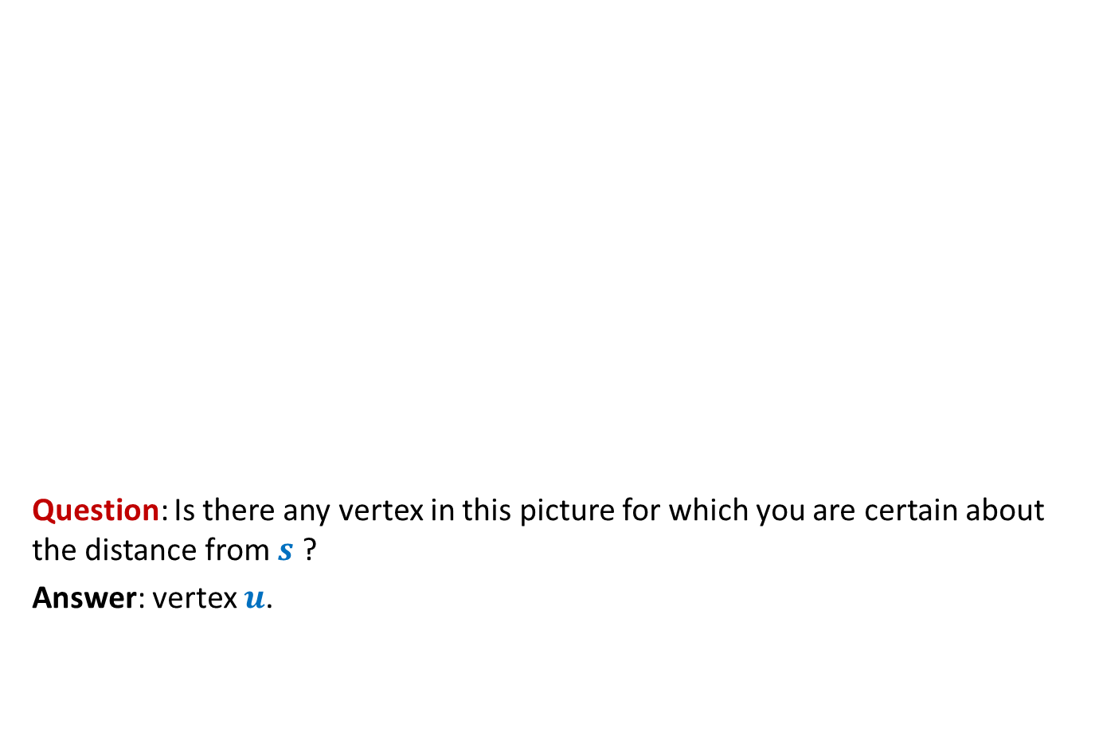



An example to get an insight into this problem
Question: Is there any vertex in this picture for which you are certain about the distance from $s$ ?
Answer: vertex $u$.
$$z$$
10
$$v$$
G
12
7
$$x$$
$$s$$
3
5
$$u$$
$$y$$
Give reasons.

Slide 8


An example to get an insight into this problem
➔ The shortest path to vertex $u$ is edge ($s$,$u$).
$$z$$
10
$$v$$
G
12
7
$$x$$
$$s$$
3
5
$$u$$
$$y$$
$$>0$$

Slide 9





Designing a greedy algorithm for shortest paths
Establish a relation between shortest paths in $G$
and
shortest paths in $G′$
$$G$$
instance of size $n$
Greedy
step
$$G′$$
instance of size $<n$

Slide 10



An example to get an insight into this problem
Question: Can you remove vertex $u$ without affecting the distance from $s$ ?
$$z$$
10
$$v$$
G
12
7
2
$$x$$
$$s$$
21
$$t$$
3
5
$$u$$
3
8
$$y$$
$$r$$

Slide 11

An example to get an insight into this problem
$$z$$
10
$$v$$
12
7
+3
G’
2
+3
$$x$$
21
$$t$$
$$s$$
5
+3
+3
8
3
$$y$$
$$r$$

Slide 12
An example to get an insight into this problem
$$z$$
10
$$v$$
G’
12
7
5
$$x$$
24
$$t$$
$$s$$
5
6
11
$$y$$
$$r$$

Slide 13
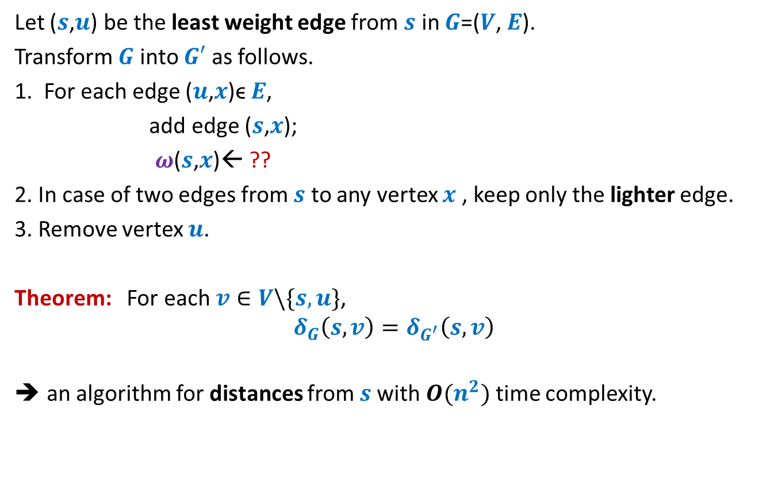


How to compute instance $G′$
Let ($s$,$u$) be the least weight edge from $s$ in $G$=($V$, $E$).
Transform $G$ into $G′$ as follows.
1. For each edge ($u$,$x$)ϵ $E$,
add edge ($s$,$x$);
$ω$($s$,$x$)← ??
2. In case of two edges from $s$ to any vertex $x$ , keep only the lighter edge.
3. Remove vertex $u$.
Theorem: For each $v∈V\backslash \{s,u\}$,
$$δ_{G}\left(s,v\right)=δ_{G^{′}}\left(s,v\right)$$
an algorithm for distances from $s$with $O(n^{2})$ time complexity.
$ω$($s$,$u$) + $ω$($u$,$x$);
Can you see some negative points of this algorithm ?

Slide 14
Shortcomings of the algorithm
No insight into the (beautiful) structure of shortest paths.
Just convinces that we can solve the shortest paths problem in polynomial time.
Very few options to improve the time complexity.
We shall now design a very insightful algorithm based on properties of shortest paths.

Slide 15
Property of a shortest path

Slide 16



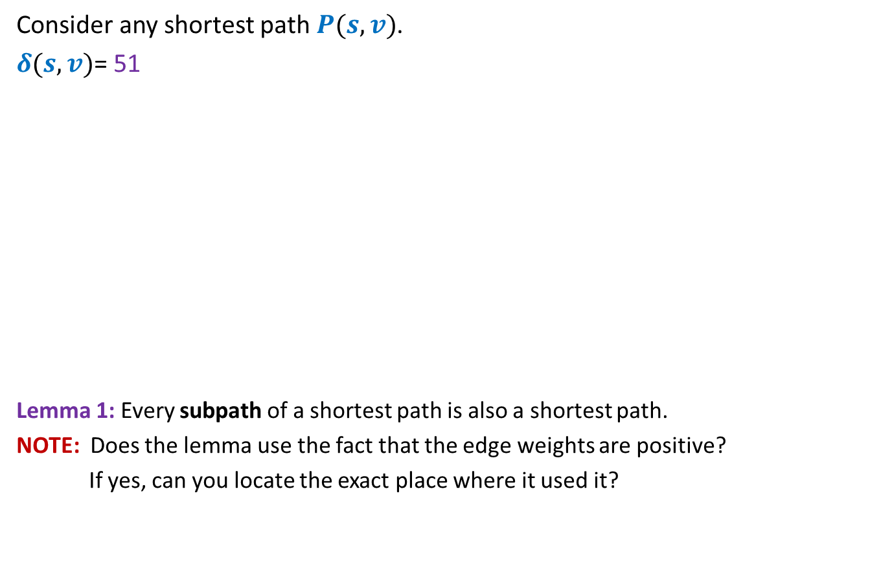




Optimal subpath property
Consider any shortest path $P(s,v)$.
$δ(s,v)$= 51
Lemma 1: Every subpath of a shortest path is also a shortest path.
NOTE: Does the lemma use the fact that the edge weights are positive?
If yes, can you locate the exact place where it used it?
Anyway, give a proof of the lemma
< 27
12
3
7
5
15
9
$$s$$
$$a$$
$$g$$
$$y$$
$$u$$
$$x$$
$v$
Can you realize an assumption in your proof ?
?
Homework: Write a complete and formal proof for Lemma 1

Slide 17




Exploiting the positive weight on edges
Consider once again a shortest path $P(s,v)$.
➔ $δ\left(s,a\right)<δ\left(s,g\right)<δ\left(s,y\right)<δ\left(s,u\right)<δ(s,x)<δ(s,v)$
The first nearest vertex of $s$ must be its neighbor.
$$>0$$
$$>0$$
$$>0$$
$$>0$$
$$>0$$
$$>0$$
$$s$$
$$a$$
$$g$$
$$y$$
$$u$$
$$x$$
$v$
(1)

Slide 18







More insights …
What can we say about $x$ ?
Let $s_{i}$ : $i$th nearest vertex from $s$.
$s_{0}$ = $s$.
Consider the shortest path $P\left(s,s_{i}\right)$.
Lemma 2: $P\left(s,s_{i}\right)$ must be of the form $s ⇝$ $s_{j} →s_{i}$ for some $j<i$.
$x$ must be $s_{j}$ for some $j<i$.
$$s$$
$$x$$
$s_{i}$
What picture captures all shortest paths from $s$?

Slide 19








Complete picture of all shortest paths ?
Shortest paths tree
$$s$$
$$s_{4}$$
$$s_{1}$$
$$s_{7}$$
$$s_{5}$$
$$s_{2}$$
$$s_{3}$$
$$s_{6}$$

Slide 20
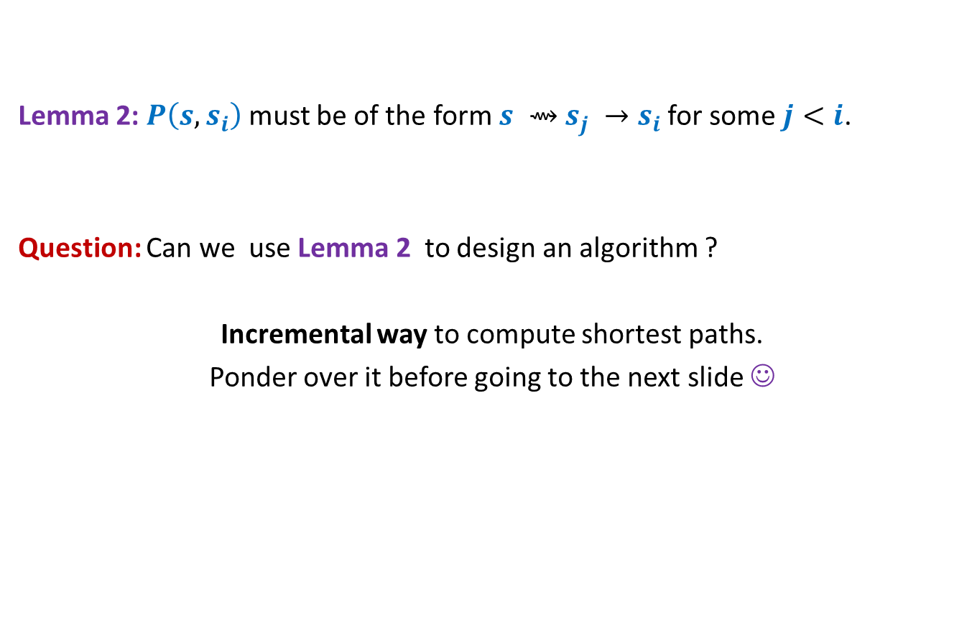
Designing the algorithm …
Lemma 2: $P\left(s,s_{i}\right)$ must be of the form $s ⇝$ $s_{j} →s_{i}$ for some $j<i$.
Question: Can we use Lemma 2 to design an algorithm ?
Incremental way to compute shortest paths.
Ponder over it before going to the next slide ☺
shortest

Slide 21

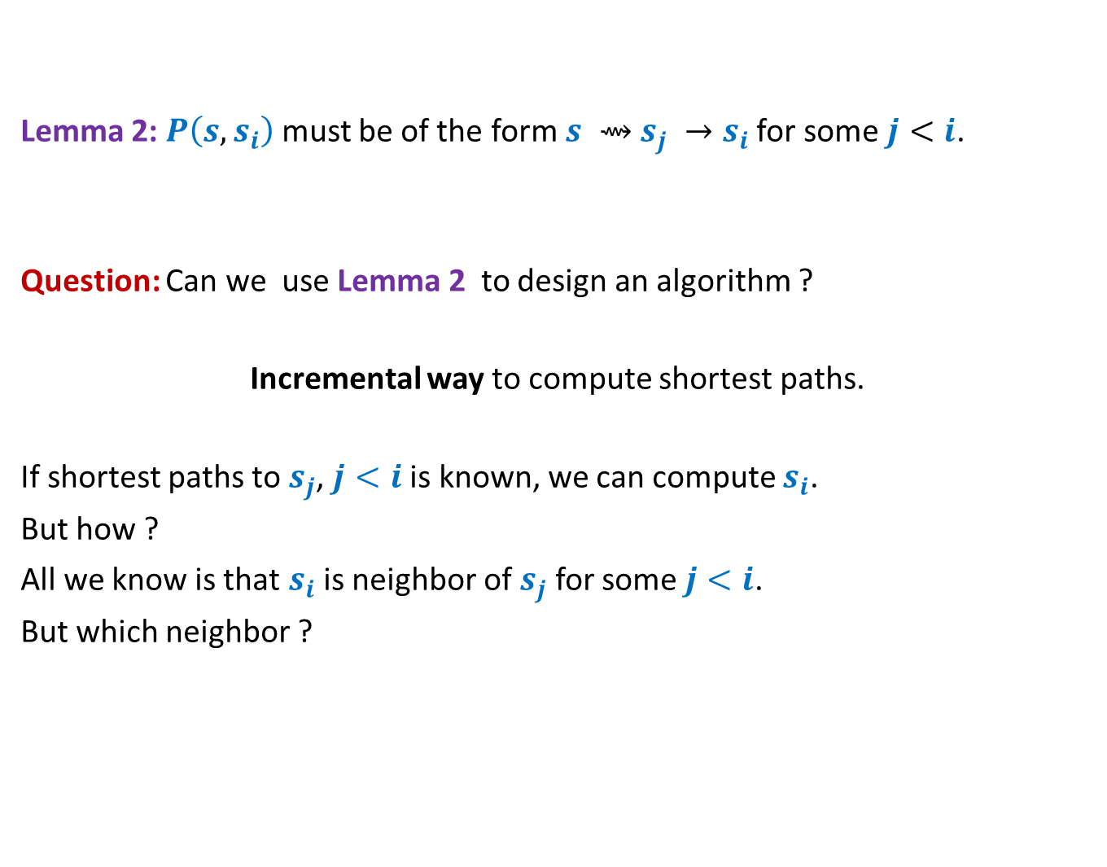
Designing the algorithm …
Lemma 2: $P\left(s,s_{i}\right)$ must be of the form $s ⇝$ $s_{j} →s_{i}$ for some $j<i$.
Question: Can we use Lemma 2 to design an algorithm ?
Incremental way to compute shortest paths.
If shortest paths to $s_{j}$, $j<i$ is known, we can compute $s_{i}$.
But how ?
All we know is that $s_{i}$ is neighbor of $s_{j}$ for some $j<i$.
But which neighbor ?
shortest
The next slide explains it precisely.
Hint:
For each neighbor, compute some label based on Lemma 2 s.t. $s_{i}$ is the neighbour with least label.

Slide 22


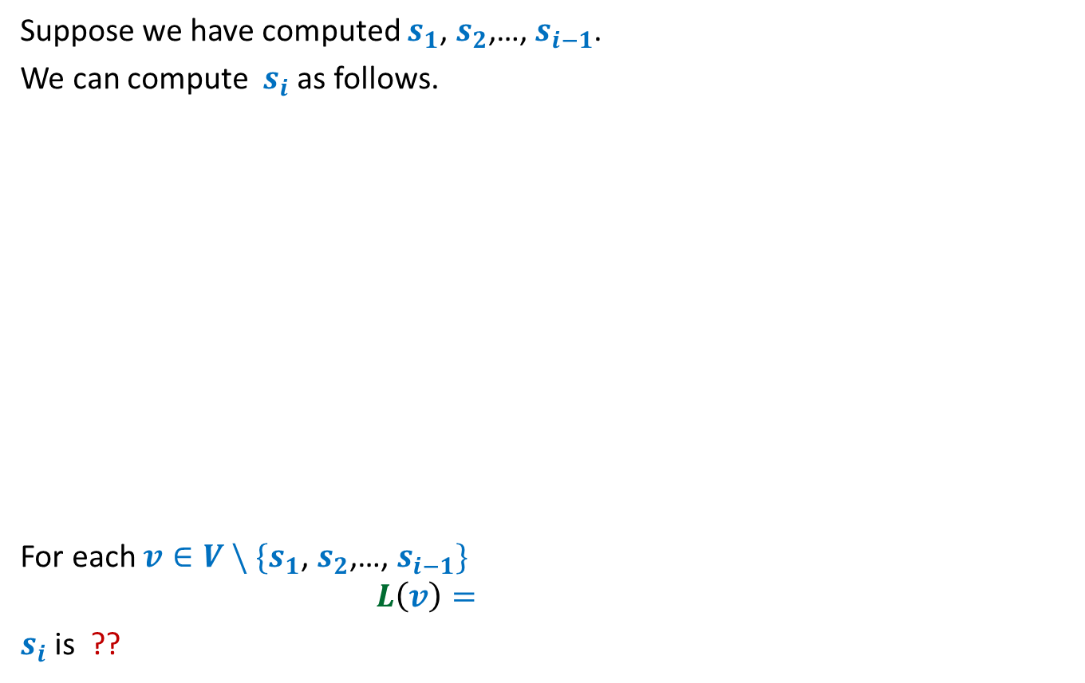






Suppose we have computed $s_{1}$, $s_{2}$,…, $s_{i−1}$.
We can compute $s_{i}$ as follows.
For each $v∈V \backslash \{s_{1}\text{,} s_{2}\text{,…,} s_{i−1}\}$
$$L\left(v\right)=$$
$s_{i}$ is ??
$$s$$
G
$$s_{1}$$
$$s_{4}$$
$$v$$
$$s_{2}$$
$$s_{3}$$
$$\left(δ\left(s,s_{j}\right)+ω\left(s_{j},v\right)\right)$$
$$\min_{\left({(s}_{j},v\right)∈E)}{ ? }$$
the vertex with minimum value of $L$.

Slide 23
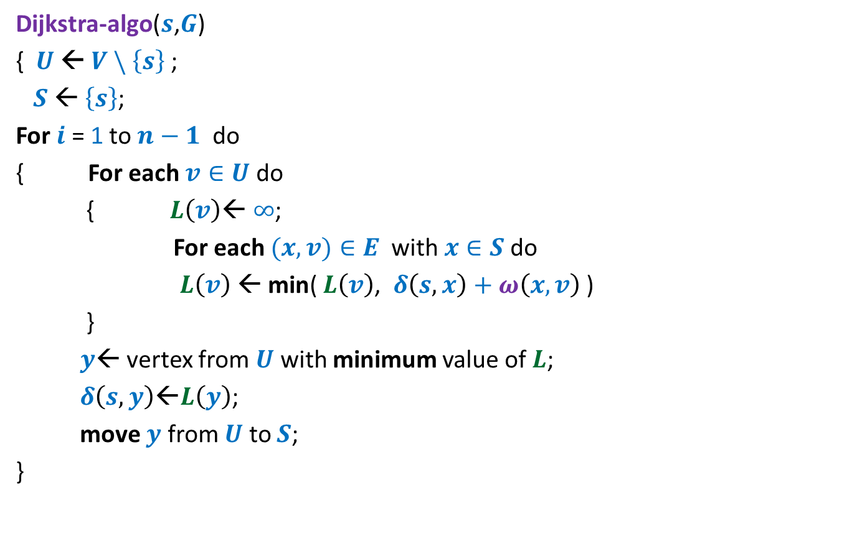
Dijkstra’s algorithm
Dijkstra-algo($s$,$G$)
{ $U$ ← $V \backslash \left\{s\right\}$;
$S$← $\left\{s\right\}$;
For $i$ = 1 to $n−1$ do
{ For each $v∈U$ do
{ $L\left(v\right)$← $∞$;
For each $(x,v)∈E$ with $x∈S$do
$L\left(v\right) \text{←}$ min( $L\left(v\right)$, $δ\left(s,x\right)+ω\left(x,v\right)$ )
}
$y$← vertex from $U$ with minimum value of $L$;
$δ\left(s,y\right)\text{←}L\left(y\right)$;
move $y$ from $U$ to $S$;
}

Slide 24
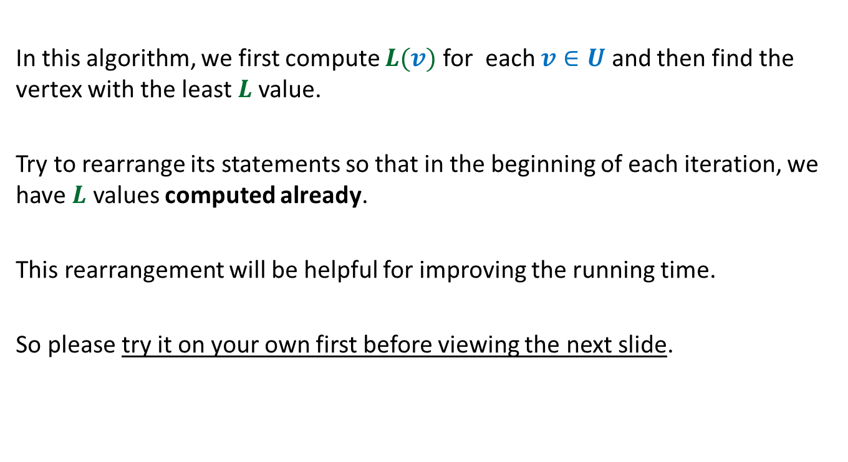
In this algorithm, we first compute $L(v)$ for each $v∈U$ and then find the vertex with the least $L$value.
Try to rearrange its statements so that in the beginning of each iteration, we have $L$ values computed already.
This rearrangement will be helpful for improving the running time.
So please try it on your own first before viewing the next slide.

Slide 25

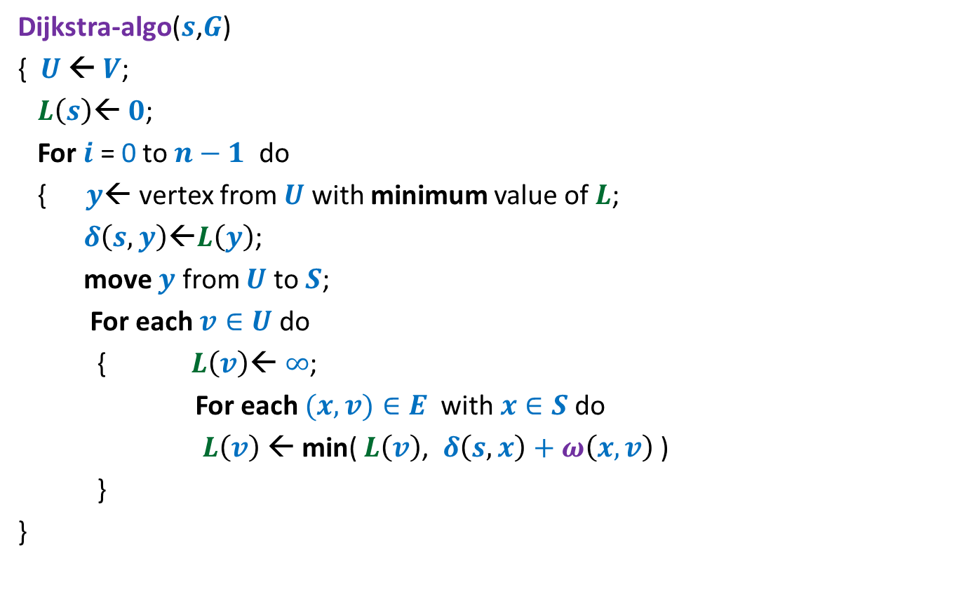
Dijkstra’s algorithm
Dijkstra-algo($s$,$G$)
{ $U$ ← $V$;
$L\left(s\right)$← $0$;
For $i$ = 0 to $n−1$ do
{ $y$← vertex from $U$ with minimum value of $L$;
$δ\left(s,y\right)\text{←}L\left(y\right)$;
move $y$ from $U$ to $S$;
For each $v∈U$ do
{ $L\left(v\right)$← $∞$;
For each $(x,v)∈E$ with $x∈S$do
$L\left(v\right) \text{←}$ min( $L\left(v\right)$, $δ\left(s,x\right)+ω\left(x,v\right)$ )
}
}
$L\left(v\right)$← $∞$ for all $v∈U$ ;
a lot of re-computation

Slide 26

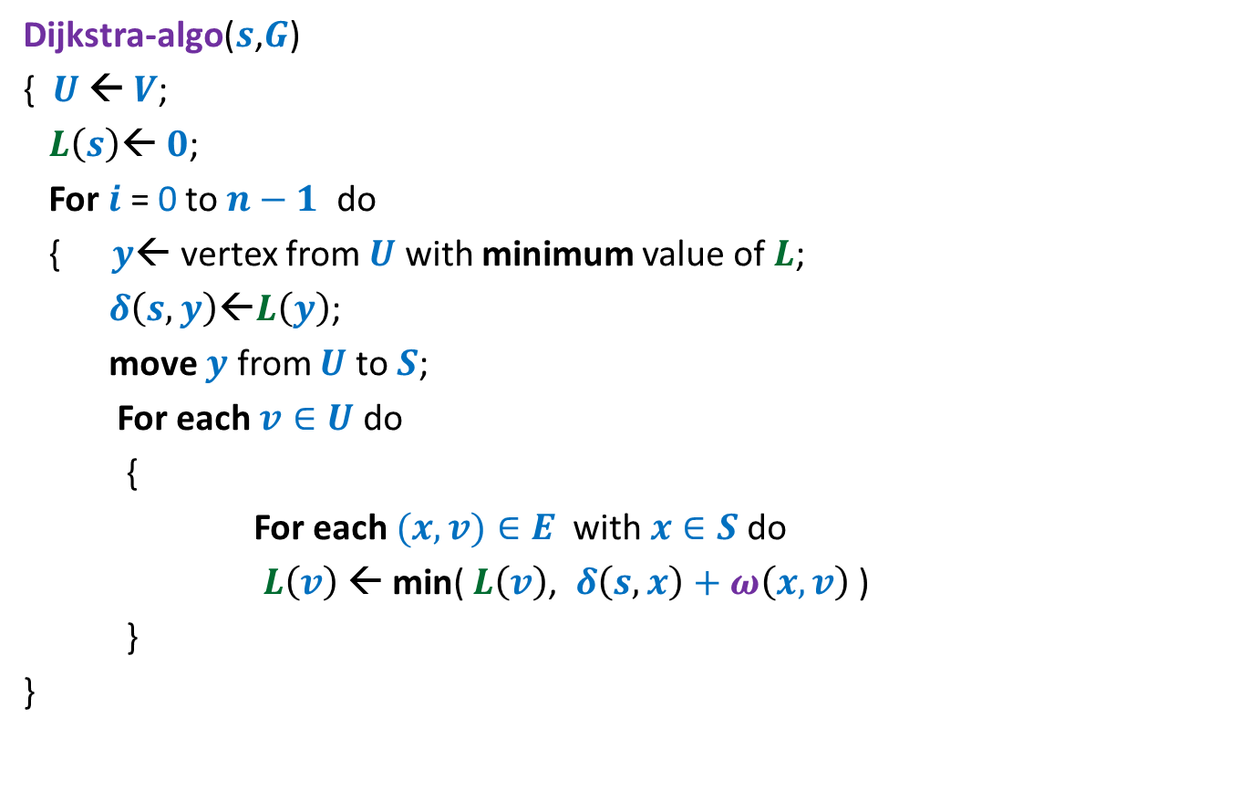


Dijkstra’s algorithm
Dijkstra-algo($s$,$G$)
{ $U$ ← $V$;
$L\left(s\right)$← $0$;
For $i$ = 0 to $n−1$ do
{ $y$← vertex from $U$ with minimum value of $L$;
$δ\left(s,y\right)\text{←}L\left(y\right)$;
move $y$ from $U$ to $S$;
For each $v∈U$ do
{
For each $(x,v)∈E$ with $x∈S$do
$L\left(v\right) \text{←}$ min( $L\left(v\right)$, $δ\left(s,x\right)+ω\left(x,v\right)$ )
}
}
Only neighbors of $y$
$L\left(v\right)$← $∞$ for all $v∈U$ ;
What are the vertices
whose $L$ value may change
in this iteration ?

Slide 27
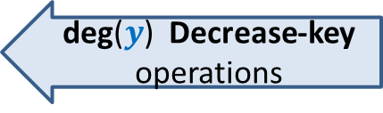
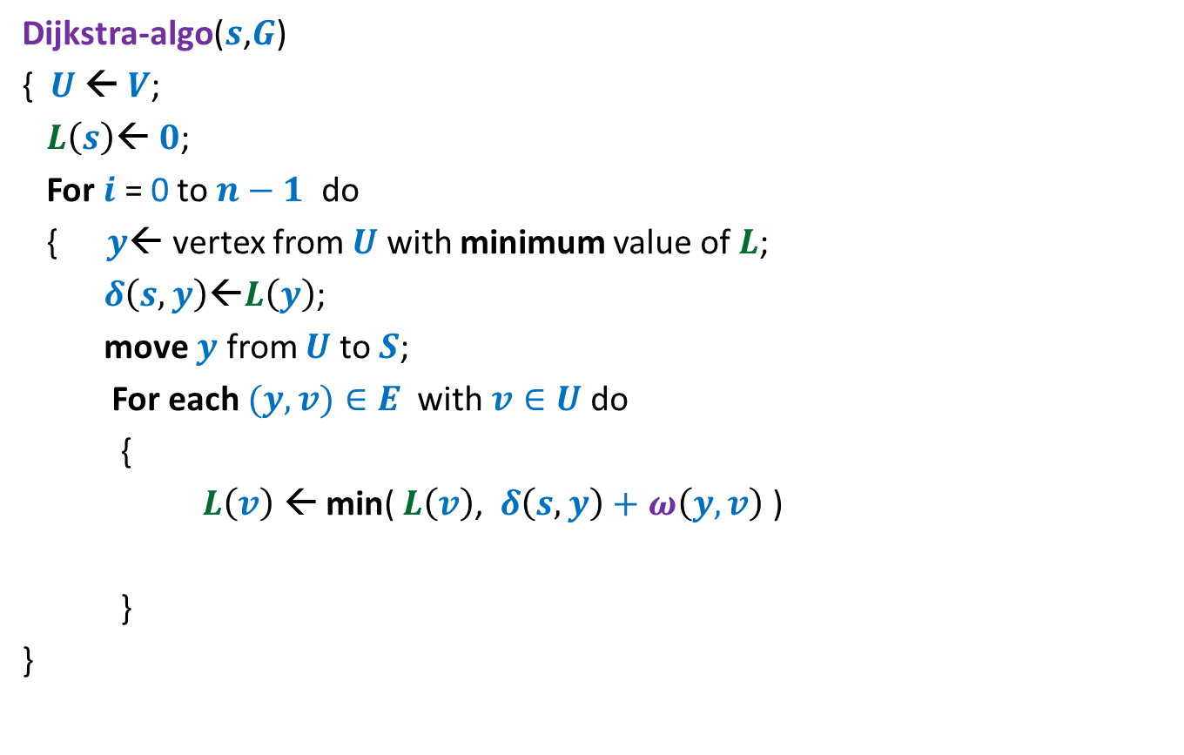
Dijkstra’s algorithm
Dijkstra-algo($s$,$G$)
{ $U$ ← $V$;
$L\left(s\right)$← $0$;
For $i$ = 0 to $n−1$ do
{ $y$← vertex from $U$ with minimum value of $L$;
$δ\left(s,y\right)\text{←}L\left(y\right)$;
move $y$ from $U$ to $S$;
For each $(y,v)∈E$ with $v∈U$do
{
$L\left(v\right) \text{←}$ min( $L\left(v\right)$, $δ\left(s,y\right)+ω\left(y,v\right)$ )
}
}
$L\left(v\right)$← $∞$ for all $v∈U$ ;
1 extract-min operation
deg($y$) Decrease-key operations

Slide 28
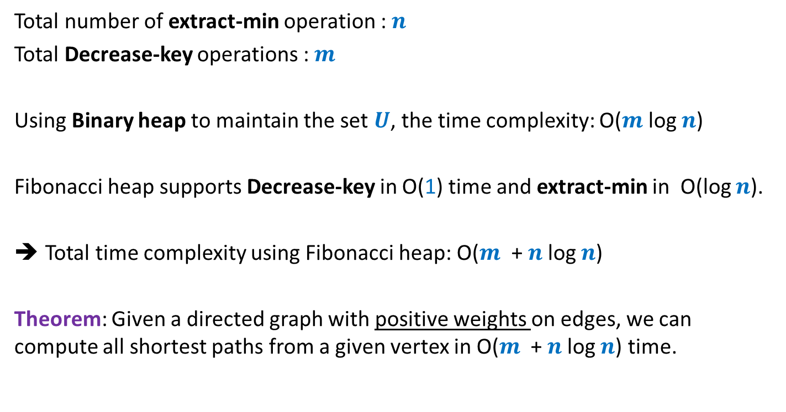
Time complexity of Dijkstra’s algorithm
Total number of extract-min operation : $n$
Total Decrease-key operations : $m$
Using Binary heap to maintain the set $U$, the time complexity: O($m$ log $n$)
Fibonacci heap supports Decrease-key in O(1) time and extract-min in O(log $n$).
Total time complexity using Fibonacci heap: O($m$ + $n$log $n$)
Theorem: Given a directed graph with positive weights on edges, we can compute all shortest paths from a given vertex in O($m$ + $n$log $n$) time.

