Slide 1
Design and Analysis of Algorithms (CS345/CS345A)
Lecture 11
Algorithms for Directed Acyclic Graphs
Hint for 1st problem of Assignment 2

Slide 2
Directed Acyclic Graphs

Slide 3






Directed Acyclic Graphs
Question: what is a cycle in $G$?
Answer: A sequence $v_{1}$, $v_{2}$,…, $v_{k}$ such that ($v_{i}$,$v_{i+1}$) $∈E$ for all $1≤i<k$
and ($v_{k}$,$v_{1}$) $∈E$ .
…
$$v_{1}$$
$$v_{2}$$
$$v_{3}$$
$$v_{k−1}$$
$$v_{k}$$

Slide 4
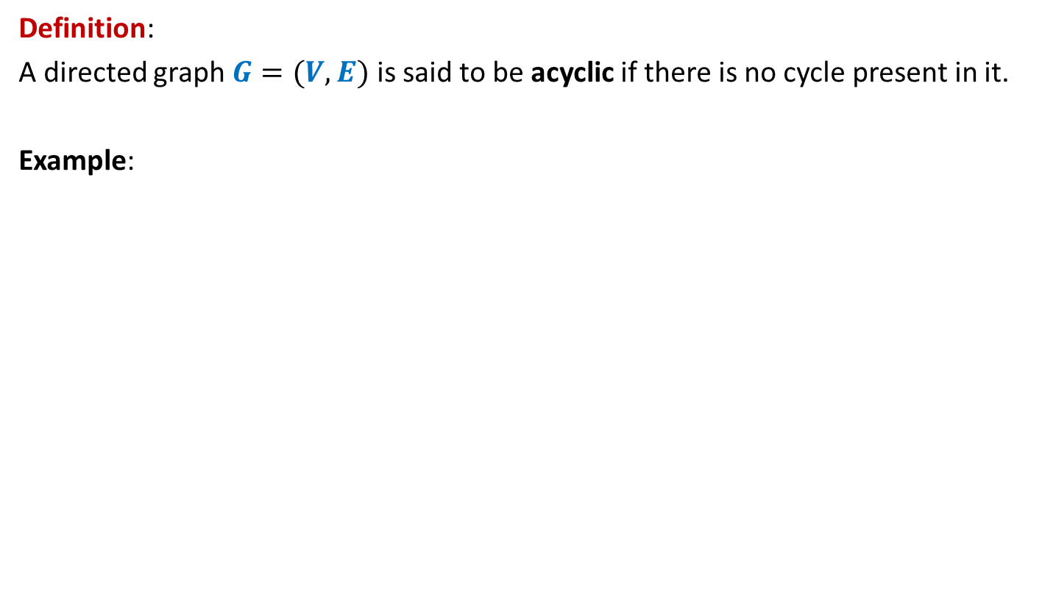
Directed Acyclic Graphs
Definition:
A directed graph $G=(V,E)$ is said to be acyclic if there is no cycle present in it.
Example:
u
DAG
z
b
v
y
x
w
a

Slide 5

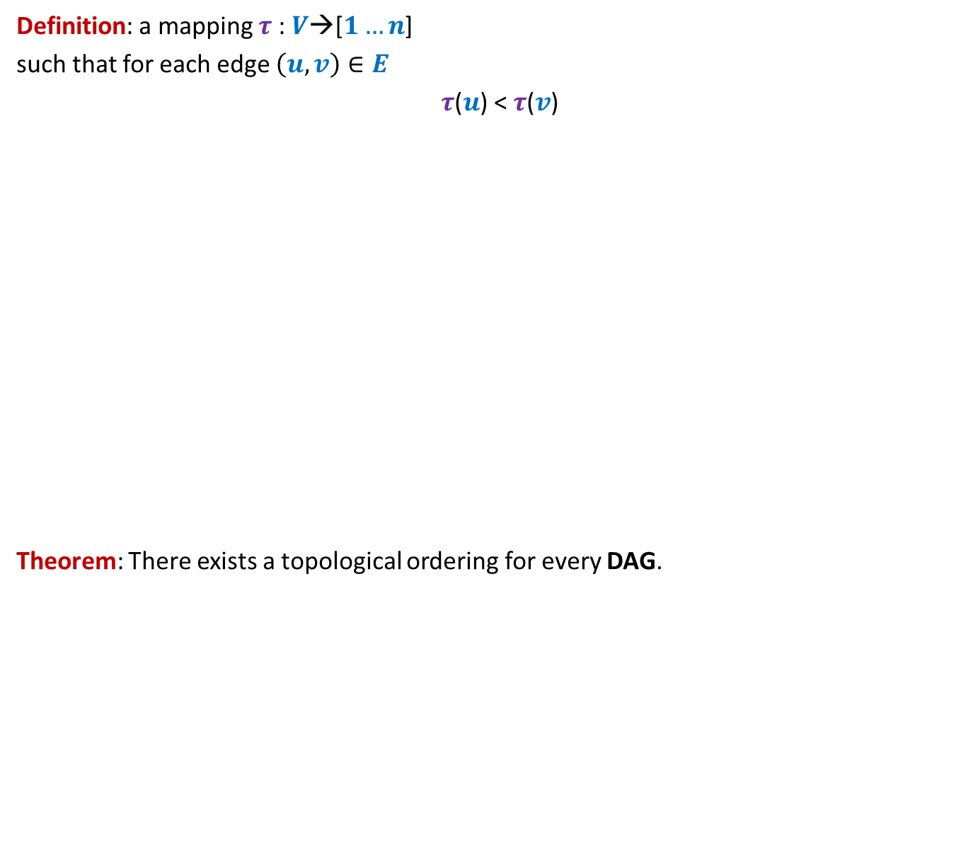
Topological ordering
Definition: a mapping $τ$ : $V$→[$1…n$]
such that for each edge $\left(u,v\right)∈E$
$τ$($u$) < $τ$($v$)
Theorem: There exists a topological ordering for every DAG.
1 2 3 4 5 6 7 8 9 10 11
Does there exist a topological ordering for every directed graph ?
>
<
<
<
<
<
<
Certainly No if there is any cycle

Slide 6
Topological ordering
Definition: a mapping $τ$ : $V$→[$1…n$]
such that for each edge $\left(u,v\right)∈E$
$τ$($u$) < $τ$($v$)
Theorem: There exists a topological ordering for every DAG.
1 2 3 4 5 6 7 8 9 10 11
>
<
<
<
<
<
<

Slide 7

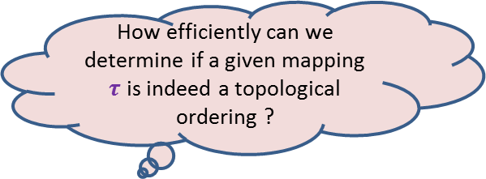
Topological ordering
Example:
This is indeed a valid topological ordering.
u
z
b
v
y
x
w
a
u
v
a
b
x
z
w
y
1 2 3 4 5 6 7 8
How efficiently can we determine if a given mapping $τ$ is indeed a topological ordering ?
O($m+n$) time

Slide 8
Topological ordering
Example:
This is indeed a valid topological ordering.
u
z
b
v
y
x
w
a
u
v
a
b
x
z
w
y
1 2 3 4 5 6 7 8
O($m+n$) time

Slide 9
Topological ordering
Three questions
Question 1: Why does a topological ordering exist for every DAG ?
Question 2: How efficiently can we compute a topological ordering ?
Question 3: What is the use of topological ordering ?

Slide 10
applications of Topological ordering
Question 3

Slide 11
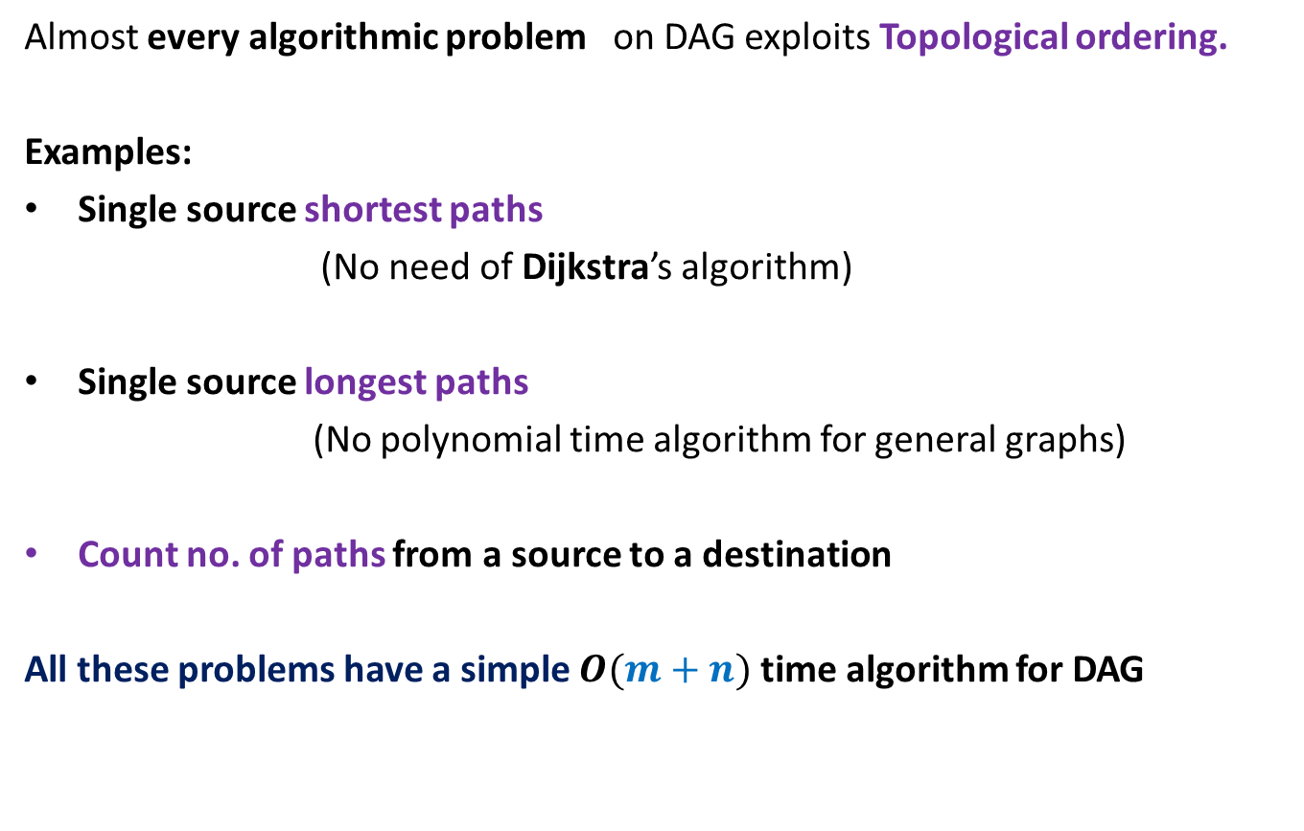
Applications of Topological ordering
Almost every algorithmic problem on DAG exploits Topological ordering.
Examples:
Single source shortest paths
(No need of Dijkstra’s algorithm)
Single source longest paths
(No polynomial time algorithm for general graphs)
Count no. of paths from a source to a destination
All these problems have a simple $O(m+n)$ time algorithm for DAG

Slide 12
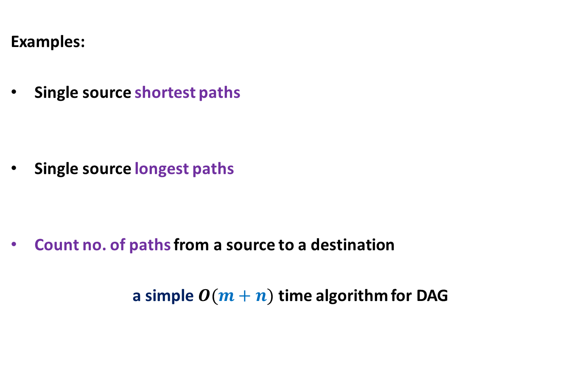
Applications of Topological ordering
Examples:
Single source shortest paths
Single source longest paths
Count no. of paths from a source to a destination
a simple $O(m+n)$ time algorithm for DAG

Slide 13
Why Does Topological ordering exist for every DAG?
Question 1

Slide 14
Why does Topological ordering exist ?
Example:
u
z
b
v
y
x
w
a
What is the guarantee that such a vertex always exists in a DAG ?
Any vertex of indegree=0 can be given number 1 in a topological ordering.
Is there any vertex for which you can be sure of its place in the ordering?

Slide 15
Why does Topological ordering exist ?
Example:
u
z
b
v
y
x
w
a

Slide 16

Why does Topological ordering exist ?
Lemma 1: Every DAG has at least one vertex with in-degree = 0.
Proof:
(an algorithmic proof)
Pick any vertex $v$.
While in-degree$(v)$ $≠$ 0 do
{ Let $(u,v)$ be an edge
$v$← $u$;
}
return $v$;
Observation: This algorithm, if terminates. will output a vertex of indegree =0.
But what is the guarantee that it will terminate.?
The algorithm does indeed terminate.
In fact, no vertex will be processed twice in while loop.
…
c
b
y
x
c
a
cycle

Slide 17

Why does Topological ordering exist ?
Lemma 1: Every DAG has at least one vertex with in-degree = 0.
Proof:
(an algorithmic proof)
Pick any vertex $v$.
While in-degree$(v)$ $≠$ 0 do
{ Let $(u,v)$ be an edge
$v$← $u$;
}
return $v$;
Observation: This algorithm, if terminates, will output a vertex of indegree =0.
…
c
b
y
x
c
a
cycle

Slide 18
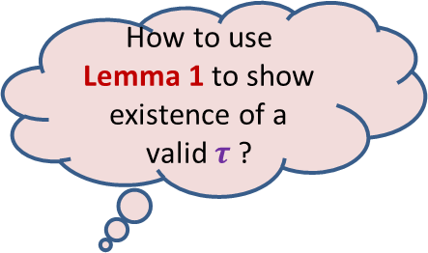
Why does Topological ordering exist ?
Lemma 1: Every DAG has at least one vertex with in-degree = 0.
u
z
b
v
y
x
w
a
How to use Lemma 1 to show existence of a valid $τ$ ?

Slide 19
Why does Topological ordering exist ?
Lemma 1: Every DAG has at least one vertex with in-degree = 0.
u
z
b
v
y
x
w
a

Slide 20
Why does Topological ordering exist ?
u
z
b
v
y
x
w
a
u
v
a
b
x
z
w
y
1
2
3
4
5
6
7
8

Slide 21

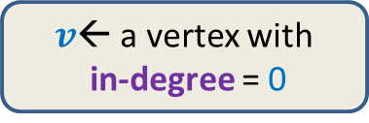
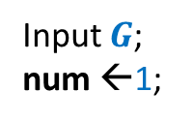
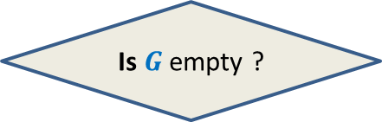

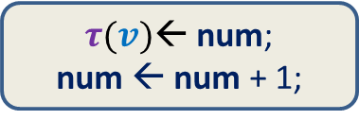

Why does Topological ordering exist ?
Time complexity of the algorithm: ?
$O(n^{2})$
Input $G$;
num ←1;
$v$← a vertex with
in-degree = 0
$τ(v)$← num;
num ← num + 1;
Remove $v$ and all its outgoing edges;
Yes
NO
Is $G$ empty ?
A valid $τ$

Slide 22

How efficiently can we compute Topological ordering ?
$O(m+n)$ time

Slide 23
Revisiting the example
..but slowly this time…
Main time consuming step:
To find next vertex with indegree=0
The new vertices with indegree=0 are created during ?
u
z
b
v
y
x
w
a
u
v
a
b
x
z
w
y
1
2
3
4
5
6
7
8
the processing of the current vertex of indegree=0

Slide 24
Revisiting the example
..but slowly this time…
Main time consuming step:
To find next vertex with indegree=0
u
z
b
v
y
x
w
a
u
v
a
b
x
z
w
y
1
2
3
4
5
6
7
8

Slide 25

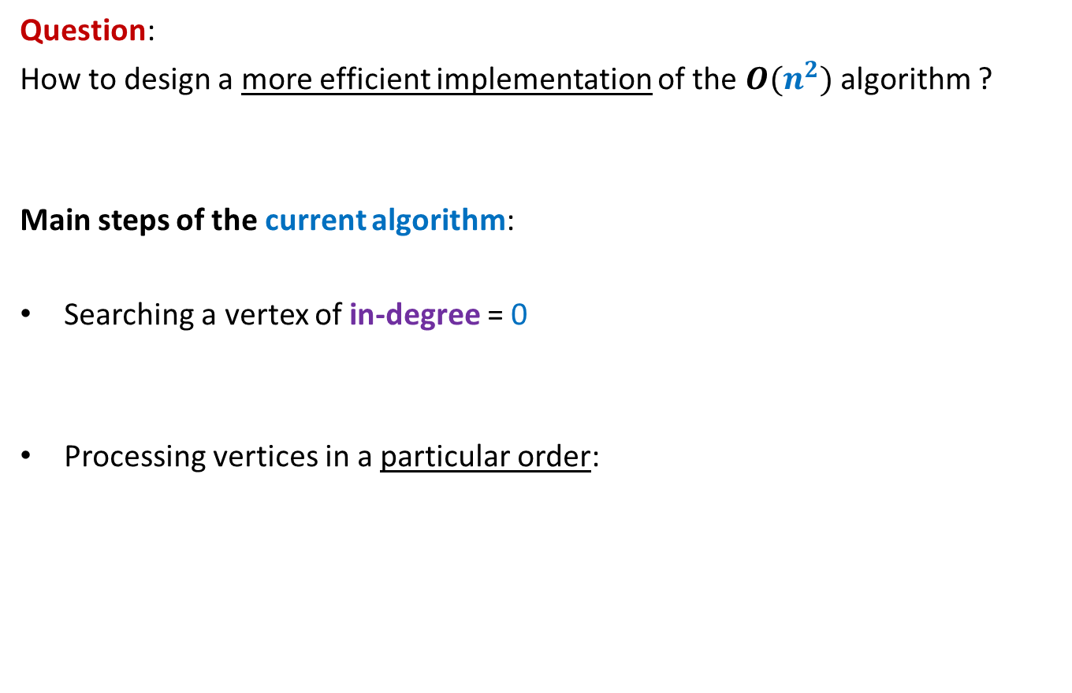
Algorithm for Topological ordering ?
Question:
How to design a more efficient implementation of the $O(n^{2})$ algorithm ?
Main steps of the current algorithm:
Searching a vertex of in-degree = 0
Processing vertices in a particular order:
Keep an array In-degree[]
Keep a queue $Q$

Slide 26
Algorithm for Topological ordering ?
Main steps of the current algorithm:
Searching a vertex of in-degree = 0
Processing vertices in a particular order:
Keep an array In-degree[]
Keep a queue $Q$

Slide 27

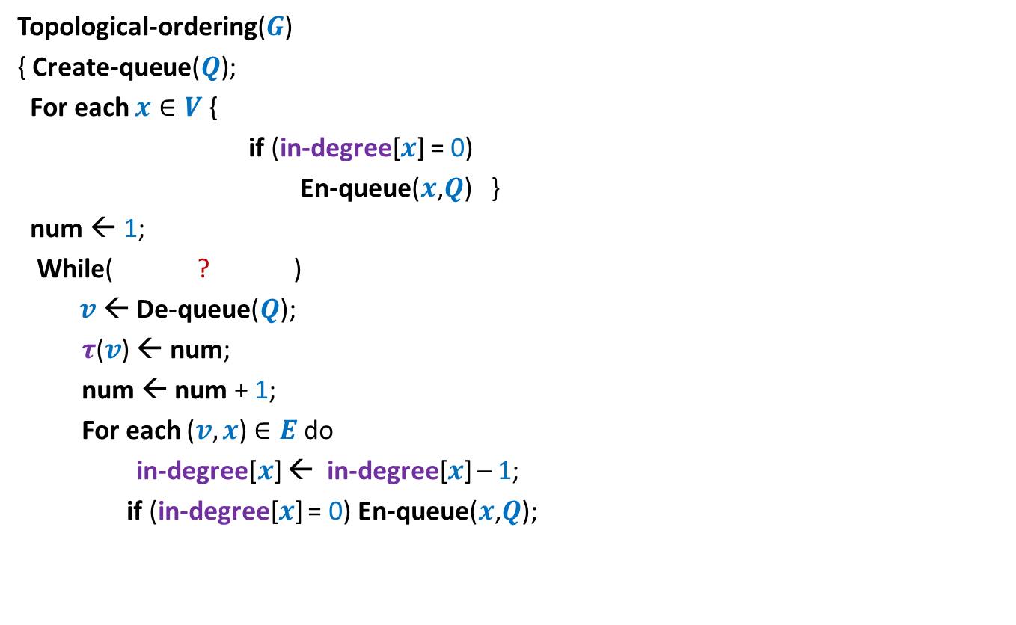
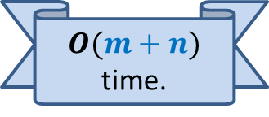


Algorithm for Topological ordering ?
Topological-ordering($G$)
{ Create-queue($Q$);
For each $x∈V$ {
if (in-degree[$x$] = 0)
En-queue($x$,$Q$) }
num ← 1;
While( ? )
$v$← De-queue($Q$);
$τ$($v$) ← num;
num ← num + 1;
For each ($v,x$) $∈E$ do
in-degree[$x$] ← in-degree[$x$] – 1;
if (in-degree[$x$] = 0) En-queue($x$,$Q$);
Proof of correctness ?
not-empty($Q$)
{
O($deg(v)$) time
{
?
}
} return $τ$ ;
$O(m+n)$ time.
x
y

Slide 28
Algorithm for Topological ordering ?
Topological-ordering($G$)
{ Create-queue($Q$);
For each $x∈V$ {
if (in-degree[$x$] = 0)
En-queue($x$,$Q$) }
num ← 1;
While( ? )
$v$← De-queue($Q$);
$τ$($v$) ← num;
num ← num + 1;
For each ($v,x$) $∈E$ do
in-degree[$x$] ← in-degree[$x$] – 1;
if (in-degree[$x$] = 0) En-queue($x$,$Q$);
not-empty($Q$)
{
O($deg(v)$) time
{
?
}
} return $τ$ ;
$O(m+n)$ time.
x
y

Slide 29
Applications of topological ordering ?

Slide 30

Topological ordering
A mapping $τ$ : $V$→[$1…n$] such that
For each edge $\left(u,v\right)∈E$ , $τ$($u$) < $τ$($v$)
1 2 3 4 5 6 7 8 9 10 11

Slide 31



Applications of Topological ordering I
A mapping $τ$ : $V$→[$1…n$] such that
For each edge $\left(u,v\right)∈E$ , $τ$($u$) < $τ$($v$)
Let $f$ be a function on $V$that we wish to compute
If $f(y)$ can be expressed in terms of ONLY $\left\{f\left(x\right) \right|\left(x,y\right)∈E\}$
➔We can compute $f$ by processing vertices in increasing order of $τ$.
It is useful to compute $f$ in this order
1 2 3 4 5 6 7 8 9 10 11
$$y$$

Slide 32
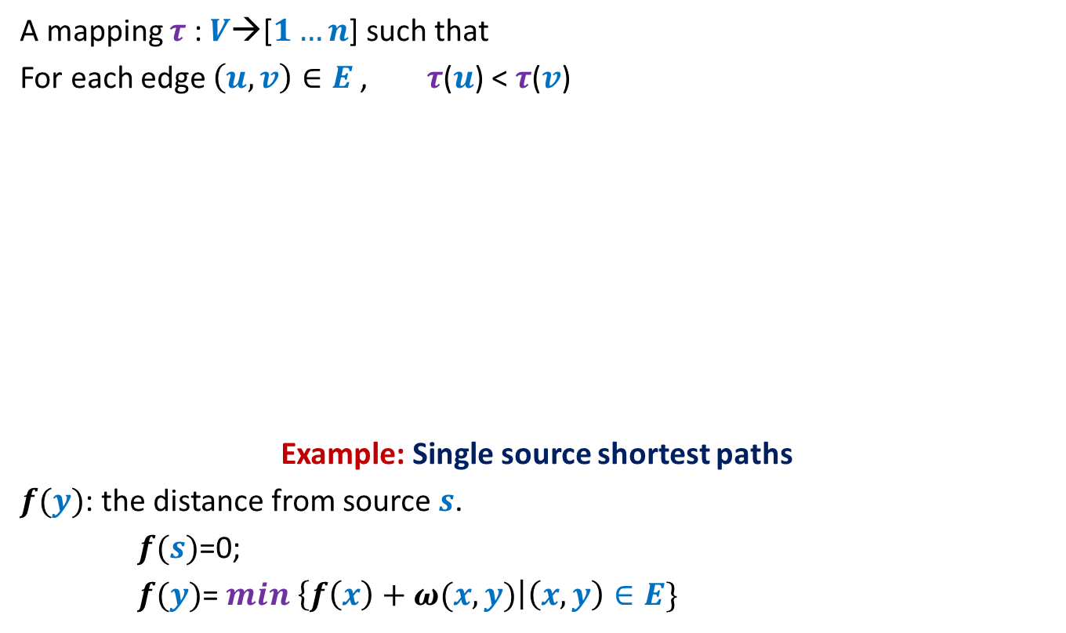

Applications of Topological ordering I
A mapping $τ$ : $V$→[$1…n$] such that
For each edge $\left(u,v\right)∈E$ , $τ$($u$) < $τ$($v$)
Example: Single source shortest paths
$f(y)$: the distance from source $s$.
$f(s)$=0;
$f(y)$= $min$ $\left\{f\left(x\right)+ω(x,y)\right|\left(x,y\right)∈E\}$
It is useful to compute $f$ in this order
1 2 3 4 5 6 7 8 9 10 11
$$y$$
$O(m+n)$ time algo

Slide 33


Applications of Topological ordering II
A mapping $τ$ : $V$→[$1…n$] such that
For each edge $\left(u,v\right)∈E$ , $τ$($u$) < $τ$($v$)
Let $f$ be a function on $V$that we wish to compute
If $f(y)$ can be expressed in terms of ONLY $\left\{f\left(z\right) \right|\left(y,z\right)∈E\}$
➔We can compute $f$ by processing vertices in decreasing order of $τ$.
It is useful to compute $f$ in this order
1 2 3 4 5 6 7 8 9 10 11
$$y$$

Slide 34
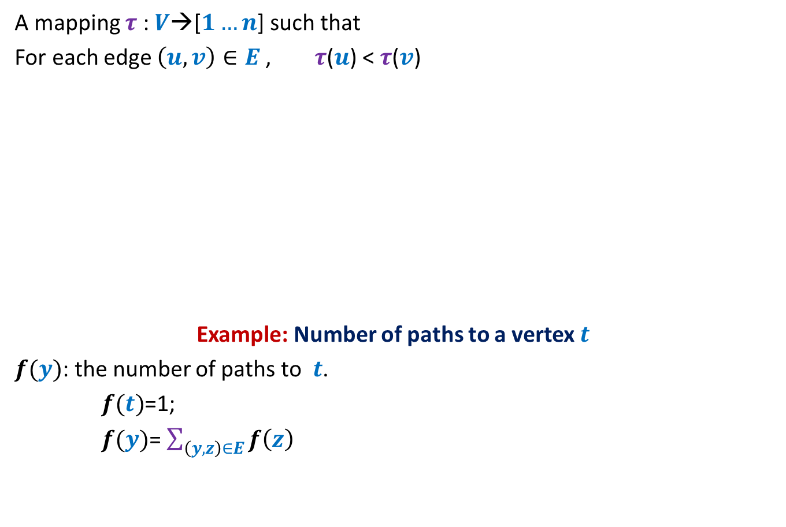
Applications of Topological ordering II
A mapping $τ$ : $V$→[$1…n$] such that
For each edge $\left(u,v\right)∈E$ , $τ$($u$) < $τ$($v$)
Example: Number of paths to a vertex $t$
$f(y)$: the number of paths to $t$.
$f(t)$=1;
$f(y)$= $\sum_{\left(y,z\right)∈E}{f\left(z\right)}$
It is useful to compute $f$ in this order
1 2 3 4 5 6 7 8 9 10 11
$$y$$
$O(m+n)$ time algo

Slide 35
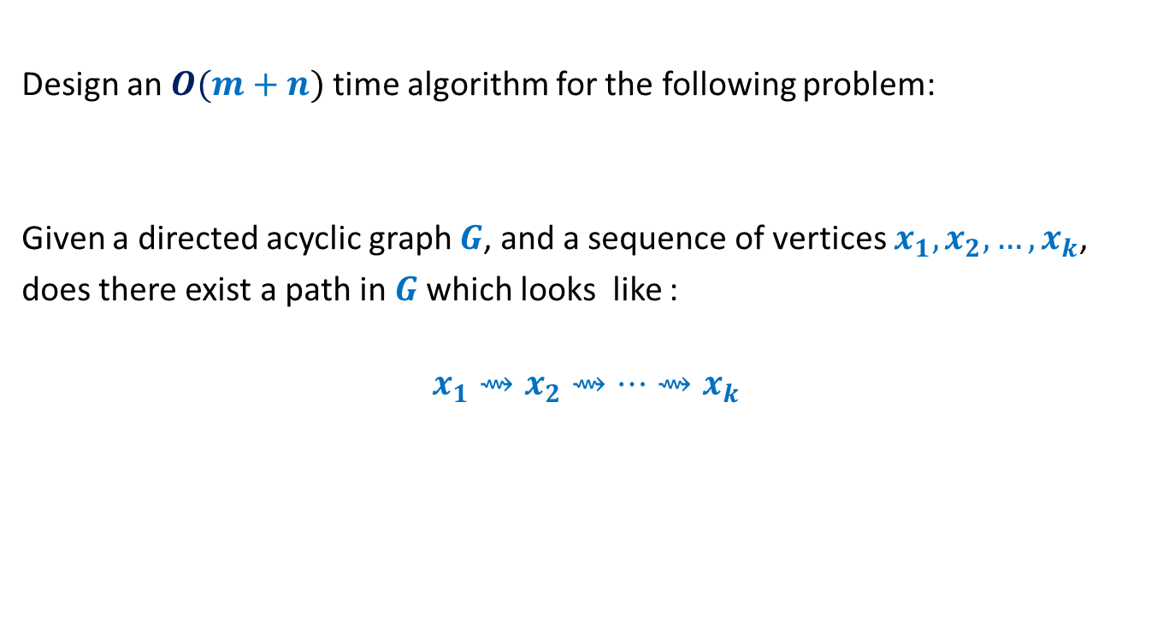
Homework
Design an $O(m+n)$ time algorithm for the following problem:
Given a directed acyclic graph $G$, and a sequence of vertices $x_{1},x_{2},…,x_{k}$,
does there exist a path in $G$which looks like :
$$x_{1}⇝x_{2}⇝…{⇝x}_{k}$$

Slide 36
Assignment 2
Hint for 1st problem

Slide 37


