Slide 1
Design and Analysis of Algorithms (CS345/CS345A)
Lecture 15
A new algorithm paradigm
Dynamic Programming

Slide 2
Longest common subsequence

Slide 3


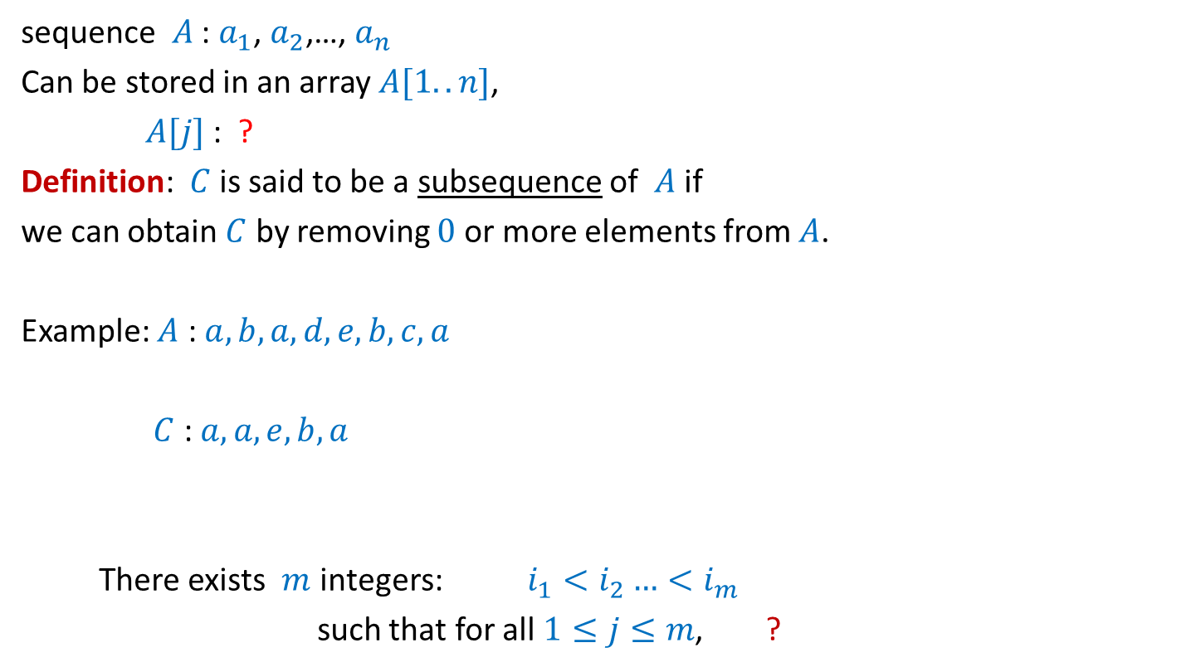





What is a subsequence ?
sequence $A$ : $a_{1}$, $a_{2}$,…, $a_{n}$
Can be stored in an array $A[1..n]$,
$A[j]$ : ?
Definition: $C$ is said to be a subsequence of $A$ if
we can obtain $C$ by removing $0$ or more elements from $A$.
Example: $A$ : $a,b,a,d,e,b,c,a$
$C$ : $a,a,e,b,a$
There exists $m$ integers: $i_{1}<i_{2}…<i_{m}$
such that for all $1≤j≤m$, ?
$$a_{j}$$
$A[1..k]$ : ?
$a_{1}$, $a_{2}$,…, $a_{k}$
A more formal definition ?
$$C[1..m]$$
$$1≤$$
$$≤n$$
$C\left[j\right]=A[i_{j}]$

Slide 4
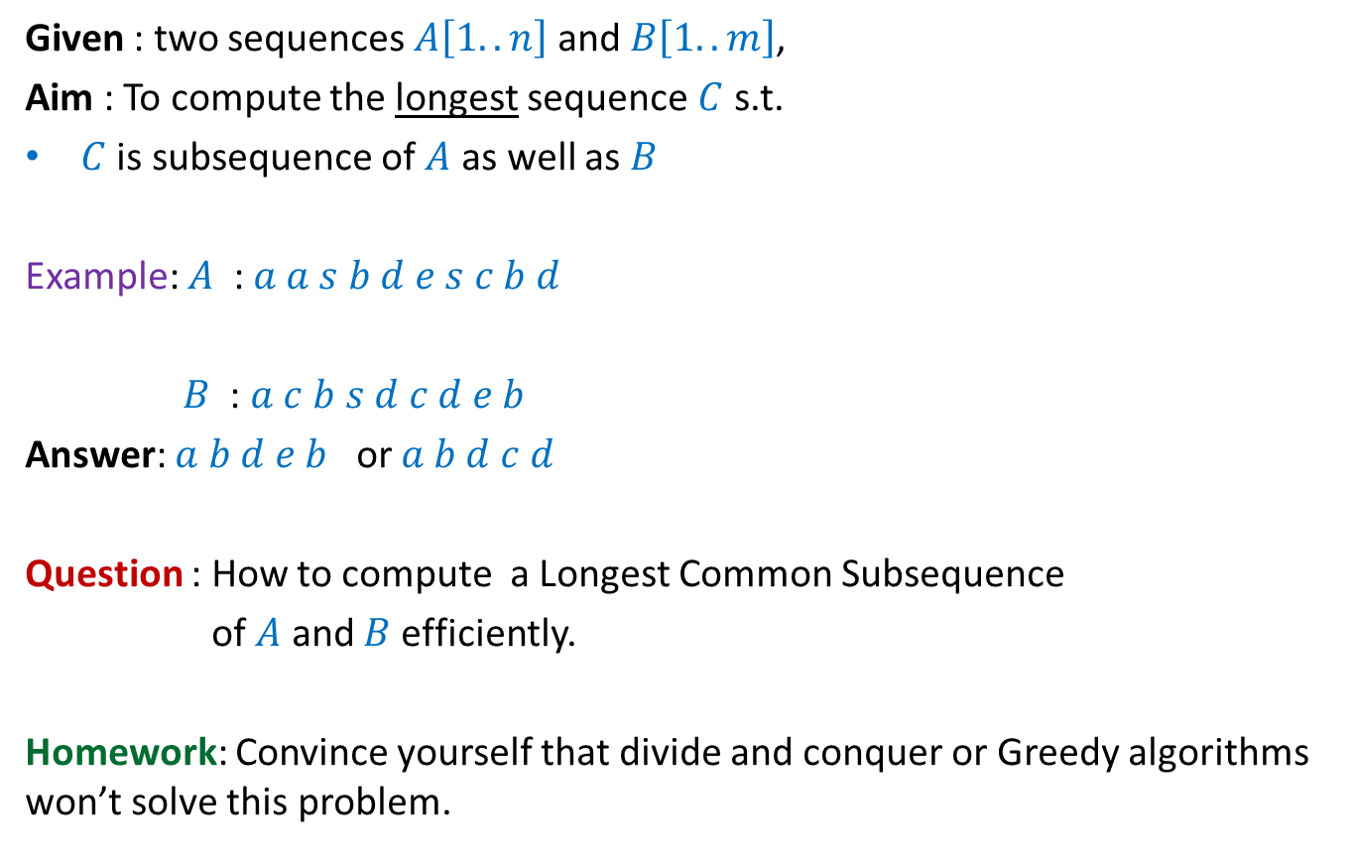
Problem Definition
Given : two sequences $A\left[1..n\right]$ and $B\left[1..m\right]$,
Aim : To compute the longest sequence $C$ s.t.
$C$ is subsequence of $A$ as well as $B$
Example: $A$ : $a a s b d e s c b d$
$B$ : $a c b s d c d e b$
Answer: $a b d e b$ or $a b d c d$
Question : How to compute a Longest Common Subsequence
of $A$ and $B$ efficiently.
Homework: Convince yourself that divide and conquer or Greedy algorithms won’t solve this problem.

Slide 5
Observations

Slide 6

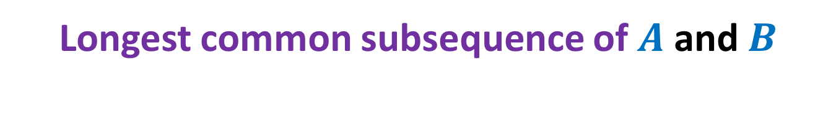


Longest common subsequence of $A$ and $B$
when $a_{n}=b_{m}$
$a_{1}$ $a_{2}$ $a_{3}$ … $a_{n−1}{ a}_{n}$
$b_{1}$ $b_{2}$ $b_{3}$ … $b_{m−1}{ b}_{m}$

Slide 7
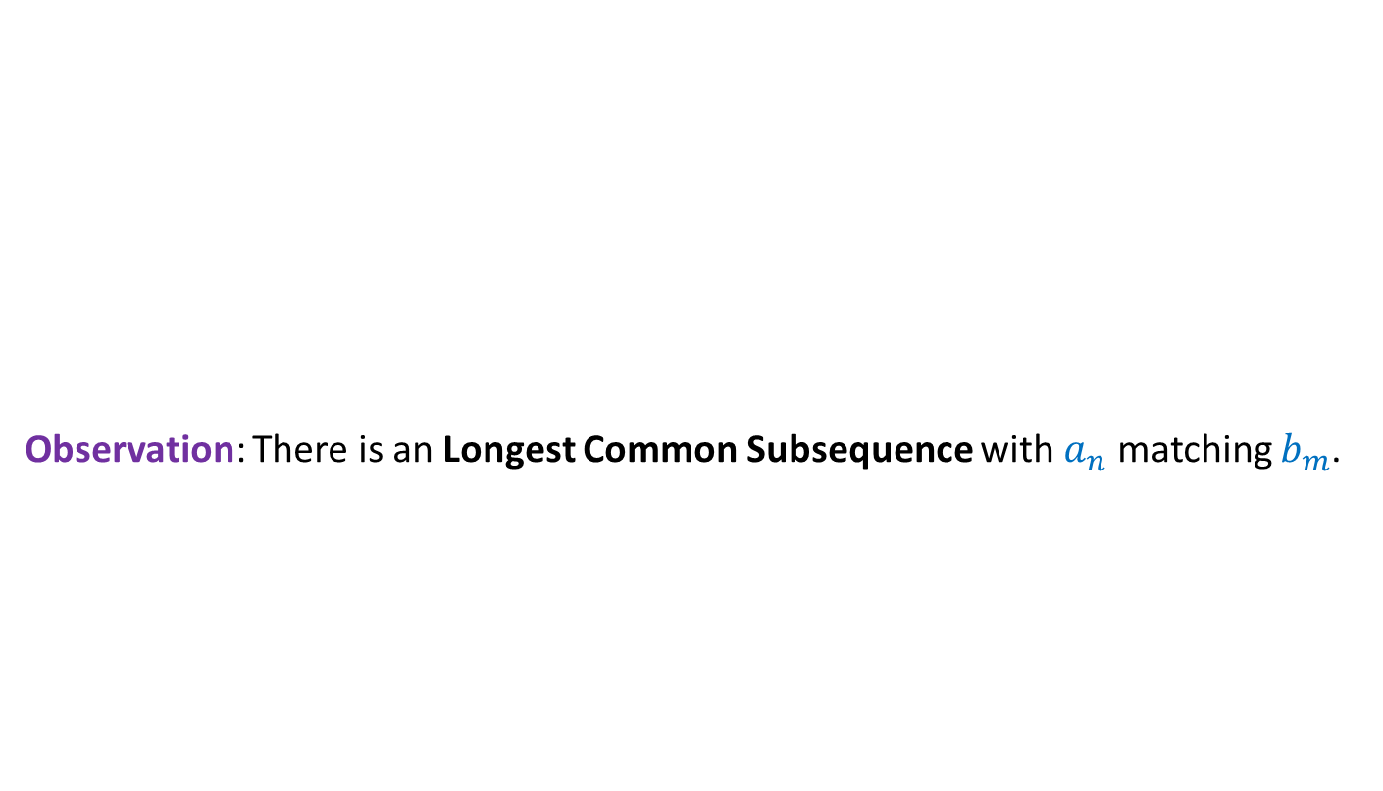



Longest common subsequence of $A$ and $B$
when $a_{n}=b_{m}$ ?
Observation: There is an Longest Common Subsequence with $a_{n}$ matching $b_{m}$.
Otherwise, $b_{m}$ is matched with $a_{i}$ for some $i<n$. Since $b_{m}$ is the last symbol of $B$, we can as well match $b_{m}$ with $a_{n}$ to get the desired LCS.
Otherwise, we can append $a_{n}$ at the end of such LCS to get a longer LCS.
A contradiction !
$a_{1}$ $a_{2}$ $a_{3}$ … $a_{n−1}{ a}_{n}$
$b_{1}$ $b_{2}$ $b_{3}$ … $b_{m−1}{ b}_{m}$
Last symbol of Longest Common Subsequence must be $a_{n}$.
We can even make a stronger observation.
What kind of picture emerge for the LCS in this case ?

Slide 8
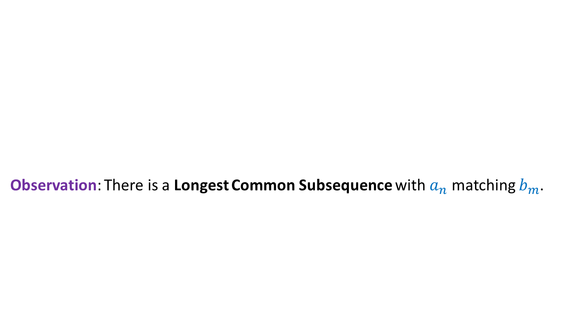

Longest common subsequence of $A$ and $B$
when $a_{n}=b_{m}$
Observation: There is a Longest Common Subsequence with $a_{n}$ matching $b_{m}$.
Otherwise, $b_{m}$ is matched with $a_{i}$ for some $i<n$. Since $b_{m}$ is the last symbol of $B$, we can as well match $b_{m}$ with $a_{n}$ to get the desired LCS.
Otherwise, we can append $a_{n}$ at the end of such LCS to get a longer LCS.
A contradiction !
$a_{1}$ $a_{2}$ $a_{3}$ … $a_{n−1}{ a}_{n}$
$b_{1}$ $b_{2}$ $b_{3}$ … $b_{m−1}{ b}_{m}$
Last symbol of Longest Common Subsequence must be $a_{n}$.
We can even make a stronger observation.
What kind of picture emerge for the LCS in this case ?

Slide 9

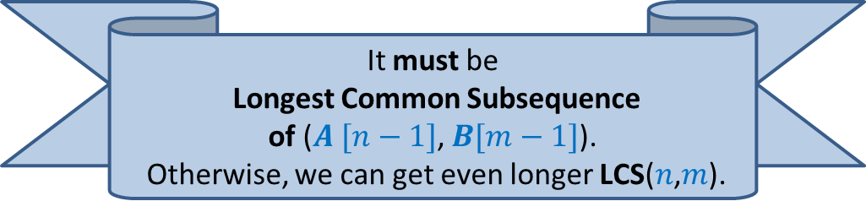

Longest common subsequence of $A$ and $B$
when $a_{n}=b_{m}$
Observation: There is a Longest Common Subsequence with $a_{n}$ matching $b_{m}$.
Lemma: If $a_{n}=b_{m}$then
LCS($n$,$m$) = ?
$a_{1}$ $a_{2}$ $a_{3}$ … $a_{n−1}{ a}_{n}$
What can you say about the Longest Common Subsequence excluding the last (red) symbol ?
$b_{1}$ $b_{2}$ $b_{3}$ … $b_{m−1}{ b}_{m}$
LCS($n−1$,$m−1$) ::${ a}_{n}$
It must be
Longest Common Subsequence
of ($A [n−1]$, $B[m−1]$).
Otherwise, we can get even longer LCS($n$,$m$).

Slide 10



Longest common subsequence of $A$ and $B$
when $a_{n}=b_{m}$
Observation: There is a Longest Common Subsequence with $a_{n}$ matching $b_{m}$.
Lemma: If $a_{n}=b_{m}$then
Longest Common Subsequence =
?
$a_{1}$ $a_{2}$ $a_{3}$ … $a_{n−1}{ a}_{n}$
What can you say about the Longest Common Subsequence excluding the last (red) symbol ?
$b_{1}$ $b_{2}$ $b_{3}$ … $b_{m−1}{ b}_{m}$
LCS($n$,$m$)
LCS($n−1$,$m−1$) ::${ a}_{n}$
Longest Common Subsequence of $A [n−1]$, $B[m−1]$::${ a}_{n}$
It must be
Longest Common Subsequence
of ($A [n−1]$, $B[m−1]$).
Otherwise, we can get even longer LCS($n$,$m$).

Slide 11
Longest common subsequence of $A$ and $B$
when $a_{n}=b_{m}$
Observation: There is a Longest Common Subsequence with $a_{n}$ matching $b_{m}$.
Lemma: If $a_{n}=b_{m}$then
Longest Common Subsequence =
?
$a_{1}$ $a_{2}$ $a_{3}$ … $a_{n−1}{ a}_{n}$
What can you say about the Longest Common Subsequence excluding the last (red) symbol ?
$b_{1}$ $b_{2}$ $b_{3}$ … $b_{m−1}{ b}_{m}$
LCS($n$,$m$)
LCS($n−1$,$m−1$) ::${ a}_{n}$
Longest Common Subsequence of $A [n−1]$, $B[m−1]$::${ a}_{n}$
It must be
Longest Common Subsequence
of ($A [n−1]$, $B[m−1]$).
Otherwise, we can get even longer LCS($n$,$m$).
LCS($i$, $j$): Longest common subsequence of $A\left[1..i\right]$ and $B\left[1..j\right]$

Slide 12


Longest common subsequence of $A$ and $B$
when $a_{n}=b_{m}$
$$≠$$
Observation: Either $a_{n}$or $b_{m}$is not the last symbol of LCS($n$,$m$).
Observation: If $a_{n}$is not the last symbol of LCS($n$,$m$)
$a_{1}$ $a_{2}$ $a_{3}$ … $a_{n−1}{ a}_{n}$
$b_{1}$ $b_{2}$ $b_{3}$ … $b_{m−1}{ b}_{m}$

Slide 13

Longest common subsequence of $A$ and $B$
when $a_{n}=b_{m}$
$$≠$$
Observation: Either $a_{n}$or $b_{m}$is not the last symbol of LCS($n$,$m$).
Observation: If $a_{n}$is not the last symbol of LCS($n$,$m$)
$a_{1}$ $a_{2}$ $a_{3}$ … $a_{n−1}{ a}_{n}$
$b_{1}$ $b_{2}$ $b_{3}$ … $b_{m−1}{ b}_{m}$

Slide 14


Longest common subsequence of $A$ and $B$
when $a_{n}=b_{m}$
$$≠$$
Observation: Either $a_{n}$or $b_{m}$is not the last symbol of LCS($n\text{,}m$).
Observation: If $a_{n}$is not the last symbol of LCS($n$,$m$)
➔ LCS($n$,$m$) is ?
$a_{1}$ $a_{2}$ $a_{3}$ … $a_{n−1}{ a}_{n}$
$b_{1}$ $b_{2}$ $b_{3}$ … $b_{m−1}{ b}_{m}$
LCS($n−1$,$m$)

Slide 15
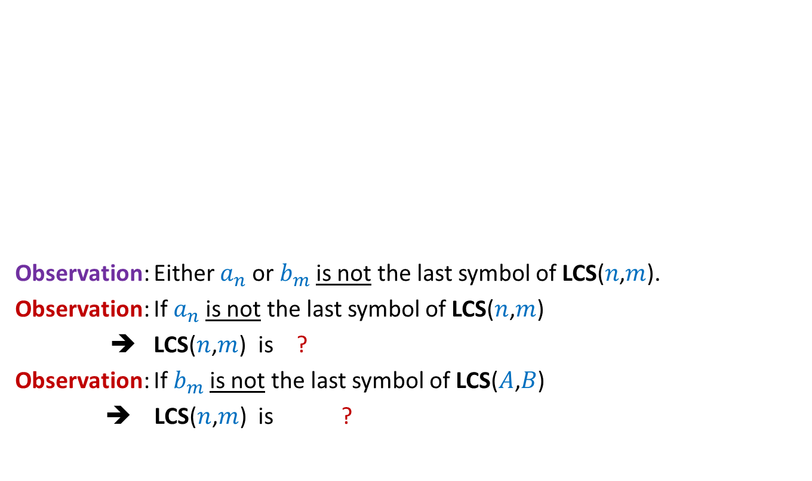

Longest common subsequence of $A$ and $B$
when $a_{n}=b_{m}$
$$≠$$
Observation: Either $a_{n}$or $b_{m}$is not the last symbol of LCS($n\text{,}m$).
Observation: If $a_{n}$is not the last symbol of LCS($n$,$m$)
➔ LCS($n$,$m$) is ?
Observation: If $b_{m}$is not the last symbol of LCS($A$,$B$)
➔ LCS($n$,$m$) is ?
$a_{1}$ $a_{2}$ $a_{3}$ … $a_{n−1}{ a}_{n}$
$b_{1}$ $b_{2}$ $b_{3}$ … $b_{m−1}{ b}_{m}$
LCS($n−1$,$m$)
LCS($n$,$m−1$)

Slide 16

Longest common subsequence of $A$ and $B$
when $a_{n}=b_{m}$
$$≠$$
Observation: Either $a_{n}$or $b_{m}$is not the last symbol of LCS($n$,$m$).
Lemma: If $a_{n}≠b_{m}$then
LCS($n\text{,}m$) is either LCS($n$,$m−1$) or LCS($n−1$,$m$)
$a_{1}$ $a_{2}$ $a_{3}$ … $a_{n−1}{ a}_{n}$
$b_{1}$ $b_{2}$ $b_{3}$ … $b_{m−1}{ b}_{m}$

Slide 17
Recursive formulation
LCS($i$, $j$): Longest common subsequence of $A\left[1..i\right]$ and $B\left[1..j\right]$

Slide 18
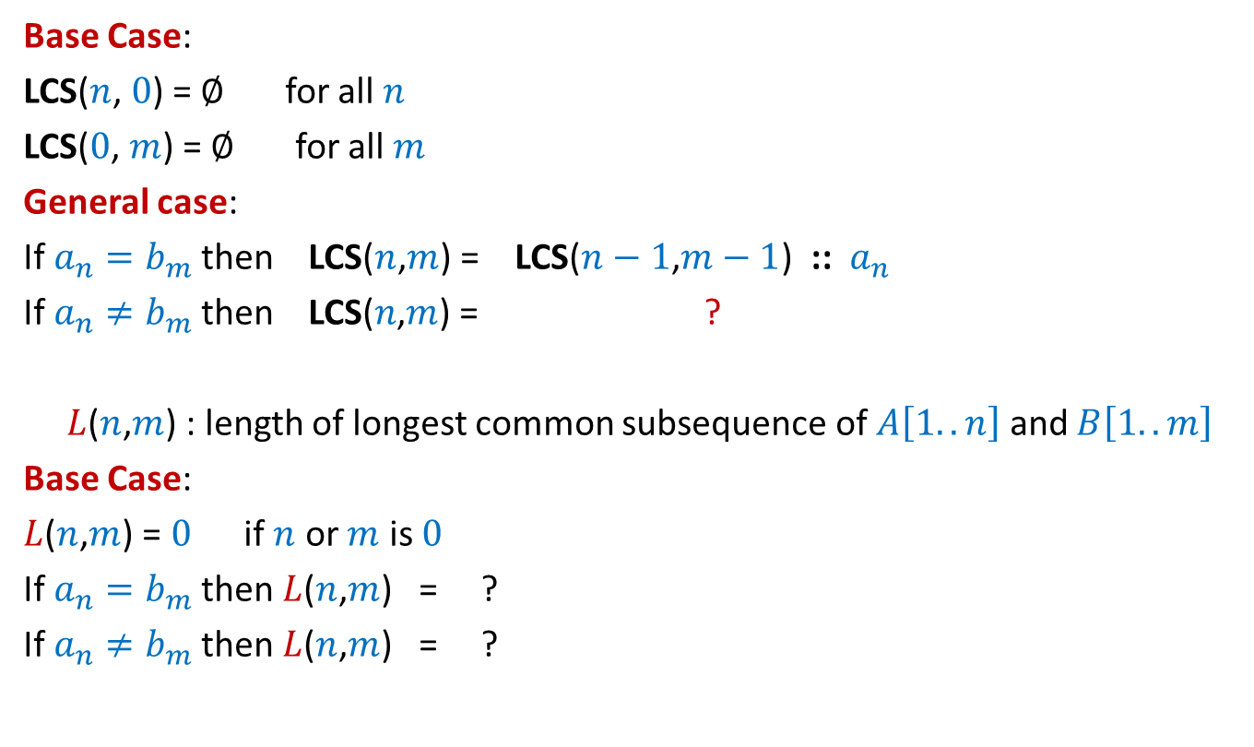




Recursive formulation for LCS($n$,$m$)
Base Case:
LCS($n$, $0$) = $∅$ for all $n$
LCS($0$, $m$) = $∅$ for all $m$
General case:
If $a_{n}=b_{m}$then LCS($n$,$m$) = LCS($n−1$,$m−1$) ::${ a}_{n}$
If $a_{n}≠b_{m}$then LCS($n\text{,}m$) = ?
$L$($n$,$m$) : length of longest common subsequence of $A\left[1..n\right]$ and $B\left[1..m\right]$
Base Case:
$L$($n$,$m$) = $0$ if $n$ or $m$ is $0$
If $a_{n}=b_{m}$then $L$($n$,$m$) = ?
If $a_{n}≠b_{m}$then $L$($n$,$m$) = ?
bigger of LCS($n$,$m−1$) or LCS($n−1$,$m$)
$L$($n−1$,$m−1$) + 1
Max( $L$($n−1$,$m$) , $L$($n$,$m−1$))

Slide 19
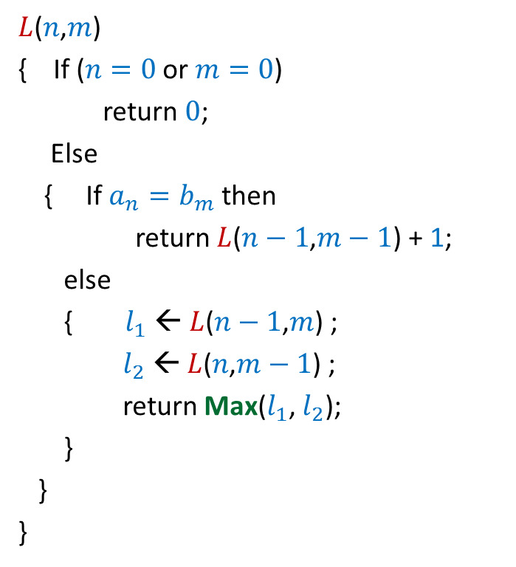

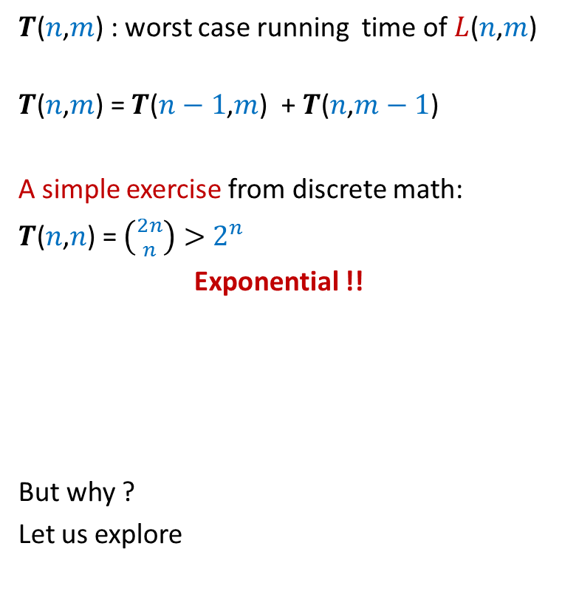
Recursive algorithm for $L$($n$,$m$)
$L$($n$,$m$)
{ If ($n=0$ or $m=0$)
return $0$;
Else
{ If $a_{n}=b_{m}$then
return $L$($n−1$,$m−1$) + 1;
else
{ $l_{1}$ ← $L$($n−1$,$m$) ;
$l_{2}$ ← $L$($n$,$m−1$) ;
return Max($l_{1}$, $l_{2}$);
}
}
}
$T$($n$,$m$) : worst case running time of $L$($n$,$m$)
$T$($n$,$m$) = $T$($n−1$,$m$) + $T$($n$,$m−1$)
A simple exercise from discrete math:
$T$($n$,$n$) = $\left({2n \atop n}\right)>$ $2^{n}$
Exponential !!
But why ?
Let us explore

Slide 20

Recursive algorithm for $L$($n$,$m$)
$L$($n$,$m$)
{ If ($n=0$ or $m=0$)
return $0$;
Else
{ If $a_{n}=b_{m}$then
return $L$($n−1$,$m−1$) + 1;
else
{ $l_{1}$ ← $L$($n−1$,$m$) ;
$l_{2}$ ← $L$($n$,$m−1$) ;
return Max($l_{1}$, $l_{2}$);
}
}
}
$T$($n$,$m$) : worst case running time of $L$($n$,$m$)
$T$($n$,$m$) = $T$($n−1$,$m$) + $T$($n$,$m−1$)
A simple exercise from discrete math:
$T$($n$,$n$) = $\left({2n \atop n}\right)>$ $2^{n}$
Exponential !!
But why ?
Let us explore its reason.

Slide 21








Recursive algorithm for $L$($n$,$m$)
Recursion tree
$L$($n$,$m$)
$L$($n$,$m$)
{ If ($n=0$ or $m=0$)
return $0$;
Else
{ If $a_{n}=b_{m}$then
return $L$($n−1$,$m−1$) + 1;
else
{ $l_{1}$ ← $L$($n−1$,$m$) ;
$l_{2}$ ← $L$($n$,$m−1$) ;
return Max($l_{1}$, $l_{2}$);
}
}
}
Solving same sub-problem multiple times !!
But how many sub-problems are there ?
only ($n+1$)*($m+1$).
Can we compute them efficiently ?
$L$($n−1$,$m$)
$L$($n$,$m−1$)
$L$($n−1$,$m−1$)
$L$($n$,$m−2$)
$L$($n−2$,$m$)
$L$($n−1$,$m−1$)
The answer lies in a programming exercise you did long ago. ☺

Slide 22
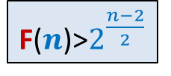
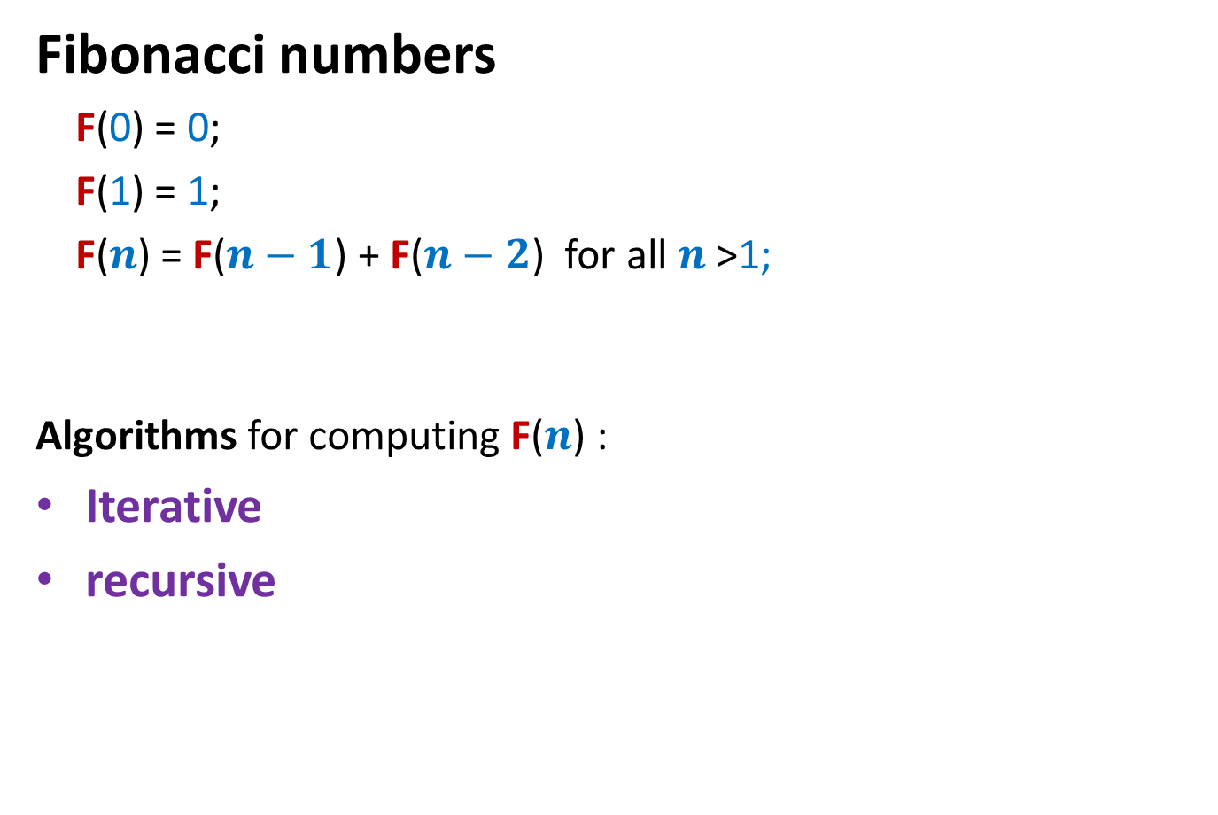
Fibonacci numbers
Fibonacci numbers
F(0) = 0;
F(1) = 1;
F($n$) = F($n−1$) + F($n−2$) for all $n$ >1;
Algorithms for computing F($n$) :
Iterative
recursive
F($n$)>$2^{\frac{n−2}{2}}$

Slide 23
Recursive algorithm for F(n)
Rfib(n)
{ if n=0 return 0;
else if n=1 return 1;
else return(Rfib(n-1) + Rfib(n-2))
}
Let G(n) : No. of instruction executed by RFib(n)
G(0) = 1; G(1) = 2;
For n>1 G(n) = G(n-1)+G(n-2) + 4
Observation 1: G(n)>F(n) for all n;
It follows from Observation 1 and Exercise 1 that G(n) is exponential in n !
Explore the recursion tree of Rfib(n) to find the reason behind this exponential time.

Slide 24




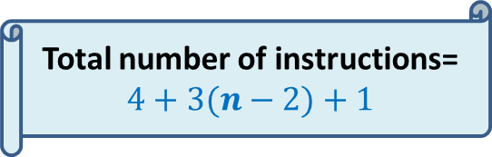

Iterative Algorithm for F($n$)
Total number of instructions= $4+3(n−2)+1$
IFib($n$)
if $n$=0 return 0;
else if $n$=1 return 1;
else { a ← 0; b← 1;
For($i$=2 to $n$) do
{ temp ← b;
b← a+b;
a← temp;
}
}
return b;
$$< 3n$$
4 instructions
$n−2$ iterations
3 instructions per iteration
the final instruction
F
0 1
0 | 1 | 2 | …
$$i$$

Slide 25







Recursive algorithm for $L$($n$,$m$)
$T$[$i$,$j$] = $L$($i$,$j$)
$L$($n$,$m$)
{ If ($n=0$ or $m=0$)
return $0$;
Else
{ If $a_{n}=b_{m}$then
return $L$($n−1$,$m−1$) + 1;
else
{ $l_{1}$ ← $L$($n−1$,$m$) ;
$l_{2}$ ← $L$($n$,$m−1$) ;
return Max($l_{1}$, $l_{2}$);
}
}
}
$$n$$
0
$$i$$
…
…
1
0
0
0 0 0 ... 0
0 1 ... $m$
$$j$$
$$T$$

Slide 26
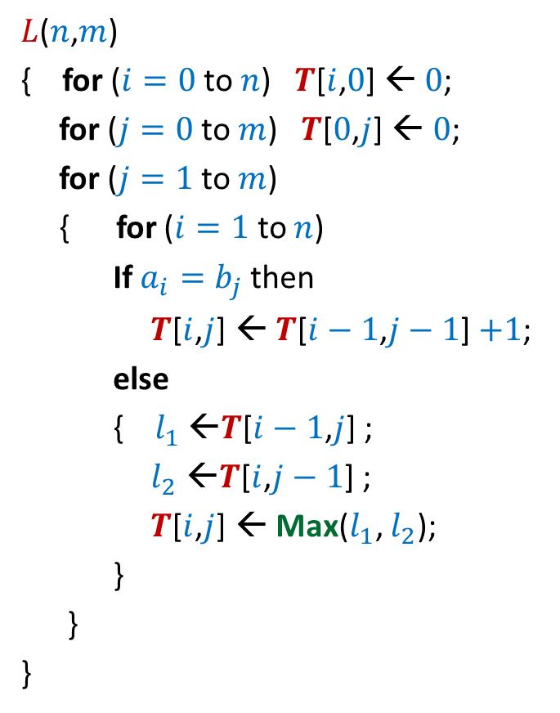


Iterative algorithm for $L$($n$,$m$)
$L$($n$,$m$)
{ for ($i=0$ to $n$) $T$[$i$,$0$] ← $0$;
for ($j=0$ to $m$) $T$[$0$,$j$] ← $0$;
for ($j=1$ to $m$)
{ for ($i=1$ to $n$)
If $a_{i}=b_{j}$then
$T$[$i$,$j$] ← $T$[$i−1$,$j−1$] $+1$;
else
{ $l_{1}$ ←$T$[$i−1$,$j$] ;
$l_{2}$ ←$T$[$i$,$j−1$] ;
$T$[$i$,$j$] ← Max($l_{1}$, $l_{2}$);
}
}
}
$$n$$
0
$$i$$
…
…
1
0
0
0 0 0 ... 0
0 1 ... $m$
$$j$$
Time complexity: O($nm$)
$$T$$

Slide 27
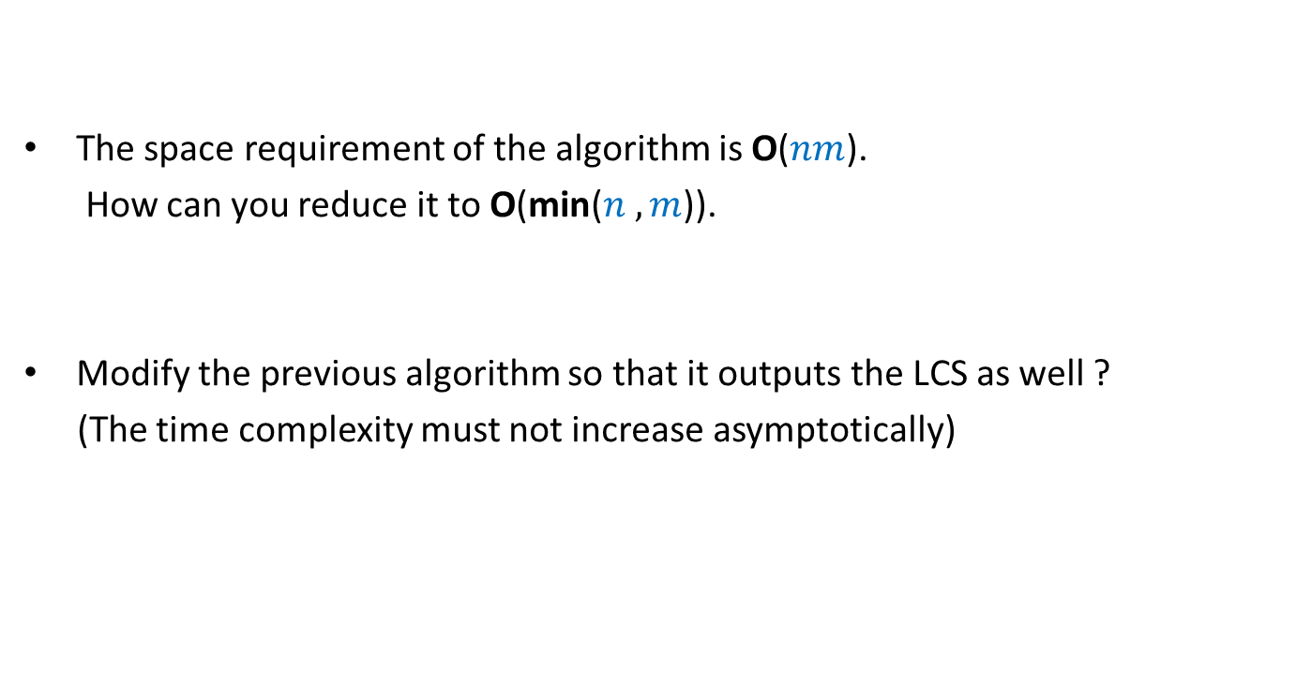
Homework
The space requirement of the algorithm is O($nm$).
How can you reduce it to O(min($n ,m$)).
Modify the previous algorithm so that it outputs the LCS as well ?
(The time complexity must not increase asymptotically)

Slide 28
Dynamic Programming algorithm paradigm
Expressing the solution recursively.
Overall there are only Polynomial number of subproblems.
But there is a huge overlap among the subproblems.
➔ So the recursive algorithm takes exponential time
(solving same subproblem multiple times).
So we compute the recursive solution iteratively in a bottom-up fashion
(like in case of Fibonacci numbers).
This avoids wastage of computation and leads to efficient implementation.

Slide 29
Steps of dynamic programming based algorithm
Recursive Formulation
Recursive Algorithm
Exponential time
Cause:
Overlap in subProblems
Polynomial no. of distinct subproblems
Bottom up approach to compute solution
A Polynomial time algorithm

