Slide 1
Design and Analysis of Algorithms (CS345/CS345A)
Lecture 19
Dynamic Programming – (Final lecture)
Bellman-Ford Algorithm (A new perspective)
All-Pairs Shortest Paths

Slide 2
BellMAN-Ford Algorithm
For shortest paths in a graph with
Negative weights
BUT No negative cycle

Slide 3









Exploiting the Optimal subpath property
Observation: If $P(s,v)$ has $i$ edges, $P(s,x)$ has $i−1$ edges.
$$P(s,v)$$
$$1$$
$$2$$
$$…$$
$$i$$
$$s$$
$$x$$
$v$

Slide 4



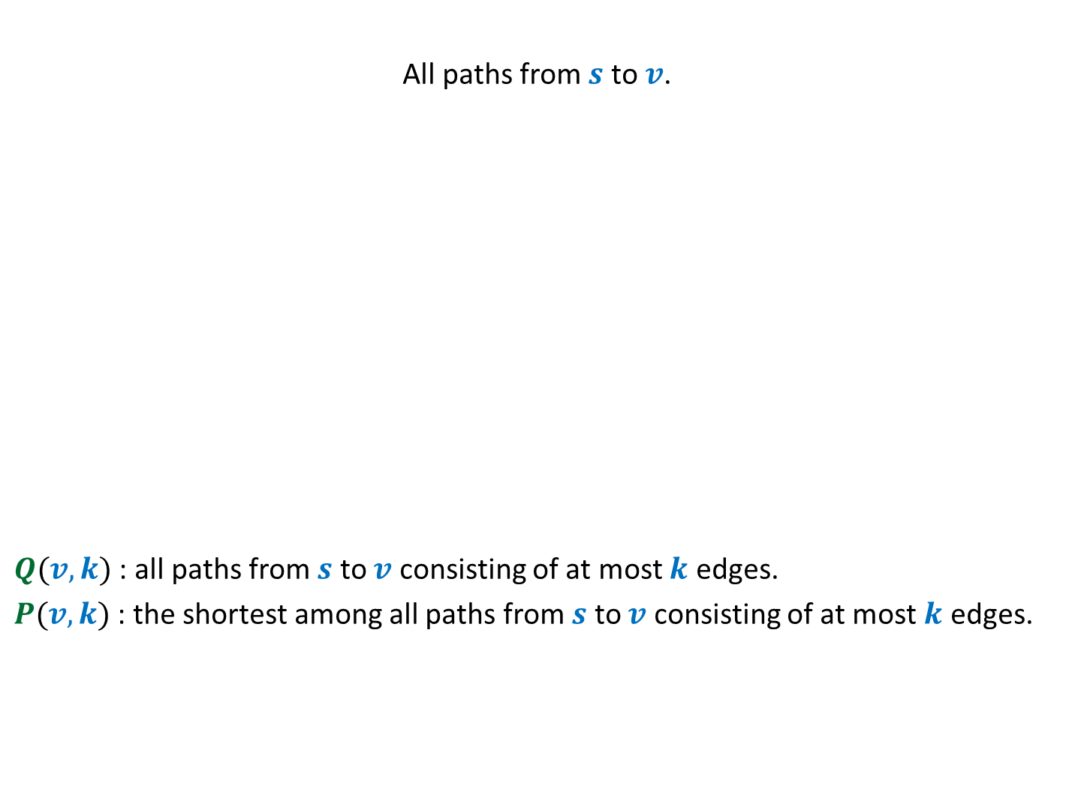




A hierarchy of set of paths
Aim: To compute $P(v,n−1)$
All paths from $s$ to $v$.
$Q(v,k)$ : all paths from $s$ to $v$ consisting of at most $k$ edges.
$P(v,k)$ : the shortest among all paths from $s$ to $v$ consisting of at most $k$ edges.
$Q(v,n−1)$
$Q(v,n−2)$
Shortest path from $s$ to $v$
$Q(v,n−3)$
.
…
…
…
$Q(v,k)$
…

Slide 5
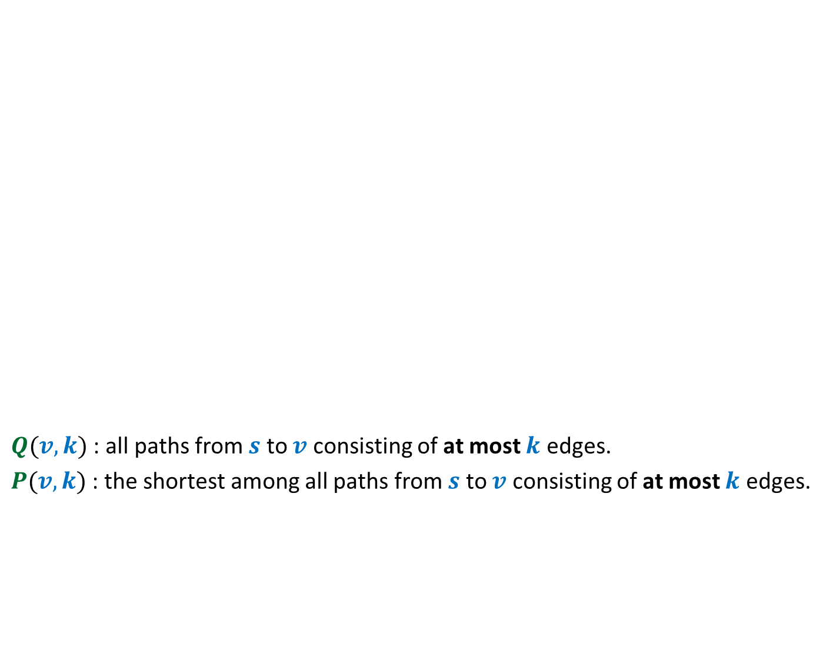



To compute $P(v,k)$
$Q(v,k)$ : all paths from $s$ to $v$ consisting of at most $k$ edges.
$P(v,k)$ : the shortest among all paths from $s$ to $v$ consisting of at most $k$ edges.
$$P(v,k)$$
= $P(v,k−1)$
.
…
…
…
$Q(v,k)$
…

Slide 6

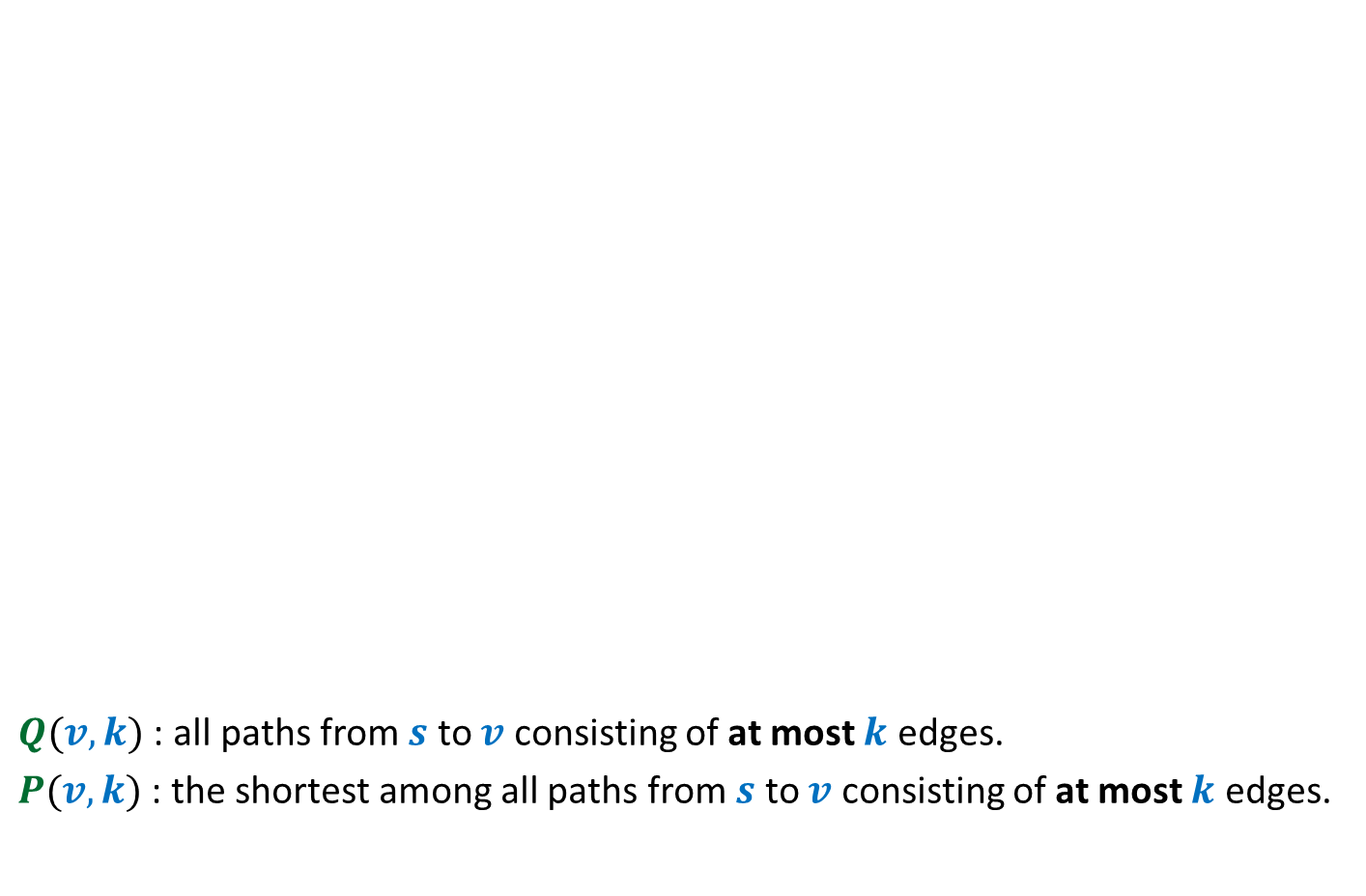


$Q(v,k)$ : all paths from $s$ to $v$ consisting of at most $k$ edges.
$P(v,k)$ : the shortest among all paths from $s$ to $v$ consisting of at most $k$ edges.
$$P(x,k−1)$$
$$Q(x,k−1)$$
$$P(v,k)$$
= $P(x,k−1)∷(x,v)$
Using Optimal Substructure property
.
.
…
…
…
…
…
…
$Q(v,k)$
…
…

Slide 7





Collaboration of vertices
Given $P(v_{j},k−1)$ for all $v_{1},…,v_{n}$.
Computing $P(v_{j},k)$ for all $v_{1},…,v_{n}$.
.
.
.
.
.
.
…
$$Q(v_{1},k−1)$$
$$Q(v_{2},k−1)$$
$$Q(v_{n},k−1)$$

Slide 8





Collaboration of vertices
Given $P(v_{j},k)$ for all $v_{1},…,v_{n}$.
Computing $P(v_{j},k+1)$ for all $v_{1},…,v_{n}$.
.
.
.
.
.
.
$$Q(v_{1},k)$$
$$Q(v_{2},k)$$
$$Q(v_{n},k)$$
And so on …

Slide 9





$L(v,i)$ :
Aim: To compute $L(v, ? )$ for each $v$.
length of the shortest $s⇝v$ having at most $i$ edges
$$n−1$$
$$L$$
$$V$$
$$i$$

Slide 10








Bellman-Ford’s algorithm
Bellman-Ford-algo($s$,$G$)
{
For each $v∈V\backslash \{s\}$ do
If $(s,v)∈E$ then $L[v,1]$← ?
else $L[v,1]$← ?
$L[s,1]$← ?
For $i$ = $2$ to $n−1$ do
{ For each $v∈V$ do
$L[v,i]$←$L[v,i−1]$;
For each $(x,v)∈E$ do
$L[v,i]\text{←}$ min( ? , ? )
}
}
$ω\left(s,v\right)$
$∞$;
Initializing $L[∗,1]$
$0$;
{
Computing$L[v,i]$
$$L[v,i]$$
$L[x,i−1]+ω\left(x,v\right)$
}
Lemma: $L[v,i]$ stores the shortest path from $s$to $v$ having at most $i$ edges.

Slide 11
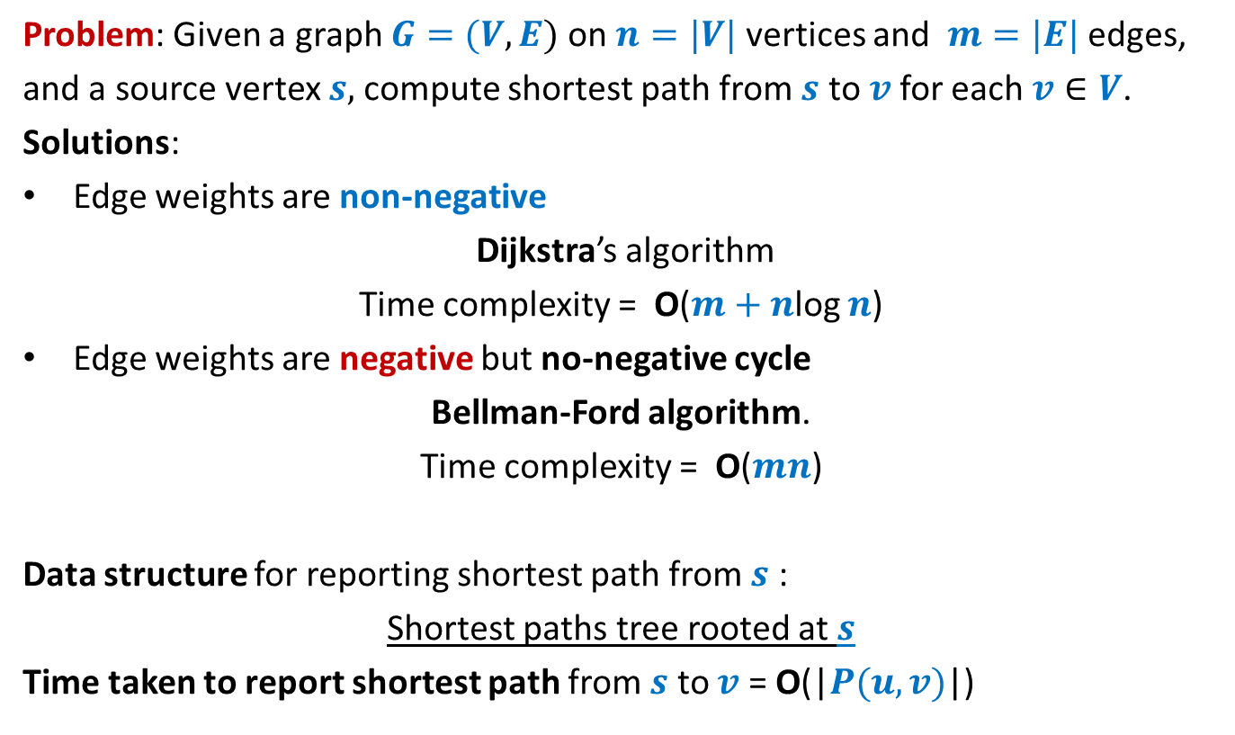
Single source shortest paths in a graph
Problem: Given a graph $G=(V,E)$ on $n=|V|$ vertices and $m=|E|$ edges,
and a source vertex $s,$compute shortest path from $s$ to $v$for each $v∈V$.
Solutions:
Edge weights are non-negative
Dijkstra’s algorithm
Time complexity = O($m+n$log $n$)
Edge weights are negative but no-negative cycle
Bellman-Ford algorithm.
Time complexity = O($mn$)
Data structure for reporting shortest path from $s$ :
Shortest paths tree rooted at $s$
Time taken to report shortest path from $s$ to $v$ = O(|$P(u,v)$|)

Slide 12
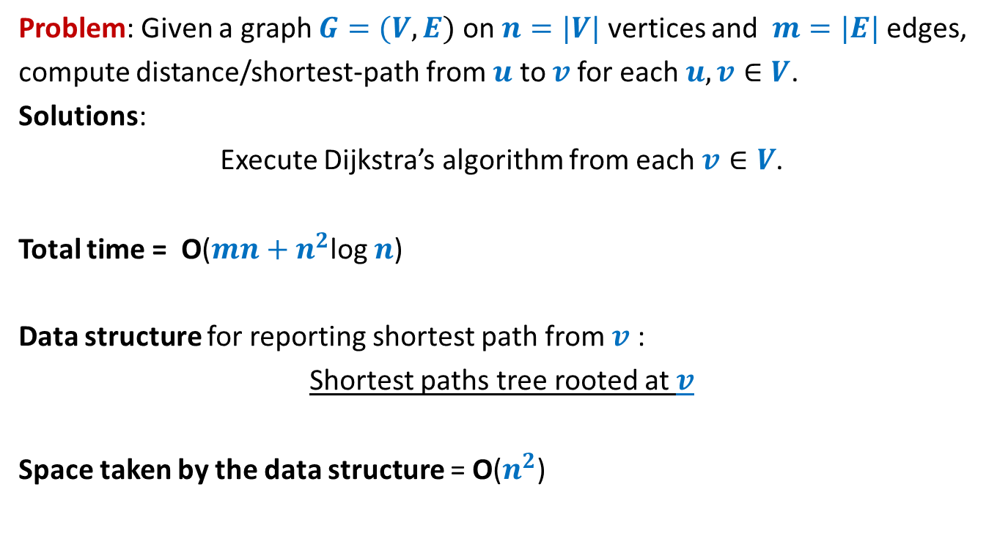
All-pairs shortest paths in a graph with positive edge weights
Problem: Given a graph $G=(V,E)$ on $n=|V|$ vertices and $m=|E|$ edges,
compute distance/shortest-path from $u$ to $v$for each $u,v∈V$.
Solutions:
Execute Dijkstra’s algorithm from each $v∈V$.
Total time = O($mn+n^{2}$log $n$)
Data structure for reporting shortest path from $v$ :
Shortest paths tree rooted at $v$
Space taken by the data structure = O($n^{2}$)

Slide 13

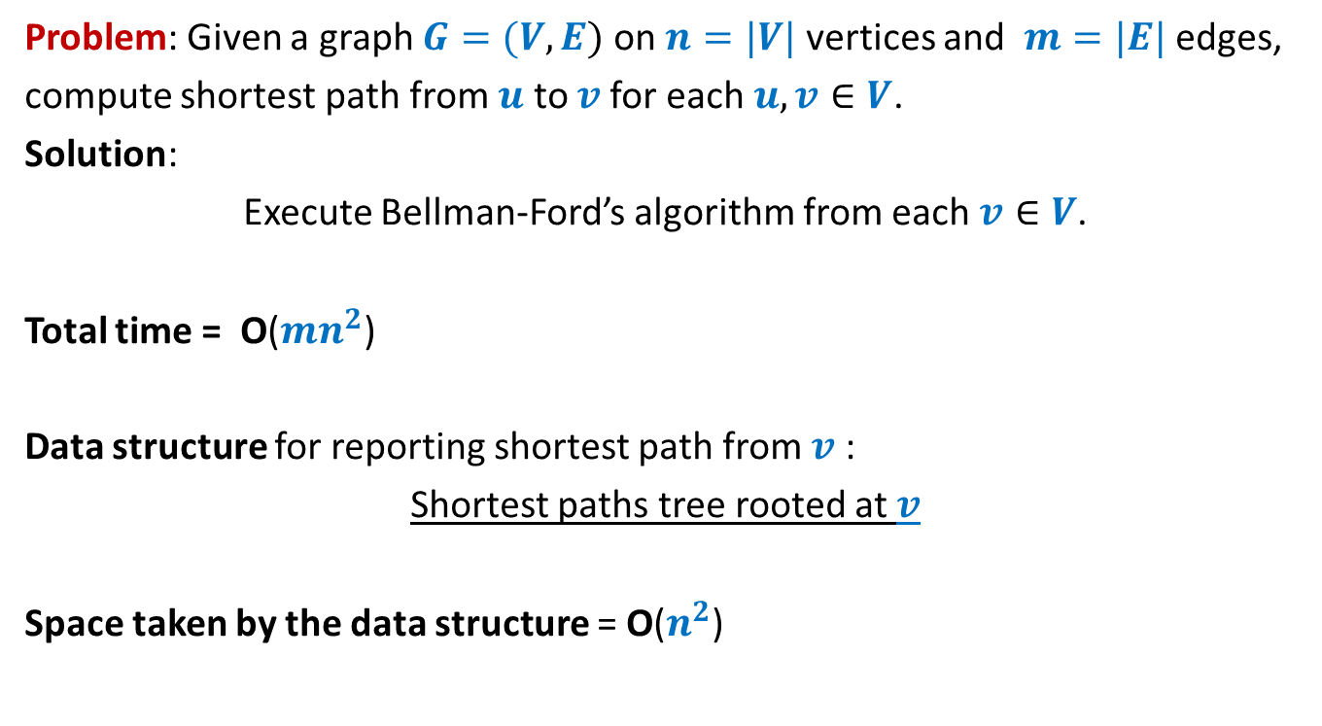
All-pairs shortest paths in a graph with negative edge weights but no negative cycle
Problem: Given a graph $G=(V,E)$ on $n=|V|$ vertices and $m=|E|$ edges,
compute shortest path from $u$ to $v$for each $u,v∈V$.
Solution:
Execute Bellman-Ford’s algorithm from each $v∈V$.
Total time = O($mn^{2}$)
Data structure for reporting shortest path from $v$ :
Shortest paths tree rooted at $v$
Space taken by the data structure = O($n^{2}$)
How to improve it to O($n^{3}$) ?

Slide 14

All-pairs shortest paths in O($n^{3}$) time
In graphs with negative edge weights
but no negative cycle

Slide 15






The Optimal substructure property
Consider any shortest path $P(u,v)$.
We used “no. of edges” for a recursive formulation of $δ(s,v)$. [Bellman Ford algo]
$L(v,i)$ : length of the shortest $s⇝v$ having at most $i$ edges.
$δ(s,v)$ =$L(v,n−1)$
Expressed $L(v,i+1)$ recursvely in terms of $L(x,i)$ for all ($x,v$) $∈E$
Base case: $L(v,1)$ = $ω(s,v)$ if ($s,v$) $∈E$, and $∞$ otherwise.
$i$edges
$$u$$
$$x$$
$v$
$i−1$edges

Slide 16

The Optimal substructure property
Consider any shortest path $P(u,v)$.
Question: Can we use “vertices” for recursive formulation of $δ(u,v)$ ?
$$u$$
$v$

Slide 17










The Optimal substructure property
Consider any shortest path $P(u,v)$.
For a recursive formulation of $δ(u,v)$,
We can use max-index of intermediate vertices on $P(u,v)$.
$$24$$
$$11$$
$$3$$
$$35$$
$$9$$
$$17$$
$$9$$
$$u$$
$v$
?
max-index
?
<$35$
<$35$

Slide 18

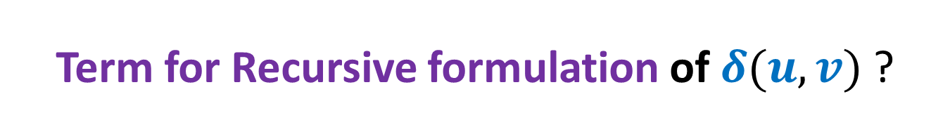


Term for Recursive formulation of $δ(u,v)$ ?
: the shortest path from $i$ to $j$with intermediate vertices of index $≤k$
$D_{k}(i,j)$: length of $P_{k}(i,j)$.
Question: How can we express $δ(i,j)$ in terms of $D_{k}(i,j)$?
Answer: $δ(i,j)$ = $D_{n}(i,j)$:
Base Case:
$D_{0}(i,j)$ = ?
Question: What is recursive formulation of $D_{k}(i,j)$ ?
$$P_{k}(i,j)$$
$$\left\{\begin{aligned}ω\left(i,j\right) if (i,j)∈E \\ ∞ otherwise\end{aligned}\right.$$

Slide 19



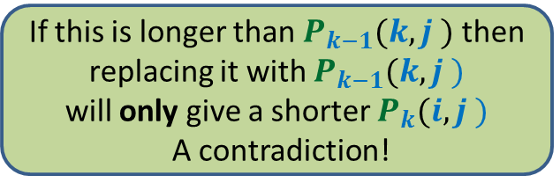







Recursive formulation of $D_{k}(i,j)$
Consider the path $P_{k}(i,j)$
There are two cases:
Case 1 : $P_{k}(i,j)$ does not pass through $k$
Case 2 : $P_{k}(i,j)$ indeed passes through $k$
➔ $D_{k}(i,j)$ = $D_{k−1}(i,j)$
➔ $?$
$$k$$
$$i$$
$j$
?
?
$P_{k−1}(i,k)$
$P_{k−1}(k,j)$
If this is longer than $P_{k−1}(i,k )$ then
replacing it with $P_{k−1}(i,k )$
will only give a shorter $P_{k}(i,j )$
A contradiction!
If this is longer than $P_{k−1}(k,j )$ then
replacing it with $P_{k−1}(k,j )$
will only give a shorter $P_{k}(i,j )$
A contradiction!

Slide 20
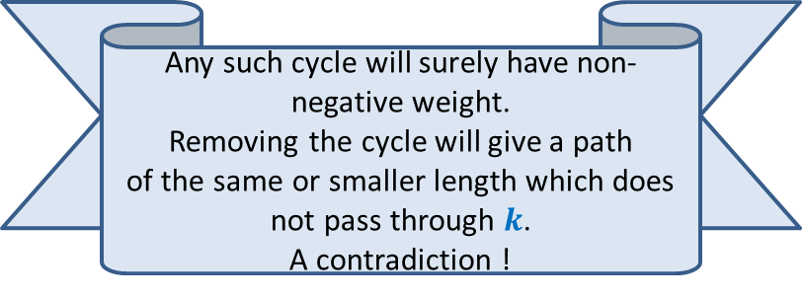
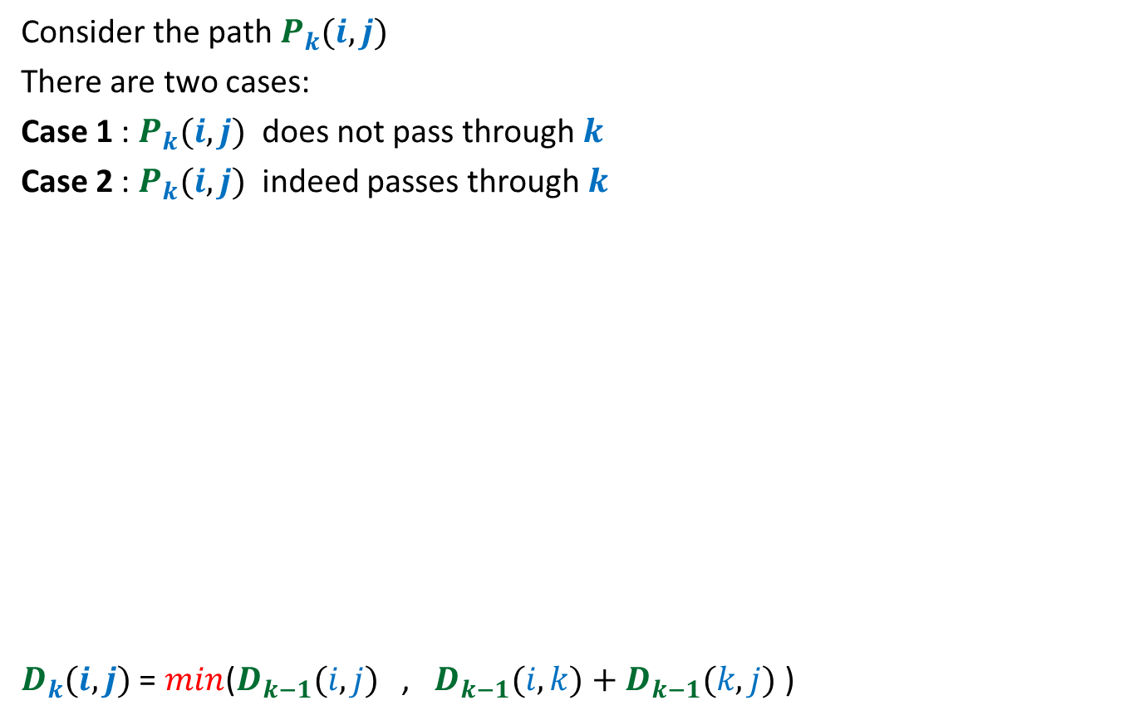
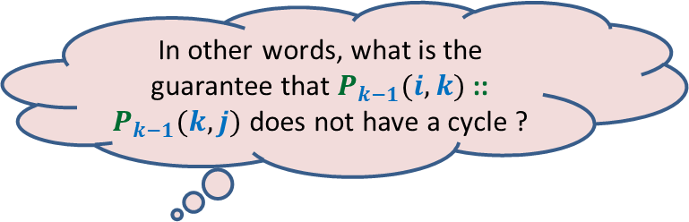

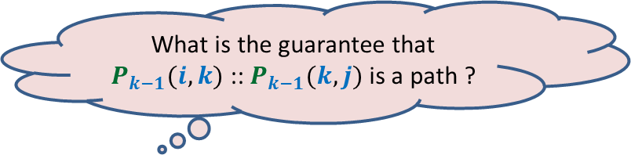
Recursive formulation of $D_{k}(i,j)$
Consider the path $P_{k}(i,j)$
There are two cases:
Case 1 : $P_{k}(i,j)$ does not pass through $k$
Case 2 : $P_{k}(i,j)$ indeed passes through $k$
$D_{k}(i,j)$ = $min$($D_{k−1}(i,j)$ , $D_{k−1}(i,k)+D_{k−1}(k,j)$ )
➔ $D_{k}(i,j)$ = $D_{k−1}(i,j)$
➔ $D_{k}(i,j)$ = $D_{k−1}(i,k)+D_{k−1}(k,j)$
$$k$$
$$i$$
$j$
?
?
$P_{k−1}(i,k)$
$P_{k−1}(k,j)$
Any such cycle will surely have non-negative weight.
Removing the cycle will give a path
of the same or smaller length which does
not pass through $k$.
A contradiction !
In other words, what is the guarantee that $P_{k−1}(i,k)$ :: $P_{k−1}(k,j)$ does not have a cycle ?
What is the guarantee that $P_{k−1}(i,k)$ :: $P_{k−1}(k,j)$ is a path ?

Slide 21

Floyd Warshal Algorithm for All Pairs Shortest Paths
in O($n^{3}$) time
and O($n^{3}$) space

Slide 22





Floyd and Warshal’s algorithm
Floyd-Warshal-algo($G$)
{ For each $i$ do
For each $j$ do
If $(i,j)∈E$ then $D_{0}[i,j]$← ?
else $D_{0}[i,j]$← ?
For each $i$ do $D_{0}[i,i]$← ?
For $k$ = $1$ to $n$ do
For each $i$ do
For each $j$ do
$D_{k}[i,j]$←$D_{k−1}[i,j]$;
$D_{k}[i,j]\text{←}$ min( ? , ? )
}
Lemma: $D_{k}[i,j]$ = length of the shortest path from $i$ to $j$ with all intermediate vertices of indices $≤k$
$ω\left(i,j\right)$
$∞$;
Computing $D_{0}[∗,∗]$
$0$;
{
Computing$D_{k}[i,j]$
$$D_{k}[i,j]$$
$D_{k−1}[i,k]+$ $D_{k−1}[k,j]$
}

Slide 23

Floyd Warshal Algorithm for All Pairs Shortest Paths
in O($n^{3}$) time
and O($n^{2}$) space

Slide 24


$$D^{k−1}$$
$D_{k}(i,j)$ = $min$($D_{k−1}(i,j)$ , $D_{k−1}(i,k)+D_{k−1}(k,j)$ )
$$k$$
$$D^{k−1}$$
$$i$$
$$D^{k}$$
$$k$$
$$j$$

Slide 25

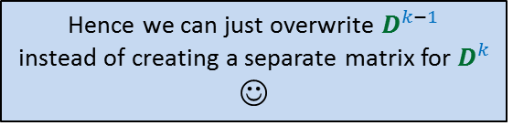
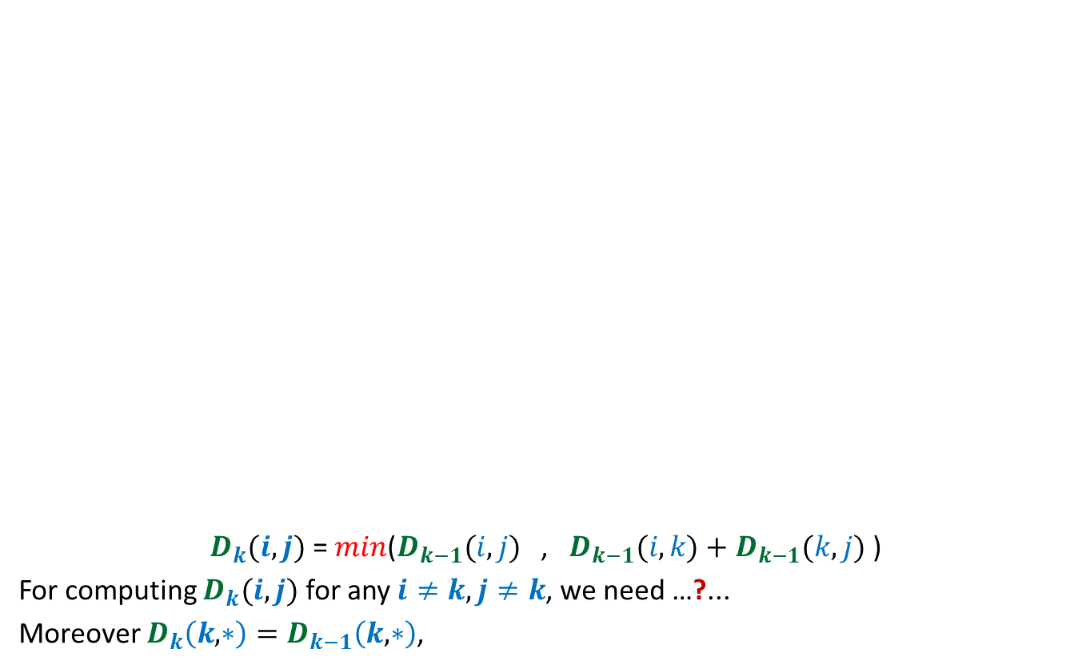



Hence we can just overwrite $D^{k−1}$
instead of creating a separate matrix for $D^{k}$
☺
$$D^{k−1}$$
$D_{k}(i,j)$ = $min$($D_{k−1}(i,j)$ , $D_{k−1}(i,k)+D_{k−1}(k,j)$ )
For computing $D_{k}(i,j)$ for any $i≠k,j≠k$, we need …?...
Moreover $D_{k}\left(k,∗\right)=D_{k−1}\left(k,∗\right)$,
$$k$$
$$D^{k−1}$$
$$D^{k}$$
$$k$$
$$i$$
$$j$$
only $k$th column and $k$th row of $D_{k−1}$.
and $D_{k}\left(∗,k\right)=D_{k−1}\left(∗,k\right)$

Slide 26

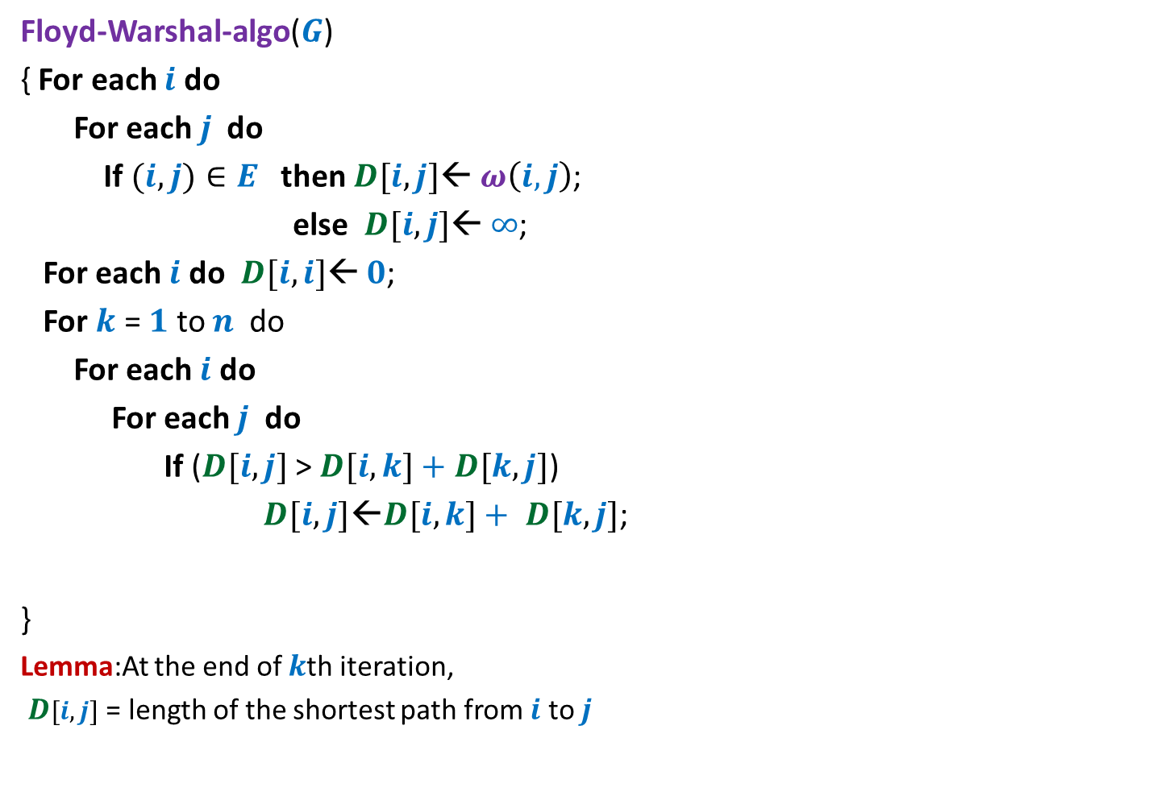
Floyd and Warshal’s algorithm
Floyd-Warshal-algo($G$)
{ For each $i$ do
For each $j$ do
If $(i,j)∈E$ then $D[i,j]$← $ω\left(i,j\right)$;
else $D[i,j]$← $∞$;
For each $i$ do $D[i,i]$← $0$;
For $k$ = $1$ to $n$ do
For each $i$ do
For each $j$ do
If ($D[i,j]$ > $D[i,k]+$ $D[k,j]$)
$D[i,j]\text{←}D[i,k]+ D[k,j]$;
}
Lemma:At the end of $k$th iteration,
$D[i,j]$ = length of the shortest path from $i$ to $j$
{
}
with all intermediate vertices of indices $≤k$

Slide 27
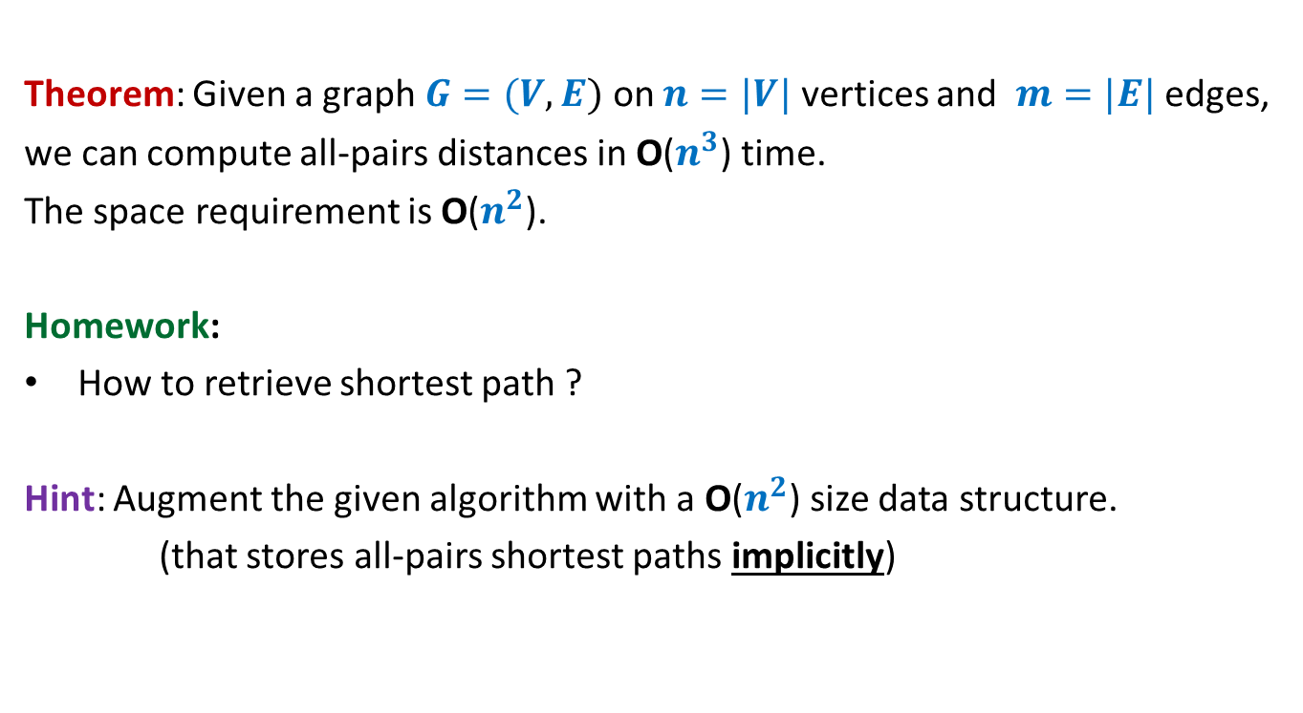
All-pairs shortest paths in a digraph with negative edge weights but no negative cycle
Theorem: Given a graph $G=(V,E)$ on $n=|V|$ vertices and $m=|E|$ edges,
we can compute all-pairs distances in O($n^{3}$) time.
The space requirement is O($n^{2}$).
Homework:
How to retrieve shortest path ?
Hint: Augment the given algorithm with a O($n^{2}$) size data structure.
(that stores all-pairs shortest paths implicitly)

Slide 28
This view will add to your understanding of these two algorithms
In the following slides, we shall provide an alternate view of
Floyd & Warshal Algorithm
Both the algorithms (Bellman-Ford and Floyd & Warshal)
use Optimal substructure property of shortest paths.
They differ due to different hierarchies of sets of paths ☺.

Slide 29
Reviewing Floyd Warshal Algorithm

Slide 30

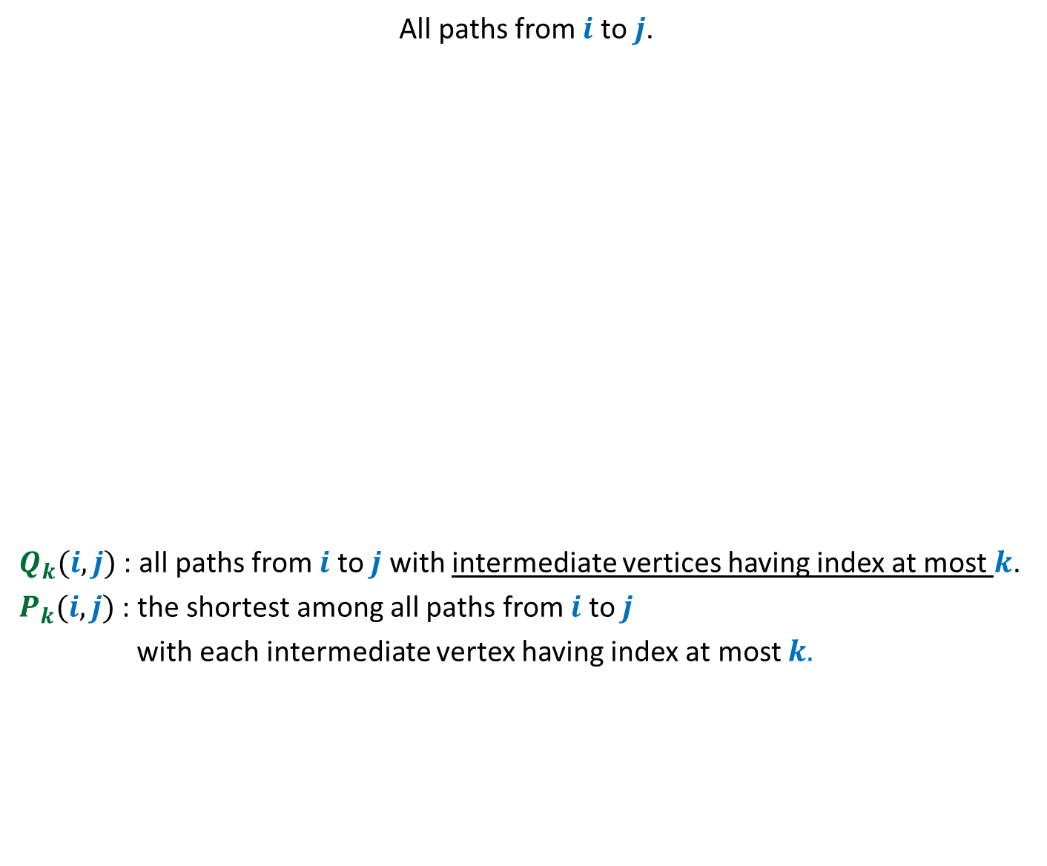




Another hierarchy of set of paths
Aim: To compute $P_{n}(i,j)$
All paths from $i$ to $j$.
$Q_{k}(i,j)$ : all paths from $i$ to $j$ with intermediate vertices having index at most $k$.
$P_{k}(i,j)$ : the shortest among all paths from $i$ to $j$
with each intermediate vertex having index at most $k.$
$Q_{n}(i, j)$
$Q_{n−1}(i,j)$
Shortest path from $i$ to $j$
$Q_{n−2}(i,j)$
.
…
…
…
$Q_{k}(i,j)$
…

Slide 31
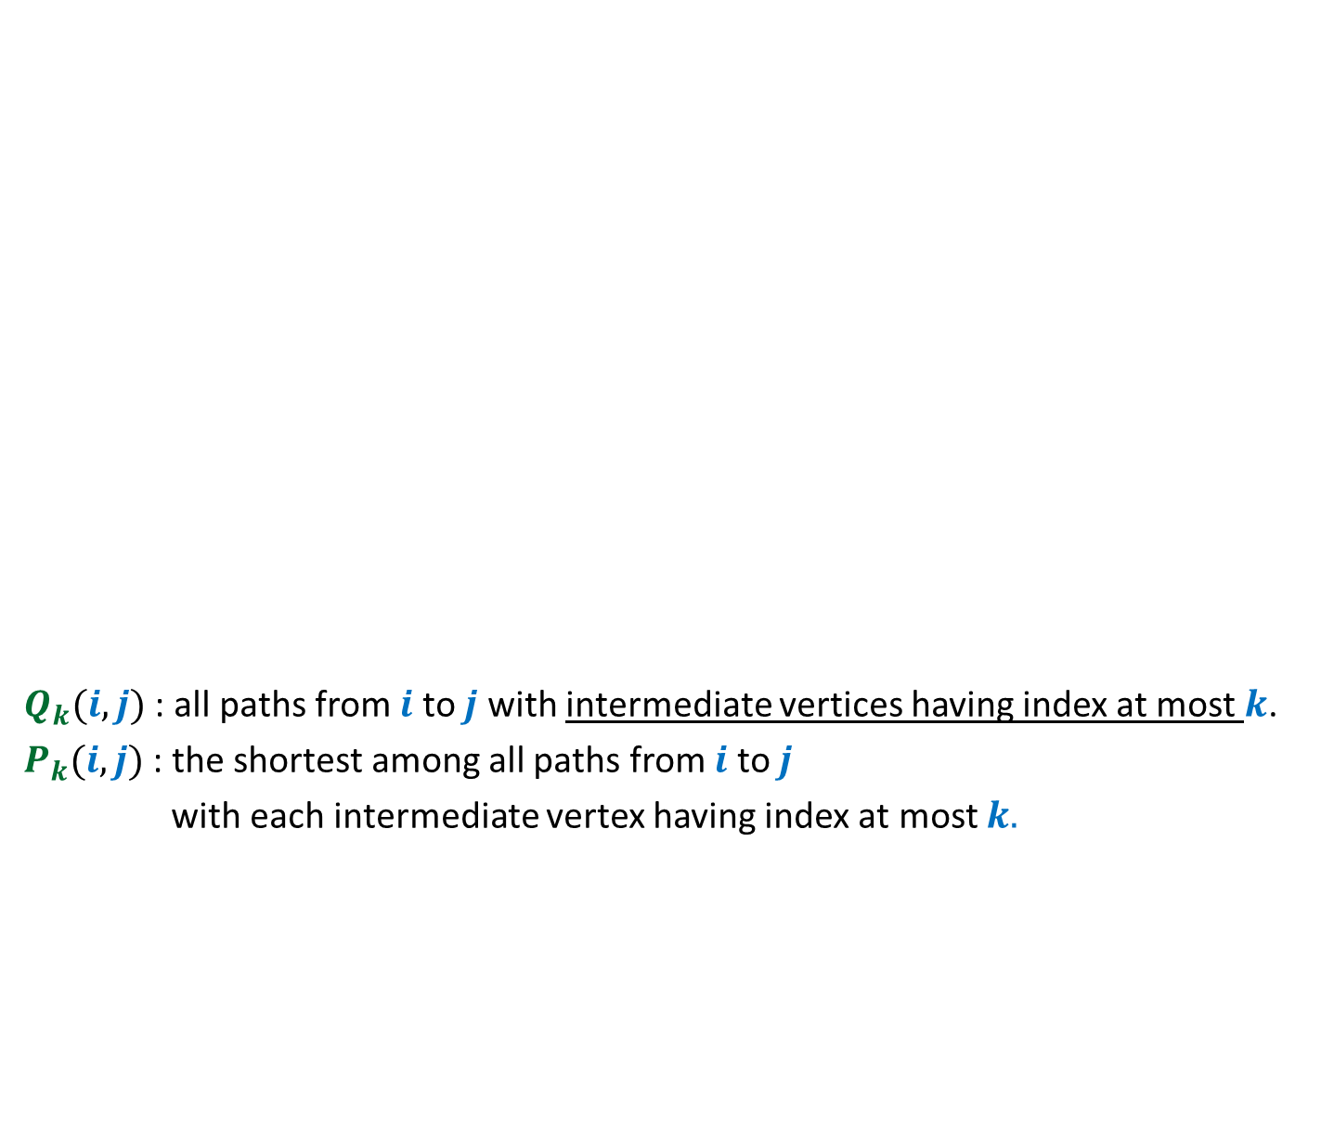




Computing $P_{k}(i,j)$
$Q_{k}(i,j)$ : all paths from $i$ to $j$ with intermediate vertices having index at most $k$.
$P_{k}(i,j)$ : the shortest among all paths from $i$ to $j$
with each intermediate vertex having index at most $k.$
$$P_{k}(i,j)$$
= $P_{k−1}(i,j)$
.
…
…
…
$Q_{k}(i,j)$
…

Slide 32


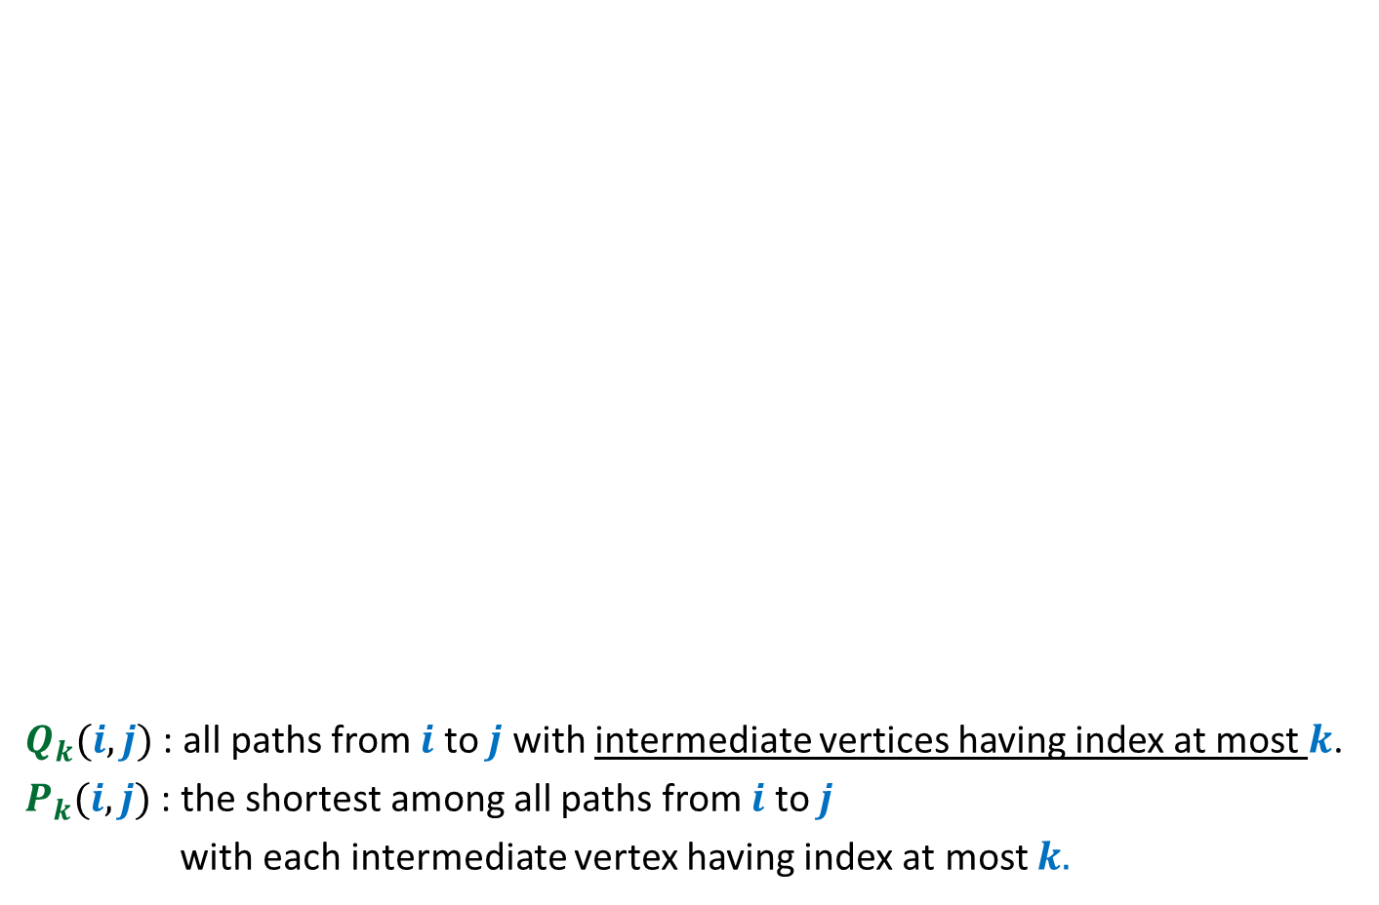





Using Optimal Substructure property
$Q_{k}(i,j)$ : all paths from $i$ to $j$ with intermediate vertices having index at most $k$.
$P_{k}(i,j)$ : the shortest among all paths from $i$ to $j$
with each intermediate vertex having index at most $k.$
$$P_{k−1}\left(i,k\right)$$
$$P_{k−1}\left(k,j\right)$$
$Q_{k−1}(i,k)$
$P_{k}(j)$= ?
$$P_{k−1}\left(i,k\right)∷P_{k−1}(k,j)$$
$Q_{k−1}(k,j)$
.
.
.
…
…
…
…
…
…
…
…
…
$Q_{k}(i,j)$
…
…
…

Slide 33



Collaboration of vertices
Given $P_{k−1}(i,j)$ for all ($i,j$) pairs
Computing $P_{k}(i,j)$ for all($i,j$) pairs.
.
.
.
.
.
.
…
$Q_{k−1}(i,j)$ sets

Slide 34



Collaboration of vertices
Given $P_{k}(i,j)$ for all ($i,j$) pairs
Computing $P_{k+1}(i,j)$ for all ($i,j$) pairs.
.
.
.
.
.
.
$Q_{k}(i,j)$ sets
And so on …

