Slide 1
Design and Analysis of Algorithms (CS345/CS345A)
Lecture 20
Dynamic Programming
Network Flow
Recursive to Iterative algorithm

Slide 2
Overview of Dynamic Programming
Recursive Formulation
Recursive Algorithm
Exponential time
Polynomial no. of
distinct subproblems
Cause of exponential time:
Overlap in subProblems
We used to spend 5-10 minutes in this transformation.
But there is a simple and almost mechanical way to do this task.
We’ll demonstrate it through the first problem “Longest Common Subsequence”
Bottom up approach
A Polynomial time algorithm

Slide 3
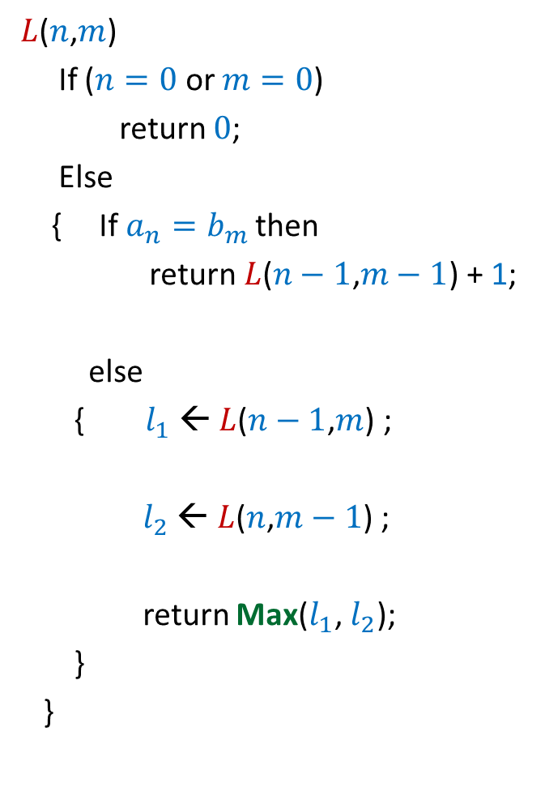

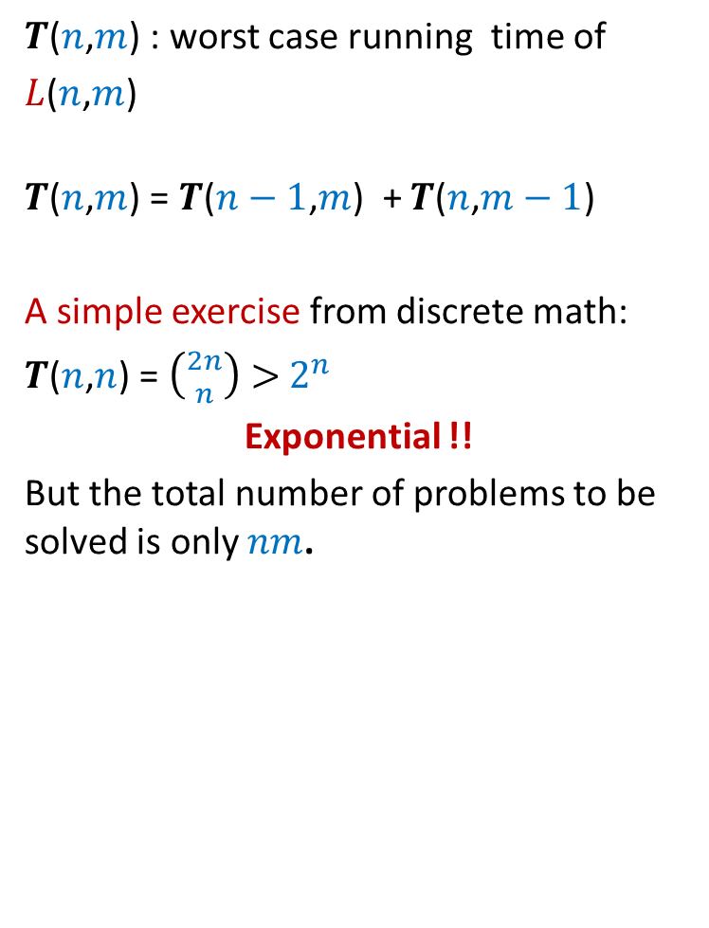
Recursive algorithm for $L$($n$,$m$)
$L$($n$,$m$)
If ($n=0$ or $m=0$)
return $0$;
Else
{ If $a_{n}=b_{m}$then
return $L$($n−1$,$m−1$) + 1;
else
{ $l_{1}$ ← $L$($n−1$,$m$) ;
$l_{2}$ ← $L$($n$,$m−1$) ;
return Max($l_{1}$, $l_{2}$);
}
}
$T$($n$,$m$) : worst case running time of
$L$($n$,$m$)
$T$($n$,$m$) = $T$($n−1$,$m$) + $T$($n$,$m−1$)
A simple exercise from discrete math:
$T$($n$,$n$) = $\left({2n \atop n}\right)>$ $2^{n}$
Exponential !!
But the total number of problems to be solved is only $nm$.
A careful inspection of recursion tree showed that the run time is exponential because we are solving same problem
multiple times.
How to avoid that ?

Slide 4



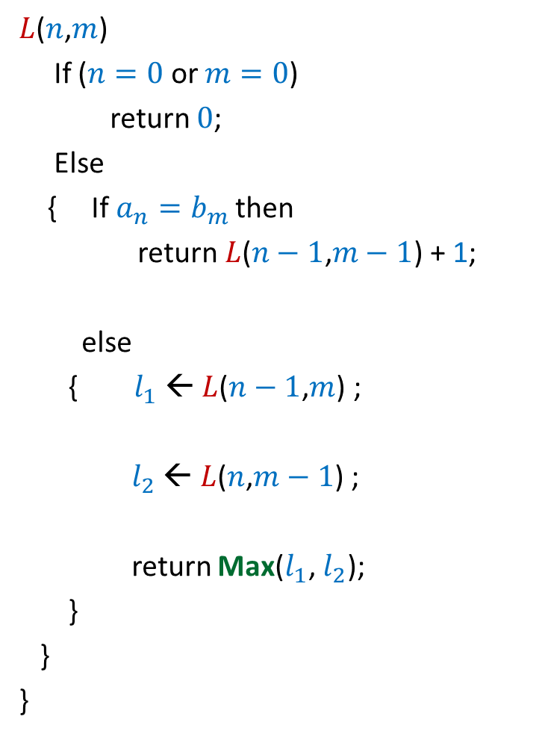














Recursive algorithm for $L$($n$,$m$)
$L$($n$,$m$)
If ($n=0$ or $m=0$)
return $0$;
Else
{ If $a_{n}=b_{m}$then
return $L$($n−1$,$m−1$) + 1;
else
{ $l_{1}$ ← $L$($n−1$,$m$) ;
$l_{2}$ ← $L$($n$,$m−1$) ;
return Max($l_{1}$, $l_{2}$);
}
}
}
O($mn$) space ☹
$T$[$i$,$j$] = $L$($i$,$j$)
$$n$$
0
$$−1 −1 −1 −1 −1 −1$$
$$−1 −1 −1 −1 −1 −1$$
{ If ($T$[$n−1$,$m−1$]$=−1$)
$$−1 −1 −1 −1 −1 −1$$
$T$[$n−1$,$m−1$]$=$ $L$($n−1$,$m−1$)
$$−1 −1 −1 −1 −1 −1$$
return $T$[$n−1$,$m−1$] $+1$ }
…
…
$$−1 −1 −1 −1 −1 −1$$
If ($T$[$n−1$,$m$]$=−1$)
1
0
$$−1 −1 −1 −1 −1 −1$$
$T$[$n−1$,$m$]$=$ $L$($n−1$,$m$)
0
0 0 0 ... 0
If ($T$[$n$,$m−1$]$=−1$)
0 1 ... $m$
$T$[$n$,$m−1$]$=$ $L$($n$,$m−1$)
$T$[$n$,$m−1$], $T$[$n−1$,$m$] );
$$T$$
This idea works for transforming each recursive algorithm to iterative algorithm for any dynamic programming based algorithm.
But it will be difficult to optimize the space in this approach.

Slide 5


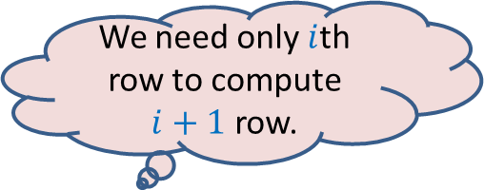



Recursive algorithm for $L$($n$,$m$)
O($min⁡(m,n$)) space ☺
We need only $i$th row to compute $i+1$ row.
$T$[$i$,$j$] = $L$($i$,$j$)
$L$($n$,$m$)
{ If ($n=0$ or $m=0$)
return $0$;
Else
{ If $a_{n}=b_{m}$then
return $L$($n−1$,$m−1$) + 1;
else
{ $l_{1}$ ← $L$($n−1$,$m$) ;
$l_{2}$ ← $L$($n$,$m−1$) ;
return Max($l_{1}$, $l_{2}$);
}
}
}
$$n$$
0
$$i$$
…
…
1
0
0
0 0 0 ... 0
0 1 ... $m$
$$j$$
$$T$$
However, the iterative implementation we discussed earlier in the class provided more insight which could be used to optimize space.

Slide 6
Algorithm Design Paradigms
Divide and Conquer
Greedy Strategy
Dynamic Programming

Slide 7

Designing an algorithm
Divide and Conquer
problem
Greedy Strategy
Dynamic Programming
Always take a fresh and unconditioned approach to solve a problem

Slide 8
Designing an algorithm
Fresh approach
Working on examples
Learning from mistakes
Theoretical formulation

Slide 9
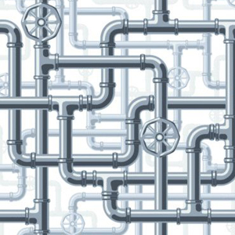
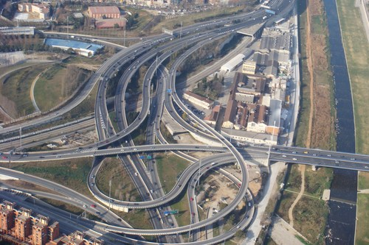
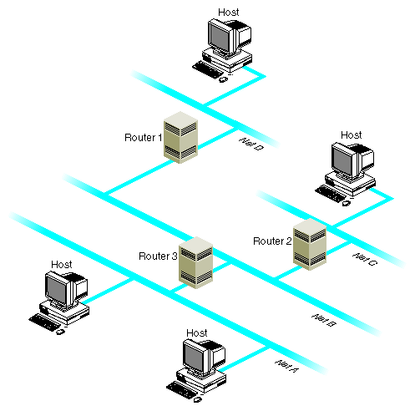
Network

Slide 10
Maximum Flow in a Network

Slide 11



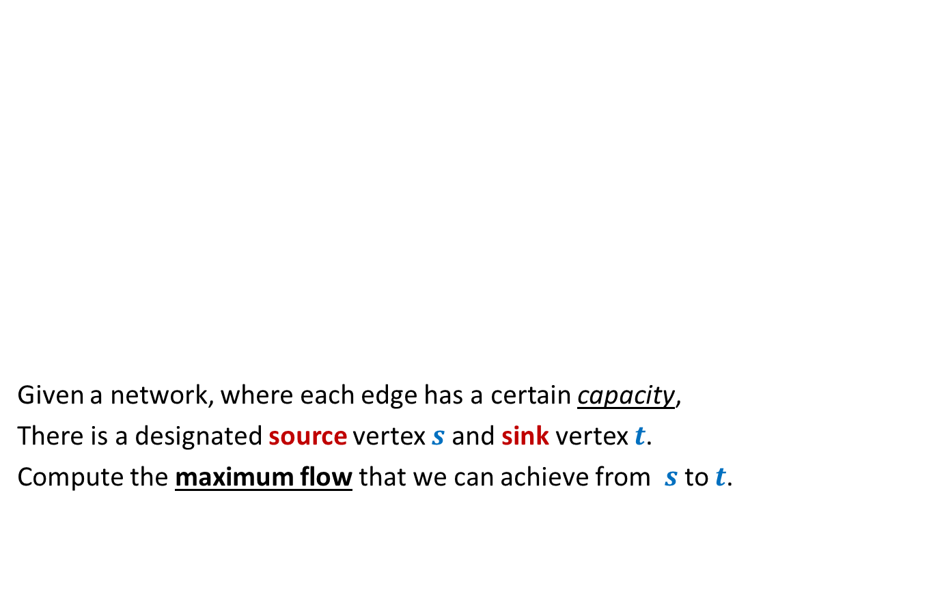



Problem definition (Informal)
2
Given a network, where each edge has a certain capacity,
There is a designated source vertex $s$and sink vertex $t$.
Compute the maximum flow that we can achieve from $s$to $t$.
$$v$$
$$x$$
5
6
15
8
$$t$$
$$s$$
6
7
14
7
17
$$u$$
4
$$y$$

Slide 12
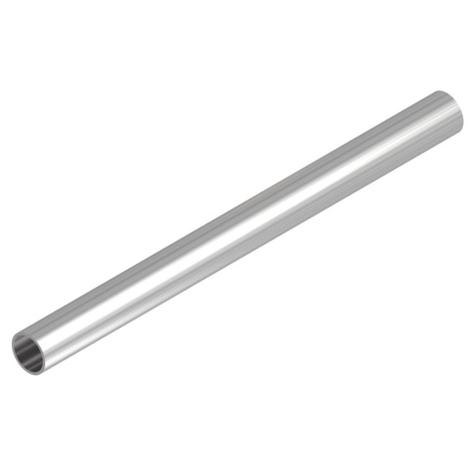
Question: What is flow along an edge ?
Answer: The rate at which the commodity is being transported along the edge.
Question: What is capacity of an edge ?
Answer: The maximum rate at which the commodity can be transported
along the edge.
Example: 25 litre/sec
1 GB /sec
An edge

Slide 13





Are there any constraints for a flow ?
$$x$$
$≤$25
Capacity constraint :
Flow along an edge cannot exceed its capacity
Conservation constraint :
Flow entering node $u$ = Flow leaving node $u$.
25
$$u$$
5
$$u$$
25
20

Slide 14
Formal Description of Flow

Slide 15
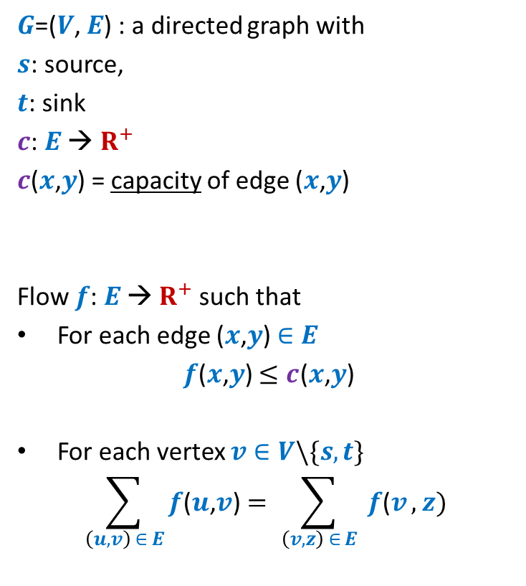
Formal Description of Flow
2
$G$=($V$, $E$) : a directed graph with
$s$: source,
$t$: sink
$c$: $E$ → $R^{+}$
$c$($x$,$y$) = capacity of edge ($x$,$y$)
Flow $f$: $E$ → $R^{+}$ such that
For each edge ($x$,$y$) $∈E$
$f$($x$,$y$) $≤c$($x$,$y$)
For each vertex $v∈V\backslash \{s,t\}$
$$\sum_{\left(u,v\right) ∈ E}{f\text{(}u\text{,}v\text{)}}=\sum_{ \left(v,z\right) ∈ E }{f\text{(}v},z)$$
$$v$$
$$x$$
5
6
15
8
$$t$$
$$s$$
6
7
14
7
17
$$u$$
4
$$y$$
Capacity constraint
Conservation constraint

Slide 16

Formal Description of Flow
2
$\text{value}\text{(}f\text{)=}$ flow leaving $s$
$$=\sum_{\left(s,v\right) ∈ E}{f\text{(}u\text{,}v\text{)}}$$
$G$=($V$, $E$) : a directed graph with
$s$: source,
$t$: sink
$c$: $E$ → $R^{+}$
$c$($x$,$y$) = capacity of edge ($x$,$y$)
Flow $f$: $E$ → $R^{+}$ such that
For each edge ($x$,$y$) $∈E$
$f$($x$,$y$) $≤c$($x$,$y$)
For each vertex $v∈V\backslash \{s,t\}$
$$\sum_{\left(u,v\right) ∈ E}{f\text{(}u\text{,}v\text{)}}=\sum_{ \left(v,z\right) ∈ E }{f\text{(}v},z)$$
$$v$$
$$x$$
4
5
5
11
6
1
15
8
$$t$$
$$s$$
6
7
1
7
7
14
7
17
$$u$$
4
$$y$$

Slide 17
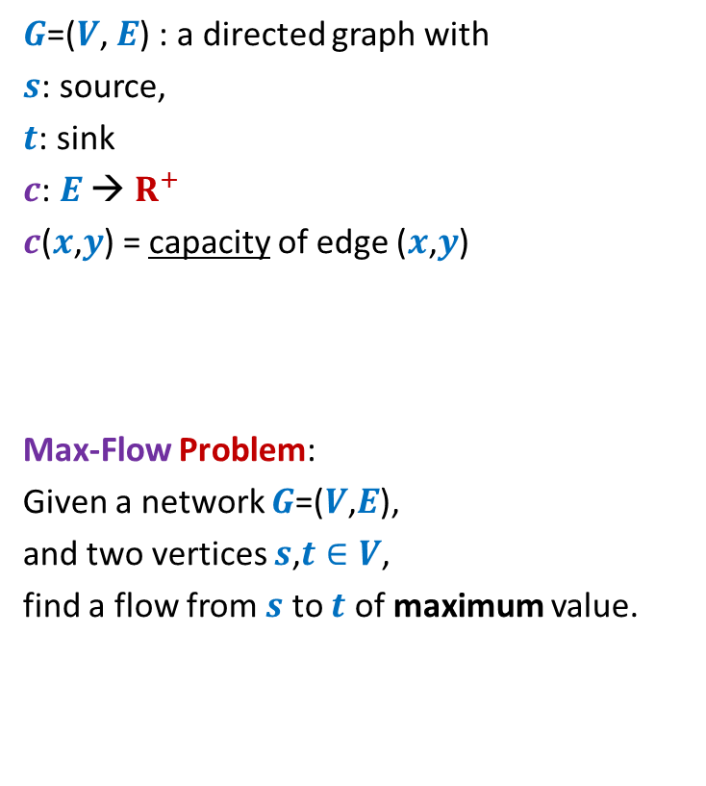
Formal Description of Flow
2
$\text{value}\text{(}f\text{)=}$ flow leaving $s$
$$=\sum_{\left(s,v\right) ∈ E}{f\text{(}u\text{,}v\text{)}}$$
$G$=($V$, $E$) : a directed graph with
$s$: source,
$t$: sink
$c$: $E$ → $R^{+}$
$c$($x$,$y$) = capacity of edge ($x$,$y$)
Max-Flow Problem:
Given a network $G$=($V$,$E$),
and two vertices $s$,$t∈V$,
find a flow from $s$ to $t$ of maximum value.
$$v$$
$$x$$
5
6
15
8
$$t$$
$$s$$
6
7
14
7
17
$$u$$
4
$$y$$

Slide 18

Towards designing max flow algorithm
2
Find some $s−t$ path,
Send flow along the path,
Update capacities,
Find some $s−t$ path,
…and so on ☺
$$v$$
$$x$$
5
6
5
5
+1
5
12
+7
6
15
What is the most natural approach to solve this problem ?
8
$$t$$
$$s$$
6
7
1
1
7
7
14
7
17
$$u$$
4
$$y$$

Slide 19
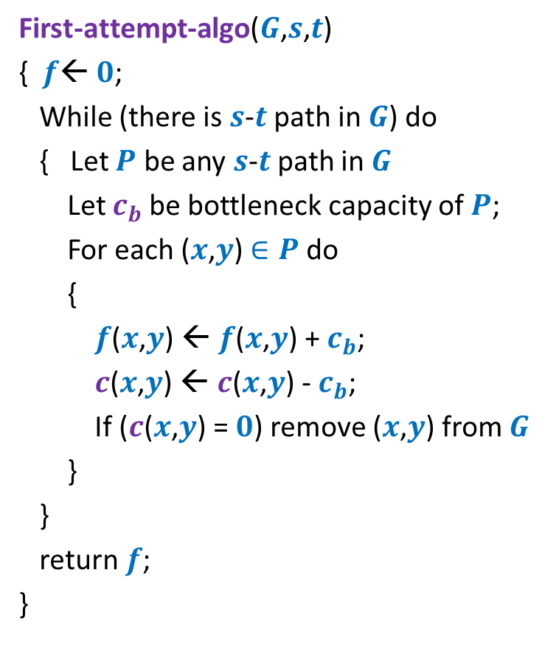
Towards designing max flow algorithm
First-attempt-algo($G$,$s$,$t$)
{ $f$← $0$;
While (there is $s$-$t$ path in $G$) do
{ Let $P$ be any $s$-$t$ path in $G$
Let $c_{b}$be bottleneck capacity of $P$;
For each ($x$,$y$) $∈P$ do
{
$f$($x$,$y$) ← $f$($x$,$y$) + $c_{b}$;
$c$($x$,$y$) ← $c$($x$,$y$) - $c_{b}$;
If ($c$($x$,$y$) = $0$) remove ($x$,$y$) from $G$
}
}
return $f$;
}
Is the algorithm correct ?

Slide 20
A counterexample for First-attempt-algo

Slide 21

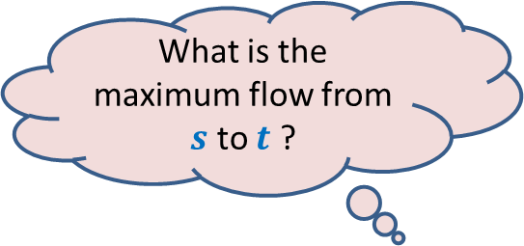



$$x$$
What is the maximum flow from $s$ to $t$ ?
20
10
$$s$$
50
$$t$$
30
10
20
$$y$$

Slide 22




Executing our first attempt algorithm
$$x$$
$$x$$
20
20
10
10
$$s$$
20
50
$$t$$
$$s$$
30
$$t$$
20
10
20
10
$$y$$
$$y$$
No $s−t$ path

Slide 23
Homework
Spend at least 30 minutes today on the following task
Work on this counterexample
and pursue a pure scientific approach
to modify the existing algorithm so that it may compute max. flow…

