Slide 1
Design and Analysis of Algorithms (CS345/CS345A)
Lecture 21
Network Flow – II

Slide 2
A quick recap from the last lecture

Slide 3

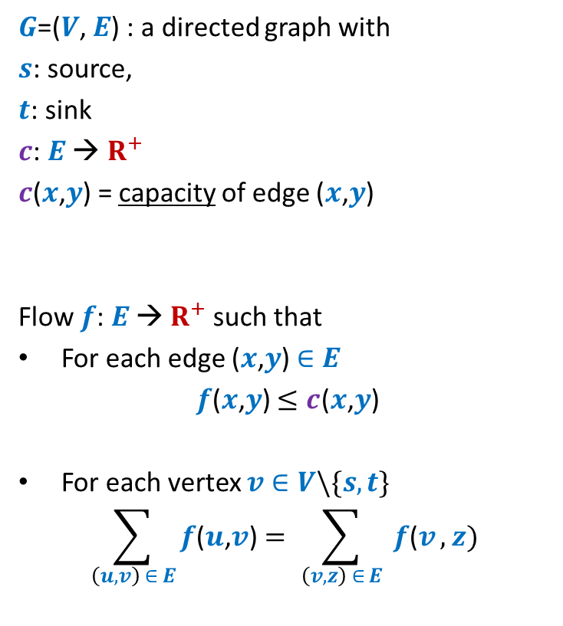





Formal Description of Flow
2
$G$=($V$, $E$) : a directed graph with
$s$: source,
$t$: sink
$c$: $E$ → $R^{+}$
$c$($x$,$y$) = capacity of edge ($x$,$y$)
Flow $f$: $E$ → $R^{+}$ such that
For each edge ($x$,$y$) $∈E$
$f$($x$,$y$) $≤c$($x$,$y$)
For each vertex $v∈V\backslash \{s,t\}$
$$\sum_{\left(u,v\right) ∈ E}{f\text{(}u\text{,}v\text{)}}=\sum_{ \left(v,z\right) ∈ E }{f\text{(}v},z)$$
$$v$$
$$x$$
5
6
15
8
$$t$$
$$s$$
6
7
14
7
17
$$u$$
4
$$y$$
Capacity constraint
Conservation constraint

Slide 4

Formal Description of Flow
2
$\text{value}\text{(}f\text{)=}$ flow leaving $s$
$$=\sum_{\left(s,v\right) ∈ E}{f\text{(}u\text{,}v\text{)}}$$
$G$=($V$, $E$) : a directed graph with
$s$: source,
$t$: sink
$c$: $E$ → $R^{+}$
$c$($x$,$y$) = capacity of edge ($x$,$y$)
Flow $f$: $E$ → $R^{+}$ such that
For each edge ($x$,$y$) $∈E$
$f$($x$,$y$) $≤c$($x$,$y$)
For each vertex $v∈V\backslash \{s,t\}$
$$\sum_{\left(u,v\right) ∈ E}{f\text{(}u\text{,}v\text{)}}=\sum_{ \left(v,z\right) ∈ E }{f\text{(}v},z)$$
$$v$$
$$x$$
4
5
5
11
6
1
15
8
$$t$$
$$s$$
6
7
1
7
7
14
7
17
$$u$$
4
$$y$$

Slide 5
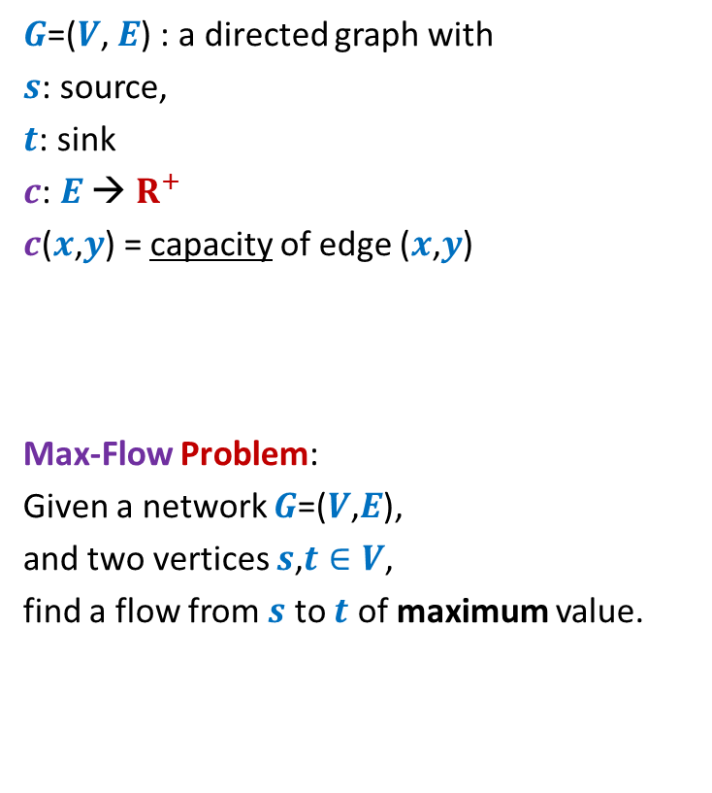
Formal Description of Flow
2
$\text{value}\text{(}f\text{)=}$ flow leaving $s$
$$=\sum_{\left(s,v\right) ∈ E}{f\text{(}u\text{,}v\text{)}}$$
$G$=($V$, $E$) : a directed graph with
$s$: source,
$t$: sink
$c$: $E$ → $R^{+}$
$c$($x$,$y$) = capacity of edge ($x$,$y$)
Max-Flow Problem:
Given a network $G$=($V$,$E$),
and two vertices $s$,$t∈V$,
find a flow from $s$ to $t$ of maximum value.
$$v$$
$$x$$
5
6
15
8
$$t$$
$$s$$
6
7
14
7
17
$$u$$
4
$$y$$

Slide 6

Towards designing max flow algorithm
A natural approach
2
Find some $s−t$ path,
Send flow along the path,
Update capacities,
Find some $s−t$ path,
…and so on ☺
$$v$$
$$x$$
5
6
5
5
+1
5
12
+7
6
15
What is the most natural approach to solve this problem ?
8
$$t$$
$$s$$
6
7
1
1
7
7
14
7
17
$$u$$
4
$$y$$

Slide 7
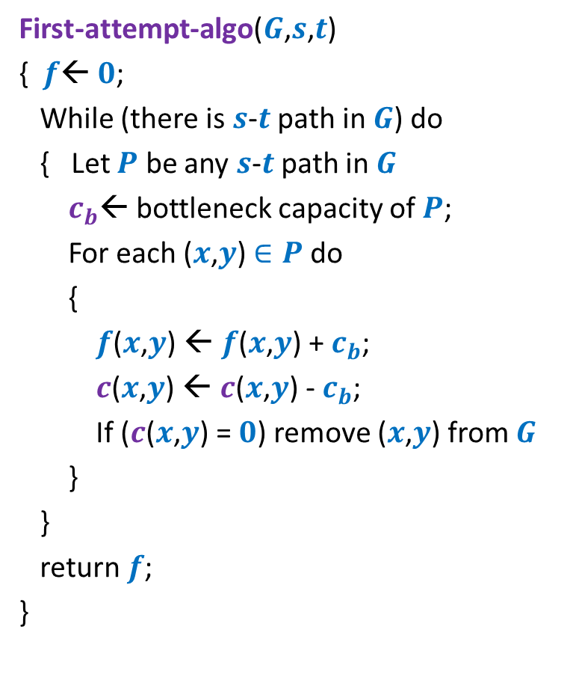
Towards designing max flow algorithm
First-attempt-algo($G$,$s$,$t$)
{ $f$← $0$;
While (there is $s$-$t$ path in $G$) do
{ Let $P$ be any $s$-$t$ path in $G$
$c_{b}$← bottleneck capacity of $P$;
For each ($x$,$y$) $∈P$ do
{
$f$($x$,$y$) ← $f$($x$,$y$) + $c_{b}$;
$c$($x$,$y$) ← $c$($x$,$y$) - $c_{b}$;
If ($c$($x$,$y$) = $0$) remove ($x$,$y$) from $G$
}
}
return $f$;
}
Is the algorithm correct ?

Slide 8
A counterexample for First-attempt-algo

Slide 9

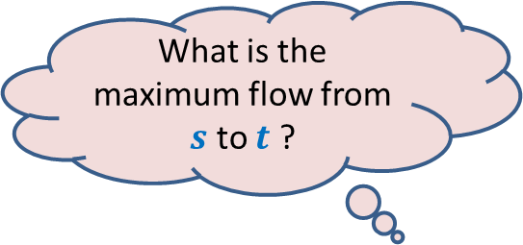



$$x$$
What is the maximum flow from $s$ to $t$ ?
20
10
$$s$$
50
$$t$$
30
10
20
$$y$$

Slide 10




Executing our first attempt algorithm
$$x$$
$$x$$
20
20
10
10
$$s$$
20
50
$$t$$
$$s$$
30
$$t$$
20
10
20
10
$$y$$
$$y$$
No $s−t$ path

Slide 11
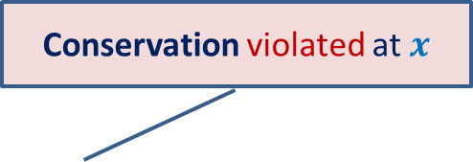
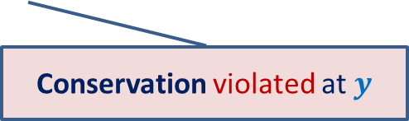

Finding a solution with scientific spirit
Conservation violated at $x$
Patience and perseverance paid ☺
$$x$$
20
10
20
10
How to send extra 10 units of flow from $s$to $t$ ?
$$s$$
20
$$t$$
10
50
10
20
10
20
$$y$$
Conservation violated at $y$

Slide 12
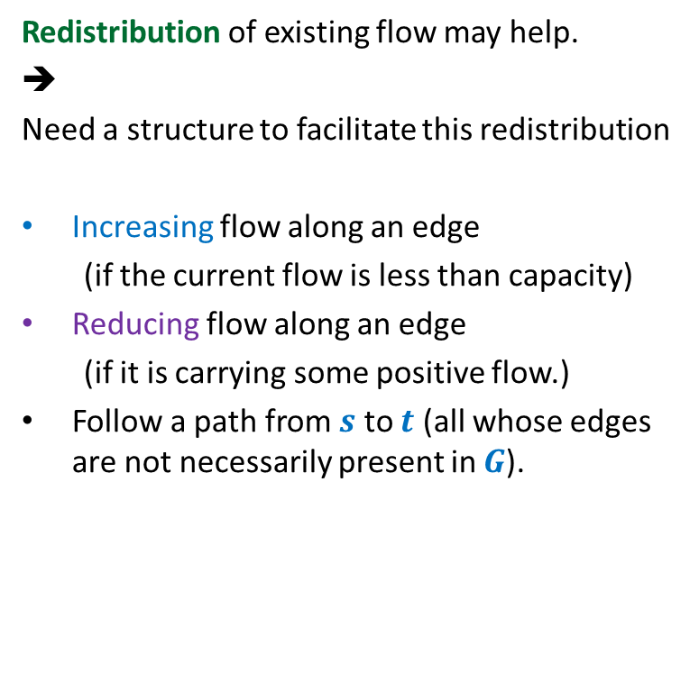
Insight gained from the example
Redistribution of existing flow may help.
➔
Need a structure to facilitate this redistribution
Increasing flow along an edge
(if the current flow is less than capacity)
Reducing flow along an edge
(if it is carrying some positive flow.)
Follow a path from $s$ to $t$ (all whose edges are not necessarily present in $G$).
$$x$$
20
10
20
10
$$s$$
10
50
$$t$$
10
20
10
20
Think for a while about the structure that will facilitate these operations.
$$y$$

Slide 13

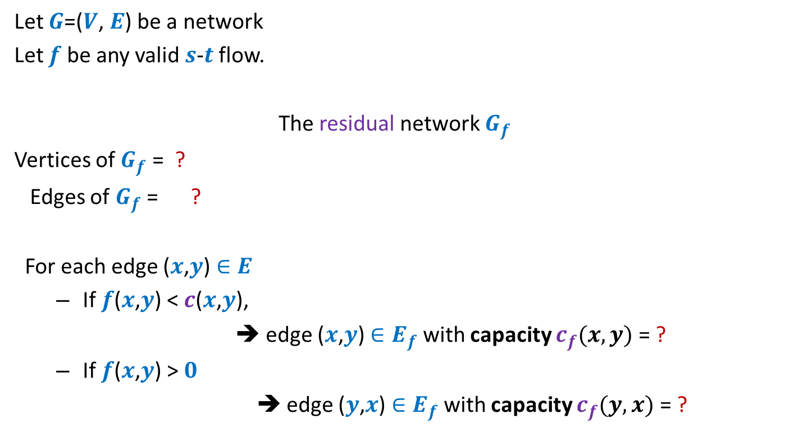



Residual network
Let $G$=($V$, $E$) be a network
Let $f$ be any valid $s$-$t$ flow.
The residual network $G_{f}$
Vertices of $G_{f}$ = ?
Edges of $G_{f}$ = ?
For each edge ($x$,$y$) $∈E$
If $f$($x$,$y$) < $c$($x$,$y$),
➔ edge ($x$,$y$) $∈E_{f}$ with capacity $c_{f}(x,y)$= ?
If $f$($x$,$y$) > $0$
➔ edge ($y$,$x$) $∈E_{f}$with capacity $c_{f}(y,x)$ = ?
$$V$$
$$E_{f}$$
Forward edge
$c$($x$,$y$) - $f$($x$,$y$)
Backward edge
$f$($x$,$y$)

Slide 14


Example of Residual Network
$$G$$
$$G_{f}$$
$$x$$
$$x$$
20
20
20
10
10
$$s$$
20
50
$$t$$
$$s$$
30
20
$$t$$
20
10
20
10
20
$$y$$
$$y$$

Slide 15
Example of Residual Network
$$G$$
$$G_{f}$$
$$x$$
$$x$$
20
20
10
20
10
10
$$s$$
20
50
$$t$$
$$s$$
30
20
$$t$$
10
10
20
10
20
10
20
$$y$$
$$y$$

Slide 16

Example of Residual Network
$$G$$
$$G_{f}$$
$$x$$
$$x$$
20
20
10
20
10
10
$$s$$
10
50
$$t$$
$$s$$
40
10
$$t$$
10
20
10
20
10
20
$$y$$
$$y$$
No $s−t$ path exists in $G_{f}$.

Slide 17












A generic step of increasing flow
Find a $s−t$ path $P$in $G_{f}$;
If edge ($x$, $y$) on the path is a forward edge
➔ Increase flow along ($x$, $y$) by $c′$ in $G$.
$$s$$
$$t$$
$$x$$
$$y$$
$$G$$
$$s$$
$$≥c′$$
$$≥c′$$
$$≥c′$$
$$t$$
$$x$$
$$y$$
$$P$$
$$G_{f}$$

Slide 18

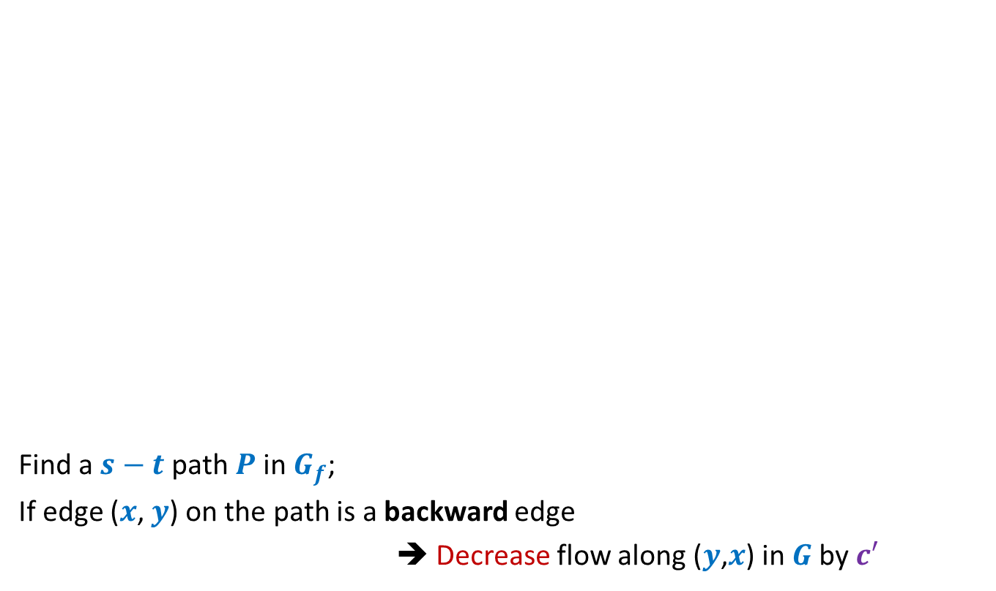
A generic step of increasing flow
Find a $s−t$ path $P$in $G_{f}$;
If edge ($x$, $y$) on the path is a backward edge
➔ Decrease flow along ($y$,$x$) in $G$by $c′$
$$s$$
$$t$$
$$x$$
$$y$$
$$G$$
This reduction of flow along ($y$,$x$) is a part of redistribution: we divert a part of $f$($y$,$x$) along some other outgoing edge of $y$, and increase flow along some edge entering $x$. Recall our example.
$$s$$
$$≥c′$$
$$≥c′$$
$$≥c′$$
$$t$$
$$x$$
$$y$$
$$P$$
$$G_{f}$$

Slide 19
Ford Fulkerson algorithm
A simple path based algorithm
+
Residual Network

Slide 20
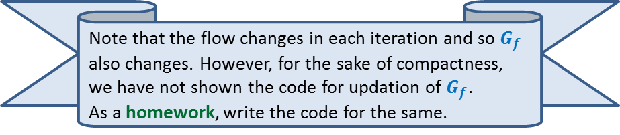
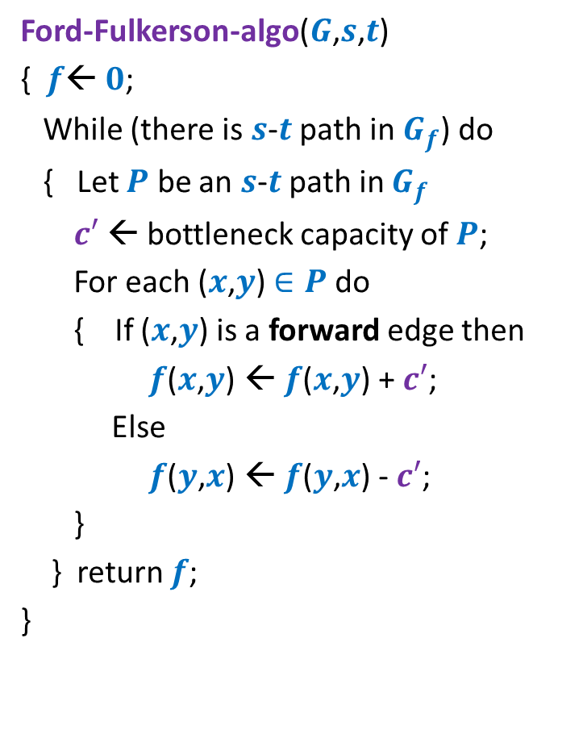
Ford Fulkerson algorithm
Ford-Fulkerson-algo($G$,$s$,$t$)
{ $f$← $0$;
While (there is $s$-$t$ path in $G_{f}$) do
{ Let $P$ be an $s$-$t$ path in $G_{f}$
$c′$ ← bottleneck capacity of $P$;
For each ($x$,$y$) $∈P$ do
{ If ($x$,$y$) is a forward edge then
$f$($x$,$y$) ← $f$($x$,$y$) + $c′$;
Else
$f$($y$,$x$) ← $f$($y$,$x$) - $c′$;
}
} return $f$;
}
Note that the flow changes in each iteration and so $G_{f}$ also changes. However, for the sake of compactness, we have not shown the code for updation of $G_{f}$.
As a homework, write the code for the same.

Slide 21









Ford Fulkerson algorithm
Ford-Fulkerson-algo($G$,$s$,$t$)
{ $f$← $0$;
While (there is $s$-$t$ path in $G_{f}$) do
{ Let $P$ be an $s$-$t$ path in $G_{f}$
$c′$ ← bottleneck capacity of $P$;
For each ($x$,$y$) $∈P$ do
{ If ($x$,$y$) is a forward edge then
$f$($x$,$y$) ← $f$($x$,$y$) + $c′$;
Else
$f$($y$,$x$) ← $f$($y$,$x$) - $c′$;
}
} return $f$;
}
Question:
Does the algorithm compute a valid flow ?
Capacity constraint is satisfied
Conservation ?
$$x∈P$$
$$G$$
$$u$$
$$x$$
$$y$$
$$G_{f}$$
$$u$$
$$x$$
$$y$$

Slide 22





Ford Fulkerson algorithm
Ford-Fulkerson-algo($G$,$s$,$t$)
{ $f$← $0$;
While (there is $s$-$t$ path in $G_{f}$) do
{ Let $P$ be an $s$-$t$ path in $G_{f}$
$c′$ ← bottleneck capacity of $P$;
For each ($x$,$y$) $∈P$ do
{ If ($x$,$y$) is a forward edge then
$f$($x$,$y$) ← $f$($x$,$y$) + $c′$;
Else
$f$($y$,$x$) ← $f$($y$,$x$) - $c′$;
}
} return $f$;
}
Question:
Does the algorithm compute a valid flow ?
Capacity constraint is satisfied
Conservation ?
$$x∈P$$
$$G$$
$$u$$
$$x$$
$$y$$
$$G_{f}$$
$$u$$
$$x$$
$$y$$

Slide 23
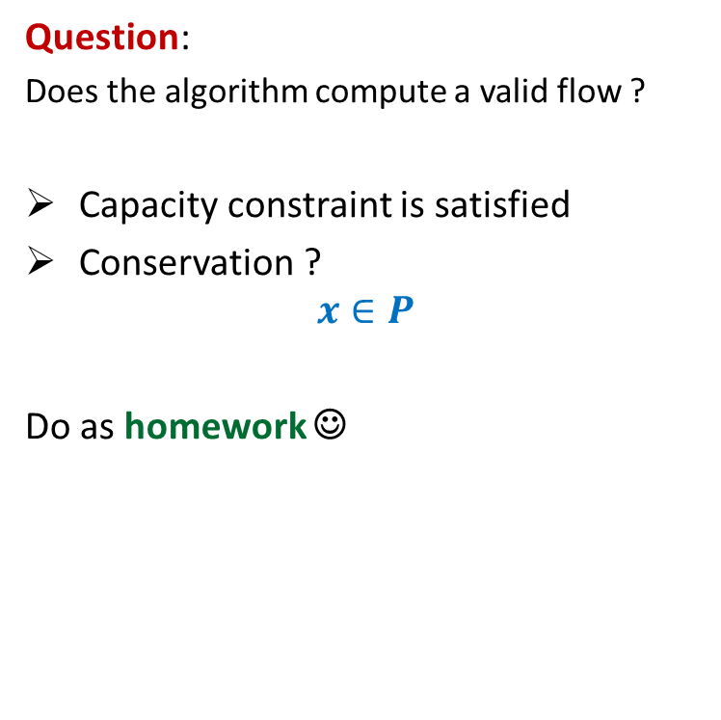
Ford Fulkerson algorithm
Ford-Fulkerson-algo($G$,$s$,$t$)
{ $f$← $0$;
While (there is $s$-$t$ path in $G_{f}$) do
{ Let $P$ be an $s$-$t$ path in $G_{f}$
$c′$ ← bottleneck capacity of $P$;
For each ($x$,$y$) $∈P$ do
{ If ($x$,$y$) is a forward edge then
$f$($x$,$y$) ← $f$($x$,$y$) + $c′$;
Else
$f$($y$,$x$) ← $f$($y$,$x$) - $c′$;
}
} return $f$;
}
Question:
Does the algorithm compute a valid flow ?
Capacity constraint is satisfied
Conservation ?
$$x∈P$$
Do as homework ☺
$$G_{f}$$
$$u$$
$$x$$
$$y$$
$$G_{f}$$
$$u$$
$$x$$
$$y$$

Slide 24
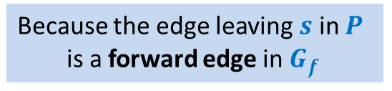
Ford Fulkerson algorithm
Ford-Fulkerson-algo($G$,$s$,$t$)
{ $f$← $0$;
While (there is $s$-$t$ path in $G_{f}$) do
{ Let $P$ be an $s$-$t$ path in $G_{f}$
$c′$ ← bottleneck capacity of $P$;
For each ($x$,$y$) $∈P$ do
{ If ($x$,$y$) is a forward edge then
$f$($x$,$y$) ← $f$($x$,$y$) + $c′$;
Else
$f$($y$,$x$) ← $f$($y$,$x$) - $c′$;
}
} return $f$;
}
Does the value of flow increase in every iteration ?
Yes.
Because the edge leaving $s$ in $P$
is a forward edge in $G_{f}$
Correctness of the algorithm ?

Slide 25





Correctness ?
Suppose you find a flow of value $19$ using FF algorithm.
$$x$$
Is $19$ the max flow ?
10
3
9
14
$$s$$
$$t$$
$$≤27$$
8
$$u$$
2
$$v$$
10
$≤2$5
3
3
1
9
$$≤37$$
$$≤19$$
$$y$$

Slide 26
$s$-$t$Cuts

Slide 27


$s$-$t$cut
$A⊂V$, with
$s∈A$, $t∈\overline{A}$
$$s$$
$$t$$
$$A$$
$$\overline{A}$$
$$G$$

Slide 28

$s$-$t$cut
$A⊂V$, with
$s∈A$, $t∈\overline{A}$
$Cut(A,\overline{A})$=
{$\left(x,y\right)∈E$ |$x∈A,y∈\overline{A}$ or $y∈A,x∈\overline{A}$}
Capacity of a cut:
$c(A,\overline{A})$=
$$\sum_{\left(u,v\right)∈E,u∈A, v∈\overline{A}}{c(u,v)}$$
$$s$$
$$t$$
$$A$$
$$\overline{A}$$
$$G$$
Note: capacity of only outgoing edges is considered in capacity of a cut.

Slide 29
Cuts and Flows
?
Spend free time during the mid semester break pondering over the relationship between s-t cuts and flows.
Think along the following lines :
Prove that max $s−t$ flow is always less than capacity of every $s−t$ cut
This should be easy.
Prove that there is an $s−t$ cut whose capacity is equal to $s−t$ flow computed by FF algorithm
This requires nothing but a good understanding of FF algorithm.
Conclude that max $s−t$ flow is equal to capacity of min $s−t$ cut.
This is the famous max-flow, min-cut theorem.

Slide 30
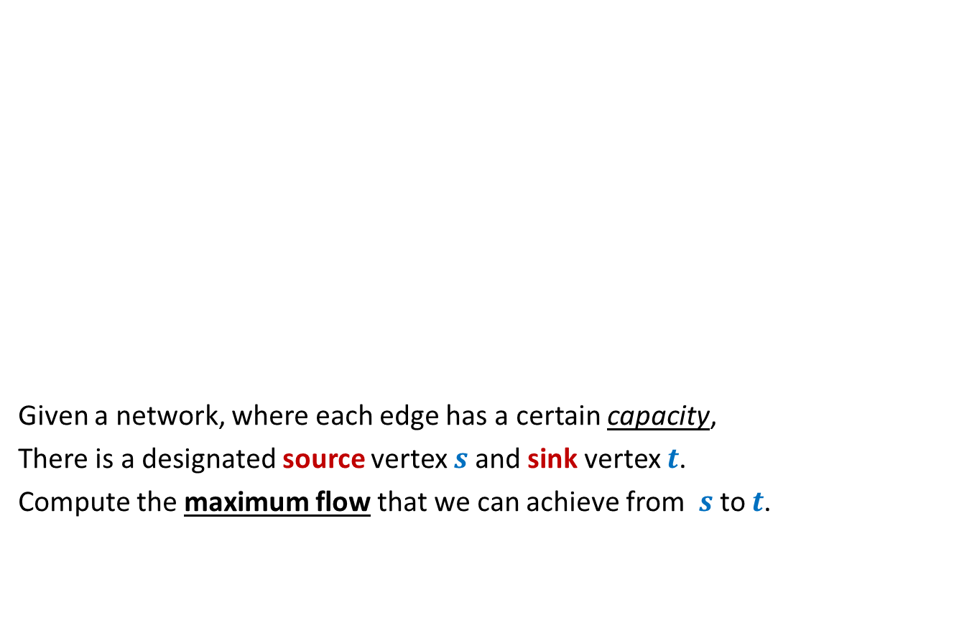

Rounding of a matrix
$$11$$
$$11.7$$
$$12$$
$$39$$ | $$19$$ | $$18$$ | $$30$$
$$37$$
$$15$$
$$20$$
$$34$$
$$11.7$$ | $$2.4$$ | $$4.3$$ | $$18.6$$
$$5.2$$ | $$6.1$$ | $$1.0$$ | $$2.7$$
$$6.7$$ | $$3.6$$ | $$9.1$$ | $$0.6$$
$$15.4$$ | $$6.9$$ | $$3.6$$ | $$8.1$$
$$12$$ | $$2$$ | $$4$$ | $$19$$
$$5$$ | $$6$$ | $$1$$ | $$3$$
$$7$$ | $$4$$ | $$9$$ | $$0$$
$$15$$ | $$7$$ | $$4$$ | $$8$$
An amazing application of max flows.
Design an algorithm to round a $n×n$ matrix, if possible ?
Rounding always exists !
Rounding can be computed efficiently.
Using Max Flow ☺

Slide 31
An earnest message to all students
Each one of you is capable to achieving extraordinary aims in this world.
You are gifted with outstanding creative and analytical skills.
➔ So it is my privilege to teach you.
It is my responsibility to introduce the world of algorithms to you in such a manner that not only you get convinced about the creativity and beauty of this classical area of computer science but also get inspired to design such algorithms on your own in future.
Keeping the above goal in my mind, I strive to teach you in the best possible way I can.
Those of you whose interest in algorithms is more than just getting a good grade are strongly encouraged to solve ponder over the previous two slides.
Please make sincere attempts to solve these two problems.
Wishing you a lot of joy and satisfaction during mid semester break. ☺
Best wishes,
Surender Baswana

