Slide 1
Design and Analysis of Algorithms (CS345/CS345A)
Lecture 22
Analysis of Ford Fulkerson algorithm
(Max-Flow Min-Cut Theorem)

Slide 2
Ford Fulkerson algorithm
A simple path based algorithm
+
Residual Network

Slide 3

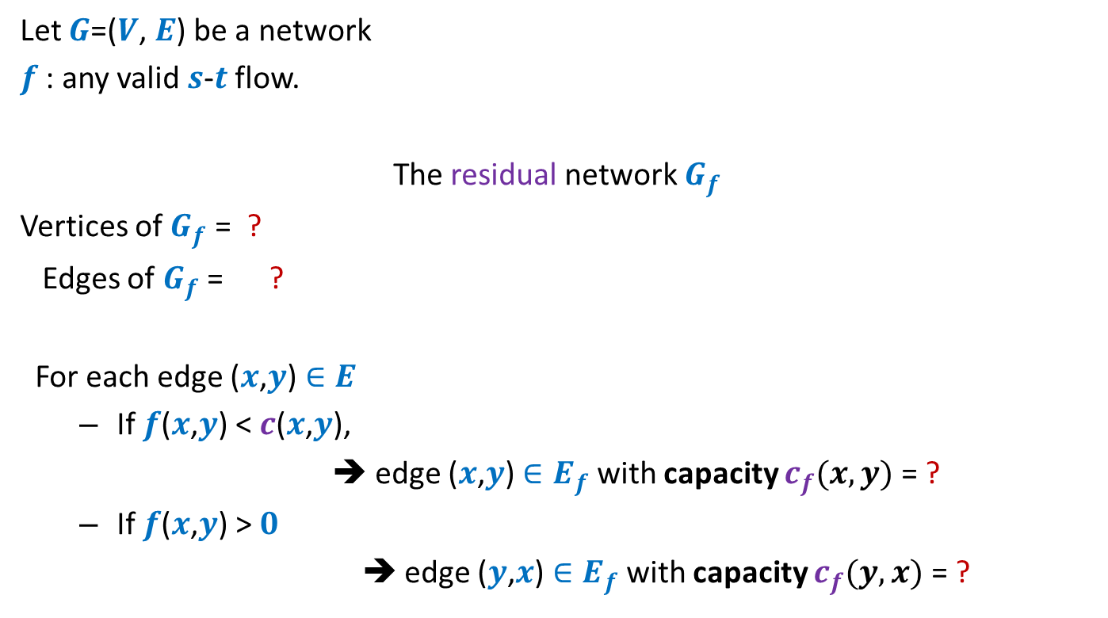



Residual network
Let $G$=($V$, $E$) be a network
$f$ : any valid $s$-$t$ flow.
The residual network $G_{f}$
Vertices of $G_{f}$ = ?
Edges of $G_{f}$ = ?
For each edge ($x$,$y$) $∈E$
If $f$($x$,$y$) < $c$($x$,$y$),
➔ edge ($x$,$y$) $∈E_{f}$ with capacity $c_{f}(x,y)$= ?
If $f$($x$,$y$) > $0$
➔ edge ($y$,$x$) $∈E_{f}$with capacity $c_{f}(y,x)$ = ?
$$V$$
$$E_{f}$$
Forward edge
$c$($x$,$y$) - $f$($x$,$y$)
Backward edge
$f$($x$,$y$)

Slide 4
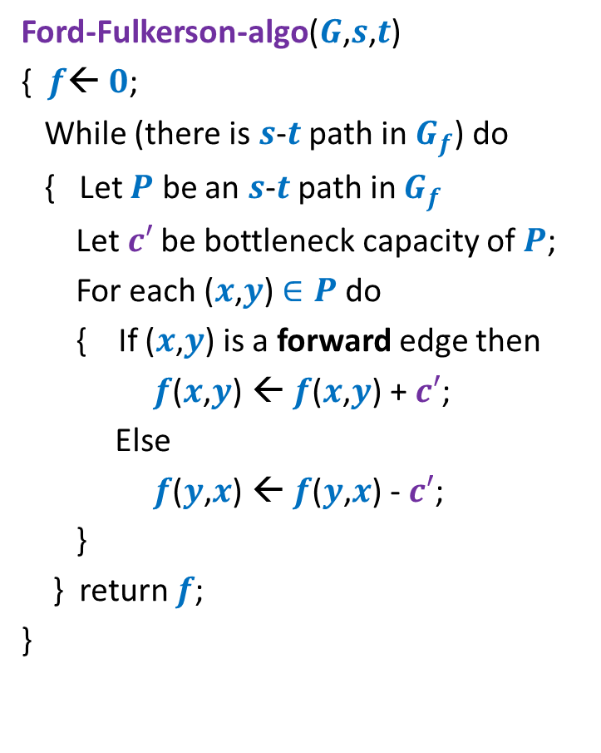
Ford Fulkerson algorithm
Ford-Fulkerson-algo($G$,$s$,$t$)
{ $f$← $0$;
While (there is $s$-$t$ path in $G_{f}$) do
{ Let $P$ be an $s$-$t$ path in $G_{f}$
Let$c′$ be bottleneck capacity of $P$;
For each ($x$,$y$) $∈P$ do
{ If ($x$,$y$) is a forward edge then
$f$($x$,$y$) ← $f$($x$,$y$) + $c′$;
Else
$f$($y$,$x$) ← $f$($y$,$x$) - $c′$;
}
} return $f$;
}
Correctness of the algorithm ?

Slide 5

$s$-$t$Cuts

Slide 6







$s$-$t$cut
$A⊂V$, with
$s∈A$, $t∈\overline{A}$
$$s$$
$$t$$
$$A$$
$$\overline{A}$$
$$G$$

Slide 7
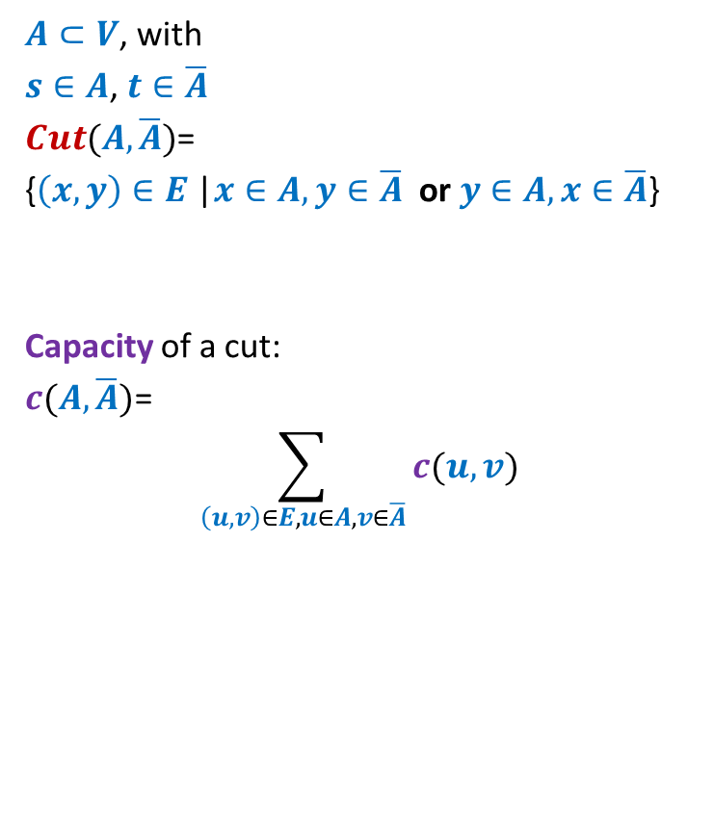
$s$-$t$cut
$A⊂V$, with
$s∈A$, $t∈\overline{A}$
$Cut(A,\overline{A})$=
{$\left(x,y\right)∈E$ |$x∈A,y∈\overline{A}$ or $y∈A,x∈\overline{A}$}
Capacity of a cut:
$c(A,\overline{A})$=
$$\sum_{\left(u,v\right)∈E,u∈A, v∈\overline{A}}{c(u,v)}$$
$$s$$
$$t$$
$$A$$
$$\overline{A}$$
$$G$$
Note: capacity of only outgoing edges is considered in capacity of a cut.

Slide 8
Cuts and Flows

Slide 9







Useful Generalizations
conservation constraint:
For each vertex $v∈V\backslash \{s,t\}$
Mathematically,
$$\sum_{\left(z,u\right) ∈ E}{f\text{(}z\text{,}u\text{)}}=\sum_{ \left(u,v\right) ∈ E }{f\text{(}u},v)$$
Lemma: $f_{out}\left(u\right)−f_{in}(u)$ =
$$f_{in}(u)$$
$$f_{out}(u)$$
$$u$$
$$f_{in}(u)$$
$$f_{out}(u)$$
0 if $u∈V\backslash \{s,t\}$
$value(f)$ if $u=s$
$−value(f)$ if $u=t$

Slide 10



Useful Generalizations
Consider any valid flow $f$.
Question: How would you define $f_{out}\left(A\right)$ ?
$$f_{out}\left(A\right)=\sum_{\left(x,y\right) ∈ E, x∈A,y∈\overline{A}}{f\text{(}x,y\text{)}}$$
$$f_{in}\left(A\right)=\sum_{\left(x,y\right) ∈ E, y∈A,x∈\overline{A}}{f\text{(}x,y\text{)}}$$
Question: What would be $f_{out}\left(A\right)−f_{in}\left(A\right)$ ?
Answer: $value(f)$
Proof ?
$$s$$
$$A$$

Slide 11



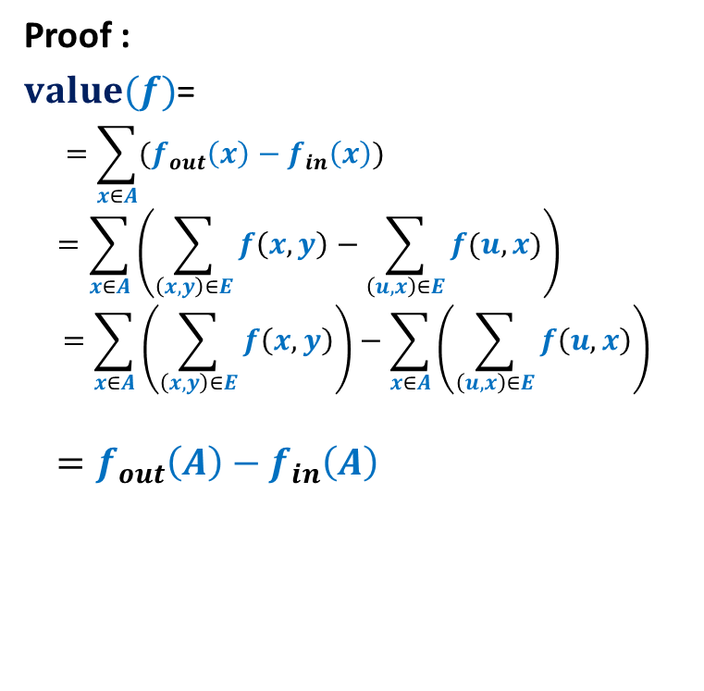

Proof for $f_{out}\left(A\right)−f_{in}\left(A\right)$ = $value(f)$
Consider any valid flow $f$.
Proof :
$value(f)$=
$$=\sum_{x∈A}{(f_{out}\left(x\right)−f_{in}\left(x\right))}$$
$$=\sum_{x∈A}{\left(\sum_{\left(x,y\right)∈E}{f\left(x,y\right)}−\sum_{\left(u,x\right)∈E}{f(u,x)}\right)}$$
$$=\sum_{x∈A}{\left(\sum_{\left(x,y\right)∈E}{f\left(x,y\right)}\right)}−\sum_{x∈A}{\left(\sum_{\left(u,x\right)∈E}{f\left(u,x\right)}\right)}$$
$$=f_{out}\left(A\right)−f_{in}\left(A\right)$$
$$f_{out}\left(s\right)−f_{in}\left(s\right)$$
$$x$$
$$s$$
$$v$$
$$A$$

Slide 12
A simple Relation
between Flows and capacity of cuts

Slide 13
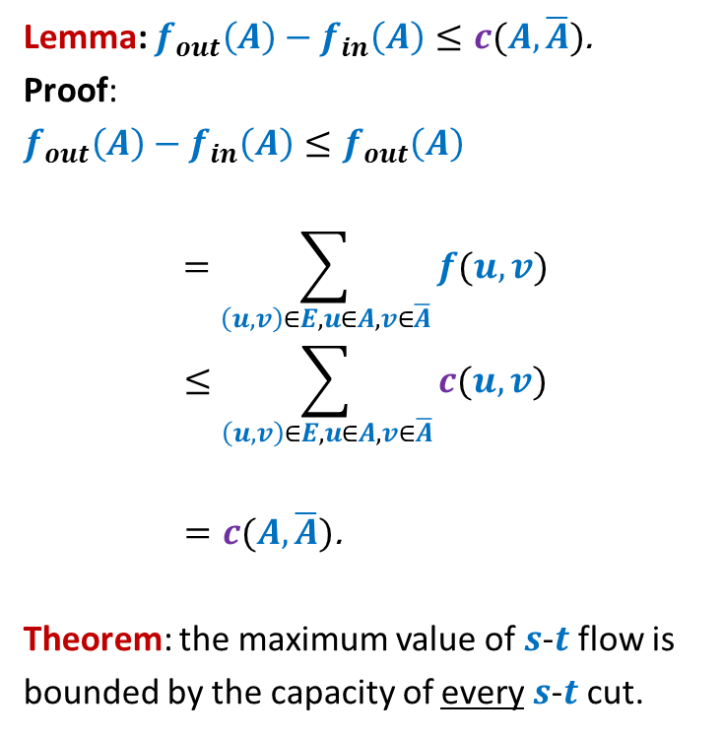
Flows and capacity of cuts
Consider any valid flow $f$.
Lemma: $f_{out}\left(A\right)−f_{in}\left(A\right)≤c(A,\overline{A})$.
Proof:
$f_{out}\left(A\right)−f_{in}\left(A\right)≤f_{out}\left(A\right)$
$$=\sum_{\left(u,v\right)∈E,u∈A, v∈\overline{A}}{f(u,v)}$$
$$≤\sum_{\left(u,v\right)∈E,u∈A, v∈\overline{A}}{c(u,v)}$$
$=c(A,\overline{A})\text{.}$
Theorem: the maximum value of $s$-$t$flow is
bounded by the capacity of every $s$-$t$cut.
$$s$$
$$t$$
$$A$$
$$\overline{A}$$
$$G$$

Slide 14
A deep Relation
between Flows and capacity of cuts

Slide 15

Max-Flow Min-Cut Theorem
Theorem: the maximum value of $s$-$t$flow is equal to the capacity of min $s$-$t$cut.
Based on
Ford Fulkerson Algorithm

Slide 16
Ford Fulkerson algorithm
Ford-Fulkerson-algo($G$,$s$,$t$)
{ $f$← $0$;
While (there is $s$-$t$ path in $G_{f}$) do
{ Let $P$ be an $s$-$t$ path in $G_{f}$
Let$c′$ be bottleneck capacity of $P$;
For each ($x$,$y$) $∈P$ do
{ If ($x$,$y$) is a forward edge then
$f$($x$,$y$) ← $f$($x$,$y$) + $c′$;
Else
$f$($y$,$x$) ← $f$($y$,$x$) - $c′$;
}
} return $f$;
}
Which is this cut defined by Ford Fulkerson algorithm?

Slide 17










Proof of max-flow min-cut Theorem
How does $G_{f}$ look like ?
$f$ : flow computed by Ford-Fulkerson algorithm.
$A$: set of vertices reachable from $s$ in $G_{f}$
Claim: $value(f)$ = $c(A,\overline{A})$.
$$s$$
$$t$$
$$s$$
$$t$$
$$A$$
$$\overline{A}$$
$$A$$
$$\overline{A}$$
$$G$$
$$G_{f}$$

Slide 18
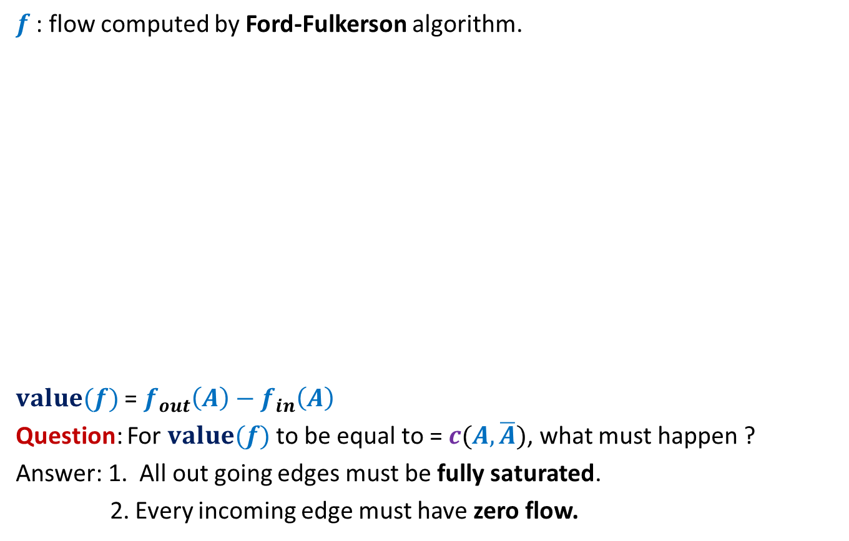
Proof of max-flow min-cut Theorem
$f$ : flow computed by Ford-Fulkerson algorithm.
$value(f)$ = $f_{out}\left(A\right)−f_{in}\left(A\right)$
Question: For $value(f)$ to be equal to = $c(A,\overline{A})$, what must happen ?
Answer: 1. All out going edges must be fully saturated.
2. Every incoming edge must have zero flow.
$$s$$
$$t$$
$$s$$
$$t$$
$$A$$
$$\overline{A}$$
$$A$$
$$\overline{A}$$
$$G$$
$$G_{f}$$
How will you show this ?

Slide 19


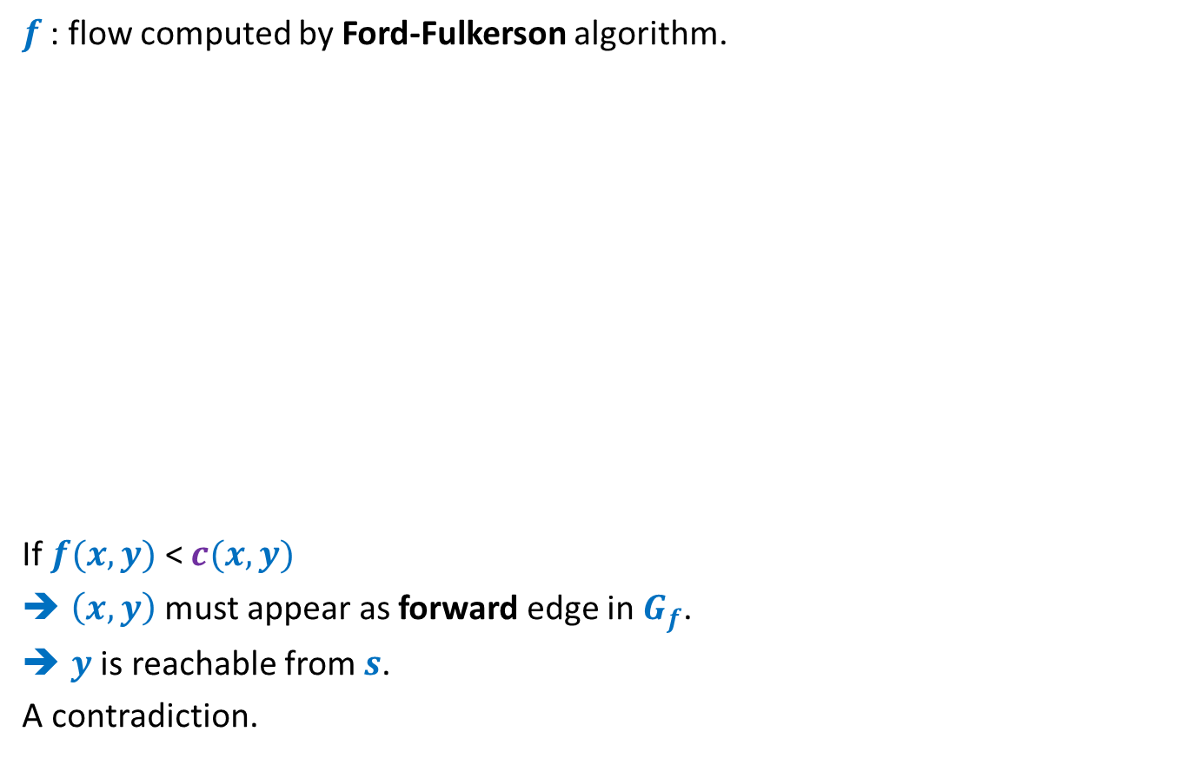


Proof of max-flow min-cut Theorem
$f$ : flow computed by Ford-Fulkerson algorithm.
If $f(x,y)$ < $c(x,y)$
$\left(x,y\right)$ must appear as forward edge in$G_{f}$.
$y$ is reachable from $s$.
A contradiction.
$$x$$
$$x$$
$$s$$
$$y$$
$$t$$
$$s$$
$$y$$
$$t$$
$$A$$
$$\overline{A}$$
$$A$$
$$\overline{A}$$
$$G$$
$$G_{f}$$

Slide 20





Proof of max-flow min-cut Theorem
Consider the flow $f$computed by Ford-Fulkerson algorithm.
If $f(x,y)$ > $0$
$\left(y,x\right)$appears as a backward edge in $G_{f}$.
$x$ is reachable from $s$.
A contradiction.
$$s$$
$$x$$
$$s$$
$$x$$
$$t$$
$$t$$
$$y$$
$$y$$
$$A$$
$$\overline{A}$$
$$A$$
$$\overline{A}$$
$$G$$
$$G_{f}$$

Slide 21
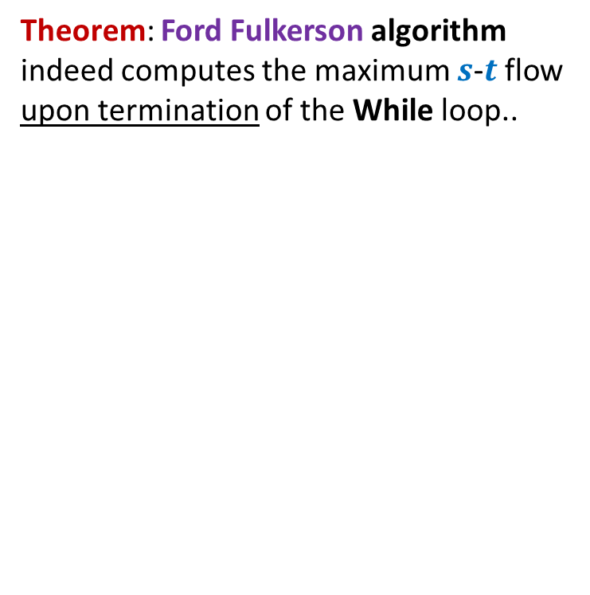
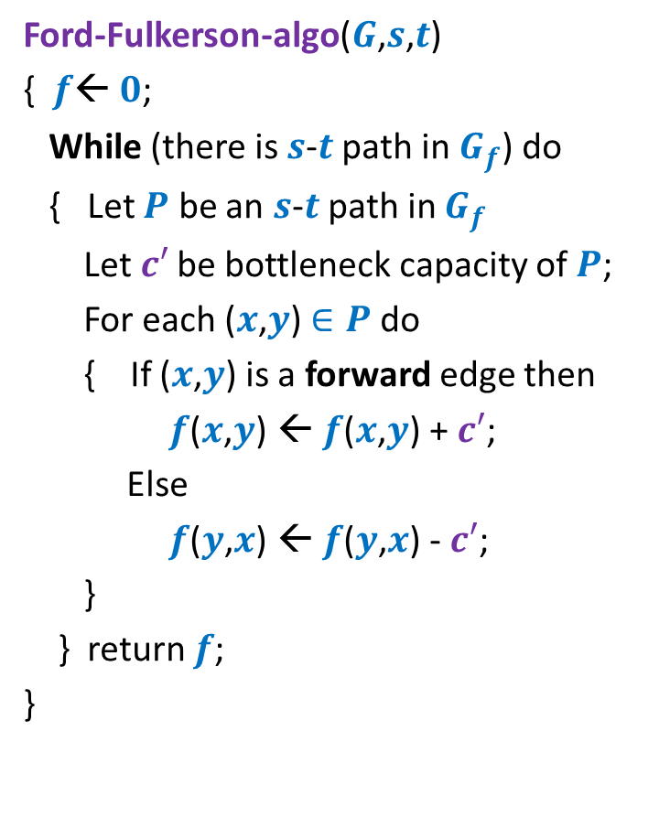
Ford Fulkerson algorithm
Ford-Fulkerson-algo($G$,$s$,$t$)
{ $f$← $0$;
While (there is $s$-$t$ path in $G_{f}$) do
{ Let $P$ be an $s$-$t$ path in $G_{f}$
Let$c′$ be bottleneck capacity of $P$;
For each ($x$,$y$) $∈P$ do
{ If ($x$,$y$) is a forward edge then
$f$($x$,$y$) ← $f$($x$,$y$) + $c′$;
Else
$f$($y$,$x$) ← $f$($y$,$x$) - $c′$;
}
} return $f$;
}
Theorem: Ford Fulkerson algorithm indeed computes the maximum $s$-$t$ flow upon termination of the While loop..
Time complexity ?

Slide 22
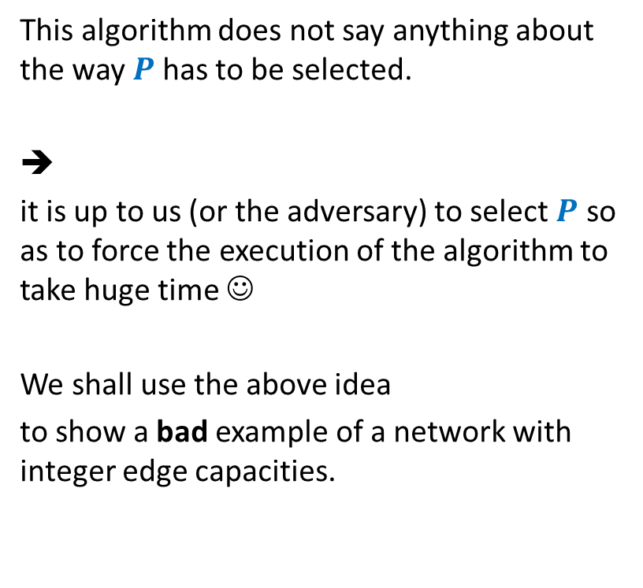
Ford Fulkerson algorithm
Ford-Fulkerson-algo($G$,$s$,$t$)
{ $f$← $0$;
While (there is $s$-$t$ path in $G_{f}$) do
{ Let $P$ be an $s$-$t$ path in $G_{f}$
Let$c′$ be bottleneck capacity of $P$;
For each ($x$,$y$) $∈P$ do
{ If ($x$,$y$) is a forward edge then
$f$($x$,$y$) ← $f$($x$,$y$) + $c′$;
Else
$f$($y$,$x$) ← $f$($y$,$x$) - $c′$;
}
} return $f$;
}
This algorithm does not say anything about the way $P$has to be selected.
➔
it is up to us (or the adversary) to select $P$ so as to force the execution of the algorithm to take huge time ☺
We shall use the above idea
to show a bad example of a network with integer edge capacities.

Slide 23



A worst case example for networks with integer edge weights
$$G$$
$$G_{f}$$
$$x$$
$$x$$
1
1000
1000
1000
1000
$$s$$
1
1
$$t$$
$$s$$
1
$$t$$
1
1000
1000
1000
1000
$$y$$
$$y$$

Slide 24
A worst case example for networks with integer edge weights
$$G$$
$$G_{f}$$
$$x$$
$$x$$
1
1
1
1000
999
1000
1000
$$s$$
1
1
$$t$$
$$s$$
1
$$t$$
1
1
1000
1000
1000
999
1
$$y$$
$$y$$

Slide 25
A worst case example for networks with integer edge weights
$$G$$
$$G_{f}$$
$$x$$
$$x$$
1
1
1
1
2
1000
999
1000
999
$$s$$
1
1
$$t$$
$$s$$
1
$$t$$
1
2
1
1000
1000
999
999
1
1
$$y$$
$$y$$
The algorithm will run for 2000 iterations to compute max-flow !

Slide 26

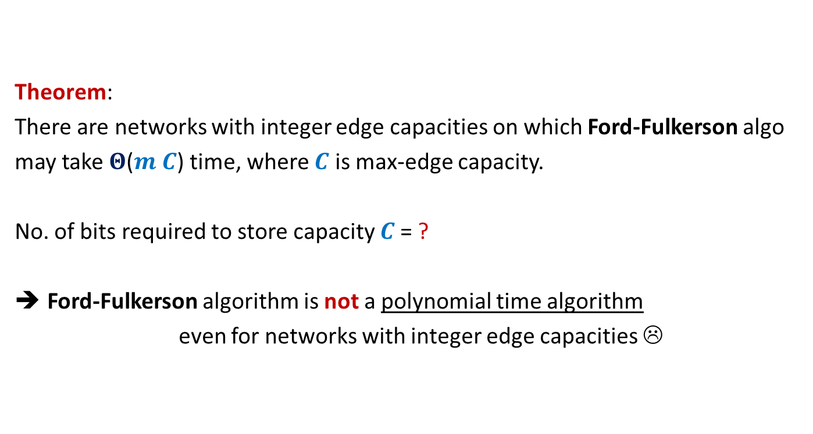
Theorem:
There are networks with integer edge capacities on which Ford-Fulkerson algo
may take $Θ$($m C$) time, where $C$ is max-edge capacity.
No. of bits required to store capacity $C$= ?
Ford-Fulkerson algorithm is not a polynomial time algorithm
even for networks with integer edge capacities ☹
$$\log_{2}C$$

Slide 27
Integrality of max-flow
A useful tool for many applications of Max-Flow

Slide 28

Integrality of max-flow
Theorem: Given a network $G$=($V$,$E$), and two vertices $s$,$t∈V$,
if edge capacities are integers, then there exists a maximum $s$-$t$flow $f$
which is “integral”.
$f\left(e\right)∈Z$for each $e∈E$
1
.67
1
.67
1
1
1
$$s$$
1
.33
$$t$$
0
.33
0
1
1

Slide 29
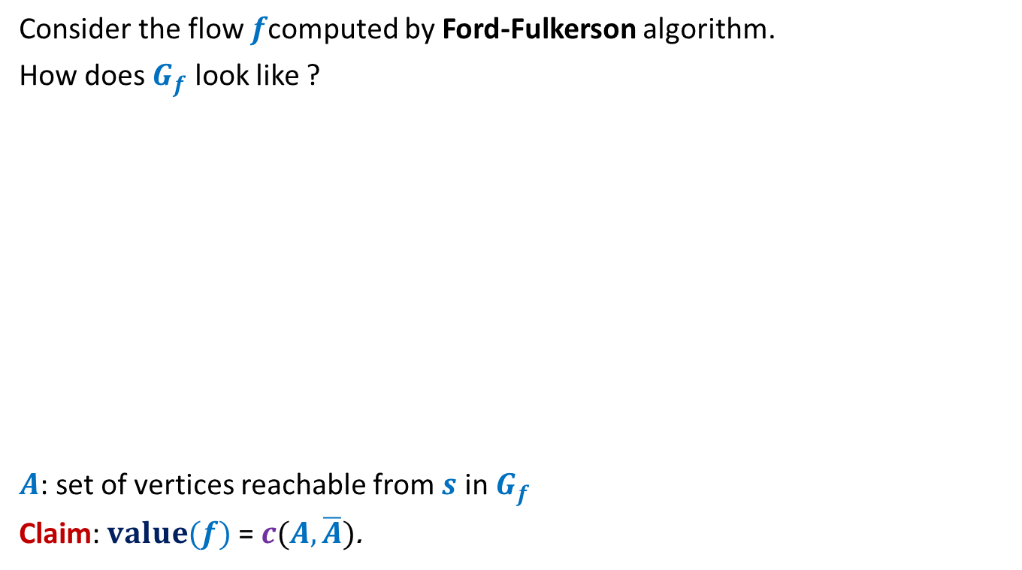
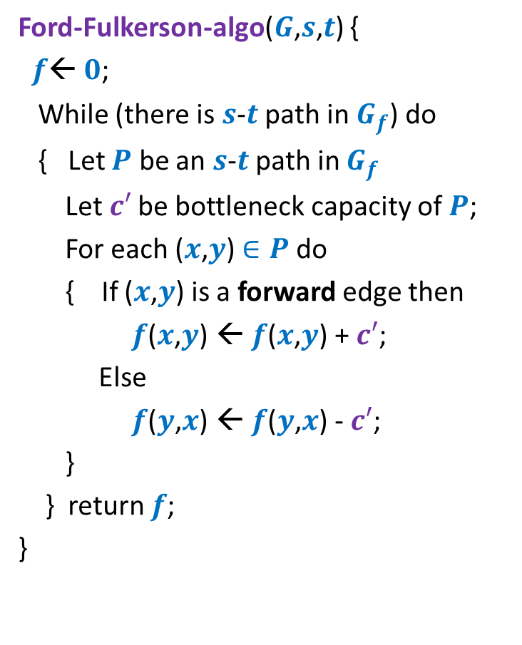
Proof for Integrality theorem
Ford-Fulkerson-algo($G$,$s$,$t$) {
$f$← $0$;
While (there is $s$-$t$ path in $G_{f}$) do
{ Let $P$ be an $s$-$t$ path in $G_{f}$
Let$c′$ be bottleneck capacity of $P$;
For each ($x$,$y$) $∈P$ do
{ If ($x$,$y$) is a forward edge then
$f$($x$,$y$) ← $f$($x$,$y$) + $c′$;
Else
$f$($y$,$x$) ← $f$($y$,$x$) - $c′$;
}
} return $f$;
}
Claim:
Ford Fulkerson algorithm computes a maximum flow which is integral.
Proof: (By induction on the no. of iteration)
Inductive Assertion:
At the end of $i$th iteration, $f$ is integral.
[Homework: give all details of the proof].
In fact, the statement can be shown to hold for any flow (not necessary max flow) $f$whose value is an integer.
Hint: In each iteration send only 1 unit of flow instead of $c′$.

Slide 30
Rounding of a matrix
A motivating application of
Integrality theorem Max Flow

Slide 31

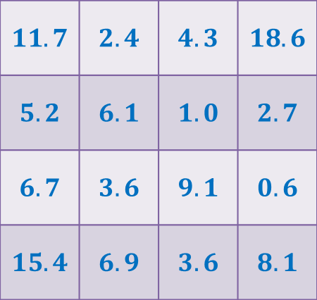

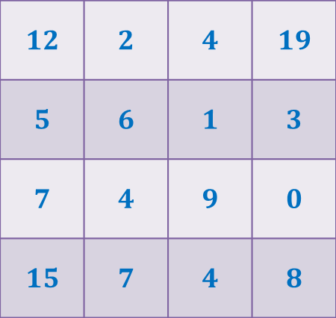
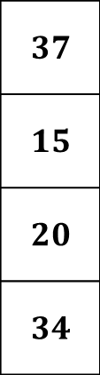

Rounding of a matrix
$$11$$
$$11.7$$
$$12$$
$$39$$ | $$19$$ | $$18$$ | $$30$$
$$37$$
$$15$$
$$20$$
$$34$$
$$11.7$$ | $$2.4$$ | $$4.3$$ | $$18.6$$
$$5.2$$ | $$6.1$$ | $$1.0$$ | $$2.7$$
$$6.7$$ | $$3.6$$ | $$9.1$$ | $$0.6$$
$$15.4$$ | $$6.9$$ | $$3.6$$ | $$8.1$$
$$12$$ | $$2$$ | $$4$$ | $$19$$
$$5$$ | $$6$$ | $$1$$ | $$3$$
$$7$$ | $$4$$ | $$9$$ | $$0$$
$$15$$ | $$7$$ | $$4$$ | $$8$$
Design an algorithm to round a $n×n$ matrix, if possible ?
Make sincere attempt to solve this problem. We shall discuss it in the next class.

Slide 32
Today’s lecture is indeed the core of the entire course. You may afford to forget anything from this course. But you must not forget what we covered in this lecture.
This lecture not only depicts the elegance involved in the design of an algorithm, but also shows that algorithmic ideas can be used to prove some deep graph theoretic results.
Even after nearly 15 years when I saw it for the first time, I still find it amazing to see that there is a short and novel proof of correctness for the Max-flow min-cut theorem.
In the next few lectures, we shall discuss equally amazing aspects of Max-Flow problem : A polynomial time algorithm and many applications.

Slide 33


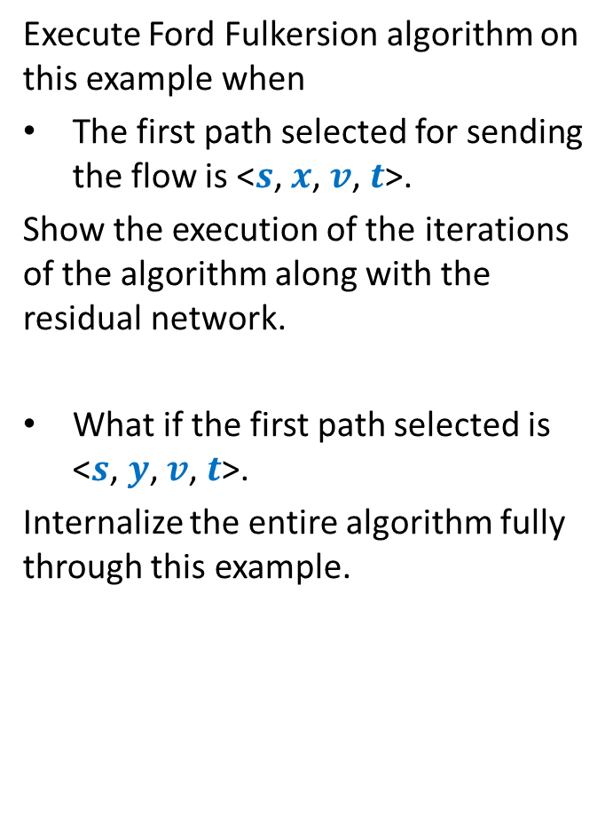
A useful exercise to internalize Ford Fulkerson algorithm
Execute Ford Fulkersion algorithm on this example when
The first path selected for sending the flow is <$s$, $x$, $v$, $t$>.
Show the execution of the iterations of the algorithm along with the residual network.
What if the first path selected is <$s$, $y$, $v$, $t$>.
Internalize the entire algorithm fully through this example.
$$x$$
10
3
9
5
$$s$$
$$t$$
8
$$u$$
10
$$v$$
10
3
3
6
5
$$y$$

