Slide 1
Design and Analysis of Algorithms (CS345/CS345A)
Lecture 24
Polynomial time algorithms for Maximum Flow
(By Carefully choosing the augmenting paths in FF-algorithm)

Slide 2

Polynomial Time algorithms for max-flow
Algorithm 2
For Networks with edge capacities $∈R^{+}$
First recall Algorithm 1
To get its main intuition and
reason why it is crucial to have Integer edge capacities in the Network.

Slide 3
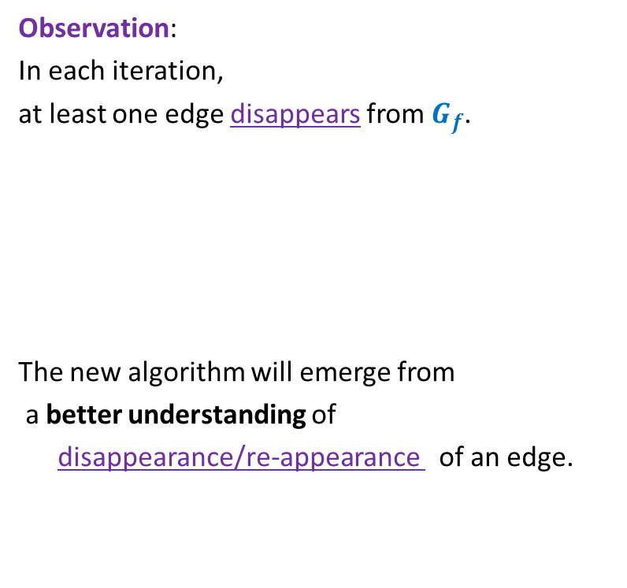
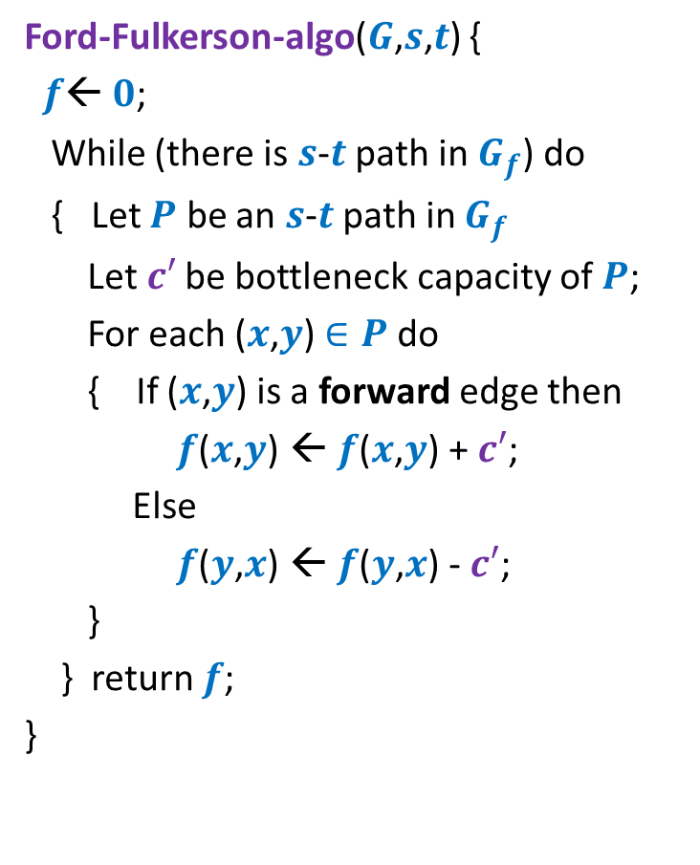

Ford Fulkerson Algorithm
Ford-Fulkerson-algo($G$,$s$,$t$) {
$f$← $0$;
While (there is $s$-$t$ path in $G_{f}$) do
{ Let $P$ be an $s$-$t$ path in $G_{f}$
Let$c′$ be bottleneck capacity of $P$;
For each ($x$,$y$) $∈P$ do
{ If ($x$,$y$) is a forward edge then
$f$($x$,$y$) ← $f$($x$,$y$) + $c′$;
Else
$f$($y$,$x$) ← $f$($y$,$x$) - $c′$;
}
} return $f$;
}
Observation:
In each iteration,
at least one edge disappears from $G_{f}$.
The new algorithm will emerge from
a better understanding of
disappearance/re-appearance of an edge.
But it may appear in $G_{f}$ again.

Slide 4

Disappearance of an edge in $G_{f}$

Slide 5












Disappearance of a forward edge
Flow must have increased along edge ($x$,$y$) up to $c$($x$,$y$).
➔ ($x$,$y$) must belong to the path $P$ selected during $i$th Iteration.
$$x$$
$$y$$
$$s$$
$$t$$
$$G_{f}$$
$$x$$
$$y$$
After $i$th Iteration
$$x$$
$$y$$
$$s$$
$$t$$
$$G_{f′}$$
$$x$$
$$y$$

Slide 6







Disappearance of a backward edge
Flow must have decreased along edge ($y$,$x$) to 0.
➔ ($x$,$y$) must belong to the path $P$ selected during $i$th Iteration.
$$y$$
$$x$$
$$s$$
$$t$$
$$G_{f}$$
$$x$$
$$y$$
After $i$th Iteration
$$y$$
$$x$$
$$s$$
$$t$$
$$G_{f′}$$
$$x$$
$$y$$

Slide 7
the (RE-)appearance of an edge

Slide 8










(Re)-Appearance of a forward edge
Flow must have reduced along edge ($x$,$y$) to less than $c$($x$,$y$).
➔ ($y$,$x$) must belong to the path $P$ selected during $i$th Iteration.
$$x$$
$$y$$
$$s$$
$$t$$
$$G_{f}$$
$$x$$
$$y$$
After $i$th Iteration
$$x$$
$$y$$
$$s$$
$$t$$
$$G_{f′}$$
$$x$$
$$y$$

Slide 9


(Re)-appearance of a backward edge
Flow must have increased along edge ($y$,$x$).
➔ ($y$,$x$) must belong to the path $P$ selected during $i$th Iteration.
$$y$$
$$x$$
$$s$$
$$t$$
$$G_{f}$$
$$x$$
$$y$$
After $i$th Iteration
$$y$$
$$x$$
$$s$$
$$t$$
$$G_{f′}$$
$$x$$
$$y$$

Slide 10
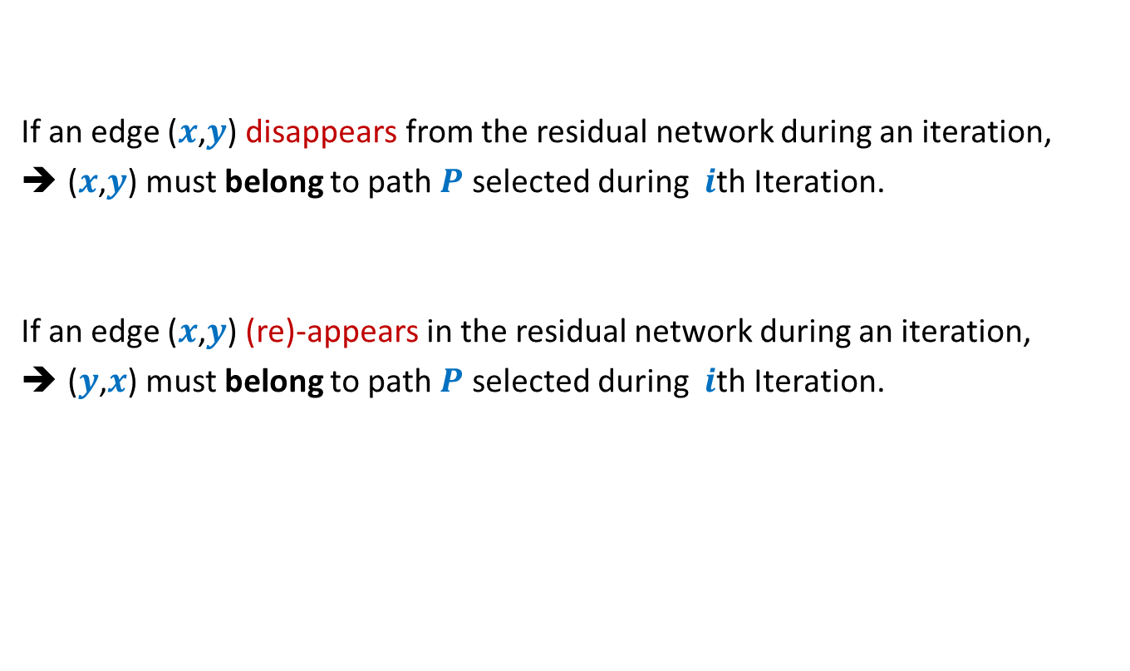
Disappearance/Reappearance of an edge in residual network
If an edge ($x$,$y$) disappears from the residual network during an iteration,
($x$,$y$) must belong to path $P$ selected during $i$th Iteration.
If an edge ($x$,$y$) (re)-appears in the residual network during an iteration,
($y$,$x$) must belong to path $P$ selected during $i$th Iteration.

Slide 11



Algorithm 2
Ford-Fulkerson-algo($G$,$s$,$t$) {
$f$← $0$;
While (there is $s$-$t$ path in $G_{f}$) do
{ Let $P$ be an $s$-$t$ path in $G_{f}$
Let$c′$ be bottleneck capacity of $P$;
For each ($x$,$y$) $∈P$ do
{ If ($x$,$y$) is a forward edge then
$f$($x$,$y$) ← $f$($x$,$y$) + $c′$;
Else
$f$($y$,$x$) ← $f$($y$,$x$) - $c′$;
}
} return $f$;
}
Algorithm-2($G$,$s$,$t$) {
In each iteration, at least one edge disappears from $G_{f}$.
This algorithm ensures that an edge can disappear and re-appear O($n$) times.
Let $P$ be the shortest $s$-$t$ path in $G_{f}$;
How to modify the FF algorithm so that the number of times an edge disappears has a polynomial bound ?

Slide 12

Algorithm 2
Ford-Fulkerson-algo($G$,$s$,$t$) {
$f$← $0$;
While (there is $s$-$t$ path in $G_{f}$) do
{ Let $P$ be an $s$-$t$ path in $G_{f}$
Let$c′$ be bottleneck capacity of $P$;
For each ($x$,$y$) $∈P$ do
{ If ($x$,$y$) is a forward edge then
$f$($x$,$y$) ← $f$($x$,$y$) + $c′$;
Else
$f$($y$,$x$) ← $f$($y$,$x$) - $c′$;
}
} return $f$;
}
Algorithm-2($G$,$s$,$t$) {
Let $P$ be the shortest $s$-$t$ path in $G_{f}$;
How to prove:
An edge can disappear and re-appear O($n$) times.

Slide 13







A crucial observation
Lemma : Distance from $s$ to each vertex increases monotonically in $G_{f}$.
$$δ_{f}\left(s,x\right)≤δ_{f′}\left(s,x\right)$$
$$δ_{f}(s,x)$$
$$s$$
$$t$$
$$x$$
$$G_{f}$$
After $i$th Iteration
$$δ_{f′}(s,x)$$
$$s$$
$$t$$
$$G_{f′}$$
$$x$$

Slide 14


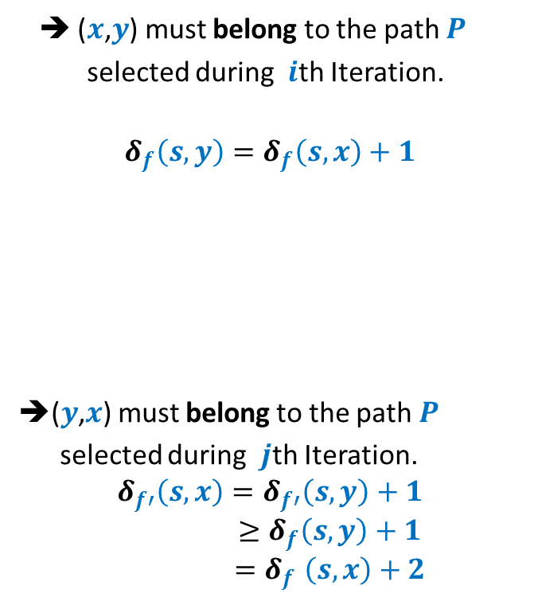



Bounding the disappearing/re-appearing of an edge
$$G_{f}$$
$$s$$
$$t$$
$$x$$
$$y$$
➔ ($x$,$y$) must belong to the path $P$
selected during $i$th Iteration.
$$δ_{f}\left(s,y\right)=δ_{f}\left(s,x\right)+1$$
➔($y$,$x$) must belong to the path $P$
selected during $j$th Iteration.
$$δ_{f′}\left(s,x\right)=δ_{f′}\left(s,y\right)+1$$
$$≥δ_{f}\left(s,y\right)+1$$
$${=δ}_{f}\left(s,x\right)+2$$
After $i$th Iteration
$$s$$
$$t$$
$$x$$
$$y$$
$$δ_{f′}\left(s,y\right)≥δ_{f}\left(s,y\right)$$
$$G_{f′}$$
After $j$th Iteration
$$s$$
$$t$$
$$x$$
$$y$$

Slide 15
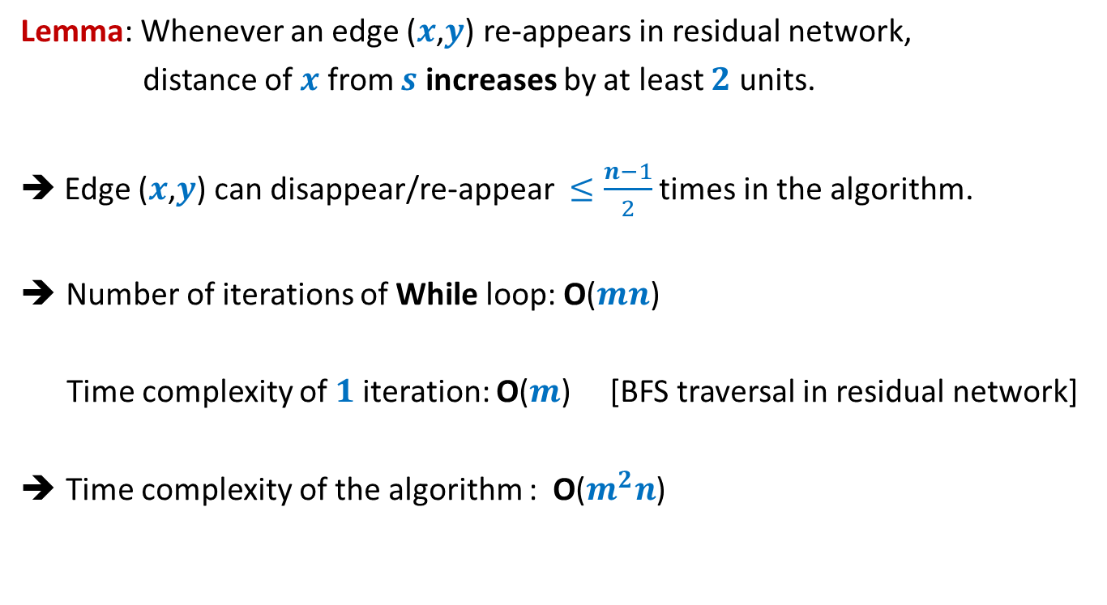
Analysis of Algorithm 2
Lemma: Whenever an edge ($x$,$y$) re-appears in residual network,
distance of $x$ from $s$ increases by at least $2$ units.
➔ Edge ($x$,$y$) can disappear/re-appear $≤\frac{n−1}{2}$ times in the algorithm.
Number of iterations of While loop: O($mn$)
Time complexity of $1$iteration: O($m$) [BFS traversal in residual network]
Time complexity of the algorithm : O($m^{2}n$)

Slide 16
Proof of the monotonic increase of distanceS in residual network

Slide 17




Proof by contradiction
$δ_{f′}\left(s,x\right)<δ_{f}\left(s,x\right)$
Let $x$be the nearest “defaulter”.
➔ For each vertex $v$in $G_{f′}$ with $δ_{f^{′}}\left(s,v\right)<δ_{f′}(s,x)$,
$δ_{f}\left(s,v\right)≤δ_{f′}\left(s,v\right)$
$$δ_{f}(s,x)$$
$$s$$
$$t$$
$$G_{f}$$
$$x$$
$i$th Iteration
$$δ_{f′}(s,x)$$
$$G_{f′}$$
$$s$$
$$t$$
$$x$$

Slide 18





Proof by contradiction
Definitely $δ_{f}\left(s,u\right)≤δ_{f′}\left(s,u\right)$
➔Edge $\left(u,x\right)$ must have appeared in residual network after $i$th iteration.
➔Edge $\left(x,u\right)∈P$ (the path selected during $i$th Iteration)
➔ $δ_{f}\left(s,u\right)=δ_{f}\left(s,x\right)+1$
$$δ_{f}(s,x)$$
$$s$$
$$t$$
$$G_{f}$$
$$x$$
$i$th Iteration
$$δ_{f′}(s,x)$$
$$G_{f′}$$
$$s$$
$$t$$
$$u$$
$$x$$
contradiction
$>δ_{f′}\left(s,x\right)+1$
$=(δ_{f^{′}}\left(s,u\right)+1)+1$
$δ_{f}\left(s,u\right)>δ_{f′}\left(s,u\right)$

Slide 19
Well Known Algorithms for Max-Flow

Slide 20




Well known algorithms for Max-Flow
Inventor(s) | Year | Time complexity
Ford & Fulkerson
1955
O($−−$)
Edmond and Karp
1972
O($m^{2}n$)
V.M. Malhotra,
Pramodh Kumar,
S.N. Maheshwari
1978
O($n^{3}$)
J. Orlin
2013
O($mn$)

Slide 21
Applications and Variants Of Max-Flow

Slide 22
















Multiple source and multiple sinks
Problem: Given multiple sources and multiple sinks, compute the maximum flow we can send from the sources to the sinks.
$$∞$$
$$s_{1}$$
$$t_{1}$$
$$∞$$
$$∞$$
$$∞$$
$$s_{2}$$
$$s$$
$$∞$$
$$t_{2}$$
$$∞$$
$$t$$
$$∞$$
$$s_{3}$$
$$t_{3}$$
$$s_{4}$$

Slide 23





Max flow when nodes also have capacity
Problem: Given a flow network $G=(V,E)$,
where each node $v∈V$also has a capacity
$c(v)$ : maximum flow that $v$ can allow to pass through it.
Compute the maximum $s$-$t$flow.
$$v$$
$c(v)$
$$v_{in}$$
$$v_{out}$$

Slide 24
Application # 2 of Max-Flow
Bipartite Matching

Slide 25
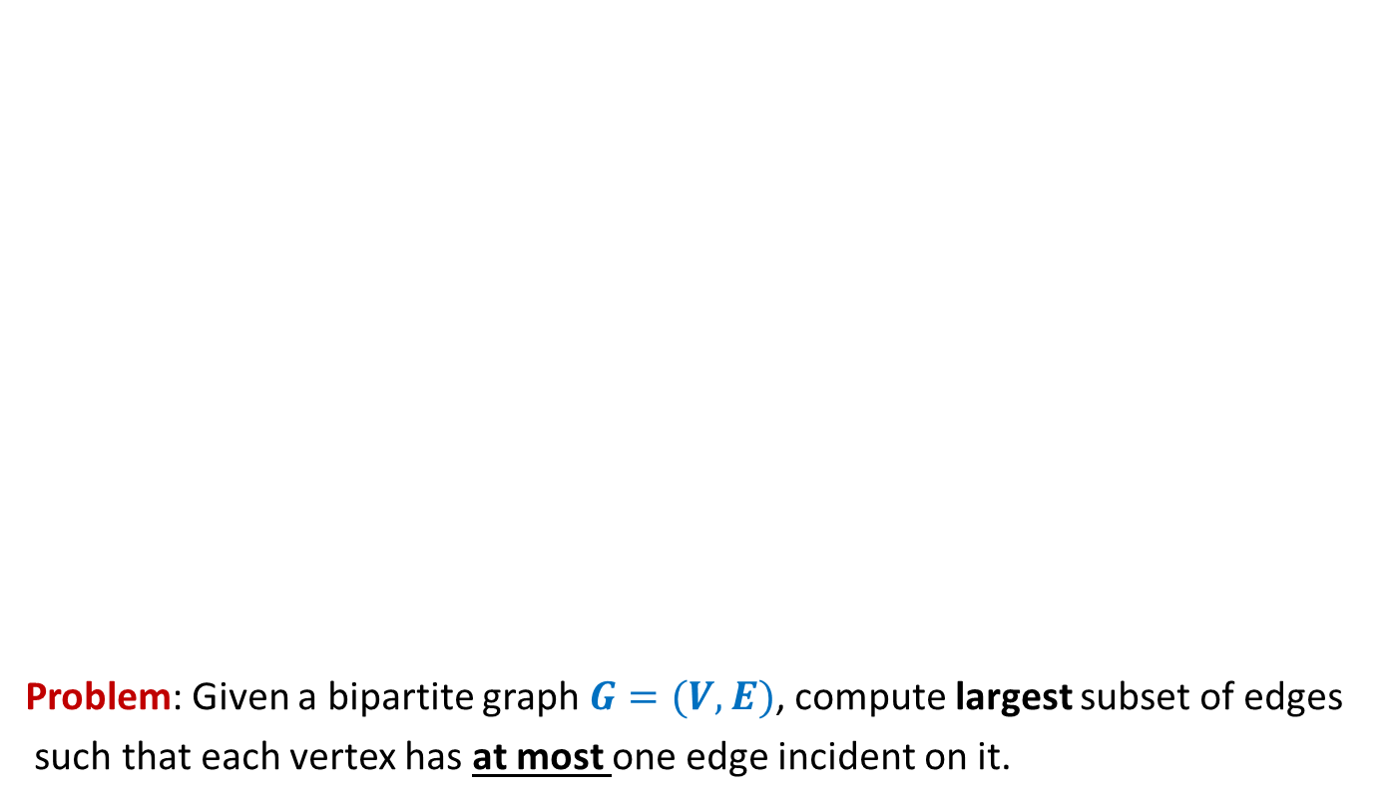
Bipartite matching
Problem: Given a bipartite graph $G=(V,E)$, compute largest subset of edges
such that each vertex has at most one edge incident on it.
applicants
jobs
Matching of size 5
Matching of size 3

Slide 26



Bipartite matching Maximum Flow
applicants
jobs
$$1$$
$$1$$
$$1$$
$$1$$
$$1$$
$$1$$
$$1$$
$$1$$
$$G′$$
$$s$$
$$1$$
$$t$$
$$1$$
$$1$$
$$1$$
$$1$$
$$1$$
$$1$$
$$1$$
$$1$$
$$1$$
$$1$$
$$1$$
$$1$$
$$1$$
$$1$$
$$1$$
How does the max-flow instance look like ?

Slide 27
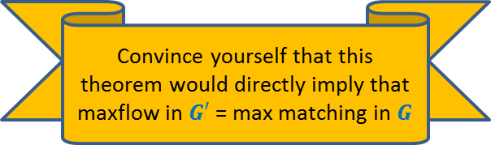
Bipartite matching Maximum Flow
Theorem: There is a matching of size $k$ in $G$ if and only if
there is a $s$-$t$ flow of value $k$ in $G′$.
Convince yourself that this theorem would directly imply that
maxflow in $G′$ = max matching in $G$
applicants
jobs
$$1$$
$$1$$
$$1$$
$$1$$
$$1$$
$$1$$
$$1$$
$$1$$
$$G′$$
$$s$$
$$1$$
$$t$$
$$1$$
$$1$$
$$1$$
$$1$$
$$1$$
Homework:
Make sincere attempt to prove this theorem.
We shall discuss it in next class.
$$1$$
$$1$$
What is the relation between the two instances ?
$$1$$
$$1$$
$$1$$
$$1$$
$$1$$
$$1$$
$$1$$
$$1$$
maximum
maximum

