Slide 1
Design and Analysis of Algorithms (CS345/CS345A)
Lecture 29
Amortized Analysis – II
(Application: Dynamic Table)

Slide 2
Summary of the Previous Lecture

Slide 3
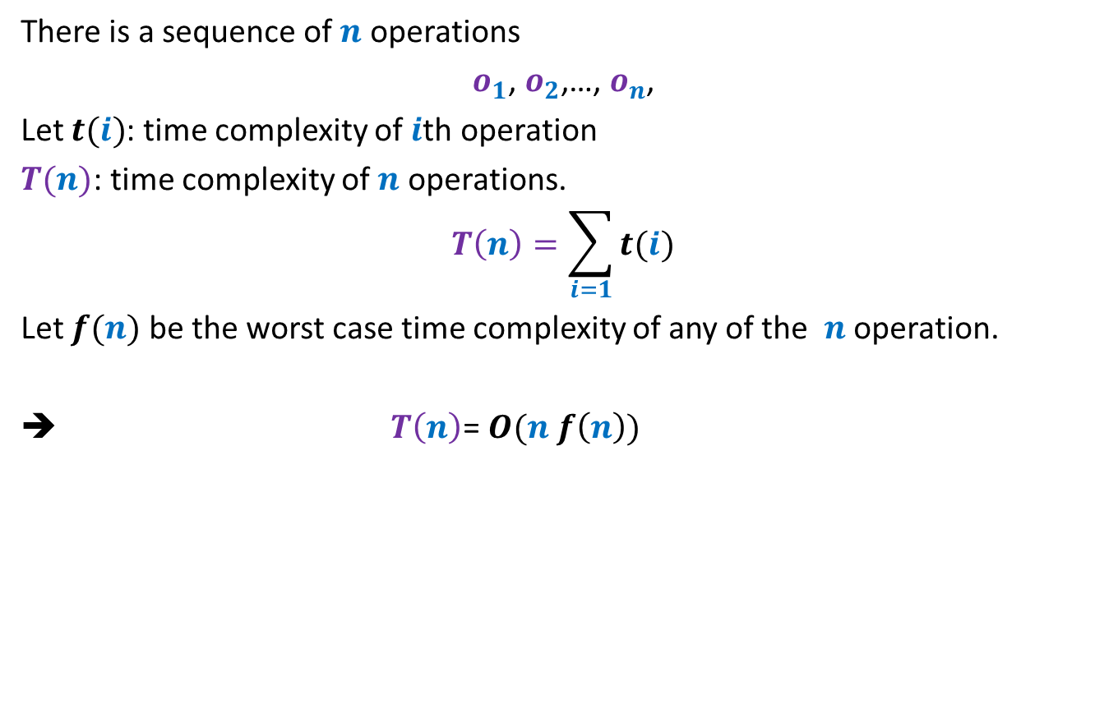
There is a huge variation in the time complexity of these operations.
There is a sequence of $n$ operations
$o_{1}$, $o_{2}$,…, $o_{n}$,
Let $t(i)$: time complexity of $i$th operation
$T(n)$: time complexity of $n$ operations.
$$T\left(n\right)=\sum_{i=1}{t(i)}$$
Let $f(n)$ be the worst case time complexity of any of the $n$ operation.
➔ $T\left(n\right)$= $O(n f\left(n\right))$
This may be grossly wrong.

Slide 4
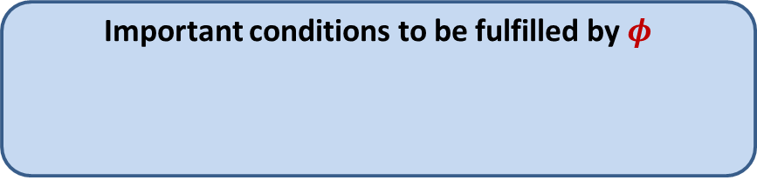




Amortized Cost
$φ$: potential function associated with the algorithm/data-structure
$φ(i)$: Potential at the end of $i$th operation
Amortized cost of $i$th operation $≝$ Actual cost of $i$th operation
Amortized cost of $n$ operations $≥$ Actual cost of $n$operations
Important conditions to be fulfilled by $φ$
$φ(0)$ = $0$
$φ\left(i\right)≥0$ for all $i$
+ $\left(φ\left(i\right)−φ\left(i−1\right)\right)$

Slide 5
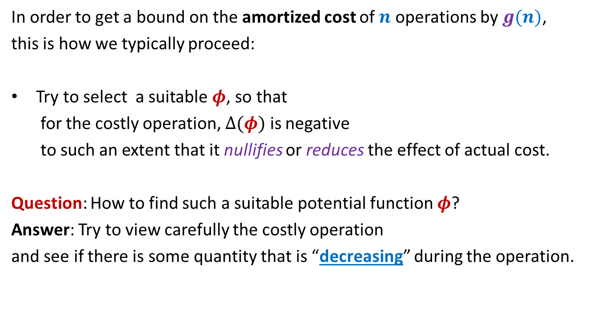
Amortized Cost
In order to get a bound on the amortized cost of $n$ operations by $g(n)$,
this is how we typically proceed:
Try to select a suitable $φ$, so that
for the costly operation, $Δ(φ)$ is negative
to such an extent that it nullifies or reduces the effect of actual cost.
Question: How to find such a suitable potential function $φ$?
Answer: Try to view carefully the costly operation
and see if there is some quantity that is “decreasing” during the operation.

Slide 6
Application 1
Dynamic Tables

Slide 7
Memory Management
What happens if more space is needed by table ?
Table T
Free space
Memory

Slide 8
SPACE and TIME Efficient Dynamic Table
For Insertions Only

Slide 9




Some notations
$n$
createTable($k$):
A system-call that creates a table of size $k$
size($T$)
copy($T$,$T′$)
free($T$)
: number of elements in the table $T$.
and returns its pointer.
: the size of table $T$.
: copies the contents of table $T$ into $T′$.
: free the space (return the space to OS) occupied by table $T$.

Slide 10
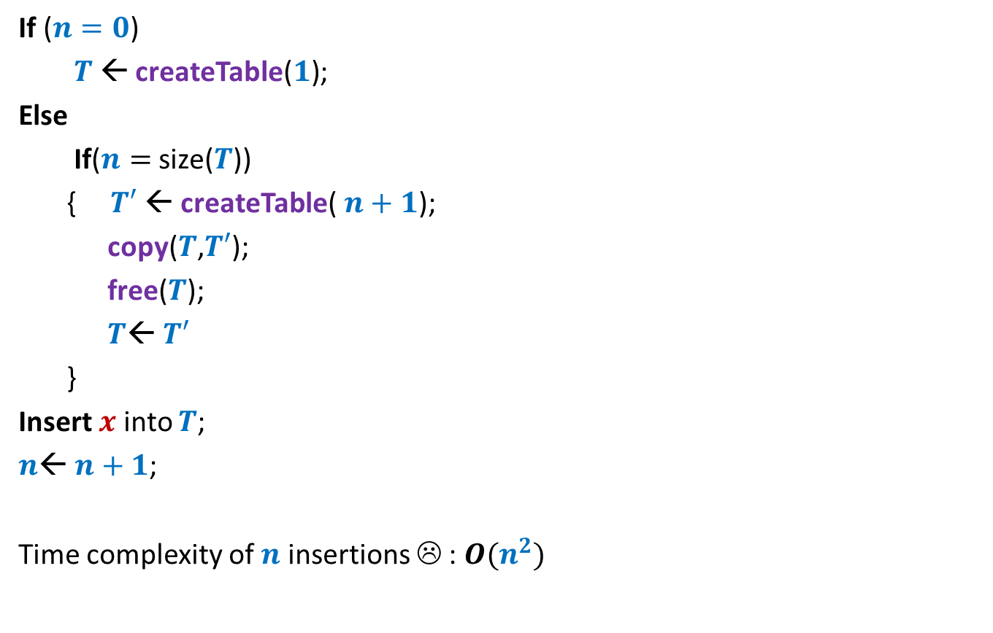



A trivial way to perform Insert($x$)
If ($n=0$)
$T$← createTable($1$);
Else
If($n=$ size($T$))
{ $T′$← createTable($n+1$);
copy($T$,$T′$);
free($T$);
$T$← $T′$
}
Insert $x$ into $T$;
$n$← $n+1$;
Time complexity of $n$ insertions ☹ : $O(n^{2})$
// Table is full !
O($1$)
O($n$)
Idea:
Every time a table is full, create a new table of double the size.

Slide 11







An efficient way to perform Insert($x$)
Space utilization ?
If ($n=0$)
$T$← createTable($1$);
Else
If($n=$ size($T$))
{ $T′$← createTable($n+1$);
copy($T$,$T′$);
free($T$);
$T$← $T′$
}
Insert $x$ into $T$;
$n$← $n+1$;
($2$);
$$50\%$$
// Table is full !
$$2n$$
O($1$)
O($n$)
Observation:
The table is at least half-full always.
So space utilization is at least 50%.

Slide 12





An efficient way to perform Insert($x$)
Actual cost per insertion
$$17$$
$$9$$
$$5$$
$$3$$
$$1$$
1 | 2 | 3 | 4 | 5 | 6 | 7 | 8 | 9 | 10 | 11 | 12 | 13 | 14 | 15 | 16 | 17 | 18
insertions

Slide 13
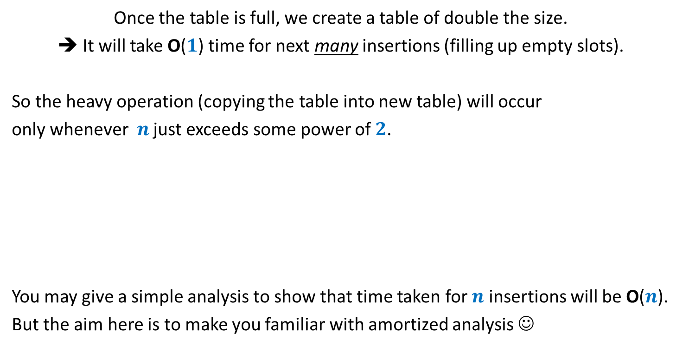

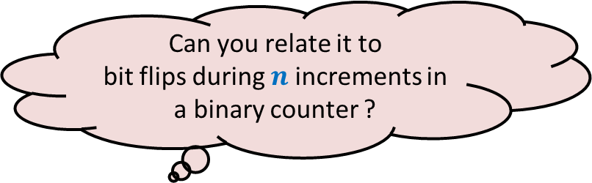
Intuition underlying efficiency of Insert($x$)
Once the table is full, we create a table of double the size.
➔ It will take O($1$) time for next many insertions (filling up empty slots).
So the heavy operation (copying the table into new table) will occur
only whenever $n$ just exceeds some power of $2$.
You may give a simple analysis to show that time taken for $n$ insertions will be O($n$).
But the aim here is to make you familiar with amortized analysis ☺
Can you relate it to
bit flips during $n$ increments in a binary counter ?

Slide 14
















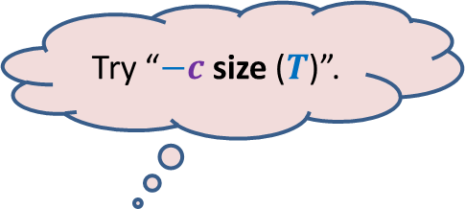
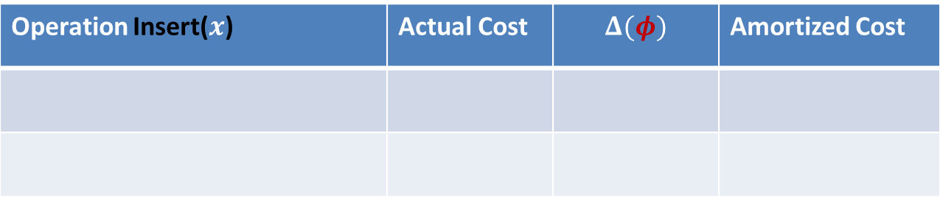


Amortized Analysis of Insert($x$)
$$m$$
$φ$ = $c$ ($m$)
Before Insert($x$)
$$2m$$
$φ$ = $c$ ($2$)
$$x$$
After Insert($x$)
$$m+1$$
Operation Insert($x$) | Actual Cost | $$Δ(φ)$$ | Amortized Cost
Case 1: when table is not full
$$c$$
Case 2: when table is already full
$$cn$$
$$c(2−m)$$
$$c(3−n)$$
$$3c$$
$φ$ at any stage = $c$ ($2n−$ size($T$))
Try “$−c$ size ($T$)”.
It ensures $Δ(φ)$ = $−c(n−1)$ ☺
But $φ$is not non-negative ☹
How to make it non-negative?
Add some positive quantity to make it non-negative.
But what should it be ?
Hint: Use the fact that
the table is at least half-full always.
What should be $φ$ ?
Apparently everything (size or $n$) seems to have increased.☹
Is there anything that has decreased ?
Look carefully the Case 2.

Slide 15



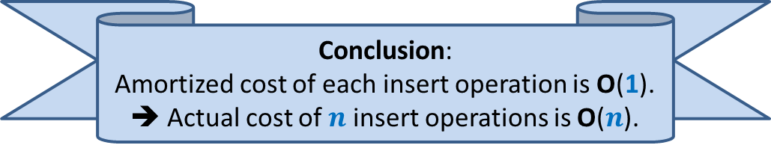
Amortized Analysis of Insert($x$)
Before Insert($x$)
After Insert($x$)
$$x$$
Operation Insert($x$) | Actual Cost | $$Δ(φ)$$ | Amortized Cost
Case 1: when table is not full
$$c$$
$$c(2)$$
$$3c$$
Case 2: when table is already full
$$cn$$
$$c(3−n)$$
$$3c$$
$φ$ at any stage = $c$ ($2n−$ size($T$))
Conclusion:
Amortized cost of each insert operation is O(1).
➔ Actual cost of $n$ insert operations is O($n$).
Analyze Case 1 now.

Slide 16
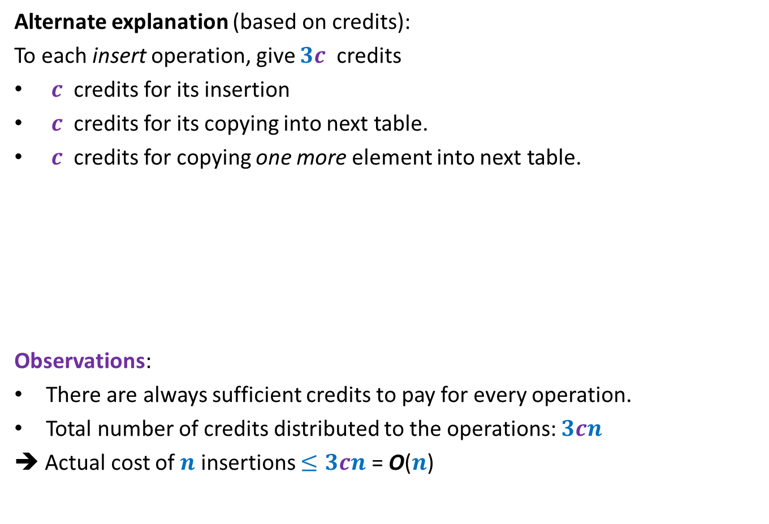
Amortized Analysis of Insert($x$)
Alternate explanation (based on credits):
To each insert operation, give $3c$ credits
$c$ credits for its insertion
$c$ credits for its copying into next table.
$c$ credits for copying one more element into next table.
Observations:
There are always sufficient credits to pay for every operation.
Total number of credits distributed to the operations: $3cn$
➔ Actual cost of $n$ insertions $≤3cn$ = O($n$)
Operation Insert($x$) | Actual Cost | $$Δ(φ)$$ | Amortized Cost
Case 1: when table is not full
$$c$$
$$c(2)$$
$$3c$$
Case 2: when table is already full
$$cn$$
$$c(3−n)$$
$$3c$$

Slide 17
SPACE and TIME Efficient Dynamic Table
For handling deletions only

Slide 18
Sequence of Deletions
Wastage of space !!

Slide 19


An efficient way to perform delete($x$)
Delete $x$ from $T$;
$n$← $n−1$;
If ($n=0$)
free($T$);
Else
If($n=$ size($T$)/2)
{ $T′$← createTable($n$);
copy($T$,$T′$);
free($T$);
$T$← $T′$;
}
// Table is half full !
O($1$)
O($n$)
O($1$)
Observation:
The table is at least half-full always.
So space utilization is at least 50%.

Slide 20
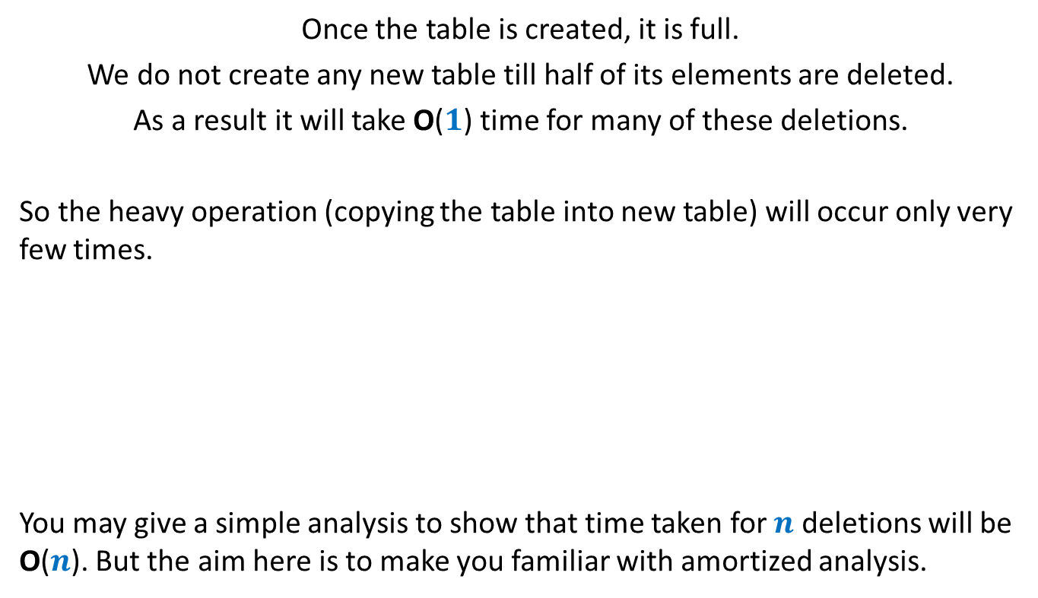
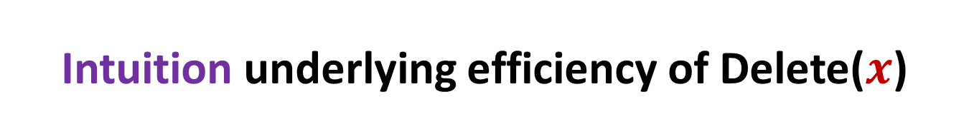
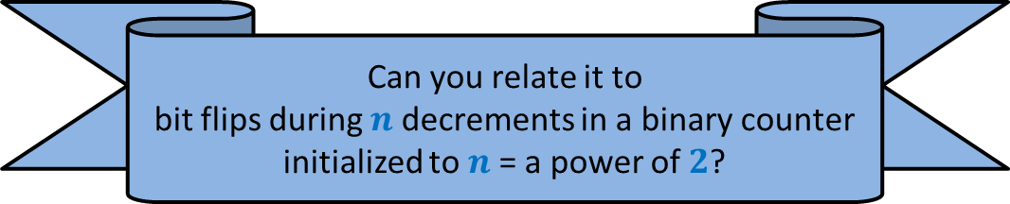
Intuition underlying efficiency of Delete($x$)
Once the table is created, it is full.
We do not create any new table till half of its elements are deleted.
As a result it will take O($1$) time for many of these deletions.
So the heavy operation (copying the table into new table) will occur only very few times.
You may give a simple analysis to show that time taken for $n$ deletions will be O($n$). But the aim here is to make you familiar with amortized analysis.
Can you relate it to
bit flips during $n$ decrements in a binary counter initialized to $n$= a power of $2$?

Slide 21
















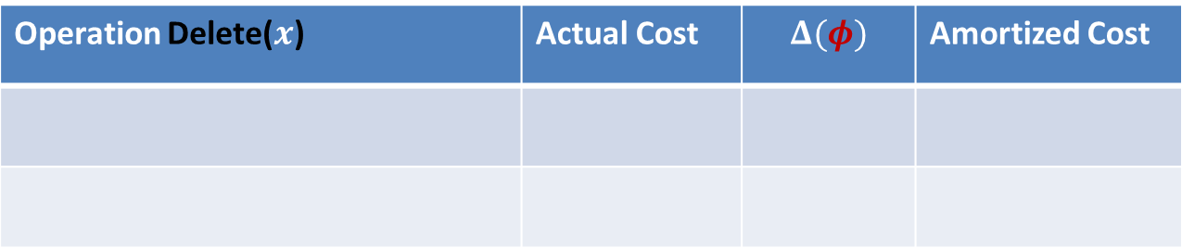



Amortized Analysis of Delete($x$)
$$2m$$
$φ$ = $c$ ($m−1$)
$$x$$
Before Delete($x$)
$$m+1$$
$φ$ = $0$
After Delete($x$)
$$m$$
Operation Delete($x$) | Actual Cost | $$Δ(φ)$$ | Amortized Cost
Case 1: when table does not shrink
$$c$$
$$c$$
$$2c$$
Case 2: when table shrinks to half
$$cn+c$$
$$c(1−n)$$
$$c(1−m)$$
$$2c$$
$φ$ at any stage = $c$ (size($T$)$−n$)
Yes, the number of empty slots has decreased in the table. ☺
So try it as a $φ$.
How can you express number of empty slots in terms of size and $n$ ?
Look carefully at the Case 2.
Is there anything that has decreased ?
What should be $φ$ ?

Slide 22
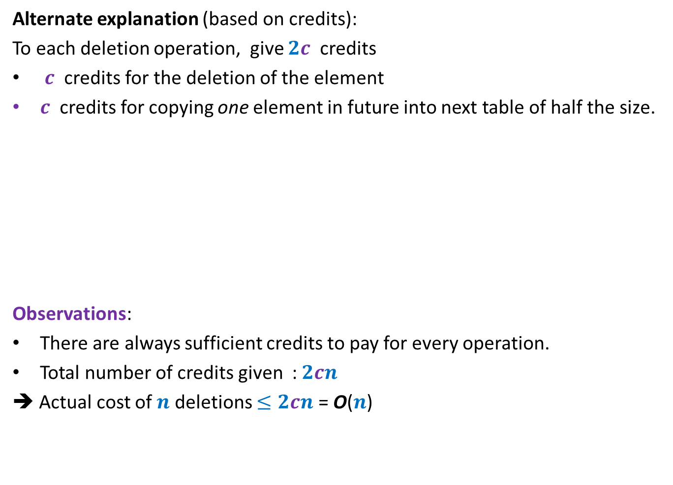
Amortized Analysis of Delete($x$)
Alternate explanation (based on credits):
To each deletion operation, give $2c$ credits
$c$ credits for the deletion of the element
$c$ credits for copying one element in future into next table of half the size.
Observations:
There are always sufficient credits to pay for every operation.
Total number of credits given : $2cn$
➔ Actual cost of $n$ deletions $≤2cn$ = O($n$)
Operation Delete($x$) | Actual Cost | $$Δ(φ)$$ | Amortized Cost
Case 1: when table does not shrink
$$c$$
$$c$$
$$2c$$
Case 2: when table shrinks to half
$$cn+c$$
$$c(1−n)$$
$$c(1−m)$$
$$2c$$

Slide 23
SPACE and TIME Efficient Dynamic Table
For handling insertions and deletions both

Slide 24






Attempt 1
“just use the insertion/deletion procedures since we spent so much time on them”.
there is a serious problem in this combination
$$2m$$
$$x$$
$$m+1$$
Delete($x$)
Each operation requires $Θ(m)$ time ☹
Insert($x$)
$$m$$

Slide 25
So there is no point in carrying out amortized analysis of the “Attempt 1” algorithm.
Instead we need to have a new algorithm.

Slide 26
Towards designing new algorithm
Our original algorithm which handles insertions has some novelty.
So let us try to extend it to handle deletions.
How should this extension look like ?
Spend some time thinking over it.

Slide 27



An efficient way to perform delete($x$)
Delete $x$ into $T$;
$n$← $n−1$;
If ($n=0$)
FreeTable($T$);
Else
If($n=$ size($T$)/2 )
{ $T′$← CreateTable($n$);
Copy($T$,$T′$);
FreeTable($T′$);
$T$← $T′$;
}
size($T$)/4
// Table is quarter full !
($2n$);
O($1$)
O($n$)
O($1$)
Idea:
Delay the shrinking

Slide 28


The intuition behind the new algorithm
Observation: Every time a table is created, it is half-full.
Only two big events can happen in future:
It becomes full
It becomes quarter full
➔ At least $n$ insertions
➔ At least $n/2$ deletions

Slide 29













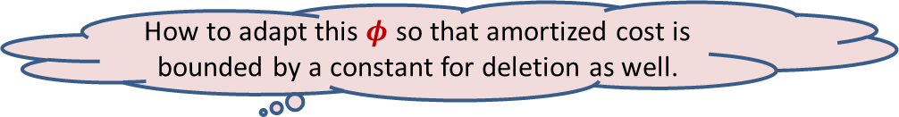



Amortized Analysis of Delete($x$)
$$4m$$
$φ$=$c$ ($2m−2$)
$$x$$
Before Delete($x$)
$$m+1$$
$φ$ = $0$
After Delete($x$)
$$2m$$
Operation Delete($x$) | Actual Cost | $$Δ(φ)$$ | Amortized Cost
Case 1: when table does not shrink
$$c$$
$$2c$$
$$3c$$
Case 2: when table shrinks to half
$$cn+c$$
$$c(2−2n)$$
$$<3c$$
$$3c−cn$$
$φ$ used by us for handling insertion = $c$ ($2n−$ size($T$))
Look carefully the Case 2.
How to adapt this $φ$ so that amortized cost is bounded by a constant for deletion as well.

Slide 30
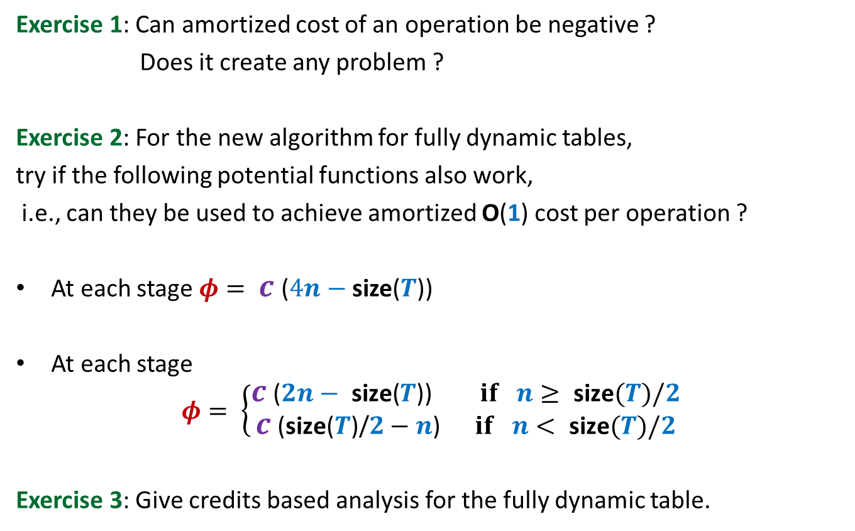
Homework
Exercise 1: Can amortized cost of an operation be negative ?
Does it create any problem ?
Exercise 2: For the new algorithm for fully dynamic tables,
try if the following potential functions also work,
i.e., can they be used to achieve amortized O(1) cost per operation ?
At each stage $φ= c$ ($4n−$ size($T$))
At each stage
$$φ= \left\{\begin{aligned}c\text{ (}2n− \text{size}\text{(}T\text{)) } if n≥ \text{size}(T)/2 \\ c\text{ (}\text{size}\text{(}T\text{)}\text{/}2−n\text{)} if n< \text{size}(T)/2\end{aligned}\right.$$
Exercise 3: Give credits based analysis for the fully dynamic table.

