Slide 1
Design and Analysis of Algorithms (CS345/CS345A)
Lecture 30
Amortized Analysis – III
A magical application

Slide 2
Algorithm
Off line
Online
Entire input is known apriori.
But there are applications where the input is not known in advance.
Input
Output
Algorithm

Slide 3

Algorithm
Online
Online Processing
$$o,o,o,o,o,o,o,o,o,o,o,o,o,o,o,o$$
Sequence of input elements/operations
Algorithm
Cache has limited number of slots. Whenever an element is required by CPU and it is absent in cache, it has to be brought into cache. This will require removing one of the element from cache. Which element should be replaced ? It is quite challenging to determine which element should be replaced since we do not know the sequence of elements requested by CPU.
Problems
Suppose we don’t know the edges of the graph in the beginning. Instead, the edges are provided in an online sequence. For each edge we see, we need to either decide whether we are going to add the edge to the matching or discard it. The aim is to maintain a matching which is of large size.
Cache management
How to measure efficiency of an online algorithm ?
Matching

Slide 4

Competitive ratio
A tool to analyze any online algorithm
A: an online algorithm for a problem.
OPT : be the optimal offline algorithm
$T_{A}(m)$: time taken by A for a sequence of $m$ operations.
$T_{OPT}(m)$: time taken by OPT for the same $m$ operations
Notation: A is said to be $α$-competitive if there is a constant $k$ such that
$$T_{A}\left(m\right)≤{α T}_{OPT}\left(m\right)+k$$
for every sequence of length $m$.
Suppose aim is to carry out the operations in
least possible time
Example:
any data structure problem
How well does A compete with OPT
for any sequence ?

Slide 5

Competitive ratio
A tool to analyze any online algorithm
A: an online algorithm for a problem.
OPT : be the optimal offline algorithm
$Q_{A}(m)$: size of the matching computed by A for any sequence of edges.
$Q_{OPT}(m)$: size of the matching computed by OPT for the same sequence of edges
Notation: A is said to be $α$-competitive if there is a constant $k$ such that
$$Q_{A}\left(m\right)≥{α Q}_{OPT}\left(m\right)+k$$
for every sequence of length $m$.
Suppose aim is to compute a solution
of good quality.
For example: matching

Slide 6
Problem : Online list search

Slide 7
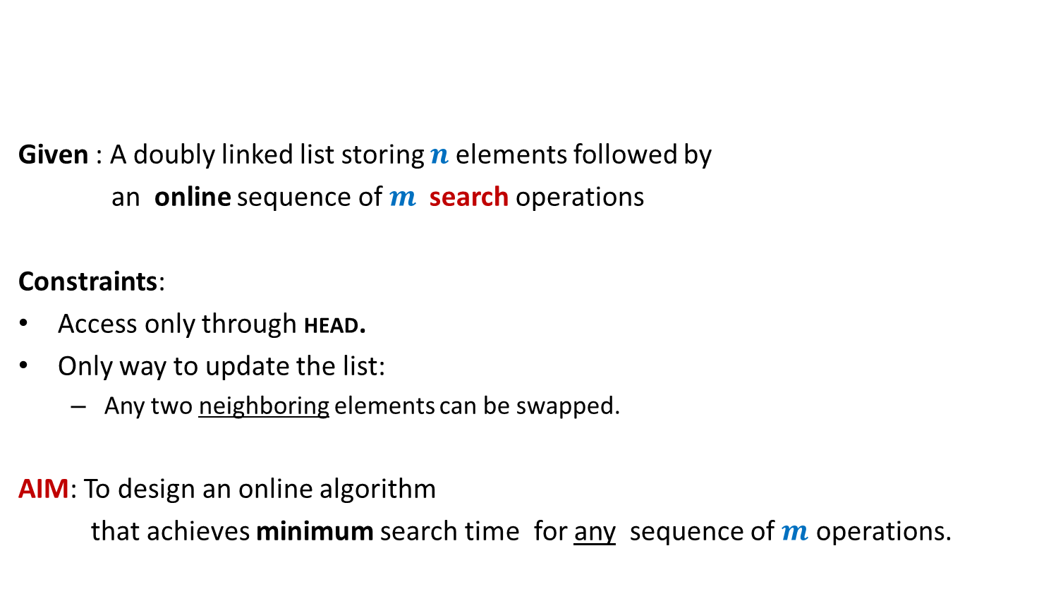
Problem : Online list search
HEAD
Given : A doubly linked list storing $n$elements followed by
an online sequence of $m$ search operations
Constraints:
Access only through HEAD.
Only way to update the list:
Any two neighboring elements can be swapped.
AIM: To design an online algorithm
that achieves minimum search time for any sequence of $m$ operations.
P
A
N
K
R
U
I

Slide 8
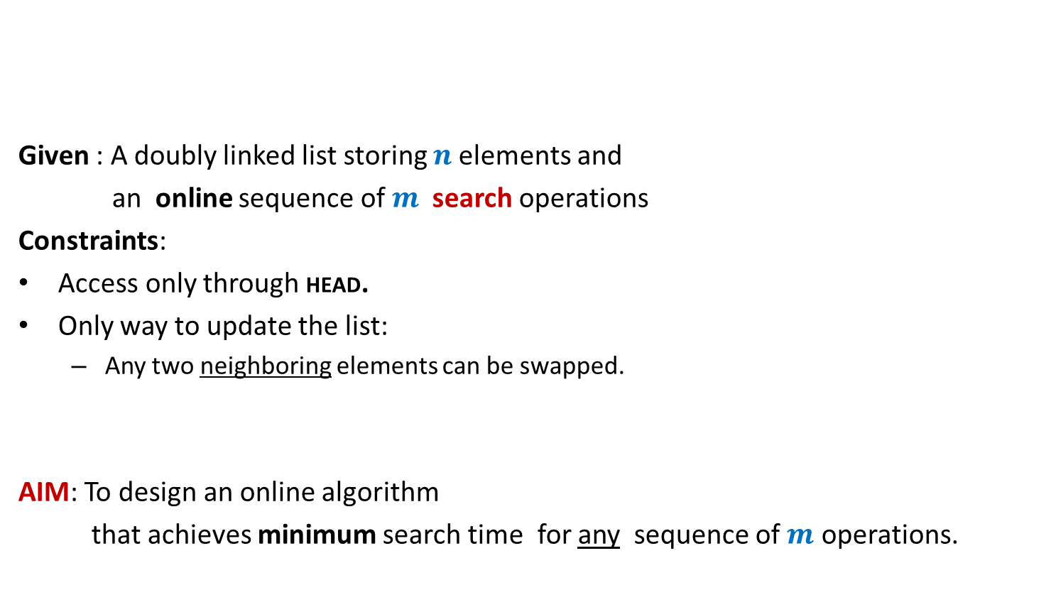
Problem : Online list search
HEAD
Given : A doubly linked list storing $n$elements and
an online sequence of $m$ search operations
Constraints:
Access only through HEAD.
Only way to update the list:
Any two neighboring elements can be swapped.
AIM: To design an online algorithm
that achieves minimum search time for any sequence of $m$ operations.
P
A
N
K
R
U
I

Slide 9
HEAD
A Heuristic for list search problem:
Whenever we search an element,
bring the element to the front of the list after the search.
P
A
N
K
R
U
I

Slide 10
Move to Front Algorithm
Caution :
For a better understanding, please go slow
and take long pauses in the remaining slides.

Slide 11

Move-to-Front algorithm
HEAD
Search(e):
Starting from HEAD pointer, scan linearly till we find element e;
Bring the node storing e to the front of list
A notation:
$r$(e): rank of element e in the list.
P
A
N
K
R
U
I
by a sequence of swaps.
Example: Search(R)

Slide 12


Move-to-Front algorithm Execution of Search(R)
$r$(R) steps for locating R
$r$(R) $−1$ swaps
HEAD
P
A
N
K
R
U
I
HEAD
P
A
N
R
K
U
I
HEAD
P
A
R
N
K
U
I
HEAD
P
R
A
N
K
U
I
HEAD
R
P
A
N
K
U
I

Slide 13
How good is MTF Algorithm ?
MTF versus OPT

Slide 14
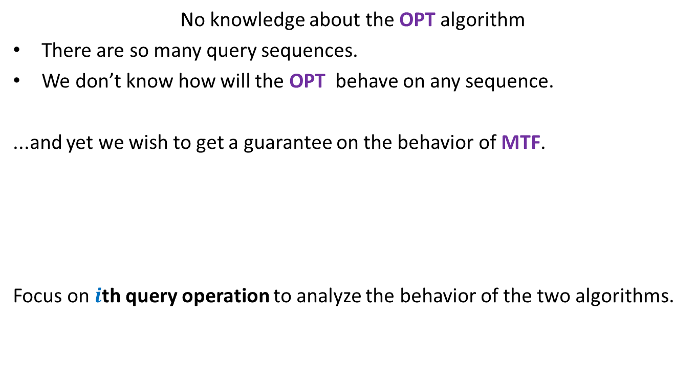
What is the main challenge ?
No knowledge about the OPT algorithm
There are so many query sequences.
We don’t know how will the OPT behave on any sequence.
...and yet we wish to get a guarantee on the behavior of MTF.
Focus on $i$th query operation to analyze the behavior of the two algorithms.
Doesn’t this goal look
impossible or unrealistic ?
But the world of algorithms is full of such magical results.
So think over “how should the analysis proceed?” for 10 minutes before you proceed

Slide 15







$i$th query operation of MTF and OPT
Let $i$th query operation be Search(x)
Actual cost of Search(x) in MTF algorithm : ?
Actual cost of Search(x) in OPT algorithm : ?
Our aim: To show that
the amortized cost of Search(x) in MTF algorithm is bounded in terms of $r^{∗}$(x) and$t_{i}$
➔ $φ$ should be such that $Δφ$must have “$−2r$(x)” term to nullify the actual cost.
HEAD
…
1
2
$r$(x)$−1$
$r$(x)
MTF list
…
…
x
What should be the potential function with this feature?
HEAD
OPT list
…
…
x
…
1
$r^{∗}$(x)
$2r$(x)$−$1
$r^{∗}$(x)$+ t_{i}$
No. of swaps by OPT

Slide 16
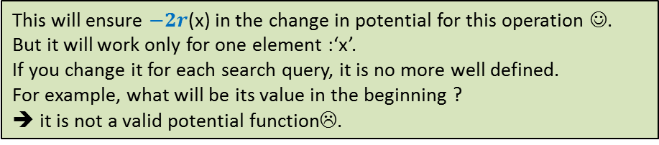


The potential function $φ$
HEAD
…
Observations :
The two lists are identical to begin with.
They start differing as the sequence of search queries get revealed.
Insight: Suppose Search(x) is much costlier during MTF than OPT.
➔Most of the elements that precede x in MTF-list follow x in OPT-list.
But after search operation using MTF, all of them also follow x in MTF-list.
1
2
$r$(x)$−1$
$r$(x)
MTF list
…
…
x
What should be the potential function with this feature?
$2r$(x) ?
HEAD
OPT list
…
…
x
…
1
$r^{∗}$(x)
Make use of this insight to design the potential function.
This will ensure $−2r$(x) in the change in potential for this operation ☺.
But it will work only for one element :‘x’.
If you change it for each search query, it is no more well defined.
For example, what will be its value in the beginning ?
➔ it is not a valid potential function☹.
We may use the difference between the lists as the potential function.
But, what should be a measure of difference between the two lists ?
It should be such that after a costly search in MTF, this difference
decreases substantially to ensure negative change in potential.

Slide 17

The potential function $φ$
The potential of the MTF algorithm after $i$ steps
$φ$($i$) = 2. # inversions
Inversions: {(E,C) , (E,A) , (E,D) , (E,B) , (D,B)}
$φ$($i$) = 10
Note: $φ$($0$)= $0$since two lists are same in the beginning.
and $φ$($i$) $≥0$ always.
➔ $φ$ is a valid potential function.
HEAD
E
C
A
D
B
MTF list
HEAD
C
A
B
D
E
OPT list

Slide 18
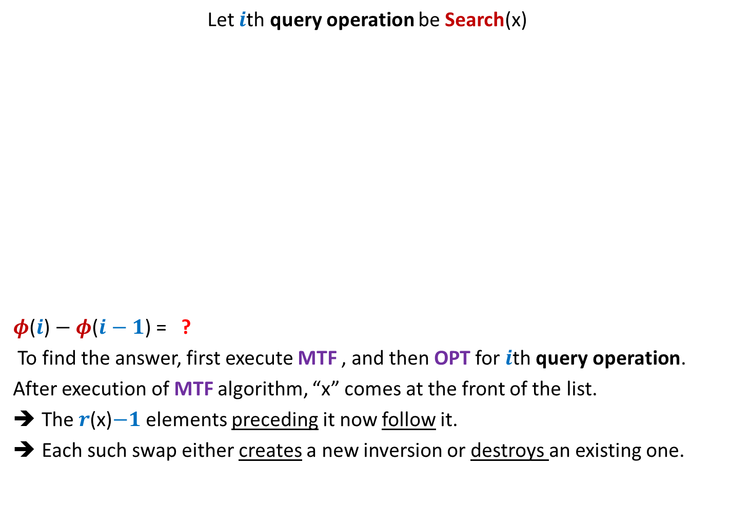

Change in potential during $i$th query operation
Let $i$th query operation be Search(x)
$φ$($i$) $− φ$($i−1$) = ?
To find the answer, first execute MTF , and then OPT for $i$th query operation.
After execution of MTF algorithm, “x” comes at the front of the list.
The $r$(x)$−1$ elements preceding it now follow it.
Each such swap either creates a new inversion or destroys an existing one.
HEAD
…
MTF list
1
2
…
$r$(x)$−1$
$r$(x)
…
x
HEAD
OPT list
…
…
x
…
1
$r^{∗}$(x)

Slide 19
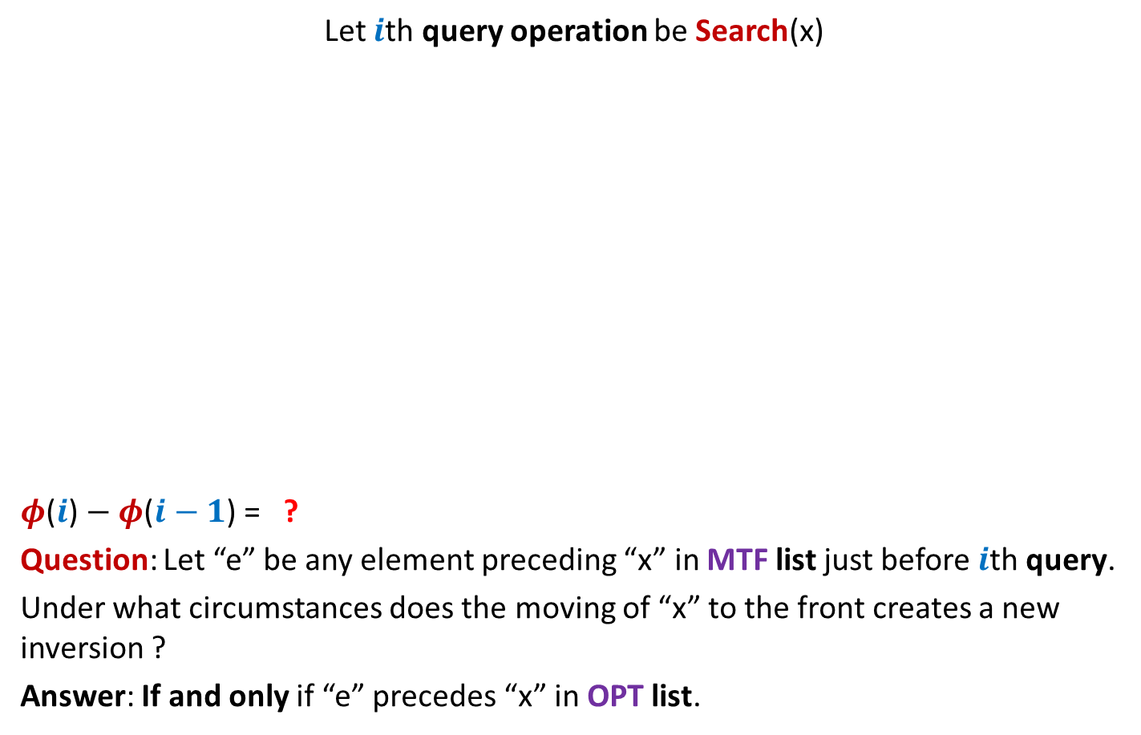
Change in potential during $i$th query operation
Let $i$th query operation be Search(x)
$φ$($i$) $− φ$($i−1$) = ?
Question: Let “e” be any element preceding “x” in MTF list just before $i$th query.
Under what circumstances does the moving of “x” to the front creates a new inversion ?
Answer: If and only if “e” precedes “x” in OPT list.
HEAD
…
MTF list
1
2
…
$r$(x)$−1$
$r$(x)
…
e
x
Inversion (x,e) gets created
Inversion (x,e) gets destroyed
HEAD
OPT list
…
…
e
x
e
…
1
$r^{∗}$(x)

Slide 20
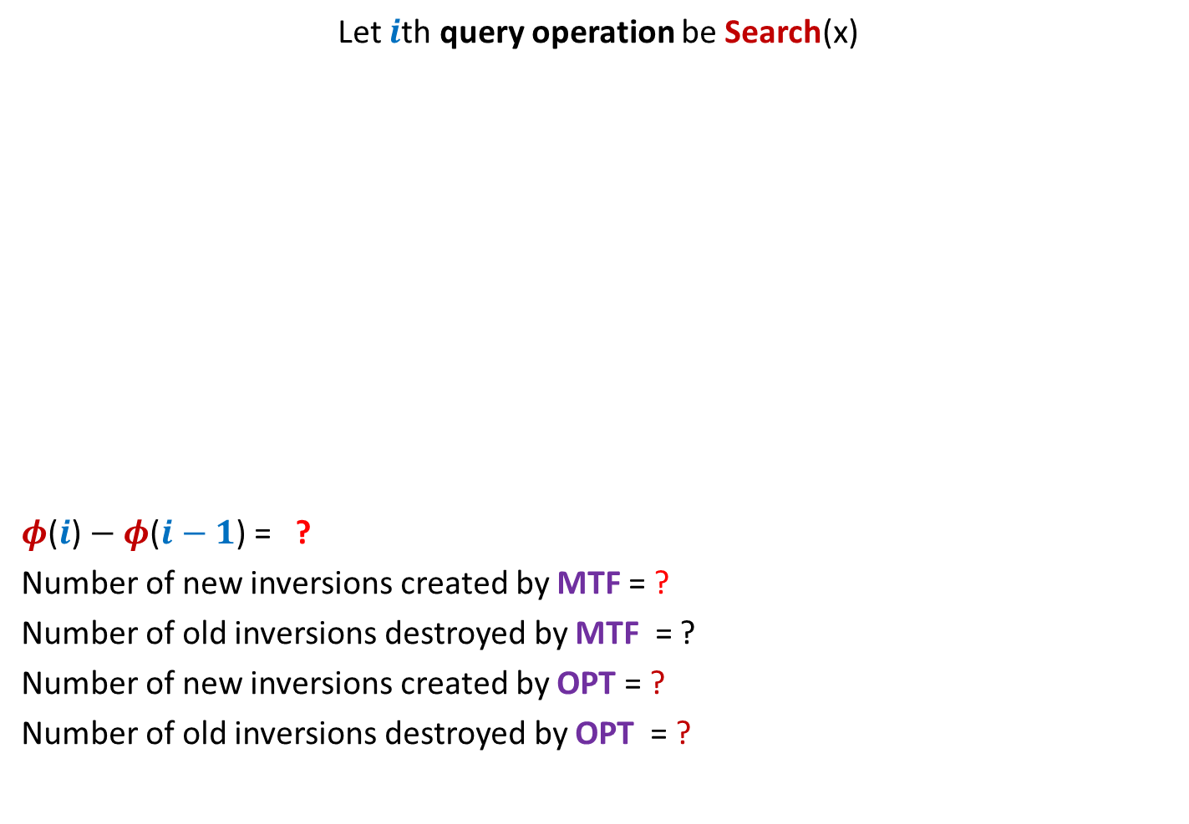




Change in potential during $i$th query operation
Let $i$th query operation be Search(x)
$φ$($i$) $− φ$($i−1$) = ?
Number of new inversions created by MTF = ?
Number of old inversions destroyed by MTF = ?
Number of new inversions created by OPT = ?
Number of old inversions destroyed by OPT = ?
HEAD
…
MTF list
1
2
…
$r$(x)$−1$
$r$(x)
…
x
HEAD
OPT list
…
…
x
…
1
$r^{∗}$(x)
$2$ (No. of new inversions created – No. of old inversions destroyed)
$≤2$ ($r^{∗}$(x)$+ t_{i}−1$ $−$ (($r$(x)$− r^{∗}\text{(}\text{x}\text{)}$) )
$≤r^{∗}$(x)$−1$
$≥r$(x)$−r^{∗}$(x)
$$≤ t_{i}$$
No. of swaps by OPT
$$≥0$$

Slide 21

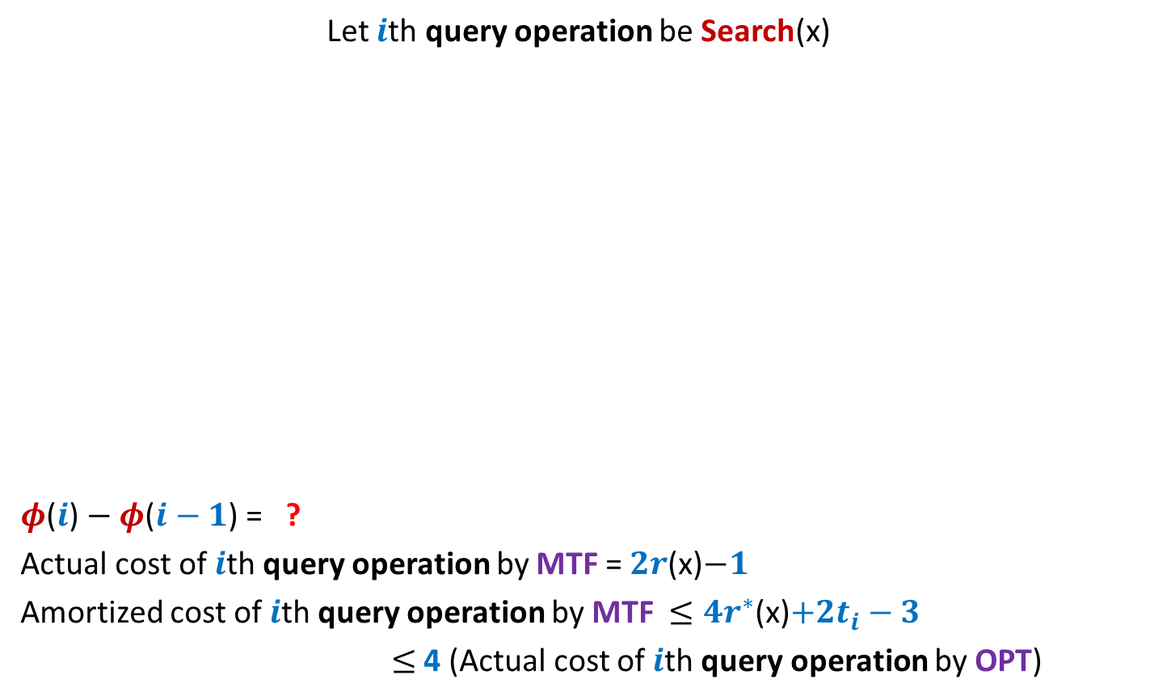



Amortized cost of $i$th query operation by MTF
Let $i$th query operation be Search(x)
$φ$($i$) $− φ$($i−1$) = ?
Actual cost of $i$th query operation by MTF = $2r$(x)$−1$
Amortized cost of $i$th query operation by MTF $≤4r^{∗}$(x)$+2t_{i}−3$
$≤$4 (Actual cost of $i$th query operation by OPT)
HEAD
…
MTF list
1
2
…
$r$(x)$−1$
$r$(x)
…
x
HEAD
OPT list
…
…
x
…
1
$r^{∗}$(x)
$≤{4r}^{∗}$(x)$+ {2t}_{i}−2$ $−$ $2r$(x)
$≤2$ ($r^{∗}$(x)$+ t_{i}−1$ $−$ (($r$(x)$− r^{∗}\text{(}\text{x}\text{)}$) )
$≤2$ (${2r}^{∗}$(x)$+ t_{i}−1$ $−$ $r$(x) )
$≤{4r}^{∗}$(x)$+{2t}_{i}$
$≤{4r}^{∗}$(x)$+{4t}_{i}$
$≤{4(r}^{∗}$(x)$+t_{i})$

Slide 22
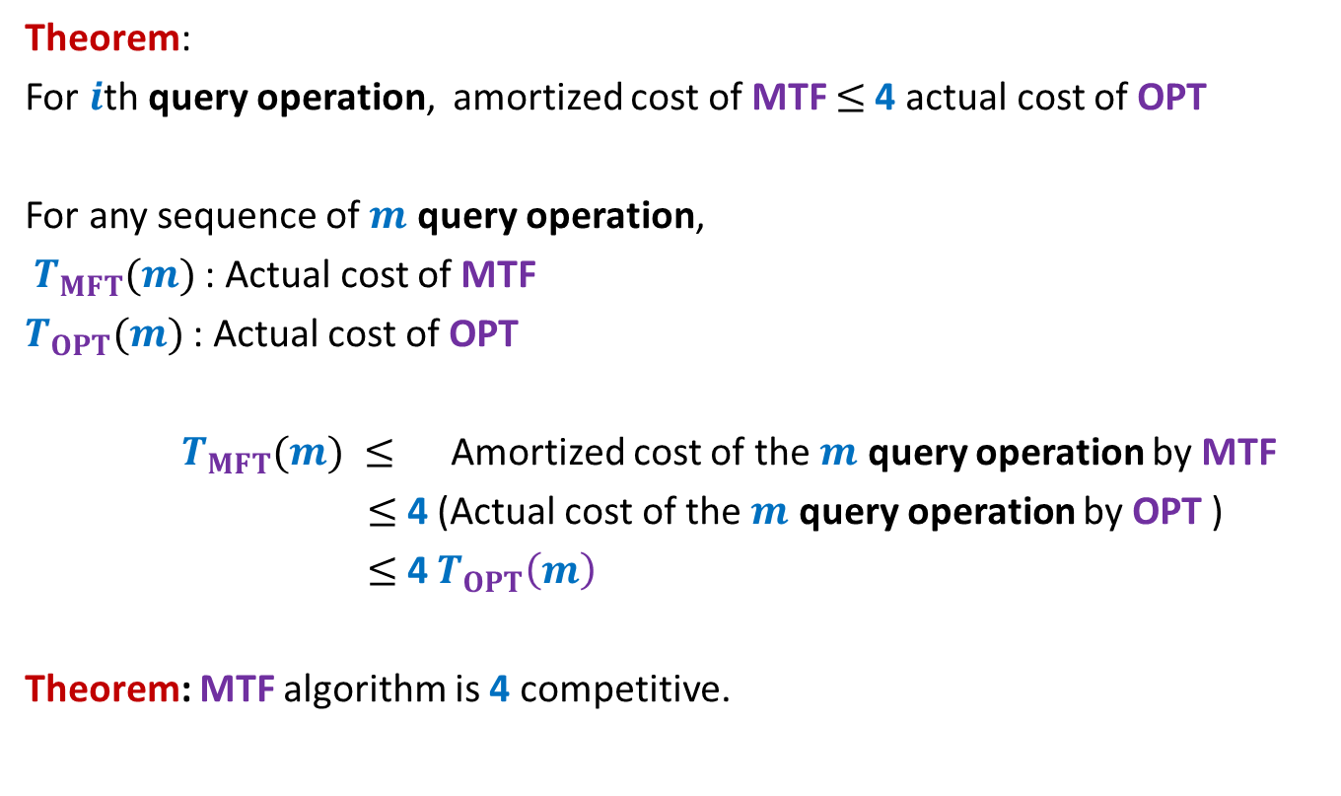
Analysis of MTF versus OPT
Theorem:
For $i$th query operation, amortized cost of MTF $≤$4 actual cost of OPT
For any sequence of $m$ query operation,
$T_{MFT}(m)$: Actual cost of MTF
$T_{OPT}(m)$: Actual cost of OPT
$T_{MFT}(m) ≤$ Amortized cost of the $m$ query operation by MTF
$≤$ 4 (Actual cost of the $m$ query operation by OPT )
$≤$ 4 $T_{OPT}\left(m\right)$
Theorem: MTF algorithm is 4 competitive.

Slide 23
Question : How would anyone have come up with such a magical analysis ?
Answer:
perhaps a persistent meditation on the problem
for a few months would have led the researcher to come up with this analysis.
I hope some of you are also inspired by such magical and elegant analysis.
You might like to study analysis of Splay tree on you tube ☺

