Slide 1
Design and Analysis of Algorithms (CS345/CS345A)
Lecture 34
Fibonacci Heap
Stable Matching Problem
Finishing touch …

Slide 2
Fibonacci Numbers
Revising Discrete math

Slide 3







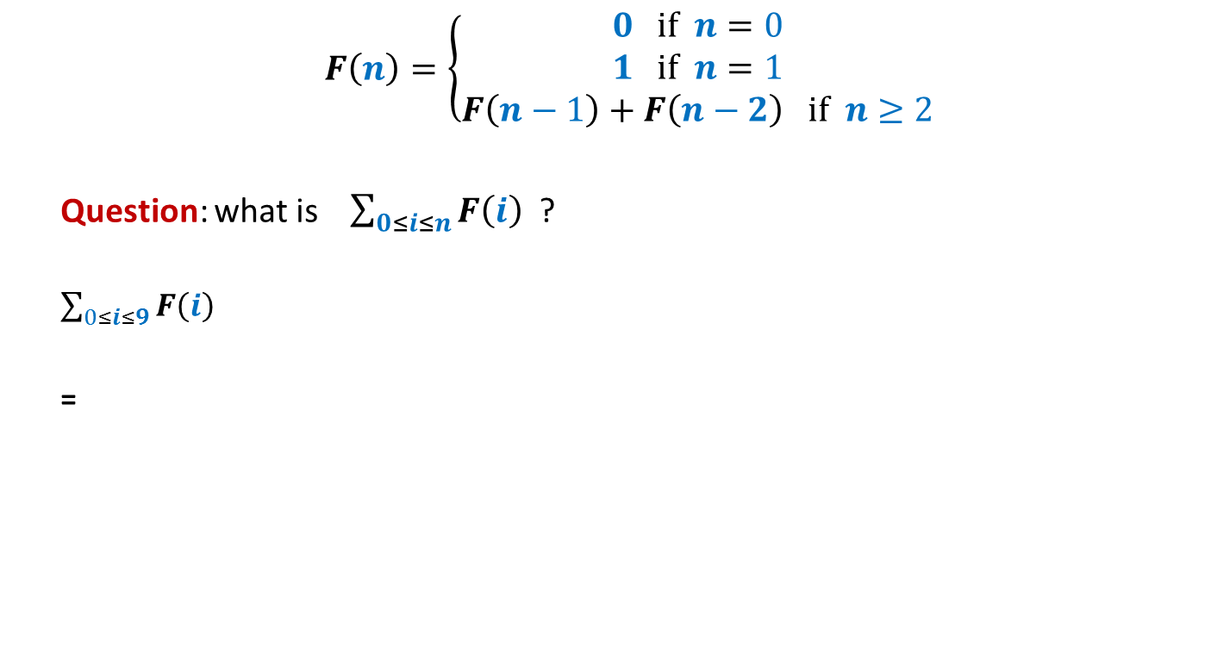














$$F\left(n\right)=\left\{\begin{aligned}0 if n=0 \\ 1 if n=1 \\ F\left(n−1\right)+F\left(n−2\right) if n≥2\end{aligned}\right.$$
Question: what is $\sum_{0≤i≤n}{F\left(i\right)}$ ?
$\sum_{0≤i≤9}{F\left(i\right)}$
=
$$=F\left(n+2\right)−1$$
$1$+
$$F\left(10\right)$$
+ $F\left(8\right)$
+ $F\left(7\right)$
+ $F\left(6\right)$
+ $F\left(5\right)$
+ $F\left(4\right)$
+ $F\left(3\right)$
+ $F\left(2\right)$
+ $F\left(1\right)$
$$F\left(11\right)$$
$$F\left(9\right)$$
+ $F\left(9\right)$
+ $F\left(8\right)$
+ $F\left(7\right)$
+ $F\left(6\right)$
+ $F\left(5\right)$
+ $F\left(4\right)$
+ $F\left(3\right)$
+ $F\left(2\right)$
We can use this to get an alternate expression for Fibonacci numbers ☺

Slide 4

$$F\left(n\right)=\left\{\begin{aligned}0 if n=0 \\ 1 if n=1 \\ 1+\sum_{0≤i≤n−2}{F\left(i\right)} if n≥2\end{aligned}\right.$$

Slide 5

Decrease-key($H$,$x$,$Δ$) in Fibonacci heap (using Cascaded-cuts)

Slide 6
Decrease-key($H$,$x$,$Δ$) in Fibonacci heap (using Cascaded-cuts)

Slide 7


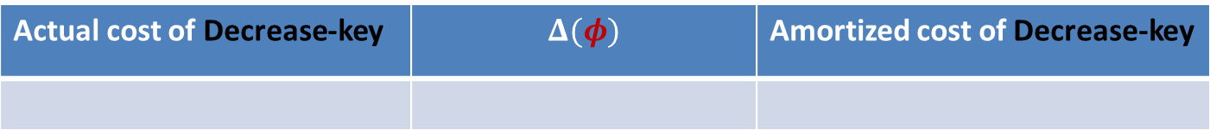


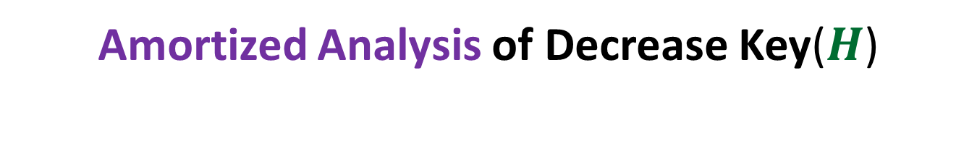



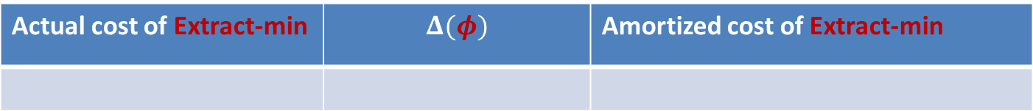


Amortized Analysis of Decrease Key($H$)
$φ$($H$): $c$ $t(H)$
$$+ 2c m(H)$$
$m(H)$: the number of marked nodes
Actual cost of Decrease-key | $$Δ(φ)$$ | Amortized cost of Decrease-key
$cm(H_{old})−cm(H_{new})$ + $c$
$$cm\left(H_{new}\right)−cm(H_{old})$$
$$c$$
Actual cost of Extract-min | $$Δ(φ)$$ | Amortized cost of Extract-min
$$c t(H_{old})$$
$$≤c(log n − t\left(H_{old}\right))$$
$$c(log n)$$

Slide 8

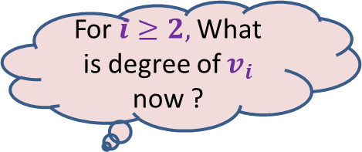






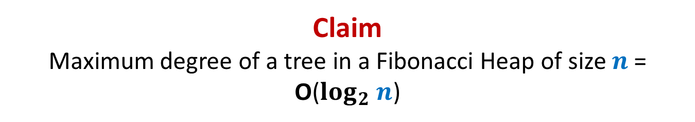









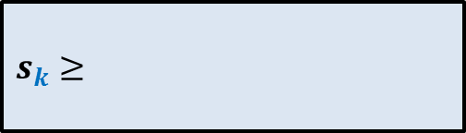

Claim Maximum degree of a tree in a Fibonacci Heap of size $n$= O($log_{2} n$)
This is equivalent to …
$s_{k}$ : the minimum size of a tree rooted at node of degree $k$
Recurrence for $s_{k}$ = ?
“For a node $x$of degree $k$ , size($x$) is $Ω(a^{k})$ always”
For $i≥2,$What is degree of $v_{i}$ now ?
What is degree of $v_{1}$ now?
$$≥i−2$$
$$≥0$$
$$x$$
Arrange the children of $x$ in the increasing order of time of becoming children of $x$.
At the time of becoming child of $x$, degree of $v_{i}≥i−1$. From that moment till now, $v_{i}$can lose at most one child.
…
…
$$k i 2 1$$
$$v_{k}$$
$$v_{i}$$
$$v_{2}$$
$$v_{1}$$
$s_{k}≥$
$$s_{0}=1$$
$$+ \sum_{2≤i≤k}{s_{i−2}}$$
$$1$$
$$+ 1$$
$$s_{1}=2$$

Slide 9
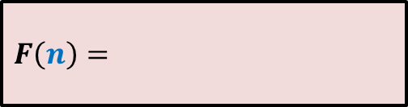


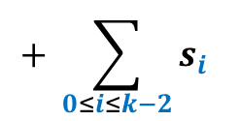








$$s_{0}=1$$
$$F(0)=0$$
$$s_{1}=2$$
$$F(1)=1$$
$F\left(n\right)=$
$s_{k}≥$
$$1+\sum_{0≤i≤n−2}{F\left(i\right)}$$
$$+ \sum_{0≤i≤k−2}{s_{i}}$$
$$1$$
$$+ 1$$
$$s_{k} ≥ F(k)$$
In fact, …
Obvious
$$F(k+2)$$

Slide 10


















Mission accomplished ☺
 | Binary heap
Binomial heap
Binomial heap
Fibonacci heap
Find-min($H$)
O($1$)
O($\log{n}$)
O($1$)
O($1$)
Insert($H$, $x$)
O($\log{n}$)
O($\log{n}$)
O($1$)
O($1$)
Extract-min($H$)
O($\log{n}$)
O($\log{n}$)
O($\log{n}$)
O($\log{n}$)
amortized
amortized
Decrease-key($H$,$x$,$y$)
O($\log{n}$)
O($\log{n}$)
O($\log{n}$)
O($1$)
amortized
Merge-heaps($H_{1}$,$H_{2}$)
O($n$)
O($\log{n}$)
O($1$)
O($1$)
Fibonacci Heaps were invented in 1985 by Fredman and Tarjan.
In 2012, Brodal, Lagogiannis & Tarjan got rid of “amortized bound” as well.
Tarjan made great contribution to the area of algorithms and data structures.
He is 68 years old, and is still so active …(truly inspiring ☺)

Slide 11
Stable Marriage Problem

Slide 12







Stable Marriage Problem
Women
Men
$$w_{1}$$
$$m_{1}$$
$$3$$
…
$$w_{2}$$
$$m_{2}$$
$$1$$
…..
$$w_{3}$$
$$m_{3}$$
$$2$$
$$w_{i}$$
$$m_{j}$$
$$w_{n}$$
$$m_{n}$$

Slide 13



Stable Marriage Problem
Women
Men
$$w_{1}$$
$$m_{1}$$
$$3$$
$$w_{2}$$
$$m_{2}$$
…
…
$$1$$
$$w_{3}$$
$$m_{3}$$
…..
$$2$$
$$k$$
$$w_{i}$$
$$m_{j}$$
$$w_{n}$$
$$m_{n}$$

Slide 14
Stable Marriage Problem
Women
Men
Marriage : ?
$$w_{1}$$
$$m_{1}$$
$$w_{2}$$
$$m_{2}$$
$$w_{3}$$
$$m_{3}$$
…
…
$$w_{i}$$
$$m_{j}$$
…
…
$$w_{n}$$
$$m_{n}$$
a bijection between Women and Men

Slide 15

Stable Marriage Problem
Meaning of unstability
Women
Men
$w_{l}$ prefers $m_{j}$ to $m_{k}$
$m_{j}$ prefers $w_{l}$ to $w_{i}$
Definition:
A marriage is said to be stable if there is no unstable pair in the society.
($w_{l}$, $m_{j}$) : an unstable pair
$$w_{l}$$
divorce
$$m_{k}$$
$$w_{i}$$
divorce
$$m_{j}$$

Slide 16
Stable Marriage Problem
$M$ : set of $n$men
$W$ : set of $n$women
For each man $m∈M$,
$L(m)$: a preference list of all women
For each woman $w∈W$,
$L(w)$: a preference list of all men
Aim: To compute a stable marriage.

Slide 17
Algorithm for Stable Marriage
1962, David Gale and Lloyd Shapley
Man proposes
Woman disposes

Slide 18


Stable Marriage Problem
Women
Men
$$w_{1}$$
$$m_{1}$$
$$2$$
$$w_{2}$$
$$m_{2}$$
$$1$$
$$w_{3}$$
$$m_{3}$$
$$1$$
$$1$$
$$w_{i}$$
$$m_{j}$$
$$w_{n}$$
$$m_{n}$$

Slide 19
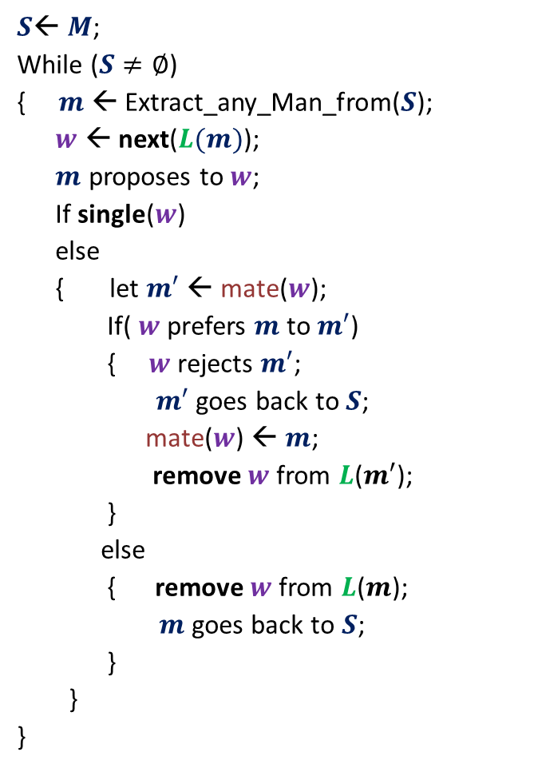
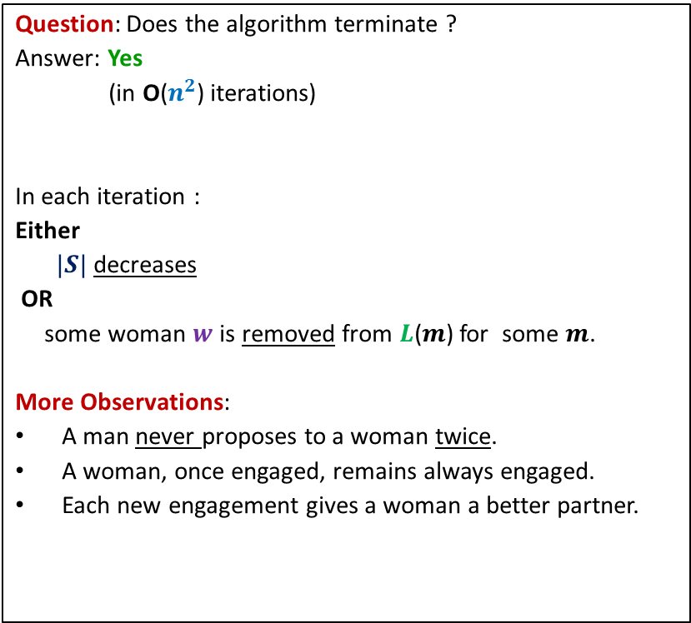
GaleShapley($M$, $W$)
$S$← $M$;
While ($S≠∅$)
{ $m$← Extract_any_Man_from($S$);
$w$ ← next($L(m)$);
$m$ proposes to $w$;
If single($w$)
else
{ let $m′$ ← mate($w$);
If( $w$ prefers $m$ to $m′$)
{ $w$rejects $m′$;
$m′$ goes back to $S$;
mate($w$) ← $m$;
remove $w$from $L$($m′$);
}
else
{ remove $w$from $L$($m$);
$m$ goes back to $S$;
}
}
}
Question: Does the algorithm terminate ?
Answer: Yes
(in O($n^{2}$) iterations)
In each iteration :
Either
$|S|$ decreases
OR
some woman $w$is removed from $L$($m$) for some $m$.
More Observations:
A man never proposes to a woman twice.
A woman, once engaged, remains always engaged.
Each new engagement gives a woman a better partner.
mate($w$) ← $m$;
Any measure of progress ?
in list $L(w)$, $m$precedes $m′$)

Slide 20
GaleShapley($M$, $W$) (Proof of stability)
Lemma : If $m_{j}$ prefers $w_{l}$ to $w_{i}$
➔ $w_{l}$ prefers $m_{k}$ to $m_{j}$.
Proof: (a sketch (the details emerged from the interaction in the class))
$m_{j}$ must have proposed to $w_{l}$.
At the moment of the proposal, $w_{l}$ was either married or unmarried.
If unmarried, $w_{l}$ would have accepted the offer at that time but divorced later.
But a woman divorces her present husband only when she gets a better partner .
So $w_{l}$ would have surely got a better partner than $m_{j}$.
Since the partner of a woman only improves in future rounds, $m_{k}$would indeed be preferred to $m_{j}$.
If married, …
$$w_{l}$$
$$m_{k}$$
$$w_{i}$$
$$m_{j}$$

Slide 21
GaleShapley($M$, $W$)
Theorem:
GaleShapley($M$, $W$) indeed computes a stable marriage.
Question : Does there exist a unique stable marriage ?
Answer: No.

Slide 22
Stable Marriage Problem
Women
Men
$$w_{1}$$
$$m_{1}$$
$$w_{2}$$
$$m_{2}$$
proposal
proposal
$$w_{3}$$
$$m_{3}$$
$$w_{n}$$
$$m_{n}$$
Men Optimal
Women Pessimal
Women Optimal
Men Pessimal

Slide 23





Gale-Shapley($M$, $W$) (Proof of man-optimality)
This proof is for fun only.
It won’t be asked in any exam/quiz/assignment
Lemma : If $m_{j}$ prefers $w_{l}$ to $w_{i}$
➔ In a marriage if $w_{l}$ is paired with $m_{j}$, the marriage must be unstable
$$w_{l}$$
$$m_{k}$$
Gale-Shapley
Algorithm
$$w_{i}$$
$$m_{j}$$
$$w_{l}$$
$$m_{j}$$
Any other
marriage
$$m_{k}$$

Slide 24
Gale-Shapley($M$, $W$) (Proof of man-optimality)
What is the assertion whose proof will establish
man-optimality ?
This proof is for fun only.
It won’t be asked in any exam/quiz/assignment
Assertion:
Let $m$ be any man married to woman $w$ after the algorithm.
If $w′$ is a woman that man $m$ prefers to $w$,
Then there can not be any stable marriage in which $m$ is married to $w′$.
First attempt:
Let MA be any marriage in which $m$ is married to $w′$.
Let $w′$ be married to $m′$ at the end of the Gale Shapley algorithm.
Surely, $w′$ must be preferring $m′$ to $m$.
We shall show that ($w′$,$m′$) is an unstable pair in Marriage MA.
Of course, $w′$ prefers $m′$ to her current partner $m$ in Marriage MA.
But how to show that $m′$ prefers $w^{′}$ to his current partner ?
☹

Slide 25
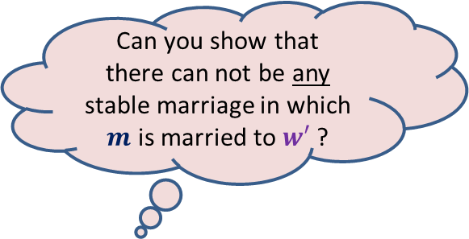
Let us work on an easier problem
Can you show that
there can not be any stable marriage in which $m$ is married to $w′$ ?
Consider the execution of Gale Shapley algorithm.
There are rejections and acceptance of proposals.
Consider the $1$st rejection :
Yes☺
Let $w′$ rejected $m$ for man $m^{′}$in Gale Shapley algorithm.
Surely, $w′$ prefers $m^{′}$ to $m$.
Let MA be any marriage in which $w′$ is married to $m$.
Let $m^{′}$ be married to $w"$ in MA.
Claim: $m′$ must prefer $w′$ to $w"$.
Proof: Since this is the first rejection in the algorithm,
So each engaged man was engaged with his first choice before this rejection.
So $w′$must be the first choice for $m′$.
Hence $m′$ must prefer $w′$ to $w"$.
Let $m$ be rejected by woman $w′$.
How to solve our main problem ?
Generalize this claim for any rejection
and use induction

Slide 26
Solving the general problem
Consider the execution of Gale Shapley algorithm.
There are rejections and acceptance of proposals.
For the $i$th rejection :
Let $w′$ rejected $m$ for man $m^{′}$in Gale Shapley algorithm.
Surely, $w′$ prefers $m^{′}$ to $m$.
Let MA be any marriage in which $w′$ is married to $m$.
Suppose $m^{′}$ is married to $w"$ in MA.
Claim: $m′$ must prefer $w′$ to $w"$.
Proof: Let Reject($m^{′}$) be the set of women that rejected $m^{′}$ till $(i−1)$th rejection.
Note : each man proposes to women in decreasing order of preference during the Gale Shapley algo.
Using Induction hypothesis,
there is no stable marriage in which $m^{′}$ is married to any woman in Reject($m^{′}$).
So $w"$ is not in Reject($m^{′}$) since MA is stable.
Moreover, $w′$ is the next most preferred woman from $W\backslash$Reject($m^{′}$)
Hence $w"$ must succeed $w′$ in the preference list of $m$.
Let $m$ be rejected by woman $w′$.
Done.

