Slide 1
Design and Analysis of Algorithms (CS345/CS345A)
Lecture number 37
NP Completeness – III
Coping with NP-completeness

Slide 2
NP Complete problems
If any NP-complete problem is solved in polynomial time
➔ P = NP
Is P = NP ?
P
NP
NP-complete

Slide 3



Showing a problem to be NP-complete
Let $X$be a problem which we wish to show to be NP-complete
Show that $X$ ϵ NP
Pick a problem $A$ which is already known to be NP-complete
Show that $A≤_{P}X$
NP
$$A$$
$$X$$

Slide 4
Example
Showing Dominating Set to be NP-complete

Slide 5







Dominating Set
Definition: Given an undirected graph $G=(V,E)$,
$N(u)$= {$v$| $v=u$ or ($u,v$) $∈E$}
In other words, $N(u)$ is the set consisting of $u$and all neighbors of $u$in $G$.
a subset $X⊆V$ is said to be an dominating set if
For each $u∈V$, $N\left(u\right)∩X≠∅$
Optimization version: compute dominating set of smallest size.
Decision version: Does there exist a dominating set of size $k$ ?
Is it the smallest dominating set ?
Is it the smallest dominating set ?
$$b$$
NO.
YES
$$a$$
$$x$$
$$z$$
$$t$$
$$y$$

Slide 6

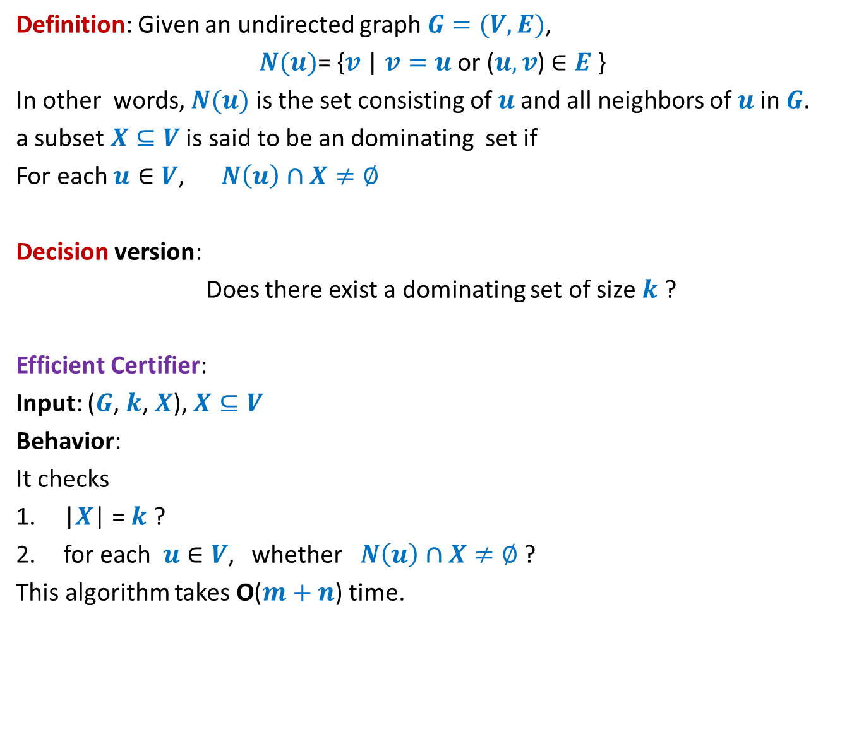
Dominating Set
Definition: Given an undirected graph $G=(V,E)$,
$N(u)$= {$v$| $v=u$ or ($u,v$) $∈E$}
In other words, $N(u)$ is the set consisting of $u$and all neighbors of $u$in $G$.
a subset $X⊆V$ is said to be an dominating set if
For each $u∈V$, $N\left(u\right)∩X≠∅$
Decision version:
Does there exist a dominating set of size $k$ ?
Efficient Certifier:
Input: ($G$, $k$, $X$), $X⊆V$
Behavior:
It checks
|$X$| = $k$ ?
for each $u∈V$, whether $N\left(u\right)∩X≠∅$ ?
This algorithm takes O($m+n$) time.
➔ Dominating Set $∈$ NP

Slide 7









VC $≤_{P}$ DS
VC: Vertex Cover
DS: Dominating Set
Input: an graph $G=(V,E)$ and $k∈Z^{+}$
Problem: Does there exist a vertex cover of size $≤k$?
Input: an graph $G=(V,E)$ and $t∈Z^{+}$
Problem: Does there exist a dominating set of size $≤t$ ?
$$b$$
$$b$$
$$a$$
$$x$$
$$a$$
$$x$$
$$z$$
$$t$$
$$z$$
$$t$$
$$y$$
$$y$$

Slide 8
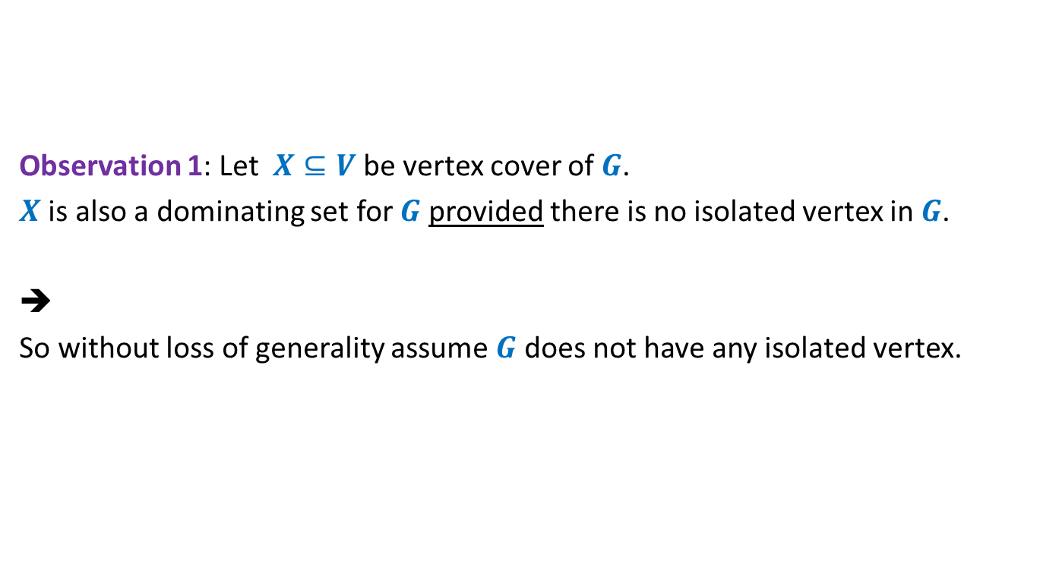
VC $≤_{P}$ DS
Observation 1: Let $X⊆V$ be vertex cover of $G$.
$X$ is also a dominating set for $G$ provided there is no isolated vertex in $G$.
➔
So without loss of generality assume $G$ does not have any isolated vertex.

Slide 9

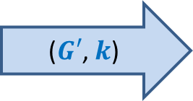
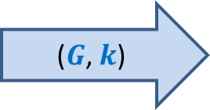

VC $≤_{P}$ DS
Aim: Given a graph $G=(V,E)$, how should $f$ transform it to graph $G′$ such that
$G$ has a vertex cover of size $≤k$if and only if $G′$has a dominating set of size $≤k$.
$$f$$
($G$, $k$)
($G′$, $k$)

Slide 10
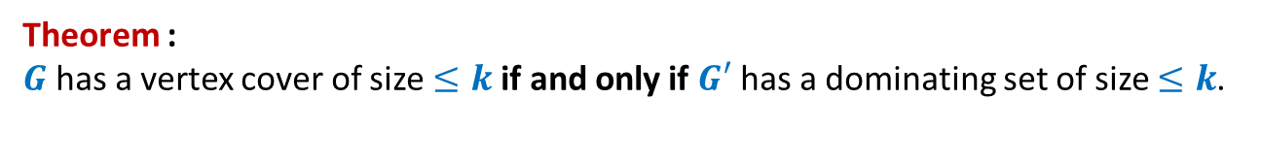






VC $≤_{P}$ DS
VC: Instance ($G$, $k$)
DS: Instance ($G′$, $k$)
$$b$$
$$b$$
$$a$$
$$x$$
$$a$$
$$x$$
$$z$$
$$t$$
$$z$$
$$t$$
$$y$$
$$y$$
Theorem :
$G$ has a vertex cover of size $≤k$if and only if $G′$ has a dominating set of size $≤k$.

Slide 11
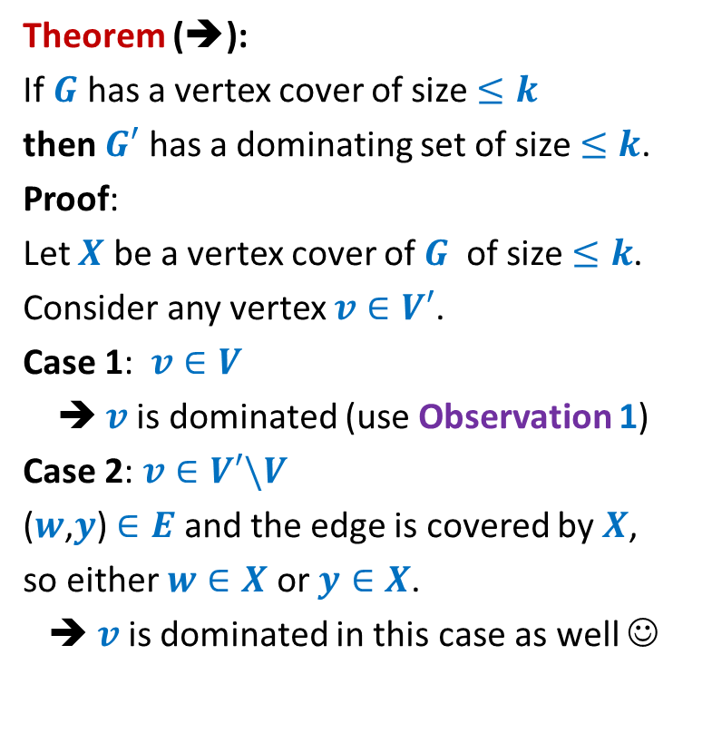




VC $≤_{P}$ DS
Theorem (➔):
If $G$ has a vertex cover of size $≤k$
then $G′$ has a dominating set of size $≤k$.
Proof:
Let $X$ be a vertex cover of $G$ of size $≤k$.
Consider any vertex $v∈V′$.
Case 1: $v∈V$
➔ $v$is dominated (use Observation 1)
Case 2: $v∈V′\backslash V$
($w$,$y$) $∈E$ and the edge is covered by $X$,
so either $w∈X$ or $y∈X$.
➔ $v$is dominated in this case as well ☺
$$v$$
$$y$$
$$v$$
$$w$$
$$y$$

Slide 12

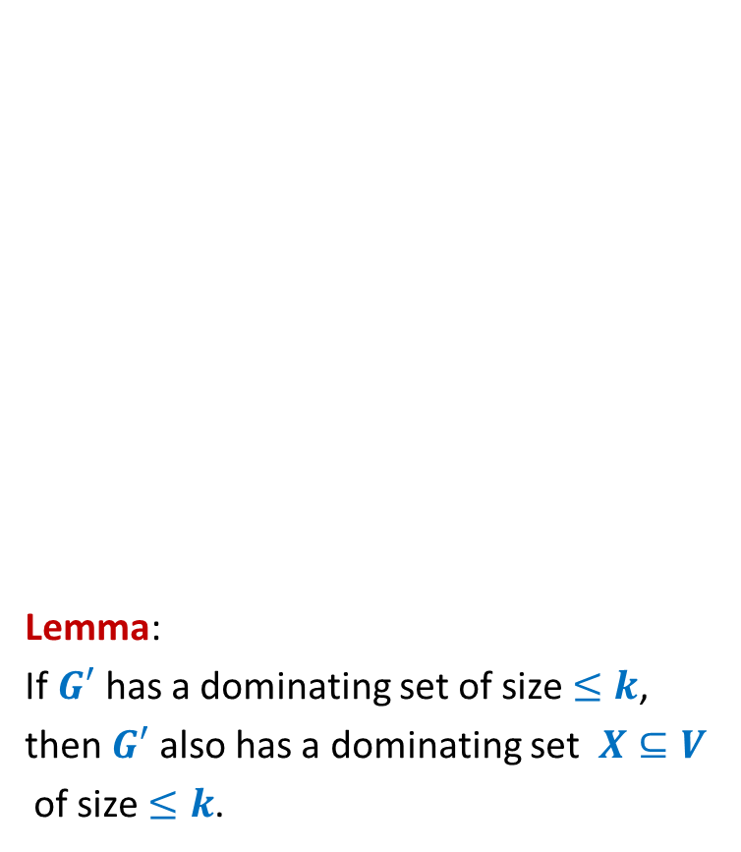
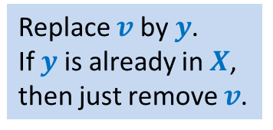
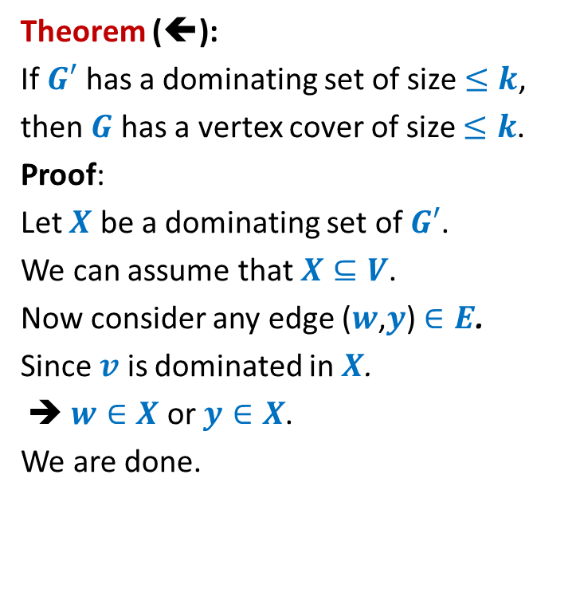

VC $≤_{P}$ DS
Replace $v$ by $y$.
If $y$ is already in $X$,
then just remove $v$.
Lemma:
If $G′$ has a dominating set of size $≤k$,
then $G′$ also has a dominating set $X⊆V$
of size $≤k$.
Theorem (⬅):
If $G′$ has a dominating set of size $≤k$,
then $G$ has a vertex cover of size $≤k$.
Proof:
Let $X$ be a dominating set of $G′$.
We can assume that $X⊆V$.
Now consider any edge ($w$,$y$) $∈E$.
Since $v$ is dominated in $X$.
➔ $w∈X$ or $y∈X$.
We are done.
$$v$$
$$w$$
$$y$$
$$v$$
$$w$$
$$y$$

Slide 13
More NP-complete Problems

Slide 14



















Subgraph Isomorphism
$a$→$1$
$$1$$
$$2$$
Definition: Graph $G=(V,E)$ is said to be isomorphic to $G′=(V′,E′)$
if there is a bijection $f$ : $V$→ $V′$ such that for any two vertices $u,v∈V$
$\left(u,v\right)∈E$ if and only if
Problem: Given two graphs $G$ and $G′$,
does there exist a subgraph of $G$ which is isomorphic to $G′$ ?
Homework: Show that subgraph isomorphism problem is NP-complete.
$$a$$
$$u$$
$b$→$3$
$c$→$5$
$$b$$
$$v$$
$u$→$2$
$$6$$
$$3$$
$v$→$4$
$$c$$
$$w$$
$w$→$6$
$$5$$
$$4$$
$$\left(f(u),f(v\right))∈E′$$

Slide 15
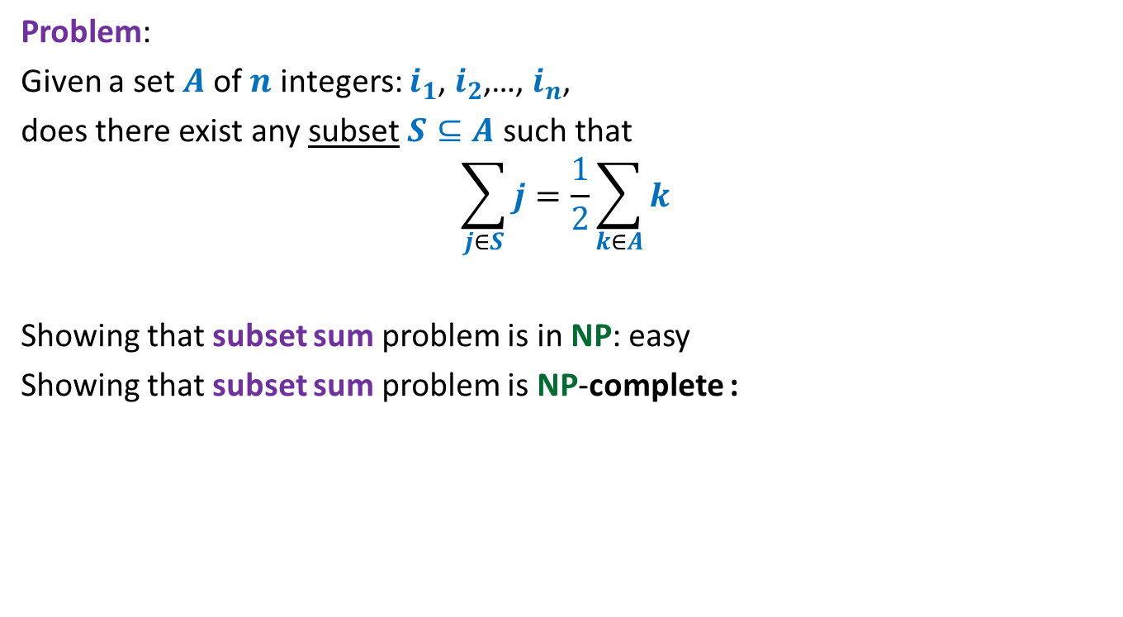
Subset sum problem
Problem:
Given a set $A$of $n$ integers: $i_{1}$, $i_{2}$,…, $i_{n}$,
does there exist any subset $S⊆A$ such that
$$\sum_{j∈S}{j}=\frac{1}{2}\sum_{k∈A}{k}$$
Showing that subset sum problem is in NP: easy
Showing that subset sum problem is NP-complete :
neither Homework
nor Exam problem

Slide 16
How to handle NP-complete Problems
Approximation Algorithms

Slide 17
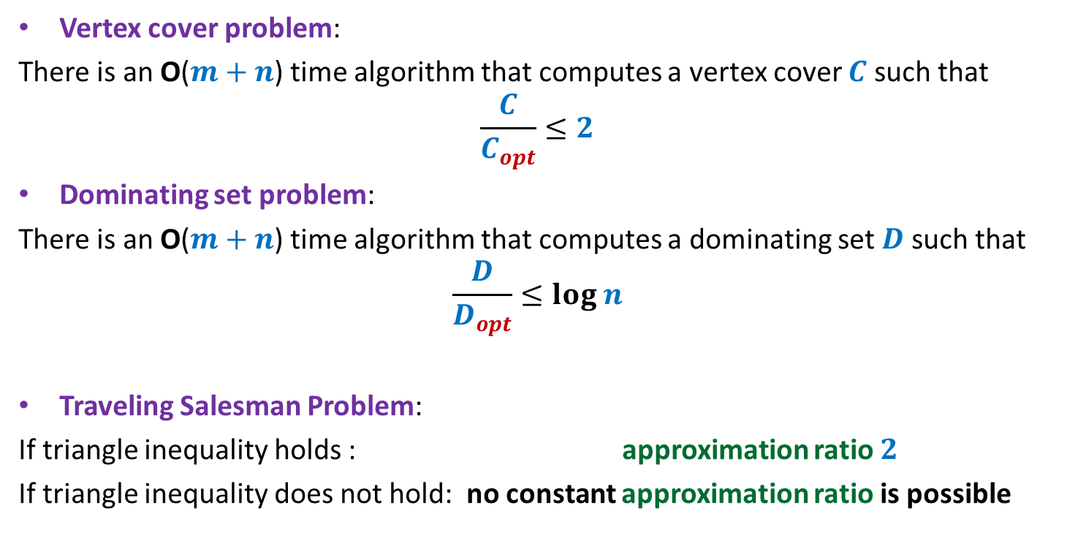
Approximation algorithms
Vertex cover problem:
There is an O($m+n$) time algorithm that computes a vertex cover $C$ such that
$$\frac{C}{C_{opt}}≤2$$
Dominating set problem:
There is an O($m+n$) time algorithm that computes a dominating set $D$ such that
$$\frac{D}{D_{opt}}≤log n$$
Traveling Salesman Problem:
If triangle inequality holds : approximation ratio $2$
If triangle inequality does not hold: no constant approximation ratio is possible

Slide 18

VERTEX Cover Problem
an O($m+n$) time algorithm
$2$-approximate solution

Slide 19
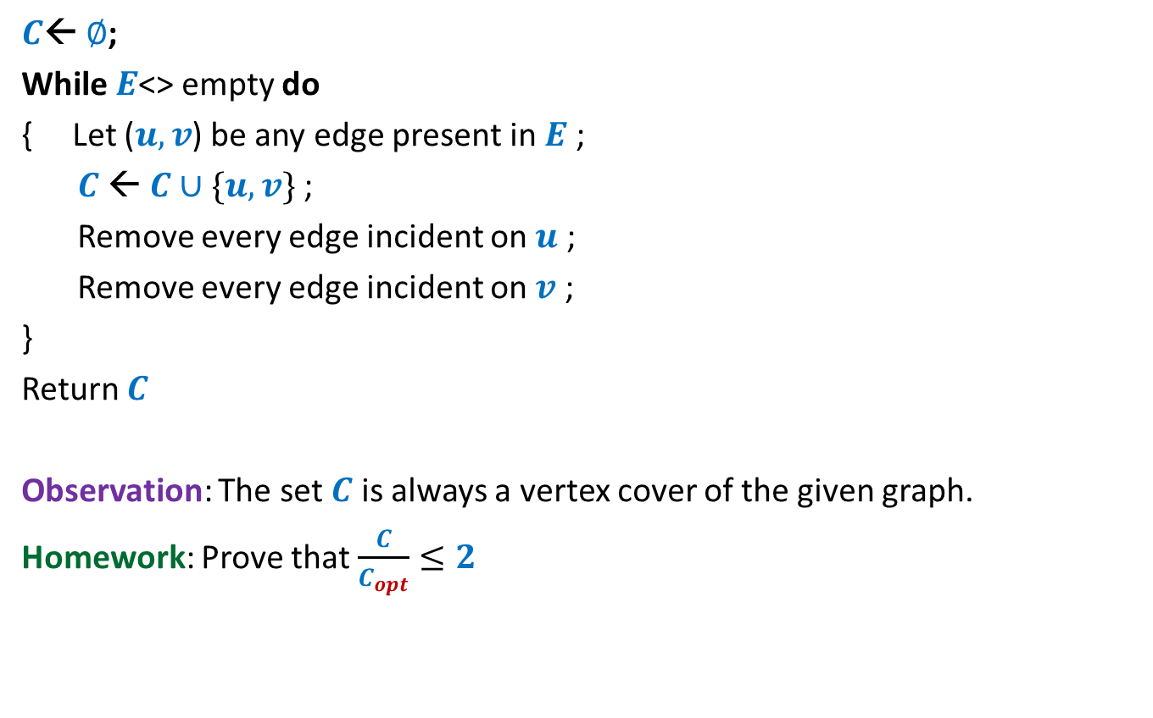
The algorithm
$C$← $∅$;
While $E$<> empty do
{ Let ($u,v$) be any edge present in $E$ ;
$C$← $C∪\{u,v\}$;
Remove every edge incident on $u$ ;
Remove every edge incident on $v$ ;
}
Return $C$
Observation: The set $C$ is always a vertex cover of the given graph.
Homework: Prove that $\frac{C}{C_{opt}}≤2$
?
Hint will be given in the practice sheet ☺

Slide 20
Set Cover Problem

Slide 21









Set Cover Problem
a set $A$= {$e_{1}$, $e_{2}$,…,$e_{n}$}
$S_{1}$, $S_{2}$,…, $S_{k}$, with $S_{i}⊆A$
Optimization version: Compute least number of sets that can cover $A$.
Decision version: Does there exist $j$subsets that can cover all elements ?
$$e_{2}$$
$$e_{7}$$
$$e_{5}$$
$$e_{1}$$
$$e_{3}$$
$$e_{8}$$
$$e_{4}$$
$$e_{6}$$
$$e_{9}$$

Slide 22
Set Cover Problem
a set $A$= {$e_{1}$, $e_{2}$,…,$e_{n}$}
$S_{1}$, $S_{2}$,…, $S_{k}$, with $S_{i}⊆A$
Optimization version: Compute least number of sets that can cover $A$.
Decision version: Does there exist $j$subsets that can cover all elements ?
$$e_{2}$$
$$e_{7}$$
$$e_{5}$$
$$e_{1}$$
$$e_{3}$$
$$e_{8}$$
$$e_{4}$$
$$e_{6}$$
$$e_{9}$$

Slide 23
Set Cover Problem
a set $A$= {$e_{1}$, $e_{2}$,…,$e_{n}$}
$S_{1}$, $S_{2}$,…, $S_{k}$, with $S_{i}⊆A$
Optimization version: Compute least number of sets that can cover $A$.
Decision version: Does there exist $j$subsets that can cover all elements ?
$$e_{2}$$
$$e_{7}$$
$$e_{5}$$
$$e_{1}$$
$$e_{3}$$
$$e_{8}$$
$$e_{4}$$
$$e_{6}$$
$$e_{9}$$

Slide 24
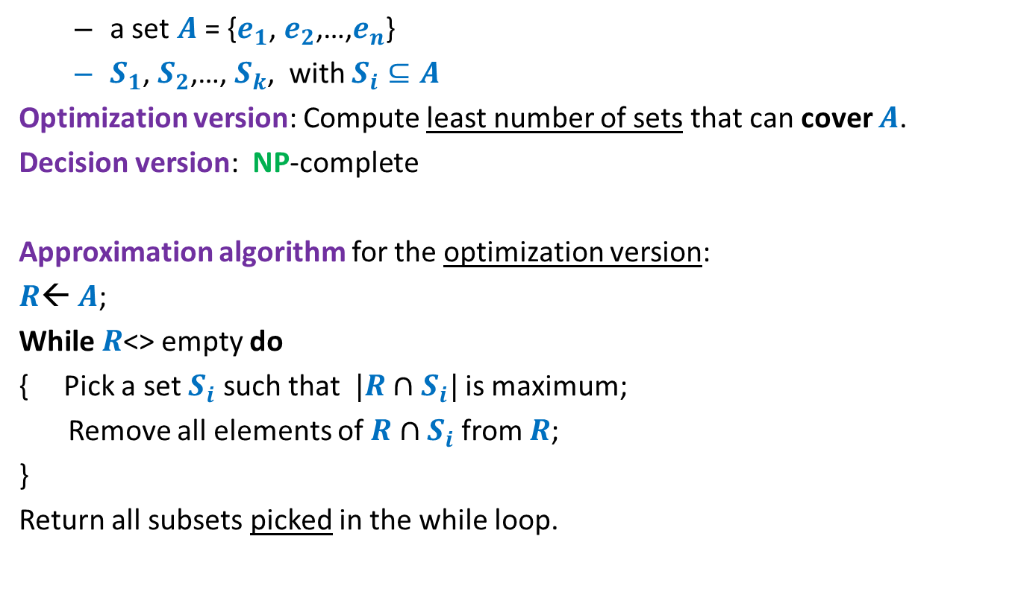
Set Cover Problem
a set $A$= {$e_{1}$, $e_{2}$,…,$e_{n}$}
$S_{1}$, $S_{2}$,…, $S_{k}$, with $S_{i}⊆A$
Optimization version: Compute least number of sets that can cover $A$.
Decision version: NP-complete
Approximation algorithm for the optimization version:
$R$← $A$;
While $R$<> empty do
{ Pick a set $S_{i}$ such that $|R∩S_{i}|$ is maximum;
Remove all elements of $R∩S_{i}$ from $R$;
}
Return all subsets picked in the while loop.
Homework
Think simple.
Follow your intuition

Slide 25
Attend the class on Monday, 13th November to see an inspiring analysis for this algorithm.

