Slide 1
Design and Analysis of Algorithms (CS345/CS345A)
Lecture 4
Data Structures :
The power of Binary Search Tree

Slide 2

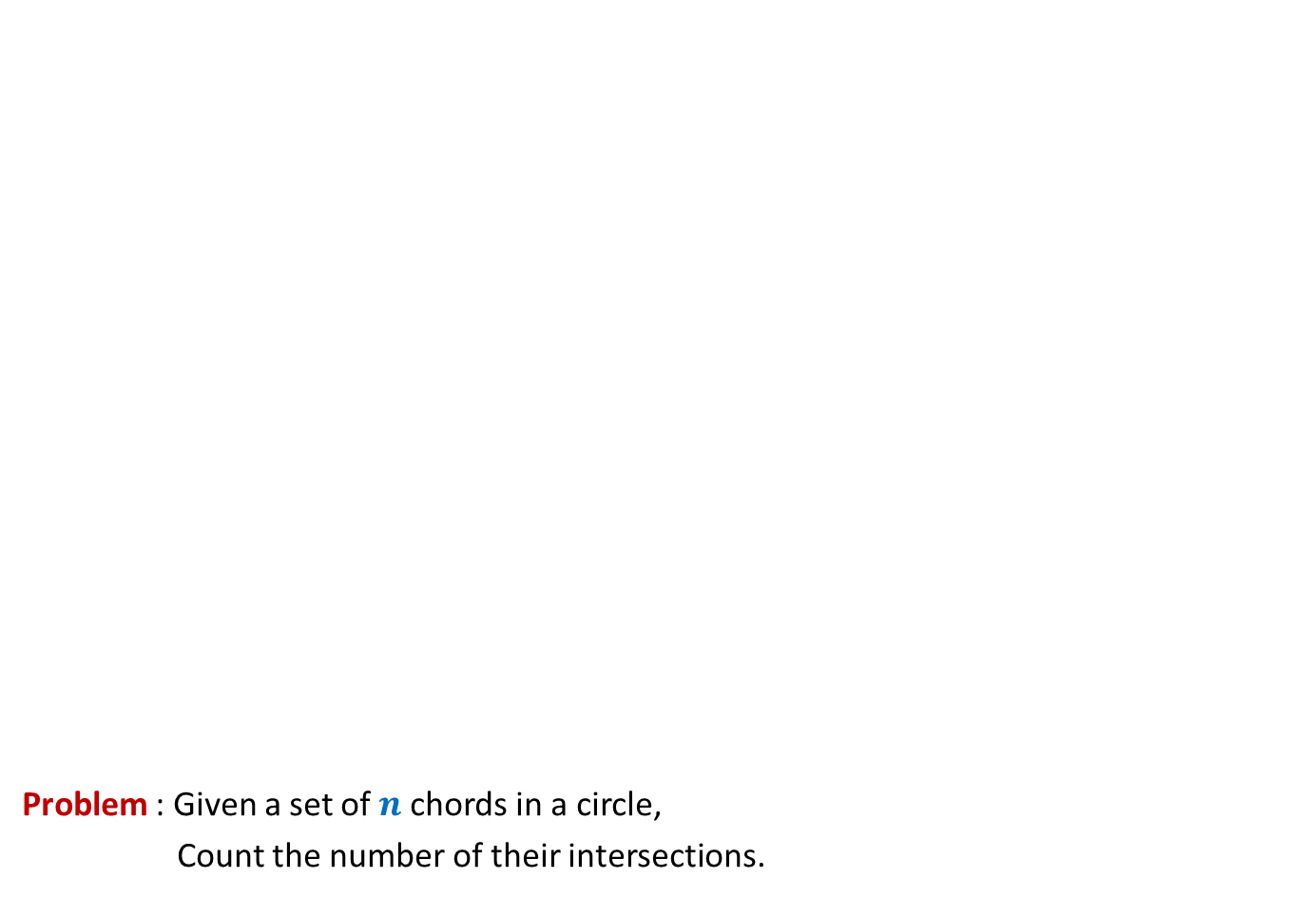
Problem : Given a set of $n$chords in a circle,
Count the number of their intersections.
O($n$ log $n$)

Slide 3
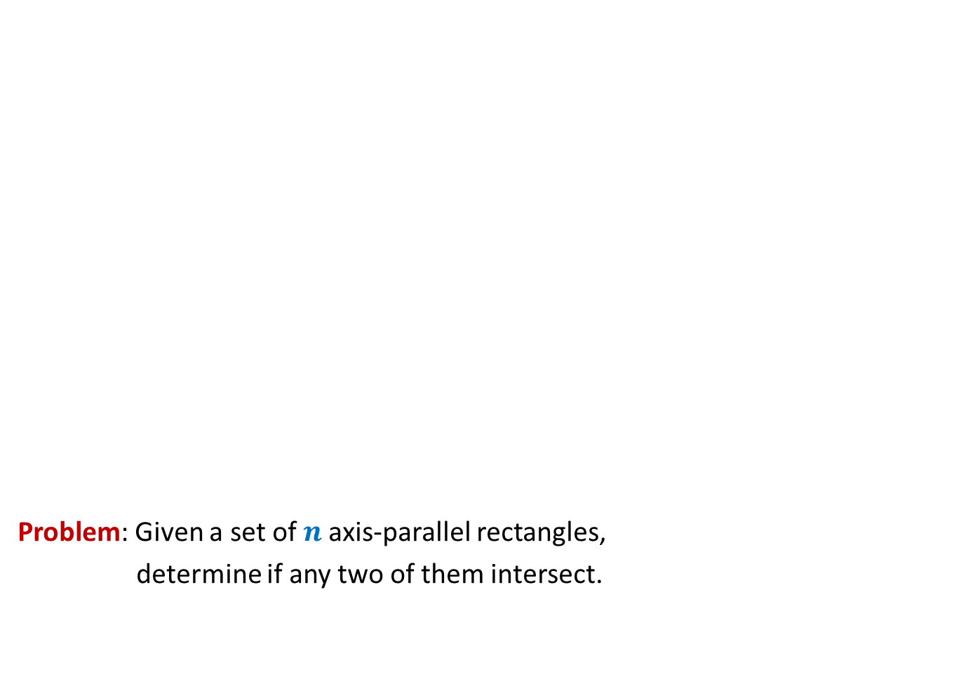
Surprising applications of data structures
Problem: Given a set of $n$axis-parallel rectangles,
determine if any two of them intersect.
O($n$ log $n$)

Slide 4
Revisiting Binary Search Tree

Slide 5
Red Black tree (Height Balanced BST)
Operations you already know
New operations
Search(T,x)
Insert(T,x)
Delete(T,x)
Min(T)
Max(T)
Predecessor(T,x)
Successor(T,x)
A NOTATION
T < T’ :
every element of T is smaller than every
element of T’.
8. SpecialUnion(T, T’):
Given T and T’ such that T < T’,
compute T*=TUT’.
NOTE: T and T’ don’t exist after the union.
9. Split(T, x):
Split T into T’ and T’’ such that T’ < x < T’’.
Every operation in O(log n) time.

Slide 6
Red-Black Tree
How well have you understood it ?

Slide 7
Insertion in a red-black tree
Can you handle color-imbalance
in general as well ?
T
46
Yes
28
67
5
35
49
83
2
25
31
41
54
44
Color imbalance

Slide 8
SpecialUnion(T,T’)
Remember:
every element of T is smaller than every element of T’

Slide 9
SpecialUnion(T,T’)

Slide 10
A trivial algorithm that does not work
Time complexity: O(log n)
Height balance lost
<
T
T’

Slide 11
Towards an O(log n) time for SpecialUnion(T,T’) …
Can we solve some simple cases easily ?
Simplifying the problem
Solving the simpler version efficiently
Extending the solution to generic version

Slide 12
Simplifying the problem
Simplified problem:
Given two trees T, T’ of same black height
and a key x, such that T<x<T’,
transform them into a tree T*=TU{x}UT’
x
<
<
T
T’

Slide 13
Solving the simplified problem
Simplified problem:
Given two trees T, T’ of same black height
and a key x, such that T<x<T’,
transform them into a tree T*=TU{x}UT’
x
O (1) time
<
<
T
T’

Slide 14
Extending the algorithm to the generic problem
T
T’

Slide 15
Extending the algorithm to the generic problem
x
<
<
T
T’

Slide 16
Extending the algorithm to the generic problem
x
T
T’

Slide 17
Extending the algorithm to the generic problem
x
T
T’

Slide 18
Extending the algorithm to the generic problem
v
x
T
T’’

Slide 19
Extending the algorithm to the generic problem
v
x
T
T’’

Slide 20

Extending the algorithm to the generic problem
Algorithm for SpecialUnion(T,T’):
Let x be the node storing smallest element of T’.
Delete the node x from T’.
Let black height of T ≤ black height of T’
Keep following left pointer of T’ until we reach a node v such that
left(v) is black
The subtree T” rooted at Left(v) has black height same as that of T
left(x)← T;
right(x) ← T”;
Color(x)← red;
left(v)← x;
parent(x)← v;
If color(v) is red, remove the color imbalance
(like in the usual procedure of insertion in a red-black tree)
Total time : O(log $n$)

Slide 21
Split(T,x)

Slide 22

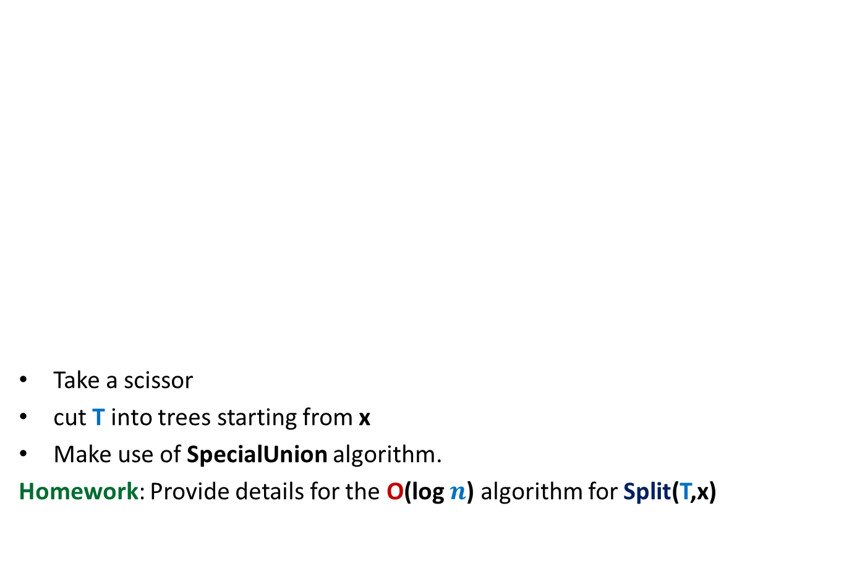

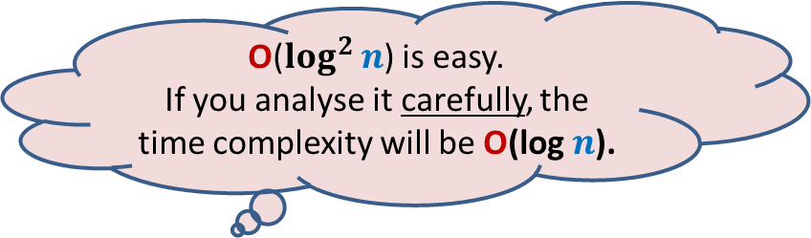
Achieving O(log $n$) time for Split(T,x)
O($\log^{2}{n}$) is easy.
If you analyse it carefully, the time complexity will be O(log $n$).
Take a scissor
cut T into trees starting from x
Make use of SpecialUnion algorithm.
Homework: Provide details for the O(log $n$) algorithm for Split(T,x)
x
T

Slide 23
Height Balanced BST (Red-black tree, AVL tree)
Operations you already know
New operation
Search(T,x)
Insert(T,x)
Delete(T,x)
Min(T)
Max(T)
Predecessor(T,x)
Successor(T,x)
SpecialMerge(T, T’)
Split(T,x)
10. FindRank(T, x):
return the no. of elements in T that are smaller
than x.
Every operation in O(log n) time.

Slide 24
Find-rank(T,x)

Slide 25

A trivial algorithm for Find-rank(T,x)
T
Repeatedly find predecessors of x and stop when you reach the min element.
Time complexity: O ($k$ log $n$) (where $k$ is rank of x in T)
Homework: Show that all predecessors can be computed in O($k$+ log $n$) time.
46
28
67
5
35
49
2
25
31
41
48
53

Slide 26
Achieving O(log n) time for FindRank(T,x)
Assume without loss of generality that x belongs to T.
View the entire tree T from perspective of the path from x to the root.
How will T look like ?
x
T

Slide 27
Achieving O(log n) time for FindRank(T,x)
Can you identify the elements that contribute to Rank of x in this picture ?
Elements that are present in the subtrees lying to the left of this path.
And some elements on this path.
x
T

Slide 28
An elegant solution
Fields associated with a node v in T:
Value(v)
Left(v)
right (v)
parent(v)
Keep one more field
Size(v): The number of nodes stored in the subtree rooted at v.

Slide 29
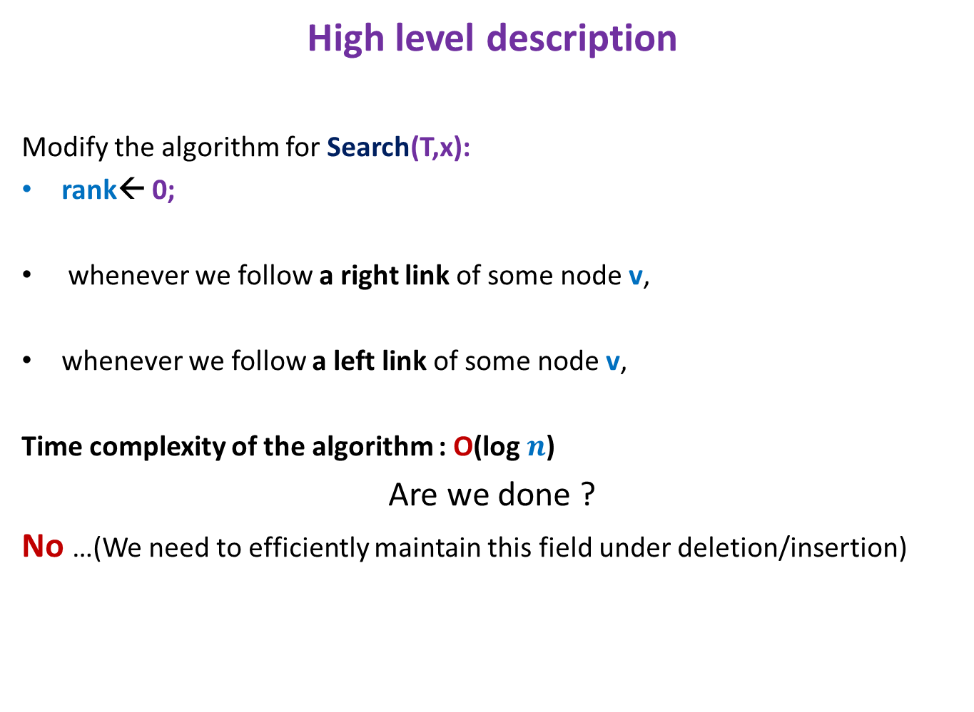
Algorithm for FindRank(T,x)
High level description
Modify the algorithm for Search(T,x):
rank← 0;
whenever we follow a right link of some node v,
whenever we follow a left link of some node v,
Time complexity of the algorithm : O(log $n$)
Are we done ?
No …(We need to efficiently maintain this field under deletion/insertion)
rank← rank + size(left(v)) + 1
Do nothing

Slide 30
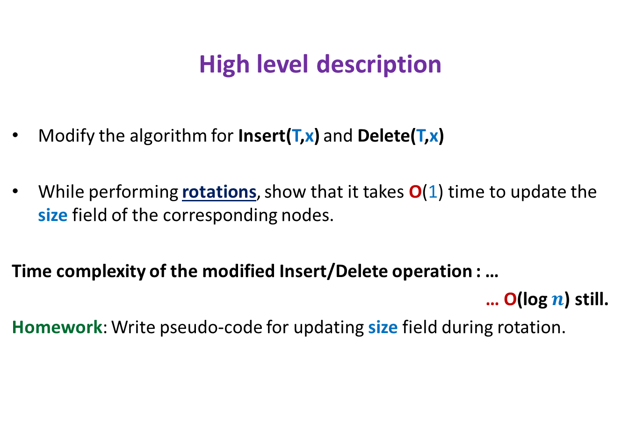
Maintaining size field T under insertion/deletion
High level description
Modify the algorithm for Insert(T,x) and Delete(T,x)
While performing rotations, show that it takes O(1) time to update the size field of the corresponding nodes.
Time complexity of the modified Insert/Delete operation : …
… O(log $n$) still.
Homework: Write pseudo-code for updating size field during rotation.

Slide 31
Hopefully you would have understood the idea of augmentING A BST by now.
So Let us visit a very interesting problem
that employs this powerful technique.

Slide 32
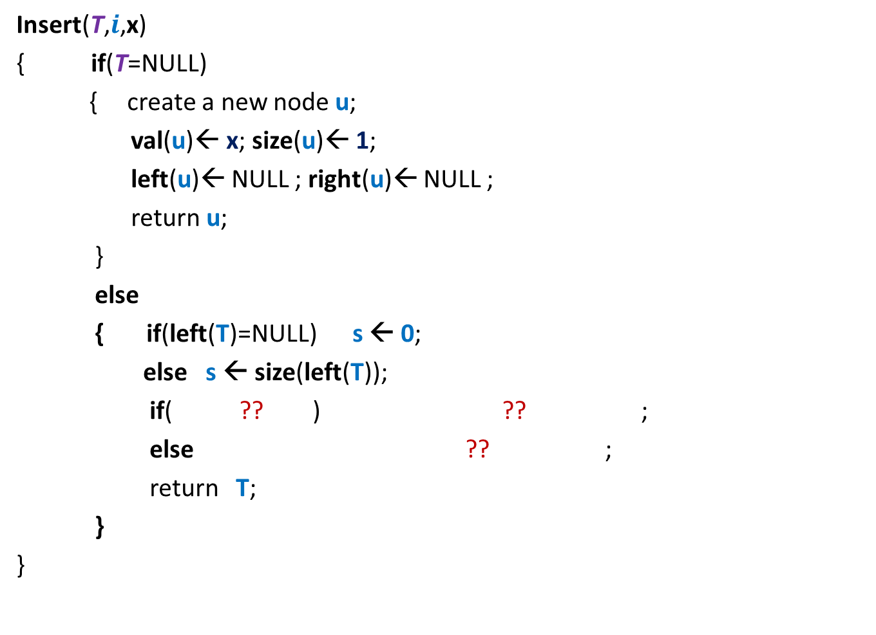
Orthogonal Range searching
Data structure: Size = O($n log n$),
Query = O($k+ \log^{2} n$),
Preprocessing time = O($n log n$)
Rectangle
No. of points in query rectangle

Slide 33





Orthogonal Range searching
RangeSearch(T, $x_{1}$, $x_{2}$, $y_{1}$, $y_{2}$):
Report all points in the rectangle defined by ($x_{1}$, $x_{2}$, $y_{1}$, $y_{2}$)
$$y_{2}$$
$$y_{1}$$
Rectangle
$$x_{1}$$
$$x_{2}$$

Slide 34
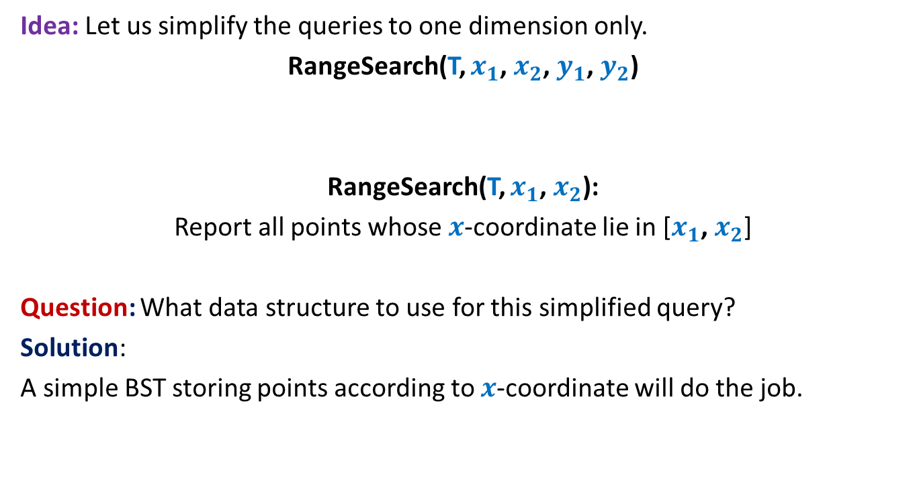
Orthogonal Range searching
Idea: Let us simplify the queries to one dimension only.
RangeSearch(T, $x_{1}$, $x_{2}$, $y_{1}$, $y_{2}$)
RangeSearch(T, $x_{1}$, $x_{2}$):
Report all points whose $x$-coordinate lie in [$x_{1}$, $x_{2}$]
Question: What data structure to use for this simplified query?
Solution:
A simple BST storing points according to $x$-coordinate will do the job.

Slide 35





RangeSearch(T, $x_{1}$, $x_{2}$):
Binary search tree on $x$-coordinates
View the entire tree T from perspective of the paths from $x_{1}$ and $x_{2}$ to the root.
How will T look like ?
LCA
$x_{2}$
$x_{1}$
T

Slide 36
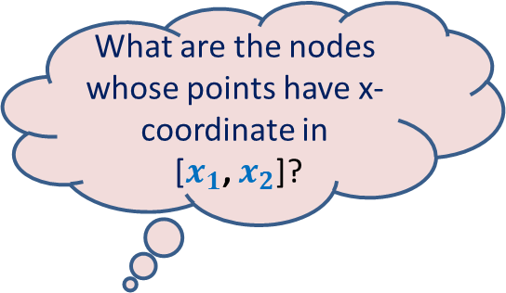

RangeSearch(T, $x_{1}$, $x_{2}$):
Binary search tree on x-coordinates
What are the nodes whose points have x-coordinate in
[$x_{1}$, $x_{2}$]?
LCA
$x_{2}$
$x_{1}$
T

Slide 37
RangeSearch(T, $x_{1}$, $x_{2}$):
Binary search tree on x-coordinates
LCA
$x_{2}$
$x_{1}$
T

Slide 38
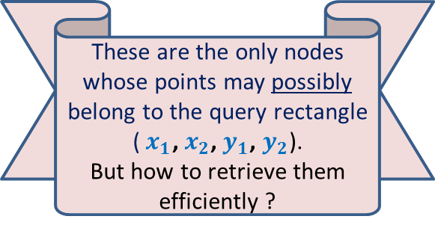
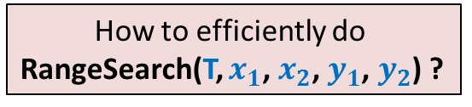
RangeSearch(T, $x_{1}$, $x_{2}$):
Binary search tree on x-coordinates
Suitably augment each node…
How to efficiently do
RangeSearch(T, $x_{1}$, $x_{2}$, $y_{1}$, $y_{2}$) ?
These are the only nodes whose points may possibly belong to the query rectangle ($x_{1}$, $x_{2}$, $y_{1}$, $y_{2}$).
But how to retrieve them efficiently ?
LCA
$x_{2}$
$x_{1}$
T

Slide 39
How should we augment each node?
Augment each node v with a pointer to another BST storing all points of T(v) according to y-oordinates.
value
Color-bit
Y-tree
left
v
right
BST storing T(v) according to y-coordinate
T(v)
v

Slide 40


RangeSearch(T, $x_{1}$, $x_{2}$, $y_{1}$, $y_{2}$)
For each subtree T(v) whose all points belong to ($x_{1}$, $x_{2}$),
perform RangeSearch(Y-tree(v), $y_{1}$, $y_{2}$).
LCA
$x_{2}$
$x_{1}$
T

Slide 41

Homework
Write a neat & compact pseudo-code of RangeSearch(T, $x_{1}$, $x_{2}$, $y_{1}$, $y_{2}$)
show that the query time for orthogonal range searching is O($k$+$\log^{2} n$).

Slide 42
Important announcement
Since many students could not follow orthogonal range searching fully, we shall revisit it in the next class as well.
But students are encouraged to make an attempt on their own from these slides so that we can clarify all doubts in the next class ☺

