Slide 1
Design and Analysis of Algorithms (CS345/CS345A)
Lecture 40
Median finding using tiny space

Slide 2
Finding Median of 5 Trillion numbers
Efficiently using a computer of 1980’s

Slide 3
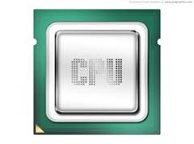
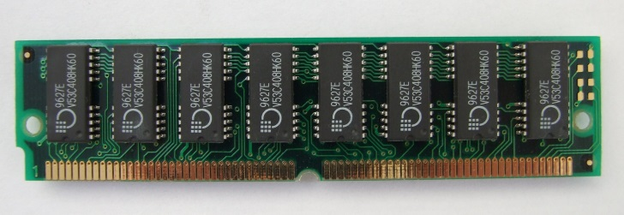
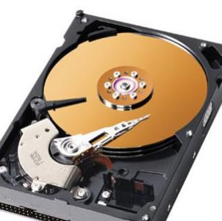
A real computer
Assumption:
Entire input resides in RAM
RAM model
of computation
Input
RAM
But when data is too large …

Slide 4
An accurate model of computer for large data
CPU time: free
Time Complexity : No. of scans to solve the problem
RAM
Disc

Slide 5






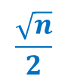

Computing median of $n$ elements
RAM size= $Θ(\sqrt{n})$
Algorithm | No. of scans
O($n$)
$$\frac{\sqrt{n}}{2}$$
Exercise
Assignment
O($\log{n}$)
Novel
$$2$$
Optimal
Assumptions:
(for ease of understanding)
$n$ = $2^{2k}$
for some $k$
All elements are distinct.

Slide 6
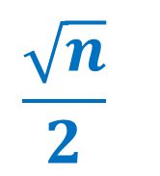
ScAns Algorithm
$$\frac{\sqrt{n}}{2}$$

Slide 7













$\frac{\sqrt{n}}{2}$ scans algorithm
RAM size= $Θ(\sqrt{n})$
Compute smallest $\sqrt{n}$ elements in one scan.
Compute next smallest $\sqrt{n}$ elements in one scan.
Compute next smallest $\sqrt{n}$ elements in one scan.
$$2 7 10 21 42$$
RAM
$$42$$
Effective input size
$$n$$
Can’t we speed it up ?
$$n−\sqrt{n}$$
$$n−2\sqrt{n}$$
$$10$$
$$42$$
$$21$$
$$2$$
$$7$$
Disc

Slide 8

$O(log n)$Scans Algorithm
Approach:
Divide and Conquer

Slide 9



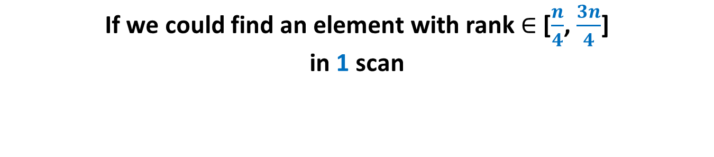

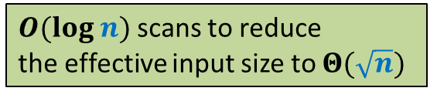




If we could find an element with rank $∈$ [$\frac{n}{4}$, $\frac{3n}{4}$] in 1 scan
RAM size= $Θ(\sqrt{n})$
RAM
Effective input size
$$412$$
Rank $=\frac{n}{3}$
$$\frac{2n}{3}$$
$$\frac{4n}{9}$$
But how to find an element with rank $∈$ [$\frac{n}{4}$, $\frac{3n}{4}$] in 1 scan ?
$$\frac{8n}{27}$$
$$<412$$
$O(log n)$scans to reduce
the effective input size to $Θ(\sqrt{n})$
$$412$$
Disc

Slide 10


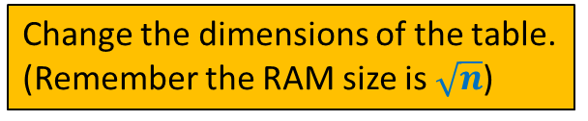

Median of medians algorithm
Recall your DS course
Element with rank $∈$ [$\frac{3n}{10}$, $\frac{7n}{10}$]
$$\frac{n}{10}$$
$$5$$
How to make use of it to solve the current problem ?
Change the dimensions of the table.
(Remember the RAM size is $\sqrt{n}$)

Slide 11



Median of medians algorithm
Recall your DS course
Element with rank $∈$ [$\frac{n}{4}$, $\frac{3n}{4}$]
$$\sqrt{n}$$
$$\sqrt{n}$$

Slide 12

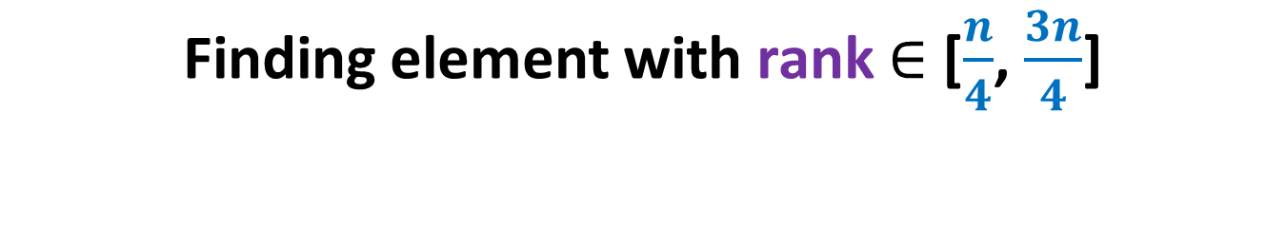
Finding element with rank $∈$ [$\frac{n}{4}$, $\frac{3n}{4}$]
RAM size= $Ω(\sqrt{n})$
RAM
Disc

Slide 13
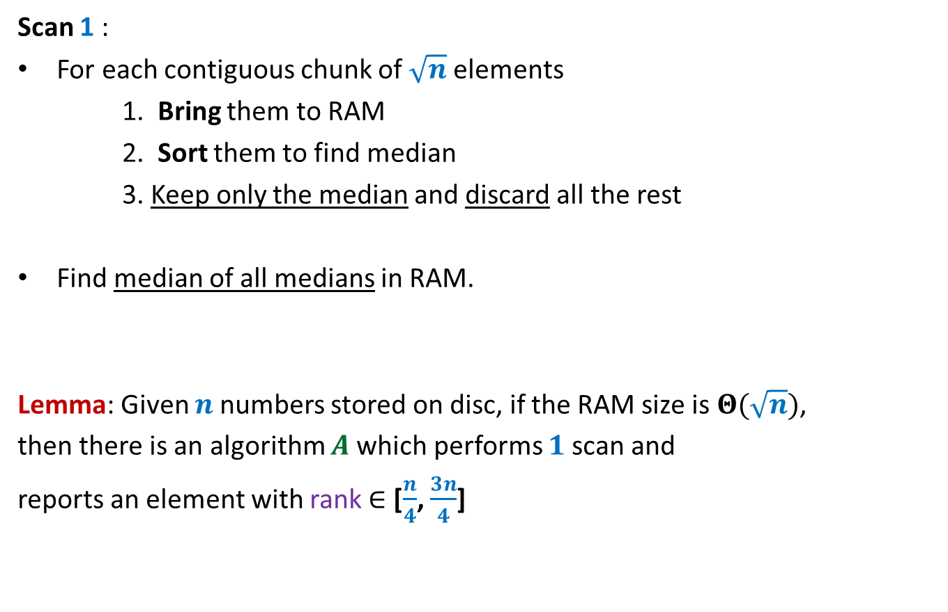
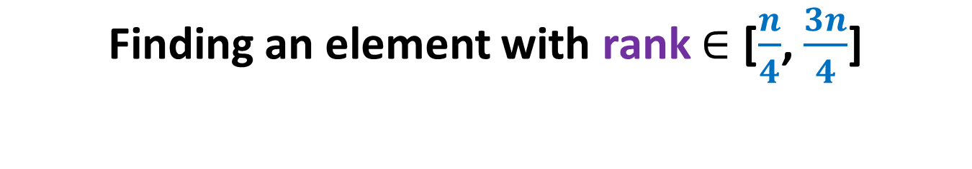
Finding an element with rank $∈$ [$\frac{n}{4}$, $\frac{3n}{4}$]
Scan 1 :
For each contiguous chunk of $\sqrt{n}$ elements
1. Bring them to RAM
2. Sort them to find median
3. Keep only the median and discard all the rest
Find median of all medians in RAM.
Lemma: Given $n$numbers stored on disc, if the RAM size is $Θ(\sqrt{n})$,
then there is an algorithm $A$which performs $1$scan and
reports an element with rank $∈$ [$\frac{n}{4}$, $\frac{3n}{4}$]

Slide 14
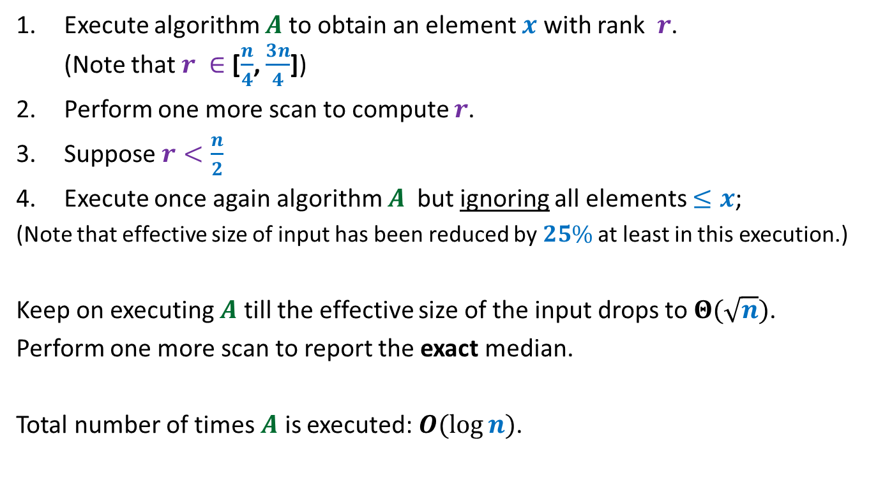

$O(log n)$scan Algorithm
Execute algorithm $A$to obtain an element $x$ with rank $r$. (Note that $r ∈$ [$\frac{n}{4}$, $\frac{3n}{4}$])
Perform one more scan to compute $r$.
Suppose $r<\frac{n}{2}$
Execute once again algorithm $A$ but ignoring all elements $≤x$;
(Note that effective size of input has been reduced by $25\%$ at least in this execution.)
Keep on executing $A$ till the effective size of the input drops to $Θ(\sqrt{n})$.
Perform one more scan to report the exact median.
Total number of times $A$ is executed: $O(\log{n})$.

Slide 15

$2$SCANs Algorithm

Slide 16



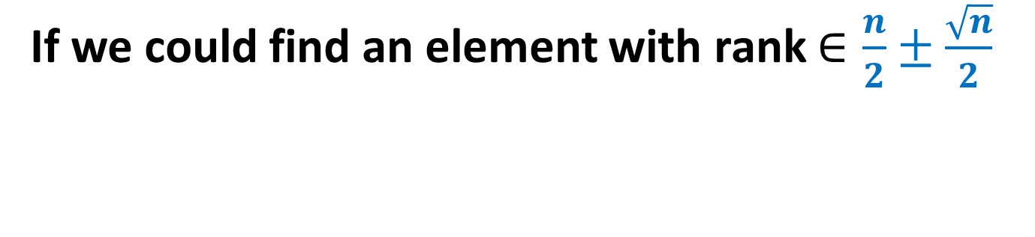


If we could find an element with rank $∈\frac{n}{2}±\frac{\sqrt{n}}{2}$
RAM size= $Θ(\sqrt{n})$
Keep largest $\frac{\sqrt{n}}{2}$ numbers less than $x$
Keep smallest $\frac{\sqrt{n}}{2}$ numbers greater than $x$
=➔ The RAM has the median
RAM
Effective input size
$$x$$
Element with rank $∈$ $\frac{n}{2}±\frac{\sqrt{n}}{2}$
$$\sqrt{n}$$
$$x$$
Disc

Slide 17

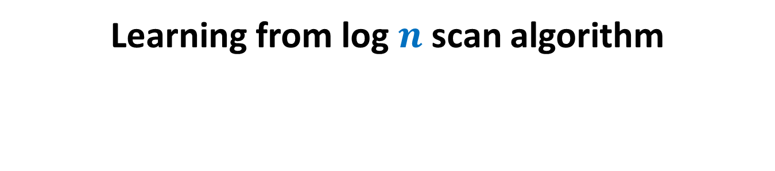



Learning from log $n$scan algorithm
RAM size= $Ω(\sqrt{n})$
RAM
$$\sqrt{n}$$
$$\sqrt{n}$$
$$\sqrt{n}$$
$$\sqrt{n}$$
$$\sqrt{n}$$
$$\sqrt{n}$$
Disc

Slide 18

Learning from log $n$scan algorithm
RAM size= $Ω(\sqrt{n})$
RAM
$$\sqrt{n}$$
$$\sqrt{n}$$
$$\sqrt{n}$$
$$\sqrt{n}$$
$$\sqrt{n}$$
$$\sqrt{n}$$
$$\sqrt{n}$$
Disc

Slide 19
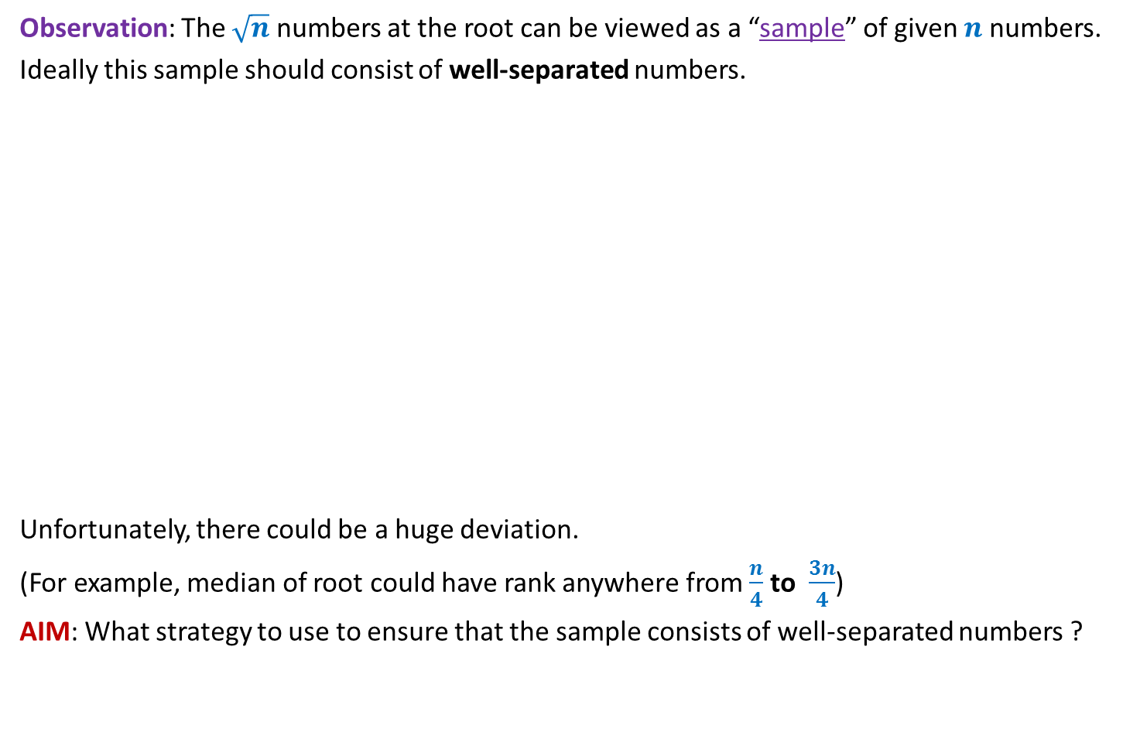
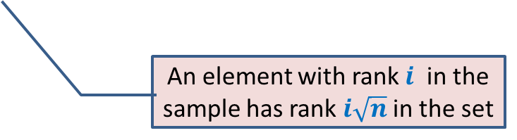

Learning from log $n$scan algorithm
Observation: The $\sqrt{n}$ numbers at the root can be viewed as a “sample” of given $n$ numbers.
Ideally this sample should consist of well-separated numbers.
Unfortunately, there could be a huge deviation.
(For example, median of root could have rank anywhere from $\frac{n}{4}$ to $\frac{3n}{4}$)
AIM: What strategy to use to ensure that the sample consists of well-separated numbers ?
An element with rank $i$ in the sample has rank $i\sqrt{n}$ in the set
$$\sqrt{n}$$
What if sample can be of large size ?
Yes, it is possible if sample size is $\frac{n}{2}$

Slide 20









Sort each contiguous chunk of $\sqrt{n}$numbers.
Pick alternate numbers in the sample.
$$9$$
$$68$$
$$7$$
$$51$$
$$43 7 51 3$$
$$3 7 43 51$$
$$9 21 5 68$$
$$5 9 21 68$$
1 2 3 4
1 2 3 4

Slide 21
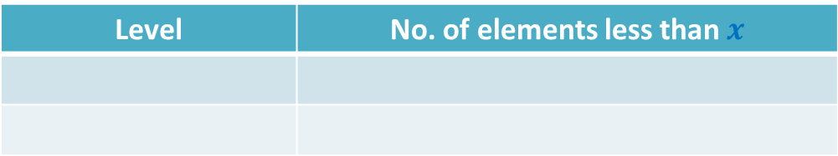





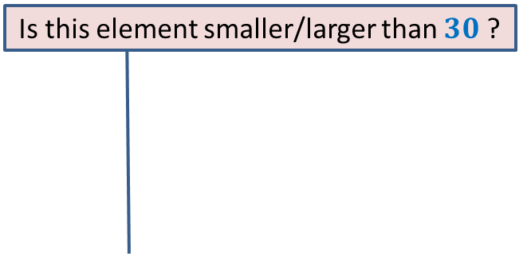







This is good ! But how to reduce the sample size ?
What picture emerges ?
Apply the same idea recursively
Let $x$ be any element.
Suppose $x=30$
Level | No. of elements less than $x$
$$1$$
$$11$$
$$0$$
At least $22$
At most $?$
$$27$$
Is this element smaller/larger than $30$ ?
1
3 9 11 39
5 7 23 69
2 18 29 57
15 17 79 87
3 39
25
0
33
9 11
5 23
7 69
2 29
18 57
15 79
17 87
$$\sqrt{n}$$
$$\sqrt{n}$$
$$\sqrt{n}$$
$$\sqrt{n}$$
$$\sqrt{n}$$
$$\sqrt{n}$$
$$\sqrt{n}$$
$$\sqrt{n}$$
Disc
In general, if there are $r$ elements smaller than $x$ at level 1,
the number of elements smaller than $x$ at level 0 is at least $2$𝒓 and at most $2r+\sqrt{n}$

Slide 22
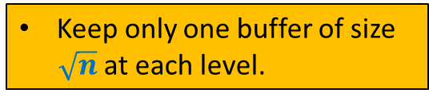
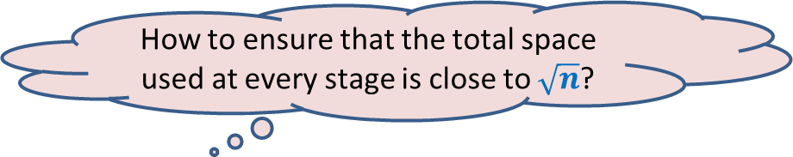
How to ensure that the total space used at every stage is close to $\sqrt{n}$?
Keep only one buffer of size
$\sqrt{n}$ at each level.

Slide 23

Total RAM size required = O($\sqrt{n} log n$ )
3
2
1
0
$$\sqrt{n}$$
$$\sqrt{n}$$
$$\sqrt{n}$$
$$\sqrt{n}$$
$$\sqrt{n}$$
$$\sqrt{n}$$
$$\sqrt{n}$$
$$\sqrt{n}$$
Keep an additional buffer for temporary storage.
Disc

Slide 24

Execution of the algorithm
3
2
1
0
$$\sqrt{n}$$
Disc

Slide 25

Execution of the algorithm
3
2
1
0
$$\sqrt{n}$$
Disc

Slide 26


Execution of the algorithm
$$9$$
$$68$$
$$7$$
$$51$$
$$5 9 21 68$$
$$3 7 43 51$$
1 2 3 4
1 2 3 4

Slide 27



Execution of the algorithm
$$7$$
sort
$$9$$
$$68$$
$$9$$
$$7$$
51
$$51$$
$$68$$
$$5 9 21 68$$
$$3 7 43 51$$
1 2 3 4
1 2 3 4

Slide 28
Execution of the algorithm
3
2
1
0
$$\sqrt{n}$$
Disc

Slide 29

Execution of the algorithm
3
2
1
0
$$\sqrt{n}$$
Disc

Slide 30
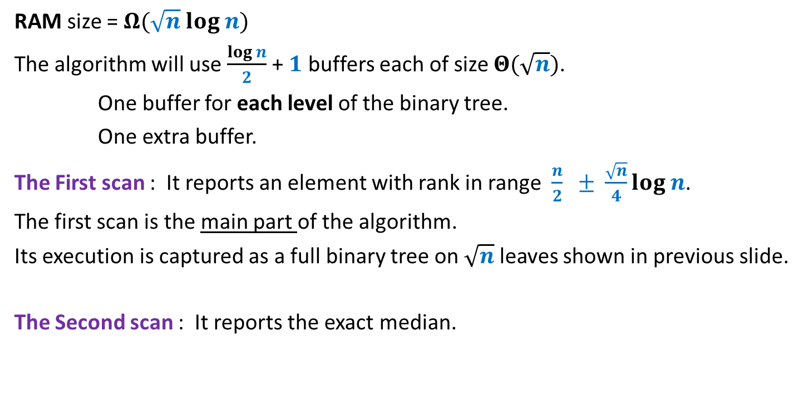

The $2$scan Algorithm
RAM size = $Ω(\sqrt{n} log n)$
The algorithm will use $\frac{log n}{2}$ + $1$ buffers each of size $Θ(\sqrt{n})$.
One buffer for each level of the binary tree.
One extra buffer.
The First scan : It reports an element with rank in range $\frac{n}{2} ± \frac{\sqrt{n}}{4}log n$.
The first scan is the main part of the algorithm.
Its execution is captured as a full binary tree on $\sqrt{n}$ leaves shown in previous slide.
The Second scan : It reports the exact median.

Slide 31
Analysis of first scan

Slide 32

Main-Lemma
The median of the root is away from the median of the set by at most
$|\frac{\sqrt{n}}{2}log n|$.

Slide 33
Proof of Main-Lemma

Slide 34
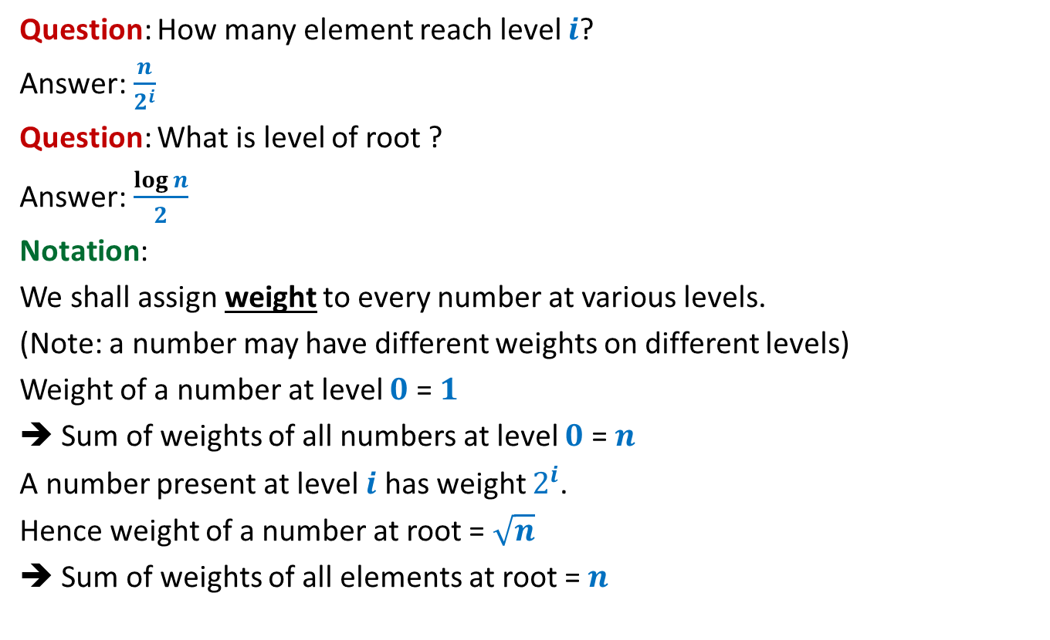
Some basic terminologies
Question: How many element reach level $i$?
Answer: $\frac{n}{2^{i}}$
Question: What is level of root ?
Answer: $\frac{log n}{2}$
Notation:
We shall assign weight to every number at various levels.
(Note: a number may have different weights on different levels)
Weight of a number at level $0$ = $1$
➔ Sum of weights of all numbers at level $0$ = $n$
A number present at level $i$ has weight $2^{i}$.
Hence weight of a number at root = $\sqrt{n}$
➔ Sum of weights of all elements at root = $n$

Slide 35
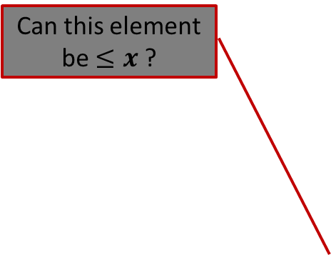
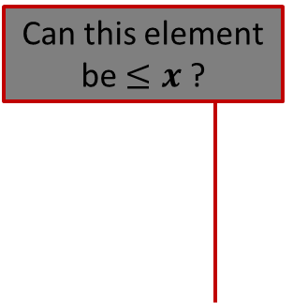

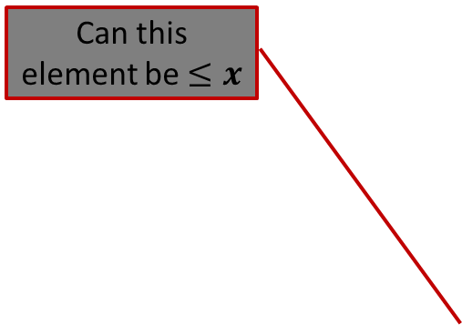

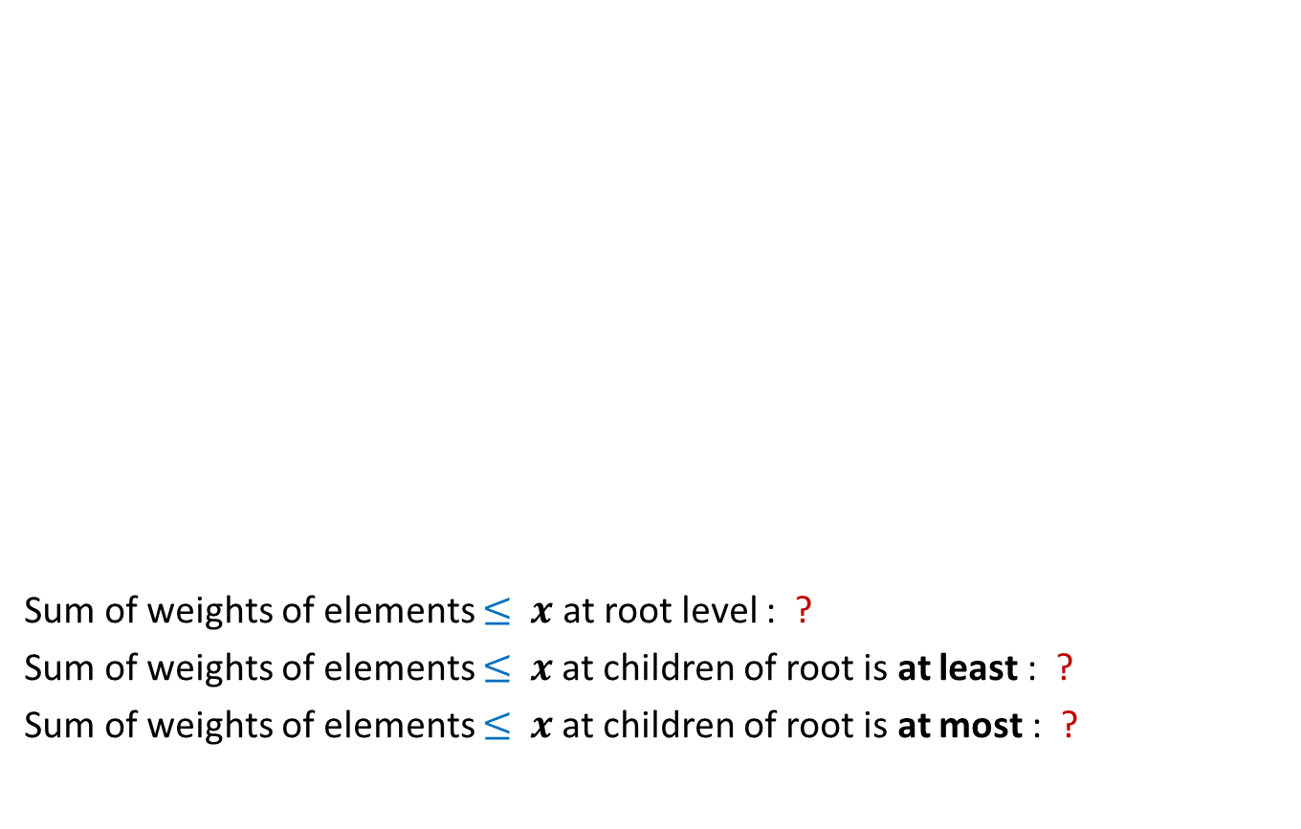








Analyzing root
$$x$$
$$k$$
1 2 3 4 5 6 7 8
Sum of weights of elements $≤$ $x$ at root level : ?
Sum of weights of elements $≤$ $x$at children of root is at least : ?
Sum of weights of elements $≤$ $x$at children of root is at most : ?
Can this element be $≤x$ ?
Can this element be $≤x$
Can be
Can this element be $≤x$ ?
never
Can this element be $≤x$ ?
Can be
never
$$x$$
$$x$$
Left
Right
$\sqrt{n} k$
$\frac{\sqrt{n}}{2} . 2k$
$\sqrt{n} k$
$\sqrt{n} k+2\frac{\sqrt{n}}{2}$
$\sqrt{n} k$ + $\sqrt{n}$

Slide 36


Analysis
3
+$\sqrt{n}$
2
+$\sqrt{n}$
1
0
$$\sqrt{n}$$
$$\sqrt{n}$$
$$\sqrt{n}$$
$$\sqrt{n}$$
$$\sqrt{n}$$
$$\sqrt{n}$$
$$\sqrt{n}$$
$$\sqrt{n}$$
Disc

Slide 37
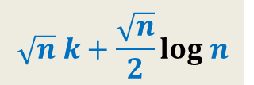
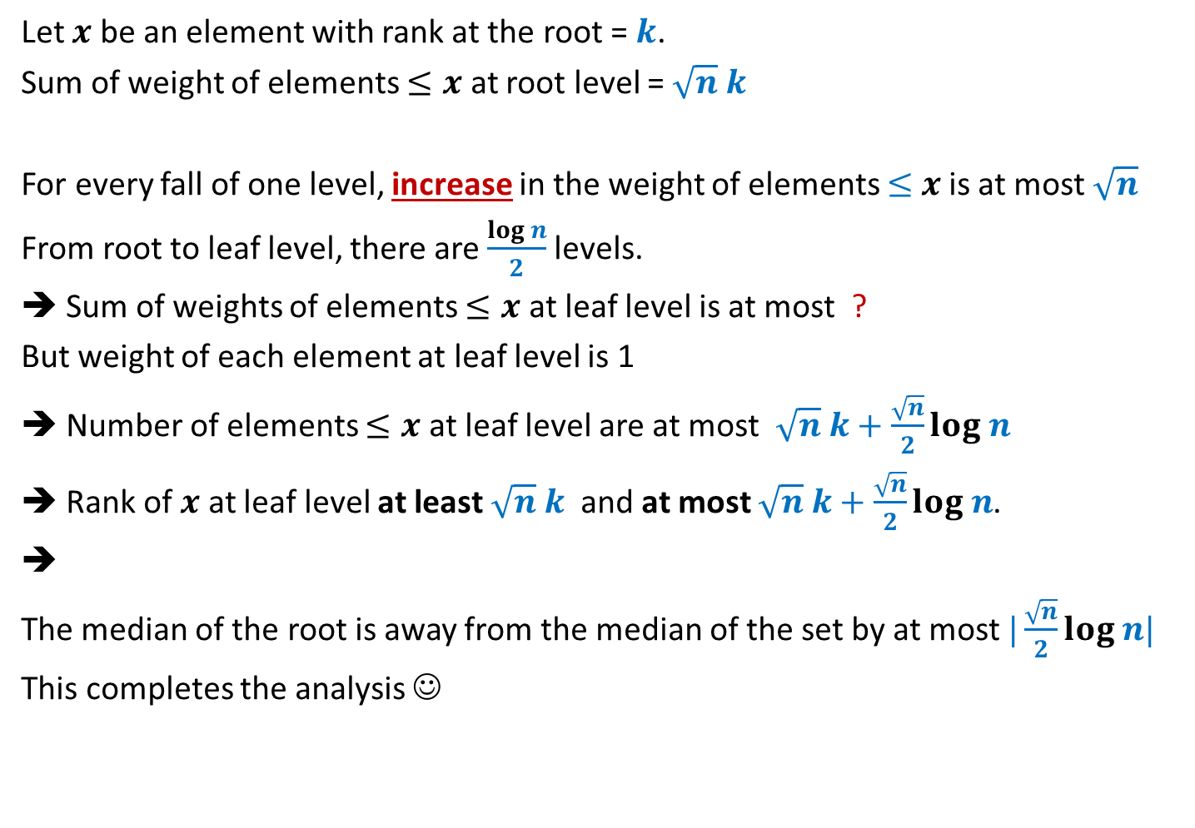
Analysis
Let $x$ be an element with rank at the root = $k$.
Sum of weight of elements $≤x$ at root level = $\sqrt{n} k$
For every fall of one level, increase in the weight of elements $≤$ $x$ is at most $\sqrt{n}$
From root to leaf level, there are $\frac{log n}{2}$levels.
➔ Sum of weights of elements $≤x$ at leaf level is at most ?
But weight of each element at leaf level is 1
➔ Number of elements $≤x$ at leaf level are at most $\sqrt{n} k+\frac{\sqrt{n}}{2}log n$
➔ Rank of $x$ at leaf level at least $\sqrt{n} k$ and at most $\sqrt{n} k+\frac{\sqrt{n}}{2}log n$.
➔
The median of the root is away from the median of the set by at most $|\frac{\sqrt{n}}{2}log n|$
This completes the analysis ☺
$$\sqrt{n} k+\frac{\sqrt{n}}{2}log n$$

Slide 38
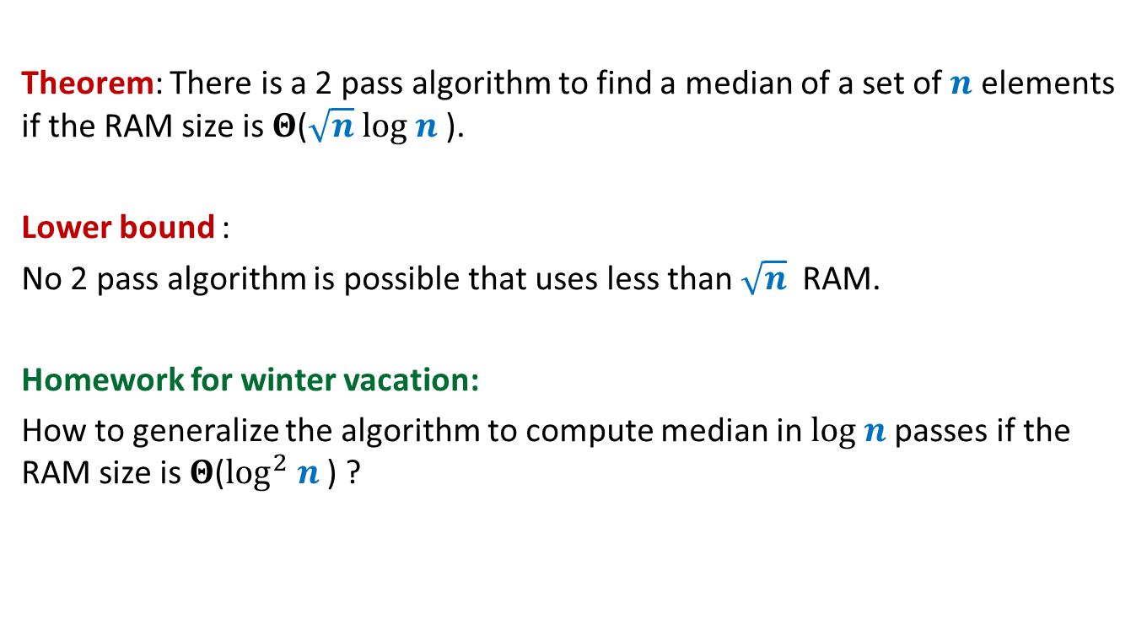
Conclusion
Theorem: There is a 2 pass algorithm to find a median of a set of $n$ elements if the RAM size is $Θ$($\sqrt{n} log n$).
Lower bound :
No 2 pass algorithm is possible that uses less than $\sqrt{n}$ RAM.
Homework for winter vacation:
How to generalize the algorithm to compute median in $log n$passes if the RAM size is $Θ$($\log^{2} n$) ?

