Slide 1
Design and Analysis of Algorithms (CS345/CS345A)
Lecture 5
Data structures for
Orthogonal Range Searching
Dynamic sequences
Revisiting from last class

Slide 2
What makes BST powerful and pervasive ?
: Additional information

Slide 3

Orthogonal Range searching
Data structure: Size = O($n log n$),
Query = O($k+ \log^{2} n$),
Preprocessing time = O($n log n$)
Rectangle

Slide 4

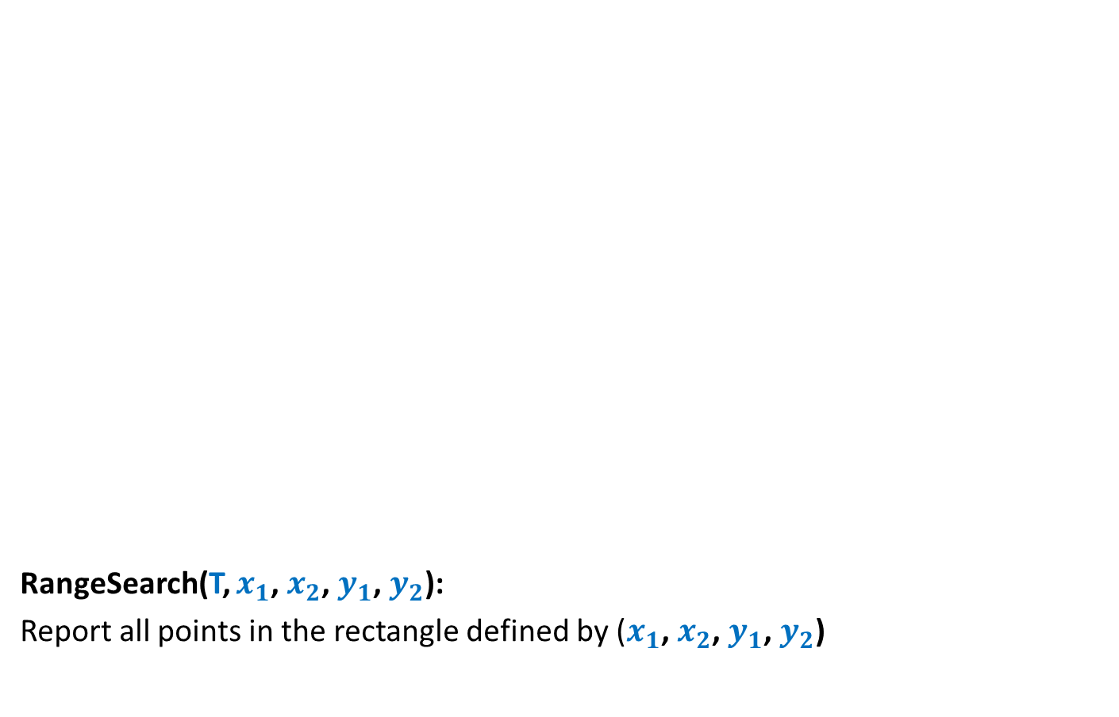



Orthogonal Range searching
RangeSearch(T, $x_{1}$, $x_{2}$, $y_{1}$, $y_{2}$):
Report all points in the rectangle defined by ($x_{1}$, $x_{2}$, $y_{1}$, $y_{2}$)
$$y_{2}$$
$$y_{1}$$
Rectangle
$$x_{1}$$
$$x_{2}$$

Slide 5

Orthogonal Range searching
RangeSearch(T, $x_{1}$, $x_{2}$, $y_{1}$, $y_{2}$)
RangeSearch(T, $x_{1}$, $x_{2}$):
Report all points whose $x$-coordinate lie in [$x_{1}$, $x_{2}$]

Slide 6




RangeSearch(T, $x_{1}$, $x_{2}$):
Binary search tree on $x$-coordinates
$x_{2}$
$x_{1}$
T

Slide 7
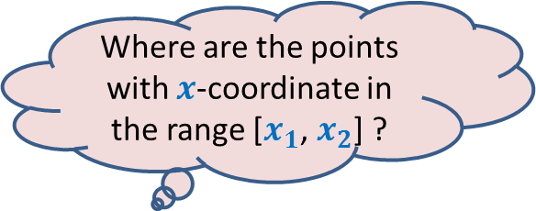
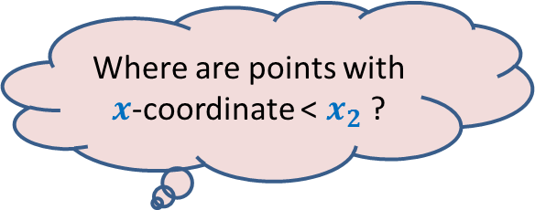
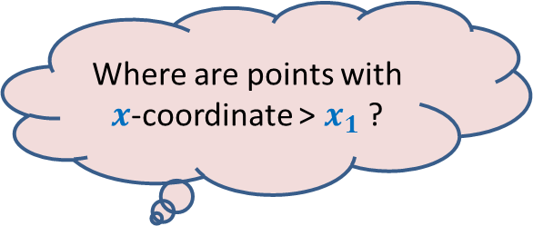

RangeSearch(T, $x_{1}$, $x_{2}$):
Binary search tree on x-coordinates
Where are points with $x$-coordinate > $x_{1}$ ?
Where are points with $x$-coordinate < $x_{2}$ ?
Where are the points with $x$-coordinate in the range [$x_{1}$, $x_{2}$] ?
LCA
$x_{2}$
$x_{1}$
T

Slide 8
RangeSearch(T, $x_{1}$, $x_{2}$):
Binary search tree on x-coordinates
LCA
$x_{2}$
$x_{1}$
T

Slide 9
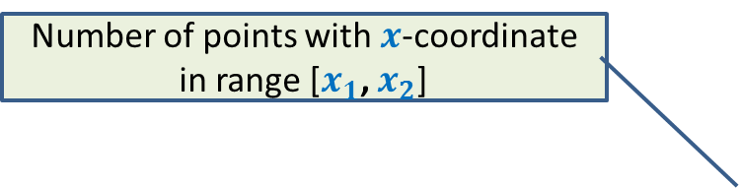

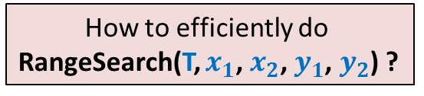
RangeSearch(T, $x_{1}$, $x_{2}$):
Number of points with $x$-coordinate in range [$x_{1}$, $x_{2}$]
Binary search tree on x-coordinates
How to efficiently do
RangeSearch(T, $x_{1}$, $x_{2}$, $y_{1}$, $y_{2}$) ?
Query time = O($k+log n$),
LCA
$x_{2}$
$x_{1}$
T

Slide 10
How should we augment each node?
value
Color-bit
Y-tree
left
v
right
BST storing T(v) according to y-coordinate
T(v)
v

Slide 11

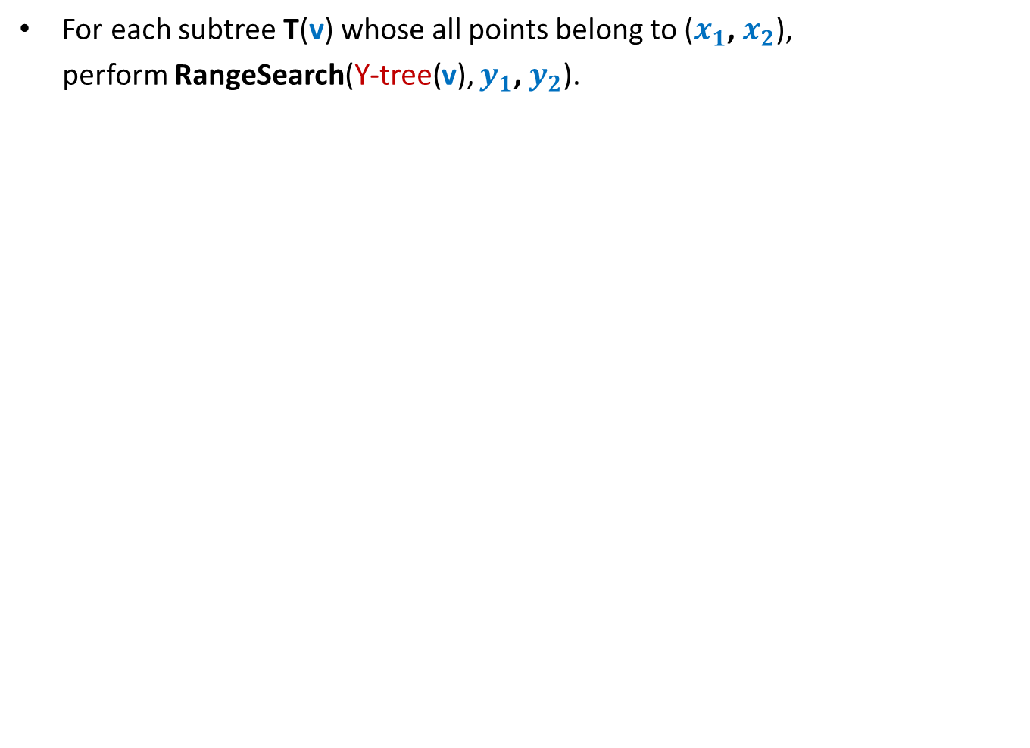

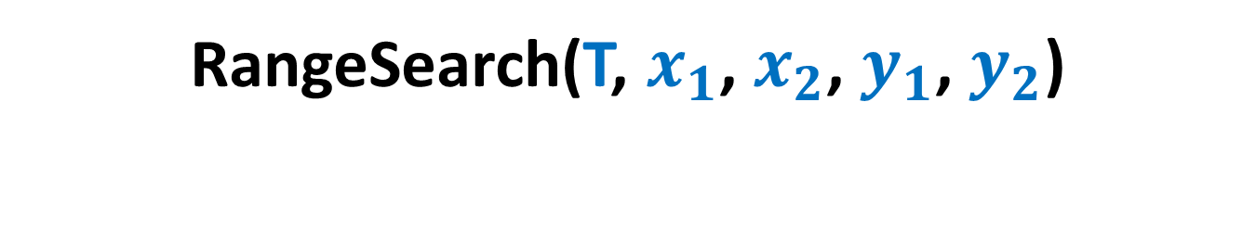
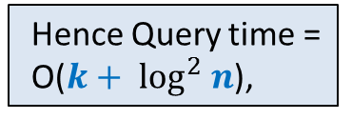
RangeSearch(T, $x_{1}$, $x_{2}$, $y_{1}$, $y_{2}$)
For each subtree T(v) whose all points belong to ($x_{1}$, $x_{2}$),
perform RangeSearch(Y-tree(v), $y_{1}$, $y_{2}$).
For each such subtree, time complexity will be O($k′+log n$), where $k′$are the points present in that subtree that belong to rectangle($x_{1}$, $x_{2}$, $y_{1}$, $y_{2}$).
LCA
There are O($log n$) such subtrees.
Hence Query time =
O($k+ \log^{2} n$),
$x_{2}$
$x_{1}$
T

Slide 12



Space of the data structure
Consider all the nodes at level $i$.
1
2
3
4
. . .
. . .
$$i$$
. . .
. . .
T
O(Log $n$)
BST before augmentation

Slide 13













Space of the data structure
$n_{1}$+ $n_{2}+$ $n_{3}$ + …+ $n_{j}$ < $n$
Total space due to the y-trees at level $i$ :
= $n_{1}$+ $n_{2}+$ $n_{3}$ + …+ $n_{j}$
= O($n$).
$$1$$
$$2$$
$$3$$
. . .
$$j$$
$$i$$
$$n_{1}$$
$$n_{2}$$
$$n_{3}$$
$$n_{j}$$
. . .
$$n_{1}$$
$$n_{2}$$
T
$$n_{3}$$
$$n_{j}$$
BST before augmentation

Slide 14






Orthogonal Range Searching
Space | Query time | Preprocessing time
O($n$ log $n$)
O($k+$ $\log^{2} n$)
O($n$ log $n$)
O($n$)
O($k+$ $\sqrt{n}$)
O($n$ log $n$)
Meant for students with pure interest in Algo. & Data str.

Slide 15
Data Structure
For Dynamic Sequences

Slide 16



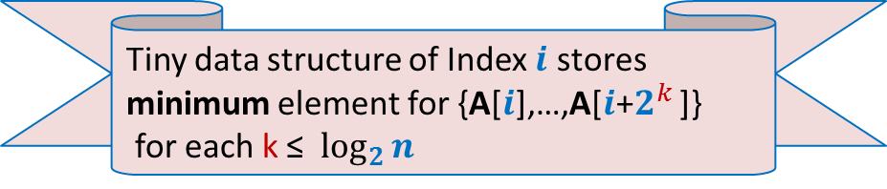

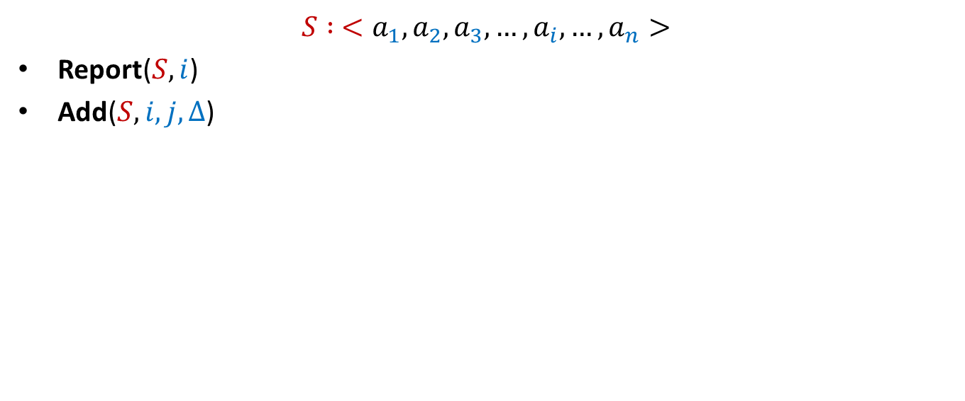




Dynamic Sequences
$$S : <a_{1}, a_{2},a_{3},…,a_{i}, …,a_{n}>$$
Report($S,i$)
Add($S,i,j,Δ$)
Add($S,3,8,6$)
Report($S,5$)
$$S$$
$$5$$
$$3$$
$$1$$
$$701$$
$$23$$
$$19$$
$$41$$
$$83$$
$$8$$
$$5$$

Slide 17




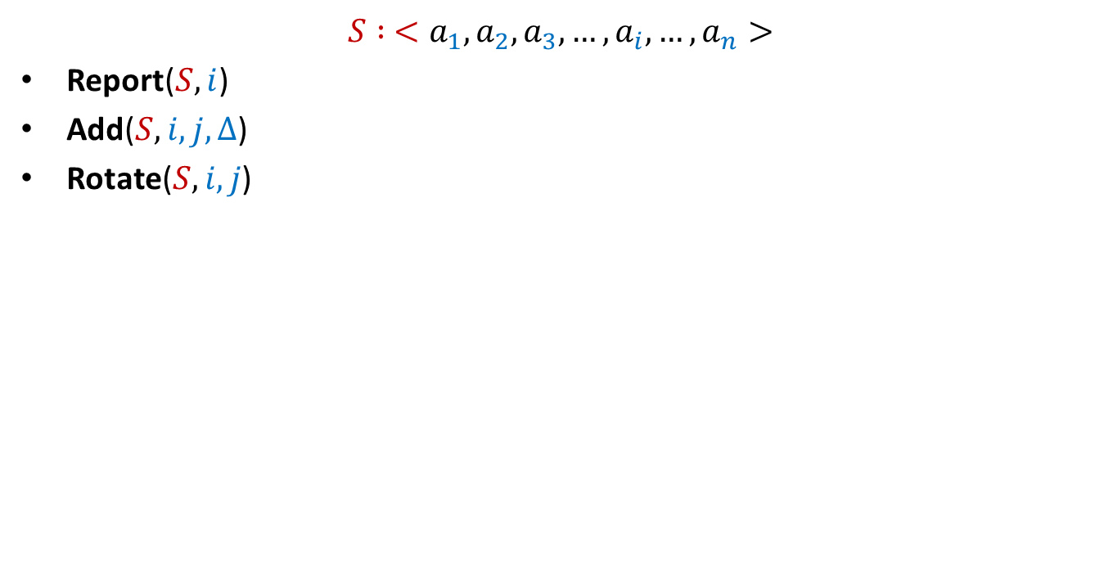


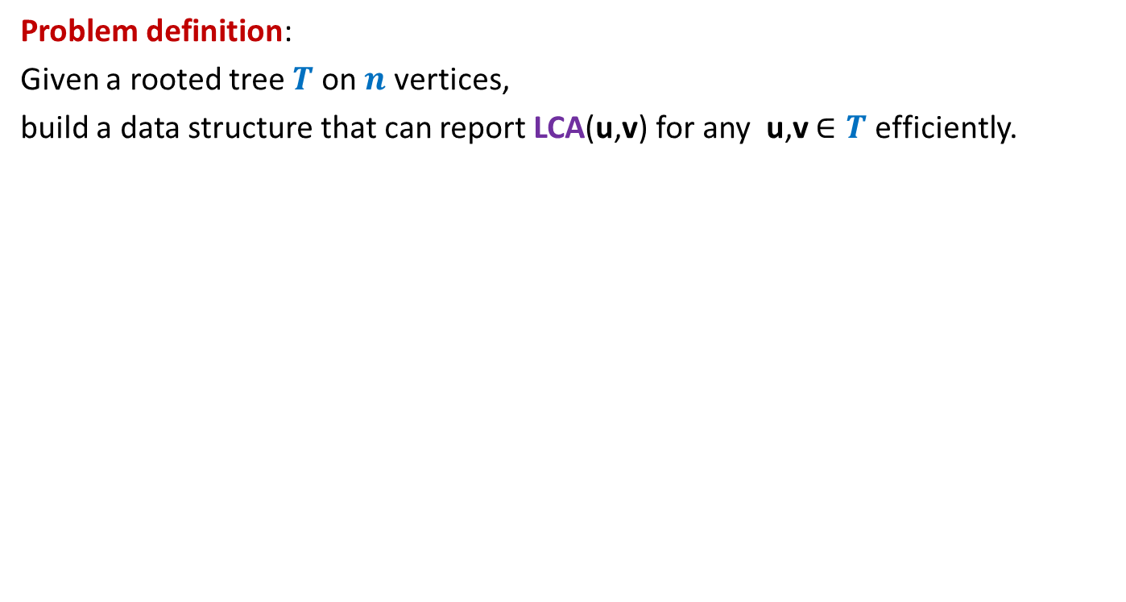






Dynamic Sequences
$$S : <a_{1}, a_{2},a_{3},…,a_{i}, …,a_{n}>$$
Report($S,i$)
Add($S,i,j,Δ$)
Rotate($S,i,j$)
$≈$ log $n$
Rotate($S,4,8$)
$$S$$
$$5$$
$$89$$
$$707$$
$$3$$
$$68$$
$$7$$
$$707$$
$$29$$
$$89$$
$$47$$
$$25$$
$$25$$
$$47$$
$$29$$
$$8$$
$$5$$

Slide 18
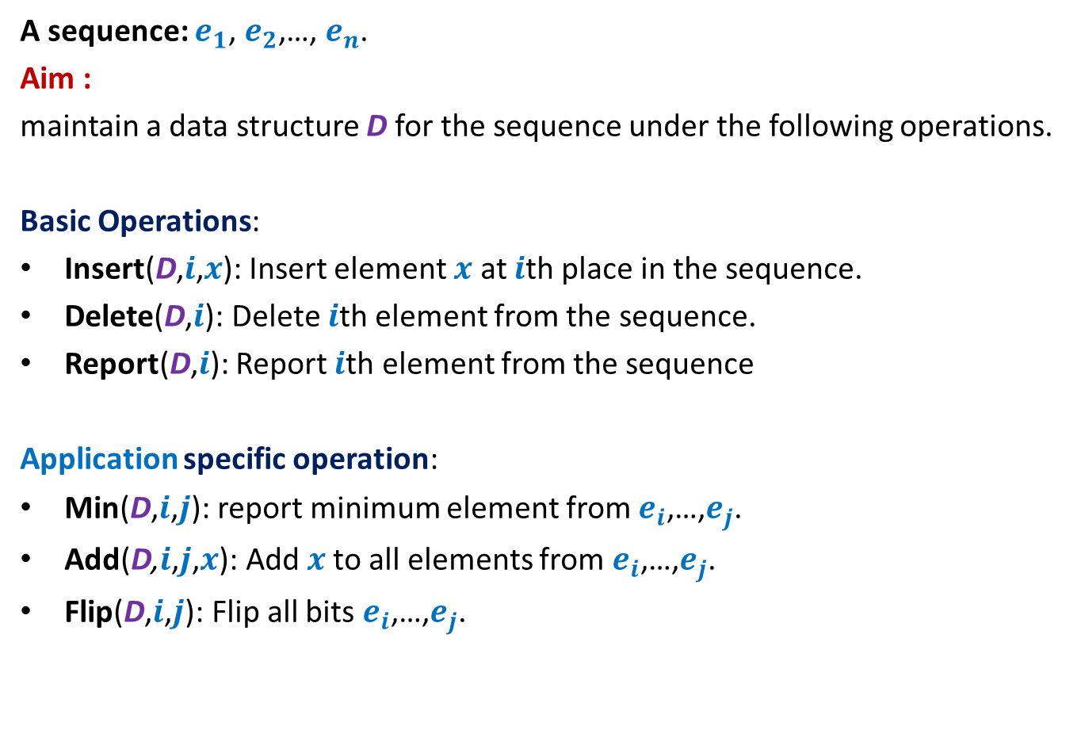
Dynamic Sequence
A sequence: $e_{1}$, $e_{2}$,…, $e_{n}$.
Aim :
maintain a data structure D for the sequence under the following operations.
Basic Operations:
Insert(D,$i$,$x$): Insert element $x$ at $i$th place in the sequence.
Delete(D,$i$): Delete $i$th element from the sequence.
Report(D,$i$): Report $i$th element from the sequence
Application specific operation:
Min(D,$i$,$j$): report minimum element from $e_{i}$,…,$e_{j}$.
Add(D,$i$,$j$,$x$): Add $x$to all elements from $e_{i}$,…,$e_{j}$.
Flip(D,$i$,$j$): Flip all bits $e_{i}$,…,$e_{j}$.
OR
OR

Slide 19



Representing sequence using a BST
A sequence: $e_{1}$, $e_{2}$,…, $e_{n}$.
Example: $6$, $0$, $5$, $13$, $2$, $14$, $1$, $32$.
“Inorder traversal produces the sequence.”
How can we represent a sequence using BST ?
$$2$$
$$0$$
$$1$$
$$6$$
$$5$$
$$14$$
$$32$$
$$13$$

Slide 20
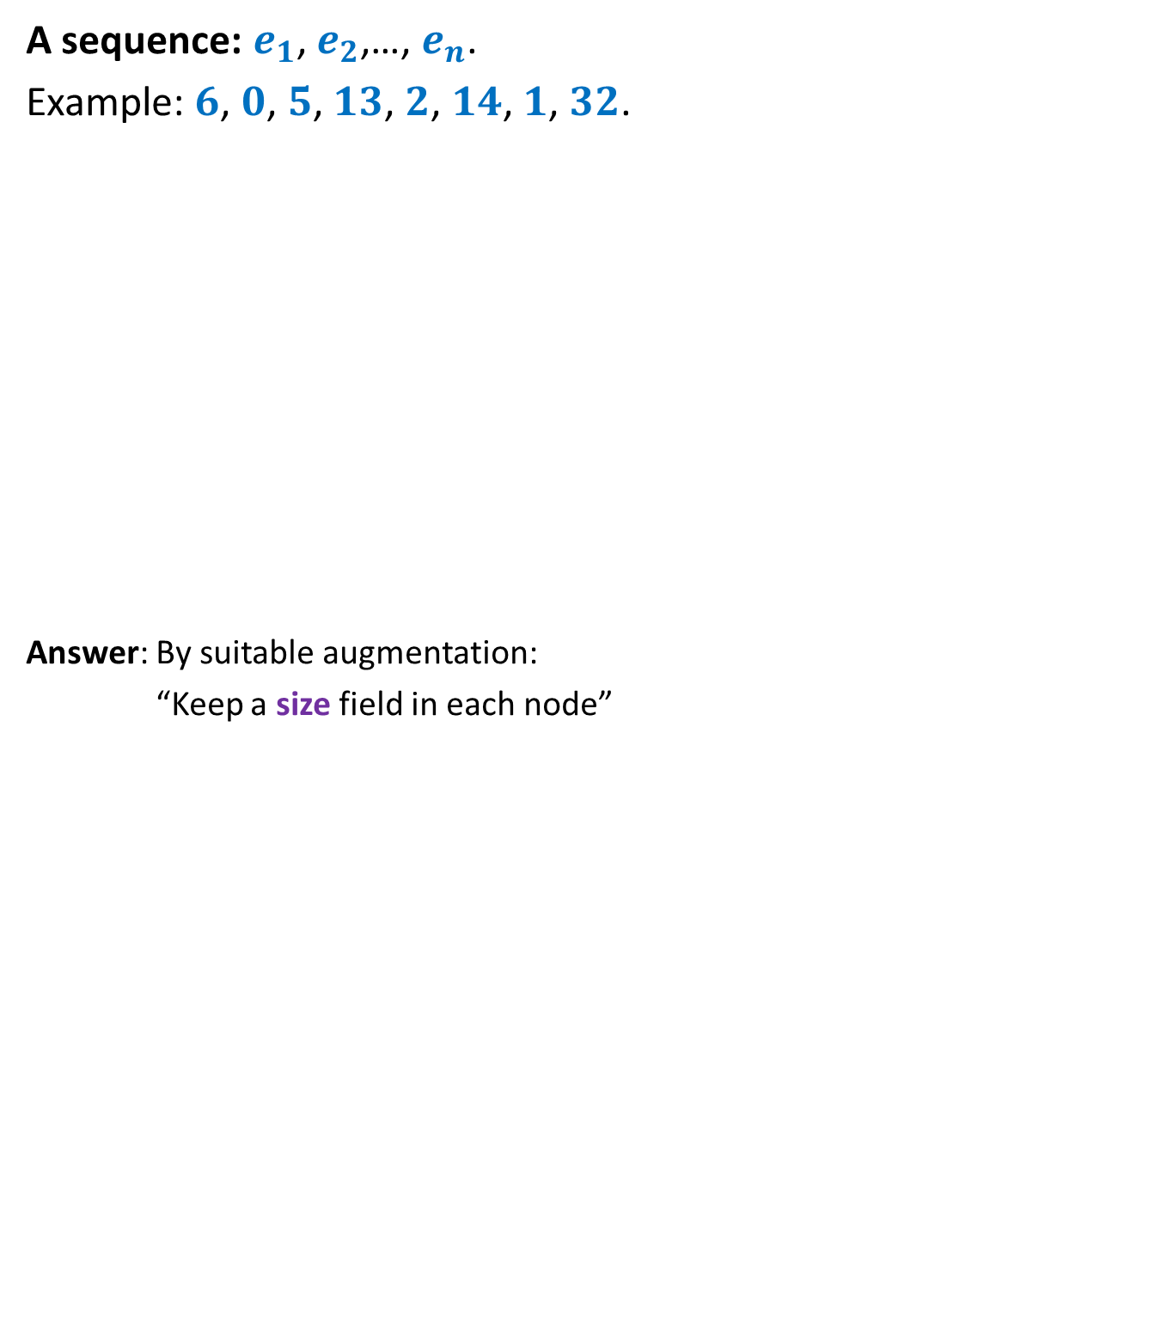

Representing sequence using a BST
A sequence: $e_{1}$, $e_{2}$,…, $e_{n}$.
Example: $6$, $0$, $5$, $13$, $2$, $14$, $1$, $32$.
Answer: By suitable augmentation:
“Keep a size field in each node”
How to access $i$th element of the sequence ?
: size field
$$2$$
8
$$0$$
4
$$1$$
3
$$6$$
1
$$5$$
2
$$14$$
1
$$32$$
1
$$13$$
1

Slide 21



Report($T,$ $i$)
Report(T,$i$)
{ found=false; $\text{u} \text{← }$T ;
While( not found)
{
s ← size(left(u));
if(s = $i−1$) ?? ;
else if(s > $i−1$) ?? ;
else {
?? ;
?? ;
}
}
return val(u);
}
u
if(left(u)=NULL) s ← 0;
else
$\text{found}\text{← }\text{true}$;
$$\text{u} \text{← }\text{left}\text{(}\text{u}\text{)}$$
$i\text{←}i−$size(left(u)) $−$1
u← $\text{right}\text{(}\text{u}\text{)}$;

Slide 22
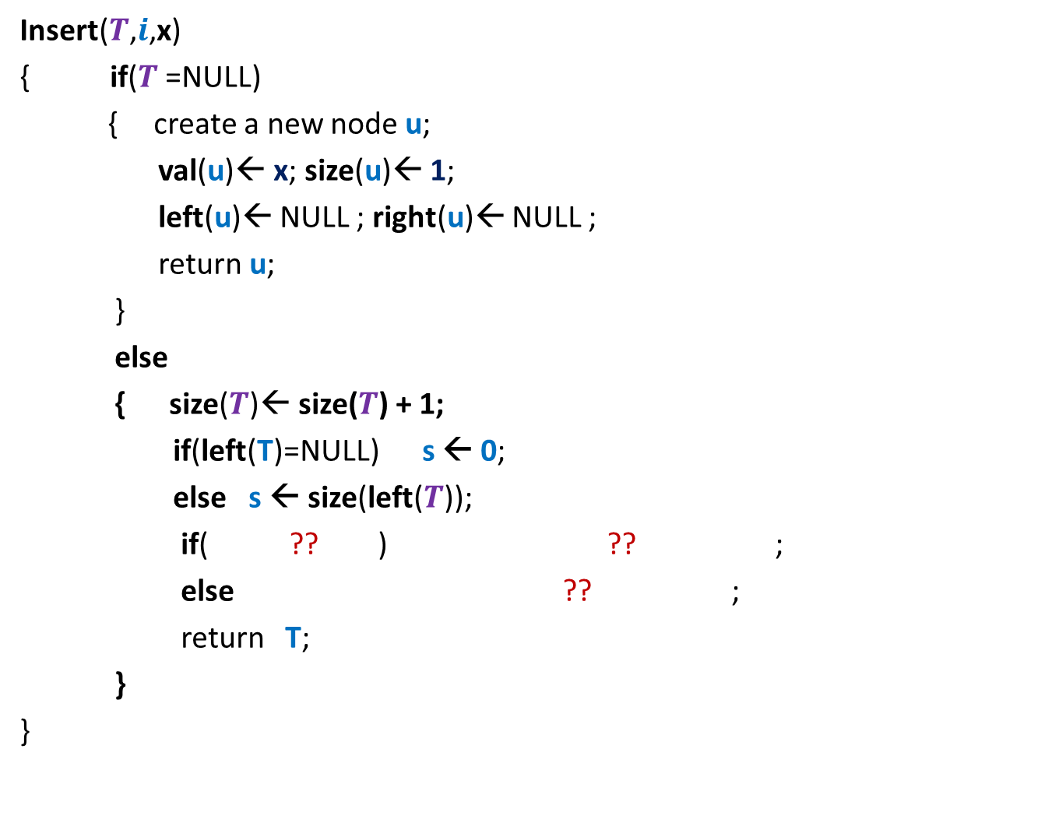




Insert($T,$ $i$, x)
Insert($T$,$i$,x)
{ if($T$=NULL)
{ create a new node $\text{u}$;
val($\text{u}$)← x; size($\text{u}$)← 1;
left($\text{u}$)← NULL ; right($\text{u}$)← NULL ;
return $\text{u}$;
}
else
{ size($T$)← size($T$) + 1;
if(left(T)=NULL) s ← 0;
else s ← size(left($T$));
if( ?? ) ?? ;
else ?? ;
return $\text{T}$;
}
}
T
Don’t forget to rebalance the tree height at the end !
$i$ $≤$s $+$1
$$\text{left}\text{(}T\text{)} \text{←}\text{Insert}\text{(}\text{(}\text{left}\text{(}T\text{))}\text{,}i\text{,}\text{x}\text{)}$$
$\text{righ}\text{t}\text{(}T\text{)} \text{←}\text{Insert}\text{(}\text{(}\text{right}\text{(}T\text{))}\text{,}i−1−\text{s}\text{,}\text{x}\text{)}$;

Slide 23
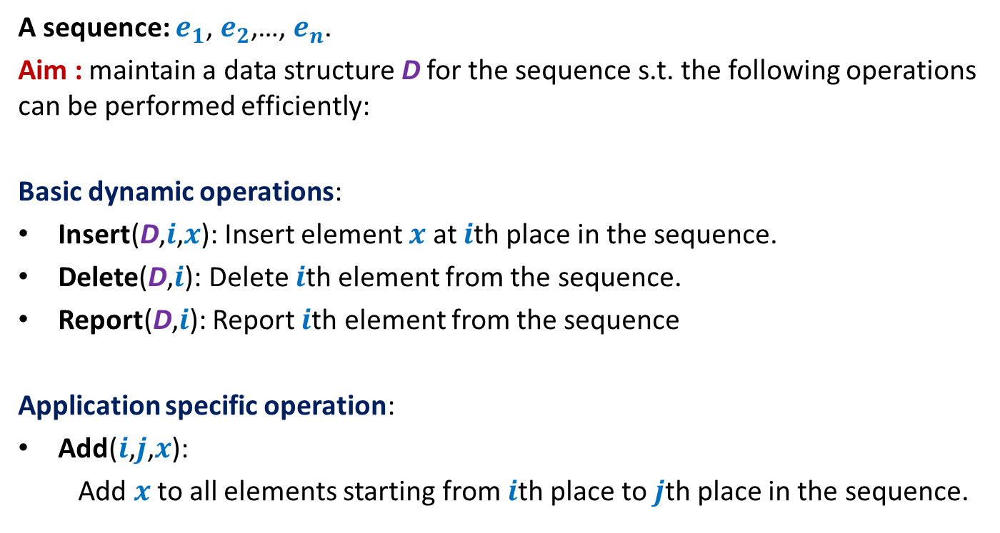
Example 2: sequence of numbers
A sequence: $e_{1}$, $e_{2}$,…, $e_{n}$.
Aim : maintain a data structure D for the sequence s.t. the following operations can be performed efficiently:
Basic dynamic operations:
Insert(D,$i$,$x$): Insert element $x$ at $i$th place in the sequence.
Delete(D,$i$): Delete $i$th element from the sequence.
Report(D,$i$): Report $i$th element from the sequence
Application specific operation:
Add($i$,$j$,$x$):
Add $x$to all elements starting from $i$th place to $j$th place in the sequence.

Slide 24
Performing Add(T,i,j,x)
View the entire tree T from perspective of the paths from i and j to the root.
How will T look like ?
LCA(i,j)
j
i
T

Slide 25
Performing Add(T,i,j,x)
What are the nodes whose values has to be incremented by x ?
LCA(i,j)
j
i
T

Slide 26
Performing Add(T,i,j,x)
LCA(i,j)
j
i
T

Slide 27
Performing Add(T,i,j,x)
Easy
There are O(log $n$) nodes on the two paths whose value needs to incremented.
There are O(log $n$) subtrees also s.t. value of each of their elements needs to incremented☹
We can not afford to increment the value of each node in these subtrees explicitly. So what to do ?
: incr
LCA(i,j)
Keep an extra field incr
such that adding x to incr field of v means
….
j
adding x to each element in T(v)
i
T

Slide 28

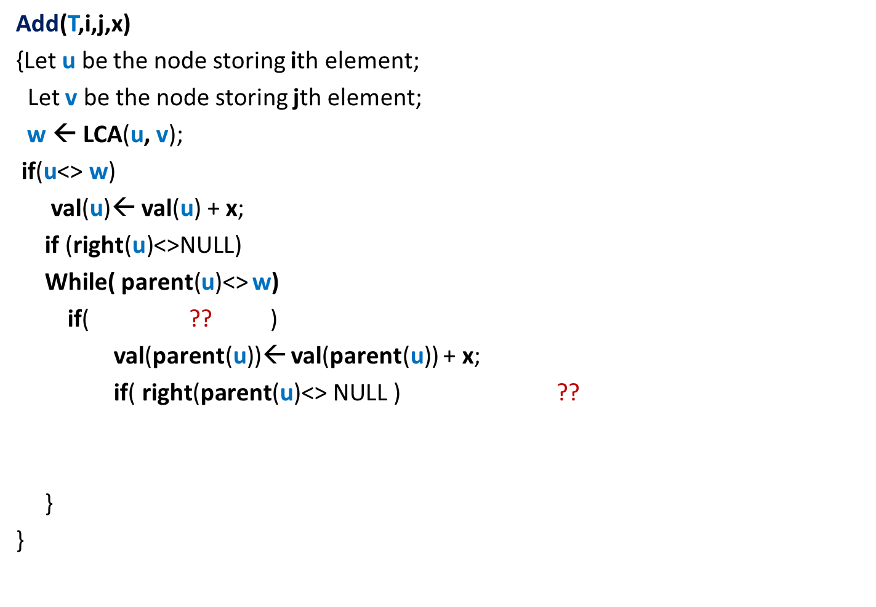


Performing Add(T,i,j,x)
Add(T,i,j,x)
{Let $\text{u}$ be the node storing ith element;
Let $\text{v}$ be the node storing jth element;
$\text{w} \text{← }$LCA($\text{u}$, $\text{v}$);
if($\text{u}$<> $\text{w}$)
val($\text{u}$)← val($\text{u}$) + x;
if (right(u)<>NULL)
While( parent($\text{u}$)<> $\text{w}$)
if( ?? )
val(parent($\text{u}$))← val(parent($\text{u}$)) + x;
if( $\text{right}\text{(}\text{parent}\text{(}\text{u}\text{)<> }\text{NULL}\text{ )}$ ??
}
}
val($\text{w}$)← val($\text{w}$) + x
{
incr(right($\text{u}$))← incr(right($\text{u}$)) + x ;
{
$\text{u}$=left(parent(u))
{
Incr(right($\text{parent}\text{(}\text{u}$)))← incr(right($\text{parent}\text{(}\text{u}$))) + x;
}
$\text{u}\text{←}\text{parent}\text{(}\text{u}$);
------- similarly process $\text{v}$---------(do it as homework);

Slide 29
Homework
Modify the pseudo-code of Report($T,$ $i$) suitably
s.t. it reports the correct value of $e_{i}$ .
Hint : Revisit the previous slide.
2. Modify the pseudo-code of Insert($T,$ $i$, x).
Hint :
You need to consider the field incr() on the path from root to the newly inserted node containing x. There are two options:
Option 1: You subtract the value of incr() field of each node on this path from x, and store that value at the newly inserted leaf node.
Option 2: Propagate the influence of incr() field of each node on the path downward lazily such that incr() field of all nodes on the path become 0.
In this case, the newly inserted node has value = x.

Slide 30
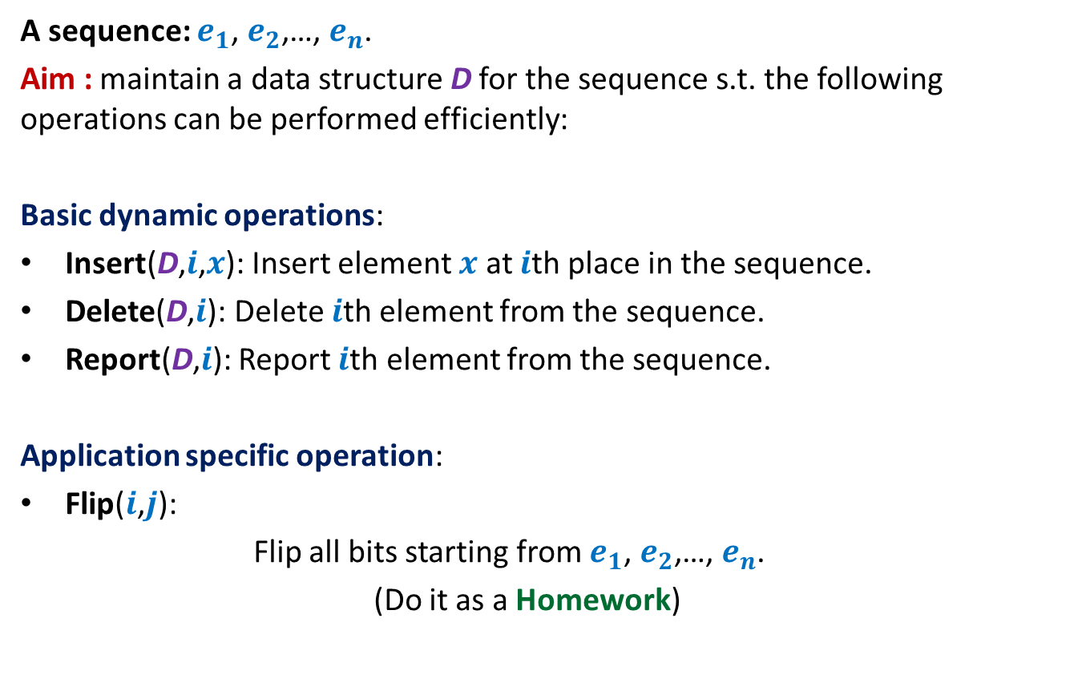
Example 3: sequence of bits
A sequence: $e_{1}$, $e_{2}$,…, $e_{n}$.
Aim : maintain a data structure D for the sequence s.t. the following operations can be performed efficiently:
Basic dynamic operations:
Insert(D,$i$,$x$): Insert element $x$ at $i$th place in the sequence.
Delete(D,$i$): Delete $i$th element from the sequence.
Report(D,$i$): Report $i$th element from the sequence.
Application specific operation:
Flip($i$,$j$):
Flip all bits starting from $e_{1}$, $e_{2}$,…, $e_{n}$.
(Do it as a Homework)

Slide 31
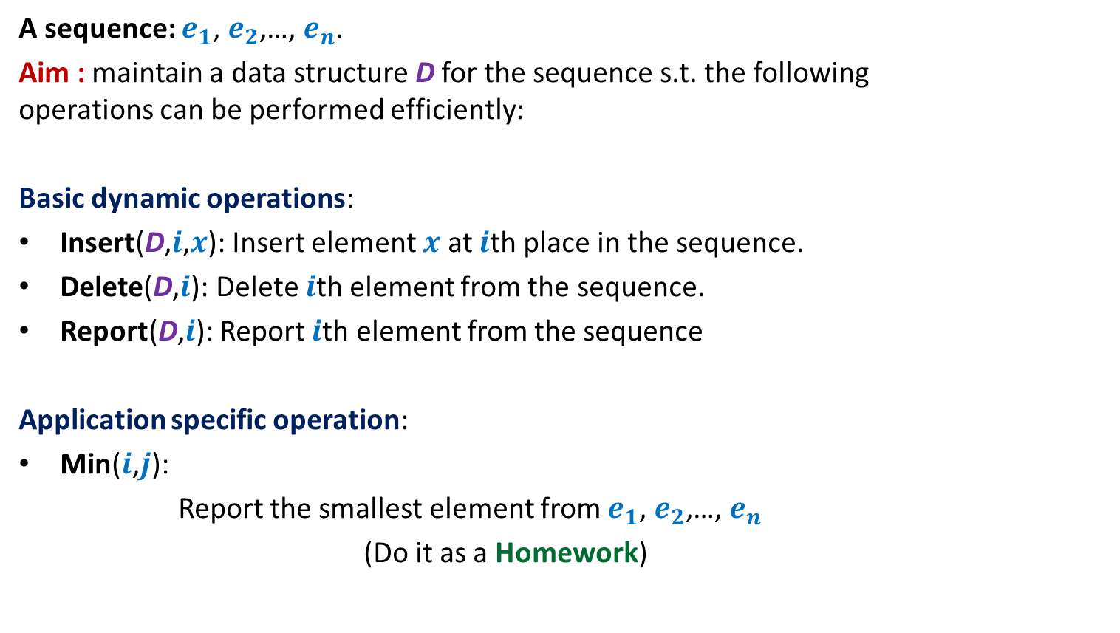
Example 1: sequence of numbers
A sequence: $e_{1}$, $e_{2}$,…, $e_{n}$.
Aim : maintain a data structure D for the sequence s.t. the following operations can be performed efficiently:
Basic dynamic operations:
Insert(D,$i$,$x$): Insert element $x$ at $i$th place in the sequence.
Delete(D,$i$): Delete $i$th element from the sequence.
Report(D,$i$): Report $i$th element from the sequence
Application specific operation:
Min($i$,$j$):
Report the smallest element from $e_{1}$, $e_{2}$,…, $e_{n}$
(Do it as a Homework)

