Slide 1
Design and Analysis of Algorithms (CS345/CS345A)
Lecture 6
Augmented BST (Final lecture)
Interval tree:
an augmented BST used for geometric problems

Slide 2
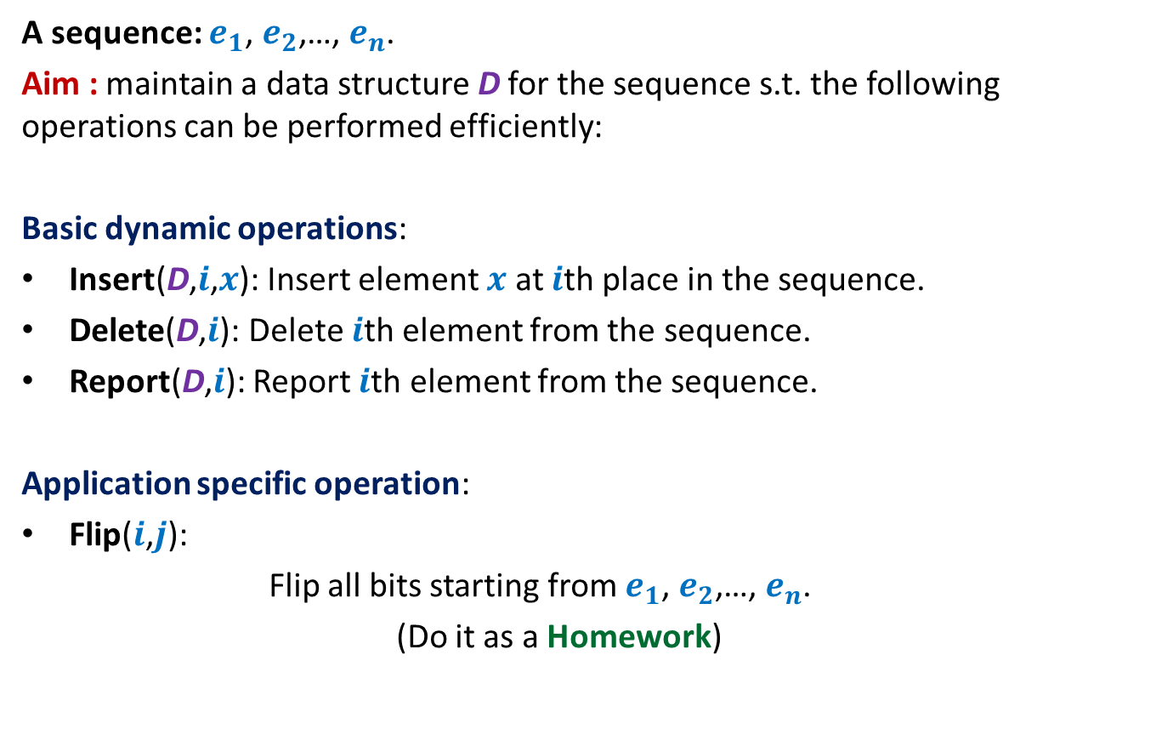
Example 3: sequence of bits
A sequence: $e_{1}$, $e_{2}$,…, $e_{n}$.
Aim : maintain a data structure D for the sequence s.t. the following operations can be performed efficiently:
Basic dynamic operations:
Insert(D,$i$,$x$): Insert element $x$ at $i$th place in the sequence.
Delete(D,$i$): Delete $i$th element from the sequence.
Report(D,$i$): Report $i$th element from the sequence.
Application specific operation:
Flip($i$,$j$):
Flip all bits starting from $e_{1}$, $e_{2}$,…, $e_{n}$.
(Do it as a Homework)

Slide 3
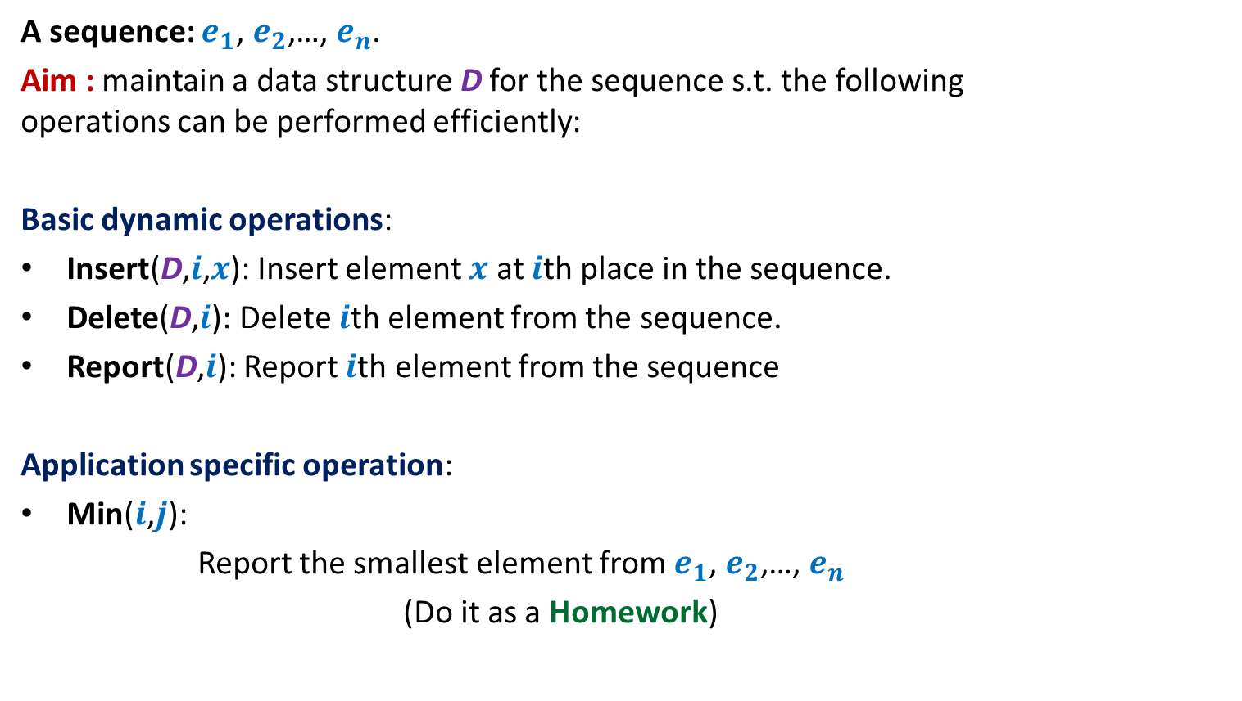
Example 1: sequence of numbers
A sequence: $e_{1}$, $e_{2}$,…, $e_{n}$.
Aim : maintain a data structure D for the sequence s.t. the following operations can be performed efficiently:
Basic dynamic operations:
Insert(D,$i$,$x$): Insert element $x$ at $i$th place in the sequence.
Delete(D,$i$): Delete $i$th element from the sequence.
Report(D,$i$): Report $i$th element from the sequence
Application specific operation:
Min($i$,$j$):
Report the smallest element from $e_{1}$, $e_{2}$,…, $e_{n}$
(Do it as a Homework)
What if you have to implement Min()
as well as ADD() for the data structure ?

Slide 4
interval tree
An augmented BST used for many
geometric problems

Slide 5





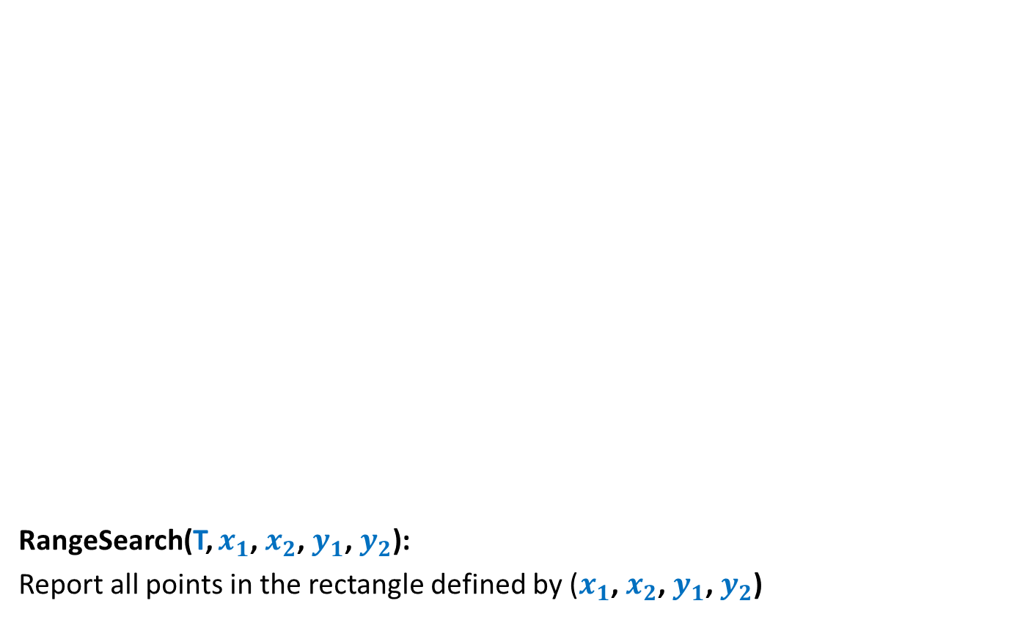
Interval
An interval [$a$, $b$] = {$x∈R$| $a≤x≤b$}.
For an interval $I$ = [$a$, $b$],
high[$I$] = $b$
low[$I$] = $a$
Given any two intervals [$a$, $b$] and [$c$, $d$],
they either overlap or don’t overlap.
➔ It takes O(1) time to check if two intervals overlap.
$$a$$
$$b$$
$$c$$
$$d$$
$$c$$
$$d$$
$$c$$
$$d$$
$$c$$
$$d$$

Slide 6



Problem Definition
Maintain a data structure for a set $S$ of intervals
so that the following operations can be performed efficiently.
Insert($S$,$I$): Insert interval $I$into $S$.
Delete($S$,$I$): Delete $I$from $S$.
Overlap($S$,$I$): determine if $I$overlaps any interval from $S$.
$$I$$
$$I$$
1
3
10
19
23
27
4
20
7
11
24
30

Slide 7
How to build a BST on intervals ?
1
3
10
19
23
27
4
20
7
11
24
30

Slide 8
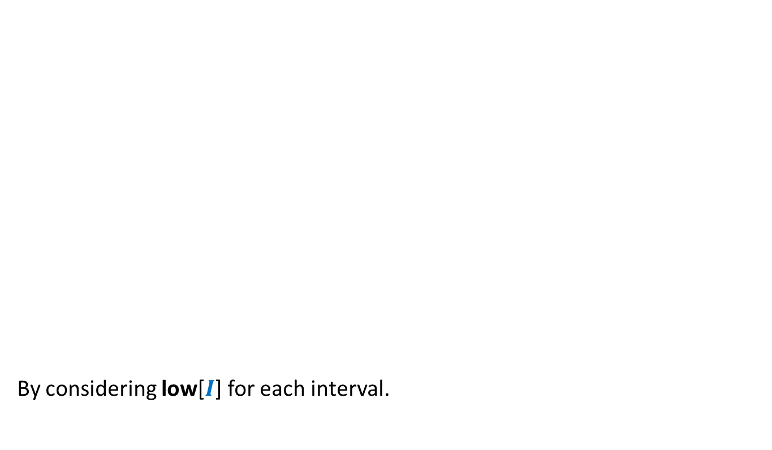
How to build a BST on intervals ?
How to define a total order on intervals ?
By considering low[$I$] for each interval.
1
3
10
19
23
27
4
20
7
11
24
30

Slide 9
How to build a BST on intervals ?
1
3
10
19
23
27
4
20
7
11
24
30

Slide 10

How to augment the BST ?
?
Main objective: How to perform Overlap($S$,$I$) efficiently ?
“determine if a query interval $I$overlaps any interval in tree storing intervals $S$.”
?
?
?
?
?

Slide 11

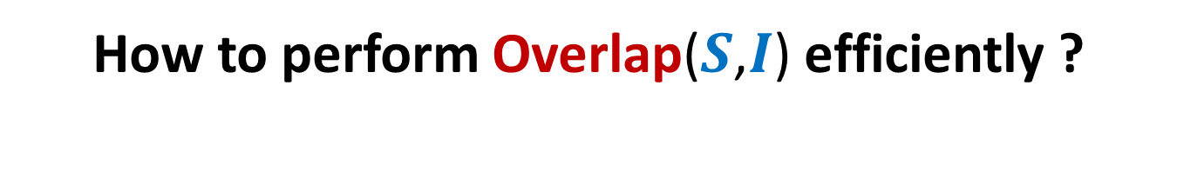

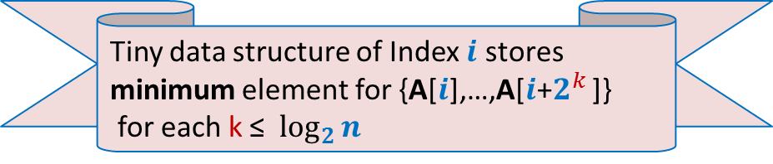



How to perform Overlap($S$,$I$) efficiently ?
$$c$$
$$d$$
$$c$$
$$d$$
$$c$$
$$d$$
$$a$$
$$b$$
$$L$$
$$R$$

Slide 12
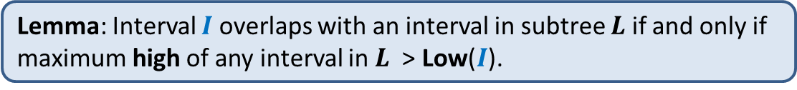
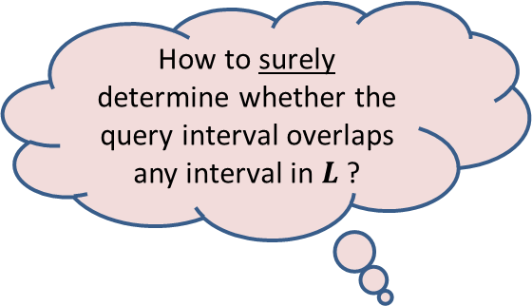

How to perform Overlap($S$,$I$) efficiently ?
$$c$$
$$d$$
$$c$$
$$d$$
$$a$$
$$b$$
How to surely determine whether the query interval overlaps any interval in $L$?
$$L$$
$$R$$
By knowing the maximum high of any interval in $L$ ?
Lemma: Interval $I$ overlaps with an interval in subtree $L$ if and only if maximum high of any interval in $L$ > Low($I$).

Slide 13




Augmentation of BST
10
30
19
For each node $\text{u}$, keep a field Max-high($\text{u}$):
Max-high($\text{u}$) = max{ high($I$) : $I∈$ T($\text{u}$)}
= max( ? , ? , ? )
4
20
23
27
20
30
1
3
7
11
24
30
3
11
30
This field is efficient to maintain during insertion/deletion
Max-high(left($\text{u}$))
high($\text{u}$)
Max-high(right($\text{u}$))

Slide 14



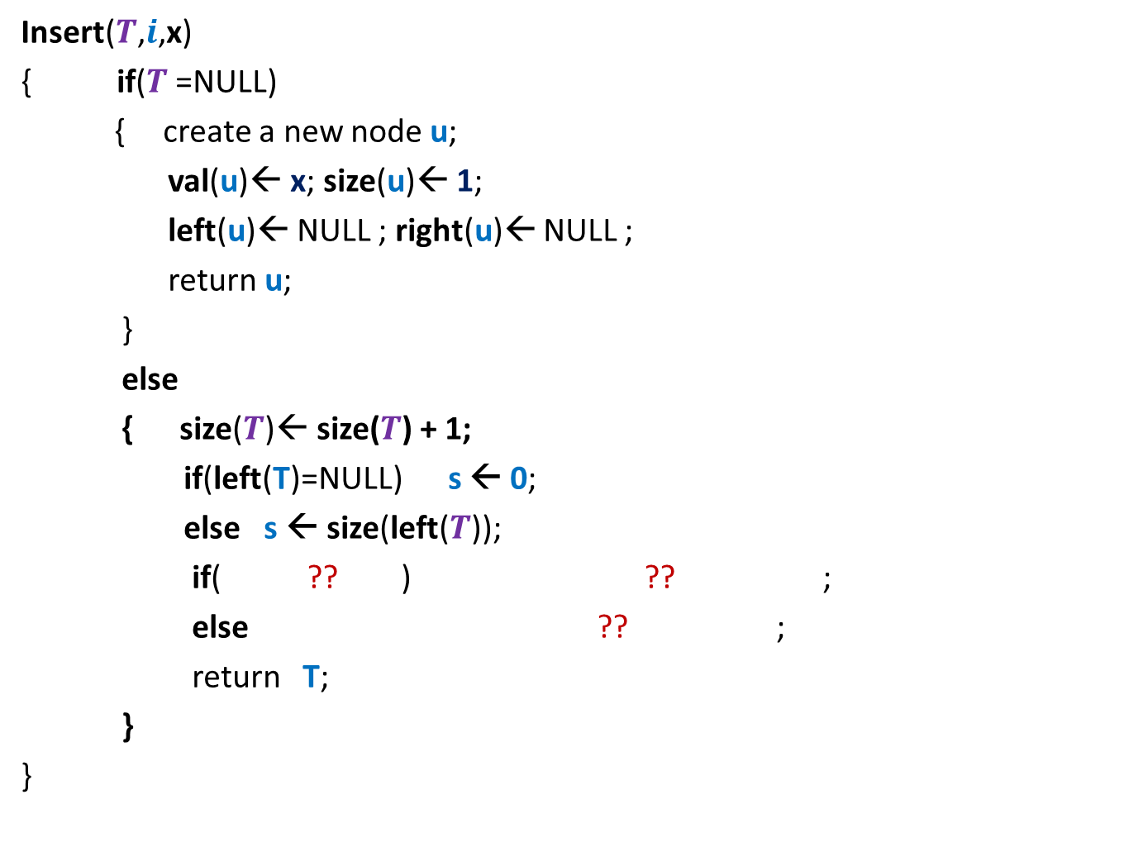




Overlap($T,$ $I$)
$$c$$
$$c$$
$$c$$
$$d$$
$$d$$
$$d$$
Overlap(T,$I$)
{ found=false;
While( ?? )
if($I$overlaps Interval(u))
$\text{found}\text{← }\text{true}$;
else
{ If( ? and ? )
u← $\text{lef}\text{t}\text{(}\text{u}\text{)}$;
else u← $\text{right}\text{(}\text{u}\text{)}$;
}
}
If(found) print “Interval(u) overlaps $I$”;
else print “No interval overlaps $I$”.
}
$\text{u} \text{← }$T ;
$\text{u}$<>NULL and not found
$$a$$
u
$$b$$
{
$\text{left}\text{(}\text{u}\text{)}$<> NULL
Max-high(left(u)) $>$Low($I$)
O(log $n$) time

Slide 15

Application 1
Given a set of $n$axis-parallel rectangles,
determine if any two of them intersect.

Slide 16
Application 1
Given a set of $n$axis-parallel rectangles,
determine if any two of them intersect.

Slide 17

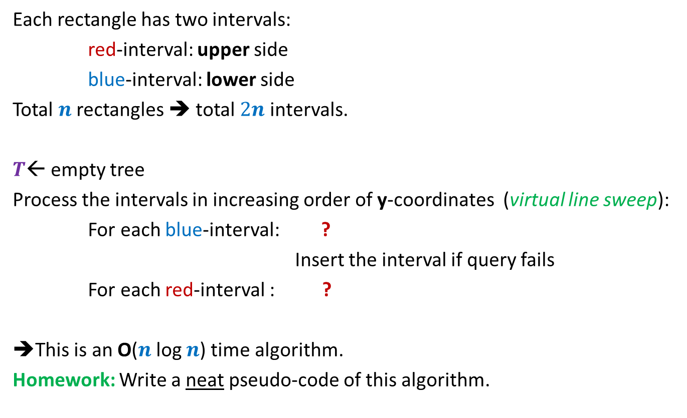
Algorithm
Each rectangle has two intervals:
red-interval: upper side
blue-interval: lower side
Total $n$ rectangles ➔ total $2n$ intervals.
$T$← empty tree
Process the intervals in increasing order of y-coordinates (virtual line sweep):
For each blue-interval: ?
Insert the interval if query fails
For each red-interval : ?
➔This is an O($n$log $n$) time algorithm.
Homework: Write a neat pseudo-code of this algorithm.
query if it intersects any interval in $T$
remove the corresponding blue interval

Slide 18

Application 2
Given a set of $n$axis-parallel rectangles,
compute their total area.
It requires some slight modifications to Interval tree.
just for a nice trial ☺. Not important from point of view of exams.

Slide 19
ProBLEM of NEXT LECTURE
Synchronizing a circuit
with minimum delay enhancement

Slide 20
An Electric Circuit
A complete binary tree
Electric signal
6
5
3
2
4
2
2
1
6
2
1
2
3
2
Delay 11 10 14 10 10 11 10 9

Slide 21
Problem definition
Given:
There is a circuit in the form of a complete binary tree.
Electric signal propagates from root to all leaf nodes.
Each edge has certain delay
The delay in reaching signal to a leaf node =
“sum of delays on all edges on the path from root.”
Objective:
Enhance delay along certain edges so that
The delay on all paths from root to leaf nodes is the same.
Total delay enhancement is minimum.
What is the first step for designing an algorithm ?

Slide 22
Working on an Example

Slide 23
Working on an Example
How to achieve 1st Objective:
Synchronizing all paths from the root?
Spend some time on this portion to see if you can reduce the total delay ?
See you in the next class ☺
+4 is necessary and sufficient as well ☺
What algorithm comes to your mind based on this inference ?
Electric signal
Total delay enhancement: 27
6
5
How much enhancement is needed for this edge ?
3
2
4
2
2
1
6
2
1
2
3
2
+3 +4 +4 +3 +4 +5
+4
Delay 11 10 14 10 10 11 10 9
New Delay 14 14 14 14 14 14 14 14
Is this the minimum delay enhancement ?

