Slide 1
Design and Analysis of Algorithms (CS345/CS345A)
Lecture 8
Job scheduling problem
Huffman code : A data compression algorithm
Revisiting an algorithm paradigm

Slide 2
A Job scheduling problem

Slide 3





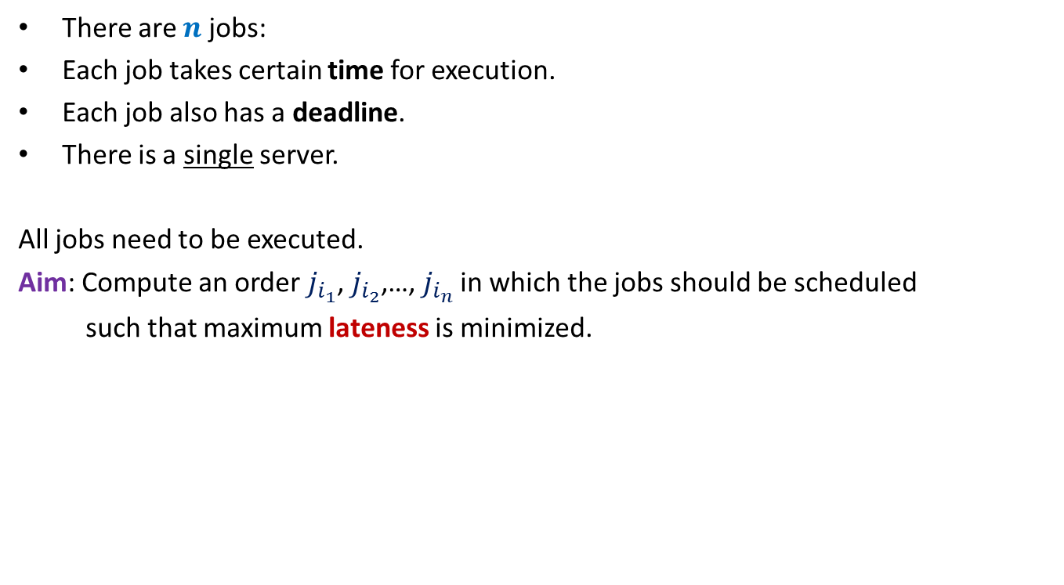








There are $n$ jobs:
Each job takes certain time for execution.
Each job also has a deadline.
There is a single server.
All jobs need to be executed.
Aim: Compute an order $j_{i_{1}}$, $j_{i_{2}}$,…, $j_{i_{n}}$ in which the jobs should be scheduled
such that maximum lateness is minimized.
$j_{1}$, $j_{2}$,…, $j_{n}$
Job $j_{i}$ takes $t_{i}$ time
Job $j_{i}$ has deadline $d_{i}$
$$f_{i_{k}}$$
$$d_{i_{k}}$$
$$d_{i_{k}}$$
Lateness of $j_{i_{k}}$
$$j_{i_{1}}$$
$$j_{i_{2}}$$
$$j_{i_{3}}$$
$$j_{i_{k}}$$
$$j_{i_{n}}$$
$$0$$
time

Slide 4













Example for a better understanding
$$t_{1}$$
$$j_{1}$$
$$d_{1}$$
$$t_{2}$$
$$j_{2}$$
$$d_{2}$$
$$t_{3}$$
Maximum lateness
$$j_{3}$$
$$d_{3}$$
$$j_{1}$$
$$j_{3}$$
$$j_{2}$$
time
$$0$$

Slide 5

Towards designing an algorithm
Each job $j_{i}$ has two parameters
Time of execution $t_{i}$
Deadline $d_{i}$
Idea 1: Schedule the jobs in the increasing order of Time of execution.
Try to prove correctness
Try to come up with a counter example
Let us try this first

Slide 6





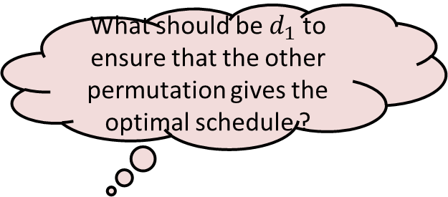


Towards designing a counterexample
What should be $d_{1}$ to ensure that the other permutation gives the optimal schedule ?
$$t_{1}$$
$$j_{1}$$
$$t_{2}$$
$$j_{2}$$
$$d_{2}$$
$$j_{1}$$
$$j_{2}$$
time

Slide 7

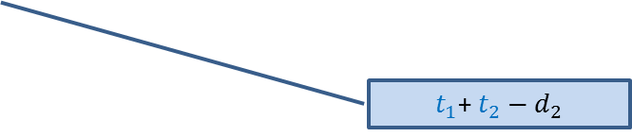

Towards designing a counterexample
Towards designing an algorithm
The job with farther deadline should be scheduled later.
the job with earlier deadline should be scheduled first.
$$t_{1}$$
This counterexample hints at a very important point as well.
$$j_{1}$$
?
$$d_{1}$$
$$t_{2}$$
$t_{1}$+ $t_{2}−d_{1}$
$$j_{2}$$
?
$$d_{2}$$
$t_{1}$+ $t_{2}−d_{2}$
$$j_{1}$$
$$j_{2}$$
time

Slide 8
How to schedule more than 2 jobs ?
time
$$0$$

Slide 9
How to schedule more than 2 jobs ?
Schedule the jobs in increasing order of their deadlines.
Homework:
Write a neat pseudocode of an efficient algorithm for this problem.
Write a formal proof of correctness of the algorithm.
time
$$0$$

Slide 10

The last 2 problems we discussed
Synchronizing the delays in a circuit
Scheduling jobs to minimize maximum lateness
Electric signal
6
5
3
2
4
2
$$0$$
time
2
1
6
2
1
2
3
2
A local approach
Optimizing a global function

Slide 11
The last 2 problems we discussed
Synchronizing the delays in a circuit (complete binary tree)
Scheduling jobs to minimize maximum lateness
These problems have adhoc algorithm with adhoc proof of correctness.
But actually they lie under the same algorithm paradigm :
greedy strategy.

Slide 12
Greedy Algorithms

Slide 13
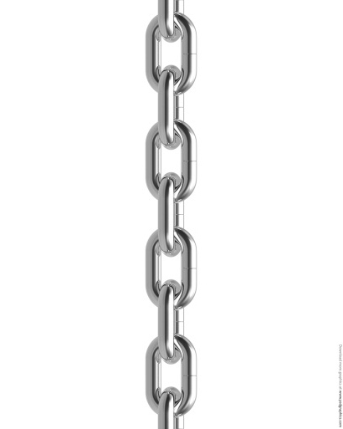


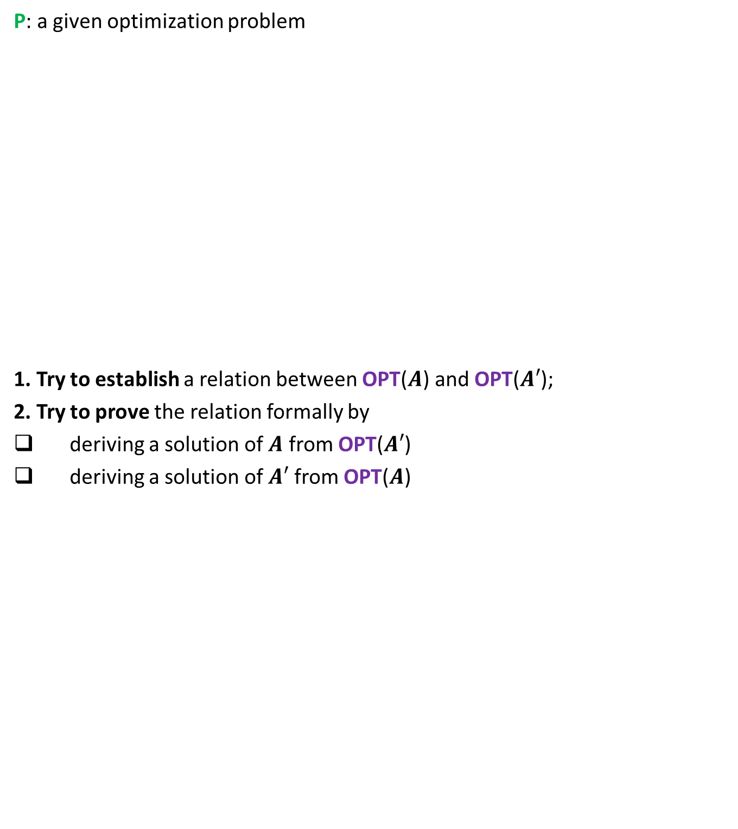


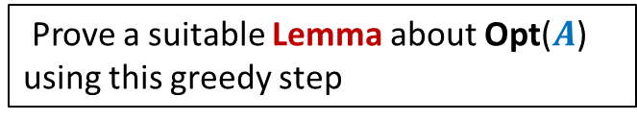


A generic way to prove that a greedy strategy works
P: a given optimization problem
1. Try to establish a relation between OPT($A$) and OPT($A′$);
2. Try to prove the relation formally by
deriving a solution of $A$ from OPT($A′$)
deriving a solution of $A′$ from OPT($A$)
If you succeed,
you have an algorithm
Opt($A$)
$$A$$
instance of size $n$of problem P
Greedy
step
Relation ?
Prove a suitable Lemma about Opt($A$) using this greedy step
Opt($A′$)
$$A′$$
instance of size $<n$of problem P
from construction
use Lemma

Slide 14
An advice
It may take time to internalize the last slide.
So it is perfectly fine if you skip it now and revisit it later.
You will be surprised to see that this generic approach is
Very powerful
Simple
Works for most of the greedy algorithms.

Slide 15
Huffman Codes
A novel and quite inspiring application of greedy algorithms

Slide 16

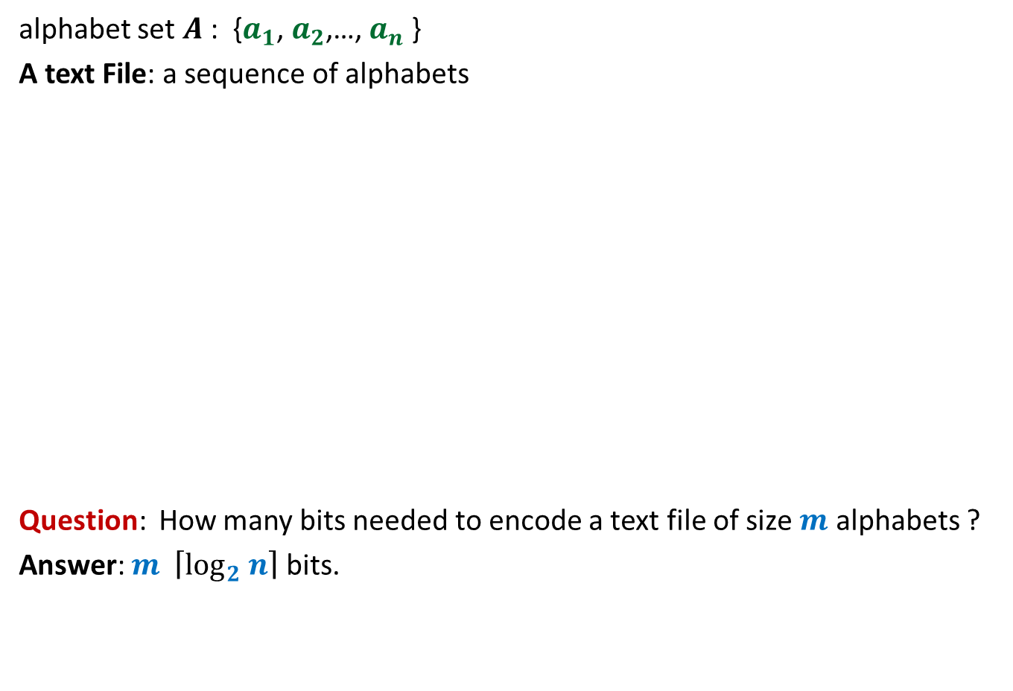
Binary coding
alphabet set $A$: {$a_{1}$, $a_{2}$,…, $a_{n}$ }
A text File: a sequence of alphabets
Question: How many bits needed to encode a text file of size $m$ alphabets ?
Answer: $m \left\lceil \log_{2} n\right\rceil$ bits.
once upon a time …………..
…………………………….
……………………………..
…………………
A text file F
Binary coding of F

Slide 17
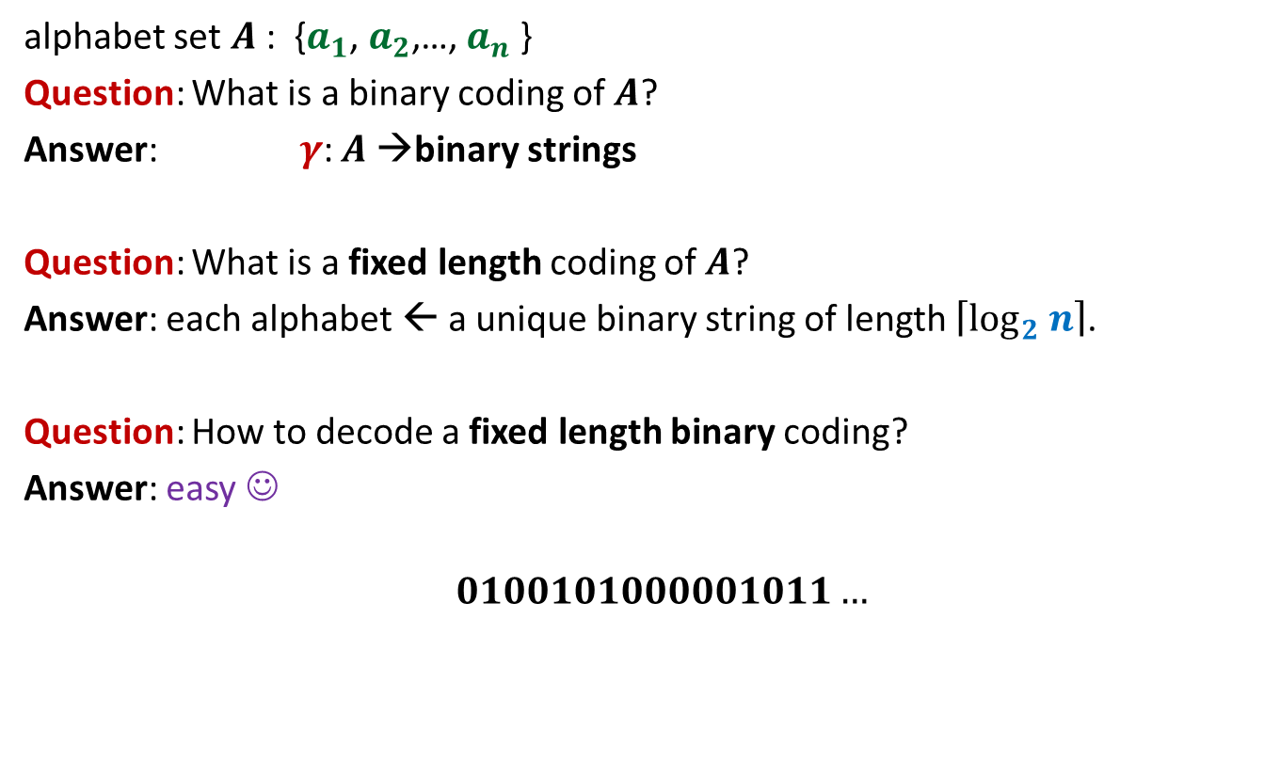
Fixed length coding
alphabet set $A$: {$a_{1}$, $a_{2}$,…, $a_{n}$ }
Question: What is a binary coding of $A$?
Answer: $γ$: $A$→binary strings
Question: What is a fixed length coding of $A$?
Answer: each alphabet ← a unique binary string of length $\left\lceil \log_{2} n\right\rceil$.
Question: How to decode a fixed length binary coding?
Answer: easy ☺
$$0100101000001011…$$

Slide 18

Fixed length coding
alphabet set $A$: {$a_{1}$, $a_{2}$,…, $a_{n}$ }
Question: Can we use fewer bits to store alphabet set $A$ ?
Answer: No.
Question: Can we use fewer bits to store a file ?
Answer: Yes

Slide 19
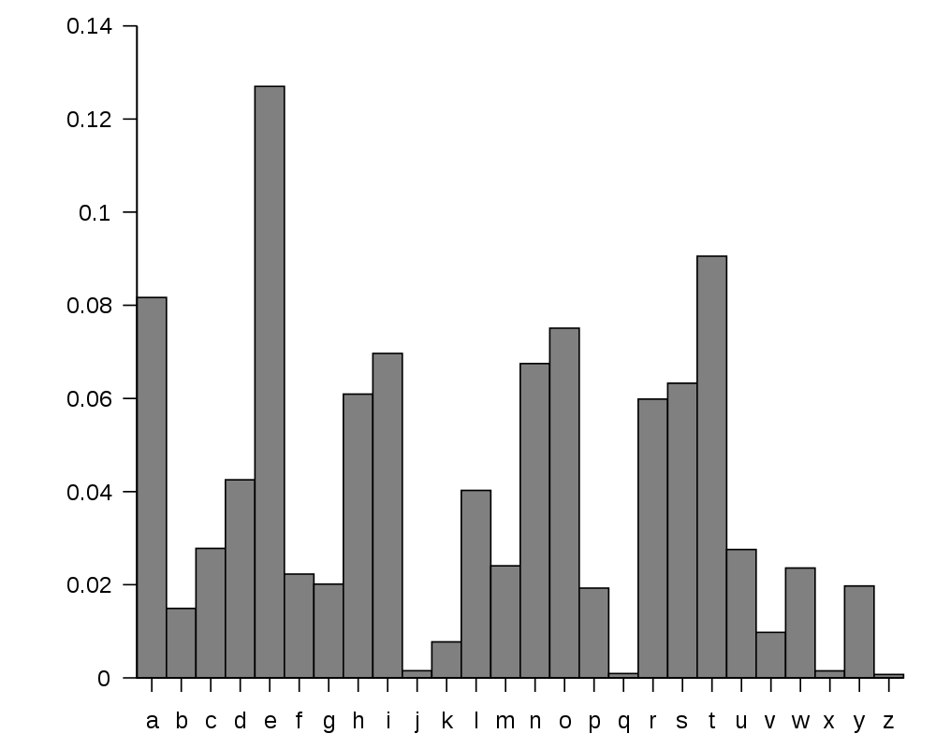
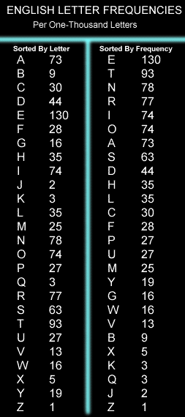
huge variation in the frequency of alphabets in a text.
http://en.wikipedia.org/wiki/Letter_frequency

Slide 20
huge variation in the frequency of alphabets in a text.
Question: How to exploit variation in the frequencies of alphabets ?
Answer:
More frequent alphabets ⬅ coding with shorter bit string
Less frequent alphabets ⬅ coding with longer bit string

Slide 21

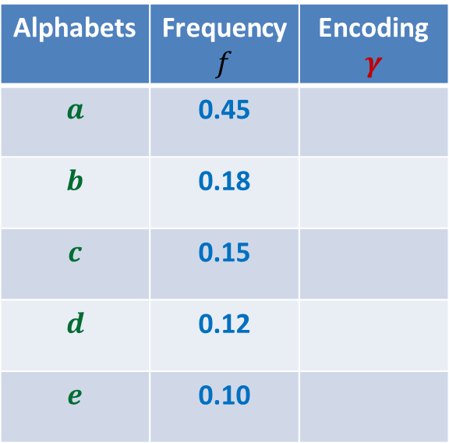
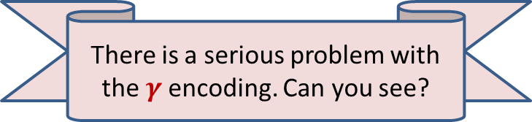
Variable length encoding
Average bit length per symbol using $γ$:
$$ABL\left(γ\right)=\sum_{x∈A}{f\left(x\right).\left|γ\left(x\right)\right|}$$
$=$ $0.45⨯1+0.18⨯2+(0.15+0.12+0.10)⨯3$
$=$ $1.92$
Question: How will you decode 01010111 ?
Answer: $abbe$ or $adae$
Question: What is the source of this ambiguity ?
Answer: $γ\left(b\right)$ is a prefix of $γ\left(d\right)$.
?
?
Alphabets | Frequency $f$ | Encoding $$γ$$
$$a$$ | 0.45
$$b$$ | 0.18
$$c$$ | 0.15
$$d$$ | 0.12
$$e$$ | 0.10
0
10
110
101
111
There is a serious problem with the $γ$encoding. Can you see?
Can we fix it ?

Slide 22

Variable length encoding
Average bit length per symbol using $γ$:
$$ABL\left(γ\right)=\sum_{x∈A}{f\left(x\right).\left|γ\left(x\right)\right|}$$
$=$ $0.45⨯1+0.18⨯3+(0.15+0.12+0.10)⨯3$
$=$ $2.1$
Alphabets | Frequency $f$ | Encoding $$γ$$
$$a$$ | 0.45
$$b$$ | 0.18
$$c$$ | 0.15
$$d$$ | 0.12
$$e$$ | 0.10
0
100
110
101
111

Slide 23
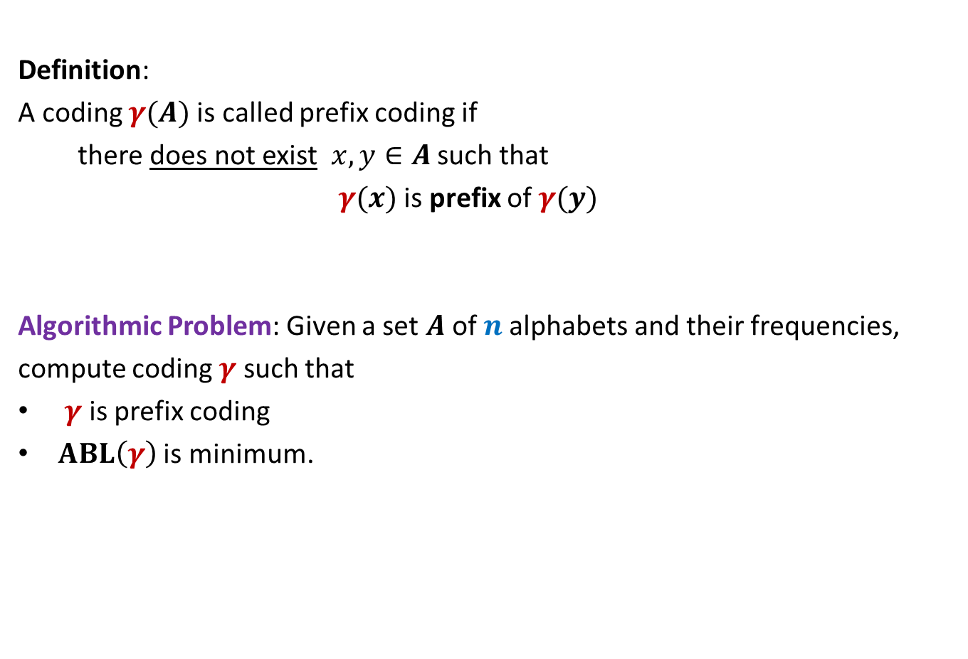
Prefix Coding
Definition:
A coding $γ(A)$is called prefix coding if
there does not exist $x,y∈A$ such that
$γ(x)$ is prefix of $γ(y)$
Algorithmic Problem: Given a set $A$of $n$alphabets and their frequencies,
compute coding $γ$ such that
$γ$ is prefix coding
$ABL\left(γ\right)$ is minimum.

Slide 24

The challenge of the problem
Among all possible binary coding of $A$, how to find the optimal prefix coding ?
It looks too complex ☹

Slide 25
The novel idea of Huffman
?
0
1
0
1
0
1
Binary coding
Labeled
Binary tree

Slide 26
A labeled binary tree
nodes → ?
Code of an alphabet = ?
0
1
0,
00,
001
01,
1,
10,
100,
101
0
1
0
1
0
1
alphabets
Label of path from root

Slide 27
prefix codes and labeled Binary tree

Slide 28
A labeled binary tree
Consider a prefix code 101
0
1
1
0
Visualize a binary tree for the prefix code ?
0
1

Slide 29
A labeled binary tree
0
1
0
1
1
0
0
1
0
1
0
1
0
1

Slide 30
A labeled binary tree
Work with the corresponding binary tree for 30 minutes
to design algorithm for computing prefix coding with leasr ABL.
leaf nodes → alphabets
Code of an alphabet =
0
1
01,
001,
0000,
11,
100,
10110,
10111
0
1
1
0
0
1
0
1
0
1
0
1
Label of path from root

