Slide 1
Design and Analysis of Algorithms (CS345/CS345A)
Lecture 9
Greedy Strategies
Huffman code : A data compression algorithm (continued. From last lecture)

Slide 2
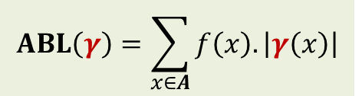
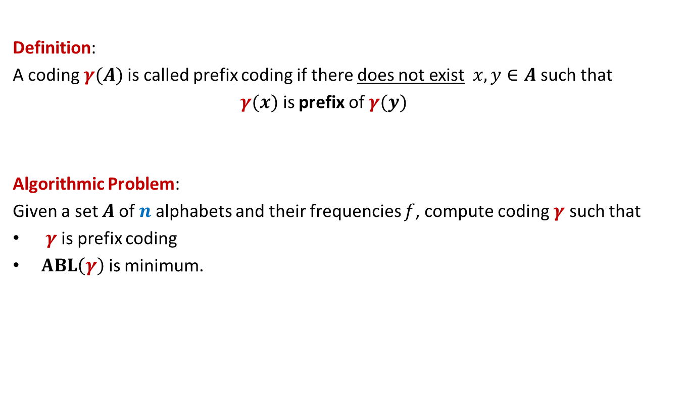
Prefix Coding
Definition:
A coding $γ(A)$is called prefix coding if there does not exist $x,y∈A$ such that
$γ(x)$ is prefix of $γ(y)$
Algorithmic Problem:
Given a set $A$of $n$alphabets and their frequencies $f$, compute coding $γ$ such that
$γ$ is prefix coding
$ABL\left(γ\right)$ is minimum.
$$ABL\left(γ\right)=\sum_{x∈A}{f\left(x\right).\left|γ\left(x\right)\right|}$$

Slide 3

The novel idea of Huffman
?
0
1
0
1
0
1
Binary coding
Labeled
Binary tree

Slide 4
A labeled binary tree
leaf nodes → alphabets
Code of an alphabet =
0
1
0
1
1
0
0
1
0
1
0
1
0
1
Label of path from root

Slide 5
A labeled binary tree
leaf nodes → alphabets
Code of an alphabet =
0
1
01,
001,
0000,
11,
100,
10110,
10111
0
1
1
0
0
1
0
1
0
1
0
1
Label of path from root

Slide 6


Prefix Coding
Question:
How to build the labeled tree for a prefix code ?
Alphabets | Frequency $f$ | Encoding $$γ$$
$$a$$ | 0.45
$$b$$ | 0.18
$$c$$ | 0.15
$$d$$ | 0.12
$$e$$ | 0.10
0
{0, 100, 101, 110, 111}
0
1
100
110
{00,01,10,11}
$$a$$
101
111

Slide 7
Prefix Coding
Question:
How to build the labeled tree for a prefix code ?
Alphabets | Frequency $f$ | Encoding $$γ$$
$$a$$ | 0.45
$$b$$ | 0.18
$$c$$ | 0.15
$$d$$ | 0.12
$$e$$ | 0.10
0
0
1
100
110
0
1
$$a$$
101
{0,1}
{0,1}
111

Slide 8




Prefix Coding
Question:
How to build the labeled tree for a prefix code ?
Alphabets | Frequency $f$ | Encoding $$γ$$
$$a$$ | 0.45
$$b$$ | 0.18
$$c$$ | 0.15
$$d$$ | 0.12
$$e$$ | 0.10
0
0
1
100
110
0
1
$$a$$
101
0
1
0
1
111
$$b$$
$$d$$
$$c$$
$$e$$

Slide 9
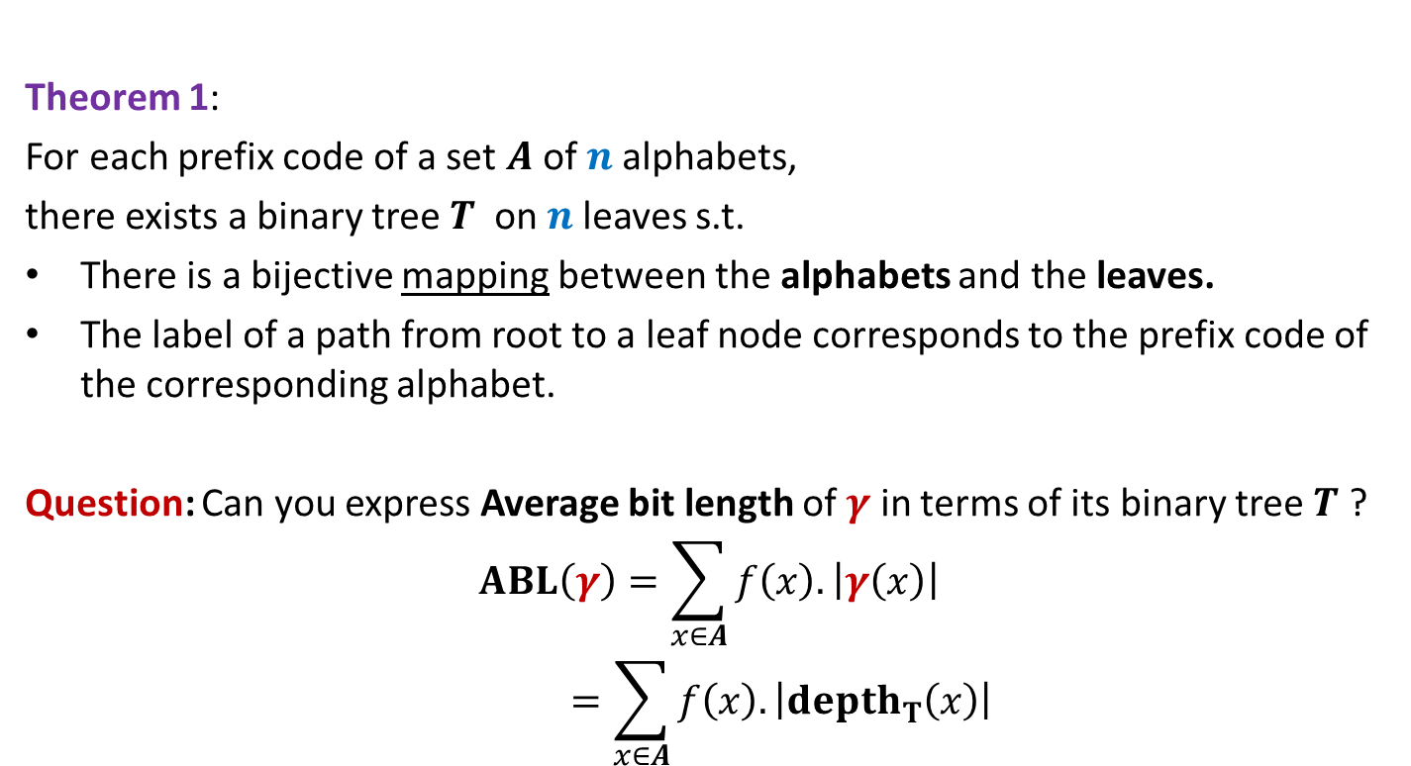
Theorem 1:
For each prefix code of a set $A$of $n$alphabets,
there exists a binary tree$T$ on $n$leaves s.t.
There is a bijective mapping between the alphabets and the leaves.
The label of a path from root to a leaf node corresponds to the prefix code of the corresponding alphabet.
Question: Can you express Average bit length of $γ$ in terms of its binary tree $T$ ?
$$ABL\left(γ\right)=\sum_{x∈A}{f\left(x\right).\left|γ\left(x\right)\right|}$$
$$=\sum_{x∈A}{f\left(x\right).\left|depth_{T}\left(x\right)\right|}$$

Slide 10
Finding the labeled binary tree for the optimal prefix codes

Slide 11
Is the following prefix coding optimal ?
full binary tree
0
1
0
1
1
0
0
1
0
1
0
1
0
1

Slide 12


Observations on the binary tree of the optimal prefix code
Lemma:
The binary tree corresponding to optimal prefix coding must be a full binary tree:
Every internal node has degree exactly 2.
Question: What next ?
We need to see the influence of frequencies on the optimal binary tree.
Non-decreasing order of frequency
$${f(a}_{i})≤{f(a}_{i+1})$$
$a_{1}$ , $a_{2}$ , … , $a_{n}$

Slide 13
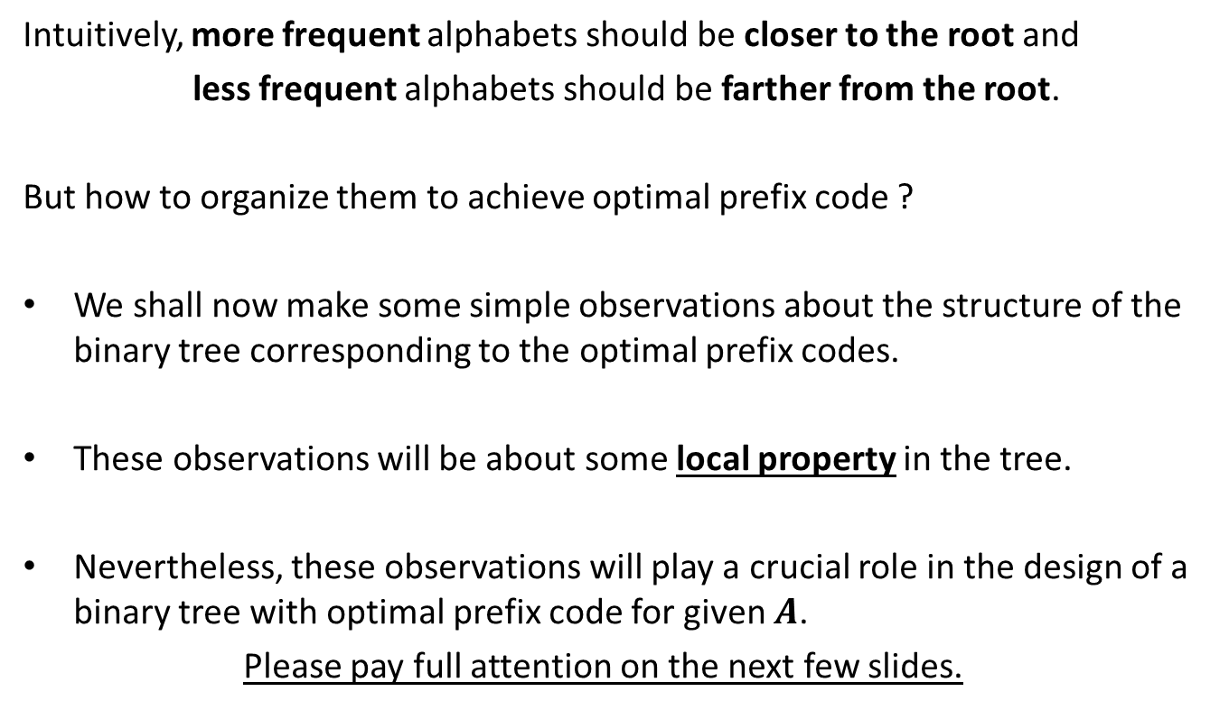
Observations on the binary tree of the optimal prefix code
Intuitively, more frequent alphabets should be closer to the root and
less frequent alphabets should be farther from the root.
But how to organize them to achieve optimal prefix code ?
We shall now make some simple observations about the structure of the binary tree corresponding to the optimal prefix codes.
These observations will be about some local property in the tree.
Nevertheless, these observations will play a crucial role in the design of a binary tree with optimal prefix code for given $A$.
Please pay full attention on the next few slides.

Slide 14

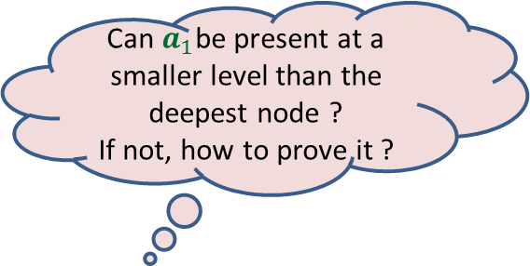

More Observations
Can $a_{1}$be present at a smaller level than the deepest node ?
If not, how to prove it ?
0
1
0
1
0
1
. . .
0
1
0
$$a_{1}$$
Deepest level
$$a_{i}$$

Slide 15

More Observations
0
1
1
Swapping $a_{1}$ with $a_{i}$ can not increase ABL.
0
1
0
. . .
0
1
0
$$a_{1}$$
Deepest level
$$a_{i}$$

Slide 16



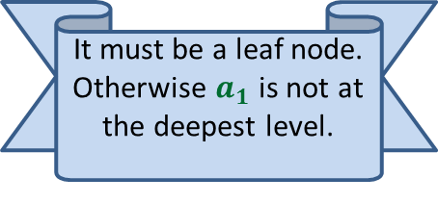


More Observations
0
1
Since the tree is full binary, $a_{1}$ must have a sibling. What can we say about it ?
1
Swapping $a_{2}$ with $a_{i}$ can not increase ABL.
0
1
0
It must be a leaf node. Otherwise $a_{1}$ is not at the deepest level.
. . .
What about $a_{2}$ ?
0
1
$$a_{2}$$
0
1
Deepest level
$$a_{1}$$
$$a_{i}$$

Slide 17
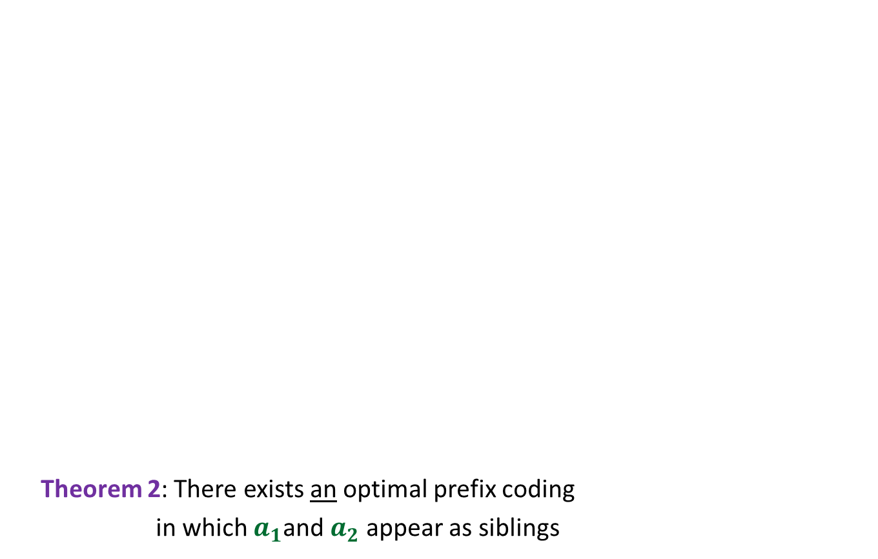

More Observations
0
1
Theorem 2: There exists an optimal prefix coding
in which $a_{1}$and $a_{2}$ appear as siblings
0
1
0
1
. . .
1
0
1
Deepest level
$$a_{1}$$
$$a_{2}$$

Slide 18
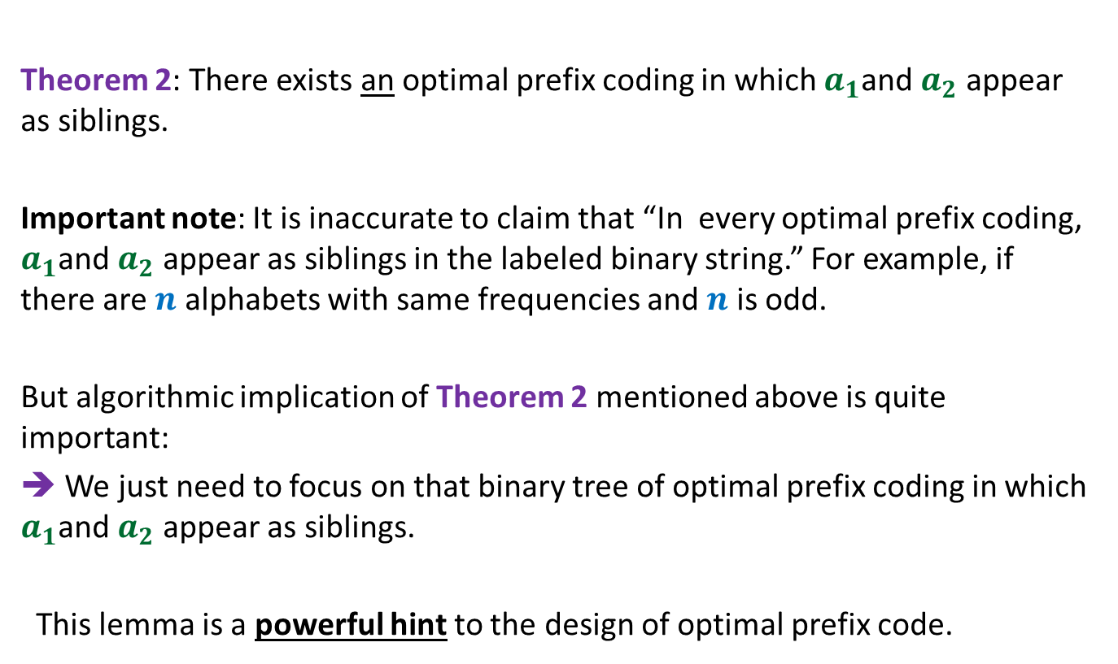
The important observation
Theorem 2: There exists an optimal prefix coding in which $a_{1}$and $a_{2}$ appear as siblings.
Important note: It is inaccurate to claim that “In every optimal prefix coding, $a_{1}$and $a_{2}$ appear as siblings in the labeled binary string.” For example, if there are $n$ alphabets with same frequencies and $n$ is odd.
But algorithmic implication of Theorem 2 mentioned above is quite important:
➔ We just need to focus on that binary tree of optimal prefix coding in which $a_{1}$and $a_{2}$ appear as siblings.
This lemma is a powerful hint to the design of optimal prefix code.

Slide 19



$$A$$
instance of size $n$of problem P
Greedy
step
$$A′$$
instance of size $<n$of problem P

Slide 20

The binary tree of the optimal prefix code
From this picture, can you design the greedy step that you will perform ?
0
1
0
1
0
1
. . .
1
0
1
Deepest level
$$a_{1}$$
$$a_{2}$$

Slide 21
The binary tree of the optimal prefix code
0
1
0
1
0
1
. . .
1
0
1
Deepest level
$$a_{1}$$
$$a_{2}$$

Slide 22

The binary tree of the optimal prefix code
0
1
0
1
0
1
. . .
1
Deepest level
$a$’

Slide 23
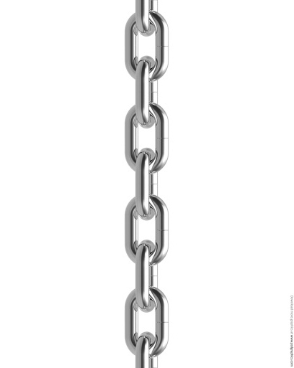



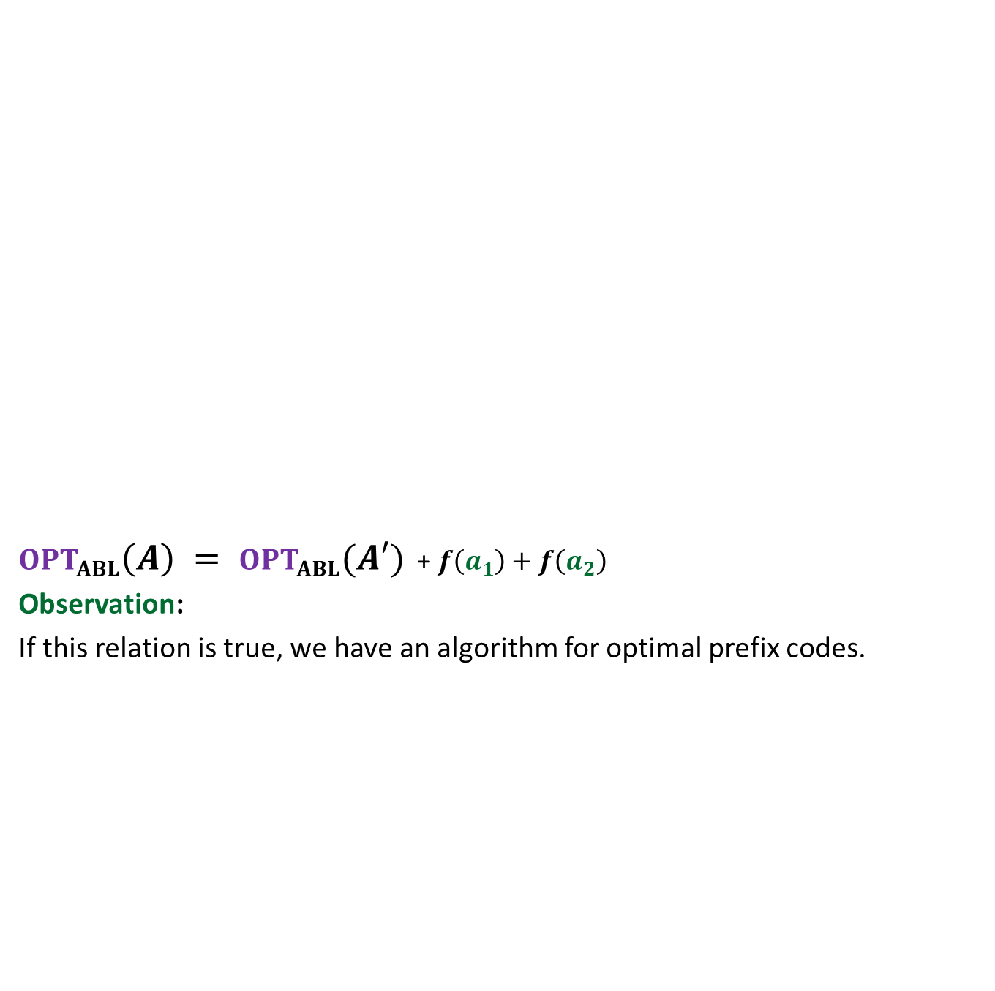





$OPT_{ABL}\left(A\right) = OPT_{ABL}(A′)$ + $f\left(a_{1}\right)+f\left(a_{2}\right)$
Observation:
If this relation is true, we have an algorithm for optimal prefix codes.
Opt($A$)
$$A$$
$a_{1}$, $a_{2}$, $a_{3}$ , … … $a_{n}$
Greedy
step
Relation ?
Opt($A′$)
$$A′$$
$a_{3}$ , … … $a_{n}$
$$a′$$
$f\left(a\text{’}\right)=$ $f\left(a_{1}\right)+f\left(a_{2}\right)$
?

Slide 24
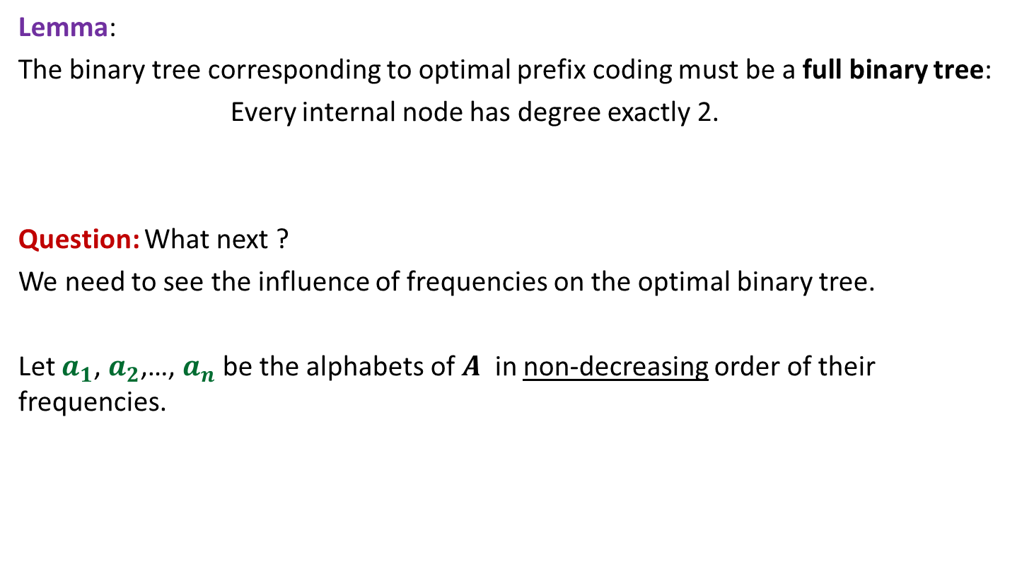
Proof for $OPT_{ABL}\left(A\right)=OPT_{ABL}(A′)$ + $f\left(a_{1}\right)+f\left(a_{2}\right)$
Spend some time thinking about the proof
before moving ahead.
☺

Slide 25
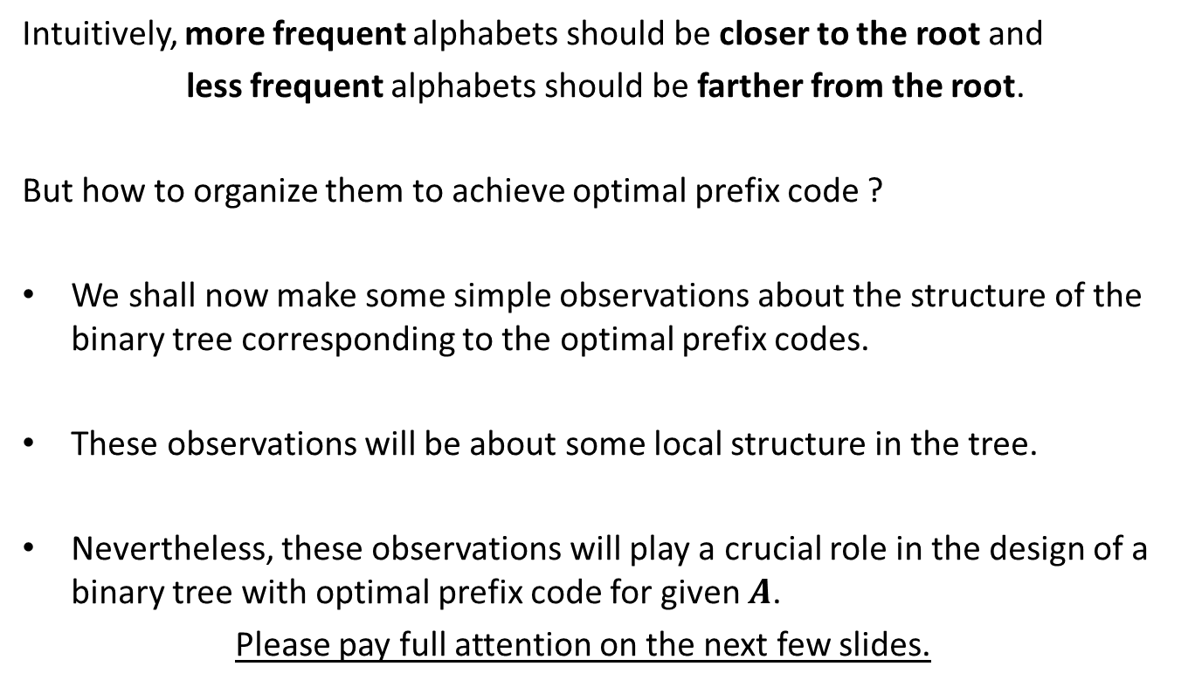
How to prove $OPT_{ABL}\left(A\right)=OPT_{ABL}(A′)$ + $f\left(a_{1}\right)+f\left(a_{2}\right)$ ?
Question: Can we derive a prefix coding for $A$from $OPT(A′)$ ?
Question: Can we derive a prefix coding for $A′$from $OPT(A)$ ?

Slide 26




A prefix coding for $A$from $OPT\left(A^{′}\right)$
$T′$: the binary tree corresponding to $OPT_{ABL}(A′)$
0
1
0
1
0
1
$$T′$$
. . .
1
$a$’

Slide 27



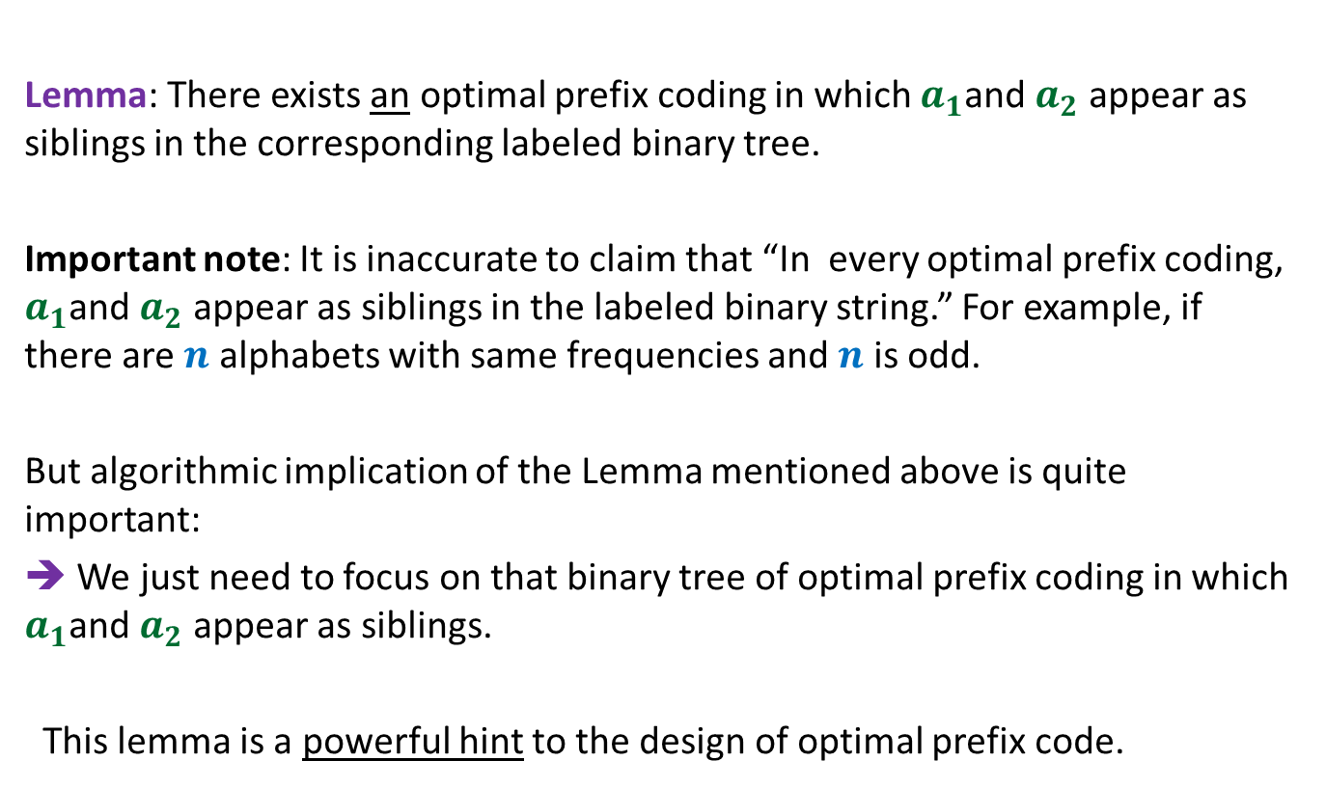
A prefix coding for $A$from $OPT(A′)$
$T′$: the binary tree corresponding to $OPT_{ABL}(A′)$
This gives a prefix coding for $A$ with $ABL$ = ??
➔ $OPT_{ABL}\left(A\right)≤OPT_{ABL}(A′)$ + $f\left(a_{1}\right)+f\left(a_{2}\right)$
0
1
0
1
0
1
$$T′$$
. . .
1
0
1
$a$’
$$a_{1}$$
$$a_{2}$$
$OPT_{ABL}(A′)$ + $f\left(a_{1}\right)+f\left(a_{2}\right)$

Slide 28





A prefix coding for $A′$from $OPT(A)$
$T$: the binary tree corresponding to $OPT_{ABL}(A)$
0
1
Using Theorem 2
0
1
0
1
$$T$$
. . .
1
0
1
Deepest level
$$a_{1}$$
$$a_{2}$$

Slide 29

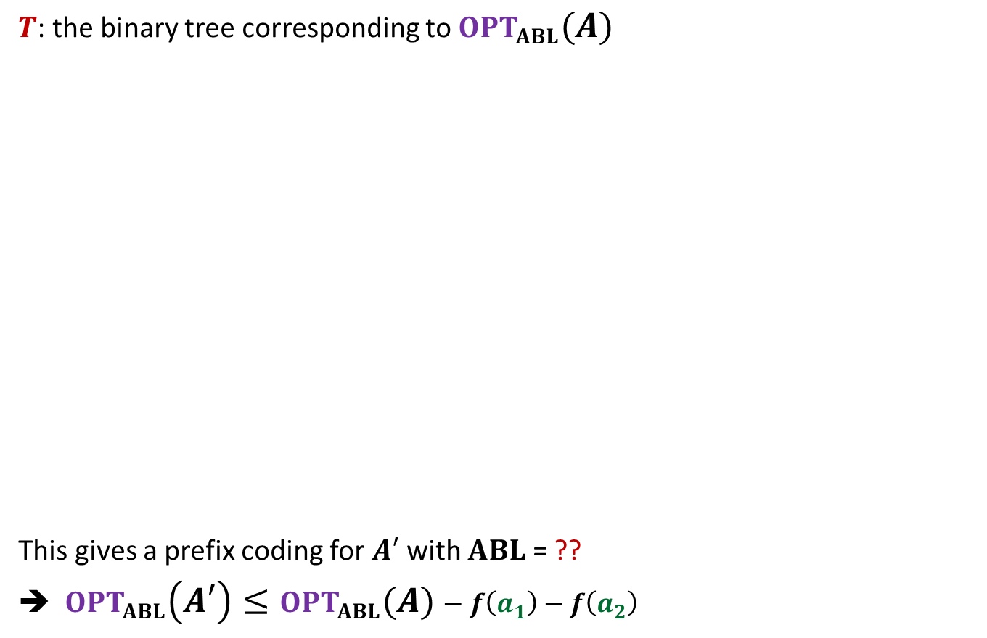

A prefix coding for $A′$from $OPT(A)$
$T$: the binary tree corresponding to $OPT_{ABL}(A)$
This gives a prefix coding for $A′$ with $ABL$ = ??
➔ $OPT_{ABL}\left(A′\right)≤OPT_{ABL}(A)−f\left(a_{1}\right)−f\left(a_{2}\right)$
0
1
Using Theorem 1
0
1
0
1
$$T$$
. . .
1
0
1
$a$’
Deepest level
$$a_{1}$$
$$a_{2}$$
$$OPT_{ABL}\left(A\right)−f\left(a_{1}\right)−f\left(a_{2}\right)$$

Slide 30
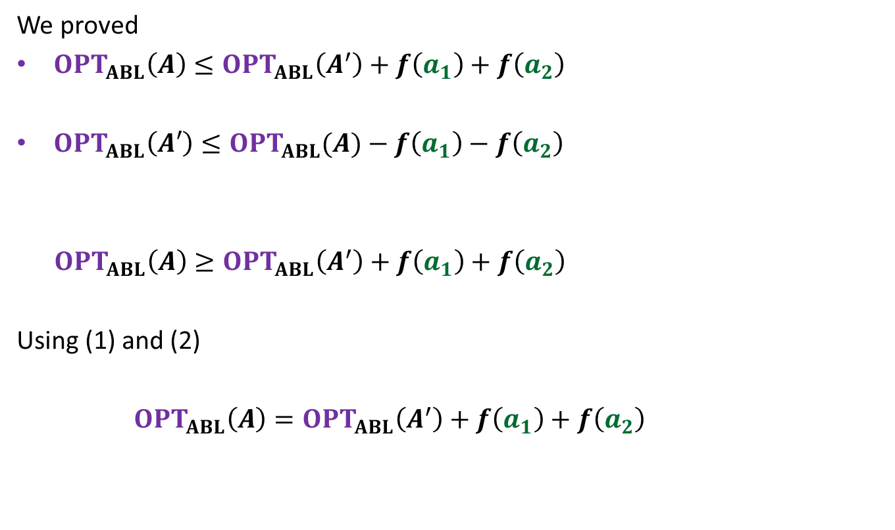
We proved
$OPT_{ABL}\left(A\right)≤OPT_{ABL}\left(A^{′}\right)+f\left(a_{1}\right)+f\left(a_{2}\right)$
$OPT_{ABL}\left(A′\right)≤OPT_{ABL}(A)−f\left(a_{1}\right)−f\left(a_{2}\right)$
$OPT_{ABL}\left(A\right)≥OPT_{ABL}\left(A^{′}\right)+f\left(a_{1}\right)+f\left(a_{2}\right)$
Using (1) and (2)
$OPT_{ABL}\left(A\right)=OPT_{ABL}\left(A^{′}\right)+f\left(a_{1}\right)+f\left(a_{2}\right)$
(1)
(2)

Slide 31

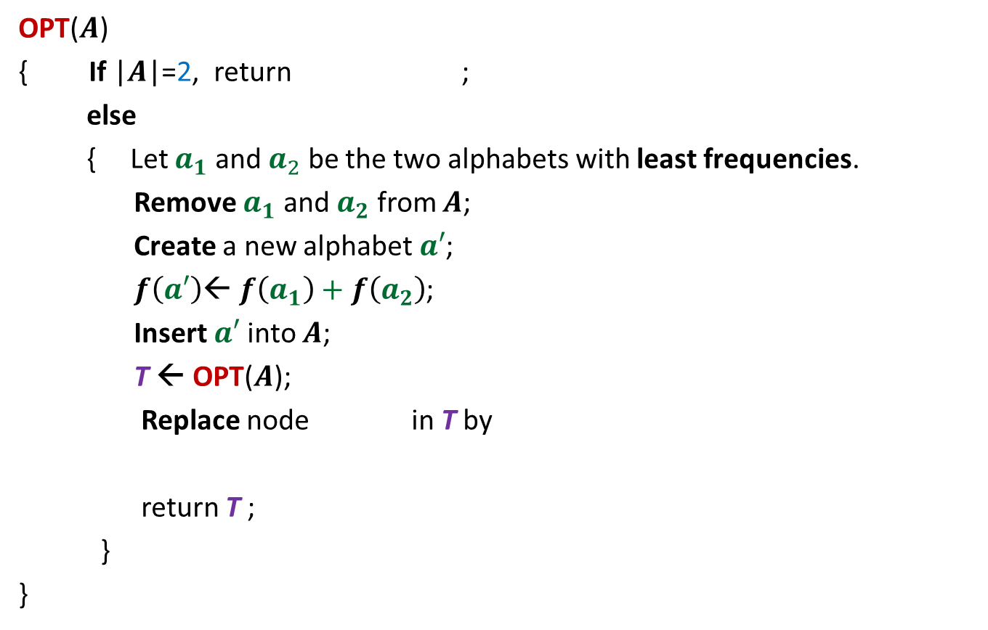






The algorithm based on $OPT_{ABL}\left(A\right)=OPT_{ABL}(A′)$ + $f\left(a_{1}\right)+f\left(a_{2}\right)$
OPT($A$)
{ If |$A$|=2, return ;
else
{ Let $a_{1}$ and $a_{2}$ be the two alphabets with least frequencies.
Remove $a_{1}$ and $a_{2}$ from $A$;
Create a new alphabet $a′$;
$f\left(a′\right)$← $f\left(a_{1}\right)+f\left(a_{2}\right)$;
Insert $a′$into $A$;
T ← OPT($A$);
Replace node in T by
return T ;
}
}
0
1
$$a_{1}$$
$$a_{2}$$
$O(n^{2})$ time complexity
Homework:
Achieve $O(n log n)$ time comp lexity
0
1
$a$’
$$a_{1}$$
$$a_{2}$$

Slide 32

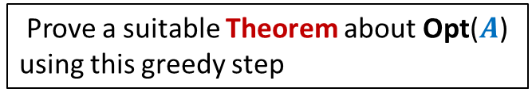

A generic way to prove that a greedy strategy works
P: a given optimization problem
1. Try to establish a relation between OPT($A$) and OPT($A′$);
2. Try to prove the relation formally by
deriving a solution of $A$ from OPT($A′$)
deriving a solution of $A′$ from OPT($A$)
If you succeed,
you have an algorithm
Opt($A$)
$$A$$
instance of size $n$of problem P
Greedy
step
Prove a suitable Theorem about Opt($A$) using this greedy step
Opt($A′$)
$$A′$$
instance of size $<n$of problem P
from construction
use Theorem

Slide 33
Example Minimum spanning tree

Slide 34

instance $A$
170
54
33
63
35
50
70
31
41
81
64
78
53
42
52
80
49
54
42
60
44
43
50
30
49
57
29
102

Slide 35
instance $A$
Lemma 1 : There is a MST with edge (u,v)
170
54
33
63
35
50
70
31
41
81
64
78
53
42
52
80
49
54
42
60
44
43
50
30
49
57
u
29
102
v

Slide 36
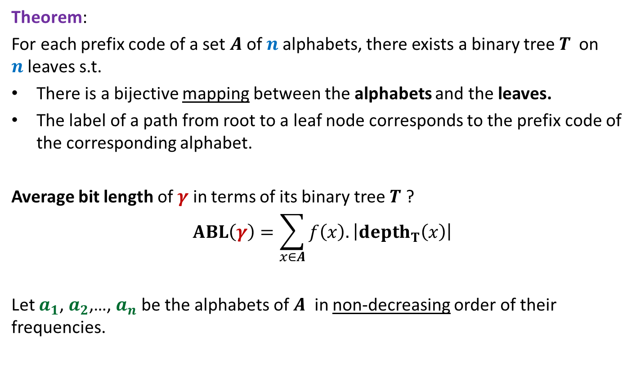

instance $A′$
170
54
33
63
35
50
70
31
41
81
64
78
53
42
52
80
49
54
42
44
60
43
50
30
49
57
w
102
This is graph $G′$

Slide 37
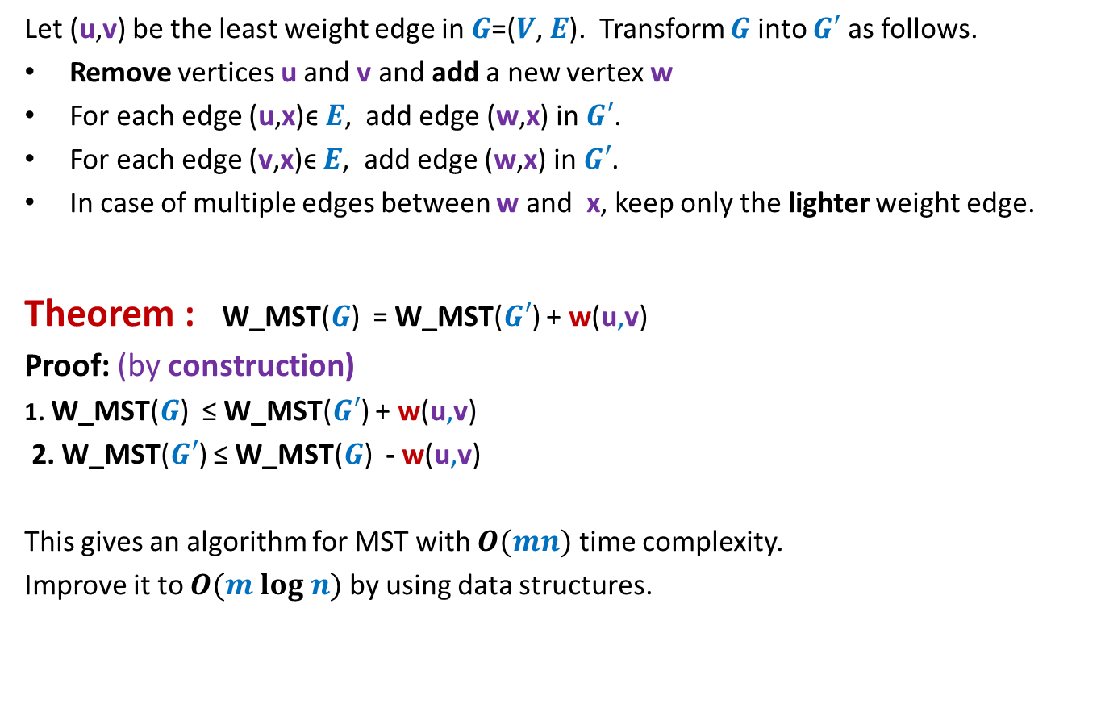

How to compute instance $A′$
Let (u,v) be the least weight edge in $G$=($V$, $E$). Transform $G$ into $G′$ as follows.
Remove vertices u and v and add a new vertex w
For each edge (u,x)ϵ $E$, add edge (w,x) in $G′$.
For each edge (v,x)ϵ $E$, add edge (w,x) in $G′$.
In case of multiple edges between w and x, keep only the lighter weight edge.
Theorem : W_MST($G$) = W_MST($G′$) + w(u,v)
Proof: (by construction)
1. W_MST($G$) ≤ W_MST($G′$) + w(u,v)
2. W_MST($G′$) ≤ W_MST($G$) - w(u,v)
This gives an algorithm for MST with $O(mn)$ time complexity.
Improve it to $O(m log n)$ by using data structures.
From construction
Use Lemma 1

