Slide 1
Final Report
Hiraj Khawle
Ben Aughton
Priyamvada
Wei He
Group 7

Slide 2
Summary & Feedback
Update Publication ( 2000 – 2023 )
Use the correct dataset for the Articles Graph
Find a way to Automate the name correction
Update the Time Span Chart
Modify the Network Graph
Update the Time Span Chart
Analyse pattern relating to the Country of publication
Group 7

Slide 3
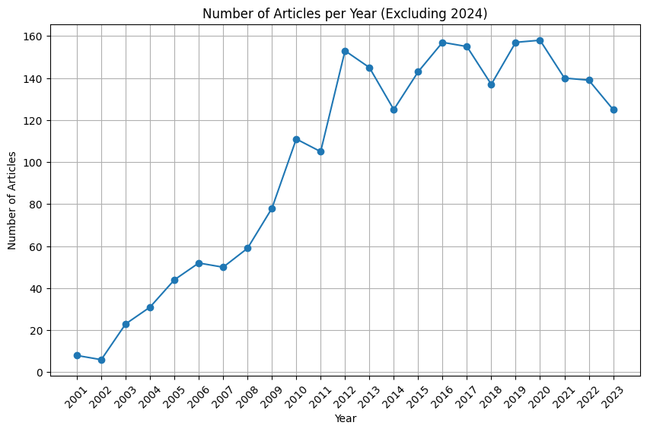
Articles

Slide 4
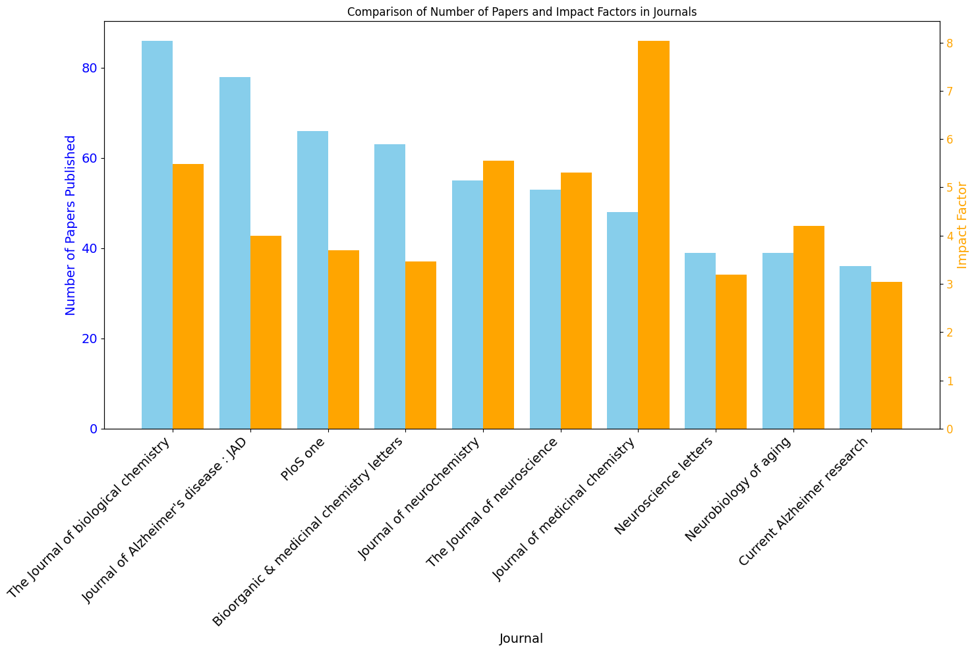
Journals
Paper | Impact
Journal of Medicinal Chemistry | 8.0
Journal of Neuro Chemistry | 5.5
Journal of Biological Chemistry | 5.5
Journal of Neuro Science | 5.3
Neuro Biology of Aging | 4.2
Journal of Alzheimer’s Disease | 4.0
PLOS One | 3.7
Bio-organic and Medicinal Chemistry Letters | 3.5
Neuro Science Letters | 3.2
Current Alzheimer’s Research | 3.0

Slide 5
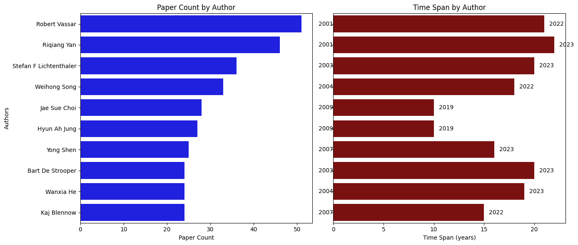
Analysis on Top Authors

Slide 6
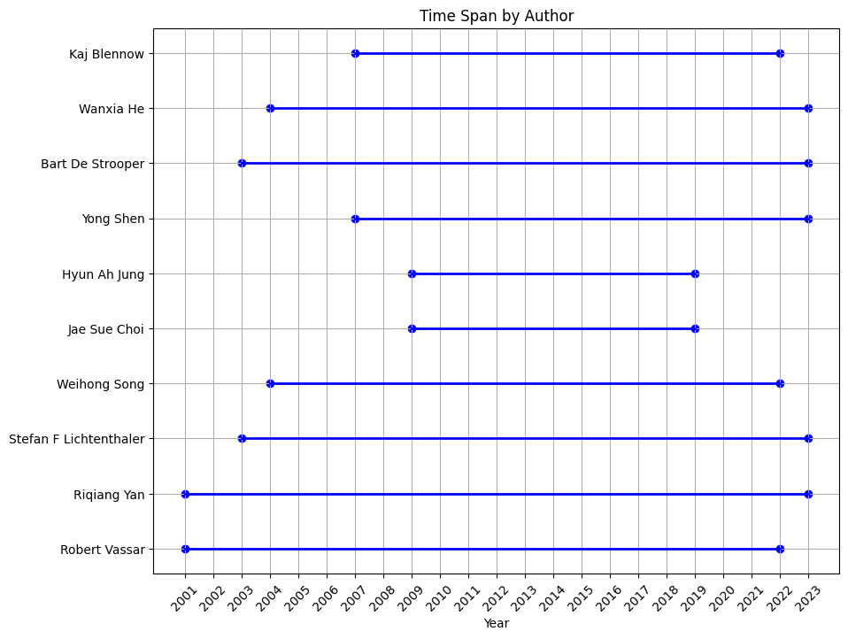
Author Time Span
Author Name | Time Span
Robert Vassar | 21 years
Riqiang Yan | 22 years
Stefan F Lichtenthaler | 20 years
Bart De Strooper | 20 years
Wanxia He | 19 years
Weihong Son | 18 years
Yong Shen | 16 years
Kaj Blennow | 15 years
Jae Sue Choi | 10 years
Hyun Ah Jung | 10 years

Slide 7
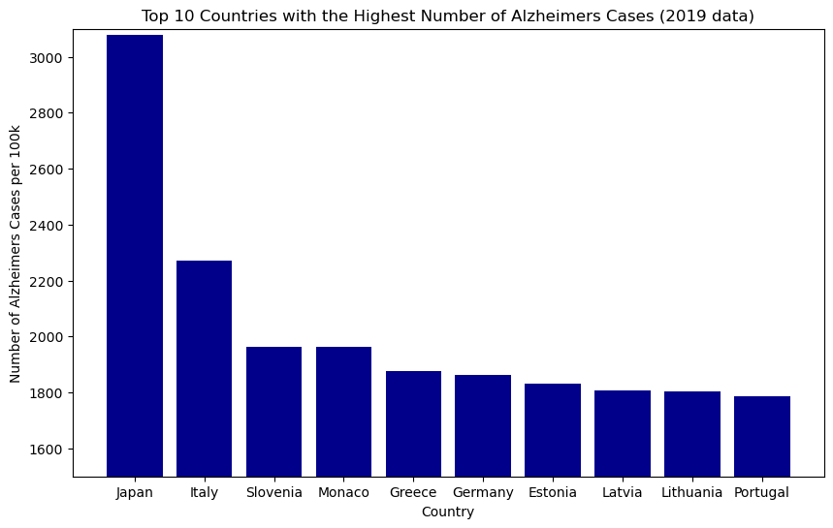
Analysis on Alzheimer’s Cases
Country | Cases
Japan | 3079
Italy | 2270
Slovenia | 1962
Population vs Cases
Country | Rate
Finland | 54.65
United Kingdom | 42.70
Slovakia | 38.15
Data obtained from : https://vizhub.healthdata.org/gbd-results/

Slide 8
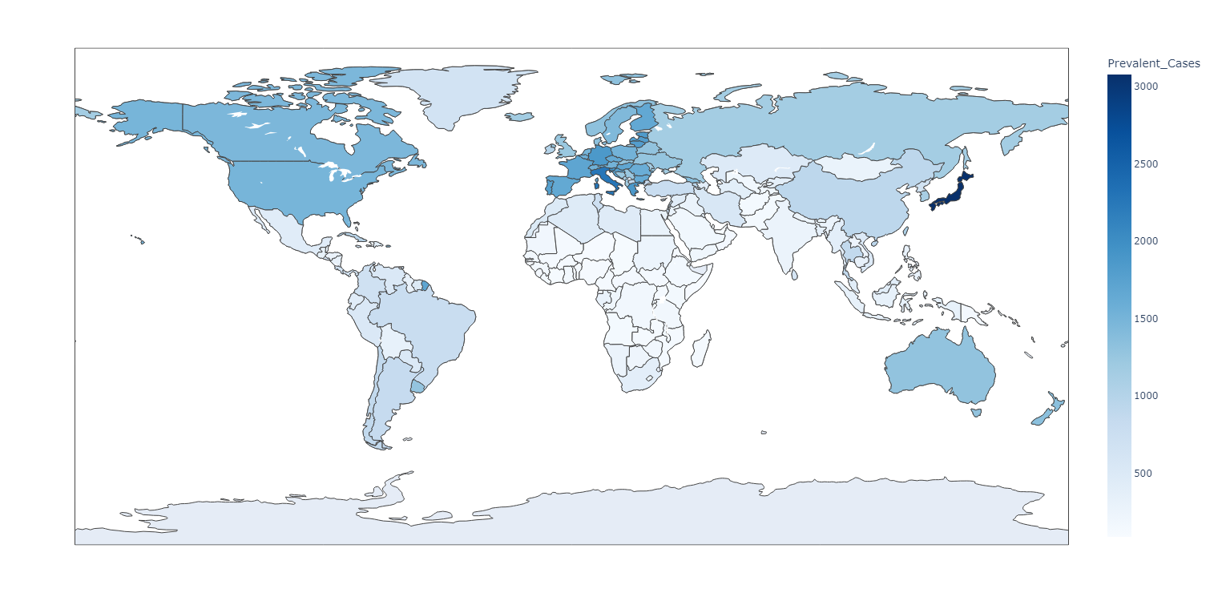
Analysis on Top Authors
Prevalent Cases

Slide 9
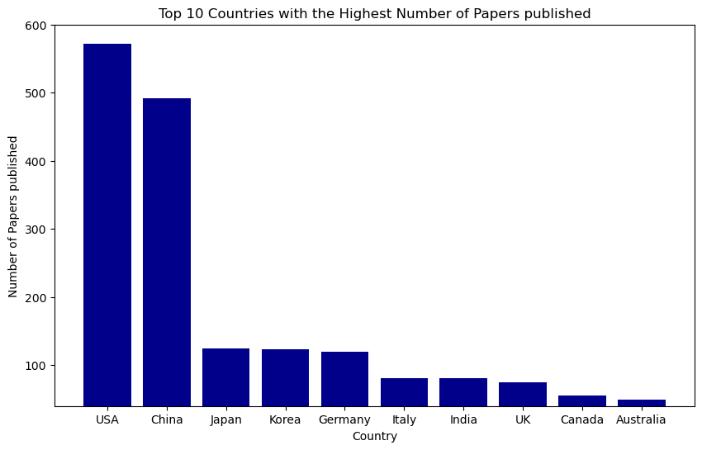
Top paper Publishing Countries
Country | Papers
USA | 572
China | 492
Japan | 124
Korea | 123
Germany | 120
Italy | 81
India | 81
UK | 75
Canada | 56

Slide 10
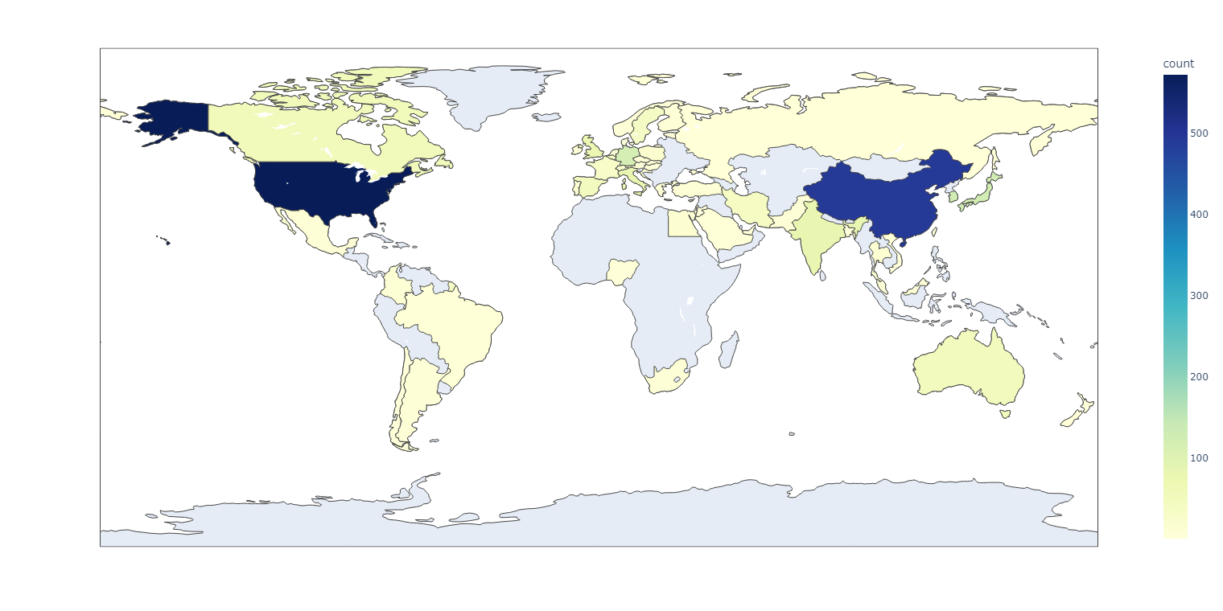
Top paper Publishing Countries
Paper Count

Slide 11
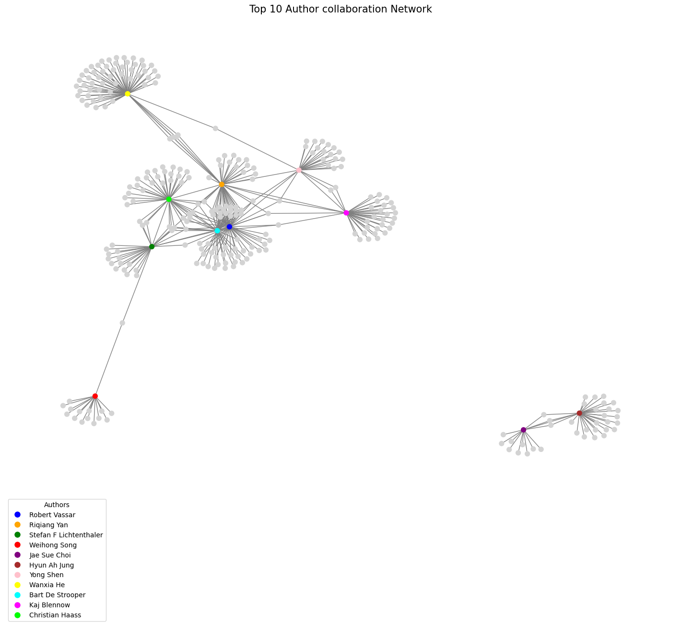
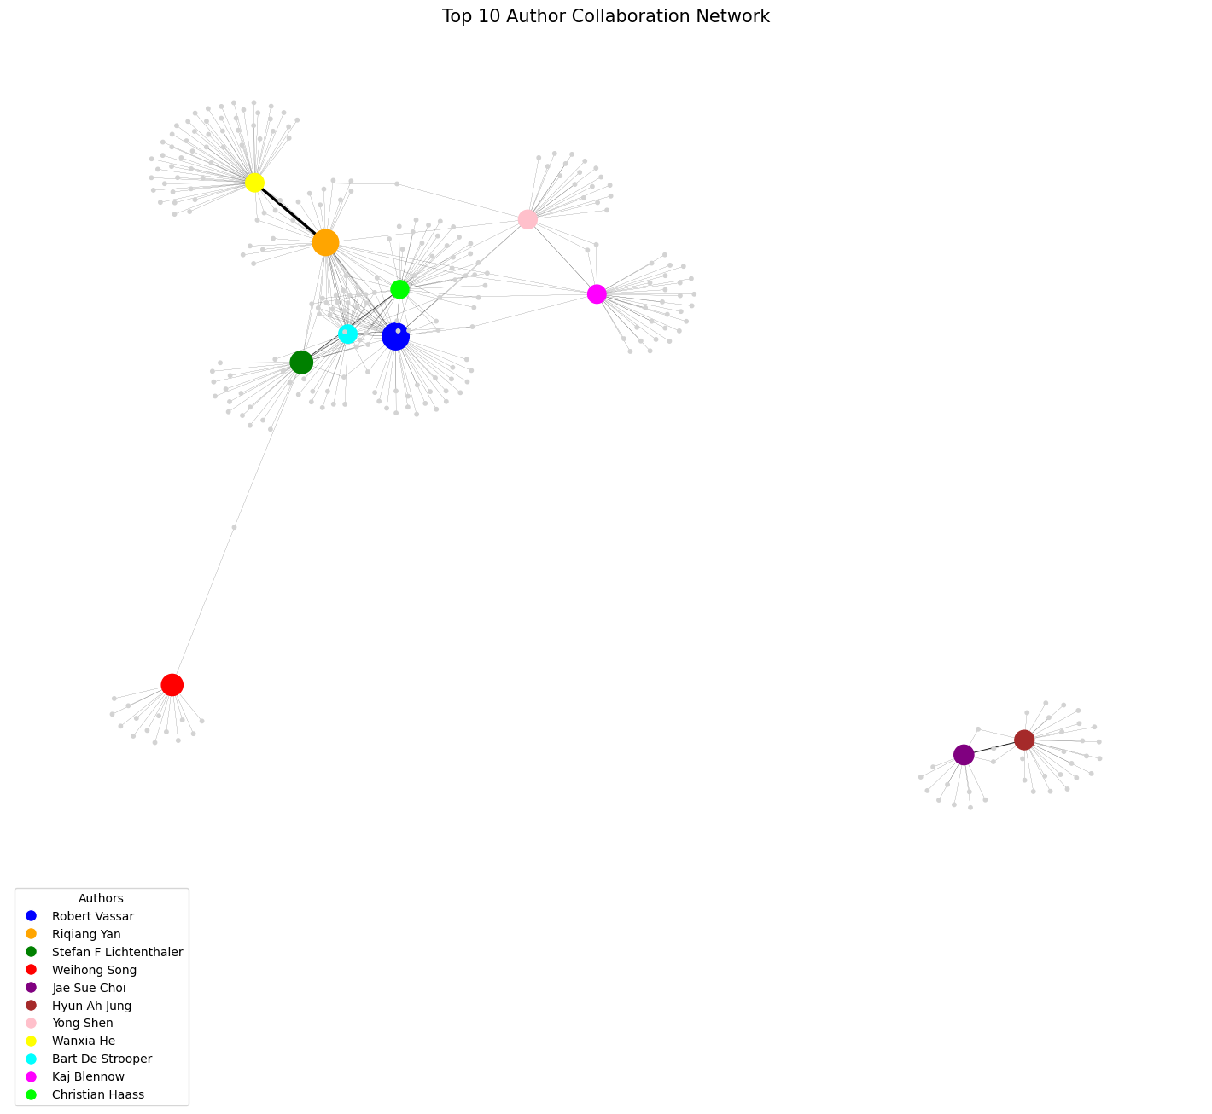
Network Graph

Slide 12
Network Graph

Slide 13



#1. Robert Vassar
Number of paper published : 51
Time Span Working : 2001 - 2022
#2. Riqiang Yan
Number of paper published : 48
Time Span Working : 2001 - 2023

Slide 14
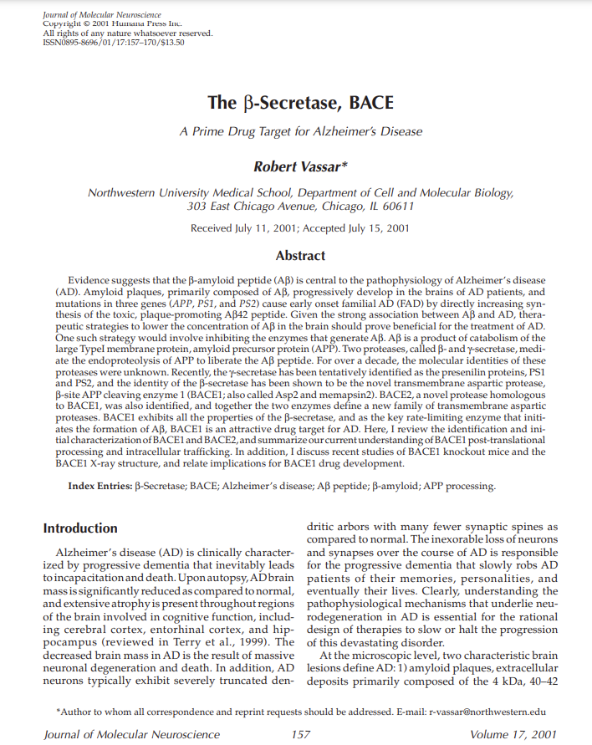
The β-Secretase, BACE
Journal of Molecular Neuroscience, July 15, 2001
Summary
This article emphasizes the pivotal role of beta-amyloid peptide (Abeta) in Alzheimer's disease (AD) pathophysiology, particularly in amyloid plaque formation. It discusses the identification of BACE1 and BACE2, proteases involved in Abeta production, and their potential as therapeutic targets.

Slide 15
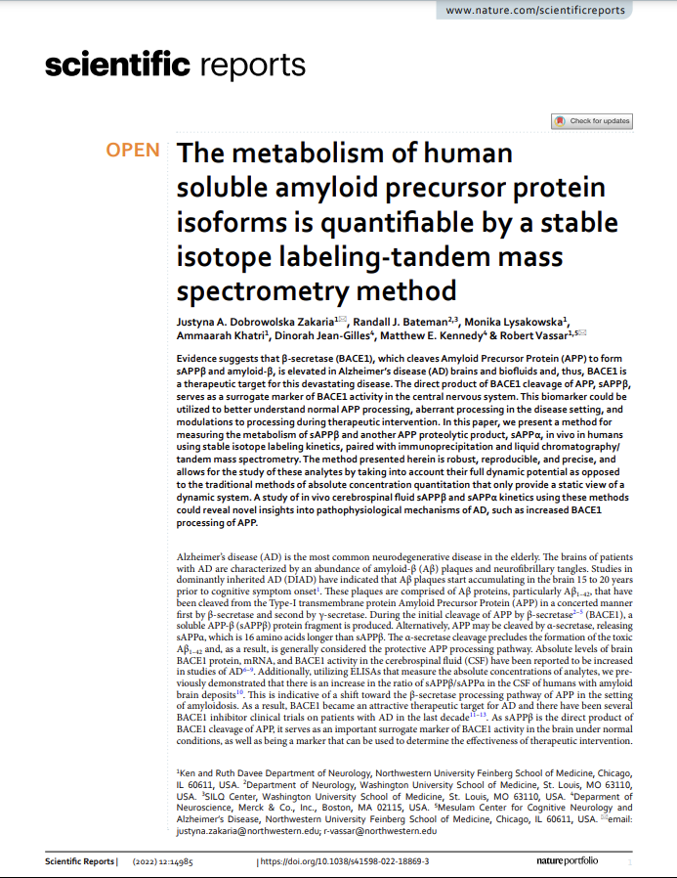
The metabolism of human soluble amyloid precursor protein isoforms is quantifable by a stable isotope labeling‐tandem mass spectrometry method
Nature, 2022
Summary
The paper focuses on β-secretase (BACE1), its elevated levels in AD, and its role as a therapeutic target. The study aims to provide insights into AD pathophysiology and BACE1's role in APP processing through dynamic analysis of these biomarkers.

Slide 16
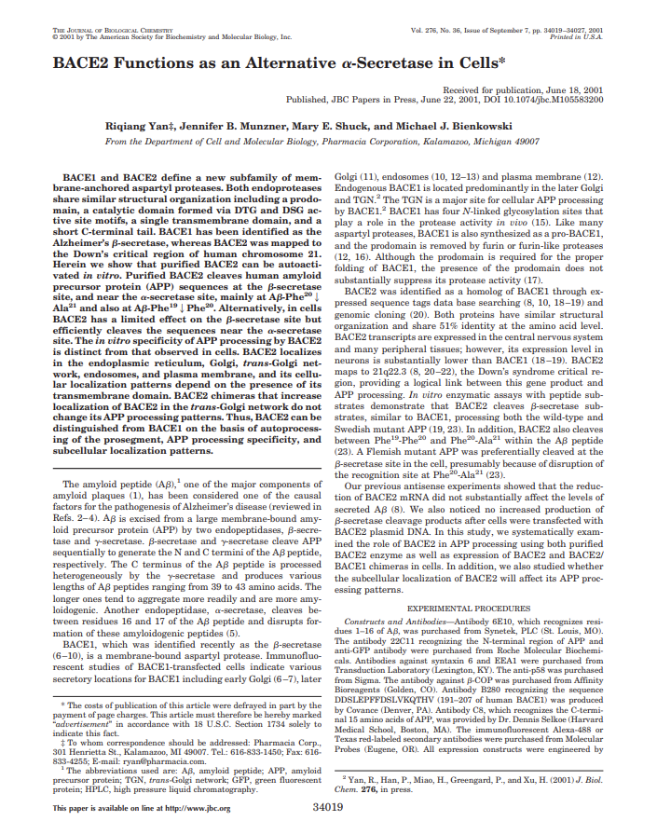
BACE - 2 Functions as an Alternative -Secretase in Cells
The Journal of Biological Chemistry, June 18, 2001
Summary
The paper highlights the differences between BACE1 and BACE2 in terms of autoprocessing, APP processing specificity, and subcellular localization.

Slide 17
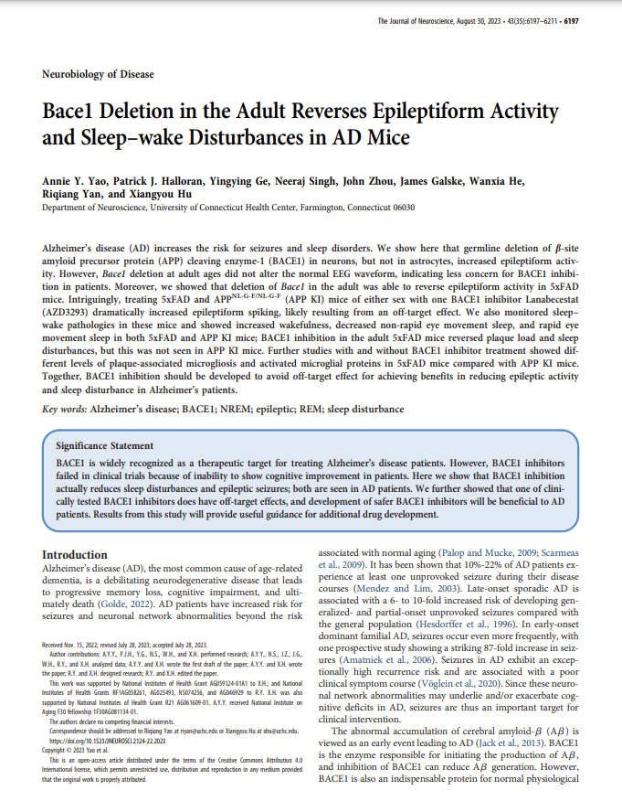
BACE - 1 Deletion in the Adult Reverses Epileptiform Activity and Sleep–wake Disturbances in AD Mice
The Journal of Neuroscience, August 30, 2023
Summary
The study emphasizes the importance of avoiding off-target effects in BACE1 inhibition for reducing epilepsy and sleep disturbances in AD patients.

Slide 18
Reflections
Created a new line graph that shows amount of papers published between 2001-2023
Updated journal graph to also show impact factor
Changed the initials into full names
Created a new scatter graph to show start and end date of publications
Made multiple graphs showing countries outputs of journals
Changed network graph to show amount of journals published via size and how many collaborations via connection width
Created profiles for top 2 authors.
Summarized top 2 authors first and latest paper to identify changes in work.

