Slide 1
Version Control Systems – General Concepts
Workshop @Uni Bonn, D. Barbi (dbarbi@uni-bonn.de)

Slide 2
Why Version Control?
Version Control Systems

Slide 3
Why version control
Organize versions
Different versions of the same files on different „hierarchies“:
Major revisions (e.g. model releases)
Projects (Ice coupling, hosing, solid earth coupling)
Minor changes (bugfixes, parameters)
Work in progress (Hey, it used to work yesterday…)

Slide 4
Why version control
Don‘t loose progress
Using a server with backup means:
A backup for all (!) your work
Accessible from all machines (no matter if ollie crashed…)
Synchronize work on different platforms / for different co-workers

Slide 5
Why version control
Organize team work
Using a database to keep work sorted means:
Merge your work with that of others, share problems and solutions
Distribute your work, make it easy to access
Apply your work to new major revisions

Slide 6
Basic Concept
Version Control Systems

Slide 7
Without Version Control
Basic concept
Bonna:
Bender:
Backup:
V1.0
V1.1
V2.0
V1.0
V2.0
V2.1
V1.0
V2.0
V2.2
Problems:
Bender crashes, but you want to work on v2.2
Are v2.0 in all three cases identical? How can you be sure it stays that way?
A bug is found in all v2.x
Your coworker has some good changes for v2.1 – but so do you
Let’s say each folder is 50 GB, but only small differences between them…

Slide 8
With Version Control (-- git)
Basic concept
Bonna:
Bender:
Server:
V1.0 and
V1.0 and
V1.0 and
History of all changes since v1.0
History of all changes since v1.0
History of all changes since v1.0
Working copy
Working copy
Features:
Synchronization between Machines and Server
Remember changes instead of versions, save in a database
Choose ANY version you ever had of your project – not only v1.1, v2.0,…
Choose that on ANY machine, even if you log in for the first time
Save a lot of place (only one instance)
Save a lot of work…

Slide 9
A lot of choice…
Basic concept
Version Control Systems:
git
svn
cvs
monotone
…
Repository Servers:
bitbucket @ Uni Bonn
Gitlab
github
…

Slide 10
Basic concept - git
Basic concept
Local
(computer you are working on)
Remote
(server, like gitlab)
Working Directory
Working Copy
Remote Database
(„Repository“)
stage
push
Working Copy
unstage / revert
commit
Local Database
(„Repository“)
checkout
pull

Slide 11
Basic concept - svn
Basic concept
Local
(computer you are working on)
Remote
(server, like swrepo)
Remote Database
(„Repository“)
Working Directory
commit
(stage)
Working Copy
unstage / revert
checkout

Slide 12
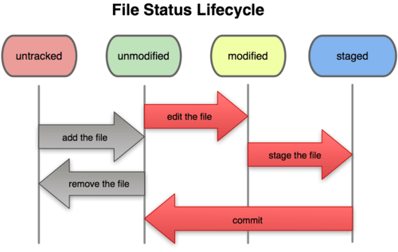
(Local) File Status Lifecycle -- git
Basic concept

