Slide 1

Seminar subset DP by Daniël Barenholz
Notes:
Greet!

Slide 2
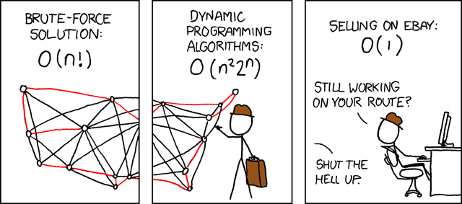



Looks familiar?
Image taken from https://xkcd.com/399/
Notes:
We’re solving TSP with DP, but first revision.

Slide 3
Refreshing: DP
Requires optimal substructure.
Avoids re-computing subproblems by storing solutions.
Running time depends on number of subproblems.
Very common in programming contests.
Information taken from Kevin’s slides. Check Canvas, you’ve got access to it.
Notes:
Why do these hold?

Slide 4


Problem: Knapsack
Choice: Do we take item i?
Subproblem: K(i, w) := optimal profit with first i items and maximum capacity w.
Recurrence:
$$K\left(i, w\right)= \max{( K\left(i−1, w\right), K\left(i−1, w−w_{i}\right)+p_{i}})$$
Compute base cases: K(0, w) = 0 && K(n, 0) = 0
Use the recurrence to compute the rest.
Information taken from Kevin’s slides. Check Canvas, you’ve got access to it.

Slide 5

Code: Knapsack
Code taken from https://www.geeksforgeeks.org/knapsack-problem/
Notes:
Completeness sake.

Slide 6
Refreshing DP?
EAPC 2005 H, EAPC 2014 D, EAPC 2012 E
Spiderman @ open.kattis.com
Treasure Diving @ open.kattis.com
Ocean's Anti-11 @ open.kattis.com
Dangerous Skiing @ open.kattis.com
Committee Assignment (also requires Inclusion-exclusion, Graph coloring) @ open.kattis.com
Notes:
Refreshing DP is advised if Knapsack was difficult.

Slide 7
Refreshing: TSP
Travelling Salesmen Problem.
Given n cities and distances between them.
Find shortest tour visiting all cities.
Find permutation of {1, ..., n}.
3
6
1
4
5
2
Information and graph taken from Bart’s slides from 2ILC0.
Notes:
Why can we just start at city 1?

Slide 8
Recursive: TSP
3
6
1
4
2
5
Algorithm TSP_BruteForce1 (R, S)
1. if S is empty
2. then minCost ← length of the tour represented by R
3. else
4. for each city i in S do
5. Remove i from S, and append i to R.
6. minCost ← min(minCost, TSP_BruteForce1 (R, S) )
7. Reinsert i in S, and remove i from R.
8. return minCost
R:= sequence of already visited cities. Initially; {1}
S:= set of remaining cities. Initially; {2, ..., n}
Information and graph taken from Bart’s slides from 2ILC0.

Slide 9
Can we do better?
!
Yes.

Slide 10
TSP using (subset) DP
“consider all subsets of a certain set when defining the subproblems”

Slide 11
Solving: TSP-DP
3
6
1
4
2
5
Subproblem:
C(S, i) := Considering starting at city 1, going through each city in the set S, and ending in city i, this is the shortest possible path.
Notes:
Table: C
Dimensions: |S| - 1 (for i) , 2^(|S| - 1) for S.

Slide 12


Bellman-Held-Karp
C(S, i) := Considering starting at city 1, going through each city in the set S, and ending in city i, this is the shortest possible path.
Recurrence:
Base-cases:
$S= ∅ :C\left(∅, i\right)=dist\left[1\right]\left[i\right]$

Slide 13


4
3
5
1
2
Notes:
Example explaining recurrence.

Slide 14
Bellman-Held-Karp
To From | Tokyo 東京 | Osaka 大阪 | Nagoya 名古屋 | Kyoto 京都
Tokyo 東京 | 0 | 503 | 347 | 453
Osaka 大阪 | 503 | 0 | 179 | 56
Nagoya 名古屋 | 347 | 179 | 0 | 135
Kyoto 京都 | 453 | 56 | 135 | 0
Notes:
Example of Bellman-Held-Karp algorithm.

Slide 15
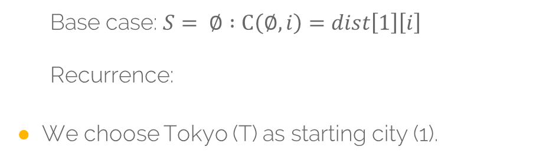
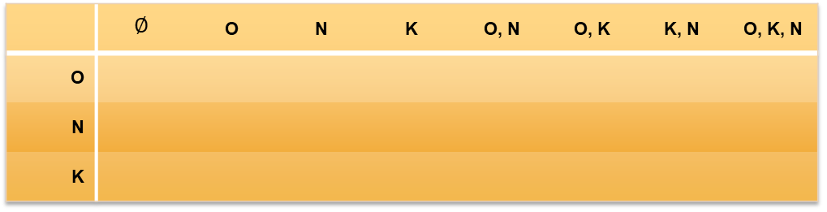
Bellman-Held-Karp
Base case: $S= ∅ :C\left(∅, i\right)=dist\left[1\right]\left[i\right]$
Recurrence:
We choose Tokyo (T) as starting city (1).
 | $$∅$$ | O | N | K | O, N | O, K | K, N | O, K, N
O
N
K

Slide 16
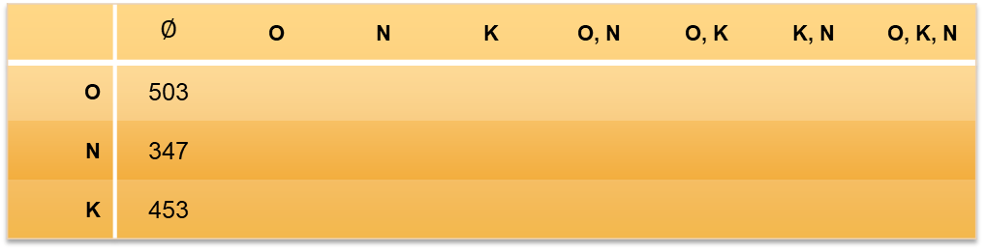
Bellman-Held-Karp
Base case: $S= ∅ :C\left(∅, i\right)=dist\left[1\right]\left[i\right]$
Recurrence:
We choose Tokyo (T) as starting city (1).
 | $$∅$$ | O | N | K | O, N | O, K | K, N | O, K, N
O | 503
N | 347
K | 453

Slide 17
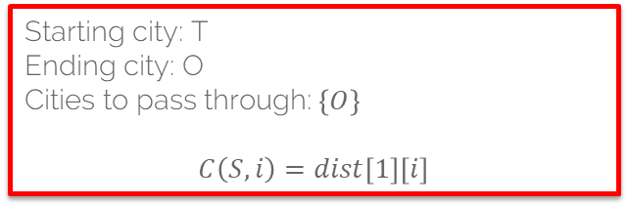
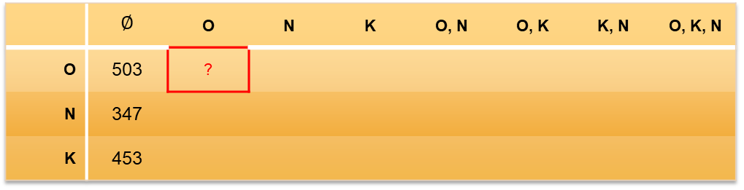
Bellman-Held-Karp
Base case: $S= ∅ :C\left(∅, i\right)=dist\left[1\right]\left[i\right]$
Recurrence:
We choose Tokyo (T) as starting city (1).
 | $$∅$$ | O | N | K | O, N | O, K | K, N | O, K, N
O | 503 | ?
N | 347
K | 453
Starting city: T
Ending city: O
Cities to pass through:$\left\{O\right\}$
$$C\left(S, i\right)=dist\left[1\right]\left[i\right]$$

Slide 18
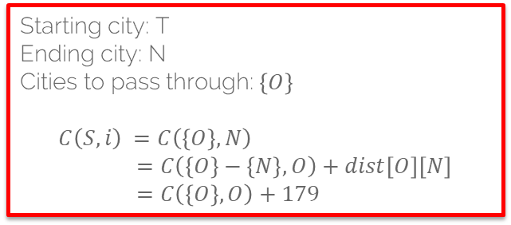
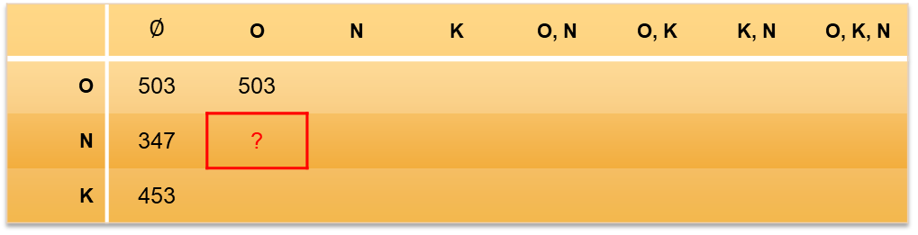
Bellman-Held-Karp
Base case: $S= ∅ :C\left(∅, i\right)=dist\left[1\right]\left[i\right]$
Recurrence:
We choose Tokyo (T) as starting city (1).
 | $$∅$$ | O | N | K | O, N | O, K | K, N | O, K, N
O | 503 | 503
N | 347 | ?
K | 453
Starting city: T
Ending city: N
Cities to pass through:$\left\{O\right\}$
$$C\left(S, i\right) =C\left(\left\{O\right\}, N\right) \\ =C\left(\left\{O\right\}−\left\{N\right\}, O\right)+dist\left[O\right]\left[N\right] \\ =C\left(\left\{O\right\}, O\right)+179$$

Slide 19

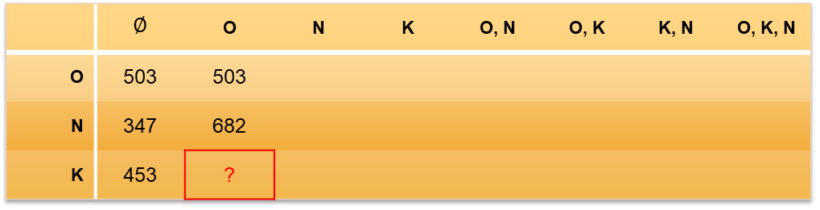
Bellman-Held-Karp
Base case: $S= ∅ :C\left(∅, i\right)=dist\left[1\right]\left[i\right]$
Recurrence:
We choose Tokyo (T) as starting city (1).
 | $$∅$$ | O | N | K | O, N | O, K | K, N | O, K, N
O | 503 | 503
N | 347 | 682
K | 453 | ?
Starting city: T
Ending city: K
Cities to pass through:$\left\{O\right\}$
$$C\left(S, i\right) =C\left(\left\{O\right\}, K\right) \\ =C\left(\left\{O\right\}−\left\{K\right\}, O\right)+dist\left[O\right]\left[K\right] \\ =C\left(\left\{O\right\}, O\right)+56$$

Slide 20
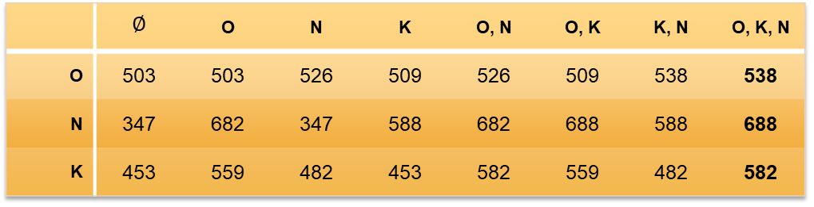
Bellman-Held-Karp
Base case: $S= ∅ :C\left(∅, i\right)=dist\left[1\right]\left[i\right]$
Recurrence:
We choose Tokyo (T) as starting city (1).
 | $$∅$$ | O | N | K | O, N | O, K | K, N | O, K, N
O | 503 | 503 | 526 | 509 | 526 | 509 | 538 | 538
N | 347 | 682 | 347 | 588 | 682 | 688 | 588 | 688
K | 453 | 559 | 482 | 453 | 582 | 559 | 482 | 582

Slide 21

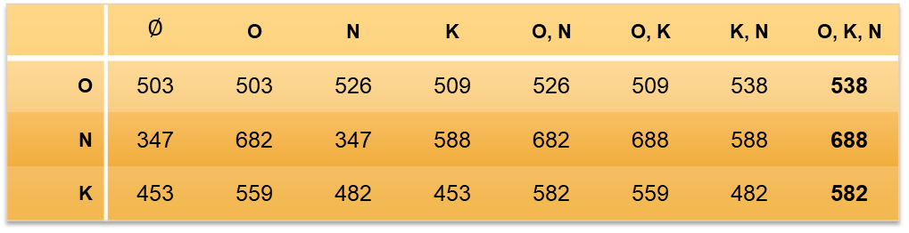
Bellman-Held-Karp
 | $$∅$$ | O | N | K | O, N | O, K | K, N | O, K, N
O | 503 | 503 | 526 | 509 | 526 | 509 | 538 | 538
N | 347 | 682 | 347 | 588 | 682 | 688 | 588 | 688
K | 453 | 559 | 482 | 453 | 582 | 559 | 482 | 582
Final result?
In this case:
1035.
Notes:
Why is this the final result?

Slide 22
Bellman-Held-Karp
C(S, i) := Considering starting at city 1, going through each city in the set S, and ending in city i, this is the shortest possible path.
function algorithm TSP (G, n)
for k := 2 to n do
C({k}, k) := d_{1,k}
end for
for s := 2 to n-1 do
for all S ⊆ {2, . . . , n}, |S| = s do
for all k ∈ S do
C(S, k) := min_{m≠k,m∈S} [C(S\{k}, m) + d_{m,k}]
end for
end for
end for
opt := min_{k≠1} [C({2, 3, . . . , n}, k) + d_{k,1}]
return (opt)
end

Slide 23
Implementation
Representing subsets?
Use Bits!
C[(‘subset’, last node passed)] := (distance, starting node)
Pseudocode:
for k := 2 to n do
C({k}, k) := d_{1,k}
end for
Python:
# Set transition cost from initial state
for k in range(1, n):
C[(1 << k, k)] = (dists[0][k], 0)
Notes:
Base-case of the recursion. Uses bits for subset-notation.

Slide 24
Implementation
Pseudocode:
for s := 2 to n-1 do
for all S ⊆ {2, . . . , n}, |S| = s do
Python:
for subset_size in range(2, n):
for subset in it.combinations(range(1, n), subset_size):
Note: itertools isn’t the fastest.
Notes:
Note how in python you can use itertools.combinations(iterable, r).

Slide 25
Implementation
Pseudocode:
for all k ∈ S do
C(S, k) := min_{m≠k,m∈S} [C(S\{k}, m) + d_{m,k}]
end for
Python:
# Set bits for all cities in this subset
bits = 0
for bit in subset:
bits |= 1 << bit
# Find the lowest cost to get to this subset
for k in subset:
prev = bits & ~(1 << k)
res = []
for m in subset:
if m == 0 or m == k:
continue
res.append((C[(prev, m)][0] + dists[m][k], m))
C[(bits, k)] = min(res)
Notes:
Rebuilds bitmask. Bad.

Slide 26
Output
C after computing all values:
{
(0010, 1): (503, 0),
(0100, 2): (347, 0),
(1000, 3): (453, 0),
(0110, 1): (526, 2),
(0110, 2): (682, 1),
(1010, 1): (509, 3),
(1010, 3): (559, 1),
(1100, 2): (588, 3),
(1100, 3): (482, 2),
(1110, 1): (538, 3),
(1110, 2): (688, 1),
(1110, 3): (582, 1)
}
Distance Matrix:
0 503 347 453
503 0 179 56
347 179 0 135
453 56 135 0
Optimal cost: 1035
Optimal path: [0, 3, 1, 2, 0]

Slide 27
Visualisation
https://visualgo.net/en/tsp

Slide 28
Intermezzo
!
Bits.

Slide 29
Bit : Operations
AND: a & b
OR: a | b
NOT: ~ a
XOR: a ^ b
Left-shift: a << b
a * 2^b
Right-shift: a >> b
a / 2^b
5 & 3 : 0101 & 0011 → 0001 = 1
5 | 3 : 0101 & 0011 → 0111 = 7
~ 5 : ~ 0101 → 1010 = -6
5 ^ 3 : 0101 ^ 0011 → 0110 = 6
5 << 3 : 0101 << 3 → 0101000 = 40
5 >> 3 : 0101 >> 3 → 0000 = 0
Notes:
~ := 2s complement!

Slide 30
Is it useful?
!
Yes.
Notes:
Why subset DP? It’s used in competitions! Here’s an example.

Slide 31

GC2017D : A Trumpian Masterplan?
* by stealing money from communities and then reimbursing his supporters.
*
Notes:
Read problem here.

Slide 32
GC2017D : A Trumpian Masterplan!
Take and give.
1 <= K <= 15 communities
0 <= C_i <= 100 money to be stolen
1 <= N <= 100 friends
1 <= B_i <= 1000 reimbursement
It’s all about reputation!
1 <= P_ij <= 10 gained when stealing
1 <= D_i <= 10 lost when reimbursing
How many friends can Trump make happy?

Slide 33
GC2017D : A Trumpian Masterplan?
Where is the subset DP?

Slide 34
GC2017D : A Trumpian Masterplan?
Where is the subset DP?
How much reputation can be gained?
int reputation(int k):
int maskSize = 2^k - 1
initialize DP table of maskSize by k
for i = 1 to 2^k – 1 do:
for j = 0 to k do:
if community j has been robbed:
continue
for h = 0 to k do:
if community h has been robbed:
continue
else set dp[i][j] to:
maximum of stealing from community j after k
rep = 0
for i = 0 to k do:
rep = max(rep, dp[maskSize][i])
return rep
Notes:
Go through code.

Slide 36
i = 4
j = 4
4 & (1 << 4) == 0
0100 & (1 << 4)
0100 & (10000)
i = 4
j = 2
4 & (1 << 2) =/= 0
0100 & (1 << 2)
0100 & (0100)
Notes:
i := subset iterator
j := community iterator

Slide 37
Can we do more?
!
Yes.

Slide 38
Steiner Tree
Treewidth

Slide 39

Problem: Steiner Tree
Given some weighted graph $G=(V, E)$ with $k$ terminals in some set $S$, find a minimum cost tree $T\left(S\right)$ connecting these points.

Slide 40
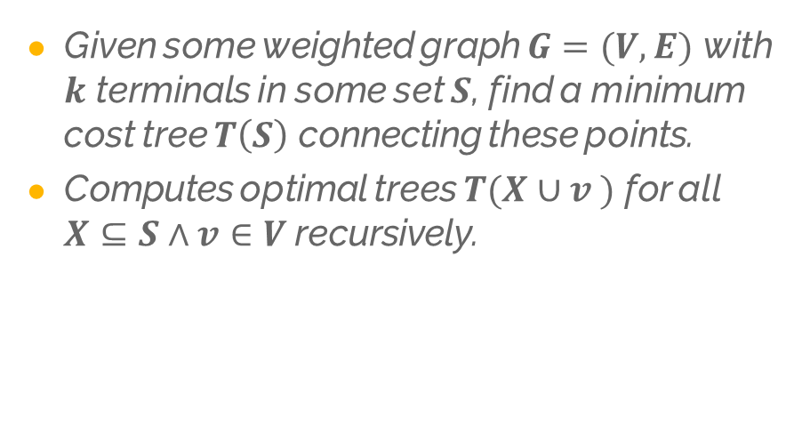
Solution: Dreyfus-Wagner
Given some weighted graph $G=(V, E)$ with $k$ terminals in some set $S$, find a minimum cost tree $T\left(S\right)$ connecting these points.
Computes optimal trees $T(X∪v )$ for all $X⊆S∧v∈V$recursively.

Slide 41
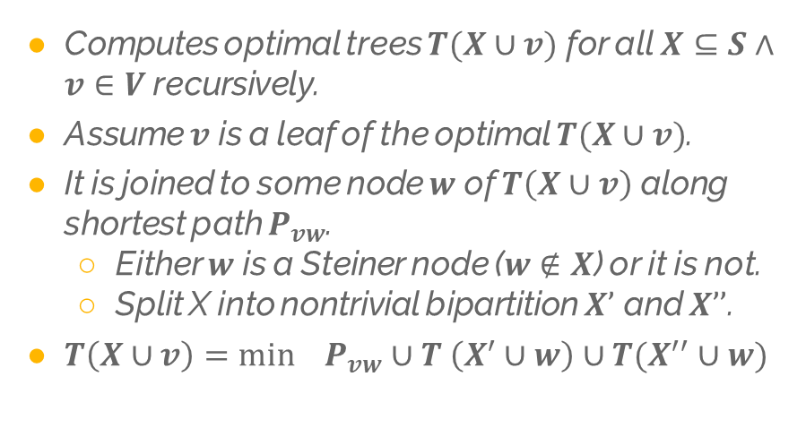
Solution: Dreyfus-Wagner
Computes optimal trees $T(X∪v)$ for all $X⊆S∧v∈V$recursively.
Assume $v$ is a leaf of the optimal $T(X∪v)$.
It is joined to some node $w$ of $T\left(X∪v\right)$ along shortest path $P_{vw}$.
Either $w$ is a Steiner node ($w∉X$) or it is not.
Split X into nontrivial bipartition $X’$ and $X’’$.
$T\left(X∪v\right)=\min_{}{P_{vw}}∪T \left(X^{′}∪w\right)∪T(X^{′′}∪w)$

Slide 42
Steiner Tree
Treewidth

Slide 43
Problem: Treewidth
A measure for how tree-like a graph is.
Measured by decomposing graphs into trees of bags.
If two nodes are neighbours, there is a bag containing both of them.
For every v, all bags containing v form a connected subtree.

Slide 44
Tree: Decompose
Decomposing graphs into trees of bags:
If two nodes are neighbours, there is a bag containing both of them.
For every v, all bags containing v form a connected subtree.

Slide 45
Tree: Decompose
Width of decomposition: Size(largest bag) – 1.
Treewidth: tw(G) = min (width of decomposition)

Slide 46
Tree: Decompose
Given graph G and integer w, decide if treewidth is at most w → NP-hard.
Bodlaender’s Theorem:
For every w, there is a linear-time
algorithm that finds a tree decomposition
of width w, if it exists.

Slide 47
Tree: Decompose
Bodlaender’s Theorem:
For every w, there is a linear-time
algorithm that finds a tree decomposition
of width w, if it exists.
So, deciding if treewidth is at most w.
Fixed Parameter Tractable: FTP.
Weighted Max Independent Set, 3-Coloring, Vertex Coloring, Hamiltonian Cycle, Subgraph Isomorphism

Slide 48

FPT?

Slide 49
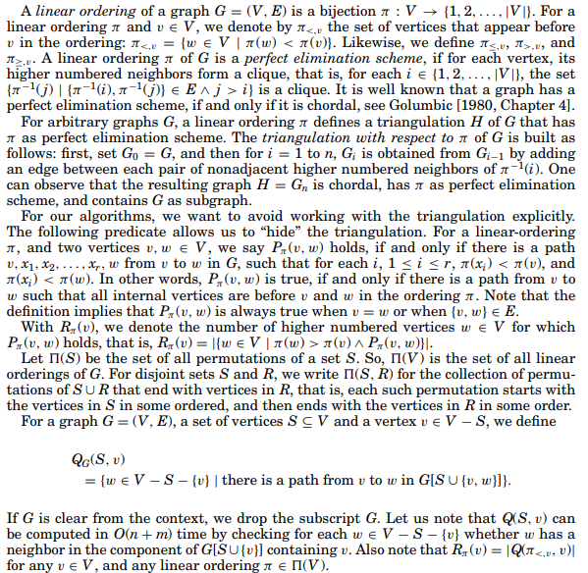
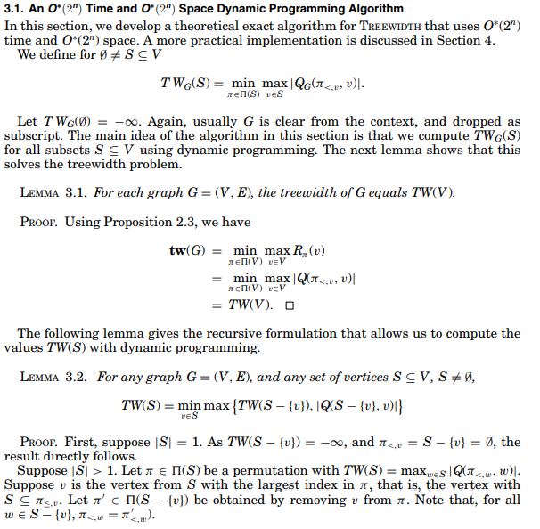
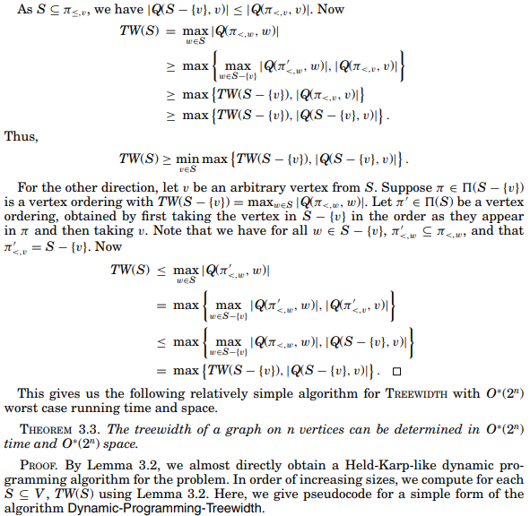
Tree: Decompose
Solved by seeing it as a linear ordering problem.

Slide 50
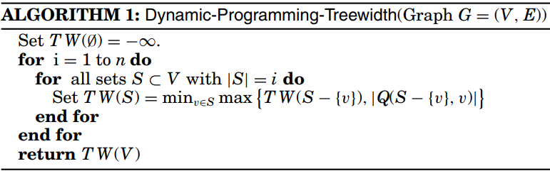
Tree: Decompose

Slide 51
Can we do more?
!
Yes.

Slide 52
Credits!
Presentation template by SlidesCarnival
Github user CarlEkerot for code (Bellman-Held-Karp).
2ILC0 – Algorithms for information.
Stijn Slot for code (Trumpian Masterplan)

Slide 53
SlidesCarnival icons are editable shapes.
This means that you can:
Resize them without losing quality.
Change fill color and opacity.
Change line color, width and style.
Isn’t that nice? :)
Examples:

