Slide 1

Event-Driven Architecture with Azure Event Grid
SoCal Azure User Group
June 12, 2018

Slide 2

About Me
{
“name”: “David Barkol”,
“title”: “Azure Architect at Microsoft – Global Black Belt (GBB) team”,
“location”: “Southern California”,
“twitter”: “@dbarkol”,
“email”: “dabarkol@microsoft.com”,
“github”: “https://github.com/dbarkol,
“blog”: “https://madeofstrings.com”
}

Slide 3
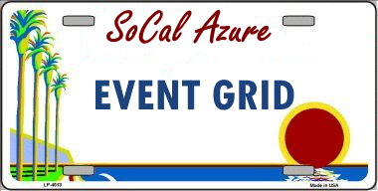

Agenda
Azure Messaging Services
Architecture Considerations
Event Grid Deep Dive
Demos
Roadmap
Thank you,
https://aka.ms/socalazure-eventgrid https://aka.ms/eventgridviewer

Slide 4


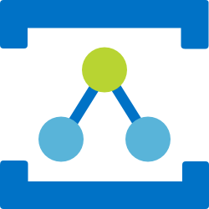
Azure Messaging Services
Service Bus
Event Hubs
Relay
Event Grid
Asynchronous enterprise messaging
Load-leveling, duplication detection, ordering, etc.
Distributed data streaming
Secure two-way communication without changes to your network
Cross-cloud reactive eventing

Slide 5
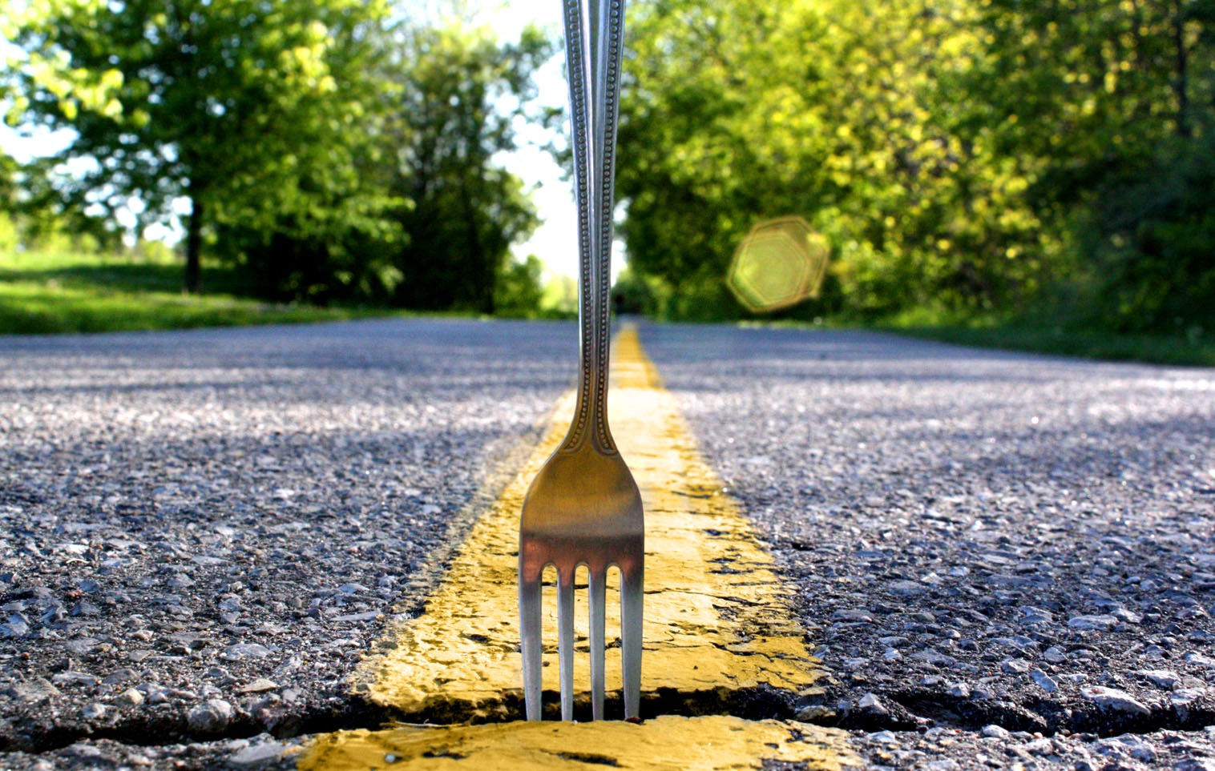
Which services should you pick?

Slide 6
Report
Command
Transfer
Notification
Query
Measurement
Assignment
Handover
Job
Trace
Update
Request

Slide 7
Command
Transfer
Query
Report
Handover
Notification
Job
Measurement
Assignment
Trace
Update
Request

Slide 8
Intents
Facts

Slide 9
Messaging
Eventing
Intents
Facts
Expectations
History
Conversations
Context
Contracts
Order
Control Transfer
Schema
Value Transfer

Slide 10
Messaging
Eventing
A
B
A
?
C
?

Slide 11
Events
Discrete
Series
Independent
Time Ordered
Report State Change
Context Partitioned
Actionable
Report Condition
Analyzable

Slide 12




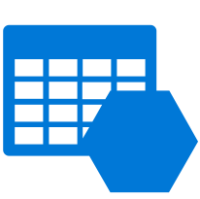

Discovering events is expensive
IoT Devices
1st party events
Storage
Cloud Subscriptions
Application
Resource Groups
Streaming Data
Tables

Slide 13
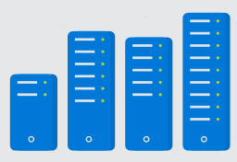
Processing events is cumbersome
IoT Devices
1st party events
Storage
Application
Cloud Subscriptions
Code
</>
Resource Groups
Streaming Data
Tables
Infrastructure

Slide 14
Communication between app components is complicated
IoT Devices
1st party events
Custom app specific events
Storage
Service 1
Service 2
Cloud Subscriptions
Code
</>
Code
</>
Resource Groups
Streaming Data
Tables
Infrastructure
Infrastructure

Slide 15

What if it could be simpler?
IoT Hub
1st party events
Custom app specific events
Blob Storage
Serverless
Function 1
Serverless
Function 2
Azure Subscriptions
Resource Groups
Code
</>
Code
</>
Event Hubs
Event Grid
Functions
Event Grid
Functions
Storage (GPv2)

Slide 16
Azure Event Grid
Fully-managed event routing
Near real-time event delivery at scale
Broad coverage within Azure and beyond
Backbone of event-driven computing

Slide 17
Demo: Azure Events

Slide 18
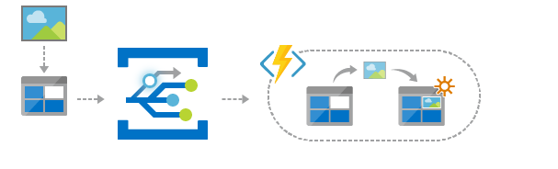
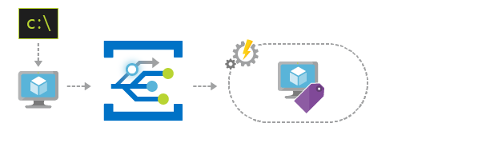
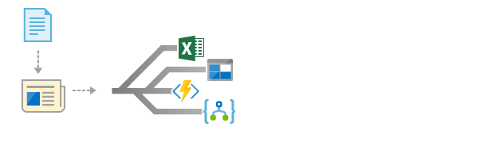
Scenarios
Serverless apps
Ops automation
Application integration
Instantly trigger a serverless function to run analysis when a new file is added to a blob storage container.
Speed up automation and simplify policy enforcement by notifying Azure Automation when underlying infrastructure is provisioned
Connects your app with other services. Create an application topic to route your app’s event data to any desired destination

Slide 19

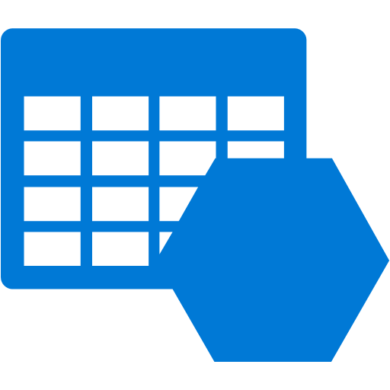


Event Publishers
Blob Storage
Event Hubs
Media Services
Storage (GPv2)
Service Bus
Resource Groups
IoT Hub
Azure Subscriptions
Custom Topic

Slide 20




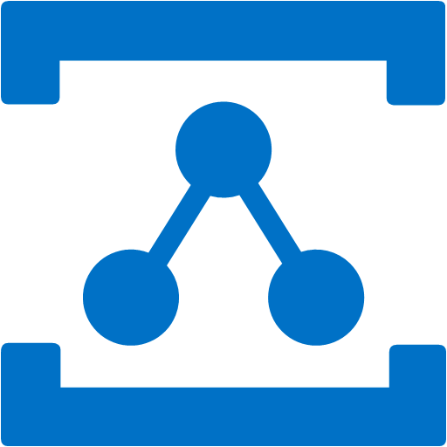

Event Handlers
Azure Functions
Event Hubs
Logic Apps
Storage Queue
Relay Hybrid Connection
Azure Automation
WebHooks

Slide 21

Manage all events in once place
IoT Hub
Blob Storage
Azure Functions
Azure Subscriptions
Logic Apps
Resource Groups
Azure Automation
Event Hubs
WebHooks
Custom Topics
Event Hubs
Storage (GPv2)

Slide 22
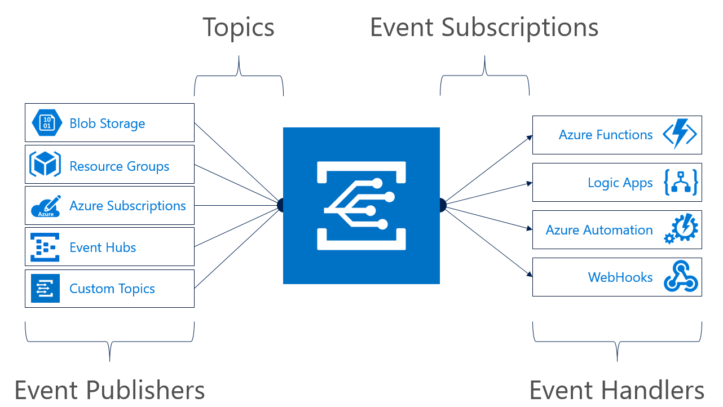
Concepts
Events: what happened
Event Publishers: where it took place
Topics: where publishers send events
Event Subscriptions: how you receive events
Event Handlers: the app or service reacting to the event

Slide 23
Event Schema
[{
"topic": "/subscriptions/{subscription-id}/resourceGroups/rg1/providers/Microsoft.Storage/storageAccounts/socalazure",
"subject": "/blobServices/default/containers/sample/blobs/grid.jpg",
"eventType": "Microsoft.Storage.BlobCreated",
"eventTime": "2018-03-08T02:32:32.3138466Z",
"id": "60b827dd-701e-010a-2e85-b6ba5f0618c4",
"data": {
"api": "PutBlockList",
"clientRequestId": "580ebc71-0b38-4e13-9c3e-5db169ad2032",
"requestId": "60b827dd-701e-010a-2e85-b6ba5f000000",
"eTag": "0x8D5849CD8572590",
"contentType": "image/jpeg",
"contentLength": 687245,
"blobType": "BlockBlob",
"url": "https://socalazure.blob.core.windows.net/sample/grid.jpg",
"sequencer": "0000000000000000000000000000043C00000000004b90e3",
"storageDiagnostics": {
"batchId": "11c2a1b3-013f-4c7a-a31e-cf455a2c7d3f"
}
},
"dataVersion": "",
"metadataVersion": "1"
}]
Properties specific to the publisher
https://docs.microsoft.com/en-us/azure/event-grid/event-schema

Slide 24
Subscription Validation
[{
"id": "d81e1cee-cd14-4bf6-8105-13cdc71284b3",
"topic": "/subscriptions/xxxxxxx/resourceGroups/cbus- eventgrid/providers/microsoft.eventgrid/topics/cbus-topic-1",
"subject": "",
"data": {
"validationCode": "BDC0D448-74DC-4E4A-B9B4-EFAB111FF10A",
"validationUrl": https://rp-eastus.eventgrid.azure.net/eventsubscriptions/mysub1/validate?id=BDC0D448-74DC-4E4A-B9B4-EFAB111FF10A&t=2018-05-19T17:42:44.7966715Z&apiVersion=2018-05-01-preview&token=yUW1lFf3PSTWyQruNtQ5vCszJ3SiIcJzBvwYnMlN80A%3d
},
"eventType": "Microsoft.EventGrid.SubscriptionValidationEvent",
"eventTime": "2018-05-19T17:42:44.8123163Z",
"metadataVersion": "1",
"dataVersion": "2"
}]
https://docs.microsoft.com/en-us/azure/event-grid/security-authentication#webhook-event-delivery

Slide 25
Demo: Custom Events

Slide 26
Publish with .NET SDK
// Step 1: Initialize credentials and client
ServiceClientCredentials credentials = new TopicCredentials(TopicKey);
var client = new EventGridClient(credentials);
// Step 2: Populate list of events
var events = new List<EventGridEvent>
{
new EventGridEvent()
{
Id = Guid.NewGuid().ToString(),
Data = feedback,
EventTime = DateTime.Now,
EventType = feedback.Score > 70 ? "Positive" : "Negative",
Subject = "eventgrid/demo/feedback",
DataVersion = "1.0"
}
};
// Step 3: Publish
await client.PublishEventsAsync(
TopicHostName,
events);

Slide 27
Publish with HttpClient
// Step 1: Initialize HttpClient
var client = new HttpClient { BaseAddress = new Uri(TopicEndpoint) };
client.DefaultRequestHeaders.Accept.Clear();
client.DefaultRequestHeaders.Accept.Add(new MediaTypeWithQualityHeaderValue("application/json"));
// Step 2: Add the topic key
client.DefaultRequestHeaders.Add("aeg-sas-key", TopicKey);
// Step 3: Create a list of events
var events = new List<GridEvent<Feedback>>
{
new GridEvent<Feedback>()
{
Data = feedback,
Subject = "eventgrid/demo/feedback",
EventType = feedback.Score > 70 ? "Positive" : "Negative",
EventTime = DateTime.UtcNow,
Id = Guid.NewGuid().ToString()
}
};
// Serialize the data
var json = JsonConvert.SerializeObject(events);
var stringContent = new StringContent(json, Encoding.UTF8, "application/json");
// Publish grid event
await client.PostAsync(string.Empty, stringContent);

Slide 28
Handling an Event (Azure Function v2)
public static IActionResult Run(
[HttpTrigger(AuthorizationLevel.Function, "post", Route = null)] HttpRequest req, TraceWriter log)
{
var requestBody = new StreamReader(req.Body).ReadToEnd();
// Check the header for the event type
if (!req.Headers.TryGetValue("Aeg-Event-Type", out var headerValues))
return new BadRequestObjectResult("Not a valid request");
var eventTypeHeaderValue = headerValues.FirstOrDefault();
if (eventTypeHeaderValue == "SubscriptionValidation")
{
// Echo back the validation code
var events = JsonConvert.DeserializeObject<EventGridEvent[]>(requestBody);
dynamic data = events[0].Data;
var validationCode = data["validationCode"];
return new JsonResult(new
{
validationResponse = validationCode
});
}
else if (eventTypeHeaderValue == "Notification")
{
log.Info(requestBody);
return new OkObjectResult("");
}
return new BadRequestObjectResult("Not a valid request");
}

Slide 29
Custom GridEvent class
public class GridEvent<T> where T : class
{
public string Id { get; set; }
public string Subject { get; set; }
public string EventType { get; set; }
public T Data { get; set; }
public DateTime EventTime { get; set; }
}

Slide 30
Demo: Feedback Events

Slide 31
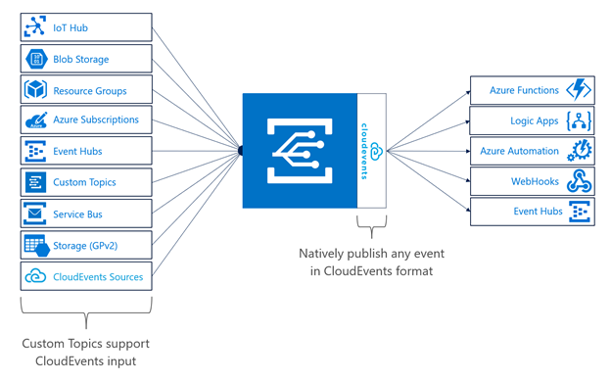

Cloud Events

Slide 32
CloudEvent schema
{
"cloudEventsVersion" : "0.1",
"eventType" : “Zohan.NewEmployee",
"eventTypeVersion" : "",
"source" : "/subscriptions/{subscription-id}/resourceGroups/{resource-group}/providers/Microsoft.Storage/
storageAccounts/{storage-account}#blobServices/default/containers/{storage-container}/blobs/{new-file}",
"eventID" : "173d9985-401e-0075-2497-de268c06ff25",
"eventTime" : "2018-04-28T02:18:47.1281675Z",
"data" : {
“name": “Frank Rizzo",
“employeeId": "6d79dbfb-0e37-4fc4-981f-442c9ca65760",
}
}

Slide 33
Guiding Principles
Events are independent
Always available
Near real-time event delivery
At least once delivery
Dynamic scale
Platform agnostic (WebHook)
Language agnostic (HTTP protocol)

Slide 34
Key Takeaways
Loosely coupled
Using the right tool for the right task
Events vs. Commands
Knowing the difference between Events and Telemetry / streams
Idempotent

Slide 35
Roadmap
In-person ☺

Slide 36
References
Azure Documentation: https://azure.com/eventgrid
Presentation & Code: https://aka.ms/socalazure-eventgrid
Event Viewer: https://aka.ms/eventgridviewer
MSDN Article: https://aka.ms/eventgridarticle

Slide 37
Thank You!

