Slide 1
Physical Activity Classified by Tri-Axial Accelerometer
Dominique Barnes
Data Science Institute
December 7th, 2023
https://github.com/dbarnes16/DATA1030-Final.git

Slide 2
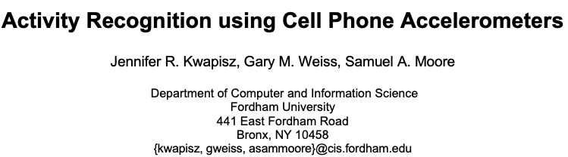
Introduction
Dataset
Kaggle dataset: Activity-Detection-IMU-Sensor
Wireless Sensor Data Mining (WISDM) Lab
  Fordham University
29 volunteer subjects
Kwapisz, J. R., Weiss, G. M., & Moore, S. A. (2011). Activity recognition using cell phone accelerometers. ACM SigKDD Explorations Newsletter, 12(2), 74-82.

Slide 3






Recap
Goal
Classify the user’s motion by the phone-based accelerometers
Downstairs
Jogging
Sitting
Standing
Upstairs
Walking

Slide 4
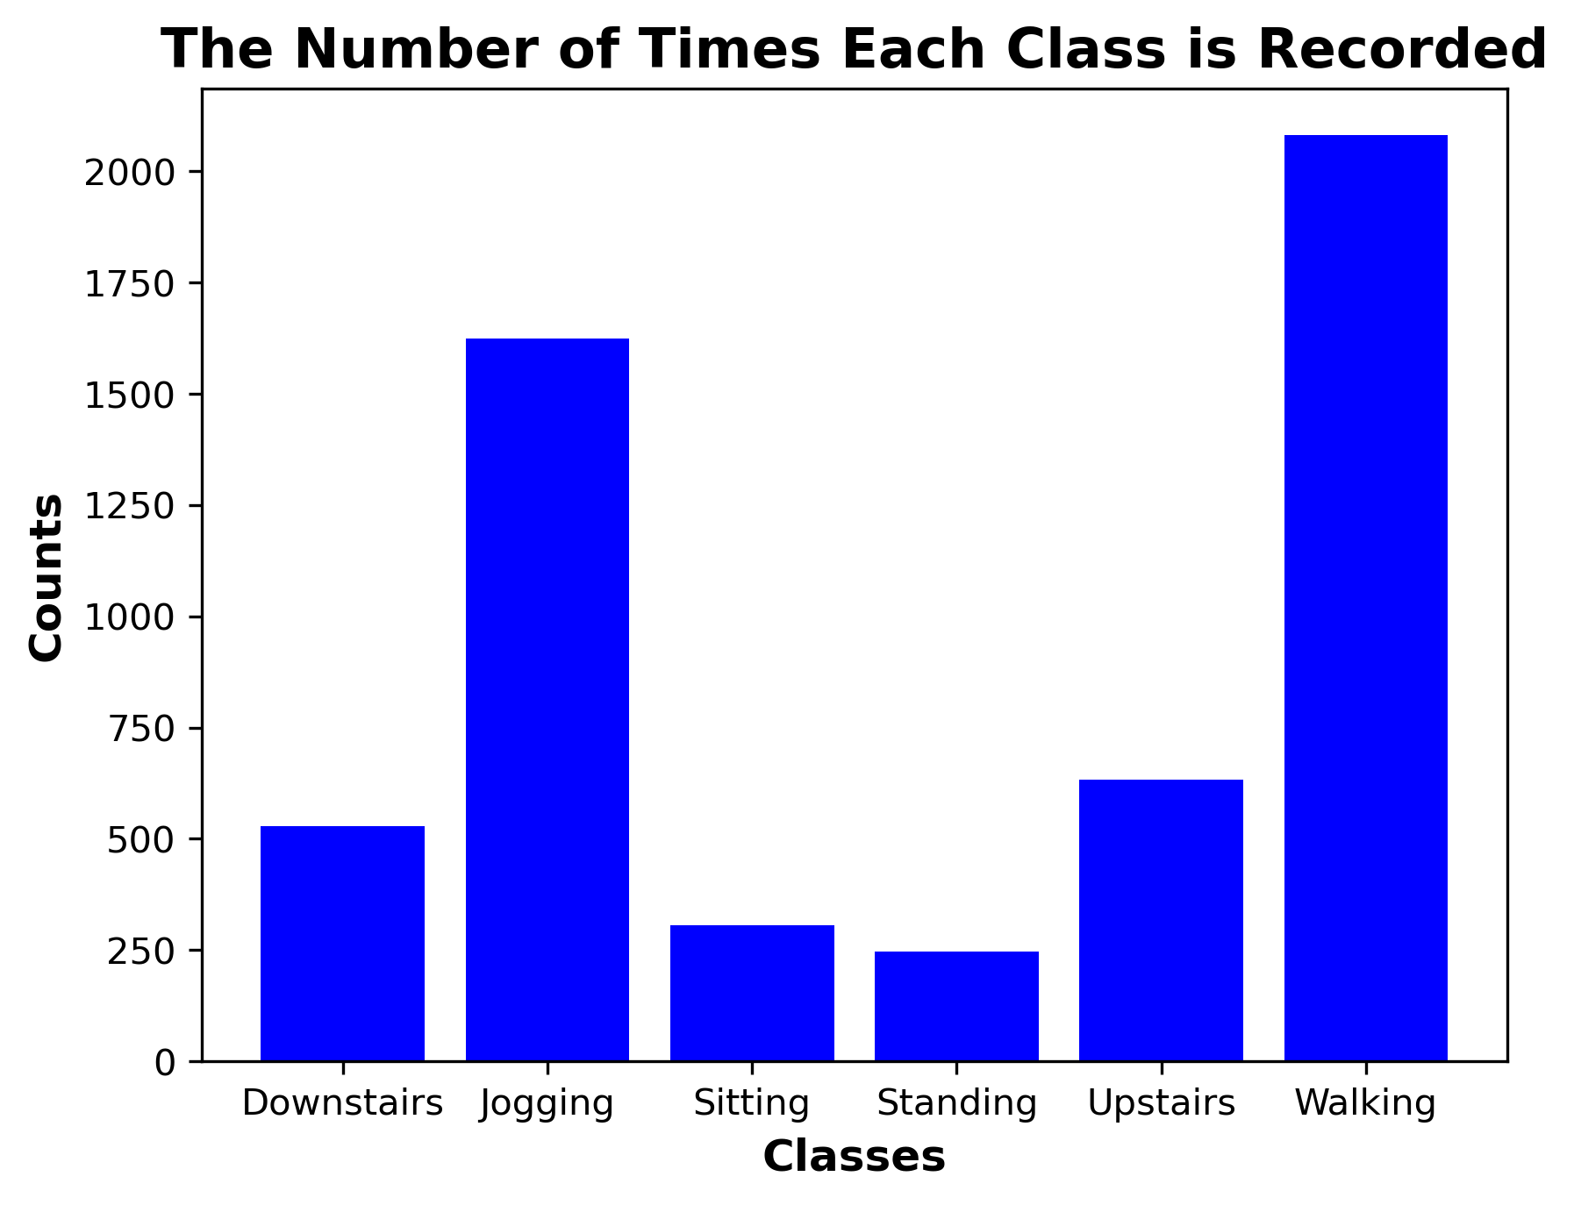
Exploratory Data Analysis
Data Imbalance

Slide 5
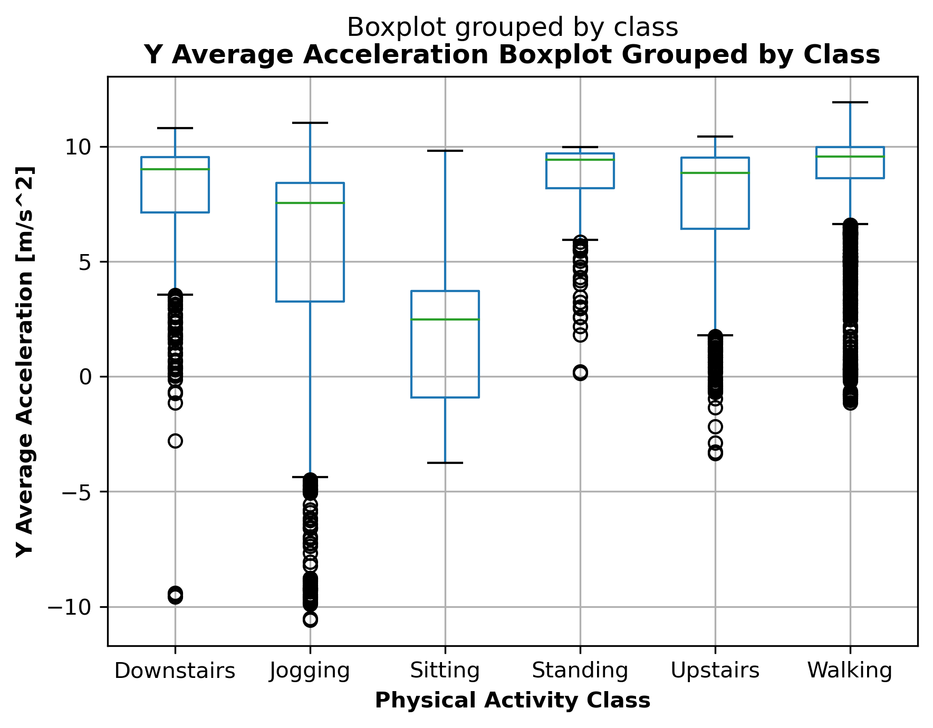
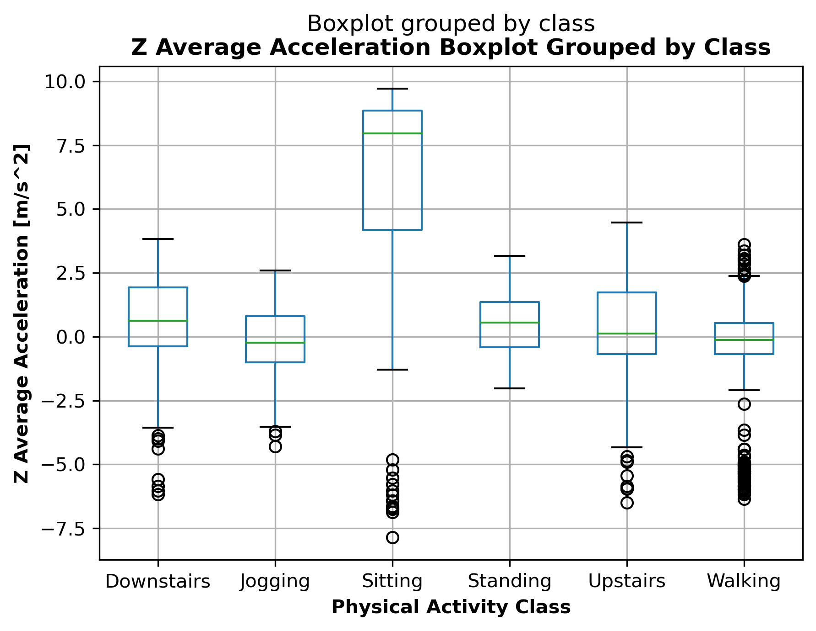
Exploratory Data Analysis
Y and Z Average Acceleration
Notes:
The acceleration recorded includes gravitational acceleration toward the center of the Earth so that when the phone is at rest on a flat surface the vertical axis will register +-10.

Slide 6
Is the data IID?
Cross- Validation
Splitting
&
Preprocessing
No. It is group-structured
What will the model predict?
Physical activity class on unseen users
Group Kfold & Standard Scaler
Notes:
Initially split 80-other, 20-test
Split other into 80-train, 20-val

Slide 7
Cross-Validation
Machine Learning Algorithms & Parameters
XGBoost
Logistic Regression L2
Random Forest
SVC
C: [0.001,0.1,1,10,100]
Max_Iter: [1000,5000]
Max_Depth: [1, 3, 10]
C: [0.1, 0, 1]
Gamma: [0.001, 0.1, 1, 1000]
N_Estimators: [50,100,500]
Max_Depth: [1,3,10,30]
Max_Features: [0.5,0.75,1.0]

Slide 8
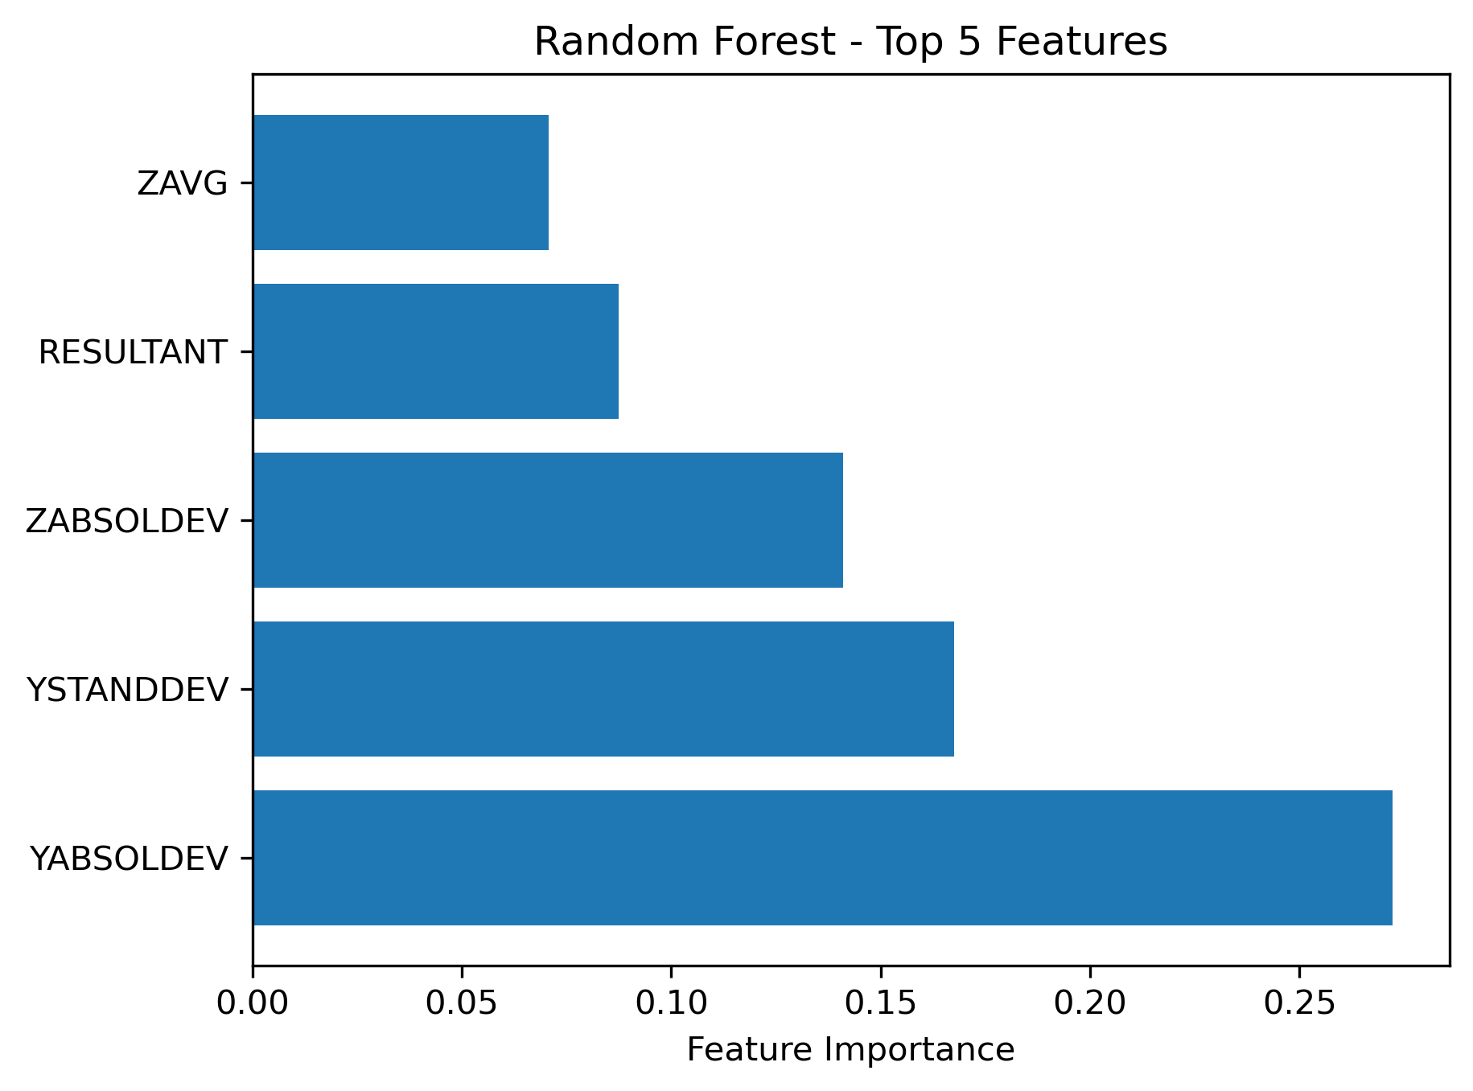
Results
Global Feature Importance

Slide 9
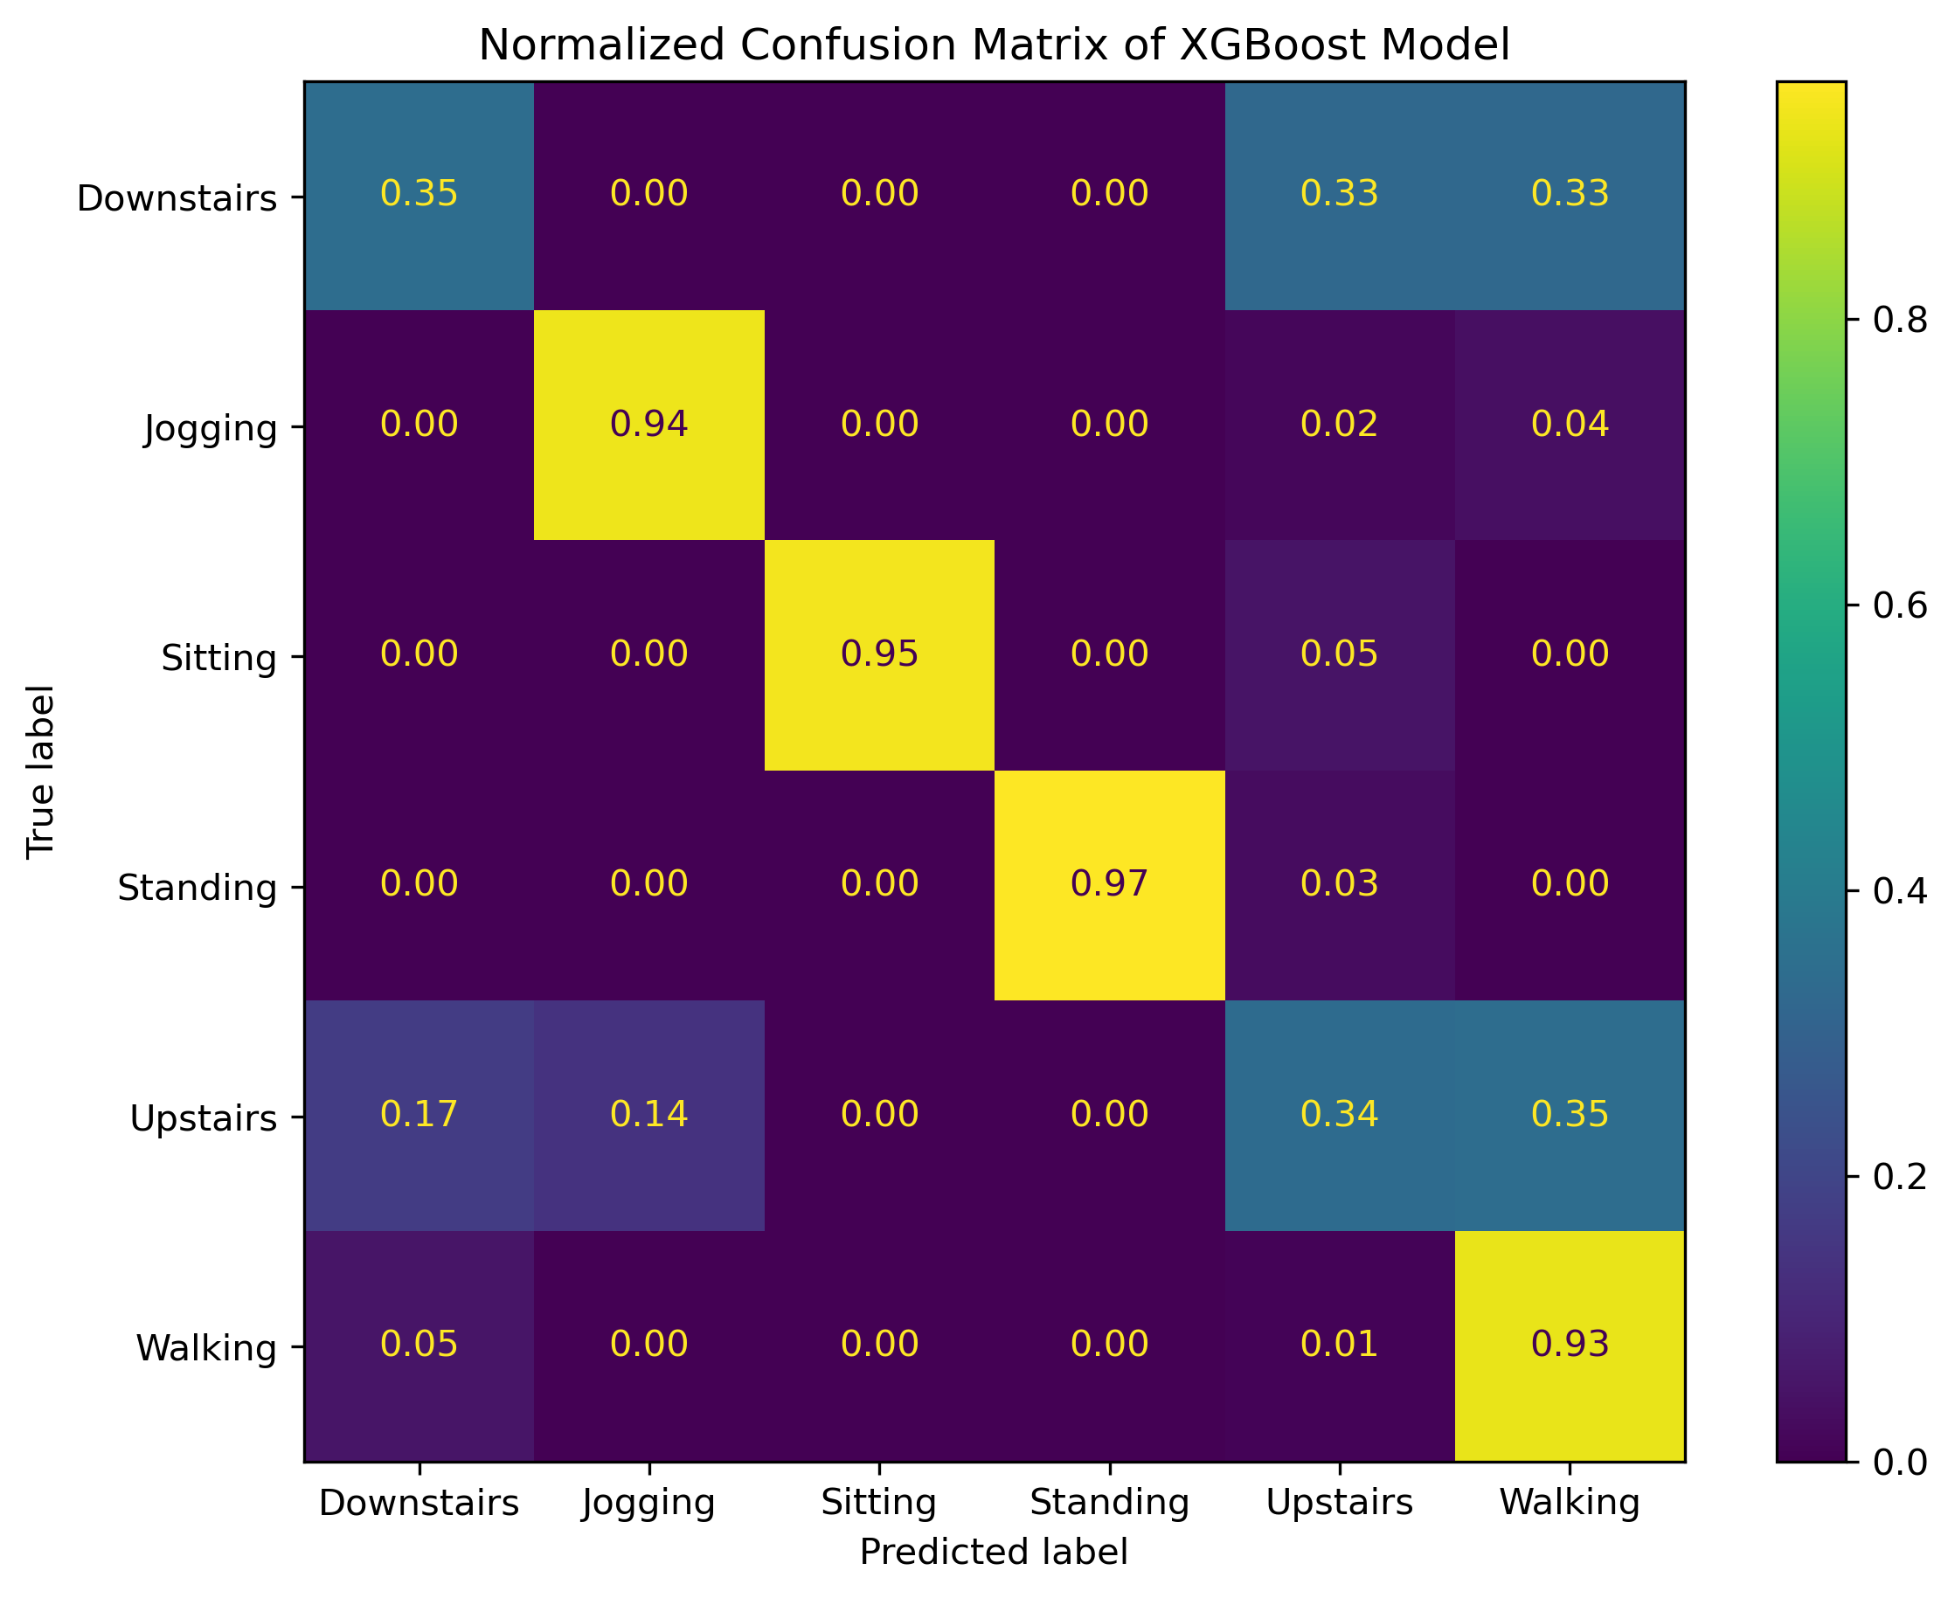
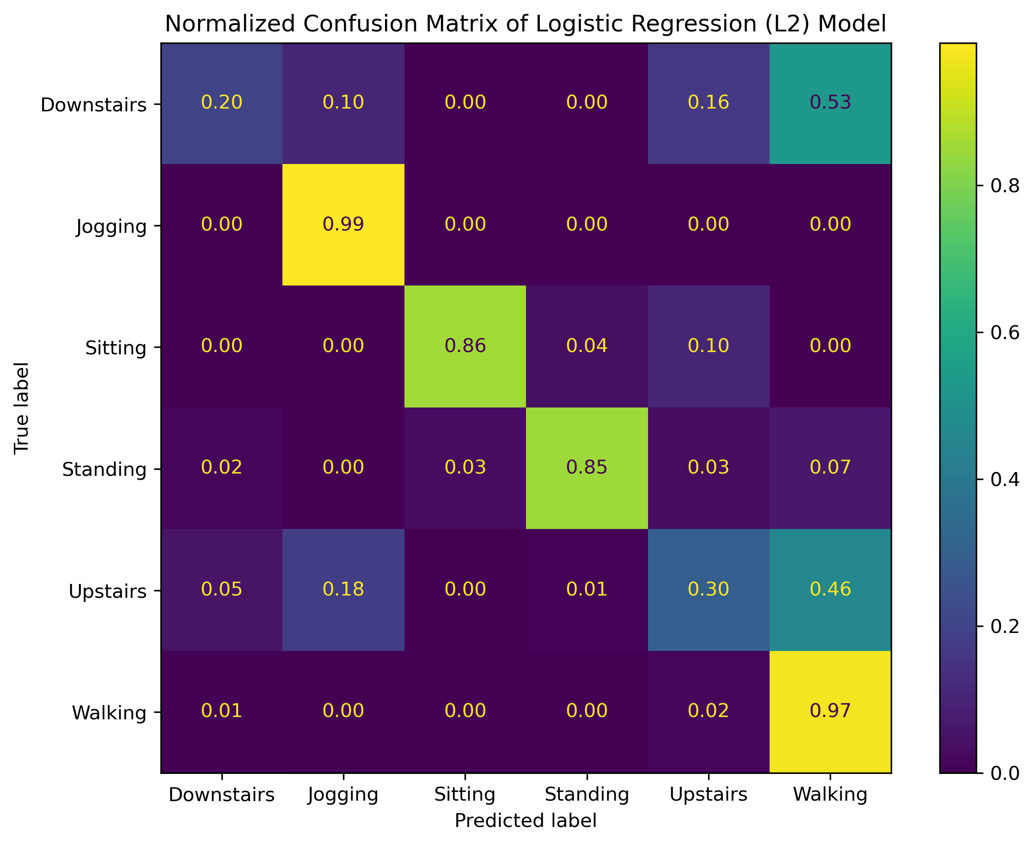
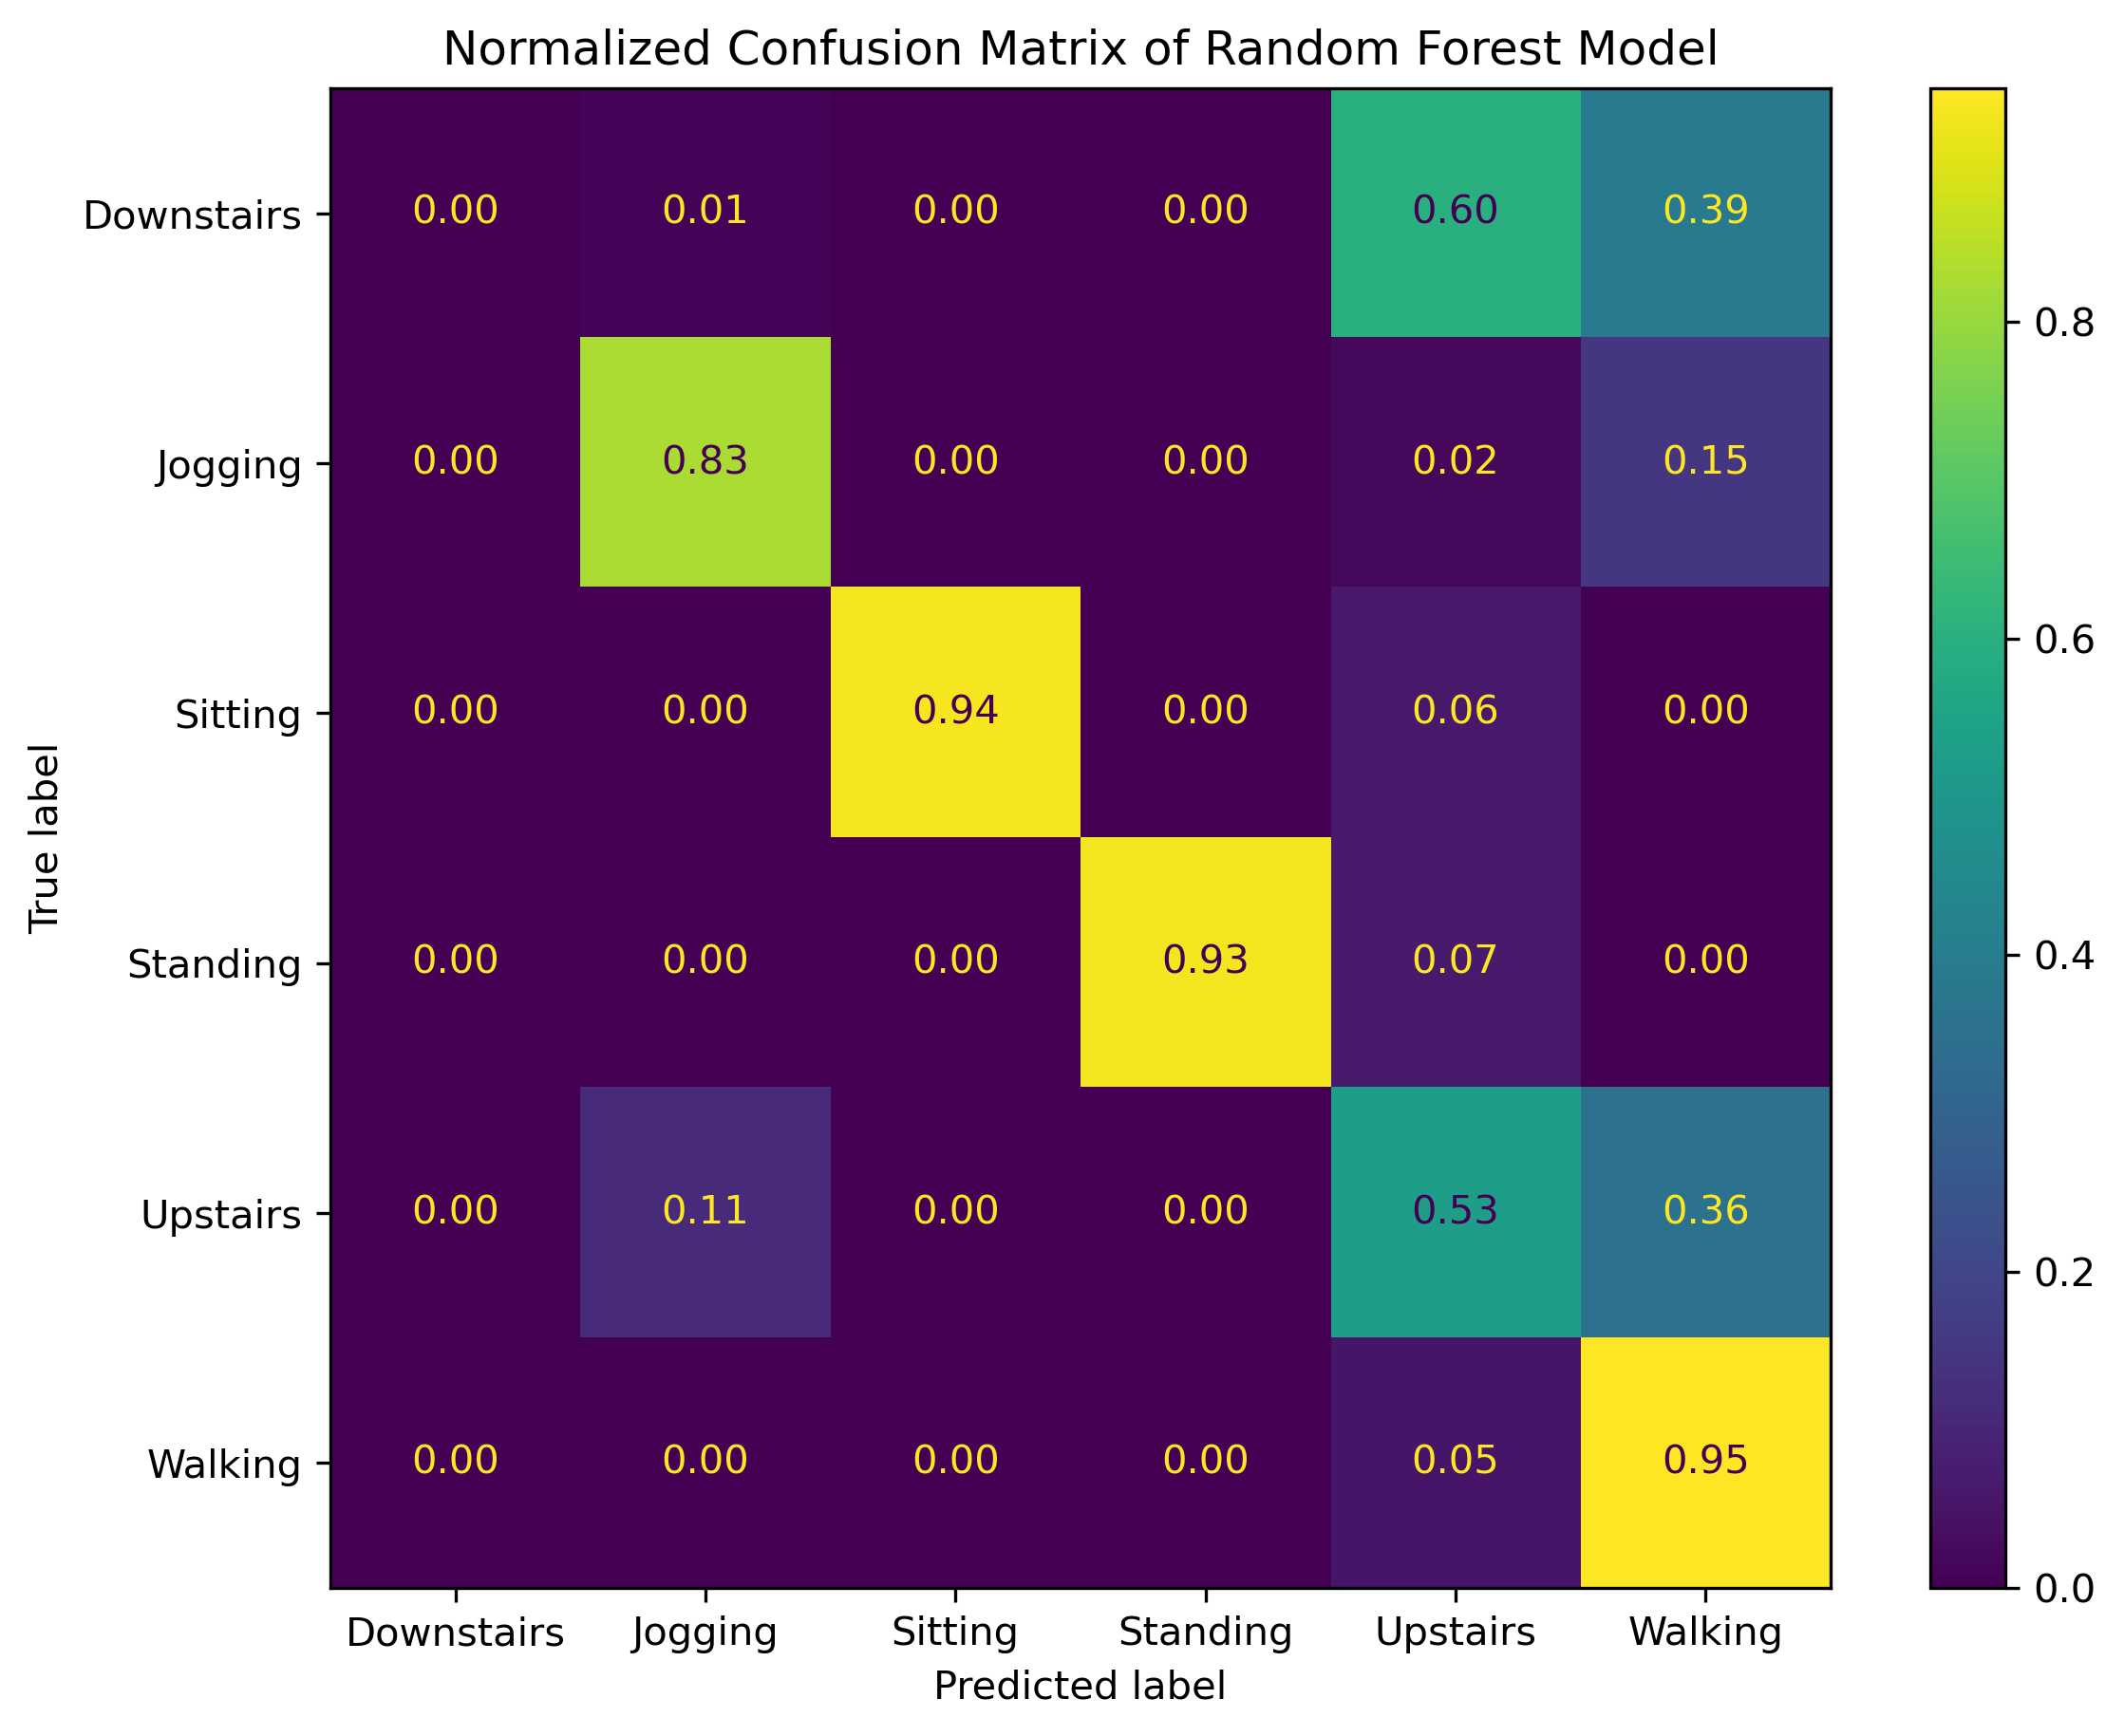
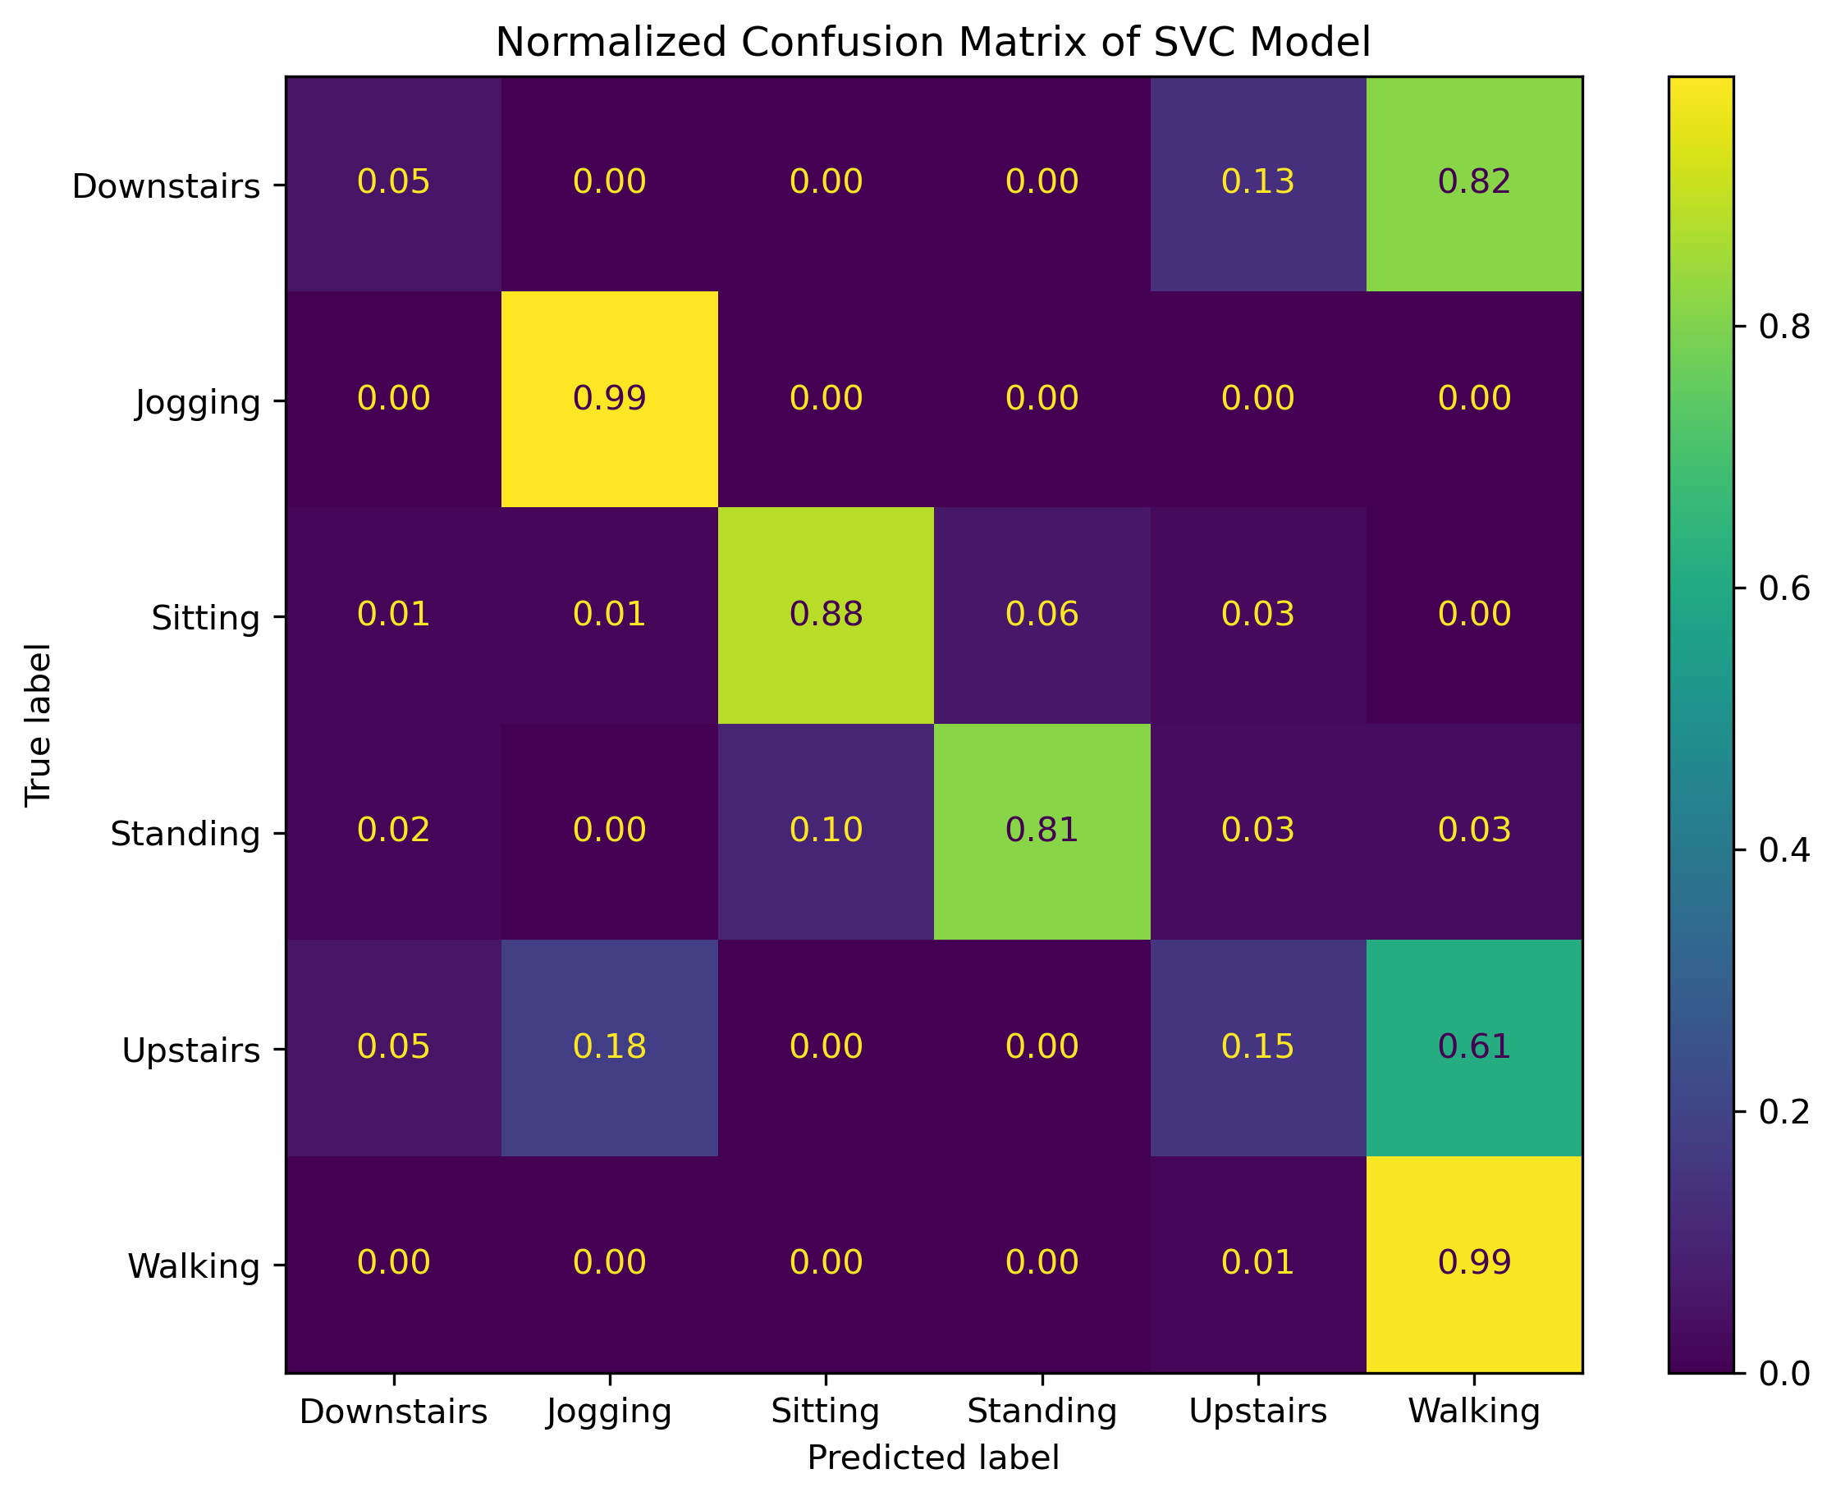
XGBoost &
Logistic Regression (L2)
Results
Normalized Confusion Matrices
Random Forest & SVC
Notes:
Normalized by true-labels, row-wise
Divided each element by the sum of the values in its respective row. This way, the values in each row represent the proportion of instances for each true class classified into each predicted class.
Important because target data imbalance

Slide 10
Results
XGBoost Normalized Confusion Matrices
Notes:
Normalized by true-labels, row-wise
Divided each element by the sum of the values in its respective row. This way, the values in each row represent the proportion of instances for each true class classified into each predicted class.
Important because target data imbalance

Slide 11
Results
Average Test Scores
 | XGBoost Mean +/-StDev | Logistic Regression L2 Mean +/-StDev | Random Forest Mean +/-StDev | SVC Mean +/-StDev
Accuracy | 0.774 +/-0.053 | 0.759 +/-0.054 | 0.766 +/-0.050 | 0.755 +/-0.059
Precision | 0.755 +/-0.050 | 0.725 +/-0.067 | 0.768 +/-0.057 | 0.717 +/-0.064
Recall | 0.774 +/-0.053 | 0.759 +/-0.054 | 0.766 +/-0.050 | 0.755 +/-0.059
F1 Beta Score | 0.751 +/-0.053 | 0.718 +/-0.060 | 0.748 +/-0.061 | 0.708 +/-0.059

Slide 12
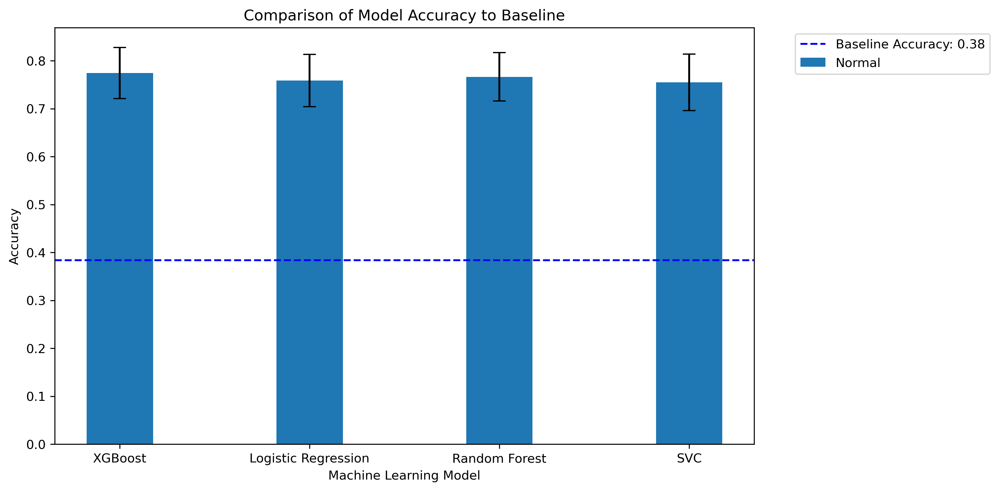
Results
Average Baseline Scores Comparison
Notes:
The tuned models are not providing significant improvement in accuracy over a simple baseline model. This may also suggest that the task is not very complex such that a simple model can capture the patterns of the data

Slide 13




Outlook
Tune more hyperparameters
Explore other machine-learning models
Increase the dataset sample size and create a balanced set
Incorporate muscle activity data

Slide 14
Questions?
Dominique_Barnes@Brown.edu
https://github.com/dbarnes16/DATA1030-Final.git

