Slide 1
Aging and Creative Productivity
Is There an Age Decrement or Not?

Slide 2
Brief history: Antiquity of topic
Quételet (1835)
Beard (1874)
Lehman (1953)
Dennis (1966)
Simonton (1975, 1988, 1997, 2000, 2004)

Slide 3
Central findings:
The typical age curve
Described by fitting an equation derived from a combinatorial model of the creative process

Slide 4
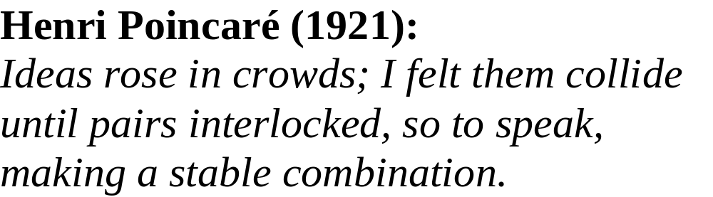
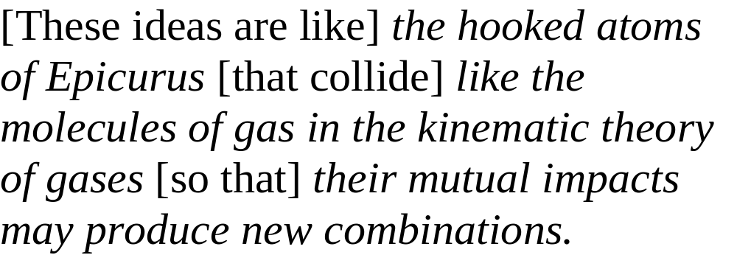

Slide 5
p (t) = c (e ^{– at} – e ^{– bt})
  where p (t) is productivity at career age t (in years),
  e is the exponential constant (~ 2.718),
  a the typical ideation rate for the domain (0 < a < 1),
  b the typical elaboration rate for the domain (0 < b < 1),
  c = abm/(b – a), where m is the individual’s creative potential (i.e. maximum number of publications in indefinite lifetime).
[N.B.: If a = b, then p (t) = a²mte ^{– at}]

Slide 6
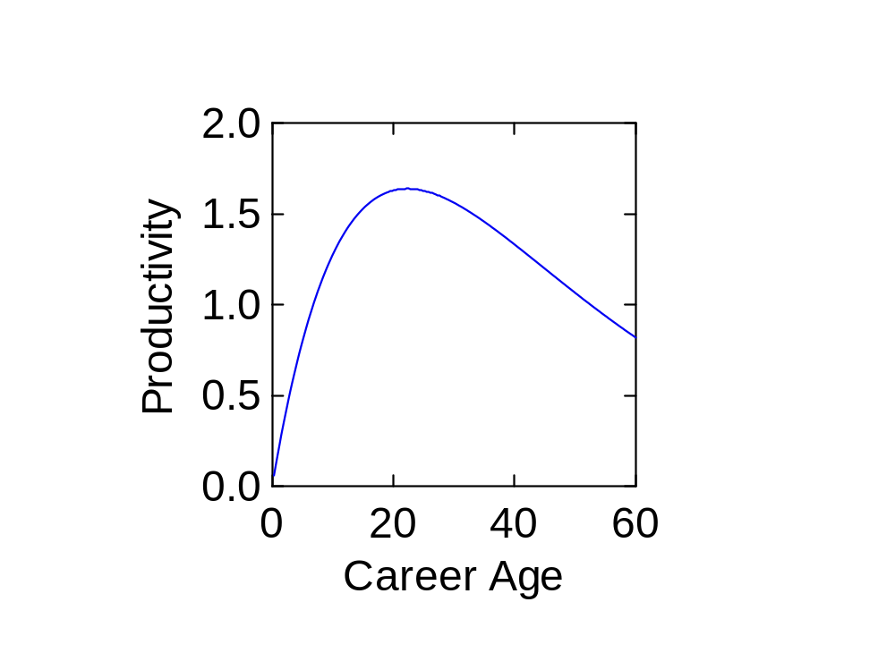

Slide 7
Central findings:
The typical age curve
Rapid ascent (decelerating)

Slide 8


Slide 9
Central findings:
The typical age curve
Rapid ascent (decelerating)
Single peak

Slide 11
Central findings:
The typical age curve
Rapid ascent (decelerating)
Single peak
Gradual decline (asymptotic)

Slide 13
With correlations with published data between .95 and .99.

Slide 14
Criticisms of findings:
Is the age decrement real?

Slide 15
Criticisms of findings:
Is the age decrement real?
Quality but not quantity?

Slide 16
Criticisms of findings:
Is the age decrement real?
Quality but not quantity?
  But high correlation between two

Slide 17
Criticisms of findings:
Is the age decrement real?
Quality but not quantity?
Differential competition?

Slide 18
Criticisms of findings:
Is the age decrement real?
Quality but not quantity?
Differential competition?
  But survives statistical controls

Slide 19
Criticisms of findings:
Is the age decrement real?
Quality but not quantity?
Differential competition?
Aggregation error?

Slide 20
Criticisms of findings:
Is the age decrement real?
Quality but not quantity?
Differential competition?
Aggregation error?
  But persists at individual level

Slide 21
e.g., the career of Thomas Edison
C_{Edison} (t) = 2595(e ^{- .044t} - e ^{- .058t}) r = .74

Slide 22
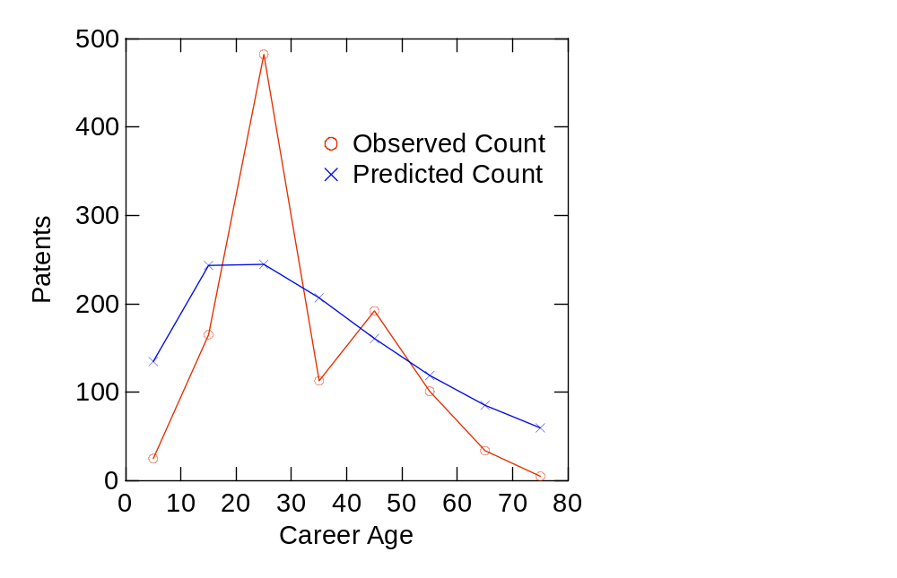

Slide 23
However ...

Slide 24
Complicating considerations

Slide 25
Complicating considerations
Individual differences

Slide 26
Complicating considerations
Individual differences
  Creative potential (m in model)

Slide 27
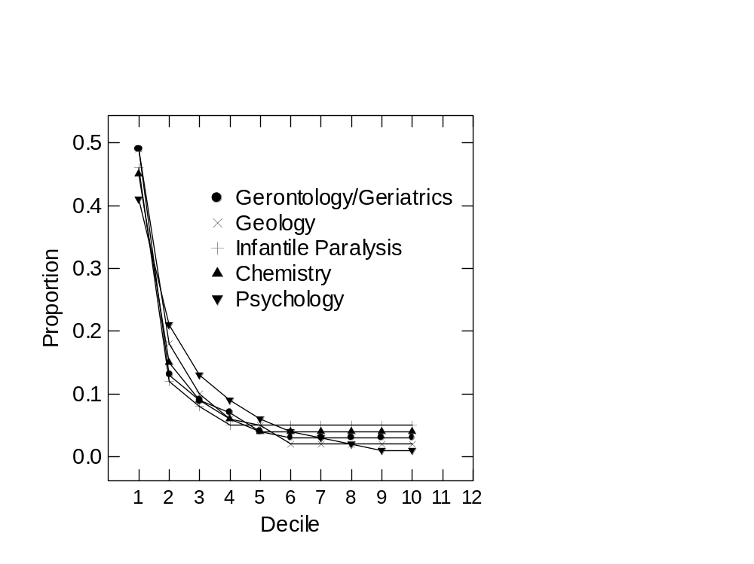

Slide 28
In fact,
1) cross-sectional variation always appreciably greater than longitudinal variation
2) the lower an individual’s productivity the more random the longitudinal distribution becomes

Slide 29
Complicating considerations
Individual differences
  Creative potential
  Age at career onset (i.e., chronological age at t = 0 in model)

Slide 30
Hence, arises a two-dimensional typology of career trajectories

Slide 31
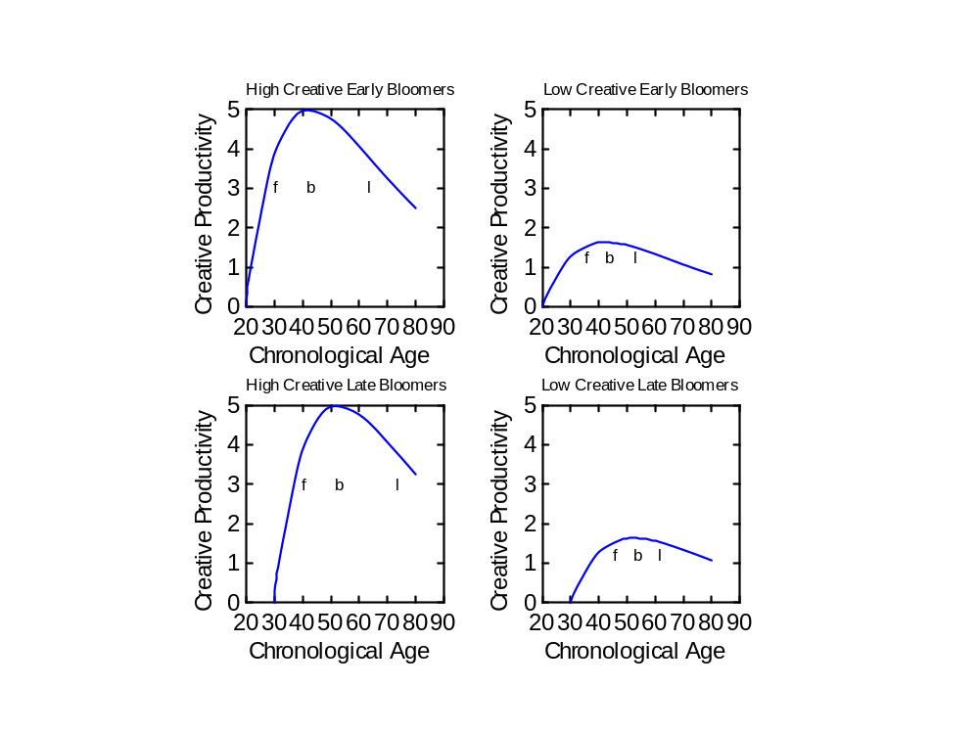

Slide 32
Complicating considerations
Individual differences
Quantity-quality relation

Slide 33
Complicating considerations
Individual differences
Quantity-quality relation
  The equal-odds rule

Slide 34
Complicating considerations
Individual differences
Quantity-quality relation
  The equal-odds rule
  Career landmarks

Slide 35
Complicating considerations
Individual differences
Quantity-quality relation
  The equal-odds rule
  Career landmarks:
    First major contribution (f)

Slide 37
Complicating considerations
Individual differences
Quantity-quality relation
  The equal-odds rule
  Career landmarks:
    First major contribution (f)
    Single best contribution (b)

Slide 39
Complicating considerations
Individual differences
Quantity-quality relation
  The equal-odds rule
  Career landmarks:
    First major contribution (f)
    Single best contribution (b)
    Last major contribution(l)

Slide 41
Journalist Alexander Woolcott reporting on G. B. Shaw:
“At 83 Shaw’s mind was perhaps not quite as good as it used to be. It was still better than anyone else’s.”

Slide 42
Complicating considerations
Individual differences
Quantity-quality relation
Inter-domain contrasts (a and b in model)

Slide 43
Complicating considerations
Individual differences
Quantity-quality relation
Inter-domain contrasts
  Differential decrements (0-100%)

Slide 44
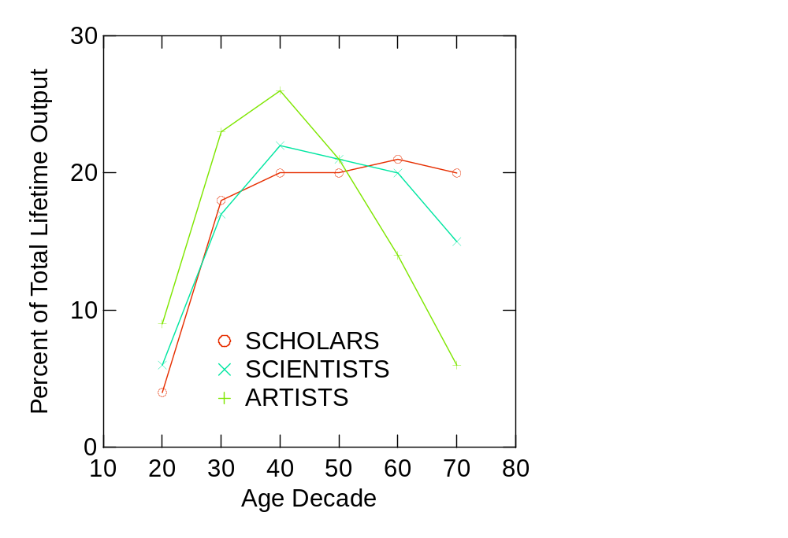

Slide 45
Complicating considerations
Individual differences
Quantity-quality relation
Inter-domain contrasts
  Differential peaks and decrements
  Differential landmark placements

Slide 46
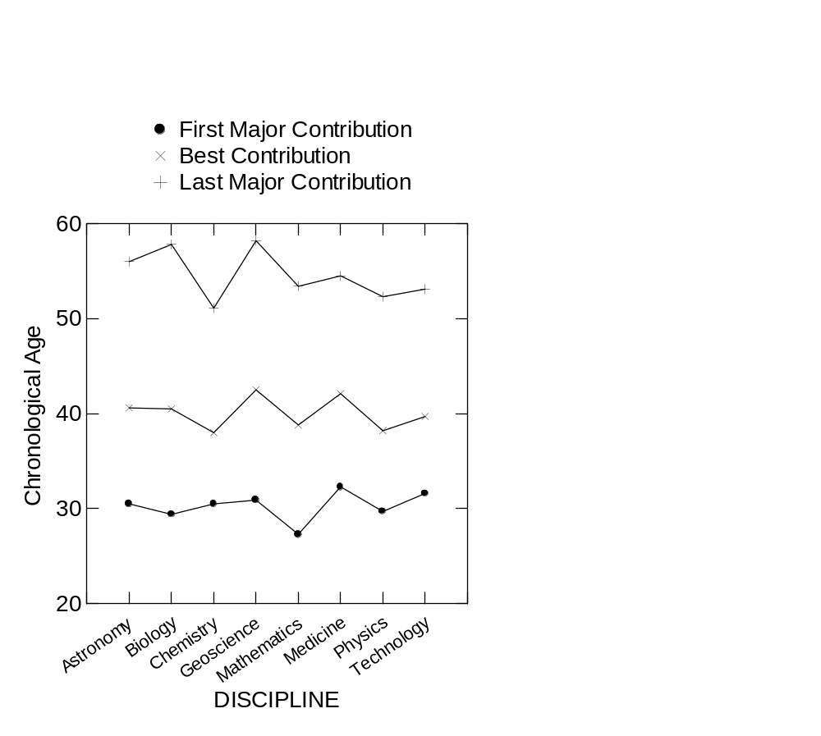

Slide 47
Complicating considerations
Individual differences
Quantity-quality relation
Inter-domain contrasts
Impact of extraneous factors

Slide 48
Complicating considerations
Individual differences
Quantity-quality relation
Inter-domain contrasts
Impact of extraneous factors
  Negative influences

Slide 49
Complicating considerations
Individual differences
Quantity-quality relation
Inter-domain contrasts
Impact of extraneous factors
  Negative influences: e.g., war

Slide 50
Complicating considerations
Individual differences
Quantity-quality relation
Inter-domain contrasts
Impact of extraneous factors
  Negative influences
  Positive influences

Slide 51
Complicating considerations
Individual differences
Quantity-quality relation
Inter-domain contrasts
Impact of extraneous factors
  Negative influences
  Positive influences: e.g.,
    disciplinary networks

Slide 52
Complicating considerations
Individual differences
Quantity-quality relation
Inter-domain contrasts
Impact of extraneous factors
  Negative influences
  Positive influences: e.g.,
    disciplinary networks
    cross-fertilization

Slide 53
Hence, the creative productivity within any given career will show major departures from expectation, some positive and some negative

Slide 54
Three Main Conclusions
Age decrement a highly predictable phenomenon at the aggregate level
Age decrement far more unpredictable at the individual level
Age decrement probably less due to aging per se than to other factors both intrinsic and extrinsic to the creative process

Slide 55
Hence, the possibility of late-life creative productivity increments;
e.g.,
Michel-Eugène Chevreul
(1786-1889)

Slide 56
References
Simonton, D. K. (1984). Creative productivity and age: A mathematical model based on a two-step cognitive process. Developmental Review, 4, 77-111.
Simonton, D. K. (1989). Age and creative productivity: Nonlinear estimation of an information-processing model. International Journal of Aging and Human Development, 29, 23-37.

Slide 57
References
Simonton, D. K. (1991). Career landmarks in science: Individual differences and interdisciplinary contrasts. Developmental Psychology, 27, 119-130.
Simonton, D. K. (1997). Creative productivity: A predictive and explanatory model of career trajectories and landmarks. Psychological Review, 104, 66-89.
Simonton, D. K. (2004). Creativity in science: Chance, logic, genius, and zeitgeist. Cambridge, England: Cambridge University Press.

