Slide 1
About Me
Name: [Your Full Name]
Role: Data Analyst / Data Science Enthusiast
Skills: Python, SQL, Streamlit, PostgreSQL
Interests: Business Analytics, FinTech, Dashboards

Slide 2
Project Problem Statement
PhonePe generates large volumes of transaction and user data.
Understanding user behavior, insurance trends, and fraud patterns is essential.
Goal: Analyze & visualize transaction data for strategic insights.

Slide 3
Business Use Cases Covered
• Customer Segmentation
• Fraud Detection
• Geographic Insights
• Payment Performance
• User Engagement
• Insurance Insights
• Marketing Optimization
• Trend Analysis
• Competitive Benchmarking
• Product Development

Slide 4
Project Workflow
1. Data Extraction from GitHub (PhonePe Pulse)
2. Load JSONs into PostgreSQL
3. Create tables: Aggregated, Map, Top
4. Analyze data using SQL & Python (Pandas, Matplotlib)
5. Build interactive Streamlit dashboard
6. Generate actionable insights

Slide 5
Database Schema
• Aggregated Tables: user, transaction, insurance
• Map Tables: user, map, insurance
• Top Tables: user, map, insurance

Slide 6
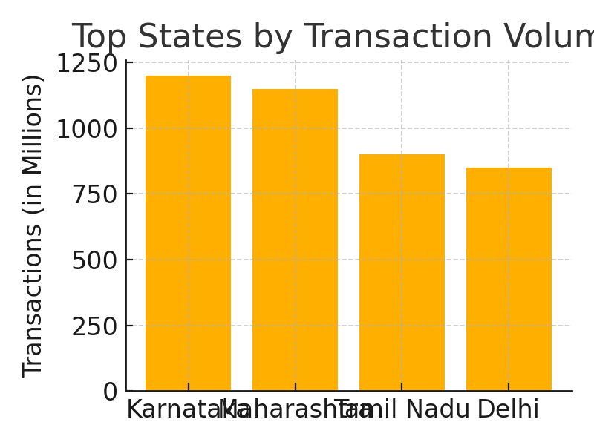
Dashboard & Visual Insights
• Interactive filters by State, District, Category
• Visualizations: bar, pie, map
• Highlights top states, categories, trends
• Real-time user interaction (Streamlit)

Slide 7
Insights & Recommendations
• Southern states lead in digital adoption
• Insurance product growth post-pandemic
• Urban pin codes show high engagement
• Focus marketing in growing districts
• Use transaction patterns for fraud detection

