Slide 1
Introduction
AEMR cares about energy stability, security, and reliability for its clients. To do so AEMR has asked Divya to look into the past database to help them figure out the following issues.
Most common outage types and their duration
Frequency of outages
Providers with a higher count of outages than their peers
Percentage of forced outages in 2016 and 2017
Increase or decrease in the average duration of forced outages
Some unreliable energy providers
By Divya Bastola

Slide 2
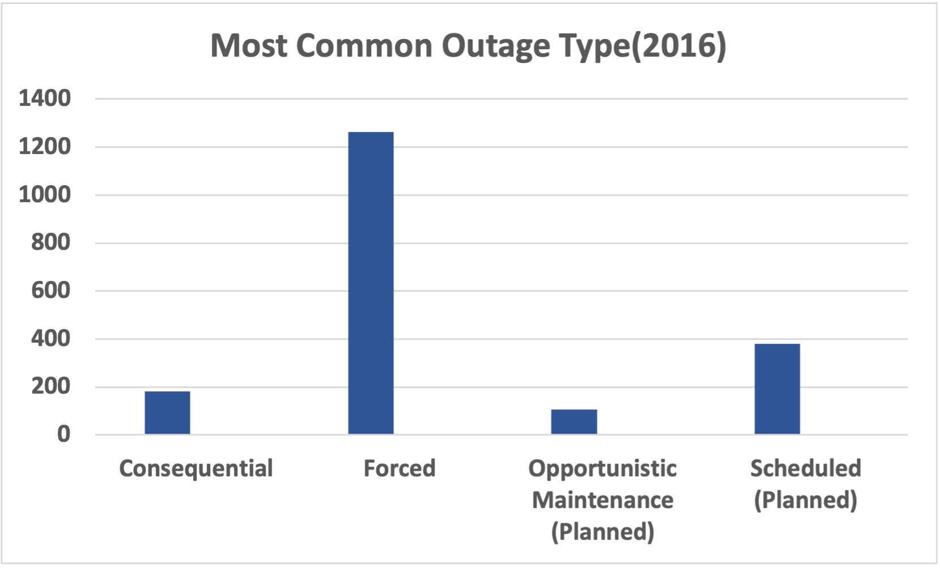
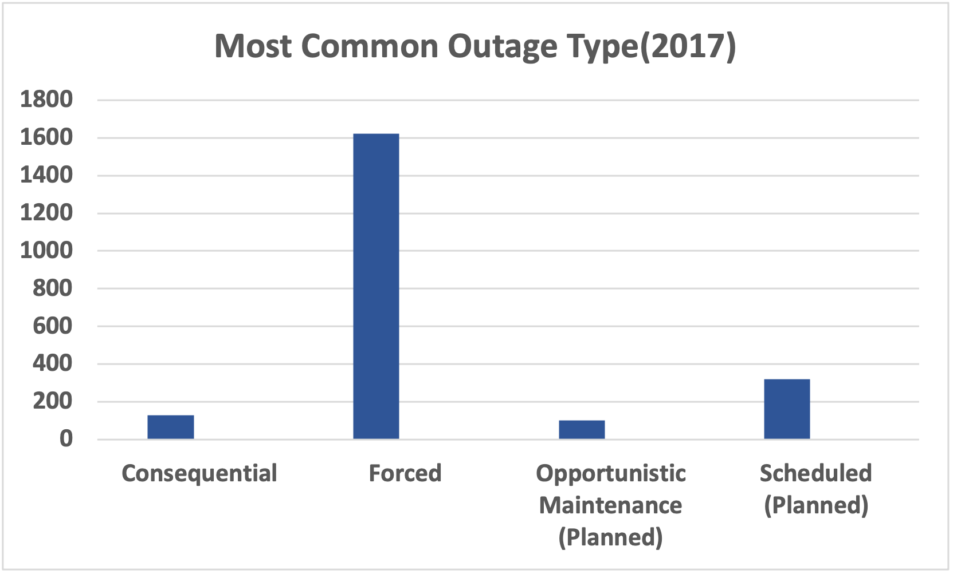
Most Common Outage Type for 2016 and 2017
Most Common Outage - Forced
Year- 2016 and 2017

Slide 3
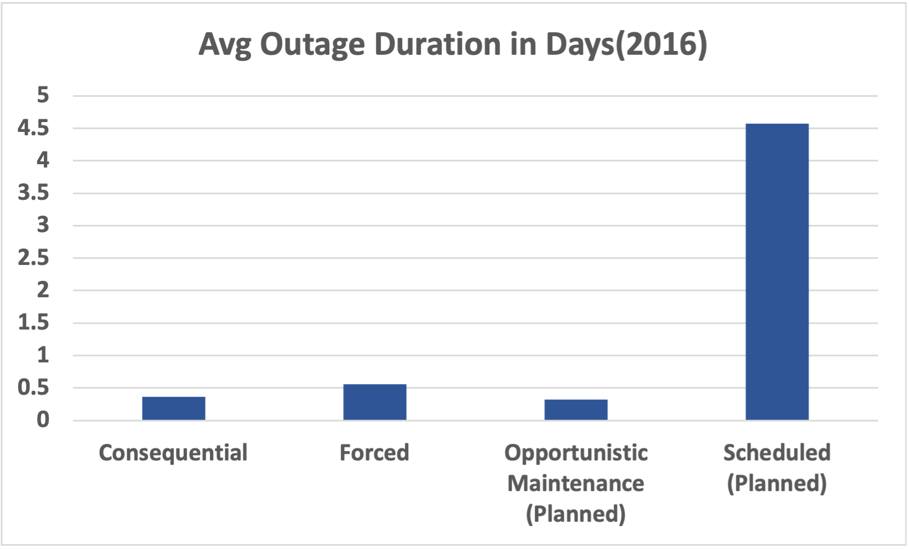
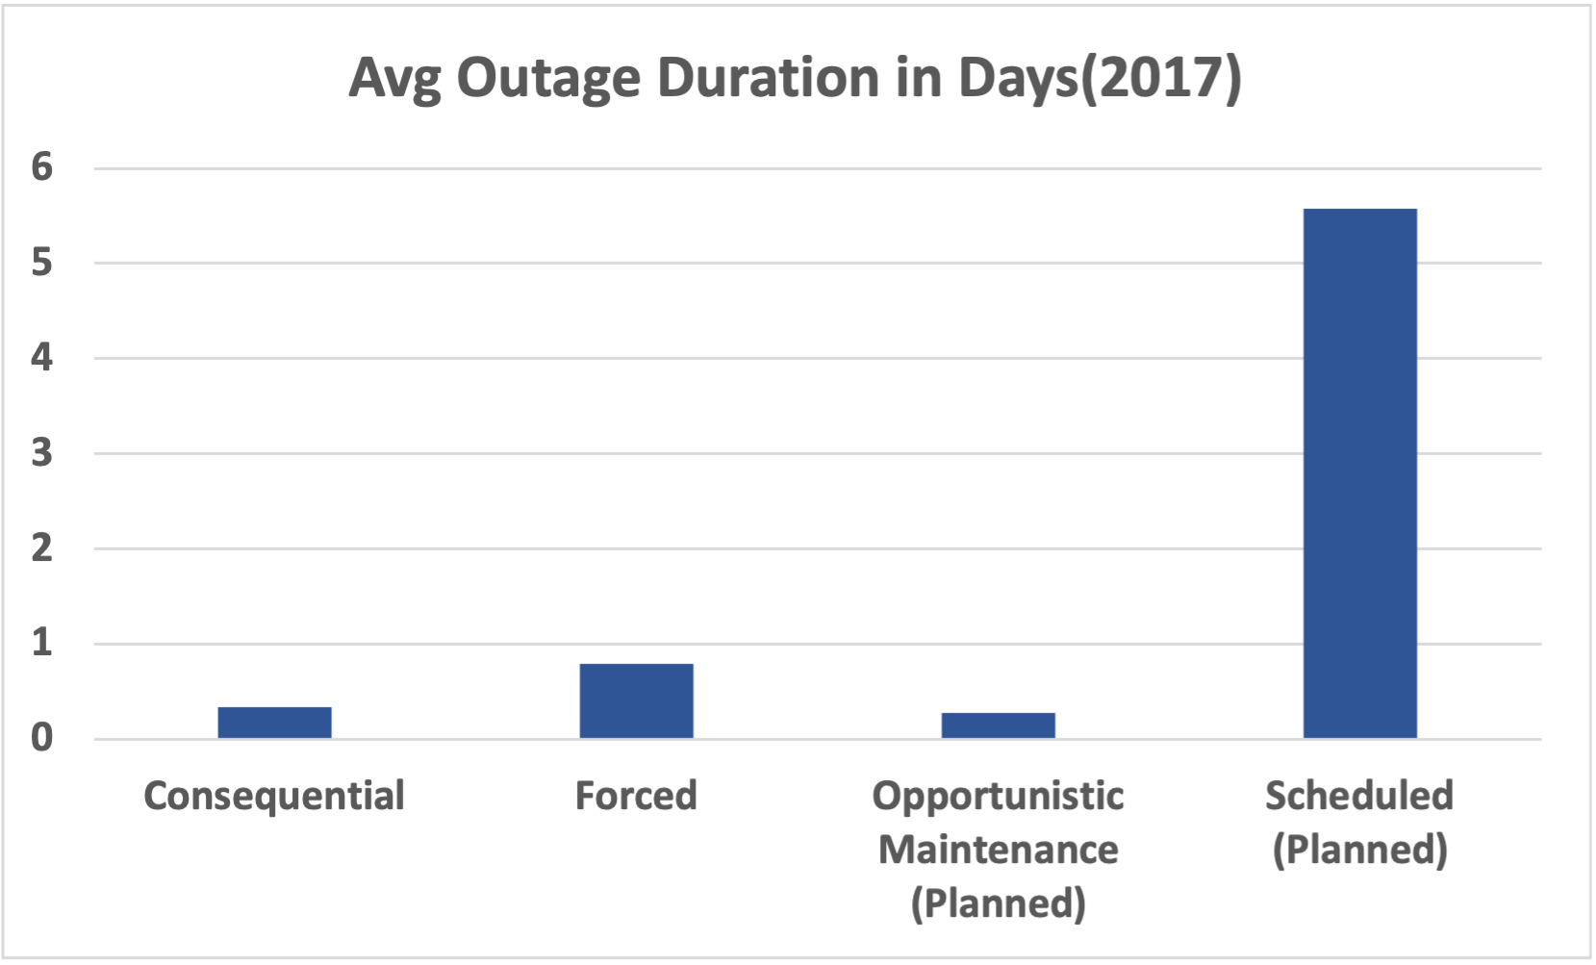
Average Outage Duration In Days
Longest Outage Duration - Scheduled(Planned)
Year - 2016 and 2017

Slide 4
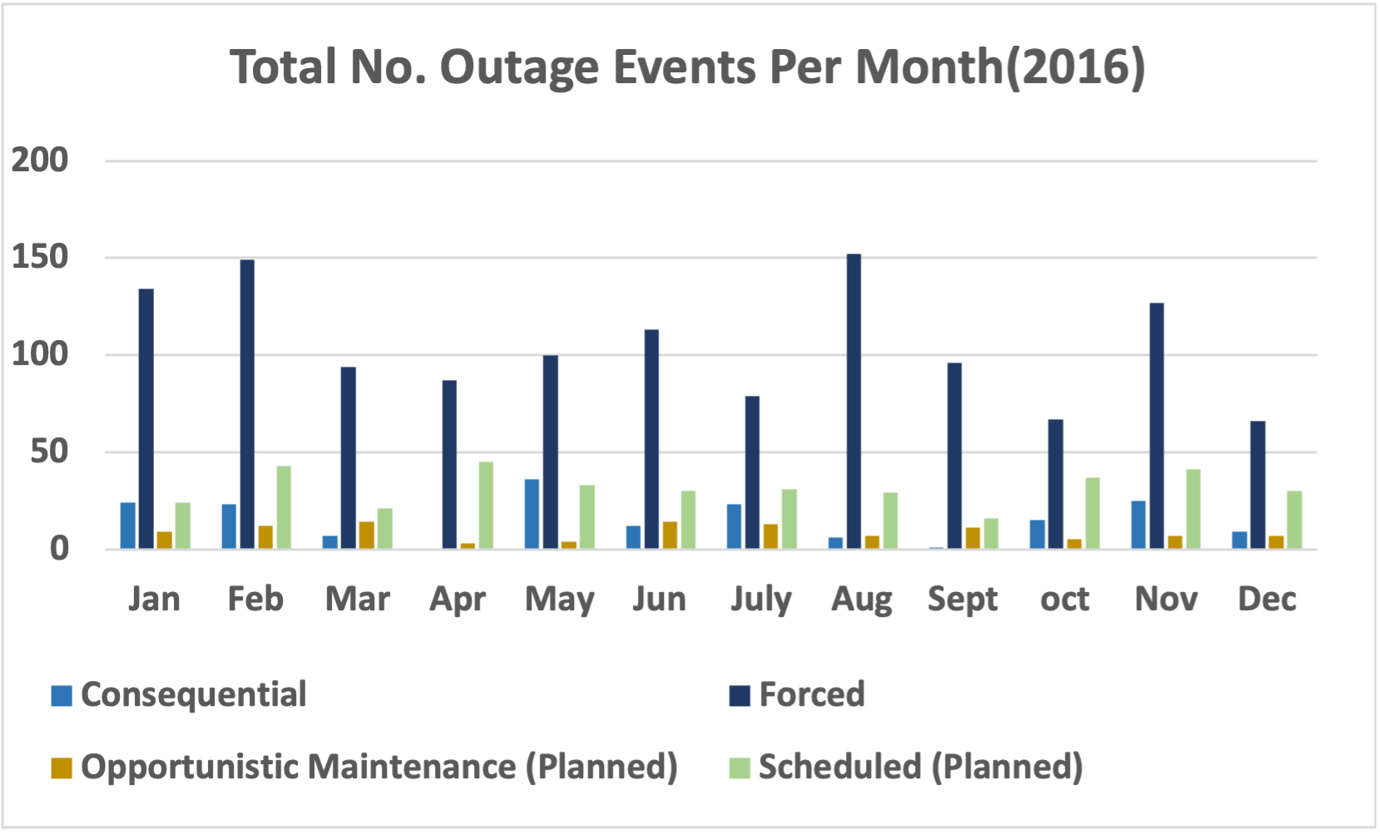
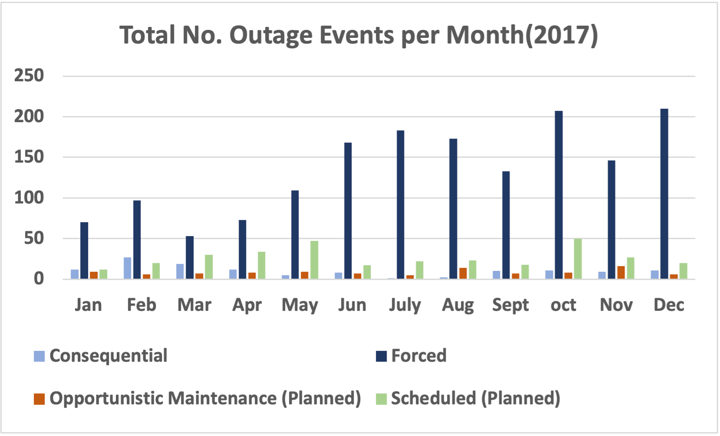
Total No. of Outage Events per Month2017
Most Frequent(2016) - Forced Highest(Aug) Lowest(Dec)
Most Frequent(2017) - Forced Highest(Dec) Lowest(Mar)

Slide 5
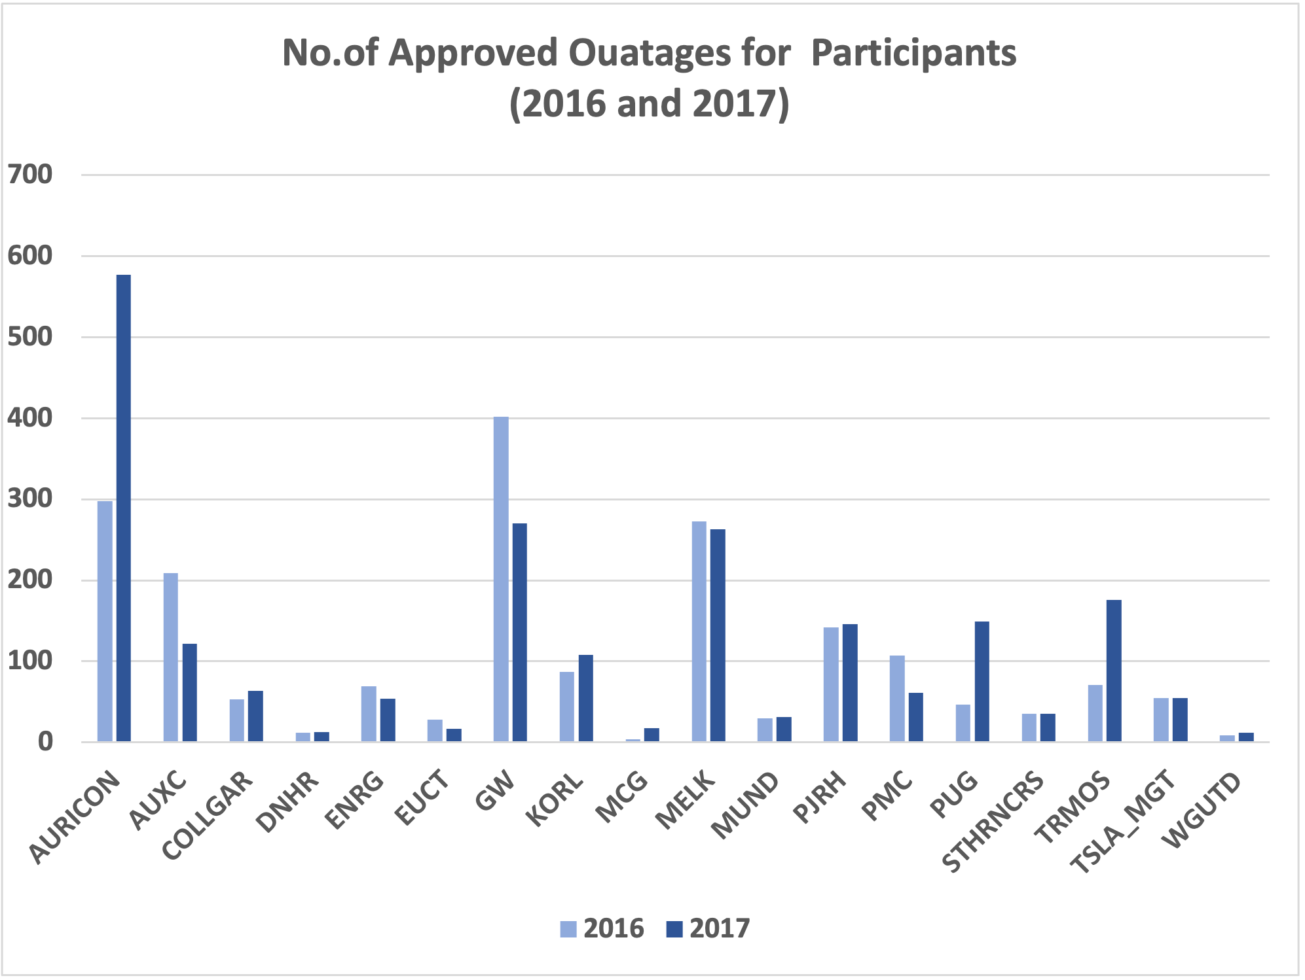
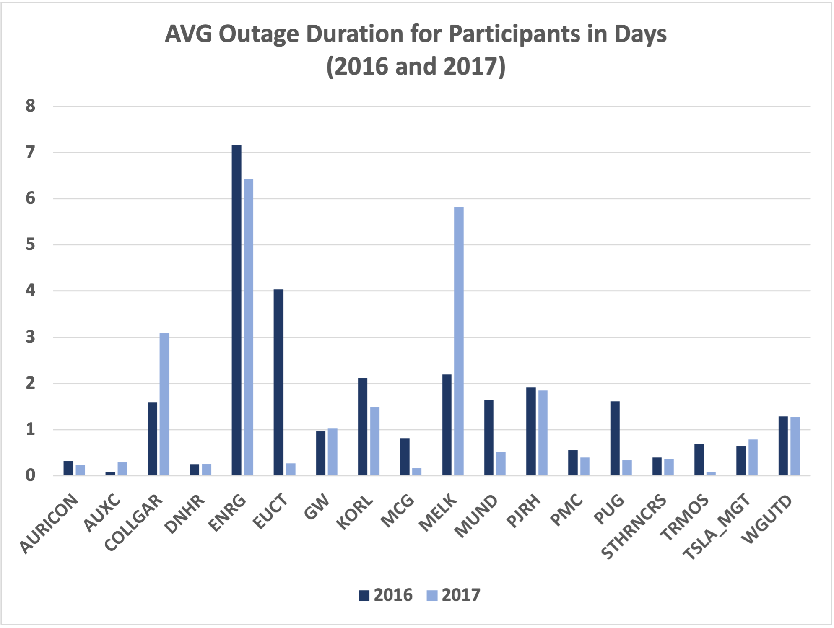
No. of Outages and Avg Duration for Participants
Highest No. of Outage – GW and Auricon (2016)
Auricon followed by GW(2017)
Longest Avg Outage Duration – ENRG followed by EUCT(2016) and ENRG followed by Melk (2017)

Slide 6
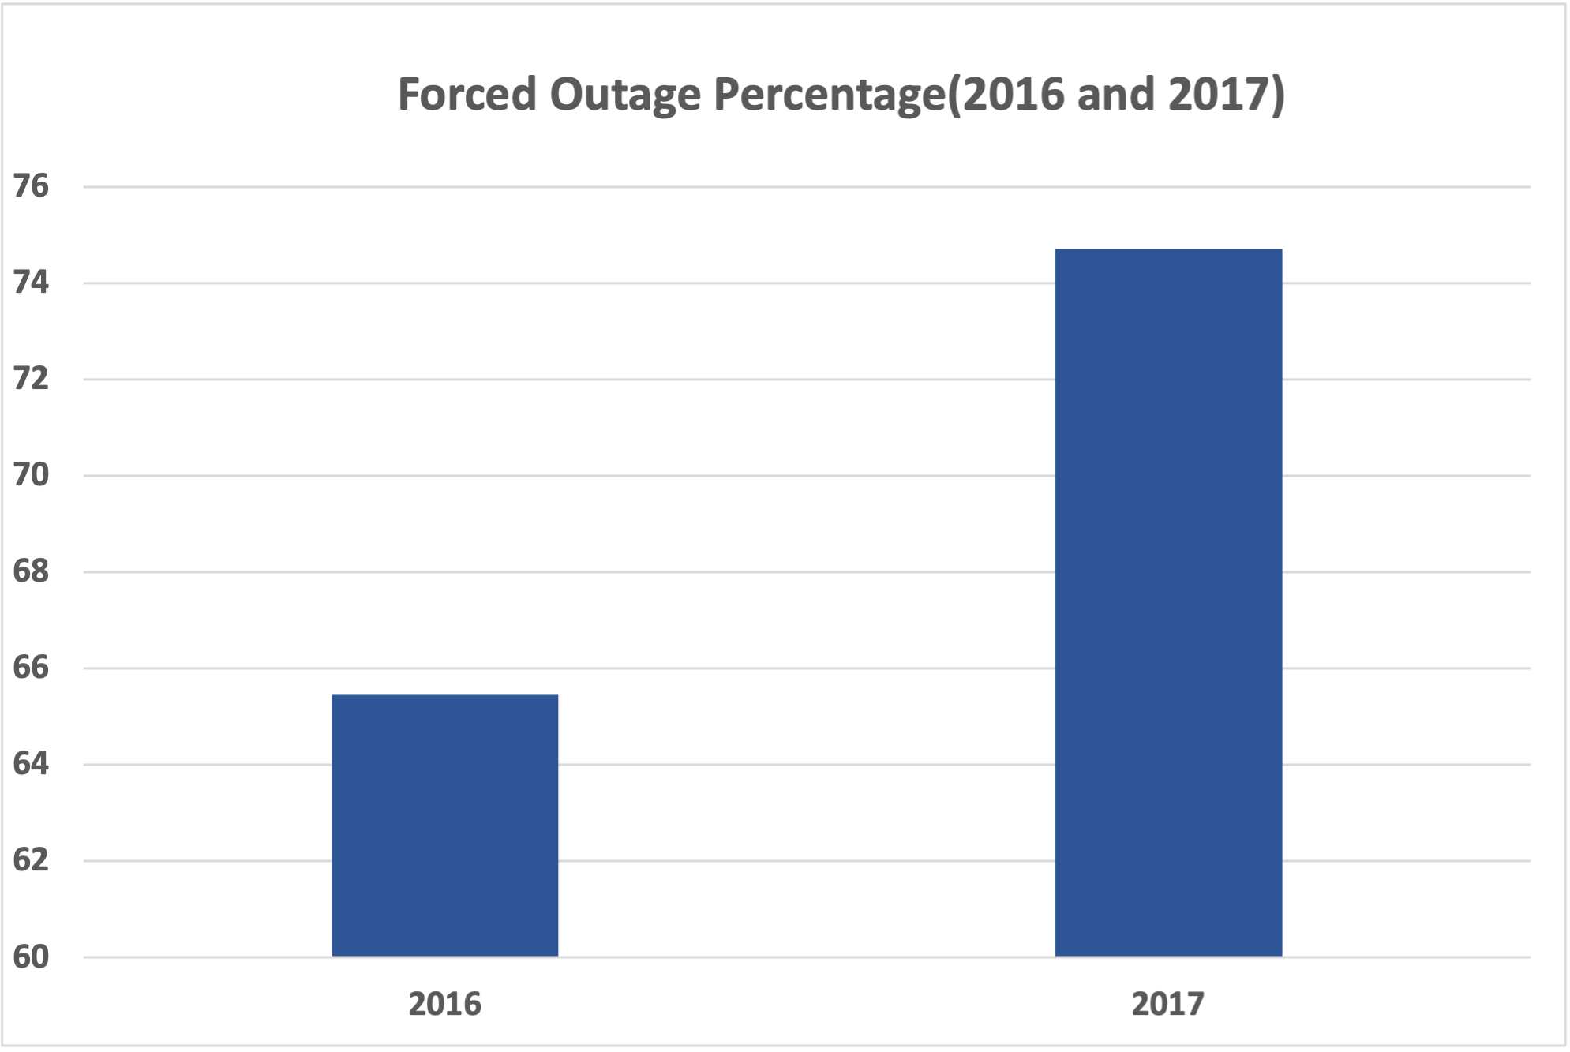
Forced Outage Percentage

Slide 7
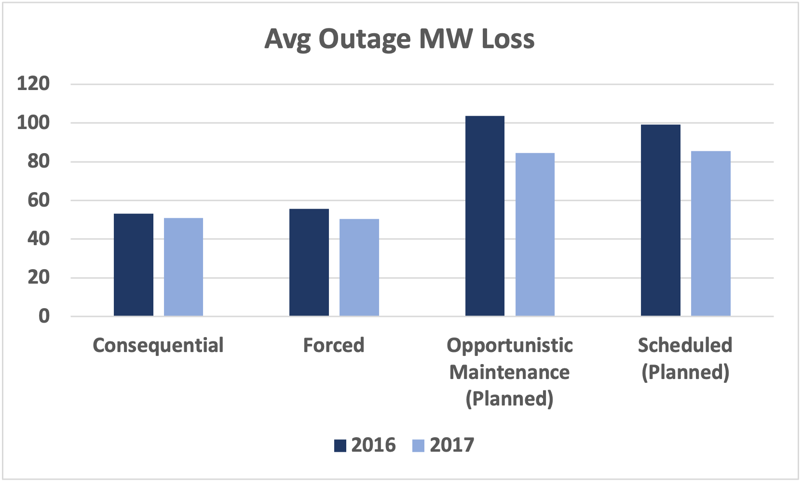
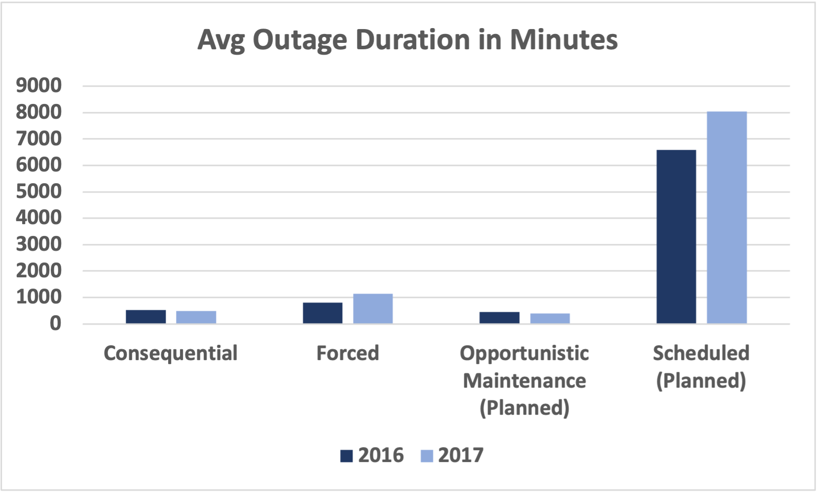
Avg Outage MW Loss and Avg Outage Duration in Minutes
Avg Outage Loss – Opportunist Highest Followed by Scheduled in 2016
Scheduled Highest Followed by Opportunist in 2017
Avg Outage Duration In Minutes – Scheduled longest duration followed by forced in both 2016 and 2017

Slide 8
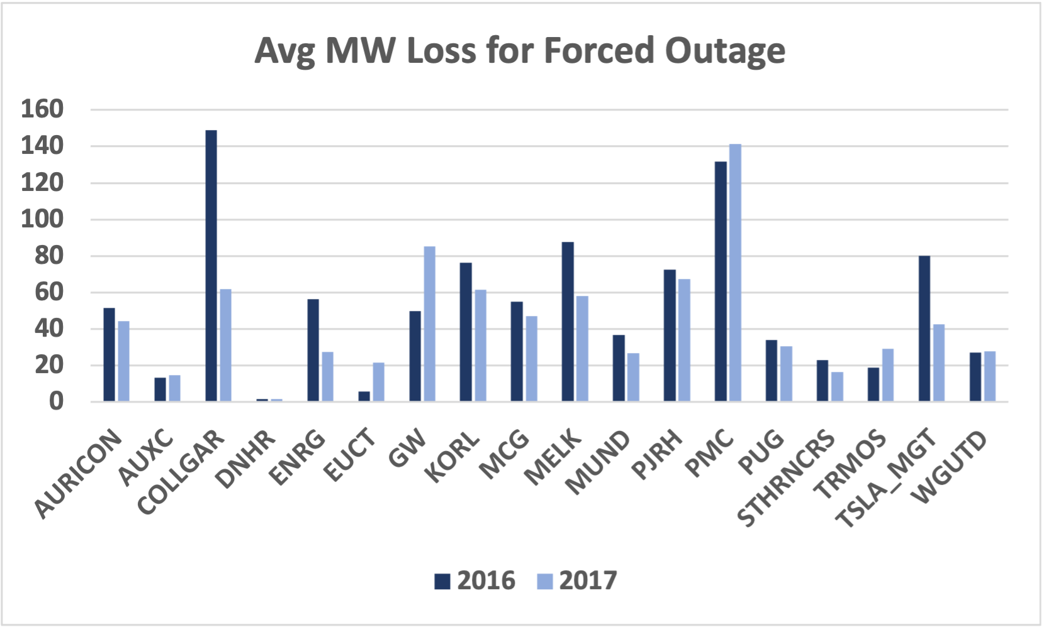
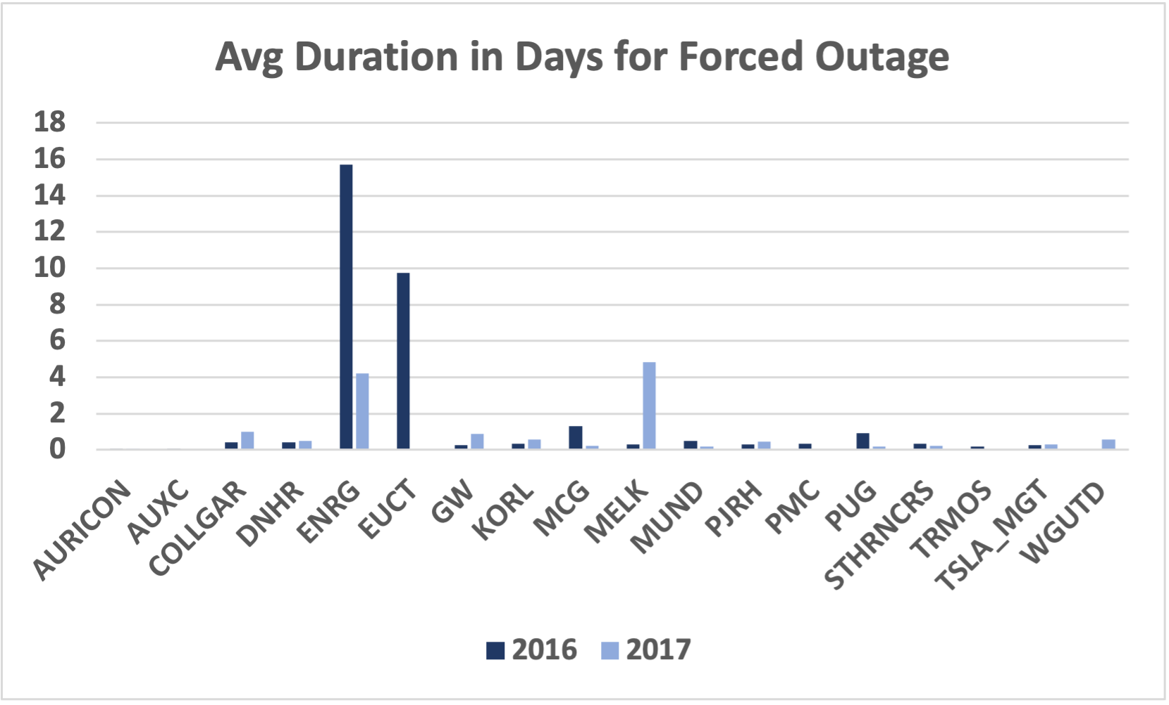
Unreliable Energy provider(Forced Outage)
Energy loss- In 2016, Collgar has highest energy loss due to forced outage followed by PMC and In 2017, PMC has highest energy loss due to forced outage followed by GW.
Avg Outage Duration – In 2016, ENRG has the longest energy outage duration followed by ECUT and in 2017, MELK has the longest energy outage duration followed by ENRG.

Slide 9
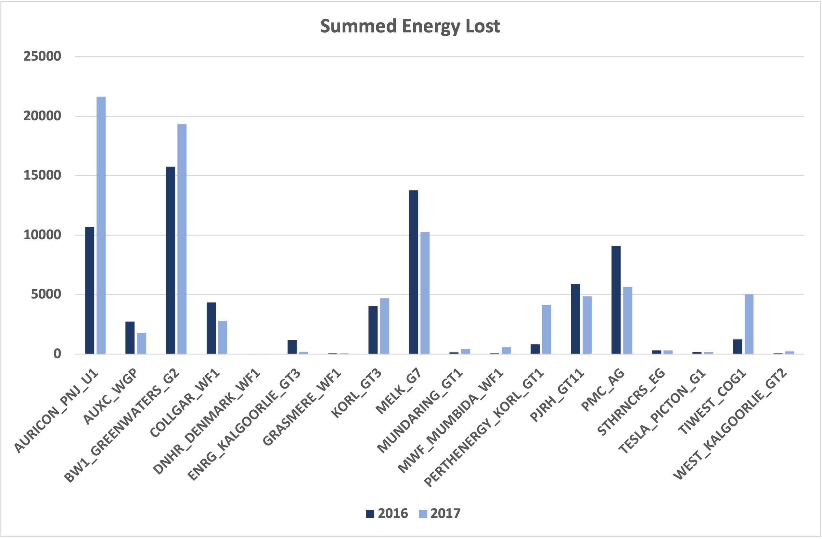
Unreliable Energy provider
Highest Summed Energy Lost(2016) – BWI GreenWater followed by MELK
Highest Summed Energy Lost(2017)- Auricon followed by BWI GreenWater

Slide 10
Conclusion
Of all participants, GW and Auricon has the highest number of outages of all types in 2016 and 2017. If focusing on forced outages only, In 2016 Collgar has the highest energy loss due to forced outages followed by PMC. In 2017 PMC has the highest energy loss due to forced outages followed by GW. Also, ENRG has the longest outage duration due to the forced outage.
An increase in the number and duration of forced outages threatens the reliability of the network. AMER wishes to avoid such risk. Therefore, to prevent future energy loss and strengthen reliability, AEMR should reconsider its contract with the following four energy supplier
•Collgar
•PMC
•GW
•ENRG

