Slide 1


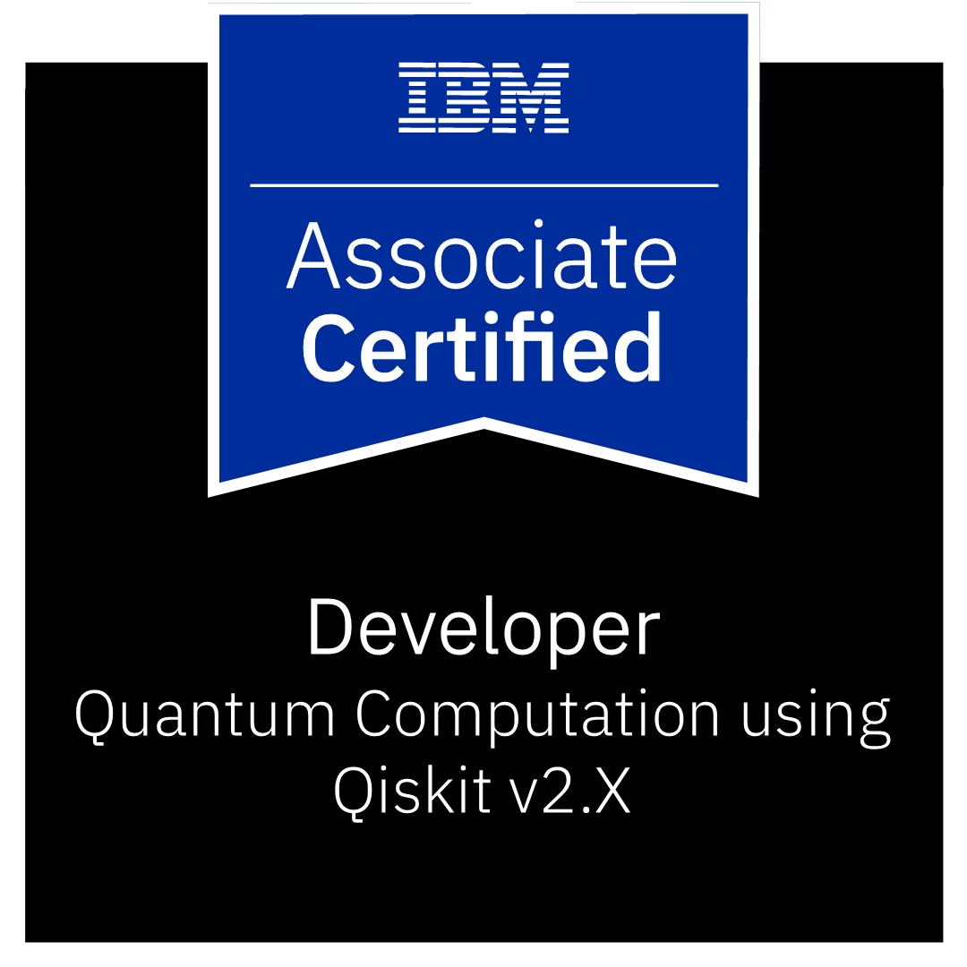
Quantum Legos –
Bits to Teleportation
Bhavna Bose
Assistant Professor,
SVKM’s NMIMS Mukesh Patel School of Technology Management and Engineering
Tier 2 Qiskit Advocate, Certified Quniverse developer

Slide 2
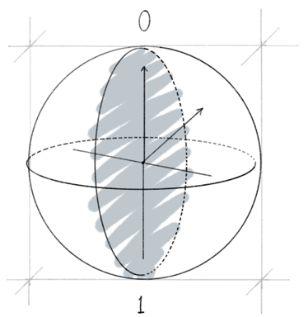

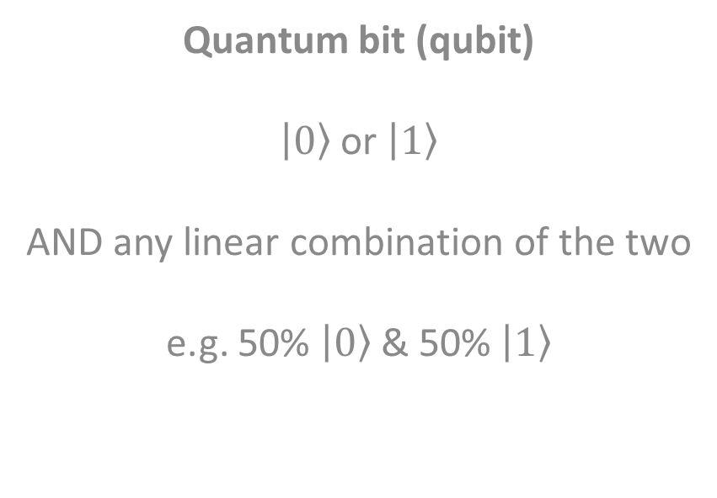
Classical vs quantum bits
Quantum bit (qubit)
$\left.\left|0\right.\right\rangle$ or $\left.\left|1\right.\right\rangle$
AND any linear combination of the two
e.g. 50% $\left.\left|0\right.\right\rangle$ & 50% $\left.\left|1\right.\right\rangle$
Classical bit (bit)
Only two possible states​
​
0 and 1​
​
Like the two faces of a coin
Heads or tails

Slide 3
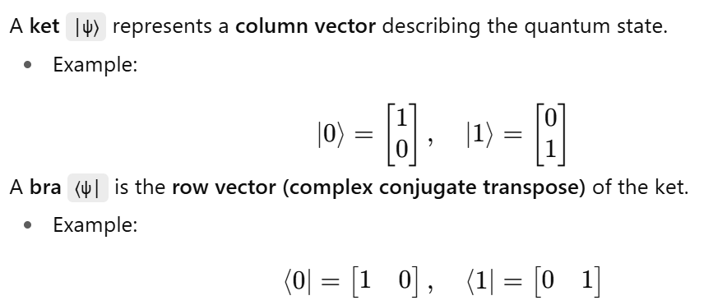
Dirac notation
Dirac notation (also called bra–ket notation) is a compact mathematical language invented by physicist Paul Dirac to represent quantum states and their inner products

Slide 4
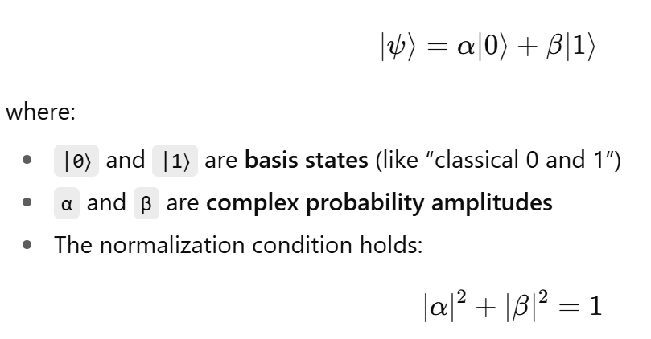
Dirac notation
In Dirac notation, we represent the state a Qubit a ket:

Slide 5
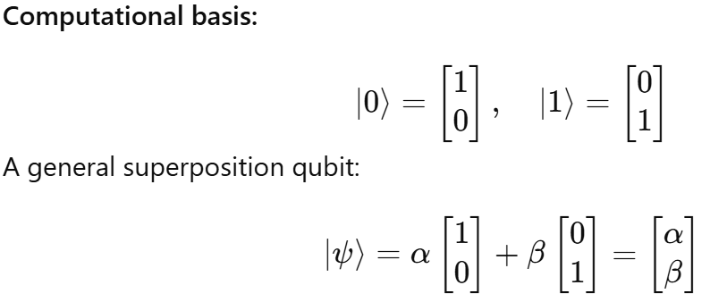
Basis States in Dirac Notation

Slide 6

Superposition
The difference between bits and qubits is that a qubit can be in a state other than |0⟩ or |1⟩. It is also possible to form linear combinations of states, often called superpositions:
The numbers α and β are complex numbers.
The state of a qubit is a vector in a two-dimensional complex vector space.
The special states |0 ⟩ and |1 ⟩ are known as computational basis states
They form an orthonormal basis for this vector space.

Slide 7
Superposition
The difference between bits and qubits is that a qubit can be in a state other than |0⟩ or |1⟩. It is also possible to form linear combinations of states, often called superpositions:
The numbers α and β are complex numbers.
The state of a qubit is a vector in a two-dimensional complex vector space.
The special states |0 ⟩ and |1 ⟩ are known as computational basis states
They form an orthonormal basis for this vector space.

Slide 8
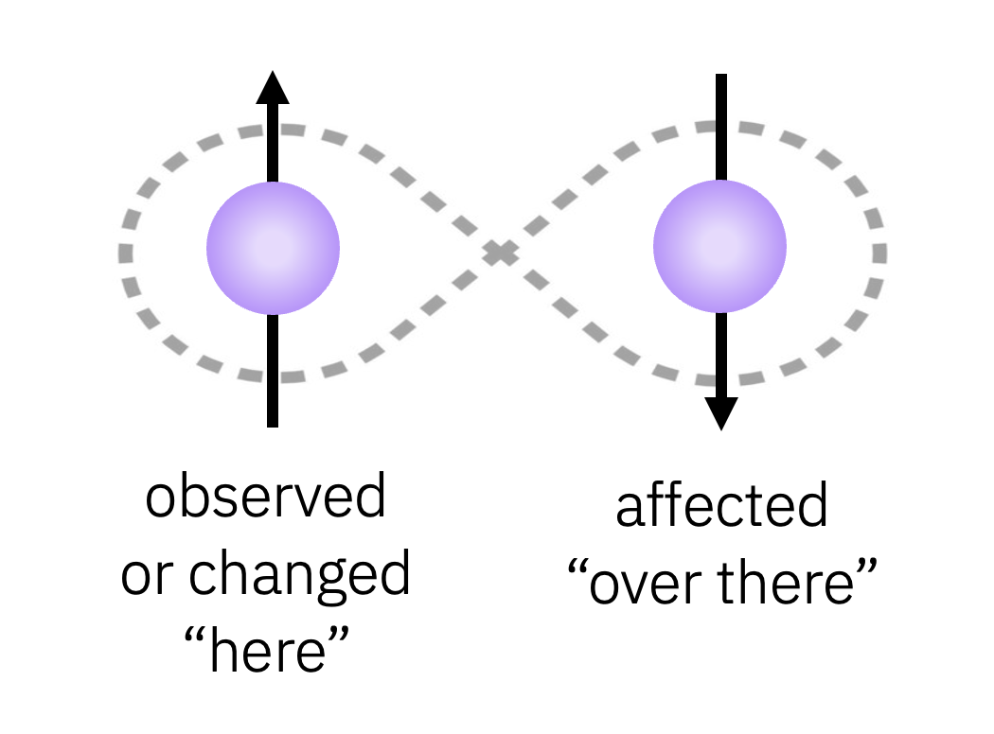
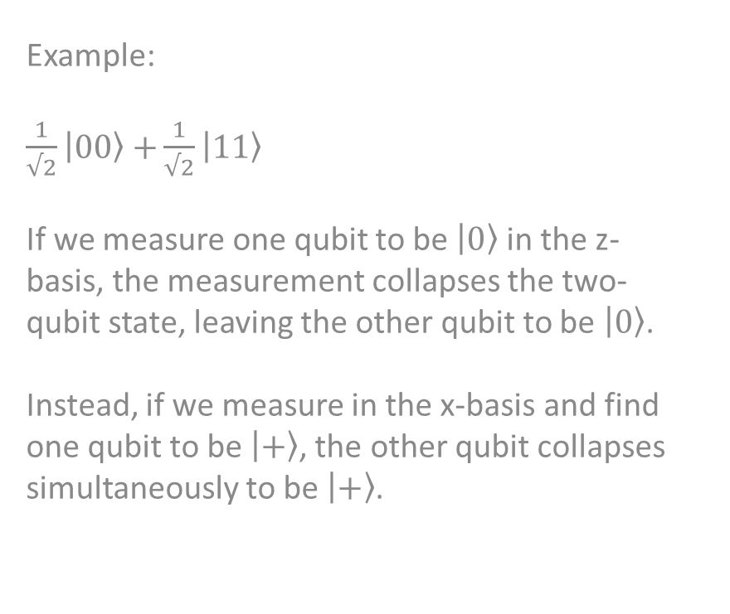
Entanglement
Quantum entanglement: occurs when two or more qubits are intrinsically linked, such that one cannot describe the state of any qubit in the entangled system independently.
Entangled qubits are correlated more strongly than classical probability allows.
Operating on or collapsing one qubit instantly influences another qubit in the entangled system (although it never violates relativity).
Example:
$\frac{1}{√2}\left.\left|0\right.0\right\rangle$ $+\frac{1}{√2}\left|\left.11\right\rangle \right.$
If we measure one qubit to be $\left.\left|0\right.\right\rangle$ in the z-basis, the measurement collapses the two-qubit state, leaving the other qubit to be $\left.\left|0\right.\right\rangle$.
Instead, if we measure in the x-basis and find one qubit to be $\left.\left|+\right.\right\rangle$, the other qubit collapses simultaneously to be $\left.\left|+\right.\right\rangle$.

Slide 9
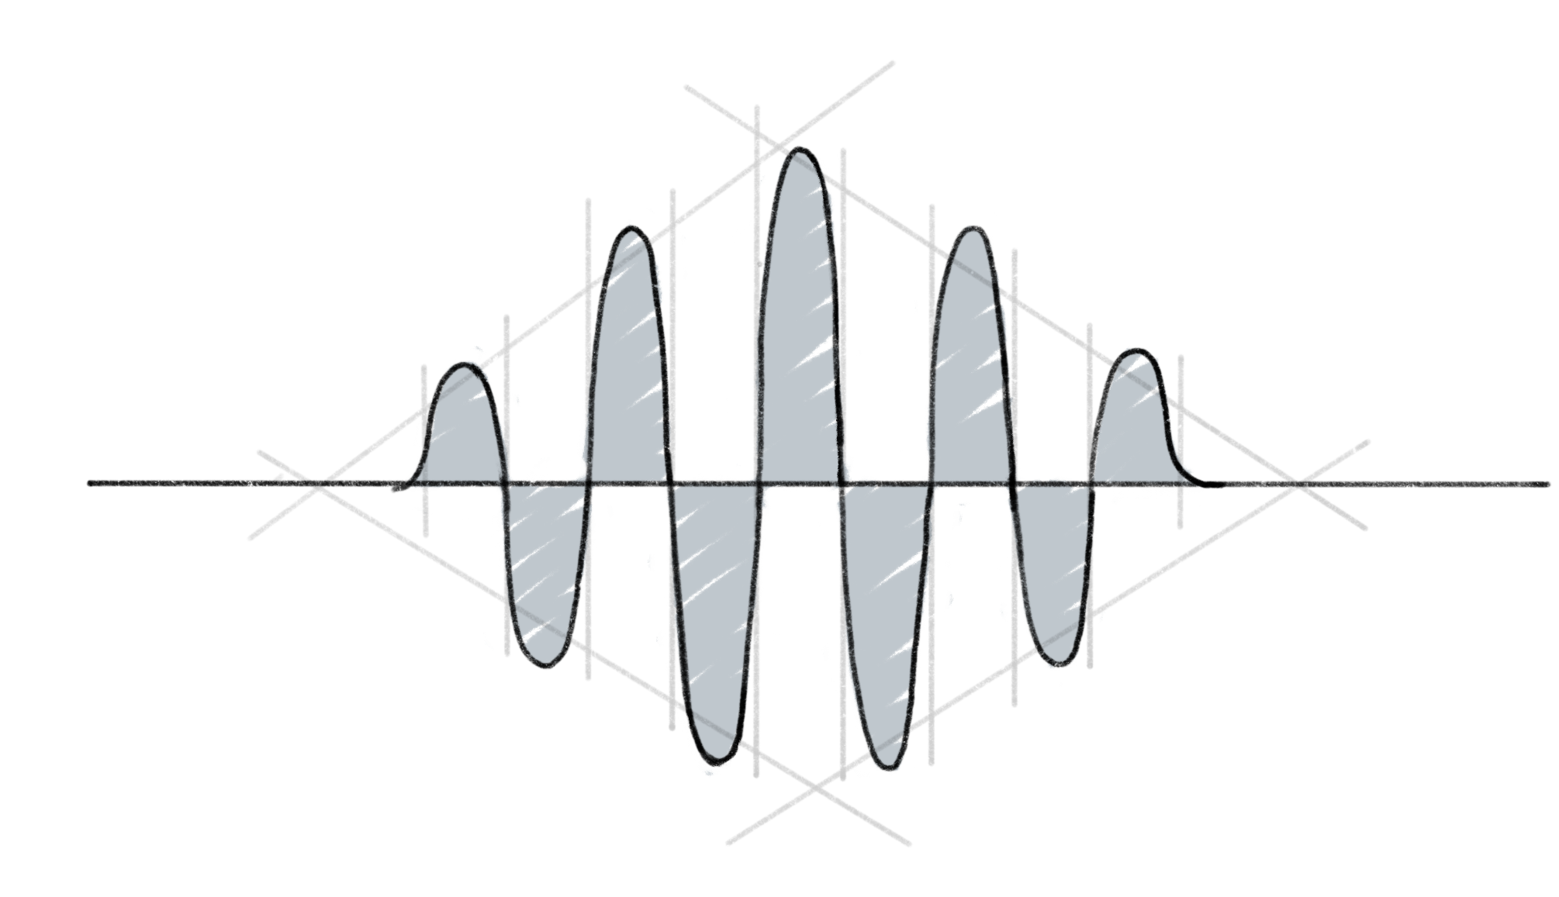
Interference
Quantum interference: occurs when two or more quantum amplitudes (associated with different possible paths or states) combine, leading to an enhancement or suppression of the total probability of an outcome due to their relative phase.
Due to the wave-like nature of quantum particles
Constructive interference: waves reinforce each other
Destructive interference: waves cancel each other out
Useful for algorithms like Grover’s where we want to amplify certain states and reduce others

Slide 10
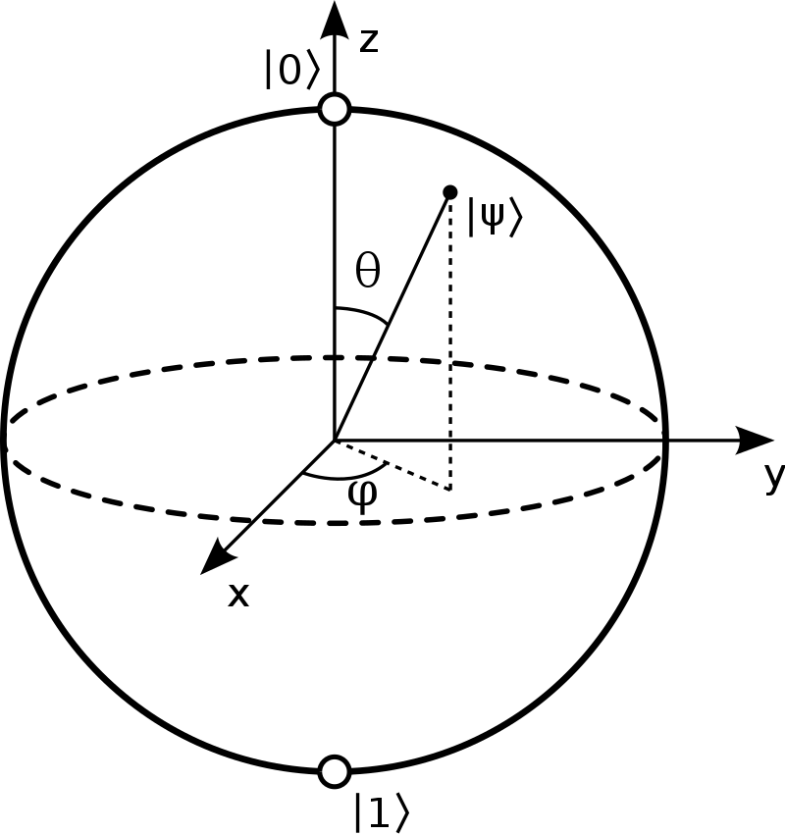
Operations on a qubit - demonstration

Slide 11
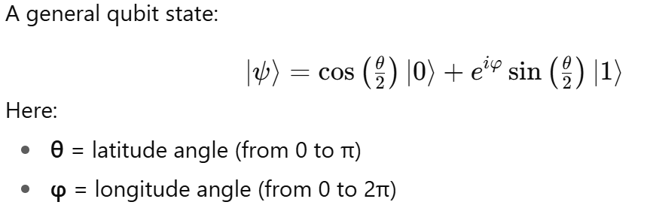
Bloch Sphere
The Bloch sphere is a geometric way to visualize the state of a single qubit. Any pure qubit state can be represented as a point on the surface of a sphere.

Slide 12
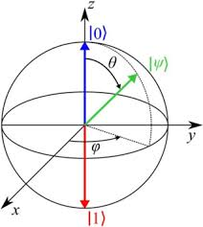
Bloch Sphere
A qubit can occupy any point in the sphere, called a Bloch sphere.
https://javafxpert.github.io/grok-bloch/

Slide 13
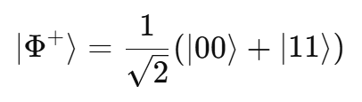
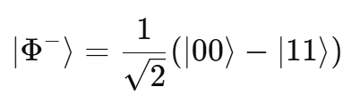
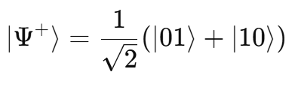
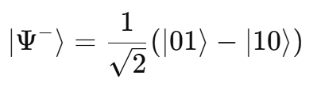
Quantum Entanglement
When both qubits are in the same state
These are correlated entangled states.
When both qubits are in opposite states
These are anti-correlated entangled states.

Slide 14
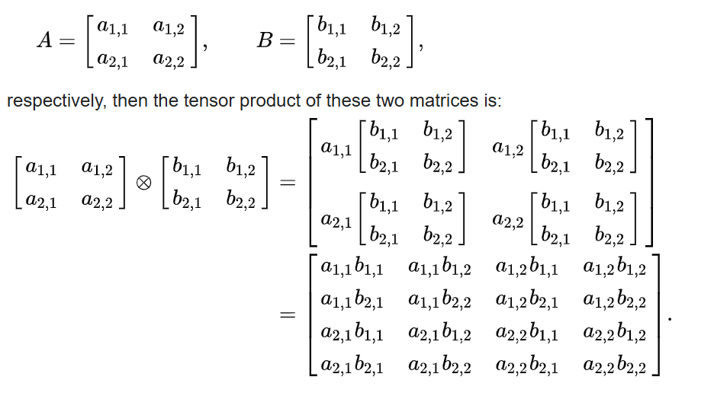
Tensor Product
https://en.wikipedia.org/wiki/Tensor_product

Slide 15
Quantum circuits
Analogous to the way a classical computer is built from an electrical circuit containing wires and logic gates, a quantum computer is built from a quantum circuit containing wires and elementary quantum gates to carry around and manipulate the quantum information.

Slide 16
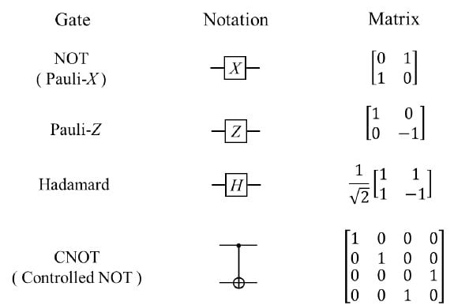
Common Gates

Slide 17
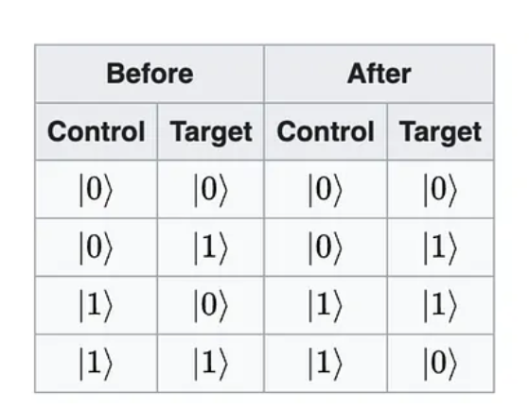
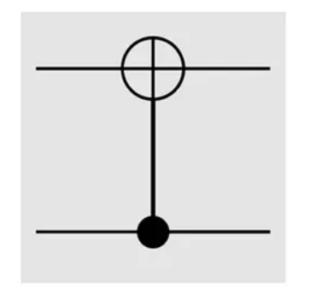
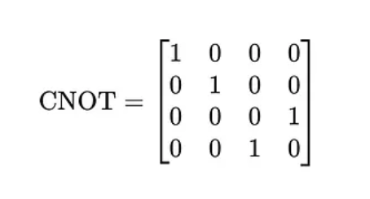
The CNOT Gate

Slide 18
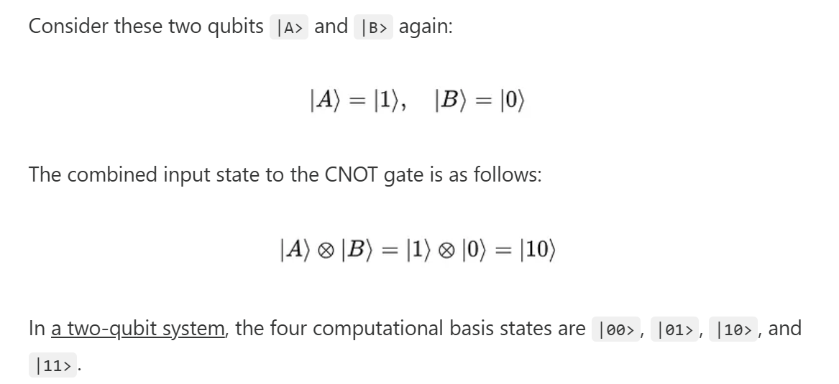

Slide 19
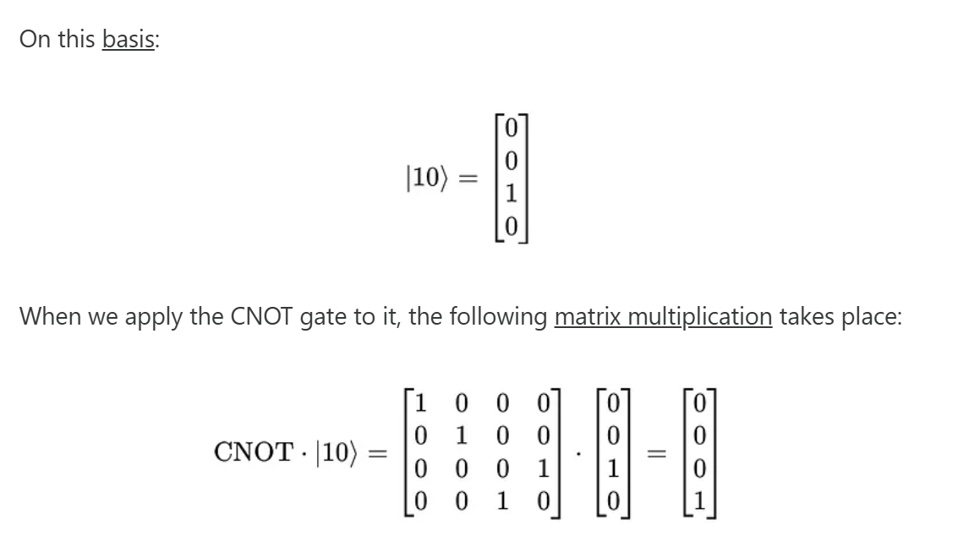

Slide 20
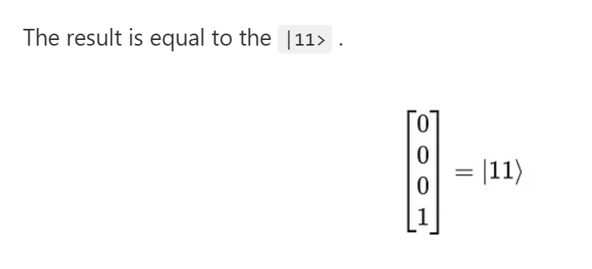

Slide 21
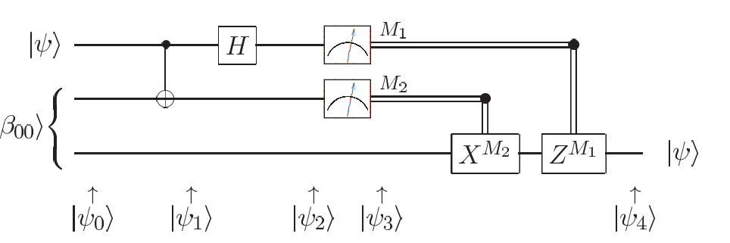
Quantum teleportation
Quantum teleportation is a technique for moving quantum states around, even in the absence of a quantum communications channel linking the sender of the quantum state to the recipient.

Slide 22
Quantum teleportation
Quantum teleportation is a technique for moving quantum states around, even in the absence of a quantum communications channel linking the sender of the quantum state to the recipient.
Ref : Nielsen, M. A., & Chuang, I. L. (2010). Quantum computation and quantum information: 10th Anniversary Edition. Cambridge University Press.

Slide 23
Here’s how quantum teleportation works. Alice and Bob met long ago but now live far apart.
While together they generated an EPR pair, each taking one qubit of the EPR pair when they separated.
Many years later, Bob is in hiding, and Alice’s mission, should she choose to accept it, is to deliver a qubit |ψ> to Bob.
She does not know the state of the qubit, and moreover can only send classical information to Bob.
Should Alice accept the mission?

Slide 24
The steps of the solution are as follows:
  Alice interacts the qubit |ψ> with her half of the EPR pair, and then measures the two qubits in her possession, obtaining one of four possible classical results, 00, 01, 10, and 11.
  She sends this information to Bob.
  Depending on Alice’s classical message, Bob performs one of four operations on his half of the EPR pair.
Amazingly, by doing this he can recover the original state |ψ>
Ref : Nielsen, M. A., & Chuang, I. L. (2010). Quantum computation and quantum information: 10th Anniversary Edition. Cambridge University Press.

Slide 25
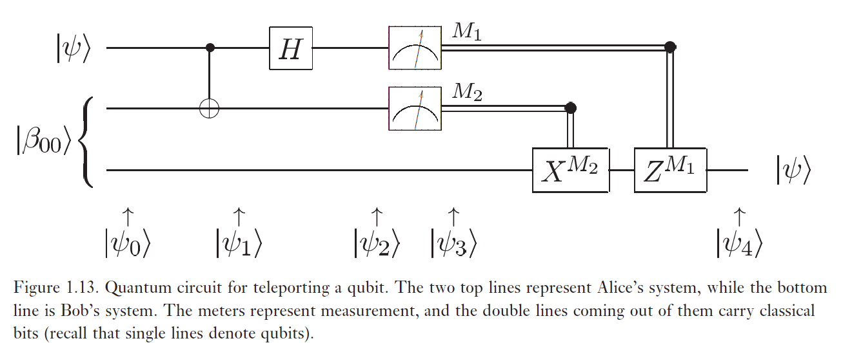
Ref : Nielsen, M. A., & Chuang, I. L. (2010). Quantum computation and quantum information: 10th Anniversary Edition. Cambridge University Press.

Slide 26
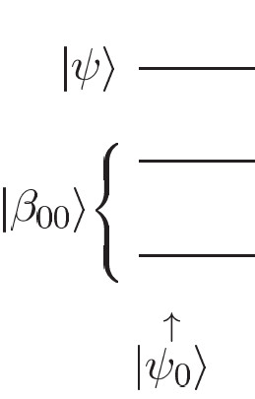

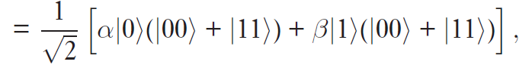
The state to be teleported is |ψ> = α|0>+β|1>, where α and β are unknown amplitudes.
The state input into the circuit |ψ₀> is
Ref : Nielsen, M. A., & Chuang, I. L. (2010). Quantum computation and quantum information: 10th Anniversary Edition. Cambridge University Press.

Slide 27
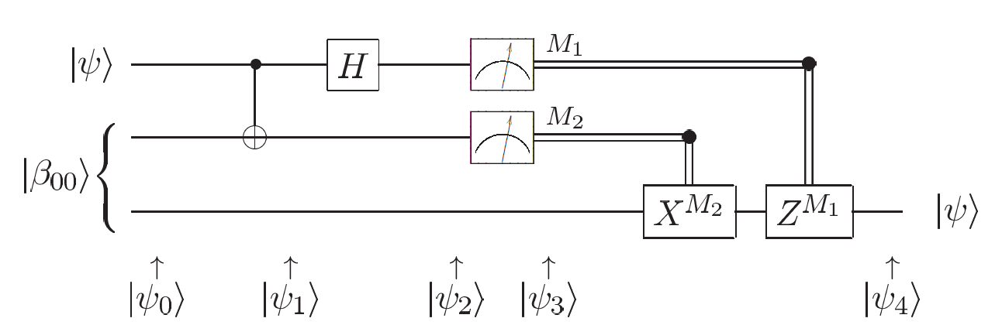
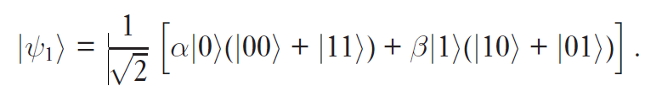
Alice sends her qubits through a CNOT gate, obtaining
Ref : Nielsen, M. A., & Chuang, I. L. (2010). Quantum computation and quantum information: 10th Anniversary Edition. Cambridge University Press.

Slide 28

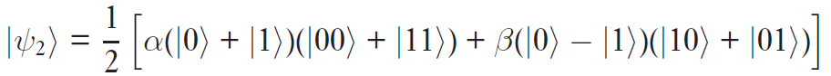
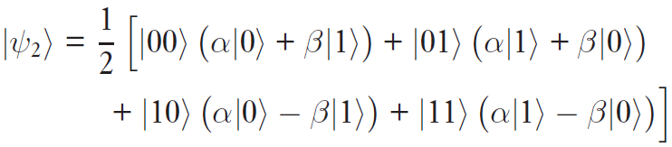
She then sends the first qubit through a Hadamard gate, obtaining
This state may be re-written in the following way, simply by regrouping terms
Ref : Nielsen, M. A., & Chuang, I. L. (2010). Quantum computation and quantum information: 10th Anniversary Edition. Cambridge University Press.

Slide 29
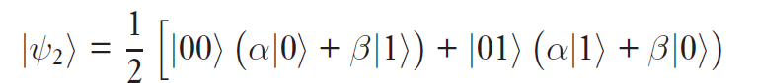

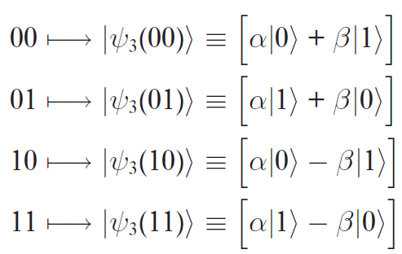
This expression naturally breaks down into four terms
The first term has Alice’s qubits in the state |00>, and Bob’s qubit in the state α|0> + β|1> – which is the original state |ψ >.
Similarly, from the previous expression we can read off Bob’s post measurement state, given the result of Alice’s measurement:
Depending on Alice’s measurement outcome, Bob’s qubit will end up in one of these four possible states
Ref : Nielsen, M. A., & Chuang, I. L. (2010). Quantum computation and quantum information: 10th Anniversary Edition. Cambridge University Press.

Slide 30
Once Bob has learned the measurement outcome, Bob can ‘fix up’ his state, recovering |ψ>, by applying the appropriate quantum gate.
For example, in the case where the measurement yields 00, Bob doesn’t need to do anything. If the measurement is 01 then Bob can fix up his state by applying the X gate.
If the measurement is 10 then Bob can fix up his state by applying the Z gate.
If the measurement is 11 then Bob can fix up his state by applying first an X and then a Z gate.
Ref : Nielsen, M. A., & Chuang, I. L. (2010). Quantum computation and quantum information: 10th Anniversary Edition. Cambridge University Press.

Slide 31
Summing up, Bob needs to apply the transformation Z^{M1}X^{M2} (note how time goes from left to right in circuit diagrams, but in matrix products terms on the right happen first) to his qubit, and he will recover the state |ψ>.
Ref : Nielsen, M. A., & Chuang, I. L. (2010). Quantum computation and quantum information: 10th Anniversary Edition. Cambridge University Press.

Slide 32
Colab Notebook
https://colab.research.google.com/drive/1u1p3OwKsPK--h1LVLyMOxHO__57EnQFl

Slide 33
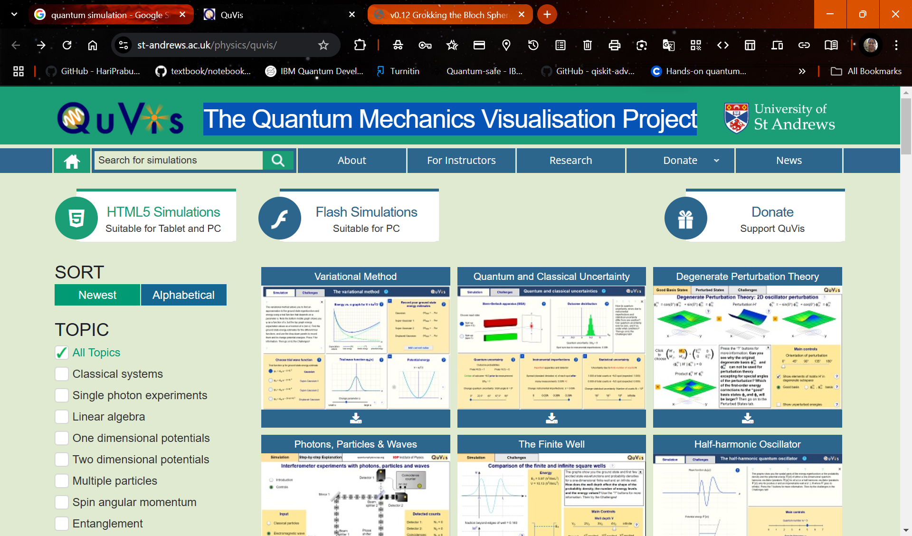
The Quantum Mechanics Visualisation Project
https://www.st-andrews.ac.uk/physics/quvis/

Slide 34
Hybrid Classical–Quantum Loop
Classical data preprocessing
Quantum circuit execution
Classical optimizer feedback loop

Slide 35
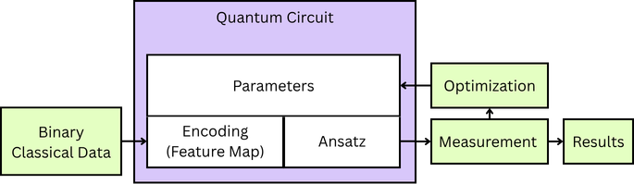
QML Circuit

Slide 36
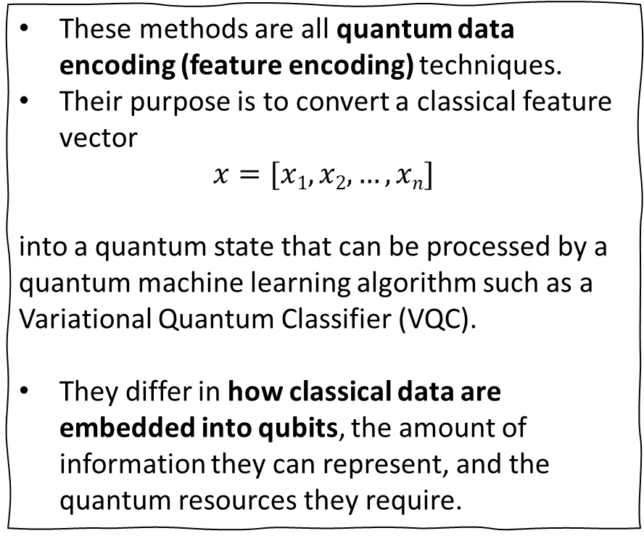
Feature encoding approaches
These methods are all quantum data encoding (feature encoding) techniques.
Their purpose is to convert a classical feature vector
$$x=[x1,x2,…,xn]$$
into a quantum state that can be processed by a quantum machine learning algorithm such as a
Variational Quantum Classifier (VQC).
They differ in how classical data are embedded into qubits, the amount of information they can represent, and the quantum resources they require.
Amplitude Encoding
Phase Encoding
Angle Encoding
RX Encoding
RY Encoding
RZ Encoding
ZFeatureMap
ZZFeatureMap
Pauli-Z Feature Map
Pauli-ZZ Feature Map

Slide 37
Encoding Method | Gates Used | Data Stored In | Entanglement | Qubits Required | Typical Use
Amplitude Encoding | State initialization | Probability amplitudes | No | log₂N | Large datasets
Phase Encoding | Phase rotations | Relative phases | No | N | Quantum algorithms
Angle Encoding | Rotation gates | Rotation angles | No | N | General QML
RX Encoding | RX | X-axis rotations | No | N | VQC
RY Encoding | RY | Y-axis rotations | No | N | Most common
RZ Encoding | RZ | Z-axis rotations | No | N | Phase-sensitive models
ZFeatureMap | Hadamard + Phase | Z rotations | Optional | N | Qiskit VQC
ZZFeatureMap | Hadamard + ZZ | Z rotations + pairwise interactions | Yes | N | Highly recommended
Pauli-Z Feature Map | Pauli Evolution | Z Hamiltonian | Optional | N | Generalized encoding
Pauli-ZZ Feature Map | Pauli Evolution | ZZ Hamiltonian | Strong | N | Rich feature interactions

Slide 38
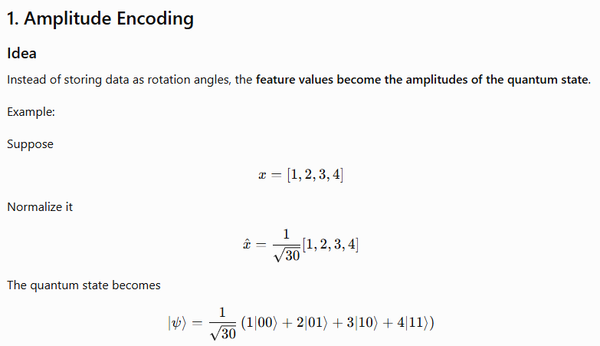
Amplitude Encoding
Advantages
  Uses exponentially fewer qubits n=log2(N)
Disadvantages
  Preparing this state is extremely difficult.
  Circuit depth is large.
  State preparation becomes expensive.
Typical Applications
  Quantum PCA
  Quantum recommendation systems
  Quantum kernels

Slide 39
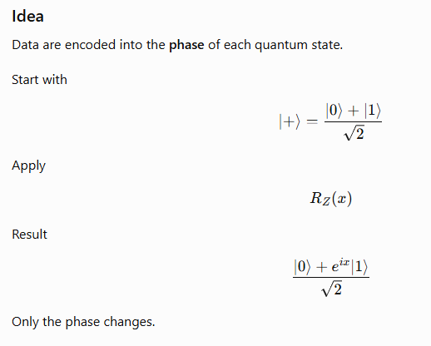
Phase Encoding
Advantages
  Small circuitsGood for interference-based algorithms
Disadvantages
  Amplitude never changes.
  Information is hidden in phase.

Slide 40
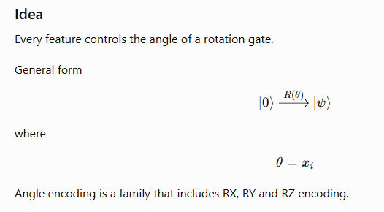
Angle Encoding
Advantages
Simple
Efficient
Used by almost all VQC models

Slide 41
Ansatz
RealAmplitudes
EfficientSU2.
TwoLocal
Hardware-Efficient Ansatz
Strongly Entangling Layers
Alternating Layered Ansatz
Circular Entanglement Ansatz
Full Entanglement Ansatz
Ry-CNOT Ansatz
Ry-CZ Ansatz
Rx-Rz Ansatz
Ry-Rz Ansatz
Rx-Ry-Rz Ansatz
Tree Entanglement Ansatz

Slide 42
Thank you !!

