Slide 1
Catalyst Effects on PEMFC Performance
By Gregory Zaylor, Andrew Baugher, Kieran Halligan, and David Janetos

Slide 2

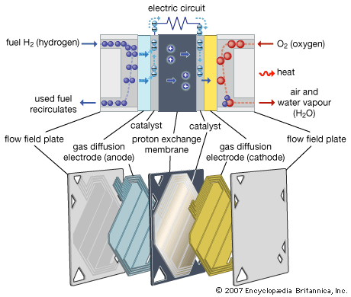
A PEMFC is a Proton Exchange Membrane Fuel Cell
Overall chemical reaction:
Hydrogen is catalytically split at the anode into protons and electrons. Cathode reaction is also catalyzed.
Electrons travel to the cathode side of the cell to generate the electric current that the fuel cell is useful for
http://media.web.britannica.com/eb-media/64/97264-004-127AEA3B.gif

Slide 3
The project will model the catalytic reaction in a PEMFC
Investigate efficiency of the fuel cell based on Pt catalyst loading levels.
Utilize Nernst equations for electric potential and kinetics in order to determine reactions rates.
The model will allow for fuel cell material inputs to be changed, including but not limited to: roughness, porosity, adhesion material.
The creation of this model would allow for expensive catalysts to be theoretically tested in order to make the cost of physically testing more affordable and less wasteful.

Slide 4
The model will be compared to previously conducted research
Large amounts of research has been conducted on the effects of Pt loading on fuel cell performance. This project will attempt to compile this data in order to create a predictive model.
Advances in solid polymer electrolyte fuel cell technology with low platinum loading electrodes http://www.sciencedirect.com/science/article/pii/0378775388800302
High Performance Catalyzed Membranes of Ultra‐low Pt Loadings for Polymer Electrolyte Fuel Cells http://jes.ecsdl.org/content/139/2/L28.short
Notes:
The US Department of Energy estimates that PEMFCs will need to use about a quarter of the platinum they currently do in order to be economically viable

Slide 5
Eventual expansion into other fuel cell regions/domains
Model transport in 2D (along cell stacking, along cell path length)
Leverage open-source FCSys from Georgia Tech
Written in Modelica, supported in Python using ModelicaRes package
Model changes in the preparation of Pt catalysts instead of just the loading
I.e. http://jes.ecsdl.org/content/145/11/3708.short Improved Preparation Process of Very‐Low‐Platinum‐Loading Electrodes for Polymer Electrolyte Fuel Cells
Include degradation effects due to cycling, heat, time.
Notes:
Alternatives being explored include cerium (IV) oxide, platinum-ruthenium or platinum-nickel alloys, and metal-organic frameworks (MOFs). Keep in mind that the oxygen reduction reaction is comparatively slow at the platinum interface, which is a major factor in the efficiency drop of the PEMFC.

