Slide 1

















$$T_{1}$$
$$T_{2}$$
$$T_{3}$$
$$T_{4}$$
$$p_{v}=1$$
$$p_{v}=0.2$$
$$p_{v}=0.8$$
$$p_{v}=0.2$$
$$p_{v}=0.24$$
$$p_{v}=0.56$$
$$p_{v}=0.24$$
$$p_{v}=0.56$$
$$λ_{1}=0.2$$
$$λ_{2}=0.3$$
$$λ_{3}=0.9$$
$$p_{v}=0.18$$
$$p_{v}=0.02$$

Slide 2



$$T_{1}$$
$$T_{2}$$
$$T_{3}$$
$$T_{4}$$
$$p_{v}=1$$
$$p_{v}=0.2$$
$$p_{v}=0.8$$
$$p_{v}=0.2$$
$$p_{v}=0.24$$
$$p_{v}=0.56$$
$$p_{v}=0.24$$
$$p_{v}=0.56$$
$$p_{v}=0.18$$
$$p_{v}=0.02$$
$$X_{2}=0.2$$
$$X_{3}=0.3$$
$$X_{4}=0.9$$

Slide 3





$$T_{1}$$
$$T_{2}$$
$$T_{3}$$
$$T_{4}$$
$$T_{5}$$
$$p_{v}=1$$
$$p_{v}=0.2$$
$$p_{v}=0.8$$
$$p_{v}=0.2$$
$$p_{v}=0.24$$
$$p_{v}=0.56$$
$$p_{v}=0.24$$
$$p_{v}=0.56$$
$$λ_{1}=0.2$$
$$λ_{2}=0.3$$
$$λ_{3}=0.9$$
$$p_{v}=0.18$$
$$p_{v}=0.02$$

Slide 4


$$p_{v}=1$$
$$p_{v}=0.2$$
$$p_{v}=0.8$$
$$p_{v}=0.2$$
$$p_{v}=0.24$$
$$p_{v}=0.56$$
$$p_{v}=0.24$$
$$p_{v}=0.56$$
$$λ_{1}=0.2$$
$$λ_{2}=0.3$$
$$λ_{3}=0.9$$
$$p_{v}=0.18$$
$$p_{v}=0.02$$

Slide 5



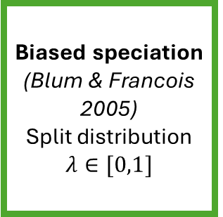



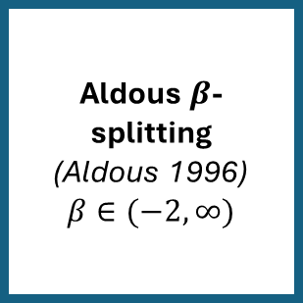

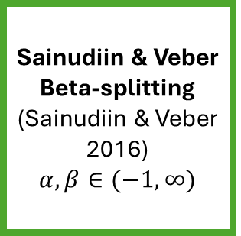

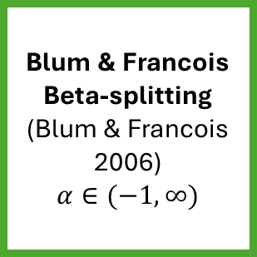


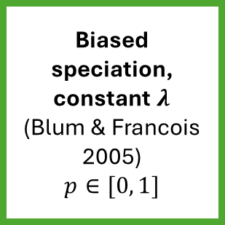


Yule model
(Yule 1925)
Sainudiin & Veber Beta-splitting
(Sainudiin & Veber 2016)
$$α,β∈(−1, ∞)$$
$$α=β=0$$
$$β=0$$
$$λ∼Beta(α+1, β+1)$$
$$α=β→−1$$
$$α=β$$
Aldous $β$-splitting
(Aldous 1996)
$$β∈(−2, ∞)$$
Uniform model
(Rosen 1978)
Blum & Francois Beta-splitting
(Blum & Francois 2006)
$$α∈(−1, ∞)$$
Biased speciation
(Blum & Francois 2005)
Split distribution $λ∈[0,1]$
$$β=−\frac{3}{2}$$
$$λ∼Beta(α+1, α+1)$$
$$α=0$$
$$α→−1$$
$$β→−2$$
Caterpillar tree
(Harary & Schwenk 1973)
Biased speciation, constant $λ$
(Blum & Francois 2005)
$$p∈[0, 1]$$
$$λ=p$$
$$p=0, p=1$$

Slide 6



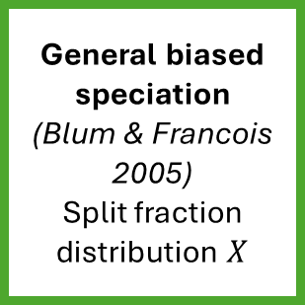



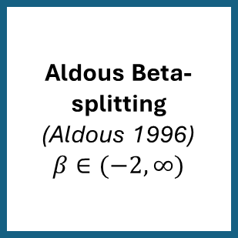

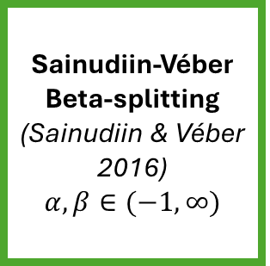

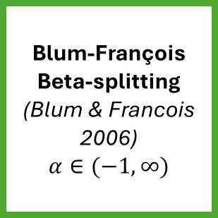


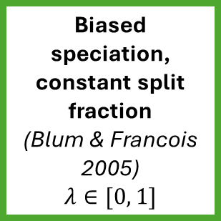


General biased speciation
(Blum & Francois 2005)
Split fraction distribution $X$
$$X=λ$$
$$X∼Beta(α+1, β+1)$$
$$X∼Beta(α+1, α+1)$$
Biased speciation, constant split fraction
(Blum & Francois 2005)
$$λ∈[0, 1]$$
Blum-François Beta-splitting
(Blum & Francois 2006)
$$α∈(−1, ∞)$$
Sainudiin-Véber Beta-splitting
(Sainudiin & Véber 2016)
$$α,β∈(−1, ∞)$$
$$α=β$$
$$λ=0, λ=1$$
$$α=0$$
$$α→−1$$
$$α=β=0$$
$$α=β→−1$$
$$β=0$$
Aldous Beta-splitting
(Aldous 1996)
$$β∈(−2, ∞)$$
$$β=−\frac{3}{2}$$
Yule model
(Yule 1925)
Uniform model
Caterpillar tree
$$β→−2$$

