Slide 1
Research objective and the next hypothesis
Question | What this study measures | Why it matters
Does BCA operate? | Scale fitting, radius refreshes and consumed multipliers | Separates execution failures from a weak uncertainty signal.
Are bands calibrated? | Fresh response coverage under a declared action shift | Tests whether the stated 90% target still holds.
Do warnings identify harm? | Within-state AUROC and AP against simulator outcomes | Tests usefulness for choosing among actions at one state.
Do choices improve? | Regret among tested actions under a fixed later policy | Connects warnings to local decision quality.
What should IW change? | Weight calibration errors for the target population | Tests a specific mismatch that ordinary CP leaves open.
Goal: useful error bands for actions that differ from the calibration population.
1
Notes:
The research objective is to determine whether BCA supplies calibrated and decision-useful uncertainty for actions that differ from those represented in its calibration data. These are separate questions: operational fitting, response coverage, harm ranking, and decisions. The current standard-BCA study supplies an equal-fitting-weight baseline. The old IW recipes changed the scale-fitting objective but did not fully implement the intended target/source weighted conformal threshold. This motivates an explicit correction and a controlled comparison. Weak pilot harm ranking does not itself prove covariate shift caused a coverage failure. The planned weighted-CP stage must measure that mechanism directly, then ask whether improved coverage helps decisions. All empirical examples in this deck retain their host, dataset and training-seed identities.
Sources: outputs/advisor_metrics/2026-09-29/METRICS_OVERVIEW.md; docs/WEIGHTED_CONFORMAL_DESIGN.md
Evidence scope: dated saved exports. No new simulator outcome or training run.

Slide 2
The study needs more than a return curve
Question | Metric | Evidence available
Are bands reliable? | Fresh empirical residual coverage | Not yet verified
Are warnings useful? | Within-state AUROC and average precision | Completed Hopper pilot
Is unfamiliarity linked to harm? | Support distance versus harm rate | Completed Hopper pilot
Are choices better? | Regret among tested actions | Exploratory pilot readout
Is BCA working during training? | Scale fits, width, radii and penalty dose | Reviewed TD3/ReBRAC; CQL preliminary
What changes in the critic? | Q estimates and Bellman/conservative loss | Training diagnostics; not true-Q error
Data are saved evidence through Sep 29, approximately 9 a.m. EDT. Pilot and revised OOD remain separate.
2
Notes:
Research objective: Determine whether BCA produces useful prediction-error bands and whether their use by the host improves action decisions. Whole-policy return is only one end result. This deck adds the missing evidence chain: empirical coverage, width/sharpness, warning discrimination, decision regret, scale fitting, component radii, consumed penalty, and critic behavior. Fresh residual coverage is not established. The prior slide deck overemphasized return and omitted already-available calibration diagnostics and secondary pilot metrics. Pilot statistics are one TD3+BC Hopper training seed; training diagnostics below use seed202609171 on Walker. Those are different cells and cannot be merged into a same-run causal explanation. Revised OOD snapshot still has zero completed pairs.
Saved closed exports; no live simulator archives or checkpoints queried.
Evidence: C:/Users/David Bayha/Documents/GitHub/BCA/outputs/ood/td3_bc/hopper/s202609171/real-harm-report-v1/summary.json
Evidence: C:/Users/David Bayha/Documents/GitHub/BCA/outputs/ood/td3_bc/hopper/s202609171/real-harm-report-v1/panels.json
Evidence: C:/Users/David Bayha/Documents/GitHub/BCA/analysis/current_results_20260929/inputs/local_exports.json
Evidence: C:/Users/David Bayha/Documents/GitHub/BCA/analysis/current_results_20260929/inputs/cluster_snapshot.json.gz

Slide 3
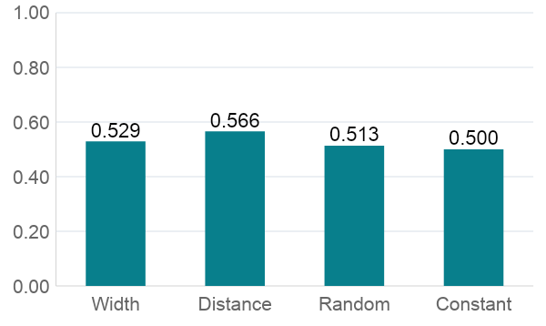
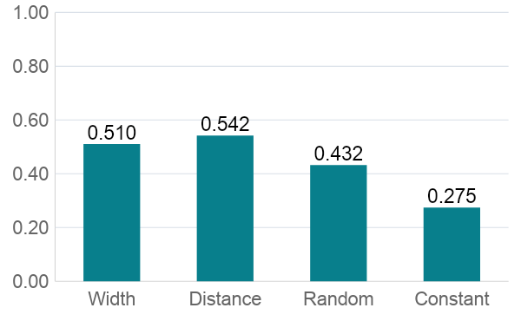
Warnings: some enrichment, weak separation
AUROC: overall harmful/nonharmful separation
Average precision: quality of top warnings
Width carries some signal, but the simple distance warning is stronger here.
Original Hopper pilot, one seed. Equal-stratum within-state summaries; 111/256 eligible panels.
3
Notes:
Original TD3+BC Hopper pilot, seed202609171, frozen BCA continuation. Harm means losing more than1 raw reward unit relative to host first action in the same state over250 total transitions. Each panel has nine alternatives. AUROC and average precision are computed within eligible panels, then averaged within the four collector/capture strata; the displayed mean gives equal weight to each stratum. There are111/256 eligible panels. All145 single-class panels are N/A for these rankings. AUROC asks how often a harmful action scores above a nonharmful action;0.5 is chance, ties half. AP summarizes precision as high-score actions are selected; higher is better, with tied-score groups handled together. Constant-score AP=.27456 is the matched eligible-panel baseline, not the11.98% pooled harm frequency. AP shows enrichment over constant/random, so it is inaccurate to say the signal contains no information. Width trails support distance on both metrics and AUROC is near chance; no significance or replicated claim. Within-state and pooled statistics remain separate.
Saved closed exports; no live simulator archives or checkpoints queried.
Evidence: C:/Users/David Bayha/Documents/GitHub/BCA/outputs/ood/td3_bc/hopper/s202609171/real-harm-report-v1/summary.json
Evidence: C:/Users/David Bayha/Documents/GitHub/BCA/outputs/ood/td3_bc/hopper/s202609171/real-harm-report-v1/panels.json

Slide 4
Harm ranking has signal, but limited separation
Result and its purpose | Meaning and impact | Improvement to test
AUROC 0.529 Checks harm ordering. | Close to the 0.500 tie baseline. Distance reaches 0.566. | Repeat across seeds and preserved state groups.
AP 0.510 Checks top warnings. | Above constant AP 0.275. Distance is higher at 0.542. | Check whether enrichment persists on new panels.
111/256 eligible panels Shows metric support. | 145 panels have one class. Their AUROC/AP remain N/A. | Report valid counts and uncertainty by reset block.
Pooled width AUROC 0.432 Checks across-state mixing. | A different question from choosing actions at one state. | Keep within-state ranking as the primary comparison.
Implication for IW | Useful warnings are incomplete. The cause is still unresolved. | Measure shifted coverage before attributing this to CP.
Original TD3+BC Hopper pilot. Frozen BCA continuation. One seed and dependent reset blocks.
4
Notes:
Why AUROC matters: a useful warning should rank a harmful alternative above a harmless alternative at the same captured state. Equal-stratum within-state width AUROC is 0.529327, compared with support distance 0.565805, fixed random 0.513251 and constant 0.5. That is weak descriptive separation, not a statistically established failure across seeds. Why AP matters: when warnings are ranked from largest to smallest, AP summarizes enrichment of harmful actions. Width AP 0.510392 exceeds constant 0.274558 but falls below distance 0.542025. Thus the pilot contains some signal; calling it completely uninformative would be wrong. AP uses eligible panels and equal stratum weights, so the constant baseline differs from the pooled 11.98% harm frequency. Why eligible counts matter: 111 of 256 panels contain both classes; the remaining 145 cannot identify binary ranking. Pooled AUROC 0.431776 mixes states and is not a replacement for the primary action-ranking quantity. Expected useful behavior is repeatable within-state ranking and top-warning enrichment, accompanied by uncertainty intervals that respect reset-block dependence. Next: complete the declared seeds, preserve all strata, and measure fresh shifted residual coverage. Weighted CP could address population mismatch in coverage, but the pilot does not identify that mismatch as the cause of weak ranking.
Sources: outputs/ood/td3_bc/hopper/s202609171/real-harm-report-v1/summary.json; outputs/advisor_metrics/2026-09-29/METRIC_EVIDENCE.json
Evidence scope: dated saved exports. No new simulator outcome or training run.

Slide 5
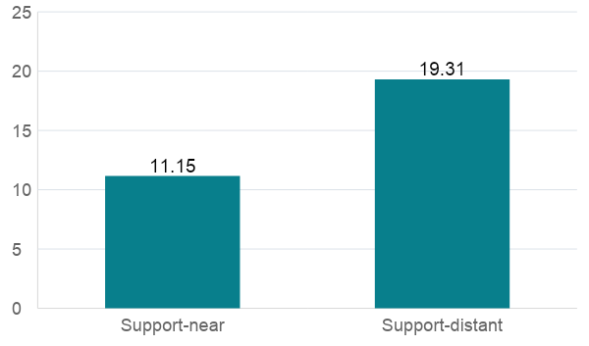
Unfamiliar actions and harmful actions differ
Observed harmful-action rate (%)
231 of 276 harmful actions were still support-near.
188 of 233 distant actions were not harmful.
Novelty is a useful descriptor, not a harm label.
Why test both? BCA must distinguish bad actions, not merely unfamiliar ones.
Original pilot: 2,304 alternatives, 276 harmful. Harm = loss >1 raw reward versus host first action.
5
Notes:
The same primary BCA-continuation pilot alternatives are used: near2071 with231 harmful, distant233 with45 harmful. Distant/nonharmful188 and near/nonharmful1840. Harm threshold >1 and support threshold .21134613219046514 are unchanged. Support is minimum RMS action distance among32 nearby recorded observations, not exact policy density or true OOD membership. The descriptive rates are231/2071=11.153...% and45/233=19.313...%. Support-distant actions have a higher observed harm rate, yet231/276 harmful alternatives are near and188/233 distant alternatives are not harmful. These correlated actions and shared resets are not independent training seeds. This motivates balanced support bands and direct harm measurements, not labelling every far action dangerous.
Saved closed exports; no live simulator archives or checkpoints queried.
Evidence: C:/Users/David Bayha/Documents/GitHub/BCA/outputs/ood/td3_bc/hopper/s202609171/real-harm-report-v1/summary.json
Evidence: C:/Users/David Bayha/Documents/GitHub/BCA/outputs/ood/td3_bc/hopper/s202609171/real-harm-report-v1/panels.json

Slide 6
Distance identifies a harder group, not every bad move
Result and its purpose | Meaning and impact | Improvement to test
Near: 231/2,071 harmful 11.15% of alternatives | Familiar-looking actions can still have poor outcomes. | Keep a near-action control when testing OOD behavior.
Distant: 45/233 harmful 19.31% of alternatives | Higher descriptive harm rate. Group sizes are unequal. | Use declared support bands with comparable sampling.
231/276 harmful are near Checks missed harmful actions. | A distance-only warning would miss much of the observed harm. | Evaluate error bands against outcomes within each band.
188/233 distant are harmless Checks unnecessary caution. | Penalizing all distant actions could discard useful actions. | Track lost good actions alongside detected harm.
Implication for IW | Distance alone does not supply a target/source probability ratio. | Define source and target laws before constructing weights.
Support means distance to recorded actions near the state. It is a proxy, not exact OOD status.
6
Notes:
These counts concern nine alternatives per captured row under the frozen BCA continuation, with harmful defined as loss greater than 1 raw reward unit against the host first action. The 2,304 alternatives contain 276 harmful outcomes. Near actions have 231/2,071 harm, or 11.153%; distant actions have 45/233, or 19.313%. The difference makes support shift a useful study dimension but cannot establish causation or a repeated seed-level effect. Most harmful alternatives are near because that group is much larger, and 188 of 233 distant alternatives are not harmful. These two facts guard against interpreting all OOD actions as bad. The support measure is minimum RMS action distance to recorded actions among 32 nearby reference states, with the frozen threshold 0.21134613219046514. It is neither true behavior density nor a calibrated density ratio. Improvement: balanced, predeclared support strata and matched same-state interventions can locate where warning quality changes. For weighted CP, use a justified population ratio; do not insert this distance as though it were Q_X/P_X. No new support threshold or penalty is tuned from these outcomes.
Sources: outputs/ood/td3_bc/hopper/s202609171/real-harm-report-v1/summary.json; outputs/advisor_metrics/2026-09-29/METRIC_EVIDENCE.json
Evidence scope: dated saved exports. No new simulator outcome or training run.

Slide 7
Warning quality changes with the situation
Collected states | Eligible / 64 | Width AUROC | Distance AUROC
Host · reset | 23 | 0.449 | 0.501
Host · step 100 | 34 | 0.640 | 0.652
BCA · reset | 25 | 0.557 | 0.588
BCA · step 100 | 29 | 0.471 | 0.522
Widths vary: 1.35–2.48. No panel has all alternative widths tied.
Changing one global radius cannot repair which action is ranked as riskier.
Original pilot, frozen BCA continuation. All strata are retained; N/A panels are not assigned zero.
7
Notes:
The four primary strata retain both policy collectors at reset and after100 collector steps. Width AUROC and support AUROC differ by stratum. Captured reset states under the collectors can coincide; they are not independent samples. The largest width ranking here is at host-collected step100 states, while the host-reset and BCA-step100 strata are below0.5. Do not select the favorable stratum as the overall result. Across all2560 fixed state-action slots the saved width min/median/max are1.352396965/1.746680200/2.478725672. No panel has all nine alternative widths tied, so the near-chance primary summary is not explained by an all-action constant warning. This does not identify the residual model's causal failure. One positive global radius scales widths without changing within-state ordering.
Saved closed exports; no live simulator archives or checkpoints queried.
Evidence: C:/Users/David Bayha/Documents/GitHub/BCA/outputs/ood/td3_bc/hopper/s202609171/real-harm-report-v1/summary.json
Evidence: C:/Users/David Bayha/Documents/GitHub/BCA/outputs/ood/td3_bc/hopper/s202609171/real-harm-report-v1/panels.json

Slide 8
Warning quality depends on the state group
Result and its purpose | Meaning and impact | Improvement to test
Host reset: 0.449 23 eligible panels | Below the tie baseline in this captured group. | Repeat this group with new seeds and reset blocks.
Host step 100: 0.640 34 eligible panels | The most favorable group in this pilot. | Check whether the advantage survives new data.
BCA reset: 0.557 25 eligible panels | Modest separation here. Same initial reset population. | Preserve shared-reset pairing in uncertainty.
BCA step 100: 0.471 29 eligible panels | Later BCA states do not show the same favorable ordering. | Separate state-visitation shift from action shift.
Widths 1.35–2.48 No all-action ties | Changing width alone does not establish useful ranking. | Test scale quality and query-specific CP separately.
Width AUROC within each stratum. No stratum is omitted because it looks unfavorable.
8
Notes:
All four groups contain 64 captured rows. Exact width AUROCs are 0.448775 at host reset, 0.640231 at host step 100, approximately 0.557 at BCA reset and approximately 0.471 at BCA step 100; the preceding result slide retains exact rounded values drawn from the same JSON. Support AUROCs are approximately 0.501, 0.652, 0.588 and 0.522, respectively. The favorable host-step-100 subgroup cannot justify a broad OOD claim. Eligibility differs across groups, and reset origins create dependence. The two reset groups use a common initial reset population, so their differences should not be explained as an isolated state-visitation effect without checking the panel construction. Widths range from 1.352397 to 2.478726, with median 1.746680 and no panel tying all alternative widths. This rules out a trivial all-tied explanation for the entire pilot. A positive global radius multiplies all action widths at a state and cannot change their order. A properly query-dependent conformal radius may change ordering, but weighted CP promises a coverage property under assumptions, not better harm ranking. Improvements should distinguish scale-model ordering, action-shift weighting and state-visitation shift rather than changing all three simultaneously.
Sources: outputs/ood/td3_bc/hopper/s202609171/real-harm-report-v1/summary.json; outputs/advisor_metrics/2026-09-29/METRIC_EVIDENCE.json
Evidence scope: dated saved exports. No new simulator outcome or training run.

Slide 9
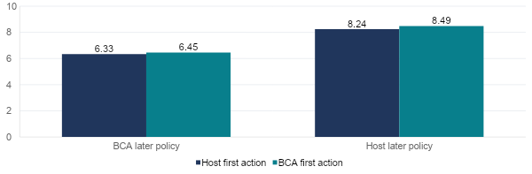
Action choice: regret among tested actions
Mean candidate-set regret (raw reward units; lower is better)
The BCA first action does not reduce average tested-action regret in this pilot.
Exploratory pilot metric. Best of ten tested actions; 256 captured rows, one training seed.
9
Notes:
Secondary exploratory endpoint declared after collection and before the readout. For a state and fixed continuation c, regret(a)=max over ten tested precommitted unique actions G_c(s,a') minus G_c(s,a). It is not optimal-policy regret, true-Q error or a guarantee about untested actions. All256 captured rows are averaged, including repeated reset blocks. BCA continuation means the same later BCA policy is used to evaluate both candidate first actions. Host continuation likewise holds the later host policy fixed. Mean regret values are6.333291153 and6.452881609 under BCA continuation, and8.242196683 and8.489875844 under host continuation. Their differences equal the negative paired first-action advantage, an arithmetic consistency check. Lower is better, but the small observed differences in one correlated panel are not a significant general disadvantage. This is a local decision metric derived from measured outcomes, separate from whole-policy average return.
Saved closed exports; no live simulator archives or checkpoints queried.
Evidence: C:/Users/David Bayha/Documents/GitHub/BCA/outputs/ood/td3_bc/hopper/s202609171/real-harm-report-v1/summary.json
Evidence: C:/Users/David Bayha/Documents/GitHub/BCA/outputs/ood/td3_bc/hopper/s202609171/real-harm-report-v1/panels.json

Slide 10
Better average action choice remains unestablished
Result and its purpose | Meaning and impact | Improvement to test
BCA later policy Host 6.333, BCA 6.453 | BCA first action has 0.120 more average tested regret. | Repeat paired first-action comparisons across seeds.
Host later policy Host 8.242, BCA 8.490 | BCA first action has 0.248 more average tested regret. | Retain both continuations to expose policy dependence.
Why regret matters | Measures missed opportunity within the tested action set. | Report the candidate set and paired uncertainty.
Expectation versus evidence | Expected lower regret with better uncertainty-guided choices. | Check warning quality and how each host uses the band.
Implication for weighted CP | Coverage can improve without improving the selected action. | Require separate evidence for decision benefit.
Exploratory regret against the best of ten tested actions. Lower is better.
10
Notes:
Regret here is max_a G(s,a; fixed continuation) minus G for the selected first action, restricted to ten tested actions. It is not regret against the unknown globally optimal action or policy. Under BCA continuation, host-first regret is 6.333291 and BCA-first regret 6.452882, a difference of 0.119590. Under host continuation they are 8.242197 and 8.489876, a difference of 0.247679. These are descriptive, exploratory means in one training seed, with correlated states/actions and no new significance claim. Both directions fail to establish the hoped-for mean reduction. They do not identify whether the cause is the scale model, the radius, the host attachment, learned policy differences or the candidate panel. The useful next step is paired replication under the frozen protocol, followed by a separated test of coverage correction and host consumption if warranted. A weighted-CP band can attain better target coverage while still ranking harm poorly or encouraging excessive conservatism. We will therefore keep regret alongside coverage, AUROC/AP, lost good actions and return.
Sources: outputs/ood/td3_bc/hopper/s202609171/real-harm-report-v1/summary.json; outputs/advisor_metrics/2026-09-29/METRIC_EVIDENCE.json
Evidence scope: dated saved exports. No new simulator outcome or training run.

Slide 11
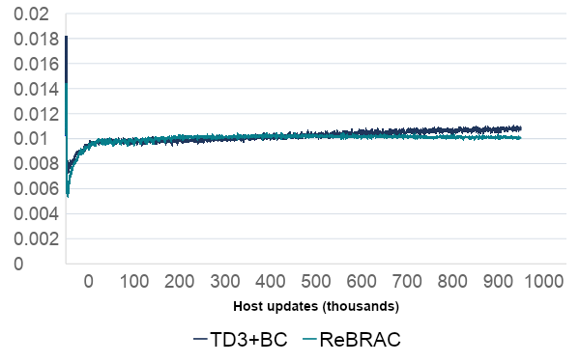
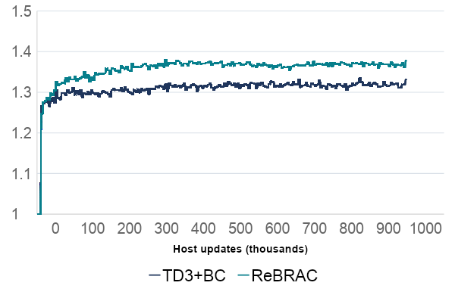
Calibration is fitting and changing the penalty
Scale-fitting objective
Actor behavior-cloning multiplier
Block mean objective
Multiplier; 1 = unchanged strength
Both accepted 1,000,000 scale fits. Final block strength: ×1.331 / ×1.377.
Reviewed standard-BCA Walker runs, seed 202609171. Full block means; actor skip rows excluded.
11
Notes:
Standard BCA Walker, seed202609171. Both TD3+BC and ReBRAC audited final checkpoint counters independently record1000000 accepted scale fits and500000 actor updates. Each plot shows1000 block means covering1000 host updates each. Actor BC multipliers use actual actor rows, excluding skipped-update zeros; genuine active zeros remain. Final block TD3 multiplier1.331356037 andReBRAC1.377447963. Scale-loss final block .0109333582/.0100045581. These are different host-specific models; the scale objectives are not a cross-host quality ranking. Width-dependent multipliers modulate actor behavior-cloning strength; ReBRAC's critic BC stays at its host value. Standard equal fitting factors do not create an importance-weight degeneracy diagnosis. A learned positive dose and accepted updates establish execution, not calibrated coverage, OOD detection or benefit.
Evidence: C:/Users/David Bayha/Documents/GitHub/BCA/analysis/current_results_20260929/inputs/local_exports.json
Evidence: C:/Users/David Bayha/Documents/GitHub/BCA/analysis/current_results_20260929/inputs/cluster_snapshot.json.gz

Slide 12
BCA is active, but activity does not prove usefulness
Result and its purpose | Meaning and impact | Improvement to test
1,000,000 accepted fits each Checks calibrator execution. | Both scale learners updated. Inactivity is not the explanation. | Measure fresh residual coverage and warning quality.
Scale objectives 0.01093 / 0.01000 | These are fitting diagnostics. Small values do not certify Q. | Test fixed-target errors on an independent bank.
Actor BC dose 1.331 / 1.377 | BCA increases imitation strength by about 33% / 38%. | Compare a declared matched fixed-strength control later.
Why dose matters | A useful band still needs an effective host intervention. | Keep host attachment fixed for the first CP comparison.
Implication for IW | Fit weights change the scale. CP weights change the threshold. | Test the weighted threshold before combining both changes.
Reviewed TD3+BC and ReBRAC Walker runs. Seed 202609171. Last 1,000-update block where stated.
12
Notes:
The checkpoint counters independently establish one million accepted scale fits in each reviewed Walker run, with one million critic/host updates and 500,000 delayed actor updates. This rules out complete fit abstention for these two examples, not for every host or historic recipe. The final block scale-fitting objectives are TD3 0.0109333582 and ReBRAC 0.0100045581. Their magnitudes do not establish true-Q accuracy, calibration validity or useful risk ordering. Final block actor BC multipliers are 1.331356 and 1.377448: about 33.14% and 37.74% greater imitation coefficients than the same host coefficient before multiplication. These are mean multipliers, not the fraction of actions copied, a coverage level, or percentages of reliance on the old policy. They also do not measure gradient norms. A matched fixed-strength control is a future separately declared comparison, not an already measured explanation or permission to choose a winning constant. The immediate weighted-CP comparison should hold the scale-fitting rule and host attachment fixed, so any coverage change can be attributed to threshold weighting. Fitting IW can be evaluated in a later factorial comparison.
Sources: outputs/advisor_metrics/2026-09-29/METRIC_EVIDENCE.json; outputs/standard_bca/*/walker2d/*/s202609171/verified-v1/; analysis/current_results_20260929/inputs/cluster_snapshot.json.gz
Evidence scope: dated saved exports. No new simulator outcome or training run.

Slide 13
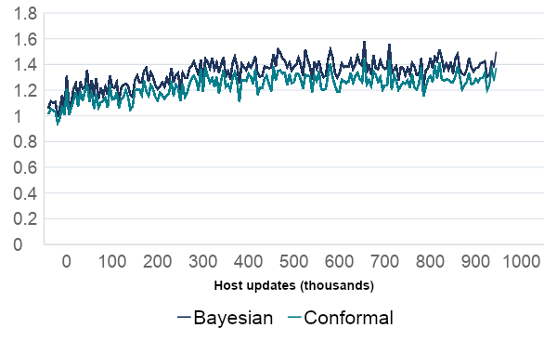
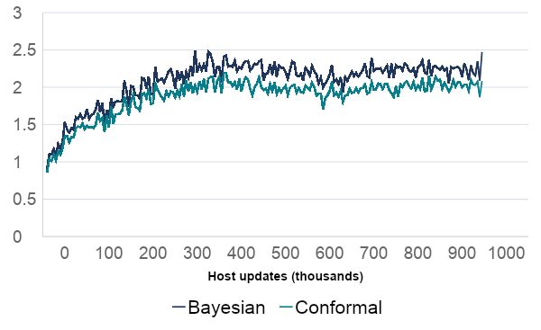
Bayesian and conformal components are retained
TD3+BC · Walker
ReBRAC · Walker
Radius in normalized residual units
Radius in normalized residual units
Conformal is below Bayesian at 198/198 refreshes in each run.
The floor remains in the algorithm; a larger global radius cannot improve action ordering.
198 refreshes per run. Effective radius is the larger component; this plot is not a coverage test.
13
Notes:
These are the198 saved refreshes from10k to995k in each reviewed standard-BCA Walker run; no interpolated or fabricated final1M refresh. The effective radius equals max(Bayesian,conformal) at every saved refresh. The conformal floor is nonbinding at198/198 for both runs; its zero contribution to the max in these observations does not authorize removing it. Bayesian mass draws remain active. TD3 final saved refresh Bayes1.499558091,conformal1.372334599, frozen residual unit5.178395748. ReBRAC units were not in this refresh export, so no unit history is invented. Radii are in normalized residual-score units, not directly Q-value width. Width also depends on the state-action scale and stored unit. Radius evolution is not empirical coverage.
Evidence: C:/Users/David Bayha/Documents/GitHub/BCA/analysis/current_results_20260929/inputs/local_exports.json
Evidence: C:/Users/David Bayha/Documents/GitHub/BCA/analysis/current_results_20260929/inputs/cluster_snapshot.json.gz

Slide 14
The Bayesian radius controls these observed bands
Result and its purpose | Meaning and impact | Improvement to test
198 refreshes each Checks radius updates. | Both components refresh through the declared schedule. | Verify freshness, snapshots and checkpoint reconstruction.
Conformal below Bayesian 198/198 in both runs | The maximum selects Bayesian at every logged refresh here. | Measure each radius and fresh coverage separately.
Why this matters for IW | A corrected CP radius may still lie below the Bayesian radius. | Check whether the correction changes the consumed band.
Larger global radius | Widens every band without changing action order. | Separate coverage correction from scale/harm alignment.
Expected useful outcome | Adequate coverage with informative finite widths. | Report width and infinity rate alongside coverage.
198 logged refreshes in each reviewed Walker run. Both radius components remain present.
14
Notes:
The effective radius is max(Bayesian, conformal). In both reviewed TD3 and ReBRAC Walker training histories, the conformal floor is lower at all 198 logged refreshes. This establishes which component sets the observed scalar maximum, but does not justify removing the floor. A larger band can cover more responses while being less informative, so both coverage and width are necessary. This result is especially relevant to weighted CP: correcting an inactive conformal floor may leave the final max unchanged. We must inspect conformal-only and full-band diagnostics, and separately specify whether the Bayesian observed-score masses also use valid target weights. Otherwise a null decision change could simply mean the corrected component never affects the consumed band. Positive global scaling cannot repair within-state action ordering. Query-specific conformal radii can vary with the query ratio, but improved ranking remains an empirical question. The Bayesian observed-support bootstrap remains an additional construction; taking a maximum does not validate a finite-draw 95%-confidence population-risk theorem. Keep both components while testing their distinct contributions.
Sources: outputs/advisor_metrics/2026-09-29/METRIC_EVIDENCE.json; outputs/standard_bca/*/walker2d/*/s202609171/verified-v1/; analysis/current_results_20260929/inputs/cluster_snapshot.json.gz
Evidence scope: dated saved exports. No new simulator outcome or training run.

Slide 15
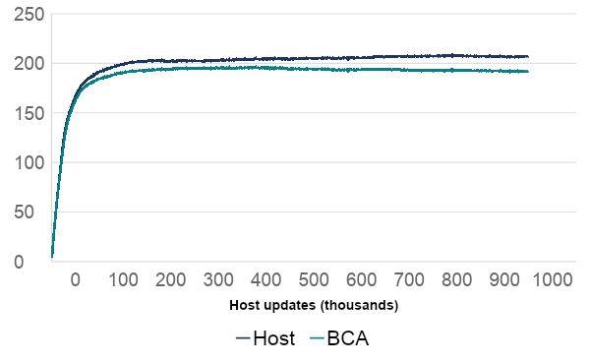
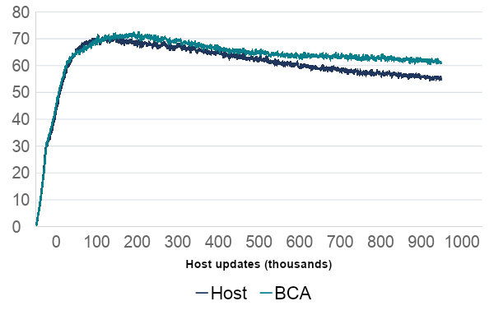
TD3+BC: inspect Q and Bellman loss
Q1 at proposed actor actions
Critic fitting loss
Block mean Q estimate
Block mean host loss
Final block Q: 207.10 → 191.92; critic loss: 55.42 → 61.31.
Lower Q does not establish more accurate Q. Larger loss does not identify OOD harm.
One reviewed Walker training seed. Training losses are fitting diagnostics, not labels for unsafe actions.
15
Notes:
TD3+BC Walker, seed202609171, audited1000-update block means. Q1 at proposed actor actions. TD3 Q is evaluated after critic update before actor update, on active actor rows; ReBRAC Qmin is pre-critic and retained across all host rows. TD3 and ReBRAC Q summaries are not the same estimand and must not be compared as a shared optimism curve. Critic loss is the host's twin-loss training objective, not measured true-Q error or OOD harm. In these last blocks BCA Q is lower but critic loss is higher. That pattern motivates investigation but does not prove corrected overestimation or excessive pessimism. Actor loss and BC accounting are also available in the saved blocks: TD3 bc_loss includes consumed dose, while ReBRAC bc_mse_policy is an unweighted coordinate sum.
Evidence: C:/Users/David Bayha/Documents/GitHub/BCA/analysis/current_results_20260929/inputs/local_exports.json
Evidence: C:/Users/David Bayha/Documents/GitHub/BCA/analysis/current_results_20260929/inputs/cluster_snapshot.json.gz

Slide 16
TD3 estimates fall while its fitting loss rises
Result and its purpose | Meaning and impact | Improvement to test
Q1: 207.10 to 191.92 Tracks value predictions. | BCA predicts lower values at proposed actor actions. | Compare against independent value probes at fixed inputs.
Loss: 55.42 to 61.31 Tracks critic fitting. | BCA has higher loss against its current training targets. | Use a shared frozen target and held-out transitions.
Why both matter | Lower Q could reduce optimism or suppress good actions. | Measure prediction error and action harm separately.
Expectation versus evidence | More caution appears in Q. More accurate Q is unverified. | Avoid interpreting lower Q as successful correction.
Implication for IW | Threshold weighting targets response coverage under shift. | It does not make these training targets ground truth.
Walker, seed 202609171. Final 1,000-update blocks. Host and BCA learn different moving targets.
16
Notes:
TD3 Walker final block Q1 at proposed actor actions changes from host 207.100791 to BCA 191.923997. The critic fitting objective changes from 55.421106 to 61.308944. Both observations are worth showing because return alone cannot reveal whether the critic values or learning signal changed. However, the policies and targets also change during training, so these logs do not compare two predictors against the same truth. Lower Q might reflect reduced overestimation, excessive pessimism or simply different actions/states evaluated by the logging path. Higher fitting loss is not a measurement of OOD harm or a proof of worse true values. Next: compare frozen predictors at common inputs against an explicitly defined fixed response, and use independent simulator outcomes for action quality. The weighted-CP response is the declared frozen one-step Bellman target; its coverage is not true long-horizon Q coverage. The first radius experiment should keep this response definition unchanged to isolate the distribution correction.
Sources: outputs/advisor_metrics/2026-09-29/METRIC_EVIDENCE.json; outputs/standard_bca/*/walker2d/*/s202609171/verified-v1/; analysis/current_results_20260929/inputs/cluster_snapshot.json.gz
Evidence scope: dated saved exports. No new simulator outcome or training run.

Slide 17
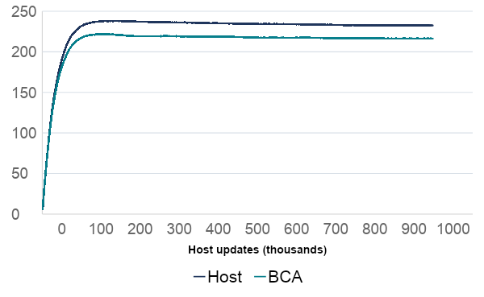
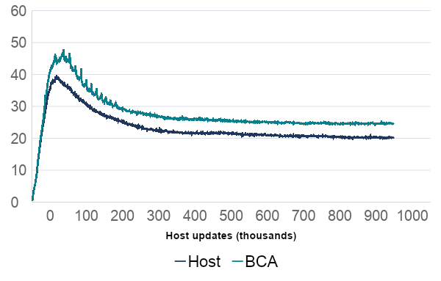
ReBRAC: inspect Q and Bellman loss
Minimum twin Q at recorded actions
Critic fitting loss
Block mean Q estimate
Block mean host loss
Final block Q: 232.63 → 216.31; critic loss: 20.30 → 24.75.
Lower Q does not establish more accurate Q. Larger loss does not identify OOD harm.
One reviewed Walker training seed. Training losses are fitting diagnostics, not labels for unsafe actions.
17
Notes:
ReBRAC Walker, seed202609171, audited1000-update block means. Minimum twin Q at recorded actions. TD3 Q is evaluated after critic update before actor update, on active actor rows; ReBRAC Qmin is pre-critic and retained across all host rows. TD3 and ReBRAC Q summaries are not the same estimand and must not be compared as a shared optimism curve. Critic loss is the host's twin-loss training objective, not measured true-Q error or OOD harm. In these last blocks BCA Q is lower but critic loss is higher. That pattern motivates investigation but does not prove corrected overestimation or excessive pessimism. Actor loss and BC accounting are also available in the saved blocks: TD3 bc_loss includes consumed dose, while ReBRAC bc_mse_policy is an unweighted coordinate sum.
Evidence: C:/Users/David Bayha/Documents/GitHub/BCA/analysis/current_results_20260929/inputs/local_exports.json
Evidence: C:/Users/David Bayha/Documents/GitHub/BCA/analysis/current_results_20260929/inputs/cluster_snapshot.json.gz

Slide 18
ReBRAC shows the same unresolved value tradeoff
Result and its purpose | Meaning and impact | Improvement to test
Qmin: 232.63 to 216.31 Tracks recorded-action values. | BCA has lower logged Q at dataset actions. | Check shared inputs and independent value evidence.
Loss: 20.30 to 24.75 Tracks critic fitting. | Higher loss accompanies the lower value predictions. | Measure frozen-target error on untouched transitions.
Why the query point matters | Recorded-action Q differs from TD3 proposed-action Q. | Do not rank host optimism using these two log scales.
Expectation versus evidence | The logs show a changed learner. Accuracy remains unresolved. | Connect each diagnostic to the same host's OOD panel.
Implication for IW | Preserve ReBRAC's target and critic BC in the first correction. | Change only the declared calibration calculation.
Walker, seed 202609171. Q is the twin minimum on recorded actions, unlike the TD3 logger.
18
Notes:
ReBRAC Walker final block twin-minimum Q at recorded dataset actions falls from 232.634650 to 216.314605, while critic loss rises from 20.296611 to 24.752905. These are the same qualitative directions as TD3 but use a different query point and logging order; cross-host Q magnitudes cannot rank relative optimism. ReBRAC's actor BC multiplier changes while its critic BC remains part of the original host. A weighted-CP experiment must preserve the host's regularized target definition and critic BC to avoid a confounded comparison. Fixed-target residual tests can assess fitting at a common response. Separate OOD interventions assess whether candidate actions actually cause harm. Neither a training-loss increase nor lower Q by itself establishes why BCA performance is weak. The proposed improvement is better isolation and measurement, followed by a specific weighted-threshold intervention if the population contract is satisfied.
Sources: outputs/advisor_metrics/2026-09-29/METRIC_EVIDENCE.json; outputs/standard_bca/*/walker2d/*/s202609171/verified-v1/; analysis/current_results_20260929/inputs/cluster_snapshot.json.gz
Evidence scope: dated saved exports. No new simulator outcome or training run.

Slide 19
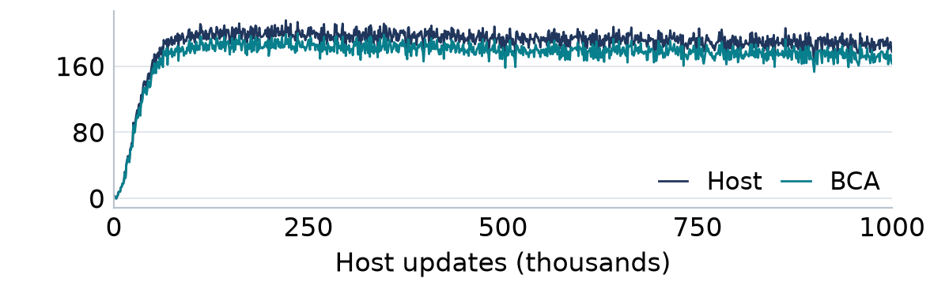
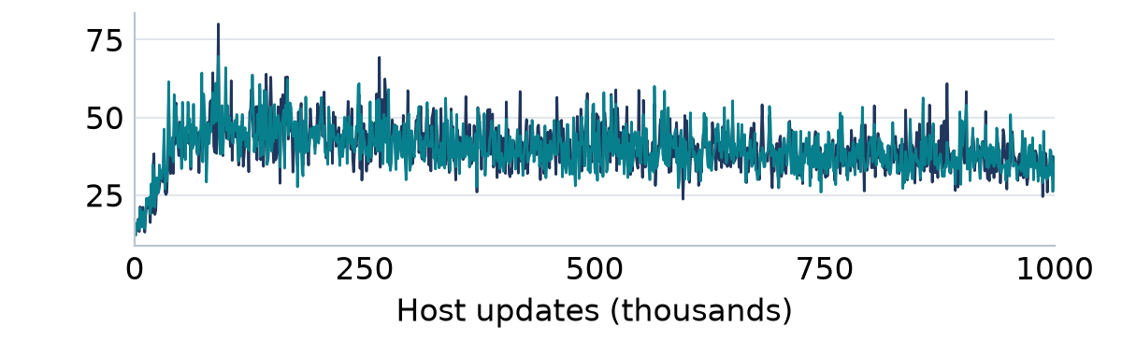
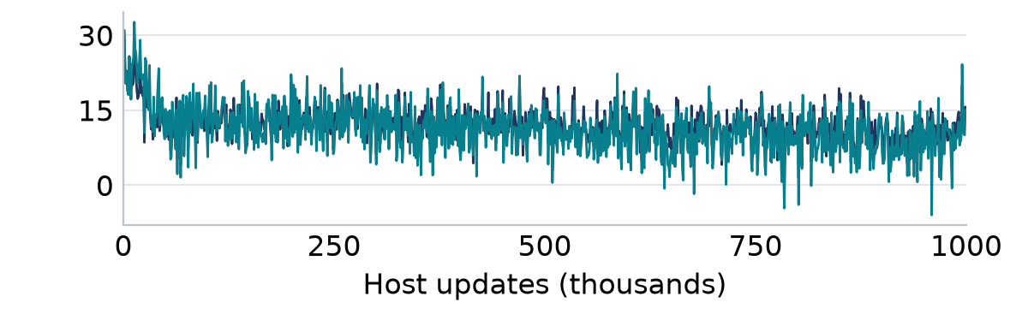
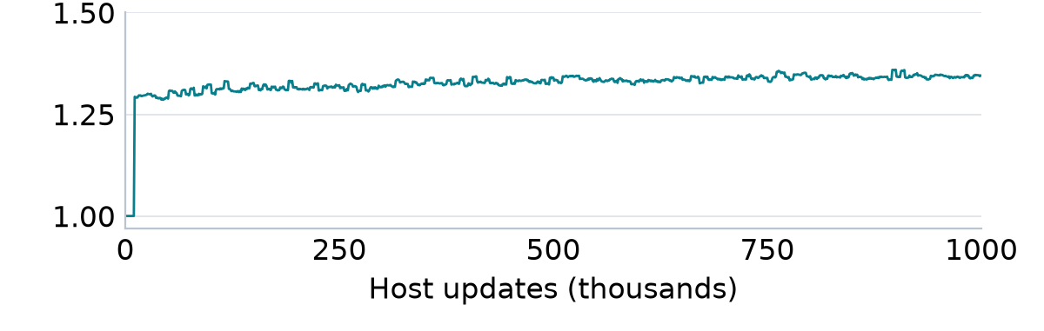
CQL: inspect its critic and consumed penalty
Q1 at recorded actions
Bellman fitting loss
Logged Q1
Logged objective
Conservative objective
Conservative-gap multiplier
Logged objective
Logged BCA multiplier
CQL Walker: preliminary saved diagnostics. Sparse last-row snapshots; full independent review pending.
19
Notes:
CQL Walker seed202609171, preliminary frozen cluster export pending full independent audit.1000 retained last-row observations at1000-update intervals; not full scan means or a million per-update rows. Q1 is on recorded actions. Bellman objective and conservative objective are scalar losses, not gradient norms. BCA width at the recorded transition changes the multiplier on the conservative gap, not a separate warning for each sampled negative action. The fourth chart is that logged multiplier; a nonzero or large multiplier is not coverage or detection. Both Hopper and Walker have198 successful refresh records, but numerical historical CQL radii are unavailable in this export. Sparse accepted scale snapshots do not establish every update accepted; checkpoint review is pending. No counters or radius traces are fabricated.
Evidence: C:/Users/David Bayha/Documents/GitHub/BCA/analysis/current_results_20260929/inputs/local_exports.json
Evidence: C:/Users/David Bayha/Documents/GitHub/BCA/analysis/current_results_20260929/inputs/cluster_snapshot.json.gz

Slide 20
CQL changes its critic, but the mechanism is unverified
Result and its purpose | Meaning and impact | Improvement to test
Q1: 177.15 to 163.12 Tracks recorded-action values. | BCA's logged values are lower. Accuracy remains unknown. | Use fixed inputs and independent value probes.
Bellman loss: 35.60 to 37.20 Tracks target fitting. | The final sampled loss is higher. Targets change during learning. | Compare frozen responses and review checkpoint counters.
CQL objective: 13.68 to 13.21 Tracks conservative training. | The scalar objective changes. It is not a gradient norm. | Measure the consumed loss contribution at fixed inputs.
Gap multiplier: 1.345 Checks BCA's intervention. | One recorded-action band scales the transition's CQL gap. | Audit input alignment before query-dependent integration.
198 refreshes Sparse fitting evidence | Historical numerical radii are absent from this export. | Retain missing values and finish independent review.
Preliminary CQL Walker seed 202609171. Final sparse snapshot, not a full-block average.
20
Notes:
CQL Walker final sparse snapshot values are host/BCA Q1 177.151443/163.115646, Q1 fitting loss 35.597420/37.195969, and conservative objective 13.682011/13.208880. The BCA critic-dose mean is 1.345180 and scale objective 0.011620161, with this sampled row accepting a fit. These are one of 1,000 sparse retained last rows, not means over all updates. They cannot independently prove one million accepted scale fits. There are 198 successful refresh records, but historical numerical radii are absent from this extracted record, and the full independent checkpoint review remains pending. Why these metrics matter: they show that the intervention reaches the critic, but neither scalar loss magnitude nor lower Q identifies a gradient mechanism or true-value improvement. Current CQL attaches a detached recorded-transition multiplier to the conservative gap. It does not assign a distinct calibrated interval to every sampled negative action in that gap. The first weighted-CP implementation must make the actual query point explicit while preserving the original dual-gap definition. Candidate-specific penalties would be a separate host-method change. Improvement begins with schema/counter review and frozen-input diagnostic comparisons, not silently relabeling the existing treatment.
Sources: outputs/advisor_metrics/2026-09-29/METRIC_EVIDENCE.json; outputs/standard_bca/*/walker2d/*/s202609171/verified-v1/; analysis/current_results_20260929/inputs/cluster_snapshot.json.gz
Evidence scope: dated saved exports. No new simulator outcome or training run.

Slide 21
Coverage remains an unanswered question
Measure | What it answers | Current evidence
Empirical residual coverage | How often does the band contain its stated target? | Not verified on fresh OOD samples
Band width / sharpness | How much uncertainty does it report? | Pilot widths 1.35–2.48; not coverage
Coverage by support band | Where does calibration fail under shift? | Requires a separate accepted readout
Fit counts and radius refreshes | Did the calibration machinery operate? | Verified for reviewed TD3/ReBRAC runs
True-Q prediction error | Does Q match actual long-run value? | Not supplied by training Bellman loss
Important gap: no verified fresh OOD residual-coverage result. Nominal 90% is a target, not a finding.
21
Notes:
Do not replace the missing calibration-validity test with fitted scale loss, successful updates, radius plots or behavioral returns. The required observable is indicator{|Y-m(X)| <= width(X)} on a fresh appropriately held-out population after the scoring function is frozen, with an explicitly declared one-step response/target, sampling design and assumptions. The target is the specified bootstrapped Bellman response, not true infinite-horizon Q. Nominal coverage90% is a configured target, not a measured90% outcome or90% imitation of the old policy. Nominal Bayesian credibility is also not population coverage. Report empirical coverage, interval width/sharpness, sampling uncertainty and predeclared support-stratum diagnostics separately. Conditional group checks are empirical; the marginal theorem is not automatically conditional coverage. Current behavioral archives do not establish fresh residual coverage, and ReBRAC's next-action target contract remains a separate compatibility constraint. Exact weighted-conformal correction needs justified density ratios/support and query mass; fitting weights alone are not sufficient.
Evidence: C:/Users/David Bayha/Documents/GitHub/BCA/docs/WEIGHTED_CONFORMAL_DESIGN.md
Evidence: C:/Users/David Bayha/Documents/GitHub/BCA/docs/superpowers/plans/2026-09-28-ood-robustness-v2.md
Saved closed exports; no live simulator archives or checkpoints queried.
Evidence: C:/Users/David Bayha/Documents/GitHub/BCA/outputs/ood/td3_bc/hopper/s202609171/real-harm-report-v1/summary.json
Evidence: C:/Users/David Bayha/Documents/GitHub/BCA/outputs/ood/td3_bc/hopper/s202609171/real-harm-report-v1/panels.json

Slide 22
What the combined metrics mean for BCA
Evidence | What it establishes | Next step and why
Fits accepted; multiplier changes | BCA is active during training | Evaluate whether that signal is useful
AP enrichment; near-chance AUROC | Some warning information, limited separation | Finish support-balanced, five-seed tests
No lower tested-action regret | No demonstrated choice benefit in the pilot | Check warning-to-host influence separately
Fresh coverage absent | Calibration validity under shift is unresolved | Measure coverage against a declared target
IW only changed fitting previously | Intended weighted-conformal stage was missing | Complete real-data ratios and query-aware host binding
One-seed pilot and reviewed training examples. These are leads to test, not identified causes.
22
Notes:
Advisor questions: Why do the experiment, what does it accomplish, do findings match expectations, and what next? We expected useful calibrated warnings and better decisions. Current evidence establishes active calibration machinery in the reviewed training examples and some average-precision enrichment in the pilot; it does not establish reliable harm separation, reduced action regret, empirical coverage or replicated OOD robustness. The raw weak performance cannot identify one causal fault. Finish the five active revised pairs and all declared seeds, report AUROC/AP and complete-tie risk retention, support-stratified harm and decision regret separately from primary stressed-return/degradation endpoints. Regret remains exploratory and no score threshold is selected from these outcomes. Add a separate accepted fresh residual-coverage test with its own target/independence contract. Diagnose the failure before the next treatment: poor harm ranking concerns residual target/scale; good warnings but weak choices concerns host use; population coverage shift with defensible support/ratios motivates corrected weighted conformal. Preserve all original attempts, alpha and both components; no tuning or training launched for this slide update.
Evidence: C:/Users/David Bayha/Documents/GitHub/BCA/docs/superpowers/plans/2026-09-28-ood-robustness-v2.md
Evidence: C:/Users/David Bayha/Documents/GitHub/BCA/docs/WEIGHTED_CONFORMAL_DESIGN.md
Saved closed exports; no live simulator archives or checkpoints queried.
Evidence: C:/Users/David Bayha/Documents/GitHub/BCA/outputs/ood/td3_bc/hopper/s202609171/real-harm-report-v1/summary.json
Evidence: C:/Users/David Bayha/Documents/GitHub/BCA/outputs/ood/td3_bc/hopper/s202609171/real-harm-report-v1/panels.json

Slide 23
Why these results lead to weighted conformal prediction
What we have learned | Question it raises | Next test and rationale
Scale fits and dose are active. | Are the resulting bands valid for the actions we test? | Measure fresh coverage on a declared target population.
Harm ranking is weak overall. | Does useful calibration degrade as the action population shifts? | Compare coverage and harm within fixed support bands.
Ordinary CP uses source errors. | Do those errors represent target queries adequately? | Weight errors by a justified target/source probability ratio.
Old IW changes scale fitting. | Does threshold weighting fix the missing population correction? | Hold fitting fixed and compare ordinary versus weighted CP.
Regret has not improved. | Would better coverage produce better decisions for this host? | Require separate gains in ranking or regret to claim help.
Working hypothesis: calibration-population mismatch may contribute. The current pilot does not establish that cause.
23
Notes:
Suggested advisor wording: Standard BCA is operational, but the pilot does not yet show strong harm ordering or reduced tested-action regret. That motivates asking whether the calibration errors represent the action population on which we use the bands. Weighted conformal prediction supplies a principled way to adjust a conformal threshold for a declared population shift when its assumptions hold. We will first test that coverage mechanism with the scale predictor and host definition held fixed, then examine whether any coverage improvement helps action ranking or regret. The current data motivate the question, not its answer. Weak AUROC does not establish a coverage violation; no verified fresh OOD residual-coverage measurement is yet available. The code audit provides independent motivation: older fitting-IW variants never connected target/source ratios and query mass to the conformal threshold. Correcting that implementation gap is necessary to test the intended method, even if it ultimately does not improve behavior. Both negative and positive results are informative because they distinguish calibration validity from decision usefulness.
Sources: outputs/advisor_metrics/2026-09-29/METRICS_OVERVIEW.md; docs/WEIGHTED_CONFORMAL_DESIGN.md
Evidence scope: dated saved exports. No new simulator outcome or training run.

Slide 24
Current IW fitting leaves the weighted-CP step incomplete
Component | What the current host path does | What weighted CP requires
Scale fitting | Old IW reweights the loss that trains the error scale. | Keep this separate from calibration-threshold weights.
Calibration errors | One group supplies equal masses to the radius refresh. | Target/source mass for each held-out error.
Query correction | The host path supplies query mass 1 and caches one radius. | The actual query ratio and its finite-sample correction.
Weight meaning | Policy density, affinity or advantage are fitting heuristics. | A declared population ratio with justified support.
Independence and output | Calibration feeds later learning. The active cache is scalar. | Fresh frozen-score validation, query-aware cache and infinity.
Code audit: calibration/reference.py and calibration/posterior.py. The lower-level routine already accepts masses.
24
Notes:
This is an implementation gap relative to the intended weighted-conformal method, not a claim that standard equal-weight BCA secretly contains a failed importance-weighting treatment. The clean repository's four host paths refresh through fit_posterior with one group. partitioned_posterior uses a group indicator as calibration mass and query mass one. Therefore enabling fitting IW does not turn the conformal threshold into target/source weighted CP. posterior_radius has lower-level unequal-mass support, but the host path does not supply the needed ratios. A query-dependent conformal threshold also cannot generally be represented by the single cached scalar currently used. CQL policy density alone lacks the behavior-density denominator; TD3/ReBRAC affinity and IQL advantage weights are not automatically density ratios. The calibration bank influences later actor/critic updates, so freezing the final model does not undo this dependence. The first valid empirical test requires a fresh calibration/test design after freezing the score construction, or a separately justified adaptive method. Source: docs/WEIGHTED_CONFORMAL_DESIGN.md and calibration/reference.py; calibration/posterior.py.
Sources: docs/WEIGHTED_CONFORMAL_DESIGN.md; calibration/reference.py; calibration/posterior.py; experiments/weighted_conformal/reference.py
Evidence scope: dated saved exports. No new simulator outcome or training run.

Slide 25
Weighted CP changes how errors set the band
Step | Calculation | Purpose
Freeze the score | S = abs(Y − m(X)) / sigma(X) X = (state, action) | Compare target errors on a common positive scale.
Weight calibration errors | w(X) = target density / source density | Give more mass to errors more relevant to target queries.
Include the query | Threshold = 0.9 × (sum of bank weights + w(query)) | Account for the unseen query in finite samples.
Find the conformal radius | First sorted error reaching the cumulative mass threshold | If no error reaches it, the radius is infinity.
Retain both components | R = max(R_CP(query), R_Bayes) Half-width = sigma(query) × R | Keep the conformal floor and Bayesian component visible.
Alpha remains 0.1. The response is a frozen Bellman target, not known true Q or a safety label.
25
Notes:
The additive reference uses frozen X=(s,a), center m(X), positive scale sigma(X), and a specified frozen one-step Bellman response Y using observed reward/next state/terminal flag and fixed target-randomness law. Score S_i=|Y_i-m(X_i)|/sigma(X_i). With w(x)=dQ_X/dP_X(x), use calibration masses w(X_i) and query mass w(x), normalized by their combined total. The conformal radius is the 1-alpha quantile of the observed-score masses plus the query's mass at positive infinity. Common positive rescaling of all weights cancels; separately normalizing query and bank weights is wrong. As a toy arithmetic example only, scores [1,2,3,4], masses [1,1,1,7], query mass 1 and alpha .4 produce cutoff .6*11=6.6, so radius 4. Equal masses instead produce radius 3. Query mass 100 produces cutoff 66 above observed mass 10, so radius infinity. This toy alpha does not change the study alpha .1. A full radius 4 with scale 2 and center 10 yields half-width 8 and interval [2,18]. Source for the conformal correction: Tibshirani et al. (2019), https://www.stat.berkeley.edu/~ryantibs/papers/weightedcp.pdf, equations (5)-(7), Corollary 1 and split-conformal discussion. Bayesian masses and credibility calculation remain a separately labeled construction; the maximum cannot narrow a conformal band, but it supplies no automatic Bayesian population-risk guarantee.
Sources: docs/WEIGHTED_CONFORMAL_DESIGN.md; calibration/reference.py; calibration/posterior.py; experiments/weighted_conformal/reference.py
Evidence scope: dated saved exports. No new simulator outcome or training run.

Slide 26
A valid ratio needs a defined population
Requirement | Why it matters here | Implementation decision
Source and target populations | Action shift and changed state visitation need different ratios. | Declare both sampling laws before measuring outcomes.
Support overlap | A point-mass actor lacks a ratio to continuous actions. | Use a justified supported target. Label any neighborhood explicitly.
Same response law given X | Changing target construction changes the quantity covered. | Freeze critic, target, scale and target-action randomness.
Fresh calibration and testing | Training-bank feedback breaks a simple independent-score claim. | Reserve untouched samples and account for trajectories.
Honest extreme-weight handling | Clipping or tempering changes the ratio or target population. | Log weight concentration and preserve infinite bands.
Estimated ratios are an additional approximation. The intended guarantee is marginal response coverage.
26
Notes:
Weighted CP requires more than plugging arbitrary weights into a quantile. We must name the source and target distributions, ensure target support is contained in source support, retain the same conditional response distribution, and justify the calibration/query sampling contract. A policy-action ratio only handles action shift under a justified common state population; changed state visitation requires its state component as well. Deterministic TD3/ReBRAC query actions can be singular relative to continuous source actions. Smoothing an estimated behavior density does not solve that measure mismatch. A declared stochastic neighborhood is a different target and cannot be quietly called deterministic-policy coverage. For an estimated-ratio stage, fit source-versus-target classification on separate covariates, correct class-prior odds, freeze the estimator, and assess overlap/weight concentration. Do not choose ratios using harm labels. Clipping or ESS tempering cannot silently enter the conformal floor as though the original ratio theorem survived unchanged. Freezing after adaptive bank reuse does not restore independence, and episode separation alone does not make within-trajectory transitions IID. Infinite intervals must remain infinite in coverage reports; a policy fallback when an interval is unbounded is a separate engineering and behavioral decision. These are gates for the next experiment, not excuses to relabel the old data.
Sources: docs/WEIGHTED_CONFORMAL_DESIGN.md; calibration/reference.py; calibration/posterior.py; experiments/weighted_conformal/reference.py
Evidence scope: dated saved exports. No new simulator outcome or training run.

Slide 27
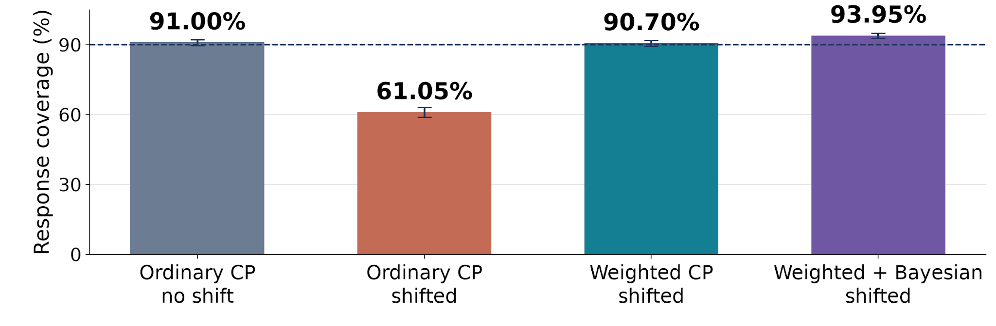
Weighted CP restores coverage in the controlled shift
Response coverage (%) with 95% intervals. Dashed line: 90% target.
Shifted coverage rises from 61.05% to 90.70%. Real RL coverage is still unverified.
2,000 independent synthetic trials. Known ratios, fixed score and unchanged conditional response law.
27
Notes:
This figure reuses outputs/weighted_conformal/2026-09-29-v2/results.json with no new samples. Ordinary CP gives 91.00% coverage on its source population but 61.05% on the constructed target shift. Correctly weighted CP gives 90.70%, while the weighted-plus-Bayesian maximum gives 93.95%. Error bars are the saved 95% binomial intervals, not standard deviations across seeds. Source hard-group frequency is .2 and target .8, with unchanged conditional response. Known ratios are .25 and 4. This directly supports the intended population-correction mechanism under the synthetic assumptions. It does not identify the cause of weak real pilot harm ranking or establish a policy improvement. Alpha remains .1. See the following analysis slide for meaning and implementation gates.

Slide 28
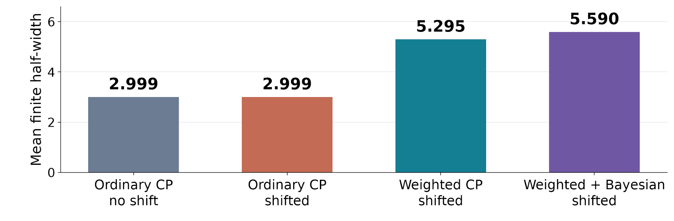
Coverage recovery comes with wider bands
Mean finite half-width. Scale = 1. Full band length is twice this value.
Wider bands improve coverage here. Their usefulness for decisions still needs testing.
Same 2,000 saved synthetic trials. All bands were finite. Means are descriptive, without uncertainty bars.
28
Notes:
The accepted synthetic result has mean finite radii 2.998574625, 2.998574625, 5.294714196 and 5.589847011 for ordinary/source, ordinary/shifted, weighted-CP/shifted and weighted-plus-Bayesian/shifted. The frozen score has scale one and center zero, so these are also half-widths. Full interval lengths are twice these values. All 2,000 bands are finite in each arm; infinity is tested separately in boundary checks. These means have no uncertainty bars in this figure. Why important: the target population contains more hard/high-error responses, so widening is part of the observed coverage recovery. The extra Bayesian maximum raises coverage and width simultaneously. That is not automatically more efficient or more useful for the host policy. Compare adequate coverage at usable widths, then risk ranking and regret, rather than maximizing coverage alone. Source: outputs/weighted_conformal/2026-09-29-v2/results.json. No new scalar trials, model query, simulator steps or learning updates.

Slide 29
A controlled shift validates the correction mechanism
Setting and observed coverage | Why this result matters | Meaning and next step
Ordinary CP on source 91.00% coverage | The source-population control is near the nominal target. | Establishes the starting point for this constructed example.
Ordinary CP after shift 61.05% coverage | Changing population alone can undermine source calibration. | Demonstrates the hypothesized failure in a controlled setting.
Weighted CP after shift 90.70% coverage | Known correct ratios recover approximately nominal coverage. | Validates threshold arithmetic. Real RL ratios remain a gate.
Weighted + Bayesian maximum 93.95% coverage | The retained maximum gives wider bands and extra coverage. | Compare informativeness too. Mean radius 5.590 vs 5.295.
15 reference checks pass 0 infinite bands in these trials | Separate tests require infinity and verify that it stays intact. | Integrate query-aware radii before claiming a host result.
CPU synthetic test only. 2,000 independent trials, 199 calibration rows per trial, target coverage 90%.
29
Notes:
The synthetic source contains 20% high-error and 80% low-error examples; the target contains 80% high-error and 20% low-error examples. Conditional responses remain Uniform(0,1) for easy examples and Uniform(0,6) for hard examples, with fixed center zero and scale one. Correct target/source ratios are .25 and 4. Ordinary source coverage is 91.00%, 95% interval 89.66–92.22%, with mean finite radius 2.999. Under the target shift ordinary coverage is 61.05%, interval 58.87–63.19%, same radius. Weighted CP gives 90.70%, interval 89.34–91.94%, radius 5.295. The weighted-plus-Bayesian maximum gives 93.95%, interval 92.81–94.95%, radius 5.590. This is the strongest existing direct evidence for the proposed coverage mechanism because the shift and ratios are known by construction. It does not establish that our RL pilot has this cause or these ratios. The wider Bayesian maximum may be less efficient despite greater coverage; no harm-ranking benefit is measured here. Fifteen unit checks include exact finite-population enumeration, query mass, support refusal, ties, common rescaling and infinity boundaries. An independent reader reconstructs all 8,000 radii across four arms. The corrected v2 arithmetic and prior failures are preserved; this slide reuses accepted results and adds no run. Source: outputs/weighted_conformal/2026-09-29-v2/READOUT.md and independent_verification.json.
Sources: outputs/weighted_conformal/2026-09-29-v2/READOUT.md; independent_verification.json; results.json
Evidence scope: dated saved exports. No new simulator outcome or training run.

Slide 30
Each host keeps its original BCA attachment initially
Host | Existing place BCA enters | What the integration must preserve
TD3+BC | Detached multiplier on actor behavior cloning | Delayed actor schedule and original host target.
ReBRAC | Detached multiplier on actor behavior cloning | Critic BC and regularized target construction.
CQL | Recorded-transition multiplier on the conservative gap | Original dual gap and actual query point for the band.
IQL | Shrinks capped AWR-weight excess above one | Shared Q/V, fixed gain 1 and original sampling semantics.
All four | Replace scalar-only radius with a query-aware calculation | Versioned checkpoints, finite/infinite behavior and parity.
The first correction isolates calibration. A different host penalty is a separate experiment.
30
Notes:
Implementation is not a blanket change to every action penalty. For TD3+BC and ReBRAC, BCA acts through a detached actor behavior-cloning multiplier; ReBRAC critic BC is unchanged. For CQL, it multiplies each recorded transition's conservative gap while the dual update retains its original unweighted gap. That is not the same as an individual bound on every negative action. For IQL, BCA shrinks capped AWR-weight excess above one, with shared nuisance Q/V and fixed gain one. Advantage-based actor weights are not automatically probability ratios for calibration. The query-aware implementation must store a sorted weighted score bank, the ratio estimator identity, frozen score/target snapshots, units and stochastic target keys. It must evaluate the query ratio at the exact same input for which the host consumes the width. Separate tests should cover normalization, state/action alignment, checkpoint restore equivalence, array shapes, and infinity fallback. Retain both radius components. Do not use the intended weighted-CP correction as an opportunity to alter host losses or select a better recipe by score.
Sources: docs/WEIGHTED_CONFORMAL_DESIGN.md; calibration/reference.py; calibration/posterior.py; experiments/weighted_conformal/reference.py
Evidence scope: dated saved exports. No new simulator outcome or training run.

Slide 31
Implementation sequence and comparison plan
Stage | Concrete work | Acceptance evidence
1. Population contract | Freeze score and response. Declare source/target sampling. | Ratios, overlap and sampling assumptions are explicit.
2. Query-aware implementation | Weighted score bank, query mass, Bayesian path and infinity. | Reference agreement and checkpoint round-trip checks.
3. Frozen-model calibration test | Use untouched calibration/test data with a controlled shift. | Coverage, width, infinity rate and weight concentration.
4. Isolated learning comparison | Standard BCA versus corrected CP. Hold fitting and host loss fixed. | Declared seeds, matched data, unchanged alpha and budgets.
5. Fitting-IW extension | Add fitting IW as a separate predeclared comparison. | Distinguish fitting benefit from threshold correction.
Proposed follow-up stages. Mathematical reference is complete. Four-host weighted-CP integration is not.
31
Notes:
Stage 1 is the next scientific prerequisite: declare a valid population and frozen response, with source/target support and independence justified. A controlled simulator design can use known action densities under a common declared state distribution, but that tests a calibration mechanism rather than proving offline deployment coverage. Stage 2 is engineering: connect calibration ratios and query mass to the host, preserve explicit infinite radii, version score-bank caches/checkpoints and compare CPU/JAX arithmetic. Stage 3 compares ordinary CP and corrected weighted CP on the same frozen predictor/scale with untouched calibration and target tests. Measure marginal coverage with sampling-aware uncertainty, width/sharpness, unbounded fraction, ratio concentration and support subgroups. Stage 4 only follows a frozen comparison plan: standard BCA versus corrected conformal threshold while holding scale fitting and host attachment fixed. Because the Bayesian component often dominates the max, report whether corrected CP actually changes the consumed band. A separate arm can then test target-weighting of Bayesian observed-score masses under a declared interpretation. Stage 5 considers fitting IW in a factorial extension. Keep the old fitting-IW recipe as a separately named reference if it is included; never rename it weighted CP. Do not choose alpha, ratios or fixed strength by favorable return. This deck is a proposal and analysis, not a new training dispatch.
Sources: docs/WEIGHTED_CONFORMAL_DESIGN.md; calibration/reference.py; calibration/posterior.py; experiments/weighted_conformal/reference.py
Evidence scope: dated saved exports. No new simulator outcome or training run.

Slide 32
What the next results would mean for BCA
Possible result | Scientific conclusion | Next action
Coverage improves and ranking/regret improve | Supports a useful correction for this declared shift. | Replicate across seeds, hosts and supported shifts.
Coverage improves but decisions do not | The correction calibrates without a demonstrated policy gain. | Study scale/harm alignment and host consumption separately.
Coverage improves only with very wide or infinite bands | The method is cautious but may be too uninformative. | Inspect overlap and ratio concentration before tuning.
Coverage remains poor under a valid test contract | The intended correction has not solved calibration here. | Audit ratios, dependence, response law and implementation.
Standard BCA already covers adequately under the shift | Coverage mismatch lacks support as the main limitation here. | Investigate decision alignment without forcing an IW narrative.
Success requires answering both calibration validity and decision usefulness. Return remains a secondary context metric.
32
Notes:
These outcomes are deliberately falsifiable. Good weighted-CP results would support a specific correction under the declared covariate shift, not a universal OOD safety claim. If coverage improves but AUROC/AP or tested-action regret does not, that separates a statistically useful calibration correction from a behavioral benefit. If coverage is obtained mainly through extreme widths or infinity, report that limitation rather than counting it as a practical win. If standard BCA already covers adequately on the declared target population, the particular coverage-mismatch explanation becomes weaker, even if ranking remains poor. Conversely, poor coverage with estimated ratios should trigger an audit of ratio error, support, dependence, response consistency and code before concluding the theorem failed. Negative results still advance the research because each rules out or narrows a mechanism. The existing one-seed pilot, Walker training examples and synthetic known-ratio experiment must remain distinct lines of evidence. The revised OOD queue snapshot in the preceding slides is as of Sep 29 approximately 9 a.m. EDT and is not a new live status check.
Sources: outputs/advisor_metrics/2026-09-29/METRICS_OVERVIEW.md; docs/WEIGHTED_CONFORMAL_DESIGN.md
Evidence scope: dated saved exports. No new simulator outcome or training run.

