Slide 1
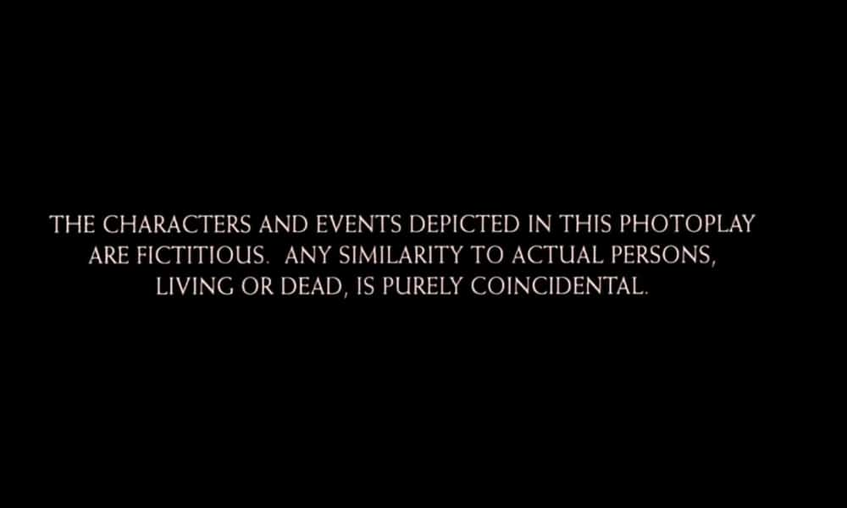
AND DATA
v
POWERPOINT

Slide 2

Improving New UMBC Student Test Performance
By: Daniel Babcock

Slide 3
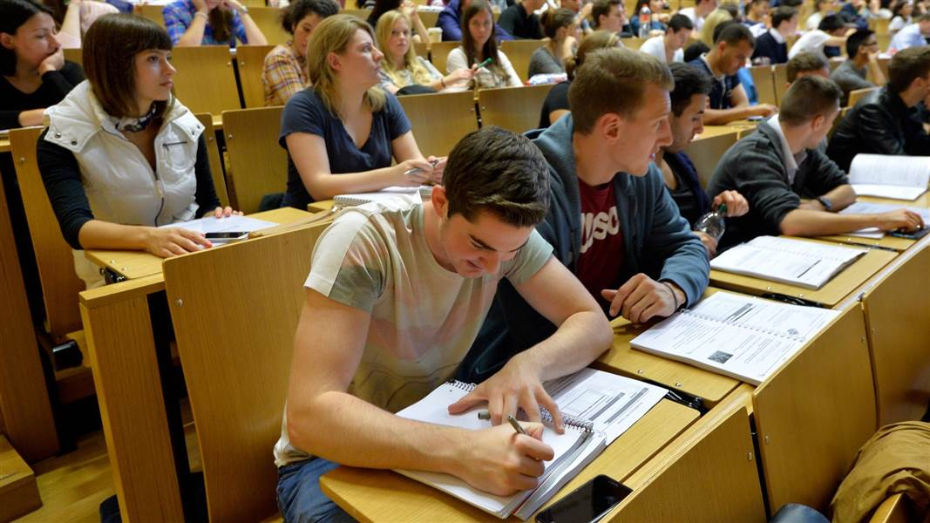
Scenario: New Testing Policy
UMBC has instituted a new policy of administering three exams in Math, Reading, and Writing to incoming students to ensure that they are prepared for the rigors of academic study.
After the first year, 5,000 potential students completed the exams and had their tests scored.

Slide 4
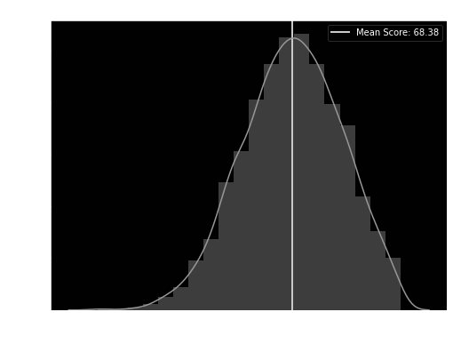
Goal: Predict Average Score
After reviewing the rather low average score, the admin wanted to see what features, if any, could be used to build a model that could predict a student’s performance on the exam.
With no budget for a professional data scientist, this task was thrown to one of the students in the DS program.

Slide 5
Gathering Features
Using the information from the student’s applications, five features were extracted to attempt to build a model for predicting the average test score of a student.
GENDER: Male / Female
RACE / ETHNIC GROUP: Groups A, B, C, D, and E
PARENT EDUCATION: Some High School, High School Diploma, Some College, Associate’s Degree, Bachelor’s Degree, or Master’s Degree.
LUNCH: Standard or Free / Reduced
TEST PREP COURSE: Completed or Not

Slide 6
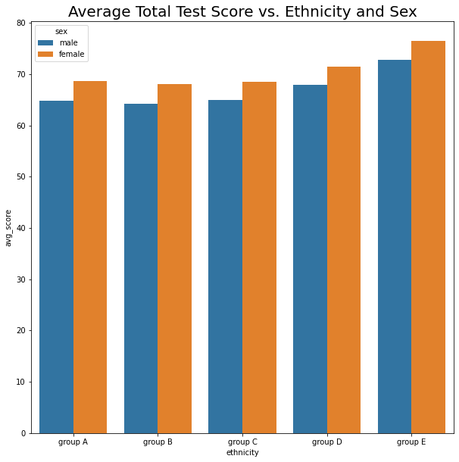
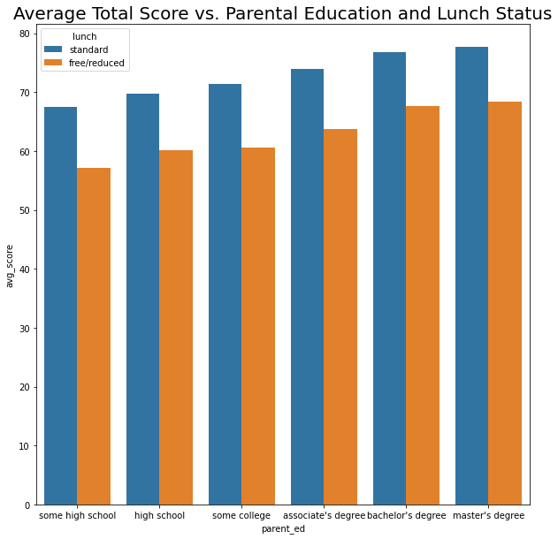
Exploratory Data Analysis

Slide 7
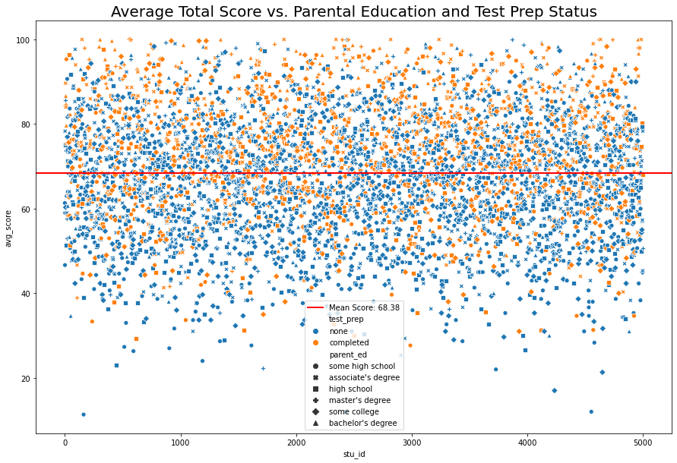
Exploratory Data Analysis
Initial EDA revealed a number of correlations between the features and the average test scores of the students.
Test scores correlated higher with increasing parental education, and completing the test prep (duh) but it also trended higher with certain ethnic groups and having the standard lunch plan which might suggest some kind of underlying socioeconomic factor that contributes to average score.

Slide 8
Building/Evaluating Models
Two models were used to attempt to predict the average score for each student based on the features selected. The first was an OLS model, the second was a decision tree one.
Some of the most important features seemed to be parent’s having a Bachelor’s or Master’s, the test prep course, and having a standard lunch plan.
Despite this, based on the R^2 results, these features do not seem to explain most of the variance that we see in the data.
Additionally, there remained a lot of variance in the predictions, as noted in the RMSE for both models.
OLS Model:
R^2: 0.29
RMSE: 14.48
Decision Tree Model:
R^2: 0.24
RMSE: 12.64

Slide 9
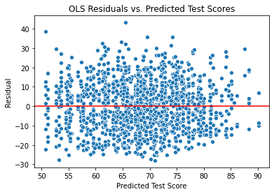
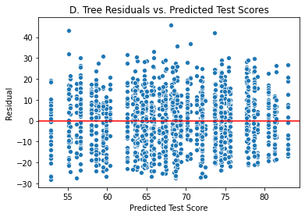
Evaluating Models

Slide 10
Conclusion
Unfortunately, the features selected, while having some impact (like the test preparation course, standard lunch, and parent education), were not able to fully capture the complexity of the relationship between the characteristics of the students and their average test scores using the selected models.
For further analysis, the UMBC administration should extract additional information about the students in order to better predict what their average score might be. There also appeared to be some underlying socioeconomic predictor in the form of ethnic group/lunch status, so those types of features should be considered as well.
Some suggestions include: High School GPA, Highest Math Completed, Time Spent Studying, Zipcode, Household Income, Citizenship, etc.

