Slide 1

Microsoft Business Analytics and AI
Building Solutions – Business Understanding
Microsoft Research and AI Team
aka.ms/BusinessAnalyticsAndAI
Notes:
Creating Solutions with the Team Data Science Process (TDSP)
In this hands-on workshop, you’ll cover a series of modules that guide you in understanding how to implement an analytics solution using the Team Data Science Process. You’ll learn how to work through a real-world scenario using Microsoft Azure Machine Learning Services along with other Microsoft technologies. You'll learn how to modify the solution we create in the class solution for implementations in your own scenarios.
This course is designed to take approximately one day.
Getting Started
You’ll need a laptop that you can install software on, a Microsoft Azure account, experience with Machine Learning and Programming in Python, along with several other pre-requisites. See the “README.md” file in the “Students” folder on the github location for this course for a full list prior to taking this course.
If these pre-requisites are new to you, there is a complete Learning Path in the “Instructions” folder called “Learning Path - Creating Solutions with the Team Data Science Process.md” that you can use to learn these technologies and processes. You should be able to complete all tasks in that Learning Path prior to attending this course.
Course Modules
1 – Introduction to the Team Data Science Process (TDSP)
In module one, we’ll cover an overview of the TDSP, with an explanation of each phase. You’ll also set up your environment for the rest of the course. By the end of the module, students should be familiar with the Team Data Science Process, the Microsoft Business Analytics and AI Platform and Azure DevOps for Data Science.
NOTE: Much of the setup must be accomplished prior to class. See the “README.md” file in the “Students” folder for these requirements.
2 – Business Understanding
At the end of this module, students should be able to determine questions from business requirements, locate and document data sources for Advanced Analytics, and use patterns to create solution frameworks.
During the module, a business case is presented, and the instructor takes the students through the process of breaking a statement down into key words used to determine the question to be answered with data storage technologies and data processing technologies, ultimately using a decision matrix to create a solution workflow.
3 - Data Acquisition and Understanding
Upon completion of this module, students should have hands-on experience and understanding of how to ingest data into the solution, explore data using the Azure Machine Learning Services (AMLS) Workbench tool, and create a mechanism to orchestrate and manage data flows through a solution.
4 – Modeling
This module is focused on Machine Learning. In this module, students will learn about Machine Learning options and create a Machine Learning solution in their AMLS environment. Students will be able to create, save, and run Machine Learning models using the AMLS Workbench tool.
5 – Deployment
This module covers the deployment of an AMLS model. Students will learn to track and monitor models and their runs using the AMLS Workbench tool. The students will learn how to deploy the results of the model to be used in client and downstream applications.
6 - Customer Acceptance
In this module, several important post-deployment activities are discussed in detail including: customer handoff and acceptance, altering and maintaining a solution, and monitoring and reporting on the solution.
Build and Test
This project contains three folders in the github folder:
Instructions
Materials needed to teach or prepare for this course are stored here.
Instructor
All source training materials, PowerPoint files, and other teaching resources are located here.
Students
Pre-Requisites, Student Workbooks, Resource files, Data Sources and other student assets are located here.
Contribute
You may fork or download this course for your own use. Please notify the training team of any errors or omissions using the “issues” feature on the course’s github location.
NOTE: These workbooks contain many resources to lead you through the course, and provide a rich set of references that you can use to learn much more about these topics. If the links do not resolve properly, type the link address in manually in your web browser. If the links have changed or been removed, simply enter the title of the link in a web search engine to find the new location or a corollary reference.

Slide 2
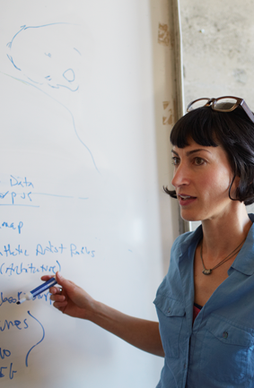
Learning Objectives
Determine questions from Business Requirements
Locate and document data sources for Advanced Analytics
Use patterns to create Solution Frameworks
Notes:
At the end of this Module, you will:
Determine questions from Business Requirements
Locate and document data sources for Advanced Analytics
Use patterns to create Solution Frameworks
We’ll be using this scenario to build out our solution - https://gallery.cortanaintelligence.com/project/69a191fde3af424b9e21ba720003bd9f

Slide 3
The Data Science Process and Platform
Notes:
This process largely follows the CRISP-DM model - http://www.sv-europe.com/crisp-dm-methodology/

Slide 4
The Team Data Science Process
Business Understanding
Define Objectives
Identify Data Sources
Data Acquisition and Understanding
Ingest Data
Explore Data
Modeling
Feature Selection
Create and Train Model
Deployment
Customer Acceptance
Operationalize
Testing and Validation
Update Data
Handoff
Re-train and re-score
Notes:
It also references the Microsoft Business Analytics and AI process - https://azure.microsoft.com/en-us/documentation/articles/data-science-process-overview/
A complete process diagram is here - https://azure.microsoft.com/en-us/documentation/learning-paths/data-science-process/
Some walk-throughs of the various services - https://azure.microsoft.com/en-us/documentation/articles/data-science-process-walkthroughs/
An integrated process and toolset allows for a more close-to-intent deployment
Iterations are required to close in on the solution – but are harder to manage and monitor
Data Science Blog - https://buckwoody.wordpress.com/

Slide 5
The Azure Platform for Analytics and AI
Big Data
Intelligence and Advanced Analytics
Information Management
Solutions
Visualization
Data Catalog
Data Factory
Event Hubs
Data Lake
SQL Data Warehouse
Cosmos DB
Cortana, Bot Service, Cognitive Framework
HDInsight
Data Lake
Azure Storage
Stream Analytics
Analysis Services
Power BI
R
Templates and Gallery
Azure Machine Learning Services
Notes:
Azure Data Catalog - http://azure.microsoft.com/en-us/services/data-catalog (Doc It)
Azure Data Factory - http://azure.microsoft.com/en-us/services/data-factory/ (Move It)
Azure Event Hubs - http://azure.microsoft.com/en-us/services/event-hubs/ (Bring It)
Platform and Storage - Microsoft Azure – https://azure.microsoft.com/ Storage - https://docs.microsoft.com/en-us/azure/storage/ (Host It)
Azure Data Lake - https://azure.microsoft.com/en-us/solutions/data-lake/ (Store It)
Azure SQL Data Warehouse - http://azure.microsoft.com/en-us/services/sql-data-warehouse/ (Relate It)
Azure Cosmos DB - https://docs.microsoft.com/en-us/azure/cosmos-db/introduction
Cortana - http://blogs.windows.com/buildingapps/2014/09/23/cortana-integration-and-speech-recognition-new-code-samples/ and https://blogs.windows.com/buildingapps/2015/08/25/using-cortana-to-interact-with-your-customers-10-by-10/ and https://developer.microsoft.com/en-us/Cortana (Say It)
Cognitive Services - https://www.microsoft.com/cognitive-services
Bot Framework - https://dev.botframework.com/
Azure Machine Learning - https://docs.microsoft.com/en-us/azure/machine-learning/preview/ (Learn It)
Azure HDInsight - http://azure.microsoft.com/en-us/services/hdinsight/ (Scale It)
Azure Stream Analytics - http://azure.microsoft.com/en-us/services/stream-analytics/ (Stream It)
Analysis Services - https://docs.microsoft.com/en-us/azure/analysis-services/analysis-services-overview
Power BI - https://powerbi.microsoft.com/ (See It)
All of the components within the suite - https://www.microsoft.com/en-us/cloud-platform/what-is-cortana-intelligence
Templates - https://gallery.cortanaintelligence.com/browse?orderby=freshness%20desc&skip=0&categories=%5B%2210%22%5D and https://caqs.azure.net/#gallery

Slide 6
Defining your Objectives
Notes:
Depends on the customer - https://www.microsoft.com/en-us/cloud-platform/cortana-intelligence-solutions
If you’re building a Cognitive Solution, it should be:
Interactive
Adaptive
Iterative with State
Contextual

Slide 7

Business Case
The Orange Telecom company in France is one of the largest operators of mobile and internet services in Europe and Africa and a global leader in corporate telecommunication services. They have 256 million customers worldwide. They have significant coverage in France, Spain, Belgium, Poland, Romania, Slovakia Moldova, and a large presence Africa and the Middle East.
Customer Churn is always an issue in any company. Orange would like to predict the propensity of customers to switch provider (churn), buy new products or services (appetency), or buy upgrades or add-ons proposed to them to make the sale more profitable (up-selling). For this effort, they think churn is the first thing they would like to focus on.
Orange is willing to provide data from their CRM system with about 14,740 numerical and 260 categorical variables .
Notes:
Real-World challenge description - http://www.kdd.org/kdd-cup/view/kdd-cup-2009/Intro
Complete rundown of competition and approaches - http://www.kdd.org/exploration_files/v11-2-12-KDDCUP09_analysis.pdf
IBM Whitepaper on their approach - http://researcher.watson.ibm.com/researcher/files/us-kclang/KDDCup-jmlr09.pdf
Another team’s approach - http://proceedings.mlr.press/v7/guyon09/guyon09.pdf
A whitepaper on the approach - http://www.mtome.com/Publications/CiML/CiML-v3-book.pdf

Slide 8
Design Statements
The Orange Telecom company in France is one of the largest operators of mobile and internet services in Europe and Africa and a global leader in corporate telecommunication services. They have 256 million customers worldwide. They have significant coverage in France, Spain, Belgium, Poland, Romania, Slovakia Moldova, and a large presence Africa and the Middle East.
Customer Churn is always an issue in any company. Orange would like to predict the propensity of customers to switch provider (churn), buy new products or services (appetency), or buy upgrades or add-ons proposed to them to make the sale more profitable (up-selling). For this effort, they think churn is the first thing they would like to focus on.
Orange is willing to provide data from their CRM system with about 14,740 numerical and 260 categorical variables .
Notes:
Would you pick these statements as well? Would you select others? Why?

Slide 9
Analytics Options
If you are looking for... | You can use this
A fully managed relational database that provisions quickly, scales on the fly, and includes built-in intelligence and security | Azure SQL Database
A fully managed, elastic data warehouse with security at every level of scale at no extra cost | Azure SQL Data Warehouse
A fully managed cloud Hadoop and Spark service backed by 99.9% SLA for your enterprise | HDInsight
An on-demand, real-time stream processing service with enterprise-grade security, auditing, and support | Stream Analytics
A no-limits data lake built to support massively parallel analytics | Data Lake Store
A fully managed on-demand pay-per-job analytics service with enterprise-grade security, auditing, and support | Data Lake Analytics
An enterprise-wide metadata catalog that makes data asset discovery simple | Data Catalog
A data integration service to orchestrate and automate data movement and transformation | Data Factory
A fully managed cloud service to easily build, deploy, and share predictive analytics solutions | Machine Learning
Notes:
Develop apps with built-in intelligence
Building intelligent apps using Azure is easy, because no other platform brings analytics and native AI to your data wherever it lives and in the languages you use. Take advantage of a rich set of cognitive APIS (https://azure.microsoft.com/en-us/services/cognitive-services/) to easily build new experiences into your apps for human-like intelligence.
SQL Database
Built for developers, SQL Database is a relational database management system with enterprise-class availability, scalability, and security, and built-in intelligence capable of learning app patterns, that can be accessed from anywhere in the world.
SQL Data Warehouse
Scale compute and storage independently with this SQL-based, fully managed, petabyte-scale cloud data warehouse that’s highly elastic and enables you to set up in minutes and scale capacity in seconds.
HDInsight
A fully managed cloud Hadoop and Spark service, HDInsight provides open source analytic clusters for Spark, Hive, MapReduce, HBase, Storm, Kafka, and Microsoft R Server backed by a 99.9% SLA.
Data Factory
Compose and manage data services at scale with this globally deployed data movement service in the cloud that connects to on-premises and cloud data sources.
Stream Analytics
Develop and run massively parallel real-time analytics on multiple streams of data with this analytics service that helps uncover real-time insights from devices, sensors, infrastructure, and applications
Data Lake Store
Built to the open HDFS standard, this is a no-limits cloud data lake for your enterprise’s unstructured, semi-structured, and structured data that’s massively scalable and secured, and allows you to run massively parallel analytics.
Data Lake Analytics
Develop and run massively parallel data transformation and processing programs in U-SQL, R, Python, and Microsoft .NET over petabytes of data with this on-demand service that provides a simple, scalable way to analyze big data—in seconds.
Data Catalog
Spend less time looking for data and more time getting value from it with this fully managed cloud service that lets you register, enrich, discover, understand, and consume your enterprise data sources.
Machine Learning
Easily build, deploy, and manage predictive analytics solutions with this fully managed cloud service and deploy your model into production as a web service in minutes that can be called from any device, anywhere.

Slide 10
Decision Matrix
Decision Point | Process and Technology | Team | Rationale
Understand the Business Question | We’ll evaluate the scenario as a group to pull out the question Machine Learning can answer. | Business, Data Science, DevOps | Widest possible audience, feasibility
Data Preparation | We’ll store the source data file locally for this run, but we could use Azure Storage or other locations. We’ll use Azure Machine Learning Services (AMLS) to ingest and inspect the data, and for the cleaning steps. | Data Science, Data Engineering, DevOps | Data Source Independence, Flexible single-tool approach
Modeling and Evaluation | We’ll use sklearn library’s Naïve Bayesian and Decision Tree algorithm to test a churn classifier, and then use AMLS to evaluate, and compare our results. | Data Science | Built-in algorithms, multi-dev
Operationalization | To deploy the solution, we’ll use Python’s Pickle library. We’ll use Docker containers as well. | Data Science, DevOps | Standardization on files, containers make the solution scalable and portable.
Customer Handoff | Use AMLS Model Management for CI/CD, Monitoring at the Web-Service layer using Azure Application Insights. | DevOps, Data Science | CI/CD lifecycle management, automatic monitoring
Notes:
Another approach on decision matrices: http://www.businessnewsdaily.com/6146-decision-matrix.html

Slide 11
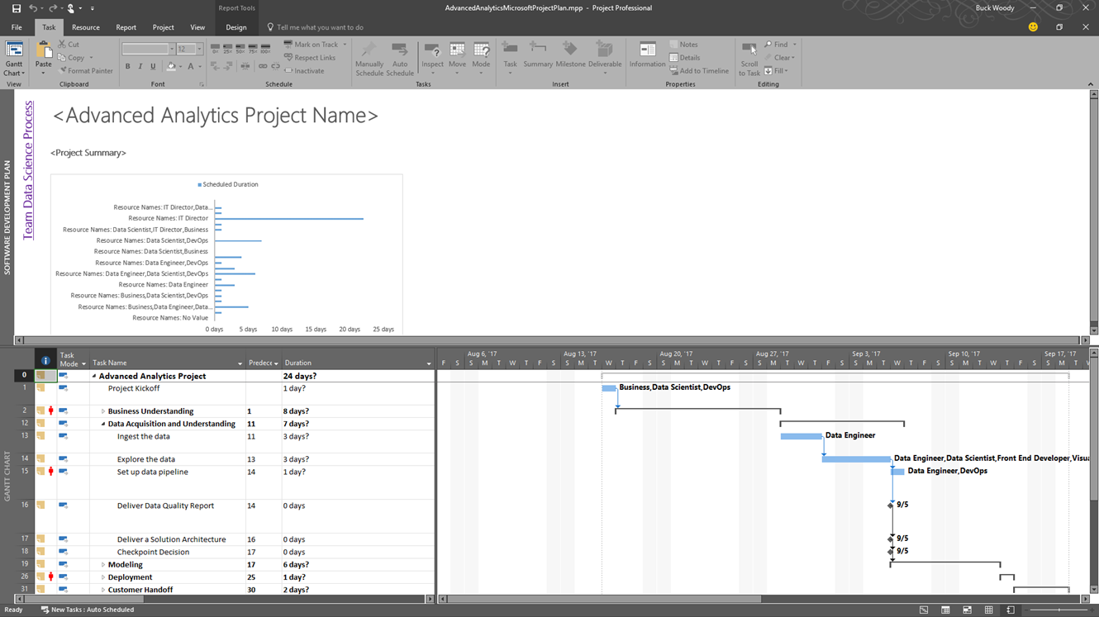
Create a Solution Workflow
Notes:
We can use project documents or other collateral to manage the solution workflow - https://buckwoody.wordpress.com/2017/08/17/a-data-science-microsoft-project-template-you-can-use-in-your-solutions/
The order for this solution is as follows:
Understand the Business Question – We’ll evaluate the scenario as a group to pull out the question Machine Learning can answer.
Data Preparation – We’ll store the CATelcoCustomerChurnTrainingSample.csv source data file locally, but we could use Azure Storage or other locations. We’ll use Azure Machine Learning Services (AMLS) to ingest and inspect the data, and for the cleaning steps.
Modeling and Evaluation – We’ll use scikit-learn library’s Naïve Bayesian and Decision Tree algorithm to develop a churn classifier, and then use AMLS to evaluate, and compare our results. We’ll use Docker containers to make the solution scalable and portable.
Operationalization – To deploy the solution, we’ll use Python’s Pickle library.
Using Azure Machine Learning example in the KDD Competition - https://github.com/Azure/Azure-MachineLearning-DataScience/blob/master/Misc/KDDCup2015/kddcup2015-sample-experiment-step-by-step-tutorial.pdf

Slide 12
Identify Data Sources
Notes:
Data Validation: https://msdn.microsoft.com/en-us/library/aa291820(v=vs.71).aspx

Slide 13
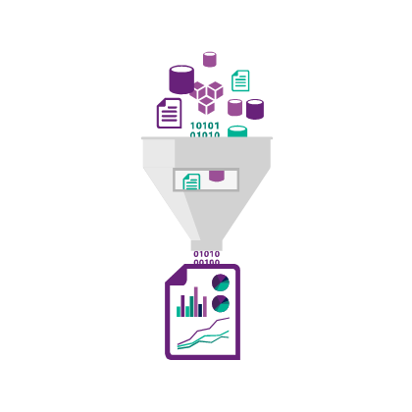
Locating and Inspecting data
Keys to quality source data
Authority
Spread
Consistency
Types and Units
Representation
Notes:
1. In reference to machine learning, but applicable to all data usage: https://azure.microsoft.com/en-us/documentation/articles/machine-learning-data-science-prepare-data/

Slide 14
Azure Data Catalog
Register data sources
Tag the data
Document the data
Search and connect
Notes:
Full example: https://azure.microsoft.com/en-us/documentation/articles/data-catalog-get-started/

Slide 15
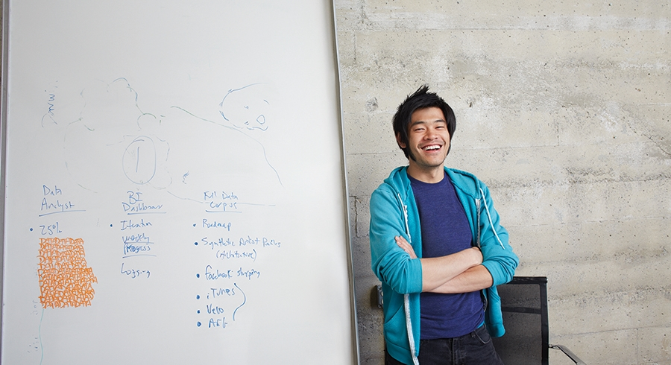


Demonstration:
Adding and searching data on the Azure Data Catalog
Notes:
The Instructor will demonstrate the use of the Azure Data Catalog. Optionally, you can create your own data catalog using these instructions - https://azure.microsoft.com/en-us/documentation/articles/data-catalog-get-started/

