Slide 1

Microsoft Business Analytics and AI
Building Solutions – Data Acquisition And Understanding
Microsoft Research and AI Team
aka.ms/BusinessAnalyticsAndAI
Notes:
Creating Solutions with the Team Data Science Process (TDSP)
In this hands-on workshop, you’ll cover a series of modules that guide you in understanding how to implement an analytics solution using the Team Data Science Process. You’ll learn how to work through a real-world scenario using Microsoft Azure Machine Learning Services along with other Microsoft technologies. You'll learn how to modify the solution we create in the class solution for implementations in your own scenarios.
This course is designed to take approximately one day.
Getting Started
You’ll need a laptop that you can install software on, a Microsoft Azure account, experience with Machine Learning and Programming in Python, along with several other pre-requisites. See the “README.md” file in the “Students” folder on the github location for this course for a full list prior to taking this course.
If these pre-requisites are new to you, there is a complete Learning Path in the “Instructions” folder called “Learning Path - Creating Solutions with the Team Data Science Process.md” that you can use to learn these technologies and processes. You should be able to complete all tasks in that Learning Path prior to attending this course.
Course Modules
1 – Introduction to the Team Data Science Process (TDSP)
In module one, we’ll cover an overview of the TDSP, with an explanation of each phase. You’ll also set up your environment for the rest of the course. By the end of the module, students should be familiar with the Team Data Science Process, the Microsoft Business Analytics and AI Platform and Azure DevOps for Data Science.
NOTE: Much of the setup must be accomplished prior to class. See the “README.md” file in the “Students” folder for these requirements.
2 – Business Understanding
At the end of this module, students should be able to determine questions from business requirements, locate and document data sources for Advanced Analytics, and use patterns to create solution frameworks.
During the module, a business case is presented, and the instructor takes the students through the process of breaking a statement down into key words used to determine the question to be answered with data storage technologies and data processing technologies, ultimately using a decision matrix to create a solution workflow.
3 - Data Acquisition and Understanding
Upon completion of this module, students should have hands-on experience and understanding of how to ingest data into the solution, explore data using the Azure Machine Learning Services (AMLS) Workbench tool, and create a mechanism to orchestrate and manage data flows through a solution.
4 – Modeling
This module is focused on Machine Learning. In this module, students will learn about Machine Learning options and create a Machine Learning solution in their AMLS environment. Students will be able to create, save, and run Machine Learning models using the AMLS Workbench tool.
5 – Deployment
This module covers the deployment of an AMLS model. Students will learn to track and monitor models and their runs using the AMLS Workbench tool. The students will learn how to deploy the results of the model to be used in client and downstream applications.
6 - Customer Acceptance
In this module, several important post-deployment activities are discussed in detail including: customer handoff and acceptance, altering and maintaining a solution, and monitoring and reporting on the solution.
Build and Test
This project contains three folders in the github folder:
Instructions
Materials needed to teach or prepare for this course are stored here.
Instructor
All source training materials, PowerPoint files, and other teaching resources are located here.
Students
Pre-Requisites, Student Workbooks, Resource files, Data Sources and other student assets are located here.
Contribute
You may fork or download this course for your own use. Please notify the training team of any errors or omissions using the “issues” feature on the course’s github location.
NOTE: These workbooks contain many resources to lead you through the course, and provide a rich set of references that you can use to learn much more about these topics. If the links do not resolve properly, type the link address in manually in your web browser. If the links have changed or been removed, simply enter the title of the link in a web search engine to find the new location or a corollary reference.

Slide 2
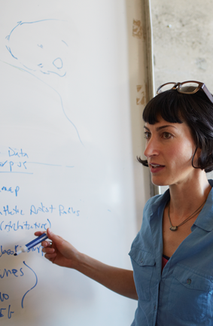
Learning Objectives
Ingest data into Azure Machine Learning Services
Explore data
Update data
Create a mechanism to orchestrate and manage data flows through a solution
Notes:
At the end of this Module, you will:
Ingest data into Azure Machine Learning Services
Explore data
Update data
Create a mechanism to orchestrate and manage data flows through a solution
We’ll be using this scenario to build out our solution - https://gallery.cortanaintelligence.com/project/69a191fde3af424b9e21ba720003bd9f

Slide 3
The Data Science Process and Platform
Notes:
This process largely follows the CRISP-DM model - http://www.sv-europe.com/crisp-dm-methodology/

Slide 4
The Team Data Science Process
Business Understanding
Define Objectives
Identify Data Sources
Data Acquisition and Understanding
Ingest Data
Explore Data
Modeling
Feature Selection
Create and Train Model
Deployment
Customer Acceptance
Operationalize
Testing and Validation
Update Data
Handoff
Re-train and re-score
Notes:
It also references the Microsoft Business Analytics and AI process - https://azure.microsoft.com/en-us/documentation/articles/data-science-process-overview/
A complete process diagram is here - https://azure.microsoft.com/en-us/documentation/learning-paths/data-science-process/
Some walk-throughs of the various services - https://azure.microsoft.com/en-us/documentation/articles/data-science-process-walkthroughs/
An integrated process and toolset allows for a more close-to-intent deployment
Iterations are required to close in on the solution – but are harder to manage and monitor
Data Science Blog - https://buckwoody.wordpress.com/

Slide 5
The Azure Platform for Analytics and AI
Big Data
Intelligence and Advanced Analytics
Information Management
Solutions
Visualization
Data Catalog
Data Factory
Event Hubs
Data Lake
SQL Data Warehouse
Cosmos DB
Cortana, Bot Service, Cognitive Framework
HDInsight
Data Lake
Azure Storage
Stream Analytics
Analysis Services
Power BI
R
Templates and Gallery
Azure Machine Learning Services
Notes:
Azure Data Catalog - http://azure.microsoft.com/en-us/services/data-catalog (Doc It)
Azure Data Factory - http://azure.microsoft.com/en-us/services/data-factory/ (Move It)
Azure Event Hubs - http://azure.microsoft.com/en-us/services/event-hubs/ (Bring It)
Platform and Storage - Microsoft Azure – https://azure.microsoft.com/ Storage - https://docs.microsoft.com/en-us/azure/storage/ (Host It)
Azure Data Lake - https://azure.microsoft.com/en-us/solutions/data-lake/ (Store It)
Azure SQL Data Warehouse - http://azure.microsoft.com/en-us/services/sql-data-warehouse/ (Relate It)
Azure Cosmos DB - https://docs.microsoft.com/en-us/azure/cosmos-db/introduction
Cortana - http://blogs.windows.com/buildingapps/2014/09/23/cortana-integration-and-speech-recognition-new-code-samples/ and https://blogs.windows.com/buildingapps/2015/08/25/using-cortana-to-interact-with-your-customers-10-by-10/ and https://developer.microsoft.com/en-us/Cortana (Say It)
Cognitive Services - https://www.microsoft.com/cognitive-services
Bot Framework - https://dev.botframework.com/
Azure Machine Learning - https://docs.microsoft.com/en-us/azure/machine-learning/preview/ (Learn It)
Azure HDInsight - http://azure.microsoft.com/en-us/services/hdinsight/ (Scale It)
Azure Stream Analytics - http://azure.microsoft.com/en-us/services/stream-analytics/ (Stream It)
Analysis Services - https://docs.microsoft.com/en-us/azure/analysis-services/analysis-services-overview
Power BI - https://powerbi.microsoft.com/ (See It)
All of the components within the suite - https://www.microsoft.com/en-us/cloud-platform/what-is-cortana-intelligence
Templates - https://gallery.cortanaintelligence.com/browse?orderby=freshness%20desc&skip=0&categories=%5B%2210%22%5D and https://caqs.azure.net/#gallery

Slide 6
Data Ingestion
Notes:
Example of a 3rd Party Solution: https://www.veeam.com/fastscp-azure-vm.html

Slide 7
Options for data ingestion into Azure Storage
PowerShell/CLI
Azure Data Factory
Azure Event Hubs
Azure storage SDKs (.NET, Node.js, python, C++, etc.)
AzCopy (blob, file, and table only)
Notes:
PowerShell in Azure Storage - https://azure.microsoft.com/en-us/documentation/articles/storage-powershell-guide-full/
Azure Data Factory data movement - https://azure.microsoft.com/en-us/documentation/articles/data-factory-data-movement-activities/
Azure Automation - https://azure.microsoft.com/en-us/documentation/articles/automation-intro/
Azure storage SDKs – for examples see https://azure.microsoft.com/en-us/documentation/articles/storage-dotnet-how-to-use-blobs/
Azure tools and SDKs in general can be downloaded here - https://azure.microsoft.com/en-us/downloads/
MS Azure Storage Explorer - http://storageexplorer.com/
AzCopy - https://azure.microsoft.com/en-us/documentation/articles/storage-use-azcopy/
Import/Export service - https://azure.microsoft.com/en-us/documentation/articles/storage-import-export-service/

Slide 8
Connect on-prem to <anything>
VPN Gateway
Send network traffic from virtual networks to on-prem locations
Send network traffic between virtual networks within Azure
Site-to-site vs. Point-to-site
You can connect multiple on-prem locations to a virtual network (Multi-site)
ExpressRoute can directly connect your WAN to Azure
Tool-Specific
Notes:
VPN Information: https://azure.microsoft.com/en-us/documentation/articles/vpn-gateway-about-vpngateways/
Connecting to VPN’s: https://azure.microsoft.com/en-us/documentation/articles/vpn-gateway-vpn-faq/#connecting-to-virtual-networks
Using ExpressRoute: https://azure.microsoft.com/en-us/documentation/articles/expressroute-faqs/

Slide 9



Lab:
Work with Cloud Storage
Notes:
Log in to your Data Science Virtual Machine and open a command prompt there, or if you installed the Azure Command-Line tools locally, open a command prompt
Open this reference: https://docs.microsoft.com/en-us/azure/storage/common/storage-azure-cli
Follow the steps from the beginning of the article and stop at the section titled “Manage storage accounts”. You do not need to complete anything for this lab from that section on.

Slide 10
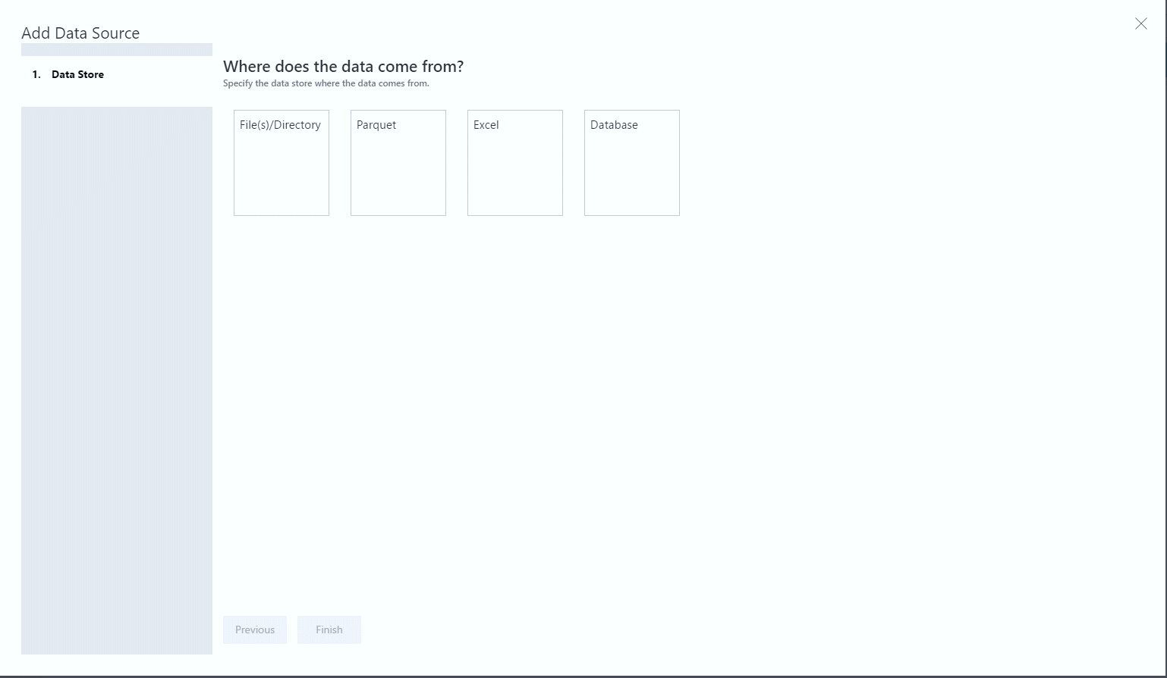
Data Preparation with the AMLS Workbench - Ingestion
Package
Dataflow
Source
Transform
Inspector
Destination
Notes:
Data Preparation Concepts - https://docs.microsoft.com/en-us/azure/machine-learning/preview/data-prep-getting-started
Data Ingestion with the Wizard - https://docs.microsoft.com/en-us/azure/machine-learning/preview/data-source-wizard
Supported Sources - https://docs.microsoft.com/en-us/azure/machine-learning/preview/data-prep-appendix2-supported-data-sources
Using the Data Preparation API - https://docs.microsoft.com/en-us/azure/machine-learning/preview/data-prep-python-execution-api
Data preparation guide - https://docs.microsoft.com/en-us/azure/machine-learning/preview/data-prep-user-guide

Slide 11
Lab:
Ingesting Data with AMLS Workbench
Notes:
In this lab, you will begin your project and ingest data from a local source.
Open this location - https://github.com/Azure/MachineLearningSamples-ChurnPrediction/blob/master/docs/DataPreparation.md
Work all steps and sub-steps on that page from 1-3.
Stop at Step 4 – we’ll do that in the next lab.

Slide 12
Data Exploration
Notes:
Understanding the statistics of exploring data: http://danshuster.com/apstat/apstat_chap01.pdf

Slide 13
Exploring Data
Microsoft R
Azure ML Studio
Excel
Other Tools
Azure Machine Learning Services Workbench
Notes:
Data Exploration and Predictive Modeling with R - https://msdn.microsoft.com/en-us/library/mt590947.aspx
Data Exploration with Azure ML Studio - https://blogs.technet.microsoft.com/machinelearning/2015/09/24/data-exploration-with-azure-ml/
Statistics Using Excel – http://www.excelfunctions.net/Excel-Statistical-Functions.html
Sed, awk, grep (in Windows as well) - https://www.simple-talk.com/cloud/data-science/data-science-laboratory-system---testing-the-text-tools-and-sample-data/
TODO: AMLS
Data Science Blog: https://buckwoody.wordpress.com/

Slide 14
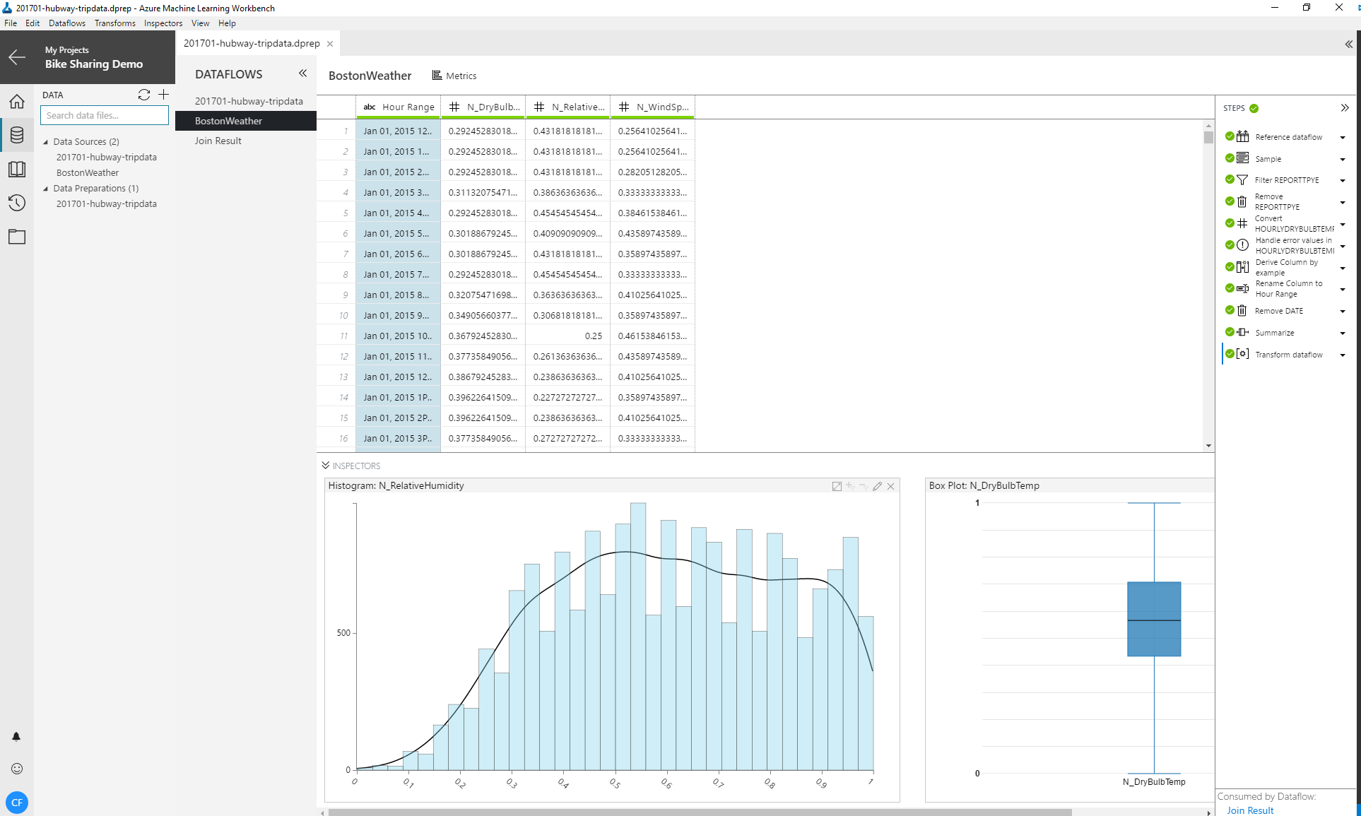
Data Preparation with the AMLS Workbench – Profile
Package
Dataflow
Source
Inspector
Transform
Destination
Notes:
Understanding and Profiling data (section marked Step 2: Understand/profile the data) - https://docs.microsoft.com/en-us/azure/machine-learning/preview/data-prep-getting-started

Slide 15
Update the Azure Data Catalog
Search
Add Tags
Add Experts
Thoroughly document the data
Notes:
Full example: https://azure.microsoft.com/en-us/documentation/articles/data-catalog-get-started/

Slide 16
Lab:
Exploring your data with AMLS Workbench
Notes:
In this lab, you will learn how to examine data for its profile.
Open the dprep file and data from the last lab.
Examine the Data Quality Bar at the top of each column. Green represents the rows that have values. Gray represents rows with a missing value and Red indicates error values. Hover over the bar to get a tool tip with the exact numbers of rows in each of the three buckets.
Next, select Metrics. Take a look at the profiles for the columns. Note how you can see the histograms and summary statistics for each column.
Select Data to return to the table view of the data. Next, we’ll use a combination of Inspectors plus the grid to better understand data characteristics. It’s likely that several Inspectors across several columns are needed to understand the data. You can scroll through various Inspectors in the Profiling Well. Within the well, you can also move Inspectors to the head of the list in order to see them in the immediately viewable area.
Open this location and examine the results of the inspectors you select - https://docs.microsoft.com/en-us/azure/machine-learning/preview/data-prep-appendix4-supported-inspectors
What transformations do you think you need for this data? Why?

Slide 17
Update Data
Notes:
Primary Site: https://azure.microsoft.com/en-us/services/data-factory/
2-minute overview video: https://channel9.msdn.com/Blogs/Windows-Azure/Introduction-to-Azure-Data-Factory/

Slide 18
Updating Data
HDInsight
Azure Data Factory
Azure Machine Learning Services Workbench
Notes:
A discussion of the options: https://buckwoody.wordpress.com/2016/05/16/the-cortana-intelligence-suite-what-to-use-when/
HDInsight - https://docs.microsoft.com/en-us/azure/hdinsight/hdinsight-upload-data and https://docs.microsoft.com/en-us/azure/hdinsight/hdinsight-hadoop-use-blob-storage
Azure Data Factory - https://docs.microsoft.com/en-us/azure/data-factory/tutorial-incremental-copy-PowerShell
AMLS Workbench - https://docs.microsoft.com/en-us/azure/machine-learning/preview/data-prep-supported-runtime-data-environments
Data Science Blog: https://buckwoody.wordpress.com/

Slide 19
Data Preparation with the AMLS Workbench – Transform
Package
Dataflow
Source
Inspector
Transform
Destination
Notes:
Transform by example - https://docs.microsoft.com/en-us/azure/machine-learning/preview/data-prep-combine-columns-by-example
Using Python - https://docs.microsoft.com/en-us/azure/machine-learning/preview/data-prep-python-extensibility-overview
Supported Transforms - https://docs.microsoft.com/en-us/azure/machine-learning/preview/data-prep-appendix3-supported-transforms

Slide 20
Lab:
Feature Engineering with AMLS Workbench
Notes:
In this lab we’ll apply the appropriate transforms for our project’s data source.
Open the .dprep file and data from your first lab in this section.
Open this location - https://github.com/Azure/MachineLearningSamples-ChurnPrediction/blob/master/docs/DataPreparation.md
Complete step 4 and all its sub-steps.
Save your work.

