Slide 1

Microsoft Business Analytics and AI
Building Solutions – Deployment
Microsoft Research and AI Team
aka.ms/BusinessAnalyticsAndAI
Notes:
Creating Solutions with the Team Data Science Process (TDSP)
In this hands-on workshop, you’ll cover a series of modules that guide you in understanding how to implement an analytics solution using the Team Data Science Process. You’ll learn how to work through a real-world scenario using Microsoft Azure Machine Learning Services along with other Microsoft technologies. You'll learn how to modify the solution we create in the class solution for implementations in your own scenarios.
This course is designed to take approximately one day.
Getting Started
You’ll need a laptop that you can install software on, a Microsoft Azure account, experience with Machine Learning and Programming in Python, along with several other pre-requisites. See the “README.md” file in the “Students” folder on the github location for this course for a full list prior to taking this course.
If these pre-requisites are new to you, there is a complete Learning Path in the “Instructions” folder called “Learning Path - Creating Solutions with the Team Data Science Process.md” that you can use to learn these technologies and processes. You should be able to complete all tasks in that Learning Path prior to attending this course.
Course Modules
1 – Introduction to the Team Data Science Process (TDSP)
In module one, we’ll cover an overview of the TDSP, with an explanation of each phase. You’ll also set up your environment for the rest of the course. By the end of the module, students should be familiar with the Team Data Science Process, the Microsoft Business Analytics and AI Platform and Azure DevOps for Data Science.
NOTE: Much of the setup must be accomplished prior to class. See the “README.md” file in the “Students” folder for these requirements.
2 – Business Understanding
At the end of this module, students should be able to determine questions from business requirements, locate and document data sources for Advanced Analytics, and use patterns to create solution frameworks.
During the module, a business case is presented, and the instructor takes the students through the process of breaking a statement down into key words used to determine the question to be answered with data storage technologies and data processing technologies, ultimately using a decision matrix to create a solution workflow.
3 - Data Acquisition and Understanding
Upon completion of this module, students should have hands-on experience and understanding of how to ingest data into the solution, explore data using the Azure Machine Learning Services (AMLS) Workbench tool, and create a mechanism to orchestrate and manage data flows through a solution.
4 – Modeling
This module is focused on Machine Learning. In this module, students will learn about Machine Learning options and create a Machine Learning solution in their AMLS environment. Students will be able to create, save, and run Machine Learning models using the AMLS Workbench tool.
5 – Deployment
This module covers the deployment of an AMLS model. Students will learn to track and monitor models and their runs using the AMLS Workbench tool. The students will learn how to deploy the results of the model to be used in client and downstream applications.
6 - Customer Acceptance
In this module, several important post-deployment activities are discussed in detail including: customer handoff and acceptance, altering and maintaining a solution, and monitoring and reporting on the solution.
Build and Test
This project contains three folders in the github folder:
Instructions
Materials needed to teach or prepare for this course are stored here.
Instructor
All source training materials, PowerPoint files, and other teaching resources are located here.
Students
Pre-Requisites, Student Workbooks, Resource files, Data Sources and other student assets are located here.
Contribute
You may fork or download this course for your own use. Please notify the training team of any errors or omissions using the “issues” feature on the course’s github location.
NOTE: These workbooks contain many resources to lead you through the course, and provide a rich set of references that you can use to learn much more about these topics. If the links do not resolve properly, type the link address in manually in your web browser. If the links have changed or been removed, simply enter the title of the link in a web search engine to find the new location or a corollary reference.

Slide 2
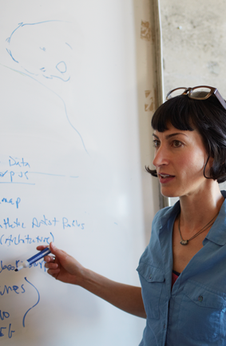
Learning Objectives
Deploy a solution using storage
Deploy a solution using Code
Deploy a solution using an API
Notes:
At the end of this Module, you will:
Deploy a solution using storage
Deploy a solution using Code
Deploy a solution using an API
We’ll be using this scenario to build out our solution - https://gallery.cortanaintelligence.com/project/69a191fde3af424b9e21ba720003bd9f

Slide 3
The Data Science Process and Platform
Notes:
This process largely follows the CRISP-DM model - http://www.sv-europe.com/crisp-dm-methodology/

Slide 4
The Team Data Science Process
Business Understanding
Define Objectives
Identify Data Sources
Data Acquisition and Understanding
Ingest Data
Explore Data
Modeling
Feature Selection
Create and Train Model
Deployment
Customer Acceptance
Operationalize
Testing and Validation
Update Data
Handoff
Re-train and re-score
Notes:
It also references the Microsoft Business Analytics and AI process - https://azure.microsoft.com/en-us/documentation/articles/data-science-process-overview/
A complete process diagram is here - https://azure.microsoft.com/en-us/documentation/learning-paths/data-science-process/
Some walk-throughs of the various services - https://azure.microsoft.com/en-us/documentation/articles/data-science-process-walkthroughs/
An integrated process and toolset allows for a more close-to-intent deployment
Iterations are required to close in on the solution – but are harder to manage and monitor
Data Science Blog - https://buckwoody.wordpress.com/

Slide 5
The Azure Platform for Analytics and AI
Big Data
Intelligence and Advanced Analytics
Information Management
Solutions
Visualization
Data Catalog
Data Factory
Event Hubs
Data Lake
SQL Data Warehouse
Cosmos DB
Cortana, Bot Service, Cognitive Framework
HDInsight
Data Lake
Azure Storage
Stream Analytics
Analysis Services
Power BI
R
Templates and Gallery
Azure Machine Learning Services
Notes:
Azure Data Catalog - http://azure.microsoft.com/en-us/services/data-catalog (Doc It)
Azure Data Factory - http://azure.microsoft.com/en-us/services/data-factory/ (Move It)
Azure Event Hubs - http://azure.microsoft.com/en-us/services/event-hubs/ (Bring It)
Platform and Storage - Microsoft Azure – https://azure.microsoft.com/ Storage - https://docs.microsoft.com/en-us/azure/storage/ (Host It)
Azure Data Lake - https://azure.microsoft.com/en-us/solutions/data-lake/ (Store It)
Azure SQL Data Warehouse - http://azure.microsoft.com/en-us/services/sql-data-warehouse/ (Relate It)
Azure Cosmos DB - https://docs.microsoft.com/en-us/azure/cosmos-db/introduction
Cortana - http://blogs.windows.com/buildingapps/2014/09/23/cortana-integration-and-speech-recognition-new-code-samples/ and https://blogs.windows.com/buildingapps/2015/08/25/using-cortana-to-interact-with-your-customers-10-by-10/ and https://developer.microsoft.com/en-us/Cortana (Say It)
Cognitive Services - https://www.microsoft.com/cognitive-services
Bot Framework - https://dev.botframework.com/
Azure Machine Learning - https://docs.microsoft.com/en-us/azure/machine-learning/preview/ (Learn It)
Azure HDInsight - http://azure.microsoft.com/en-us/services/hdinsight/ (Scale It)
Azure Stream Analytics - http://azure.microsoft.com/en-us/services/stream-analytics/ (Stream It)
Analysis Services - https://docs.microsoft.com/en-us/azure/analysis-services/analysis-services-overview
Power BI - https://powerbi.microsoft.com/ (See It)
All of the components within the suite - https://www.microsoft.com/en-us/cloud-platform/what-is-cortana-intelligence
Templates - https://gallery.cortanaintelligence.com/browse?orderby=freshness%20desc&skip=0&categories=%5B%2210%22%5D and https://caqs.azure.net/#gallery

Slide 6
Operationalizing Your Solution
Notes:
Main Base Page - https://docs.microsoft.com/en-us/azure/machine-learning/preview/model-management-service-deploy

Slide 7
Options for Operationalization
Coding access/REST
Service Bus/Streaming
Sending Results to Storage
Visualization
Using a Web Service
Notes:
TDSP Documentation on Deployment - https://docs.microsoft.com/en-us/azure/machine-learning/team-data-science-process/lifecycle-deployment
Data Science Blog: https://buckwoody.wordpress.com/

Slide 8


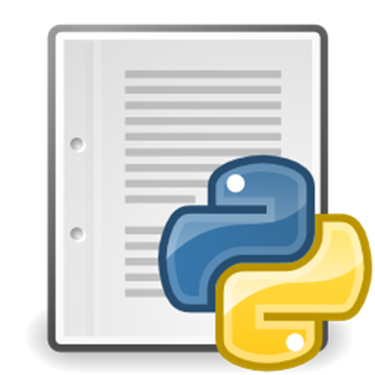
Deploy using Code Access – Cortana and Bots Example
Notes:
What Developers Need To Know About the Cortana API - https://channel9.msdn.com/Blogs/Dev-Inspiration/What-Developers-Need-To-Know-About-the-Cortana-API
Full Training Course: https://mva.microsoft.com/en-US/training-courses/universal-windows-app-development-with-cortana-and-the-speech-sdk-8487
Quickstart - https://code.msdn.microsoft.com/Voice-Commands-Quickstart-64ce68ce (Note - will install Windows Phone emulator in your VS)
App Dev with Cortana - https://channel9.msdn.com/Shows/Visual-Studio-Toolbox/App-Development-with-Cortana
Cortana Interactions (XAML) - https://msdn.microsoft.com/en-us/library/windows/apps/xaml/dn974230.aspx?f=255&MSPPError=-2147217396
Speech Recognition and Synthesis Samples - https://github.com/Microsoft/Windows-universal-samples/tree/master/Samples/SpeechRecognitionAndSynthesis
Cortana Voice Command - https://github.com/Microsoft/Windows-universal-samples/tree/master/Samples/CortanaVoiceCommand
Building with Cortana - http://www.slideshare.net/ActiveNick/building-windows-10-universal-apps-with-speech-and-Cortana
Azure Bot Framework Tutorial: https://docs.microsoft.com/en-us/bot-framework/azure/azure-bot-service-quickstart
Python and Cortana example - https://dialogflow.com/docs/integrations/cortana-exporter

Slide 9
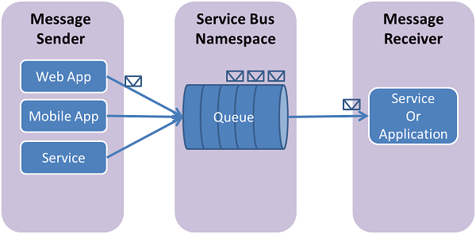
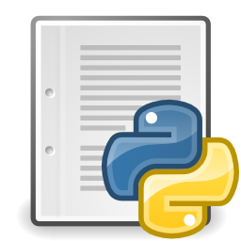
Deploy using Azure Service Bus
Notes:
Message Delivery - https://docs.microsoft.com/en-us/azure/service-bus-messaging/service-bus-messaging-overview
Service Bus Fundamentals - https://docs.microsoft.com/en-us/azure/service-bus-messaging/service-bus-fundamentals-hybrid-solutions
Using with Python - https://docs.microsoft.com/en-us/azure/service-bus-messaging/service-bus-python-how-to-use-queues

Slide 10
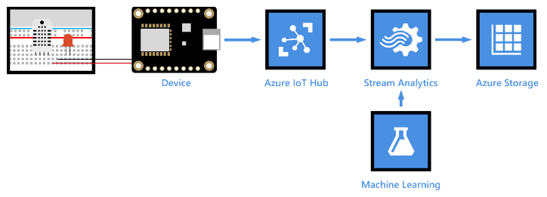
Deploy to Storage
Notes:
IoT Example that consumes a service to storage - https://docs.microsoft.com/en-us/azure/iot-hub/iot-hub-weather-forecast-machine-learning
Azure Storage access via Python code - https://docs.microsoft.com/en-us/azure/storage/blobs/storage-python-how-to-use-blob-storage
Example code on Github - https://azure.microsoft.com/en-us/resources/samples/storage-blob-python-getting-started/

Slide 11
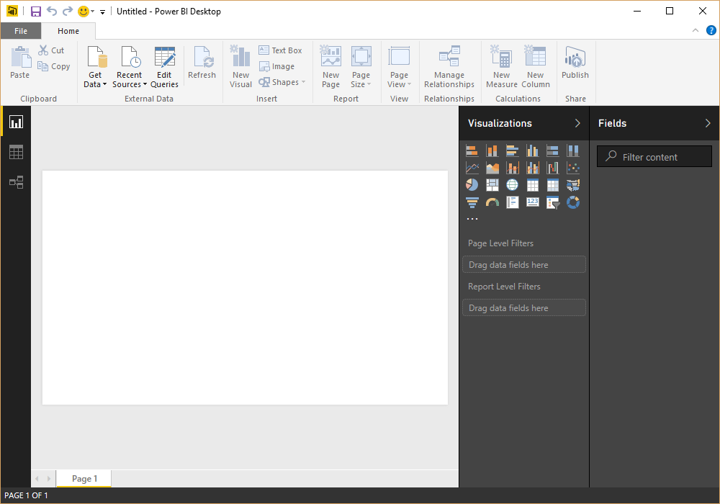
Deploy using Visualization - Power BI
A Reporting System for Multiple Data Sources
Available in:
Web Portal
Power BI Desktop
Microsoft Excel
Mobile apps (iOS, Android, Windows)
Author
Connect to Data
Shape the Data
Model the Data
Report on the Data
Publish
Local
To Service
Notes:
Getting Started: https://powerbi.microsoft.com/en-us/documentation/powerbi-desktop-getting-started/
Guided Learning: https://powerbi.microsoft.com/en-us/guided-learning/
4-part online course for Power BI in Excel 2013: https://mva.microsoft.com/en-US/training-courses/data-visualizations-with-power-bi-in-excel-2013-8889?l=kBrlM2A3_104984382
Web Portal – http://powerbi.com
Power BI Desktop - https://powerbi.microsoft.com/en-us/documentation/powerbi-desktop-latest-update/
Excel - https://support.office.com/en-us/article/Get-Transform-in-Excel-2016-881c63c6-37c5-4ca2-b616-59e18d75b4de?ui=en-US&rs=en-US&ad=US
Mobile Apps - https://powerbi.microsoft.com/en-us/Mobile
Also visualizing in Notebooks - https://docs.microsoft.com/en-us/azure/machine-learning/preview/scenario-aerial-image-classification
Another visualization - https://docs.microsoft.com/en-us/azure/machine-learning/preview/scenario-tdsp-biomedical-recognition

Slide 12

Deploy as a Web Service
Notes:
Deploying a Web Service in AMLS - https://docs.microsoft.com/en-us/azure/machine-learning/preview/model-management-service-deploy
Consuming the Web Service - https://docs.microsoft.com/en-us/azure/machine-learning/preview/model-management-consumption

Slide 13
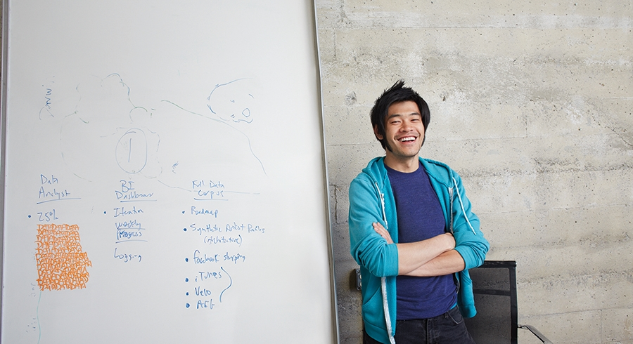


Lab:
Deploy your solution using Docker
Notes:
In this lab, you will create a Machine Learning Model and deploy it locally.
Open this location - https://github.com/Azure/MachineLearningSamples-ChurnPrediction/blob/master/docs/Operationalization.md
Work all steps and sub-steps on that page.
Tips:
You do not need to execute/locate the .cmd file in Setup. As long as you set the environment with ‘az ml env set -g <resourcegroup> -n <environmentname>’
Be sure to update the score.py file and add the churn_schema_gen.py file to your root directory
You do not need to create an additional resource group (az group create -l <location> -n <resourcegroup>), you can use the same one as the DSVM.

