Slide 1
PROJECT 3
SQL FOR DATA ANALYSIS

Slide 2
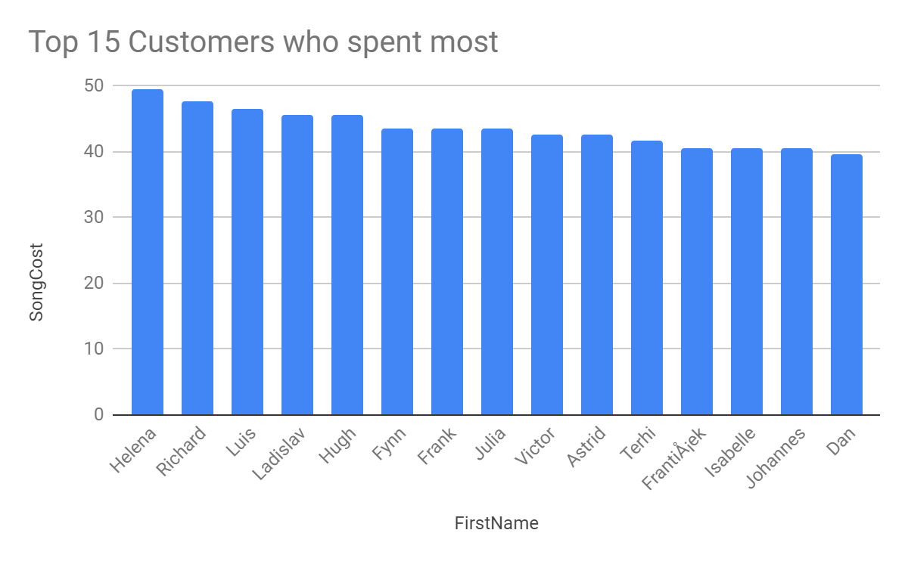
Top 15 Customers who spent most according to invoice-line
<visualization>
From visualization we can observe list of top 15 customers who provided maximum revenue to music store. Most of them spent above 40$.
Providing them with additional discounts will help the music store to retain these top paying customers for a longer period.

Slide 3
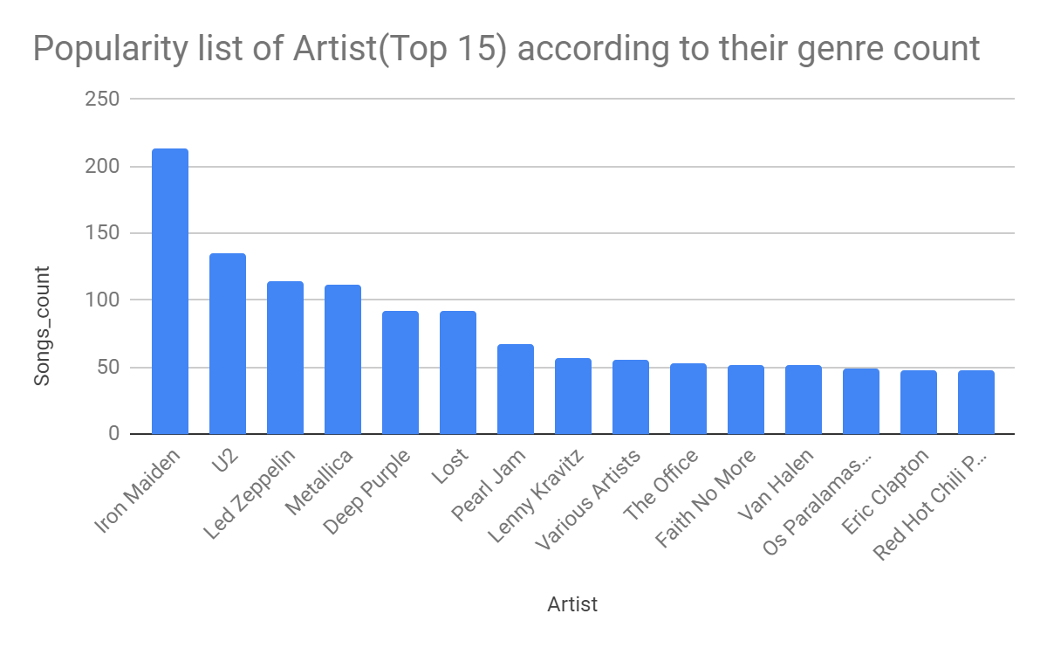
Popularity list of Artist(Top 15) according to their genre count
<visualization>
From visualization we can observe that the leading singer is Iron Maiden. He has a total of 213 songs. Followed by U2 with 135 songs.
Iron Maiden concerts will bring more revenue to the music store.

Slide 4
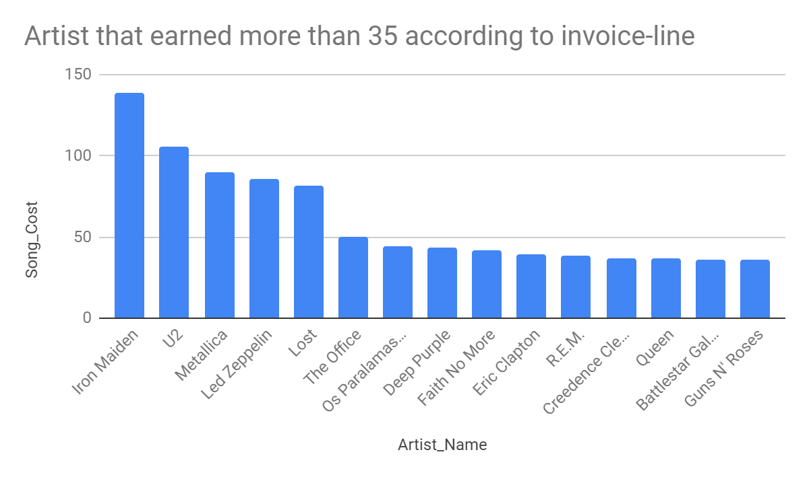
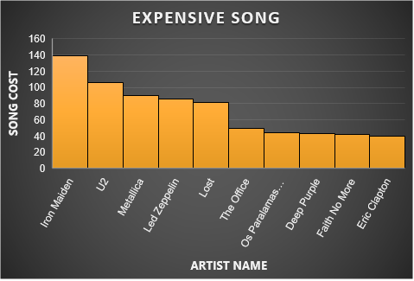
ARTISTS THAT EARNED MORE THAN 35$
<visualization>
From visualization we can observe list of the most expensive singers.
Iron Maiden earned most 138.6$ followed by other artists like U2,Metallica,etc earning more than 35$.

Slide 5
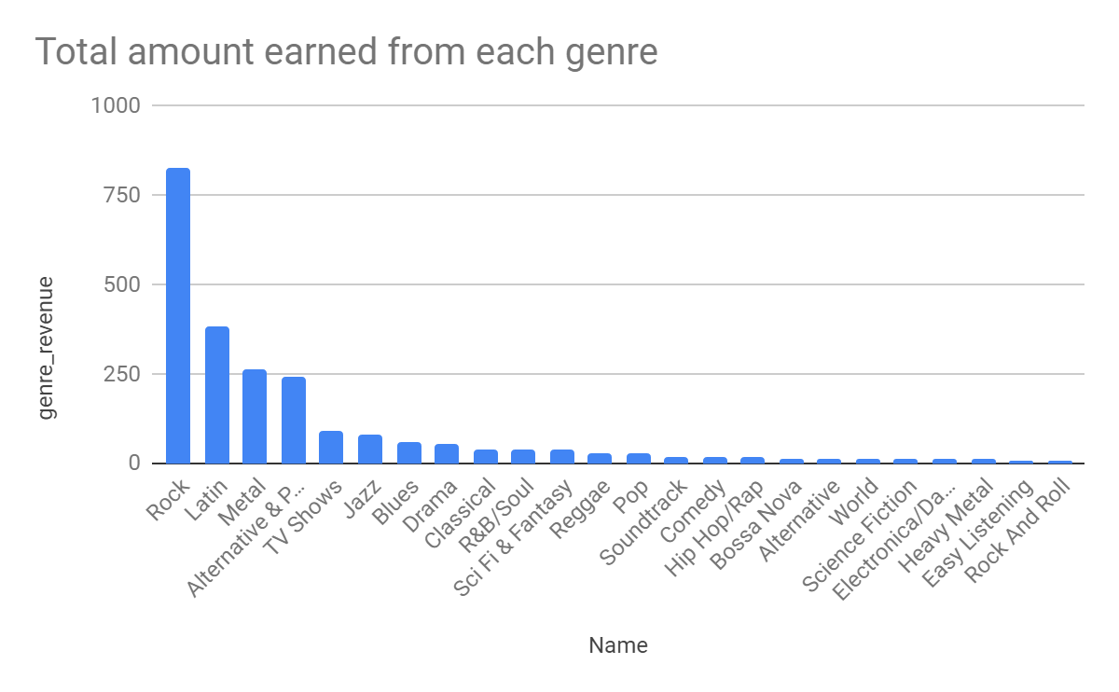
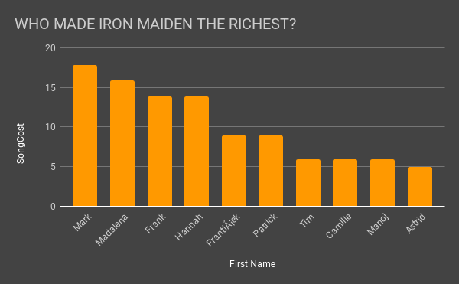
Revenue from each genre
<visualization>
From visualization we can observe that Rock genre earned maximum revenue for music store.
From this we can say that Rock is most popular genre. If music store is looking to do some promotions Rock genre is the best choice.

