Slide 1
NYSE database analysis
What is the Yearly Gross Profit Comparison between the Health Care Distributors(HCD) and the Health Care Equipment (HCE) of Health care sector for year 4?

Slide 2
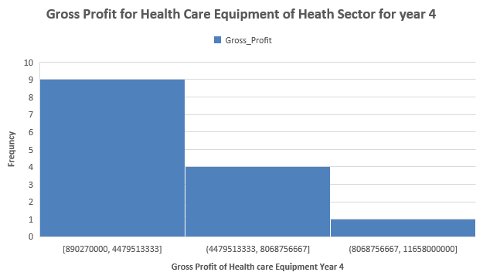
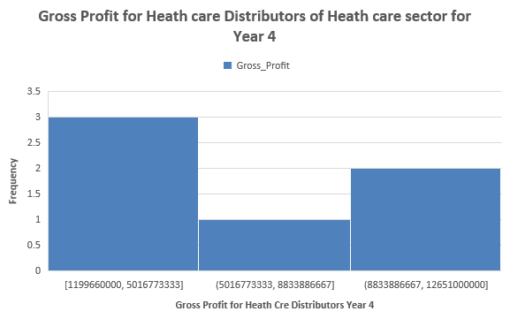
Here are histograms for yearly Gross Profit of Health care Distributors(HCD) and Health care Equipment(HCE) for Health Care Sector in year 4.
The distributions of HCD and HCE are right-skewed with positive skewness value as mean values are higher than the median.

Slide 3
Together HCD and HCE contribute about 22% to Health care sector.

Slide 4
From summary statistics we can observe that the total gross profit contribution of HCE(13% of total Health Care) to Health Care is more compared to HCD(9% of total Health Care) as the number of HCE companies is more than HCD.
Despite this, the mean gross profit of HCD(6.5 billion) is still more than HCE(4.1 billion). The median of HCD(5.4
billion) is also more. The standard deviation of HCD(4.6billion) is higher than HCE(3.2 billion) implying that variability in HCD expenses is more.
The range of HCD is more than HCE implying high dispersion in expenses of HCD even when there are less number of HCD companies.

