Slide 1
ZONAL ENERGY
DEMAND OF ONTARIO
- Vishwanath Sai Ravuri
- Disha Bhadauria
- Drishya Sarah Mathew

Slide 2
Data Description
Zonal Demands
The daily Zonal Demands for the 5 zones in the province of Ontario are derived from operational meters.
Zones
Ontario Demand
Toronto
Ottawa
Niagara
Bruce
Data Range
Training : 1st January 2017 to 31st December 2017
Test : 1st January 2018 to 15th January 2018

Slide 3
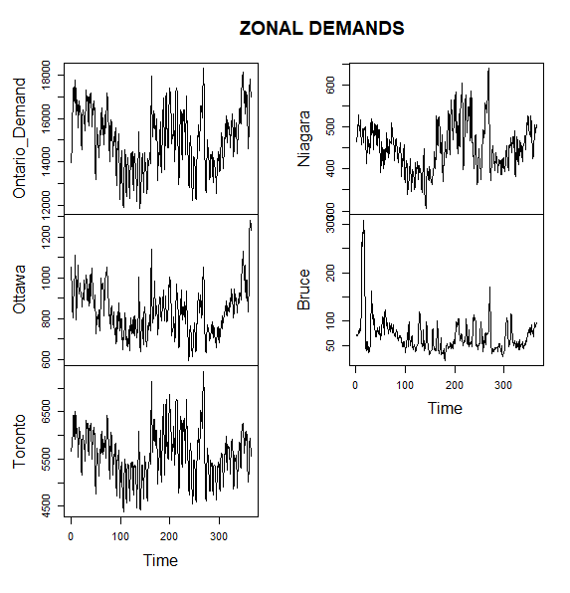
Data Interpretation
No trend
No Seasonality
Stationary
Few outliers may be present

Slide 4
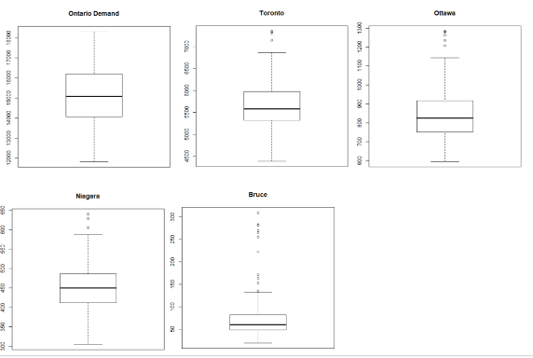
OUTLIERS
Ontario Demand : No Outliers
Toronto : 3 Outliers
Ottawa : 5 Outliers
Niagara : 3 Outliers
Bruce : 11 Outliers

Slide 5
Implemented Models
Exponential Smoothing (Holts)
Error Trend Seasonality (ETS)
ARIMA
Support Vector Machine (SVM)
Logistic Regression
* Taking RMSE as reference to select best fit model

Slide 6
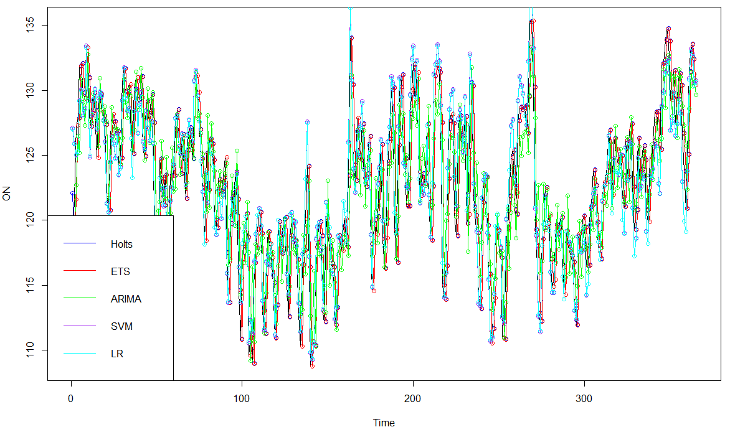
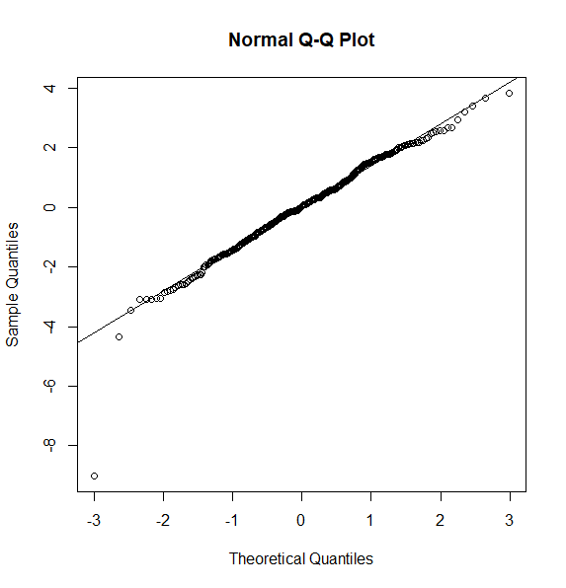
Ontario Demand
Best fit : SVM

Slide 7
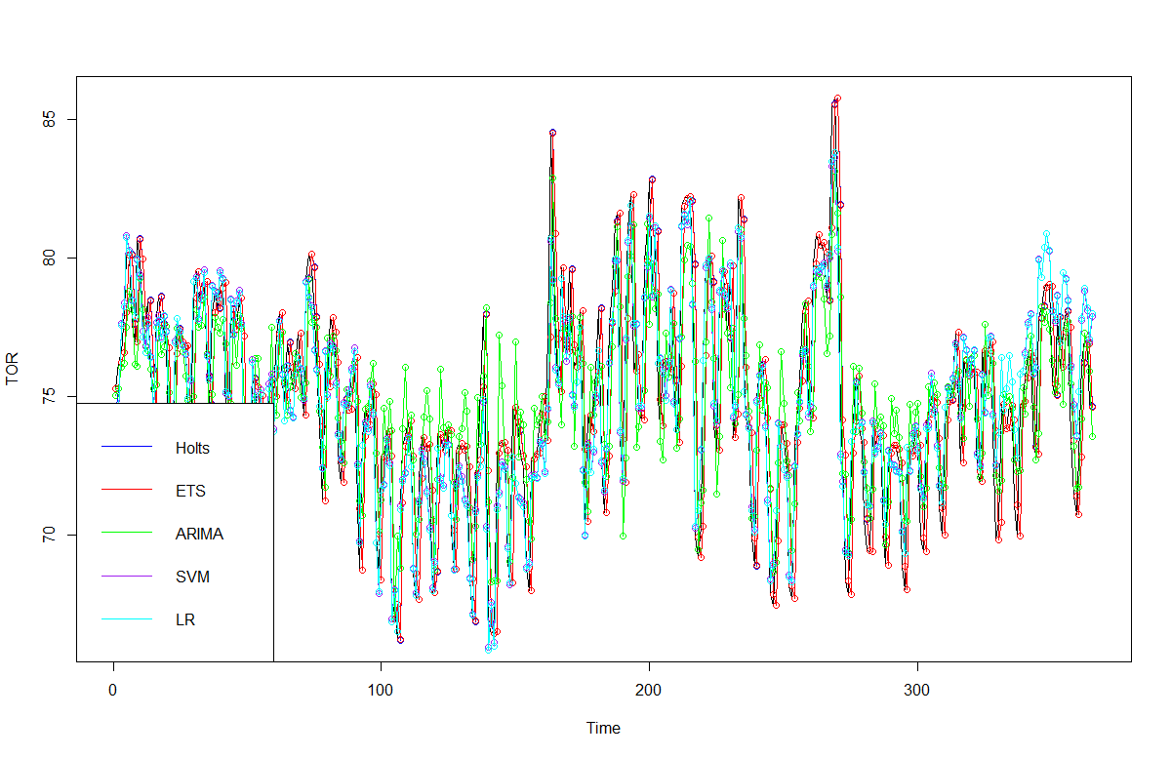
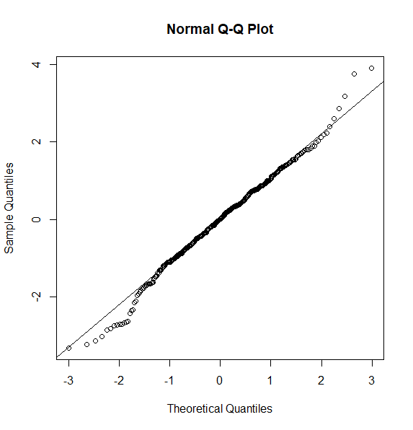
Toronto
Best fit : SVM

Slide 8
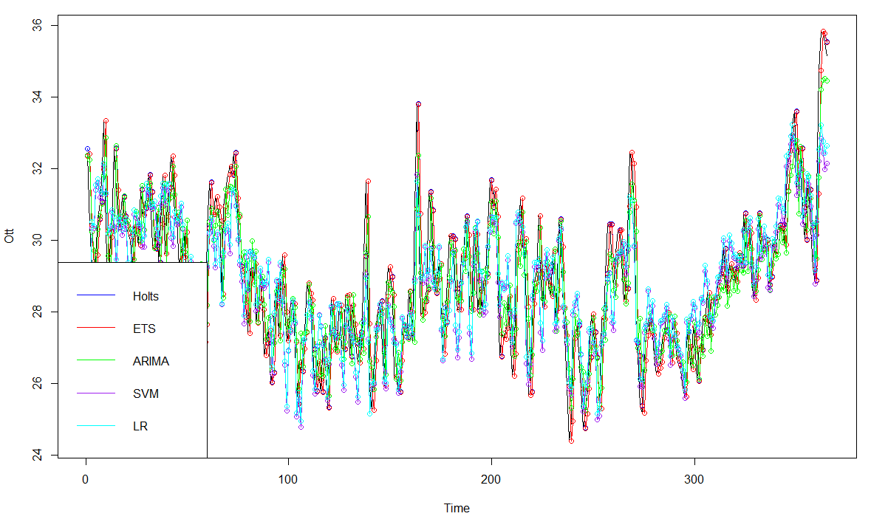
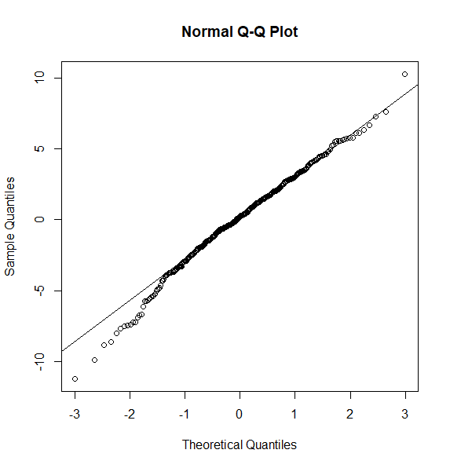
Ottawa
Best fit : ARIMA

Slide 9
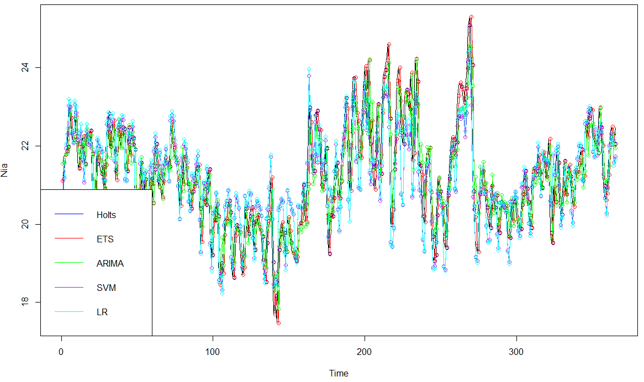
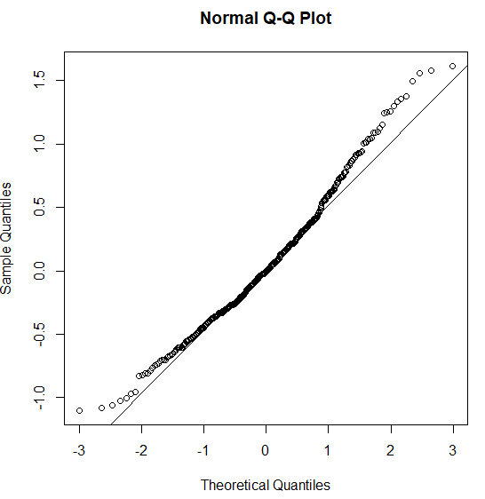
Niagara
Best fit : SVM

Slide 10
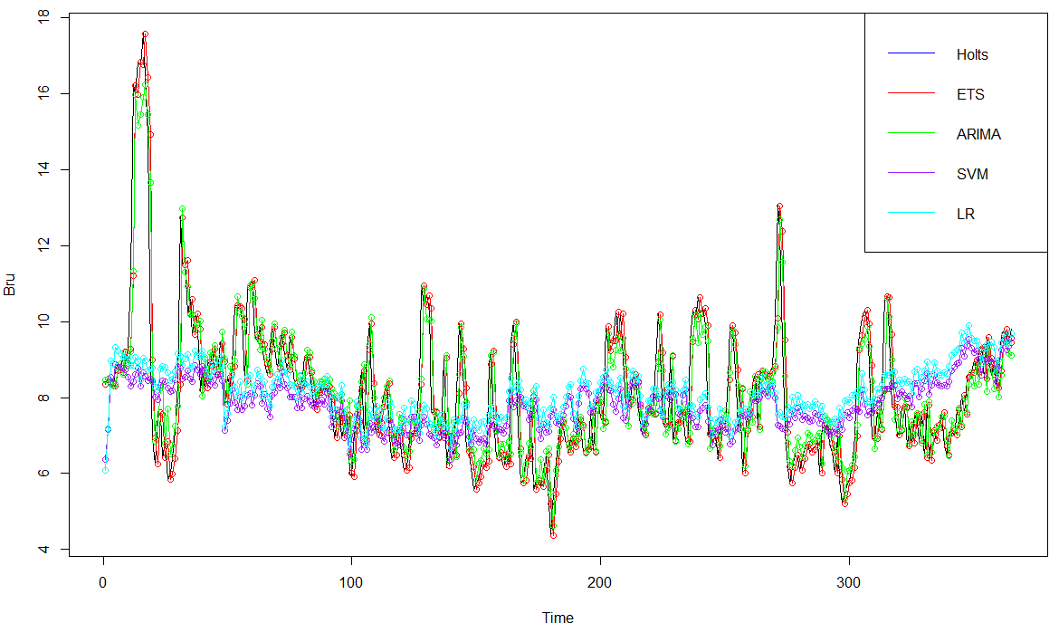
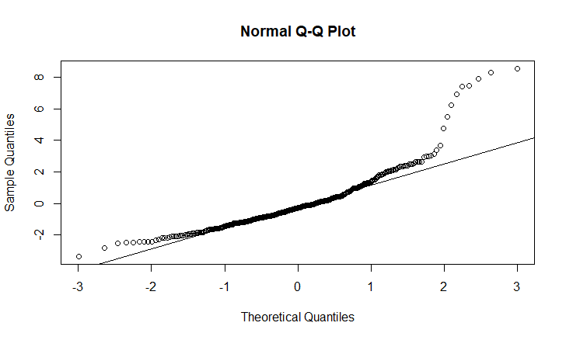
Bruce
Best fit : Logistic Regression

Slide 11
SUMMARY
REGION MODEL | Ontario Demand | Toronto | Ottawa | Niagara | Bruce
Holts | 3.12 | 3.198 | 2.48 | 0.935 | 1.062
ETS | 3.14 | 3.22 | 2.45 | 0.77 | 1.053
ARIMA | 3.75 | 2.19 | 1.07 | 0.719 | 0.9746
SVM | 1.76 | 1.59 | 1.93 | 0.579 | 1.002
LOGISTIC REGRESSION | 1.80 | 1.64 | 1.70 | 0.601 | 0.8908
BEST FIT | SVM | SVM | ARIMA | SVM | LOGISTIC REGRESSION

