Slide 1
Updates CTC 09/03/2026

Slide 2
Pipeline
Cerebello-Thalamic connections
Thalamus setup
Thalamo-Cortical connections
Closing the loop
Spinocerebellar Ataxia degeneration
Healthy vs. Ataxic

Slide 3
Status
Cerebello-Thalamic connections
Mouse terminal connections from Gornati et al. (2018)
Main experiments on connectivity found on cats and rats
Stuck at the moment

Slide 4
Status
Thalamus Setup
The Ventro-Medial (VM) lobe is the most dense with terminals from the cerebellum
Still thinking of keeping only the reticular thalamic neurons and the VM lobe from POLIMI thalamic SNN
Need to talk with Francesco for more insights and advises

Slide 5
Updates CTC 24/03/2026

Slide 6
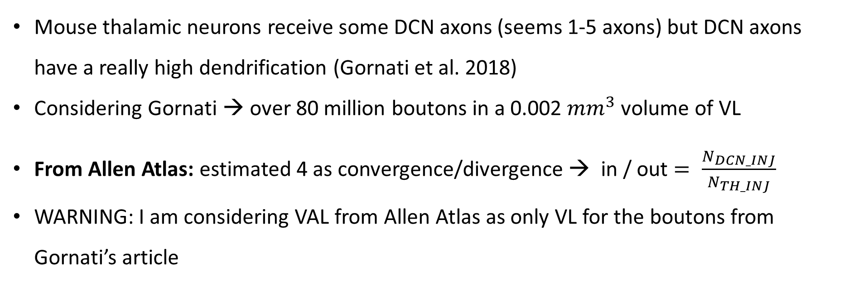
Status
Cerebello-Thalamic connections
Mouse thalamic neurons receive some DCN axons (seems 1-5 axons) but DCN axons have a really high dendrification (Gornati et al. 2018)
Considering Gornati → over 80 million boutons in a 0.002 ${mm}^{3}$ volume of VL
From Allen Atlas: estimated 4 as convergence/divergence → in / out $= \frac{N_{DCN_INJ}}{N_{TH_INJ}}$
WARNING: I am considering VAL from Allen Atlas as only VL for the boutons from Gornati’s article

Slide 7
Status
Thalamus Setup
Update: The Ventro-Lateral (VL) lobe is the most dense with terminals from the cerebellum
Thinned code → no plots, only the Network reconstruction and simulation
Still no answer from Milan for the missing adex model
Rescaled number of neurons: 99, but probably wrong → need adex model to then analyze the thalamic network

Slide 8
Status
Cortical Setup
Two possible networks: simplified M1 or complex multilayer M1 *
Depends on what we want to see from the cortex itself
Main data from * is available here: https://github.com/suny-downstate-medical-center/M1_NetPyNE_CellReports_2023
*Dura-Bernal, Salvador, et al. "Multiscale model of primary motor cortex circuits predicts in vivo cell-type-specific, behavioral state-dependent dynamics." Cell reports 42.6 (2023). DOI: https://doi.org/10.1016/j.celrep.2023.112574

