Slide 1
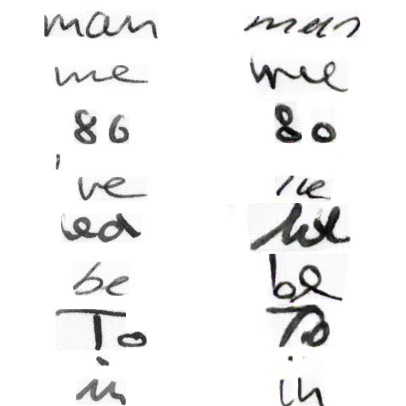
Small word experiment: fine-tuning on one author

Slide 2
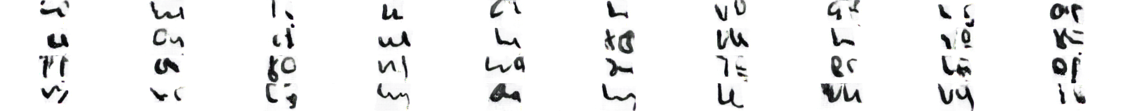
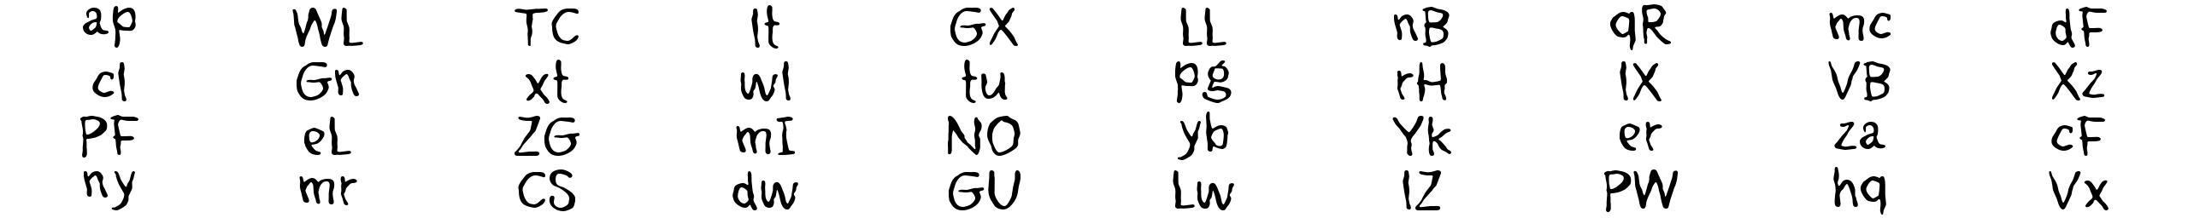
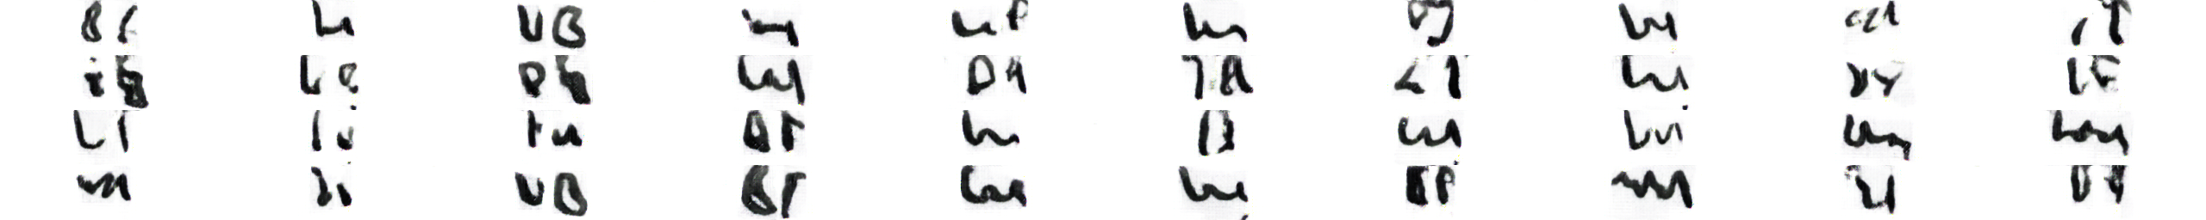
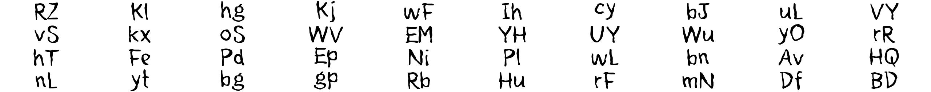
But letters are limited and it doesn’t generalize well

Slide 3

After looking at data some more, realized:
Problems:
Words not aligned
Size drastically different
Font not cursive

Slide 4

Align, resize, use different font
(also, smaller image size for faster training)

Slide 5
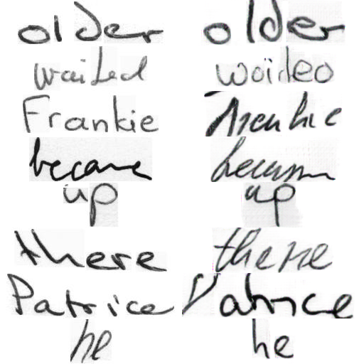
Results (on longer words): better, not perfect-at least words are more recognizable

Slide 6
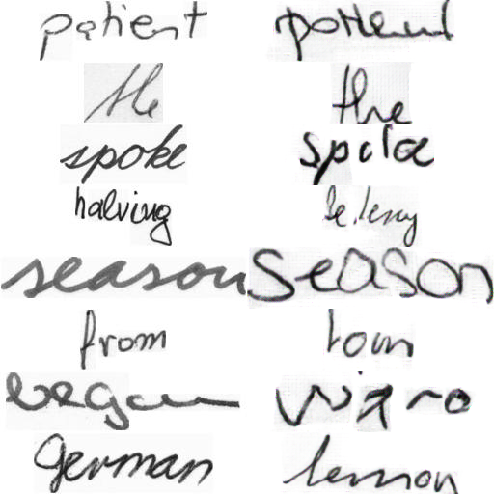

Slide 7
Potential Problems
Results still a little messy-even recognizable words don’t look natural
Has a bit of trouble learning proper styles-cursive vs lower case s, etc.
Not all long words get rendered well

Slide 8
Solutions
Preselect font based off of handwriting style? (is this doable?)
Test generating small letters from model trained on longer words
If problems persist, still kinda curious in attention-sliding window with attention over letters?

Slide 9
Note:
I’m leaving for Indonesia next Thursday to renew my visa, should be gone for ~1.5 weeks

