Slide 1
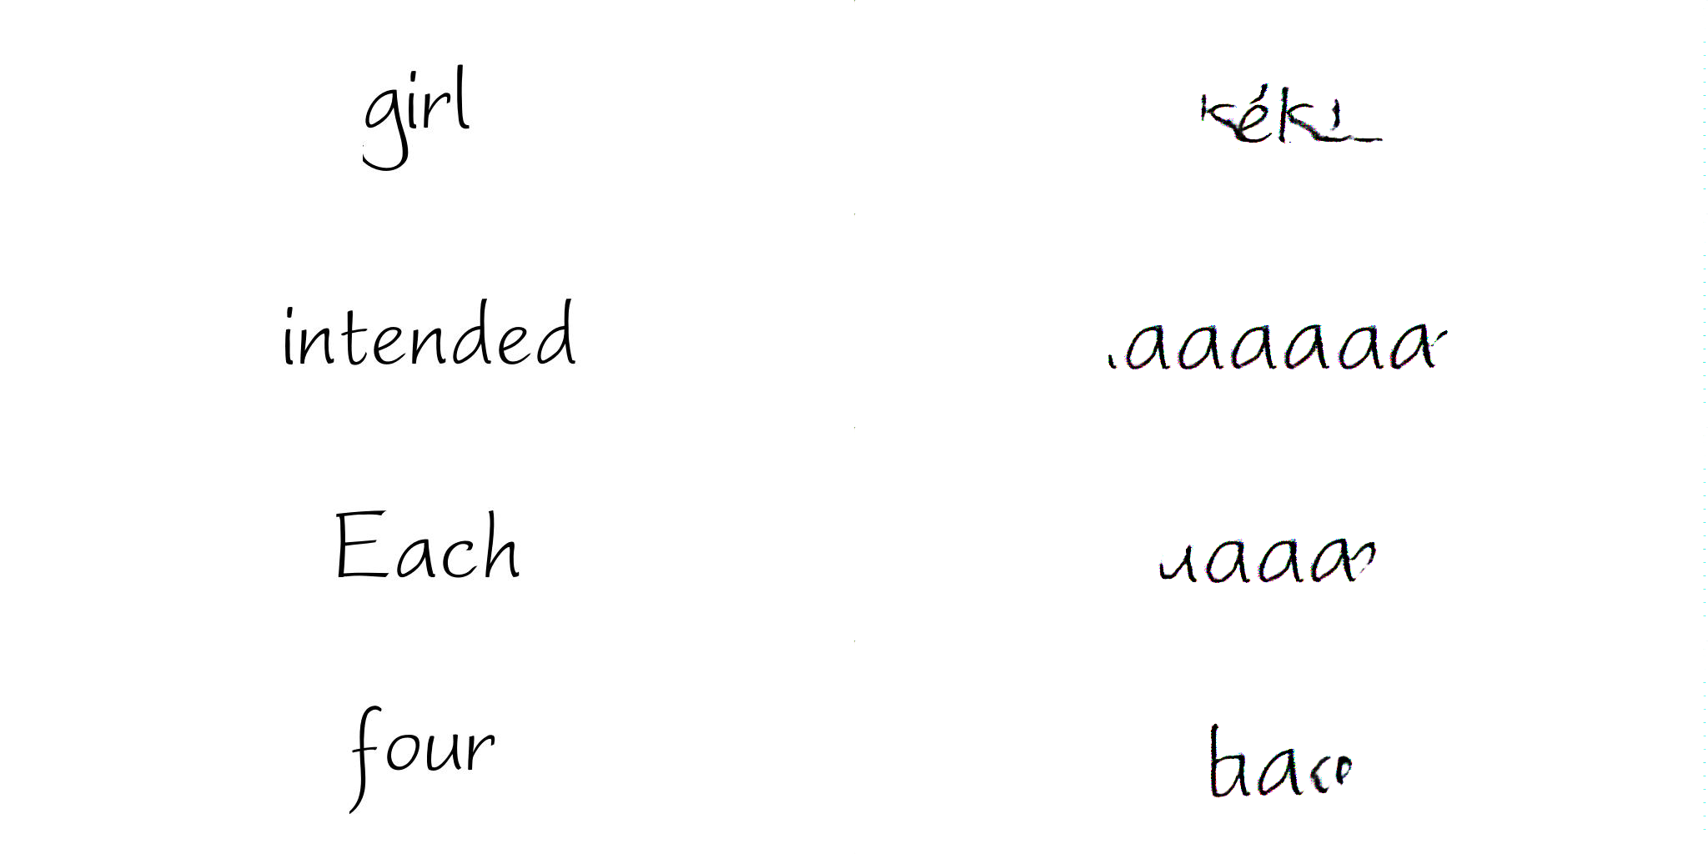
More Font2Font… all failed

Slide 2
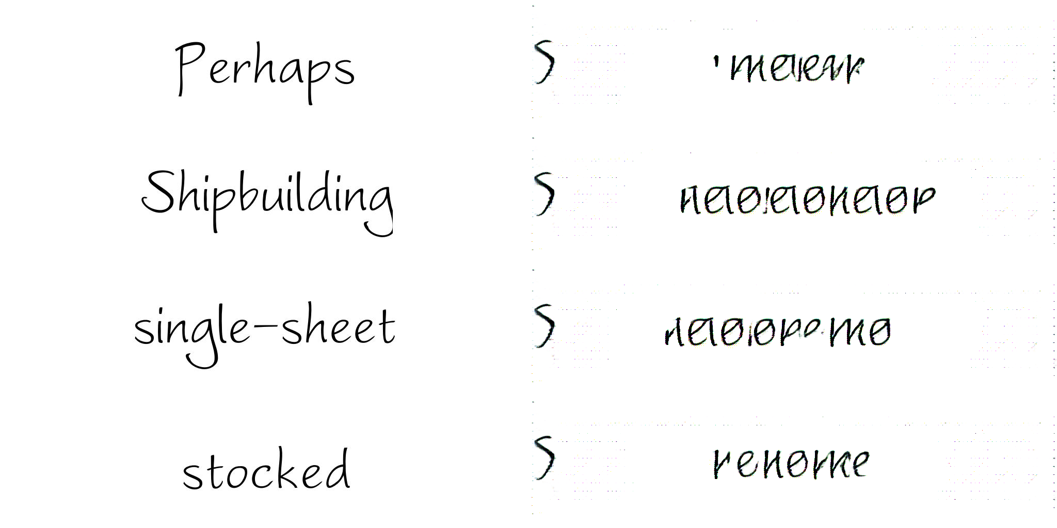

Slide 3

One word-can memorize one word

Slide 4
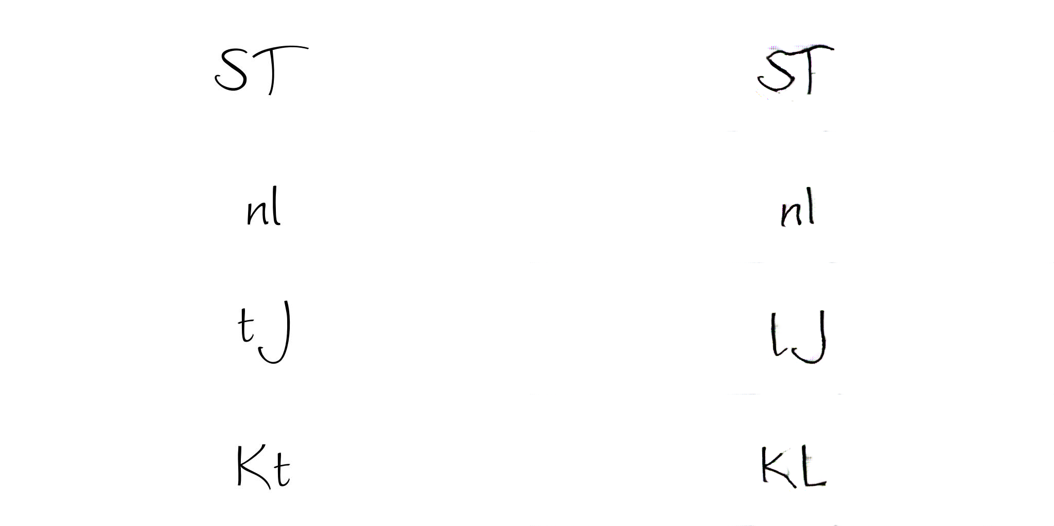
All Combinations of two letters (52^2)

Slide 5
Hasn’t converged after ~40 epochs, but results are recognizable
Want to train until it stops converging, currently training for 20 more epochs
Because images are larger, it is possible it needs to be trained for longer

Slide 6
Stack-Gan
Implementation complete-may still contain bugs
Will start training after combinations of two letter experiment finishes
Architecture-see next slide

Slide 8
For next week
Finish 2 letter experiment
Start training stack gan
Explore other additions-encoding words?
Try pretraining, more epochs?
  These will almost certainly help, but will take significantly longer
  Try pretraining on shrunk data?
Other ideas?

