Slide 1
Update 6/23
Daniel Clothiaux

Slide 2
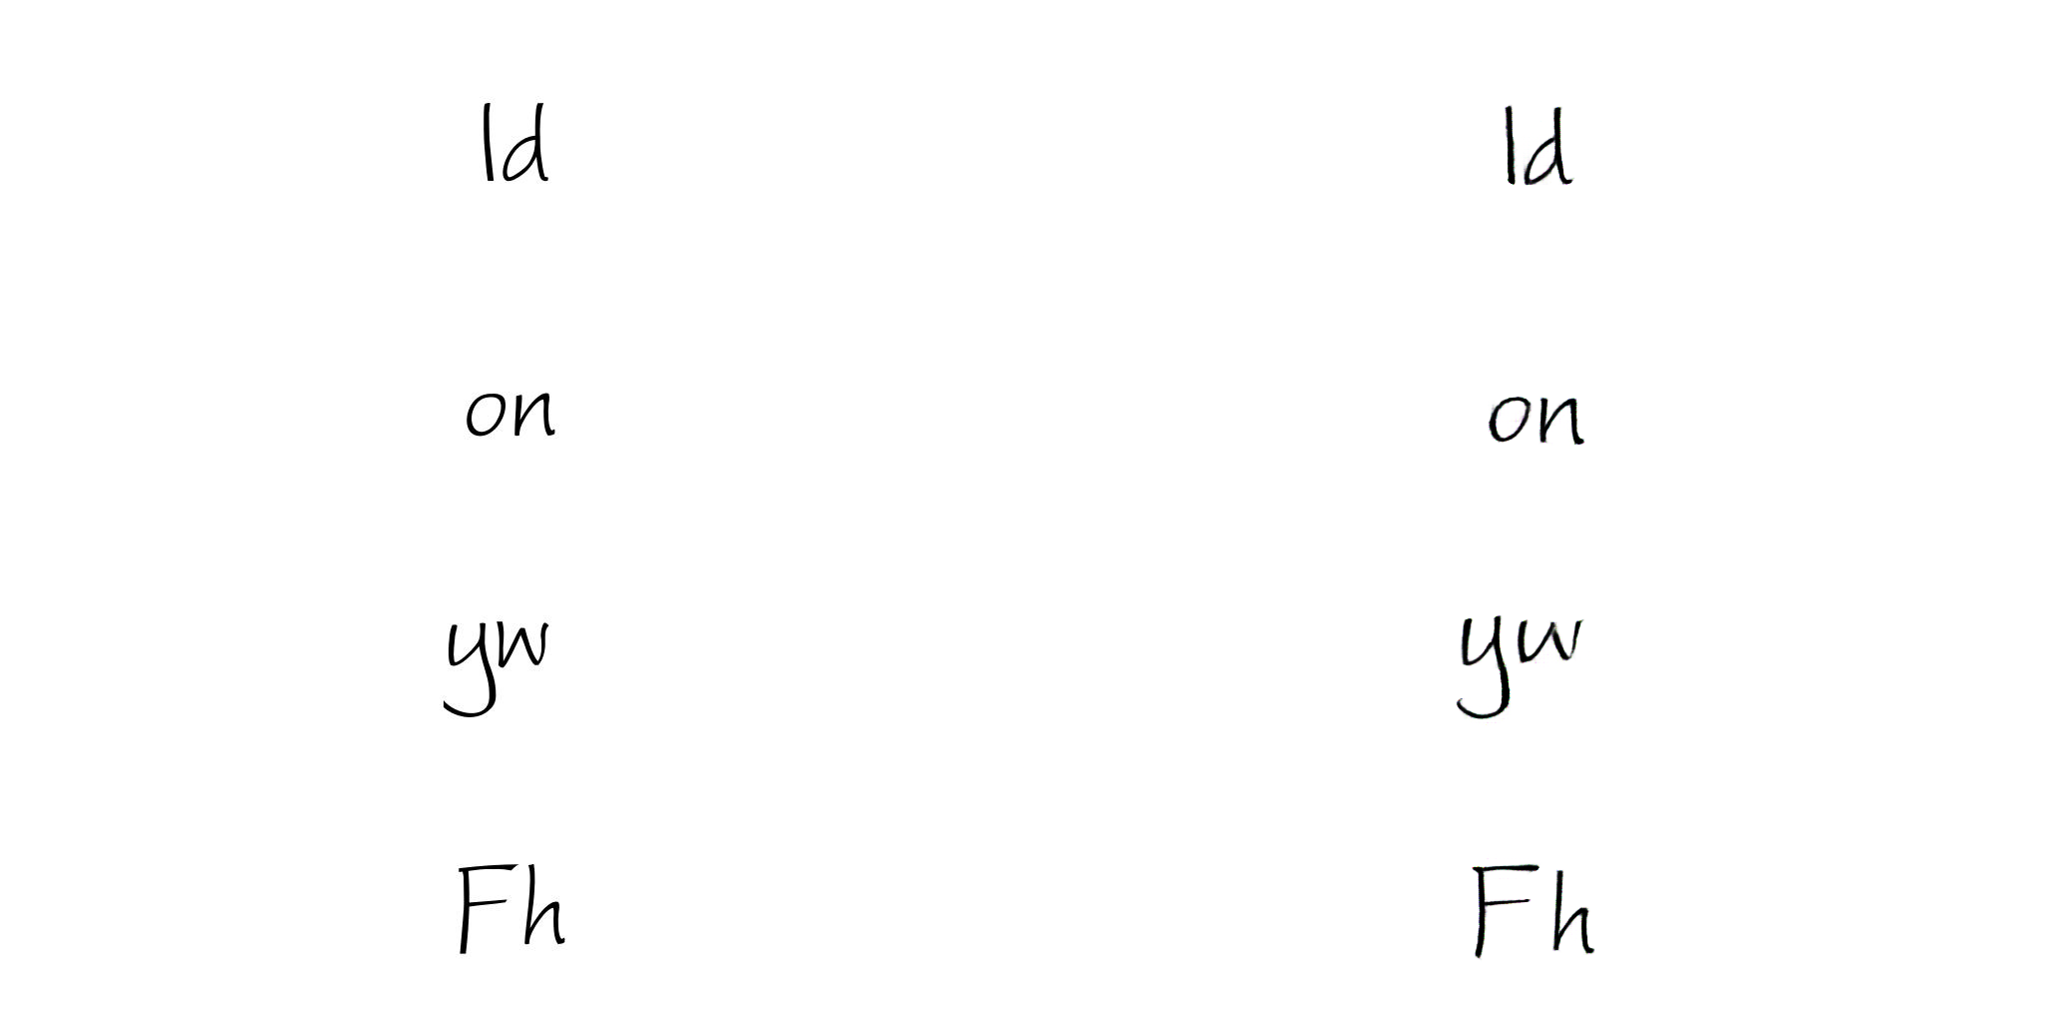
2 letter font experiment
Decent results, almost all recognizable

Slide 3
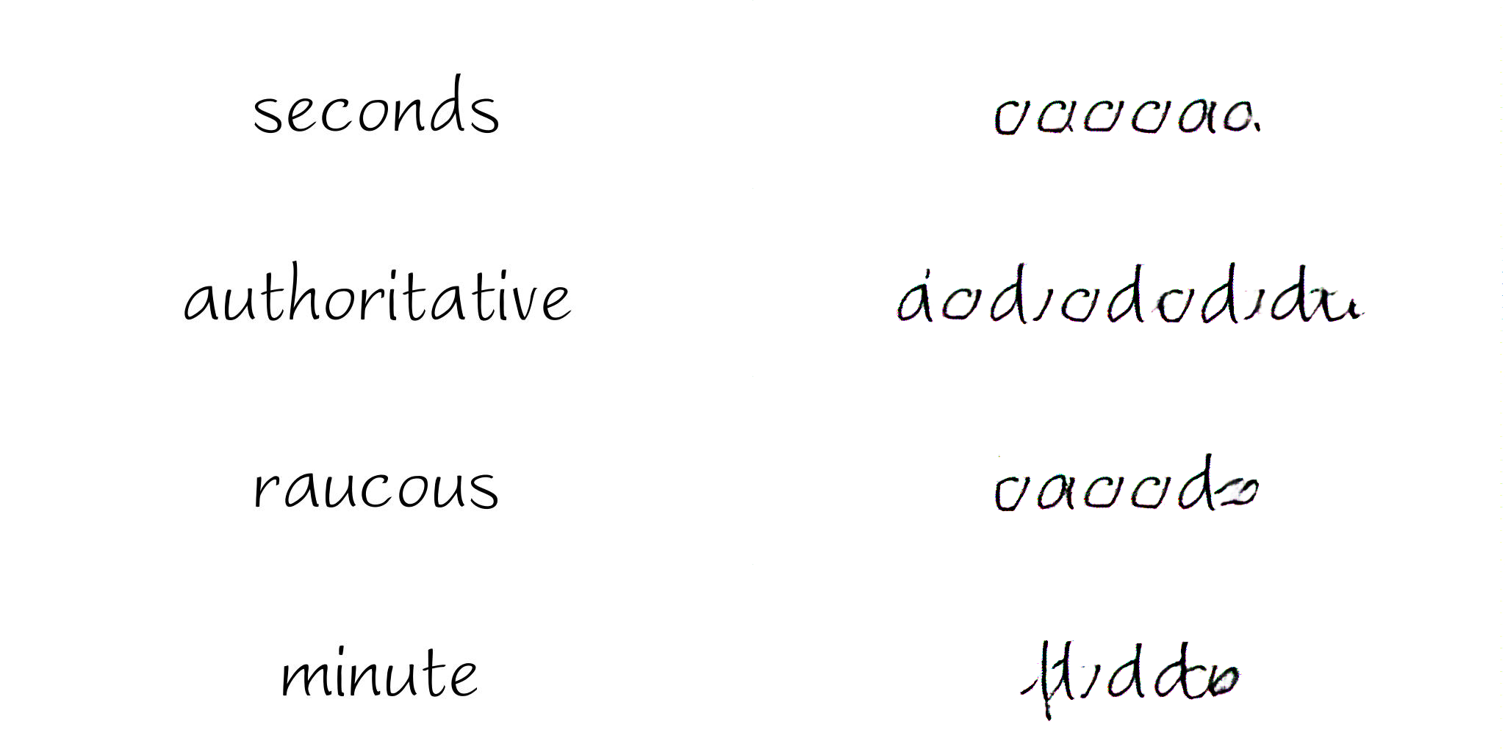
Stack GAN
Successfully debugged, ran initial experiments on small GAN
Previous problems persist

Slide 4
Stack gans con’t
This suggests problems aren’t in scale of output, but rather in length of word
Encoder can’t properly encode the entire word
The rest of this weeks experiments focused on the ‘generate small chunks, stitch them together’ idea

Slide 5
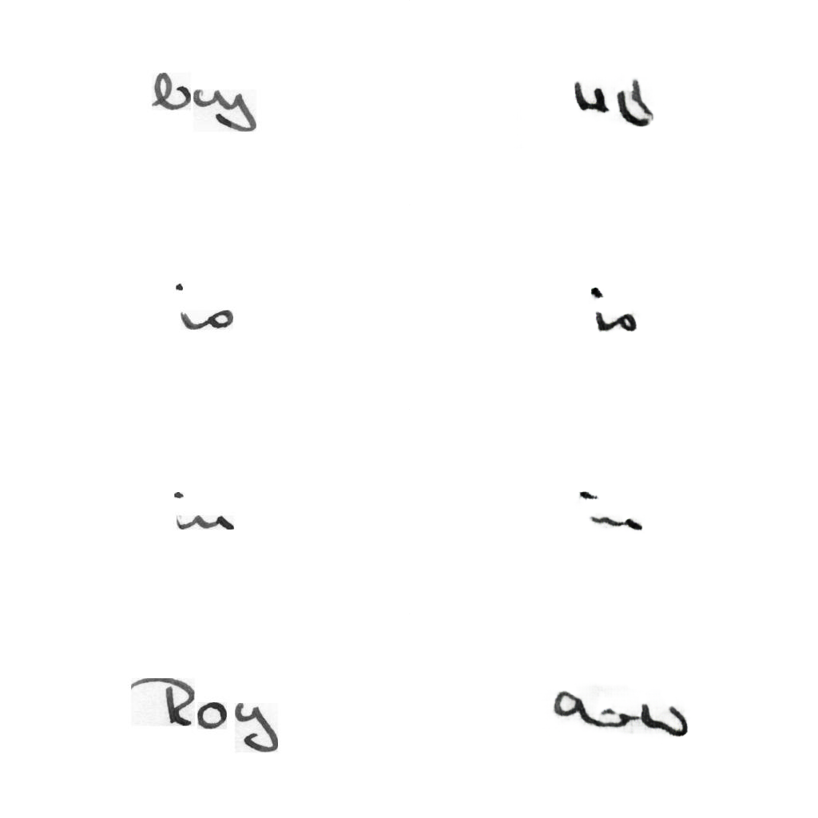
Small words with real author, experiment 1
Collected all small words (<4 letters) from one author (~1500 images)
Initial results work for previously seen words (‘is’, ‘in’), break outside (‘Boy’, ‘Roy’)

Slide 6
Small words experiment con’t
Looking at training data suggests a small subset of words compose a majority of training data (is, of, the, etc.)
It’s possible the model is overfitting to those words
Problem: training data/author now too small to train on
Potential solution: aggregate all training data on small words with at most one of each word per author for either ten authors (~1,500 images) or all authors (~18,000 images), pretrain on this dataset
As dataset is significantly larger, shrink images to 256x64

Slide 7
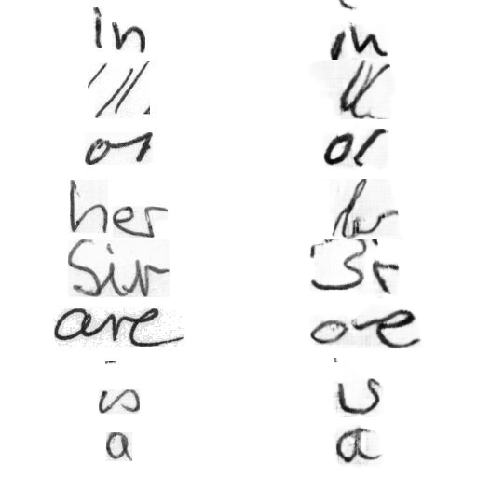
Results-subset of authors
Still not great…
Longer words-her, sir,
etc. still are bad

Slide 8
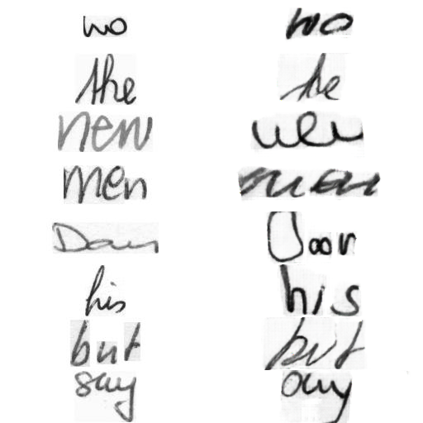
Results-all authors
Better! More on
next slide

Slide 9
Results continued
Styles a bit jumbled up-see two different styles of ‘s’ in ‘say’ on last line
Some words look a little weird-‘Door’, for example
Fine tuning with respect to a different font should hopefully alleviate this problem
Training still ongoing (as it’s a little bit slower even with the shrunk image size),
once training is complete, run tests on…
  common letter combinations that are not words (‘ch’, ‘sh’, ‘qu’...),
  weird combinations to test generalization (‘rt’, ‘vs’, numbers, etc.)

Slide 10
Next week
Try fine-tuning to a specific author’s style
Run letter combination experiments mentioned on previous slide
If both of these are successful, begin work on combining small chunks
  Stitch images of chunks together
  Run a GAN over stitched images to form larger words
Otherwise, keep exploring different architectures?
  Attention? unsure

Slide 11
Future work
These results suggest that pretraining helps, but needs as many authors/data as is available
Can train over complete dataset, but that will be slow-potentially 1-2 weeks, even on shrunk images
I plan on doing this when I go abroad mid-July, hopefully when I return the pretraining will have completed or near completion

