Slide 1


Bank Nifty Price Prediction
By
Aman Bhawsar -248506
Vivek more -248555
Group no - 21
Dr. Shantanu Pathak Mrs. Priyanka Bhor Mr. Rohit Puranik
Course Coordinator Project Guide Centre Coordinator

Slide 2
Introduction:
Problem:
Financial markets, including Bank Nifty, are highly volatile and influenced by various factors. Predicting price movements accurately is crucial for traders and investors to make informed decisions and minimize risks.
Objectives:
Collect and preprocess historical Bank Nifty data.
Engineer relevant features for better model performance.
Train and evaluate Machine Learning models (LSTM , LGBM and GBM etc.).
Optimize models to enhance prediction accuracy.
Visualize results and explore future improvements for better forecasting.

Slide 3
DETAILS OF DATASET :
Name - banknifty_5min_10000days_data.csv
Link - https://docs.google.com/spreadsheets/d/1zui9YockRnxLxjvclaE03s_6LkK_n8mb/edit?usp=drive_link&ouid=105105999521702736583&rtpof=true&sd=true
No of columns – 1,37,634
No. of rows - 6

Slide 4
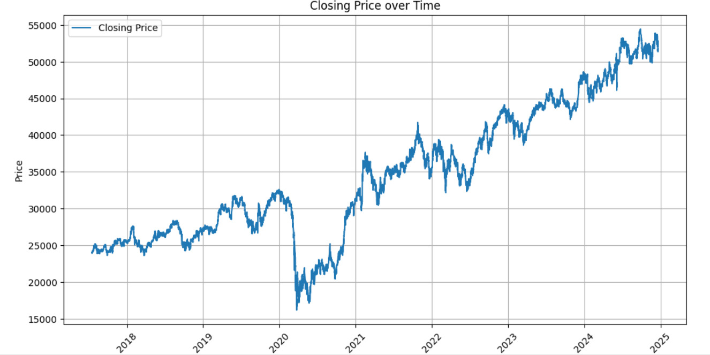
Exploratory data analysis (eda) :

Slide 5
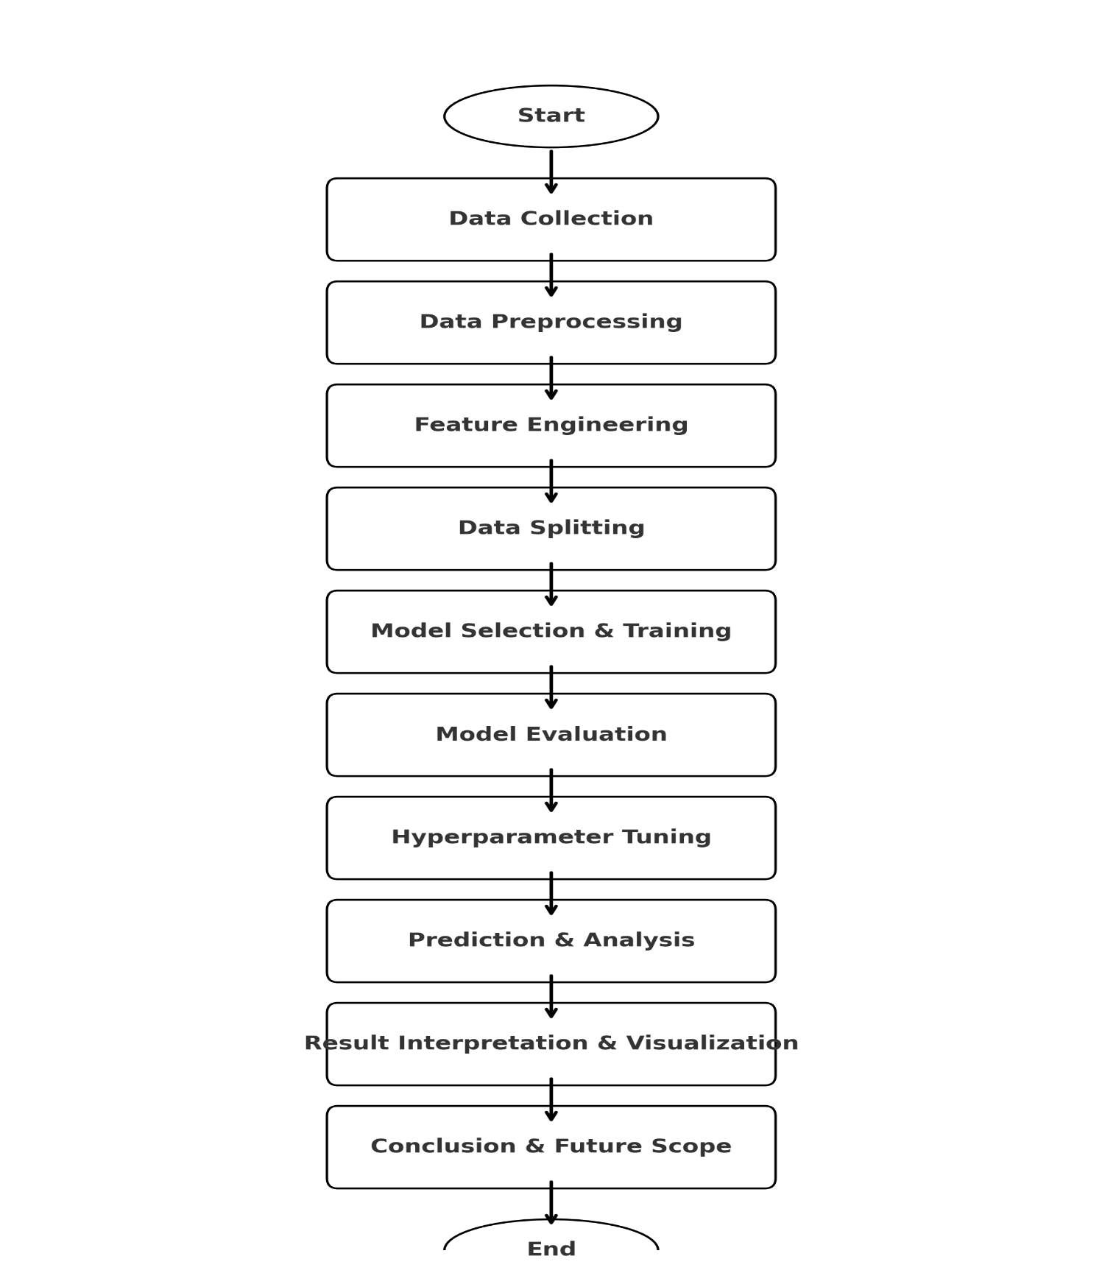
Flow diagram :

Slide 6
LIBRARIES AND Platform used :
Jupyter Notebook / Google Colab
Used for writing and running Python code interactively.
Supports data visualization and model building efficiently.
Python
Core programming language for implementing machine learning models. Provides powerful libraries for data processing and analysis.
Scikit-Learn
Used for data preprocessing, feature selection, and machine learning models. Provides tools for splitting datasets and evaluating model performance.
Pandas & NumPy
Essential for handling stock market datasets and numerical computations. Helps in cleaning, transforming, and structuring data.
Matplotlib
Used for visualizing stock trends, model predictions, and data insights.

Slide 7
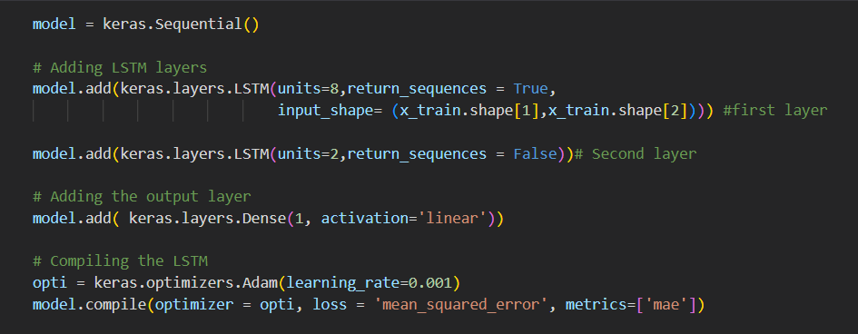
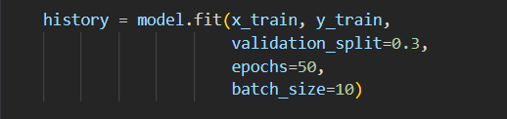
WORKING :
LONG SHORT TERM MEMORY -

Slide 8
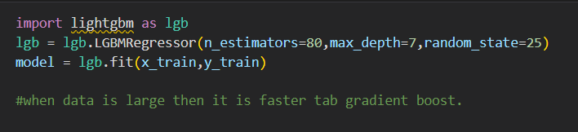
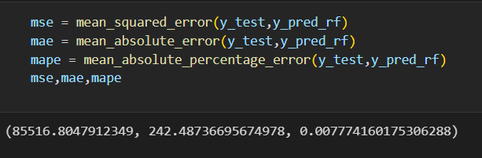
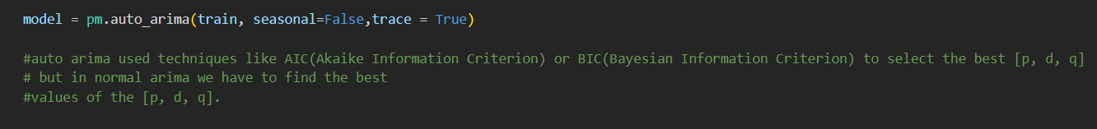

LIGHTGBM-
ARIMA-

Slide 9
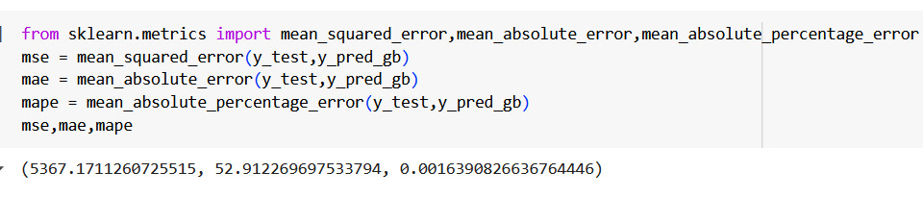
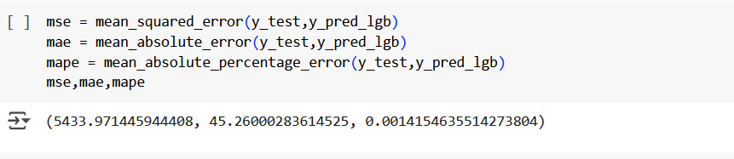
comparing different models :
GRADIENT BOOST
LIGHT GBM

Slide 10
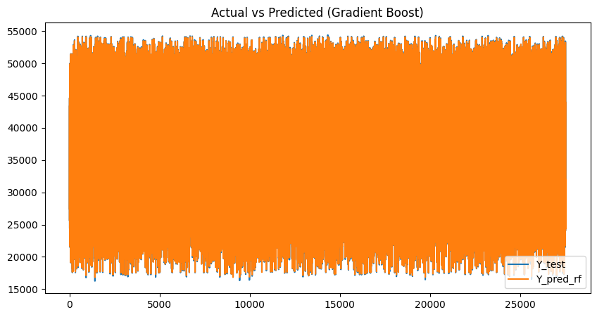
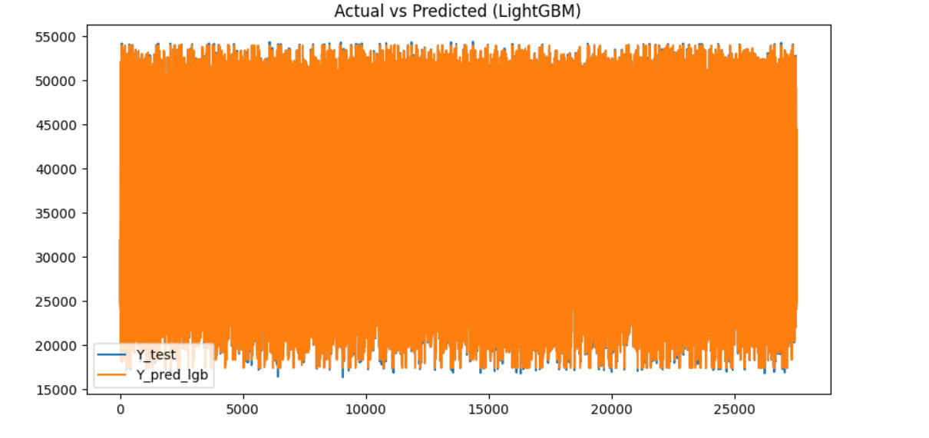
GRADIENT BOOST
LIGHT GBM

Slide 11
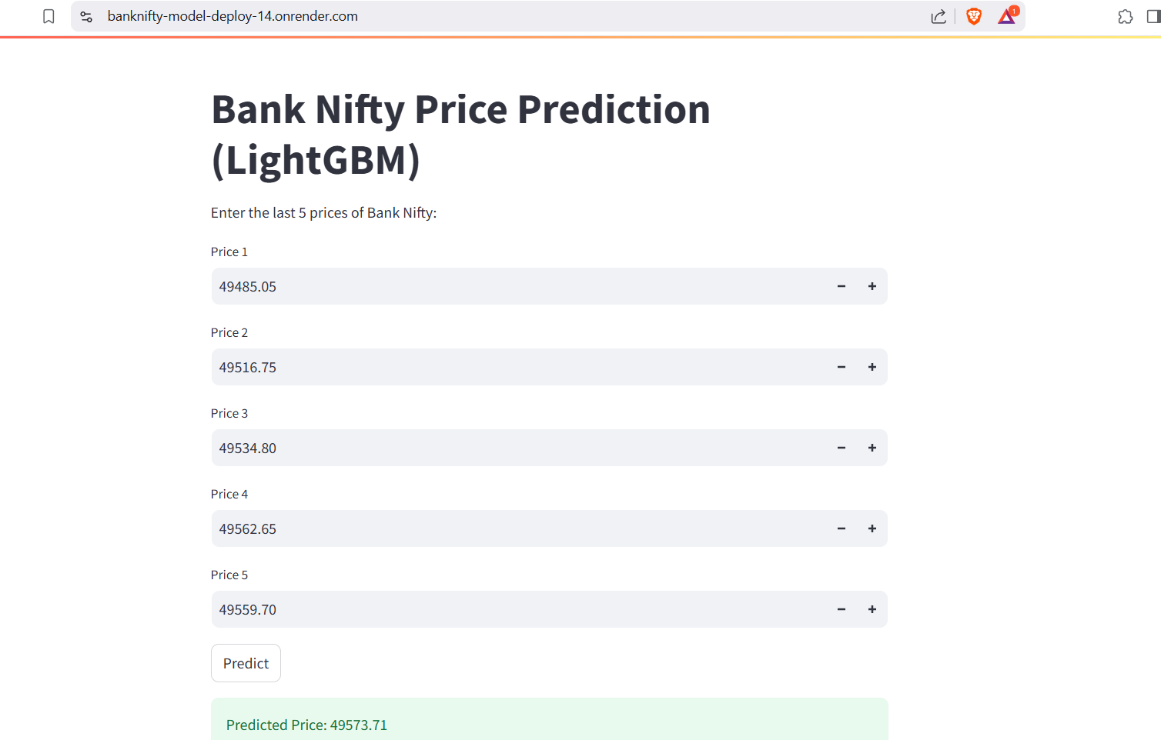
Deployment & result:

Slide 12
Conclusion :
This project successfully demonstrates the application of Machine Learning and Deep Learning models for Bank Nifty price prediction. By leveraging LSTM, ARIMA, and LightGBM, we effectively analyzed historical stock market trends and built predictive models for future price movements.
The results indicate that LSTM captures sequential dependencies, ARIMA handles time-series trends, and LightGBM provides fast and efficient boosting-based predictions. These models enhance decision-making in trading and investment strategies.
While the models show promising accuracy, further improvements can be made by incorporating real-time market data, sentiment analysis, and advanced feature engineering.
This project highlights the potential of AI-driven stock price forecasting, making it a valuable tool for traders, investors, and financial analysts.

Slide 13
THANK YOU! 🙏
“In investing, what is comfortable is rarely profitable.” - Robert Arnott
📊 Project: Bank Nifty Price Prediction Using Machine Learning
🎯 Presented By: Aman Bhawsar & Vivek More
Thank you for your time and attention! 🚀📈

