Slide 1
Agenda
February 21, 2019

Slide 2
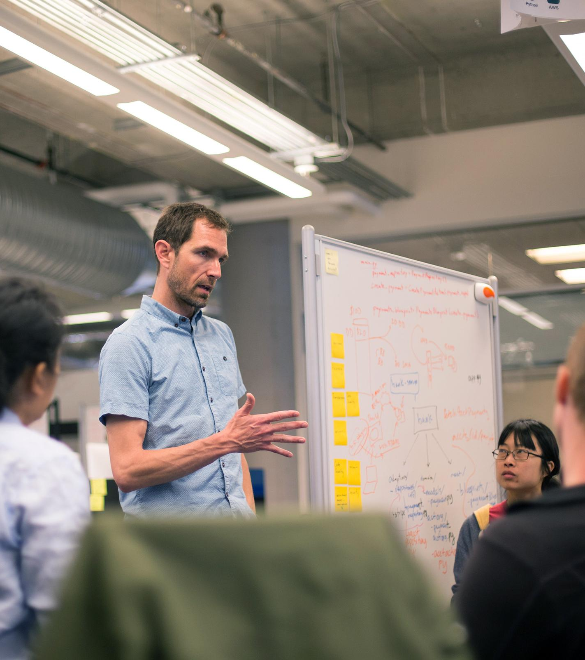
Agenda
Introductions
Platform Background
Steeltoe
Config
Demo
Lab
Service Discvoery
Demo
Lab
Circuit Breaker
Demo
Lab

