Slide 1
Kim “Avrama” Blackwell
George Mason University
  Modelling Calcium Concentration
  Second Latin American School on Computational Neuroscience

Slide 2
Chemesis Calcium Objects
CICR implements calcium release states
  One element for each state
  One of the elements may be conserved
  Parameters (Fields)
  'Forward' rate constants, α β γ
  State vector, e.g. 001 for 1 Ca⁺⁺ and 0 IP₃ bound
  Fraction of receptors in this state
  Whether this element is conserved

Slide 3
Chemesis Calcium Objects
CICR (cont.)
  Messages (Inputs) required:
  IP₃ concentration
  Cytosolic Ca⁺⁺ concentration
  fraction of molecules in states that can transition to this state
  rate constant governing transition from other states to this state
  Calculates
  Fraction of molecules in the state

Slide 4
Chemesis Calcium Objects
CICRFLUX implements calcium release
  Messages (inputs) required:
  Calcium concentration of ER
  Calcium concentration of Cytosol
  Fraction of channels in open state, X
  Parameters (Fields)
  Permeability, P
  Number of independent subunits, q
  Calculates Ca flux = P*X^{q} (Ca_{ER}-Ca_{Cyt})

Slide 5
Chemesis Calcium Objects
Diffusion
  Parameters (Fields)
    Diffusion constant, D
  Messages (Inputs)
    Length, concentration, surface area from two reaction pools
  Calculates
    Flux from one pool to another
    D SA Conc / len

Slide 6
Chemesis Calcium objects
MMPUMP used for SERCA or PMCA Pump
  Fields
    Affinity
    Power (exponent)
    Maximum rate
  Messages (inputs)
    Concentration
  Calculates flux due to pump

Slide 7
Chemesis Calcium Objects
Leak implemented using CICRFLUX
  Messages (inputs) required:
  Calcium of cytosol
  Calcium of ER or EC space
  Value of 1.0 instead of open state
  Parameters (Fields)
  Maximal Permeability (P_{L})
  Hill coefficient (should be 1.0)

Slide 8
Integrating Calcium Mechanisms
RXNPOOL takes flux messages from various calcium sources
  VDCC sends message CURRENT, with fields current and charge
  Diffusion and calcium release send message RXN2MOLES or RXN2, with fields difflux1 and difflux2, or fluxconc1 and fluxconc2, respectively
  Mmpump sends message RXN0MOLES with field moles_out (to cytosol) or moles_in

Slide 9
Genesis Calcium Objects
Ca_concen
  Simplest implementation of calcium
  Fields
    Time constant of decay
    Minimum calcium
    B = 1 / (z F vol): volume to produce 'reasonable' calcium concentration
  Inputs
    Calcium current

Slide 10
Genesis Calcium Objects
Code of all the following is in src/concen
Concpool
  Calcium concentration without diffusion
  Fields: Shape and size
  Inputs:
    Buffer rate constants, bound and free
    MMPump coefficients
    Influx and outflux of stores

Slide 11
Genesis Calcium Objects
difshell
  concentration shell. Has ionic current flow, one-dimensional diffusion, first order buffering and pumps, store influx
fixbuffer
  Non-diffusible buffer (use with difshell)
difbuffer
  Diffusible buffer (use with difshell)

Slide 12
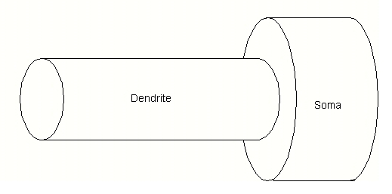
Morphology of Model Cell

Slide 13
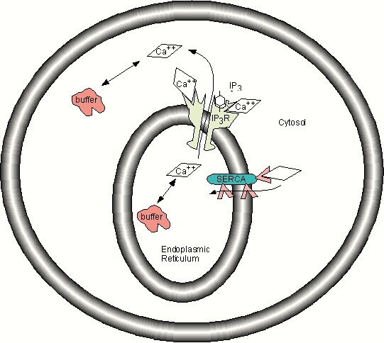
Calcium Dynamics in Model Cell

Slide 14
Calcium Buffers
cal1.g
Creates pools of buffer, calcium and calcium bound buffer
Creates bimolecular reaction for buffering

Slide 15
Calcium Buffers and Diffusion
cal2.g
Two compartments: soma and dendrite
Calcium binding to buffer is implemented in function
Diffusion between soma and dendrite

Slide 16
Calcium Release
cal3.g
Illustrates how to set up calcium release using cicr object
Requires ER compartment with calcium and buffers
Calcium concentration increases, and then stays elevated due to lack of pumps

Slide 17
Calcium Release and SERCA
cal4.g
Implements IICR from cal4.g
Adds SERCA pump to remove calcium from cytosol

Slide 18
Voltage Dependent Calcium Channels
cal5.g
Two concentration compartments, but no calcium release channels
Requires two voltage compartments
Uses the Goldman-Hodgkin-Katz formulation for driving potential
Depolarizes the cell with current injection to activate calcium channel

Slide 19
Genesis Calcium Concentration
cal6.g
Implements calcium concentration using genesis objects: Ca_concen and tabchannels
Once Ca compartment and two voltage compartments (no diffusion)
Current amplitude and kinetics similar to cal5.g

