Slide 1

Phoenix Home Price Predictor
By Dawn belbin

Slide 2
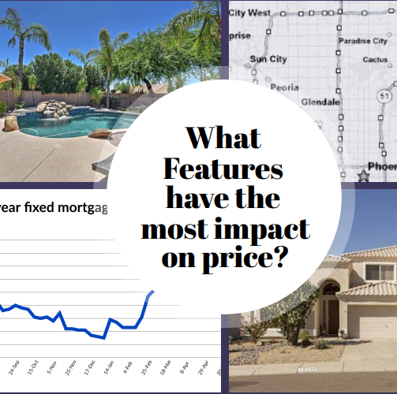
Project Overview
As a casual real estate investor, it is hard to make sense of what features have the biggest impact on price.
The purpose of the project is to be able to input different features and predict the price of the property and determine if the price is in line with what the model is predicting.

Slide 3

Model Limitations and Constraints
Constraints
Redfin does not allow web scraping of its site but does allow non-proprietary data to be downloaded no more than 350 properties at a time. Because of this the data collected had to be limited to the following:
Single family homes
City of Phoenix zip codes (85001 – 85087)
Sold for $500,000 or less
Sold between November 2021 and January 2023

Slide 4
Exploring the data
Exploring and cleaning the data
Removing private sales
Analyzing outliers and determining which outliers to remove
Removing null values
Reviewing the correlation between the features
Notes:
Interesting facts on correlation
HOA had a higher correlation to price than number of bedrooms or pool
Number of bathrooms had a higher correlation than number of bedrooms

Slide 5
Features selected for use in model
From the downloaded data, the following features were selected to be used for the model:
Sold Date
Zip Code
Price
Beds
Baths
Square Feet
Lot Size
Year Built
HOA/Month converted to HOA Y/N
Pool
Other features were included in the app such as longitude and latitude to plot each property on the map.
Notes:
Features available:
Sale Type
Sold Date
Property Type
Address
City
State
Zip code
Price
Beds
Baths
Location
Square Feet
Lot Size
Year Built
Days on Market
$/Sq Feet
HOA/month
Status
MLS#
Latitude
Longitude

Slide 6
Selecting the Optimal Model
There were many models that were initially considered and tested with poor results. The following four models were the final models reviewed:
Decision Tree Regression
XG Boost Regression
Gradient Boosting Regression
Random Forest Regression
After testing the models, the Random Forest Regression had the highest R² and the lowest MAE and was selected as the optimal model to use for the project.
Once selected, the hyperparameters were tuned using GridSearchCV where the accuracy of the model increased from 0.65475 to 0.8001

Slide 7

Streamlit
The web-based application chosen for the project was Streamlit. This is an open-source framework that uses the Python language and allows users to easily create web apps for machine learning models.
Once the model was created, a Python page for each Streamlit page was created.
Streamlit links to GitHub where the source code is stored

Slide 8
Link to GitHub and Streamlit
GitHub: https://github.com/dbelbin/Capstone.git
Streamlit App: https://dbelbin-capstone-app-mp6x0y.streamlit.app/

Slide 9
Conclusion
Streamlit Implementation Challenge
Overcoming Challenges with GitHub

