Slide 1
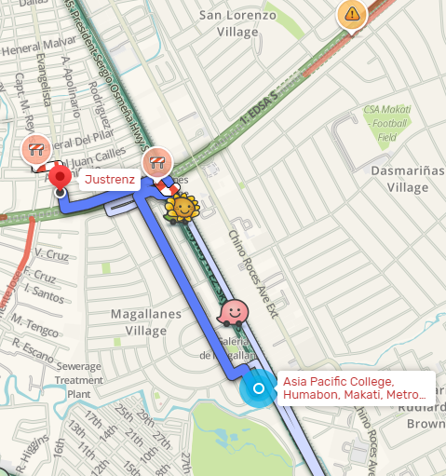
Nearest
Justrenz
HANAP
PC
JUSTRENZ
200 Meters
“Find cheapest pc rental near you.”
show
ROG 500 Meters
Nearest
show
Cheapest
TNC 600 Meters
PC QUALITY
show
LOW PC – 13PHP HR
MID PC- 25 PHP HR
HIGH PC – 30PHP HR

Slide 2
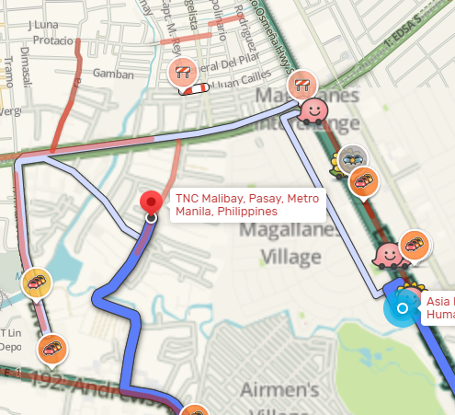
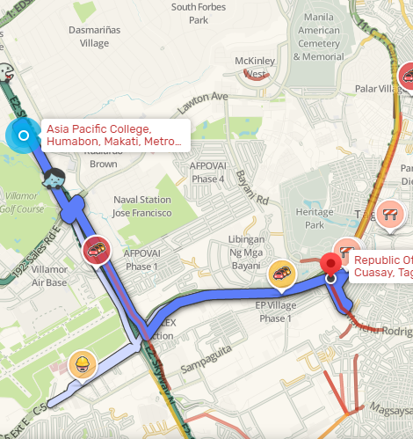
Tnc
ROG
Cheapest
JUSTRENz 13 php hr
show
Tnc 15 php hr
show
Rog 20 php hr
LOW PC – 15 PHP HR MID PC- 25 PHP HR
HIGH PC – 35 PHP HR
LOW PC – 20 PHP HR MID PC- 30 PHP HR
HIGH PC – 40 PHP HR
show

Slide 3
Pc quality
JUSTRENz
LOW PC – 13PHP HR
MID PC- 25 PHP HR
HIGH PC – 30PHP HR
Tnc
LOW PC – 15 PHP HR
MID PC- 25 PHP HR
HIGH PC – 35 PHP HR
Rog
LOW PC – 20 PHP HR
MID PC- 30 PHP HR
HIGH PC – 40 PHP HR

Slide 4




MyCafe
Add new user
Add time
Monitoring
Logout
Gaming
Printing
Editing
Surfing
PC1
PC2
PC3
PC4
PC1
PC2
PC3
PC4
PC1
PC2
PC3
PC4
PC1
PC2
PC3
PC4
PC5
PC6
PC7
PC8
PC5
PC6
PC7
PC8
PC5
PC6
PC7
PC8
PC5
PC6
PC7
PC8
PC9
PC10
PC11
PC12
PC9
PC10
PC11
PC12
PC9
PC10
PC11
PC12
PC9
PC10
PC11
PC12
PC13
PC14
PC15
PC16
PC13
PC14
PC15
PC16
PC13
PC14
PC15
PC16
PC13
PC14
PC15
PC16
PC17
PC18
PC19
PC20
PC17
PC18
PC19
PC20
PC17
PC18
PC19
PC20
PC17
PC18
PC19
PC20

Slide 5
New User
1hr
2hr
3hr
Enter username
Enter password
4hr
5hr
6hr
Enter pincode
Submit
Status
Username
N/A
Start time
00:00
Used time
00:00
Remaining time
00:00
Usage cost
000.000

Slide 6
MyCafe
admin
*********
Submit

