Slide 1
NEED FINDING PRESENTATION
Jesus Bermudo
Daniel Eler

Slide 2
Student with no personal computer
Problem
Students doesn’t have their own personal computer to work with their assignments and projects.
They always do their work in other computers.
Go to a computer shop to rent a computer.
Expensive computer rent.

Slide 3
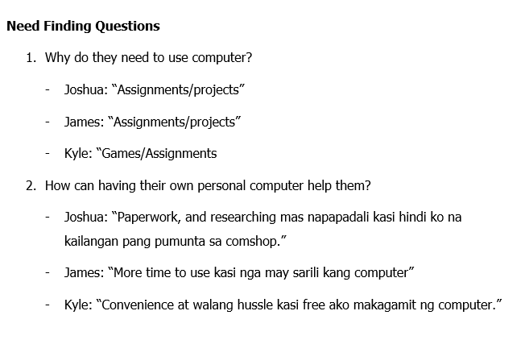

Slide 4
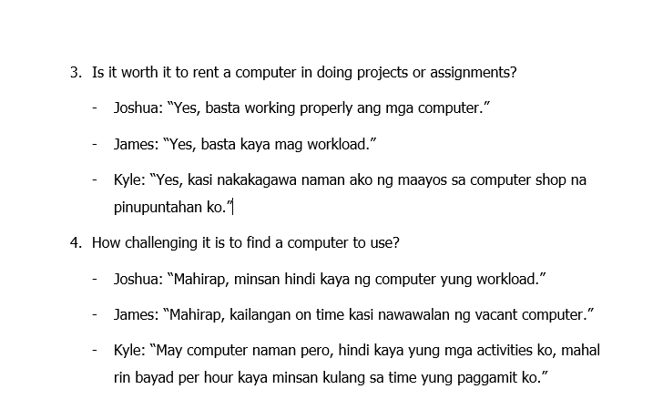

Slide 5
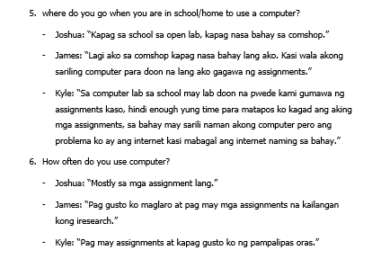

Slide 6
USER NEEDS
Users prefer cheaper rent prizes than expensive ones especially when there is no need for longer use of computers
Users want to use capable computers to accommodate their works or activities properly
Users do not want to waste time and want to have easy access to available computers
Users want to know the opening hours of different Internet Cafes due to their different time schedules

Slide 7
POINT OF VIEW
Knowing the important information about internet cafes through mobile devices is recommended by most users especially students.
Having an application to manage the state of computers in internet cafes is a must for internet cafes owners.

Slide 8
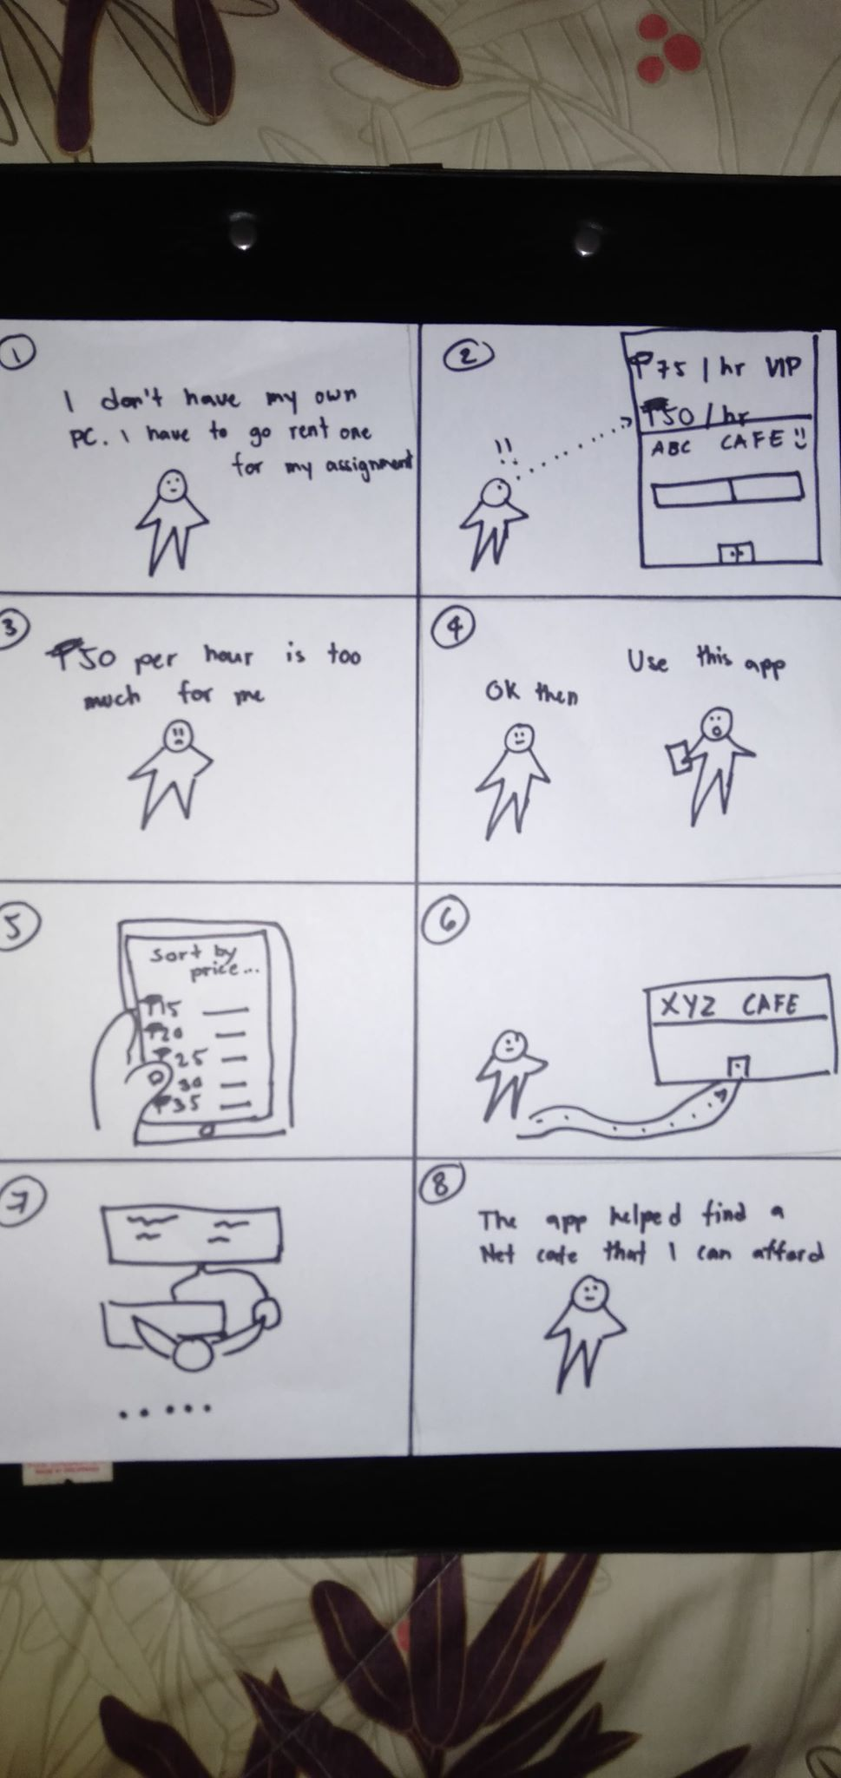
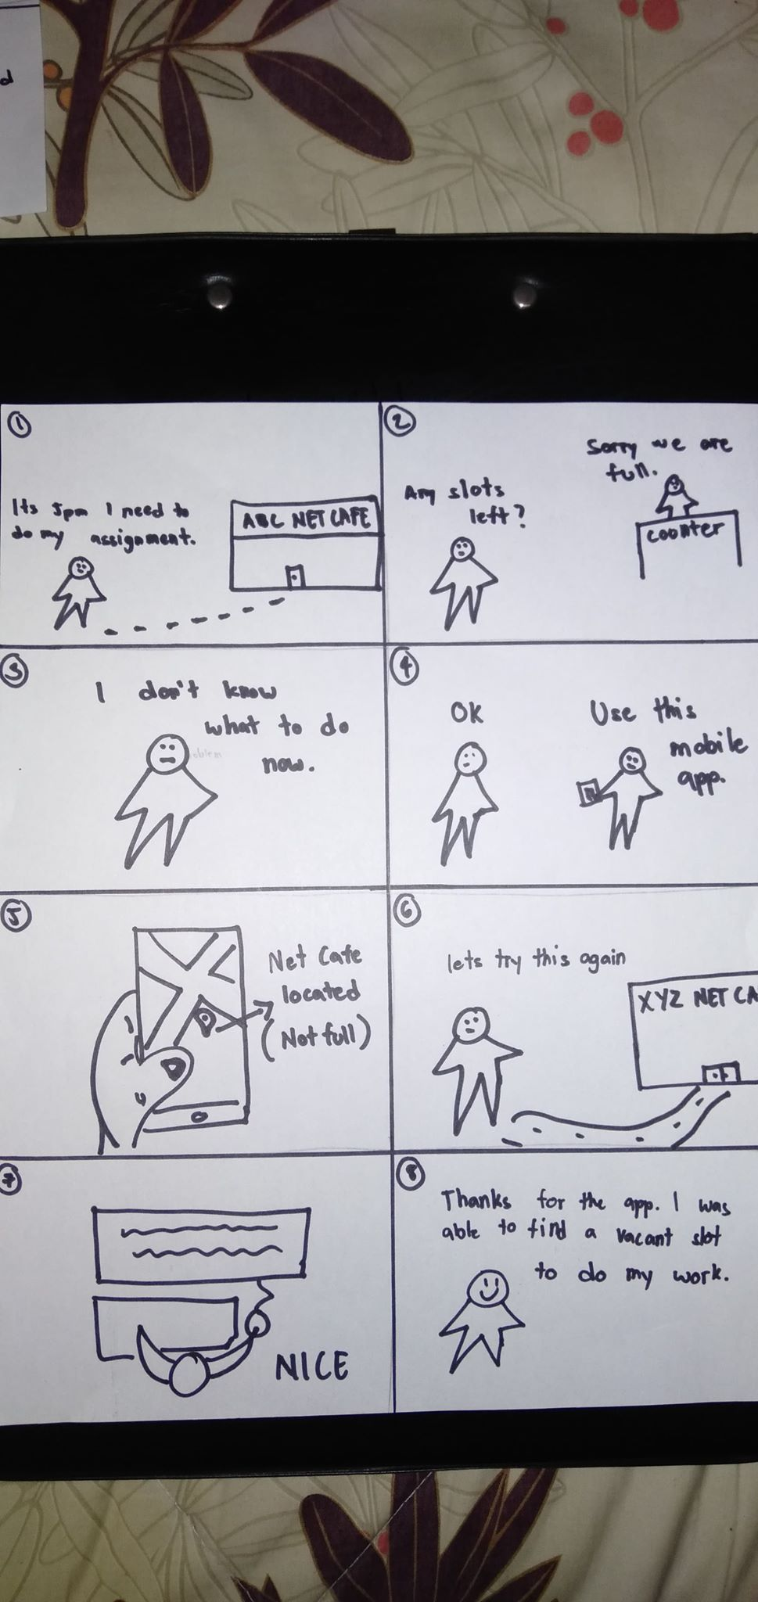
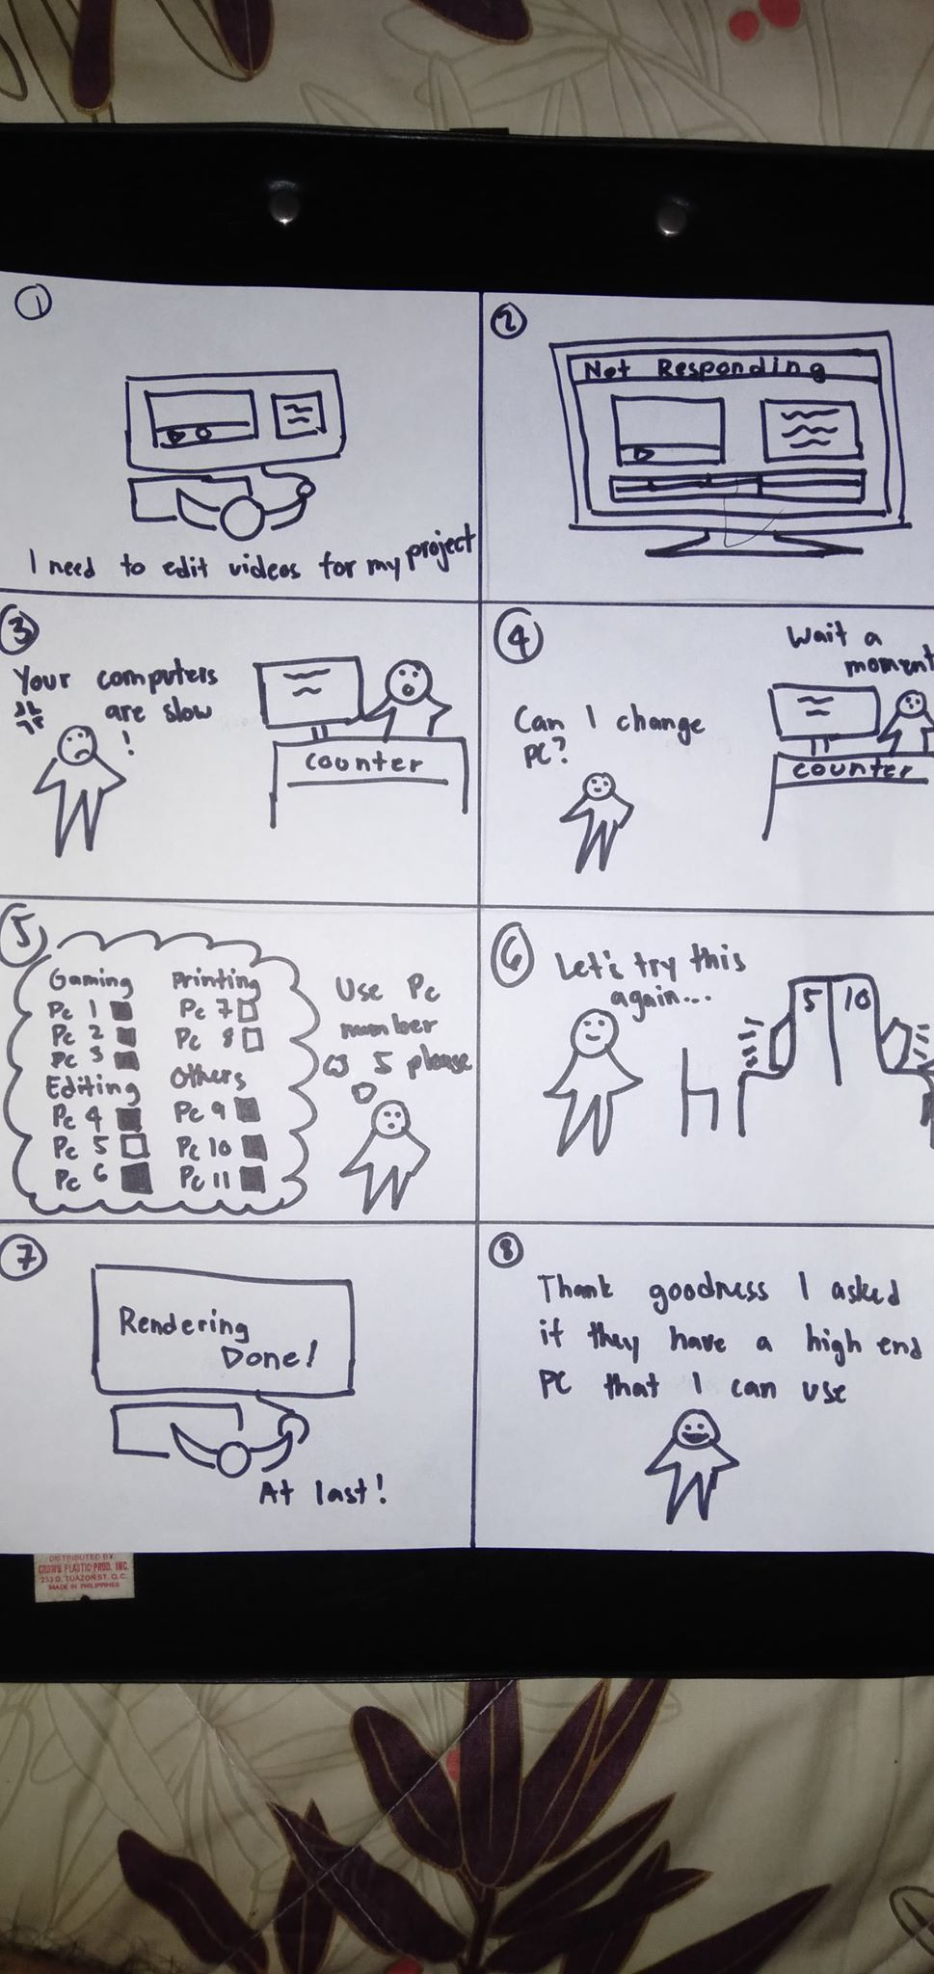
STORYBOARD

Slide 9
PROTOTYPE

Slide 10
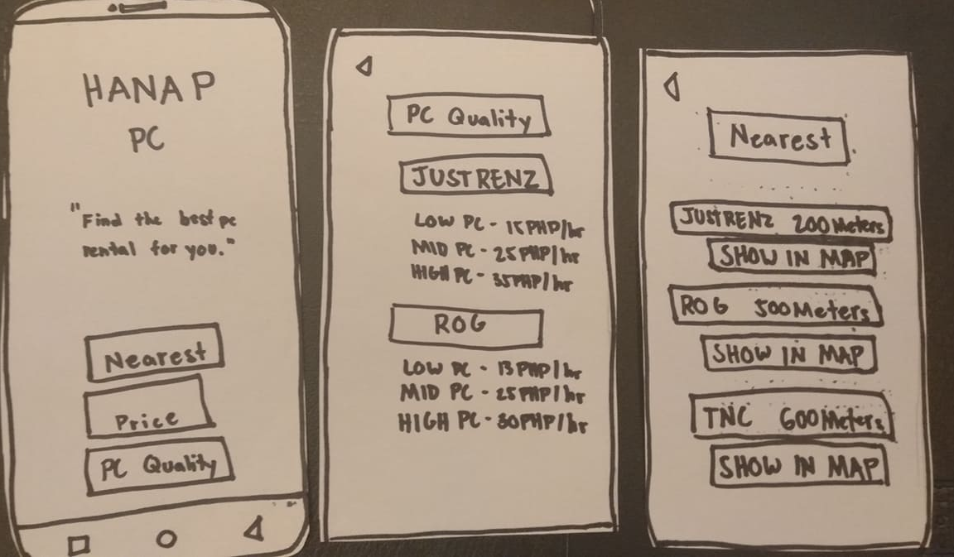

Slide 11
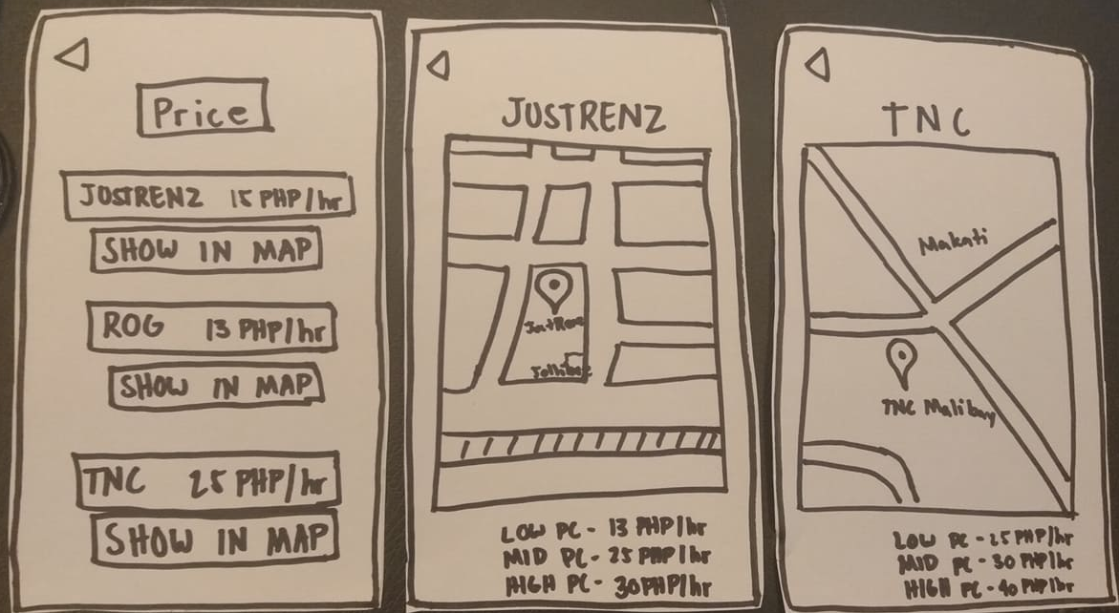

Slide 12
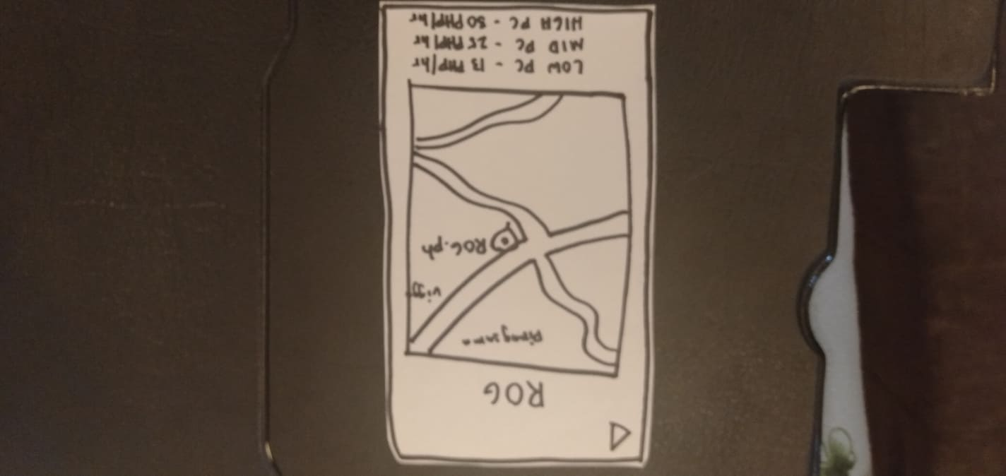

Slide 13
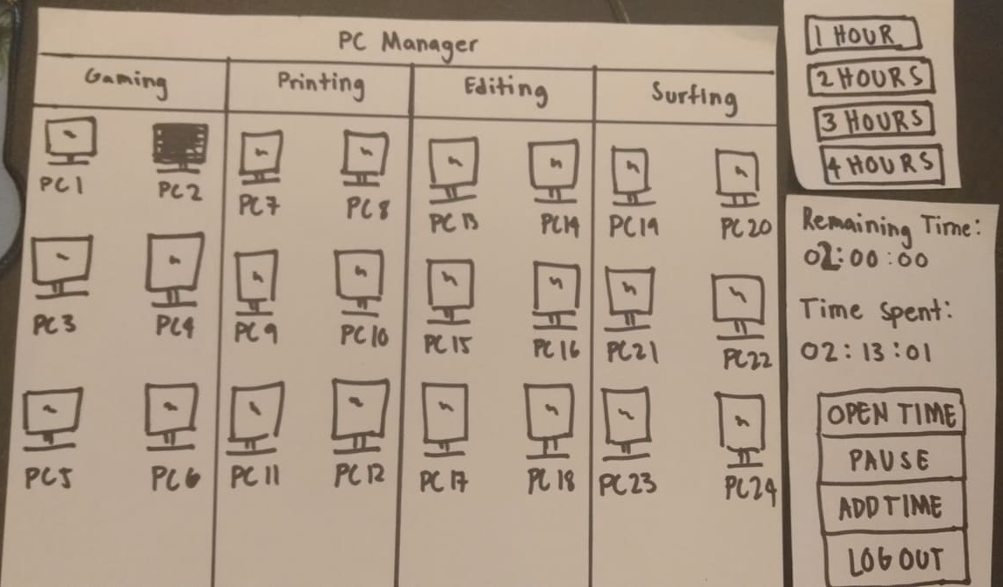

Slide 14
OLD DIGITAL MOCKUP

Slide 15
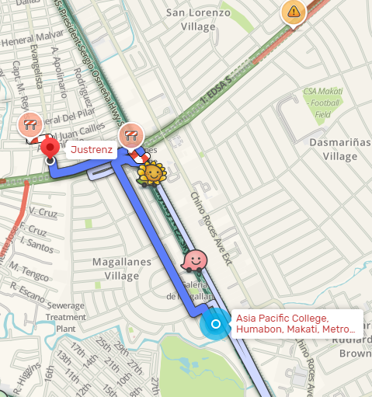
Nearest
Justrenz
HANAP
PC
JUSTRENZ
200 Meters
“Find cheapest pc rental near you.”
show
ROG 500 Meters
Nearest
show
Cheapest
TNC 600 Meters
PC QUALITY
show
LOW PC – 13PHP HR
MID PC- 25 PHP HR
HIGH PC – 30PHP HR

Slide 16
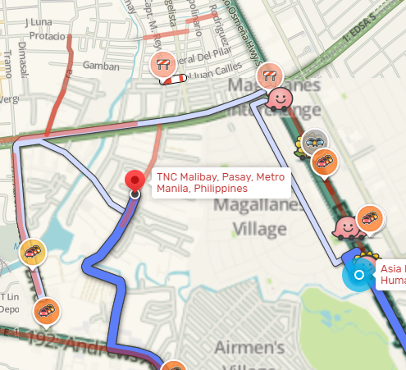
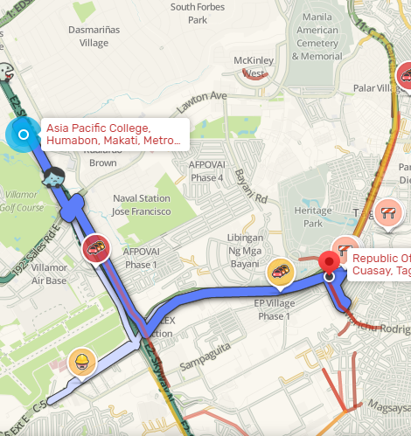
Tnc
ROG
Cheapest
JUSTRENz 13 php hr
show
Tnc 15 php hr
show
Rog 20 php hr
LOW PC – 15 PHP HR MID PC- 25 PHP HR
HIGH PC – 35 PHP HR
LOW PC – 20 PHP HR MID PC- 30 PHP HR
HIGH PC – 40 PHP HR
show

Slide 17
Pc quality
JUSTRENz
LOW PC – 13PHP HR
MID PC- 25 PHP HR
HIGH PC – 30PHP HR
Tnc
LOW PC – 15 PHP HR
MID PC- 25 PHP HR
HIGH PC – 35 PHP HR
Rog
LOW PC – 20 PHP HR
MID PC- 30 PHP HR
HIGH PC – 40 PHP HR

Slide 18
New User
1hr
2hr
3hr
Enter username
Enter password
4hr
5hr
6hr
Enter pincode
Submit
Status
Username
N/A
Start time
00:00
Used time
00:00
Remaining time
00:00
Usage cost
000.000

Slide 19
NEW DIGITAL MOCKUP

Slide 20
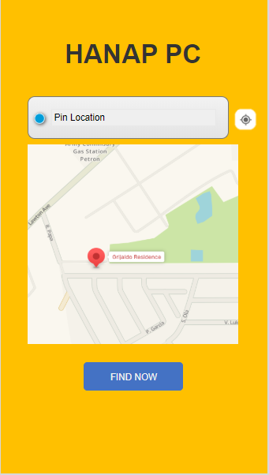
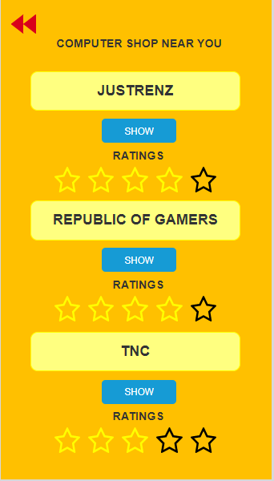
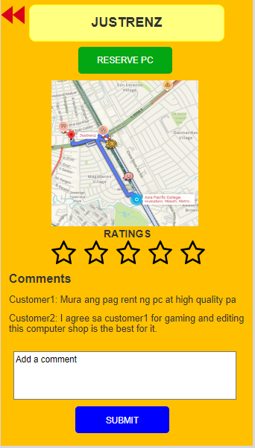

Slide 21
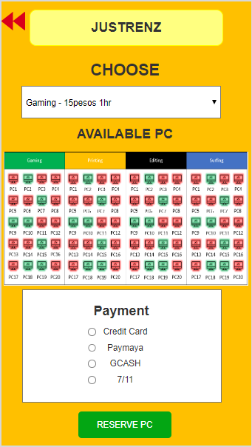
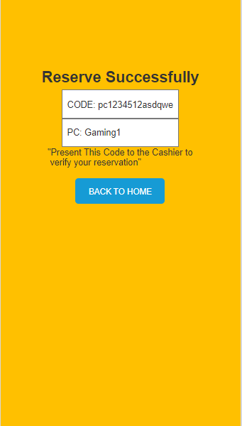


Slide 22
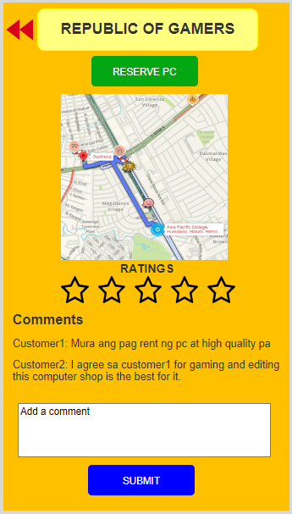
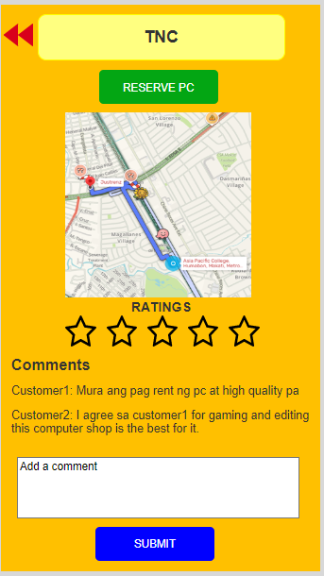

Slide 23
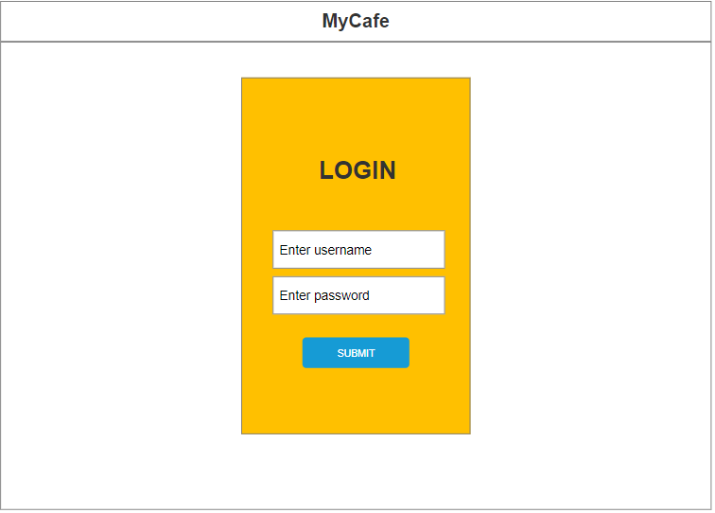

Slide 24
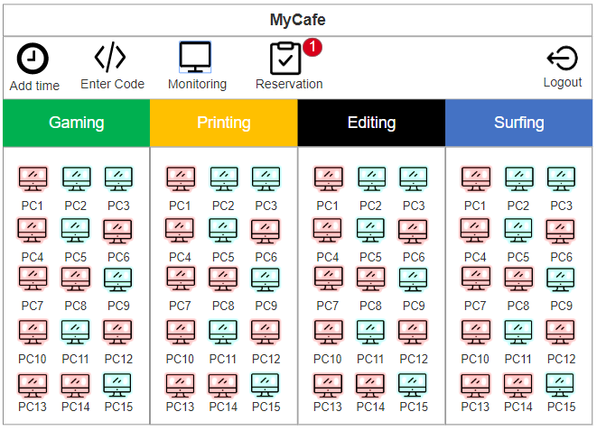

Slide 25
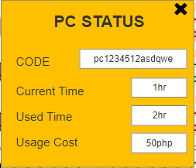
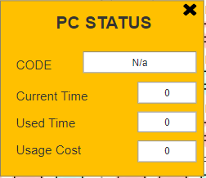
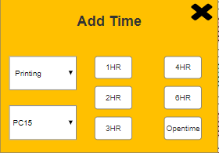
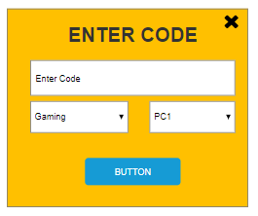
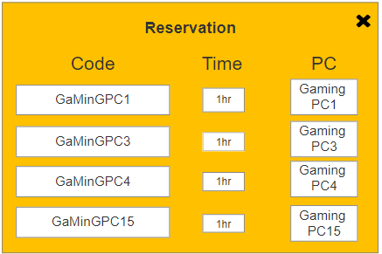

Slide 26
Testing Link
Eimelle Test
https://youtu.be/qlEcciWr1mM
https://youtu.be/RmbmS1gbGnU
Yobhel Test
https://youtu.be/olEvNzlY9KY
https://youtu.be/lWygqX3jETs
Zen Test
https://youtu.be/UJjt7AbnokE
https://youtu.be/42Ta8ZJza4Q

Slide 27
User Feedback (First Prototype) [OLD]
Prototype has no pictures
Unresponsive Map
Provide current reviews of the Internet Cafes, also let the users comment, or do a review about the place.
Create an advanced booking system

Slide 28
User Feedback (Second Prototype) [OLD]
Provide the total price
Create hints or clues for the users to have an idea how the interface works
See the reservation of the user
Close button

Slide 29
User Feedback (First Prototype) [NEW]
Good and Helpful application
Make a way to verify the computer shop’s service
Add instructions
Add more computer shop choices

Slide 30
THANK YOU

